Slide 1
National Association of Publicly Funded Truck Driving Schools

Slide 2
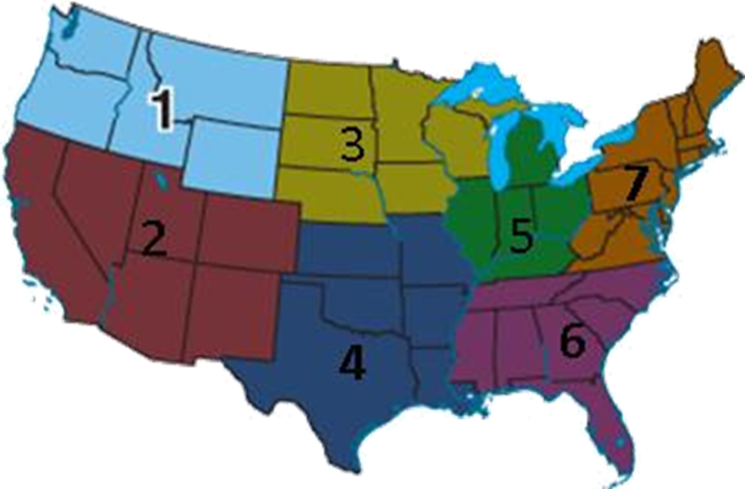
Who do we represent?
NAPFTDS represents 110 publicly funded schools from 32 states across the nation.

Slide 3
National Average of NAPFTDS School Members
Number of Weeks
Number of Days
Hours of Training
Classroom Hours
BTW Hours
Graduates Per School-Yearly
Total Cost of Training
7
30
238
81
74
120
$2970

Slide 4
From a recent survey* …
10 states have minimum training standards for truck driver training with instructors being required to have certification by their state, ranging from 160 to 360 training hours.

