Slide 1
CDL Test System Modernization Project
Presented By: Karen Morton, Program Director AAMVA Driver Programs Division
FMCSA Motor Carrier Safety Advisory Committee
October 1, 2019

Slide 2
Topics
Objectives
Goals
Overview of Proposed Vehicle Inspection
Overview of Proposed Basic Control Skills
Pilot Test – Jacksonville, Florida
Pilot Test – Concord, New Hampshire
Next Steps
Notes:
The current CDL testing system, 2005 CDL Testing System, was developed in the late 1990’s and released for use by SDLAs on April 1, 2005.
It has been well over a decade since the release of the current testing system.
There have been significant changes in vehicle technologies and components which have advanced at a fast pace and continue to evolve.

Slide 3
Objectives
Revise the AAMVA CDL Testing System to more closely align with industry standards and training practices.
Produce a revised test model that will maintain high standards for evaluating whether an entry-level commercial driver has the required technical knowledge and skill to safely operate a CMV.
Improve test administration effectiveness and efficiency.
Notes:
This will be a multi-year effort

Slide 4
Core Project Goals
Safety – Safety of drivers and the general public.
Basic Skills – Ensuring drivers have entry-level skill sets for licensure to enter the industry.
Technology – Create a test model that remains both valid and reliable in a fast changing technological environment.
Rigid Flexibility – An entry-level testing system with rigid standards that is flexible enough to adapt to change.

Slide 5
2005 Vehicle Inspection Test
Overview of the 2019 Revised Vehicle Inspection Test

Slide 6
Draft Score Sheet
Notes:
Number of items to be inspected on Tractor Semi-Trailer has decreased from 90 items to 34.
Focus is on Safety Related Items
Looked at Out of Service criteria and citations.

Slide 7
Draft Instructions

Slide 8
Draft Check List
Page 11-11 and 11-12

Slide 9
Draft Check List
Page 11-13

Slide 10
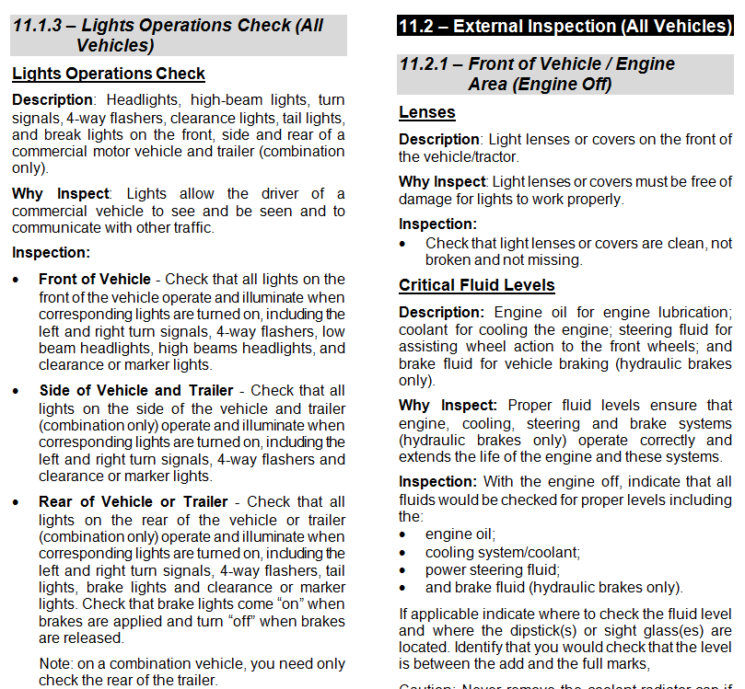
Driver Manual Section 11

Slide 11
What’s the Same?
Much of the Vehicle Inspection is the same.
Replaces the current Vehicle Inspection.
Much of the scoring criteria with some enhancements to the Examiner’s Manual.
Score form layout.
Marking the score form.
Automatic failures.

Slide 12
What’s Different?
Vehicle Inspection:
Fewer items (focus on safety critical items).
Driver VI Checklist.
Driver’s Manual now includes “Description” and “Why Inspect” (rationale). Driver’s and Examiner’s Manuals will be in sync on criteria.
Drivers will be required to describe “What” they are inspecting and may include “Why” they are inspecting it.
Four part Air Brakes check / revised hydraulic brake check.
Revised coupling system criteria.
Other revised scoring criteria.
Calculate number of items missed.

Slide 13
2005 Basic Control Skills Test
Overview of the 2019 Revised Basic Control Skills Test

Slide 14
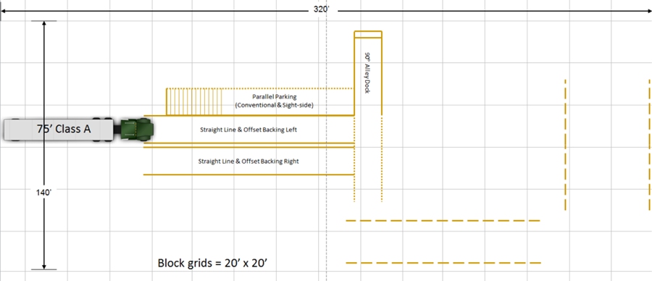
Basic Control Skills
Current BCS Carousel
75’ Class A

Slide 15
Proposed Basic Control Skills
Proposed BCS – Forward Stop; Straight Line Backing; Forward Offset Tracking; Reverse Offset Tracking
280’
75’ Class A
40’
Page 12-4

Slide 16
Proposed Basic Control Skills
Exercise Dimensions
Page 12-5

Slide 17
Comparison
Forward Stop Box, Straight Line Backing, Forward Tracking and Off-Set Reverse Tracking – Comparison of current BCS exercises
Parallel Parking (Conventional & Sight-side)
Offset Backing Left
Straight Line Backing
Offset Backing Right
90° Alley Dock

Slide 18
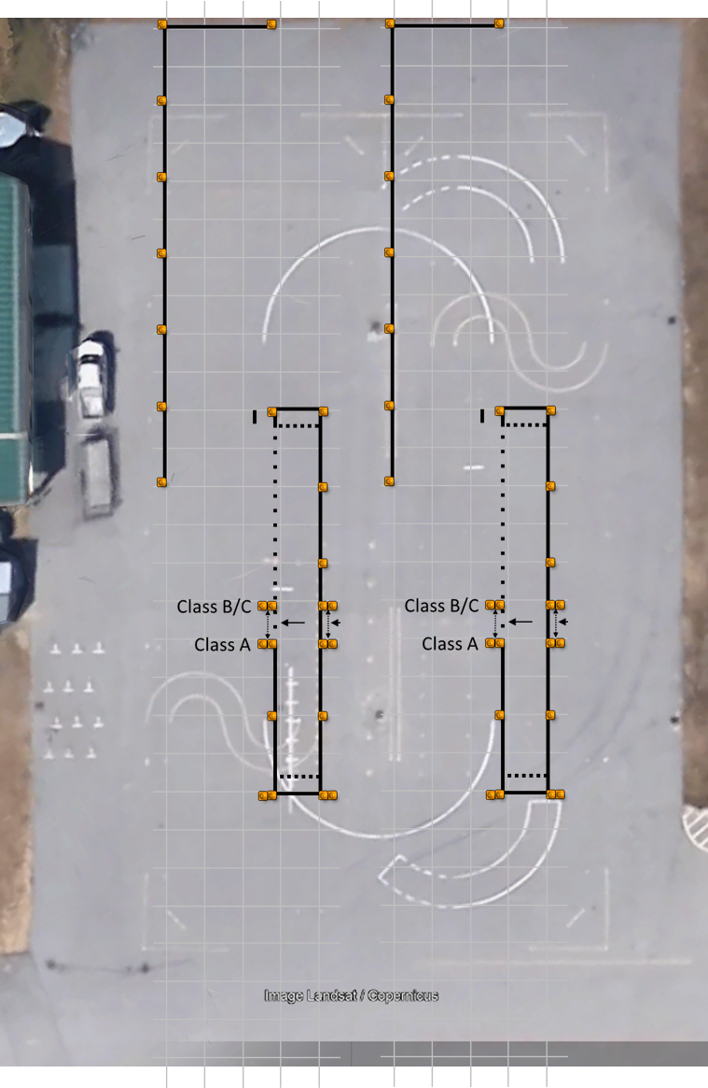
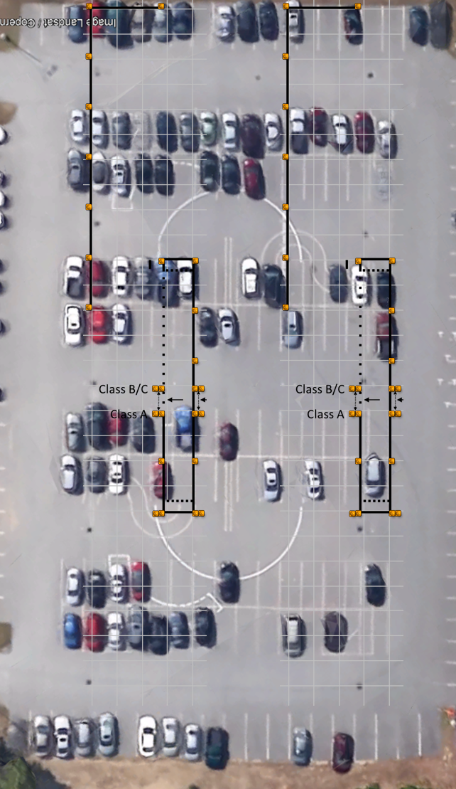

Slide 19
Proposed Basic Control Skills
Step 1 – Forward Stop
Step 2 – Straight Line Backing
Page 12-2 thru 12-3

Slide 20
Proposed Basic Control Skills
Step 3 – Forward Offset Tracking
Step 4 – Reverse Offset Backing
Page 12-2 thru 12-3

Slide 21
BCS Video
View Video of Revised BCS

Slide 22
BCS Score Instructions

Slide 23
BCS Score Sheet
Notes:
Point Values have not been determined

Slide 24
BCS Scoring Standards
Clearance – the distance between the cone and the line when performing Part 3 – Forward Offset Tracking
Back-ups – backing up on a forward moving exercise to clear an encroachment or to get a better position is scored as a “back-up”.
Pull-ups – pulling forward on a backing exercise to clear an encroachment or to get a better position is scored as a “pull-up”. Stopping without changing direction does not count as a pull-up.
Encroachments – crossing over or touching exercise boundary lines or cones with any portion of the vehicle is scored as an encroachment.
Page 12-1
Notes:
Clearance – the distance between the cone and the line when performing Part 3 – Forward Offset Tracking (refer to Section 12.2.3 on page 12-2).
Back-ups – backing up on a forward moving exercise to clear an encroachment or to get a better position is scored as a “back-up”. “Back-ups” will be scored on Part 3 – Forward Offset Tracking. The examiner will score the number of times you back-up.
Pull-ups – pulling forward on a backing exercise to clear an encroachment or to get a better position is scored as a “pull-up”. These exercises include
Part 2 – Straight-Line Backing and Part 4 – Reverse Offset Backing. The examiner will score the number of times you pull-up.
Stopping without changing direction does not count as a pull-up.
You will not be penalized for initial pull-ups. However, an excessive number of pull-ups, will count as errors.
Encroachments – crossing over or touching exercise boundary lines or cones with any portion of your vehicle is scored as an encroachment. If you have encroached, the examiner will stop you and you must return the vehicle within the exercise boundaries. The examiner will score the number of times you touch or cross over an exercise boundary line or cone. Each encroachment will count as an error.

Slide 25
BCS Scoring Standards
Looks – exiting the vehicle to look around during a backing exercise. You may be permitted to safely stop and exit the vehicle to check the external position of the vehicle (look).
You may be allowed a maximum of one (1) look on Part 2 – Straight-line Backing and two (2) looks on Part 4 – Reverse Offset Backing, to check the position of your vehicle.
Page 12-1
Notes:
Looks – exiting the vehicle to look around during a backing exercise. You may be permitted to safely stop and exit the vehicle to check the external position of the vehicle (look).
When doing so, you must set the parking brake(s) and place the vehicle in neutral. Then, when exiting/entering the vehicle, you must do so safely by facing the vehicle and maintaining three (3) points of contact with the vehicle at all times (when exiting/entering a bus, you may face forward and maintain a firm grasp on the handrail at all times. If you do not safely secure the vehicle or safely exit/enter the vehicle, it may result in an automatic failure for an unsafe act.
If you open your door or move from a seated position, it will count as a "look”. If you open your door while the vehicle is moving (not in neutral and park), it may result in an automatic failure for an unsafe act.
On a bus, if you walk to back of the bus to get a better view, it will count as a “look”. You may be allowed a maximum of one (1) look on Part 2 – Straight-line Backing and two (2) looks on Part 4 – Reverse Offset Backing, to check the position of your vehicle.

Slide 26
BCS Scoring Standards
Final Position – the final position of the vehicle for backing exercises. You will be scored for final vehicle position on Part 2 – Straight-line Backing and on Part 4 – Reverse Offset Backing.
Failure to Follow Instructions or Unsafe Act – Failure to follow examiner instructions for completing the exercise as directed may result in an automatic failure and the test may be terminated by the examiner.
Committing an “unsafe act” (e.g., not entering or exiting the vehicle safety or forgetting to set the parking brake), may result in an automatic failure for an unsafe act and the test may be terminated by the examiner.
Page 12-1
Notes:
Final Position – the final position of the vehicle for backing exercises. You will be scored for final vehicle position on Part 2 – Straight-line Backing and on Part 4 – Reverse Offset Backing.
It is important that you finish each exercise exactly as the examiner has instructed you. If you do not maneuver the vehicle into its final position as described by the examiner, you will be penalized and will fail the basic control skills test. You MUST complete the exercises as directed.
Failure to Follow Instructions or Unsafe Act – Failure to follow examiner instructions for completing the exercise as directed may result in an automatic failure and the test may be terminated by the examiner. Always follow the examiner instructions and directions. If you do not understand the instructions or understand how to complete the exercises, ask the examiner for clarification. If permitted, you may ask the examiner to walk you through the exercise area.
Committing an “unsafe act” (e.g., not entering or exiting the vehicle safety or forgetting to set the parking brake), may result in an automatic failure for an unsafe act and the test may be terminated by the examiner. Safety of the driver, the examiner and the testing area is of the highest priority. Always think SAFETY.

Slide 27
What’s the Same?
Much of the Basic Control Skills is the same by design.
An alternative or addition to the current BCS.
Pullups, encroachments, looks and final position are all scored the same.
Stopping the driver on an encroachment to return within boundary lines is the same.
Incorporates many of the same maneuvers into a circuit concept.
Straight-line backing
Offset backing
Parallel parking
Reverse docking

Slide 28
What’s the Same?
Score form layout.
Marking the score form.
Automatic failures.

Slide 29
What’s Different?
Basic Control Skills:
Forward Stop Box
Forward Offset Tracking
Scoring “Clearance” on Forward Offset Tracking
Scoring “Back-ups” on forward moving exercises
Reverse Offset Tracking vs. Parallel and Alley Dock
Much smaller footprint

Slide 30
VI and BCS Score Forms

Slide 31
Pilot Test - Florida
The Test Maintenance Subcommittee conducted the first research and development pilot of the CDL Test Modernization at Florida State College Jacksonville - Cecil Center in Jacksonville Florida the week of February 18th.
Thirty six drivers (36) drivers with varying levels of driving experience participated in the pilot with each driver taking two or more test segments.
97 test segments were conducted in a 2 day period by 5 teams of experienced CDL Skills Test Examiners.
The R & D Pilot team consisted of volunteers from Florida (Highway Safety & Motor Vehicles, Florida State College Jacksonville, North Florida Technical College & Pike Electric), Iowa, Oklahoma, New Hampshire, Vermont, Missouri, Test Maintenance Subcommittee (Maine, Missouri & Virginia), Highway Safety Services, FMCSA and AAMVA.

Slide 32
Pilot Test - Florida
Class A New Vehicle Insp: 12 used checklist
Class B New Vehicle Insp: 7 used checklist
Class A Vehicles: Tractor Trailer, Pintle Hook
combination
Class B Vehicles: Straight truck, School Bus,
Coach/Transit
Class A |  | Class B
New Vehicle Insp | 27 | New Vehicle Insp | 13
Curr Vehicle Insp | 3 | Curr Vehicle Insp | 5
New BCS | 14 | New BCS | 11
Curr BCS | 12 | Curr BCS | 12
Notes:
In this pilot we were experimenting with the use of a checklist and explaining “why” it was important to inspect the components.
Test segments were paired and assigned to each applicant.
Current vehicle inspection and new vehicle inspection (with checklist & why)
Current vehicle inspection and new vehicle inspection (no checklist & no why)
Current BCS & New BCS
New Vehicle Inspection & Current BCS, etc

Slide 33
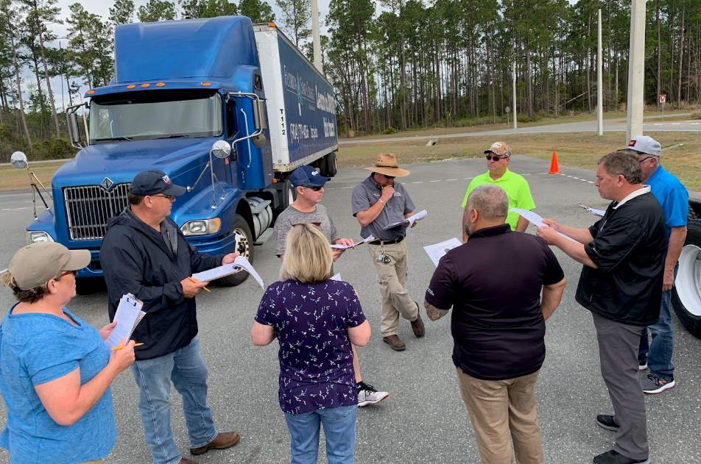
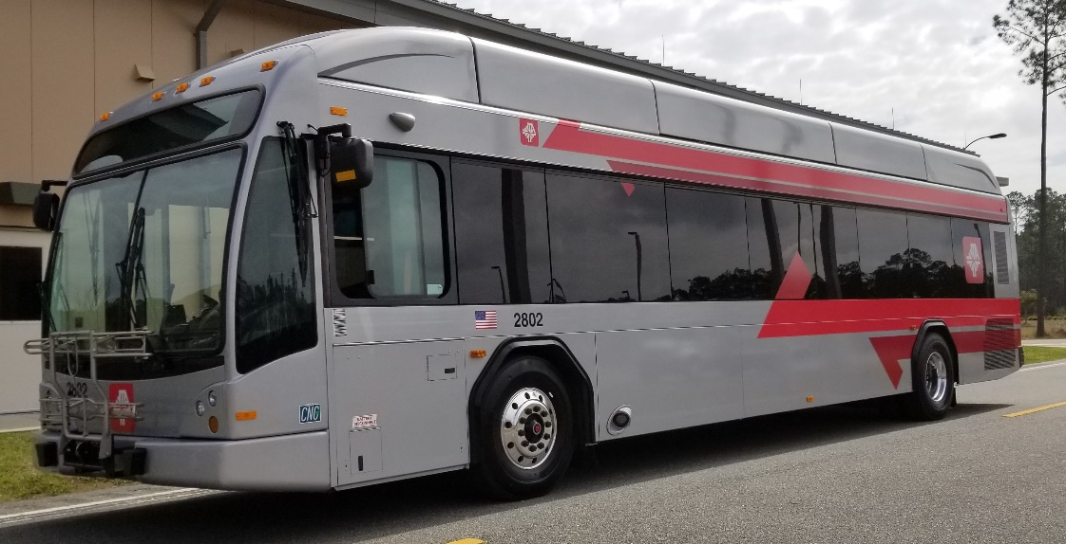
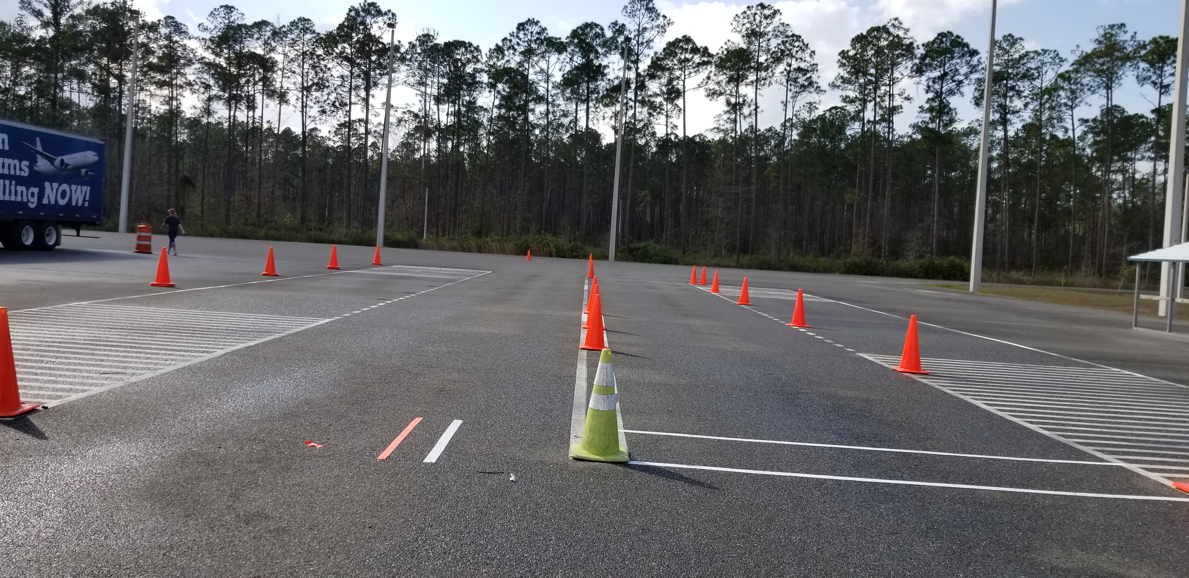

Slide 34
Pilot Participants - Florida
Jacksonville Transportation Authority
Student Transportation of America
First Group America
Florida State College at Jacksonville
City of St Augustine
North Florida Sales
National Training, Inc.
Marion Technical College
North Florida Technical College
Cypress Truck Lines
Pike Electric
Florida Highway Safety & Motor Vehicles

Slide 35
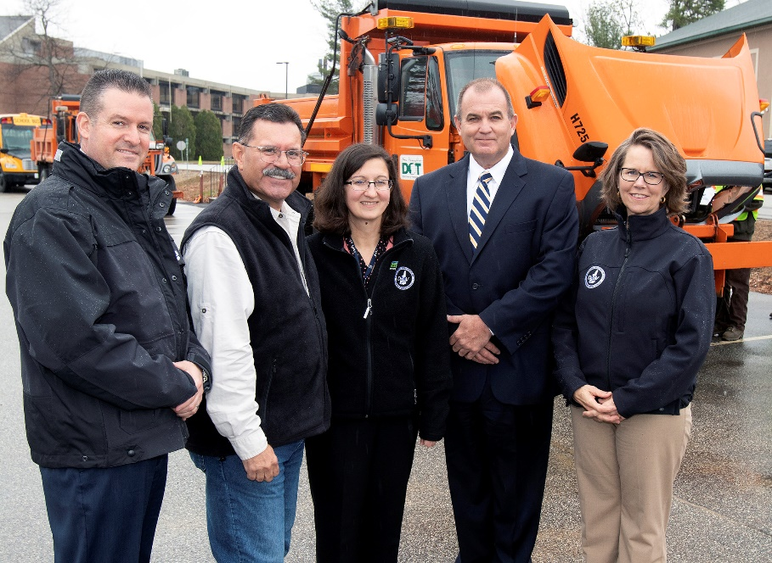
Pilot Test – New Hampshire
The Test Maintenance Subcommittee conducted the second research and development pilot of the CDL Test Modernization at New Hampshire Division of Motor Vehicles in Concord, New Hampshire the week of April 29th .
Sixty three drivers (63) drivers with varying levels of driving experience participated in the pilot with each driver taking two or more test segments.

Slide 36
126 test segments were conducted in a 3-day period by 5 teams of experienced CDL Skills Test Examiners.
The R & D Pilot team consisted of volunteers from New Hampshire (Department of Public Safety, Division of Motor Vehicles), Iowa, Oklahoma, Vermont, Missouri, Utah, Test Maintenance Subcommittee (Maine, Missouri, Idaho & Virginia), Highway Safety Services, FMCSA and AAMVA.

Slide 37
Pilot Test – New Hampshire
Class A |  | Class B
New Vehicle Insp | 39 | New Vehicle Insp | 24
New BCS | 39 | New BCS | 24
The Modernized Vehicle Inspection and Basic Control Skills test segments were given to all drivers.
The Checklist was used during the Vehicle Inspection by all drivers.
The age range drivers/participants was between 19 and 63 years of age with the average age of drivers being 42 years.
Class A Vehicles: Tractor Semi-Trailer, Truck Trailer combination, Pintle Hook
Class B Vehicles: Straight truck, School Bus, Coach/Transit, Fire Apparatus

Slide 38
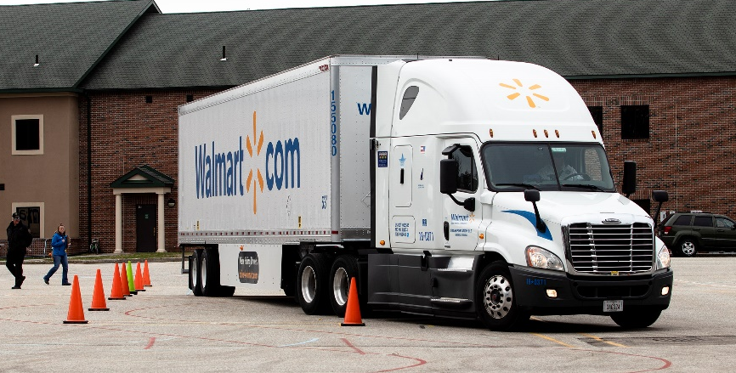
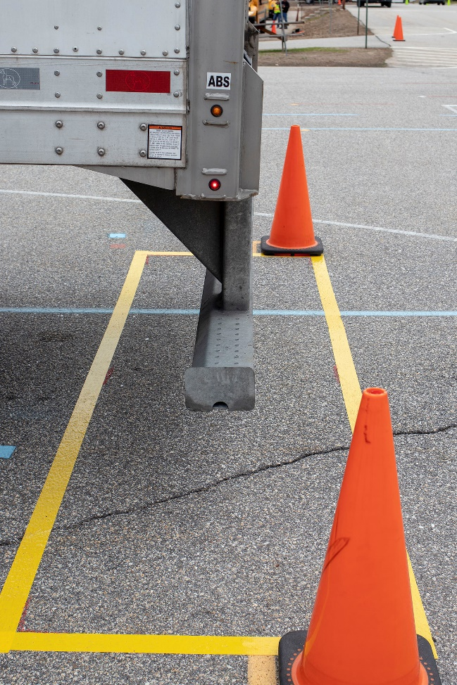
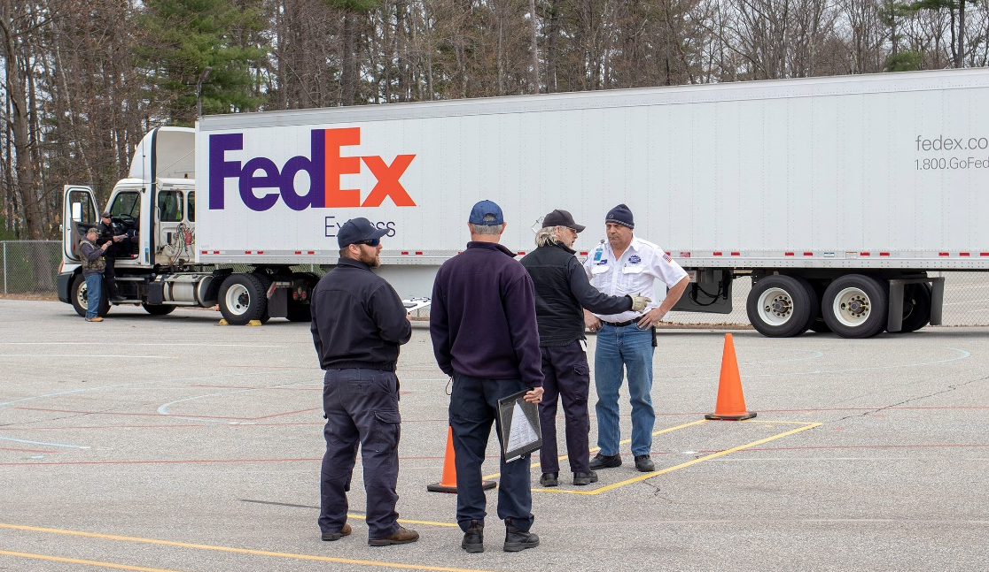
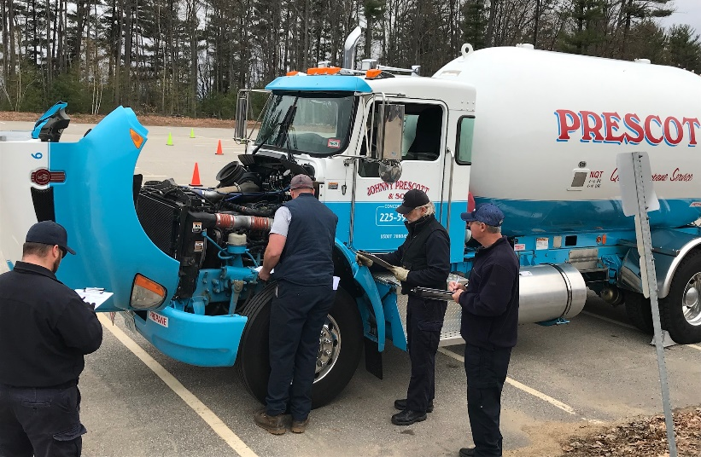

Slide 39
Pilot Participants – New Hampshire
NE Tractor Trailer School (NETTS)
United States Air Force
Palmer Gas
State of New Hampshire, Department of Transportation (DOT)
City of Concord, School district
Community Transportation
State of New Hampshire, Liquor Enforcement
Commercial Driving School of New Hampshire (CDS)
Ross Express
Johnny Prescott Heating and Oil
XPO Logistics
Walmart
FedEx
Amoskeag Beverages
YRC Freight
State of New Hampshire, Fire Academy
Phoenix Precast Products
Concord Coach Lines
Ford Mountain Trucking
New Hampshire Towing Association
Continental Paving
Associated Grocers of New England
Student Transportation of America, Goffstown NH
Student Transportation of America, Epsom NH
Student Transportation of America, Weare NH
Notes:
25 companies

Slide 40
Next Steps
AAMVA has procured the services of the Traffic Injury Research Foundation (TIRF) to conduct a detailed analysis of the data collected during the pilot and field test phases.
Pilot Test result data will be analyzed to determine test validity, test reliability and passing scores.
The data analysis will begin in earnest the week of October 21st. The anticipated delivery date of the Pilot Test Report from TIRF is on/about January 1, 2020.

Slide 41
Field Tests
Field Tests will be conducted in three States
Each State will be representative of State and Third Party Testers.
(1) - All State CDL Skills Test Examiners,
(1) – Hybrid mix of both State and Third Party CDL
Skills Test Examiners; and
(1) – All Third Party CDL Skills Test Examiners
Each State will test in three (3) test sites within the State

Slide 42
Field Tests (cont’d)
The Field Test will run for 60 – 90 days in each State. Each State will conduct at least 300 CDL Skills Tests (combined number of all 3 sites) during that time:
We anticipate bringing up one Field Test State in early February, followed by one in March and the last in April.
States will be notified of the process to be followed for submissions Field Test participation.
Upon completion of the Field Test, TIRF will conduct the data analysis and produce the Field Test Report and the Final Report to consolidate the Pilot and Field Tests and recommendations for moving forward

Slide 43
Contact
For More Information Contact
Test Maintenance Subcommittee
kmorton@aamva.org

