Slide 1
Compliance, Safety, Accountability
(CSA)
Motor Carrier Safety Advisory Committee (MCSAC)
August 2012

Slide 2
Agenda
High level description of CSA Components and Current Implementation Status
  Where things stand today
CSA impacts on individual drivers
CSA Analysis
  How many are assessed by SMS
  Effectiveness Testing
  Strategic intervention thresholds and High-Risk Carriers
Recently announced Safety Measurement System (SMS) Improvements coming in December

Slide 3
Agenda
Discussion of SMS improvements under consideration for next round
MCSAC Task 12-03
  Evaluation of and Recommendations on the CSA Program

Slide 4
CSA – Three Major Elements
New Safety Management System (SMS)
  Better targets carriers for Agency interventions
Broader array of interventions
  Includes warning letters and focused on and off-site investigations to augment the full investigations
Planned revisions to Safety Fitness Determination (SFD) Regulations
  To incorporate on-road performance into SFD methodology

Slide 5
New Safety Measurement System
  Replaced the SafeStat system as the FMCSA tool to identify carriers for intervention
  Reviews regulatory compliance and identifies unsafe carrier and driver behaviors that lead to crashes
  Uses all safety-based roadside inspection violations
  ~3.5 million inspections per year

Slide 6

SMS
OLD
Safety Evaluation Areas (SEAs)
NEW
Behavior Analysis and Safety
Improvement Categories (BASICs)
Unsafe
Driving
Fatigued
Driving
(HOS)
Driver
Accident
Crash
Indicator
Driver Fitness
SafeStat
SMS
Safety
Management
Cargo-
Related
Controlled
Substances/
Alcohol
Vehicle
Vehicle
Maintenance
Notes:
6

Slide 7
SMS Implementation Status
Fully implemented in December 2010
  Roadside inspection violations declined 8% in 2011
Used to prioritize enforcement resources
  Identifies “high-risk” carriers per Congressional mandate
  Influences roadside Inspection Selection System (ISS)
Results are available on a public website
  Over 30 million visits to public SMS website in 2011
  Current Cargo and Crash BASIC assessments restricted from public view

Slide 8
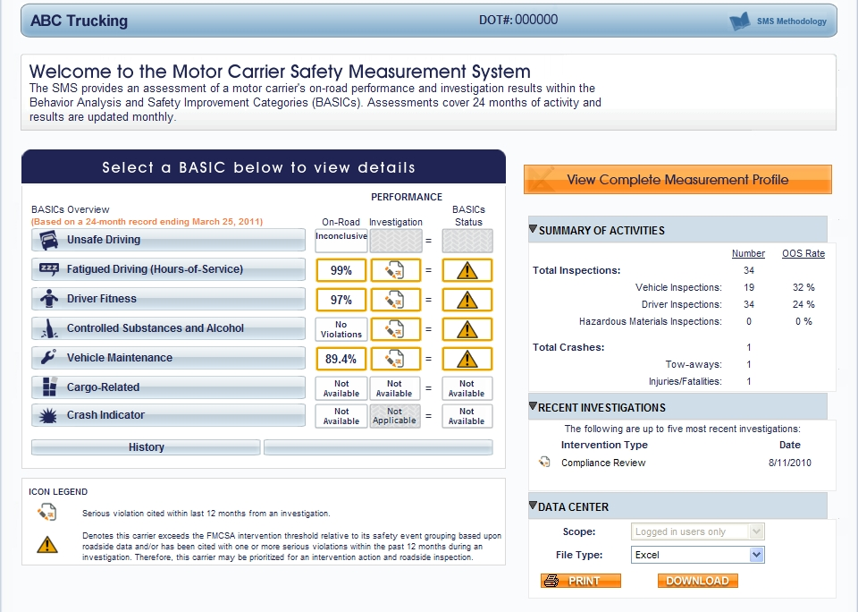
Carrier SMS Results

Slide 9
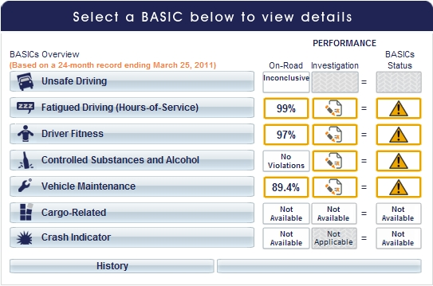
Carrier SMS Results

Slide 10
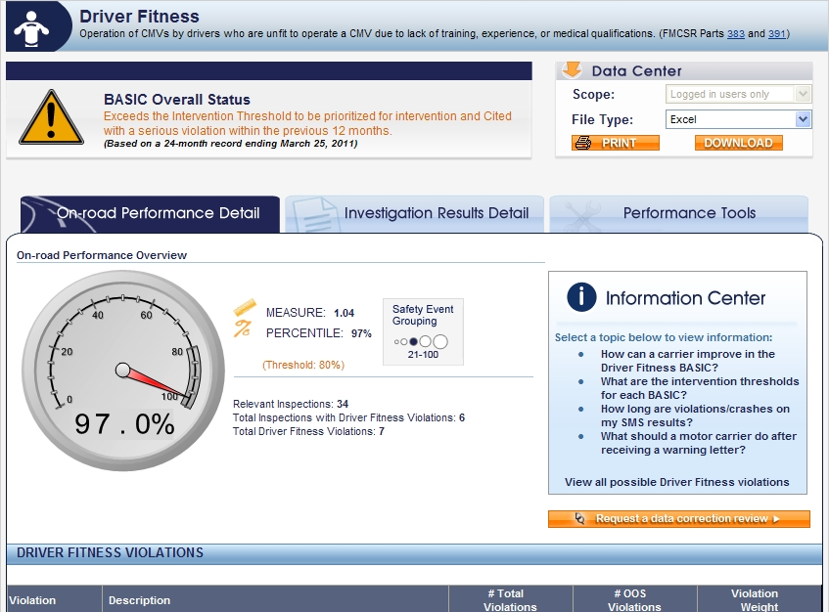
Violation Details in SMS

Slide 11
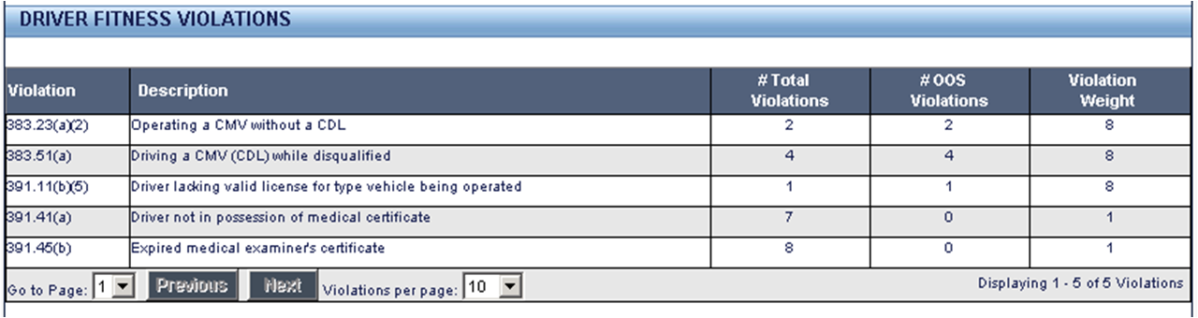
Further Drilldown in SMS

Slide 12
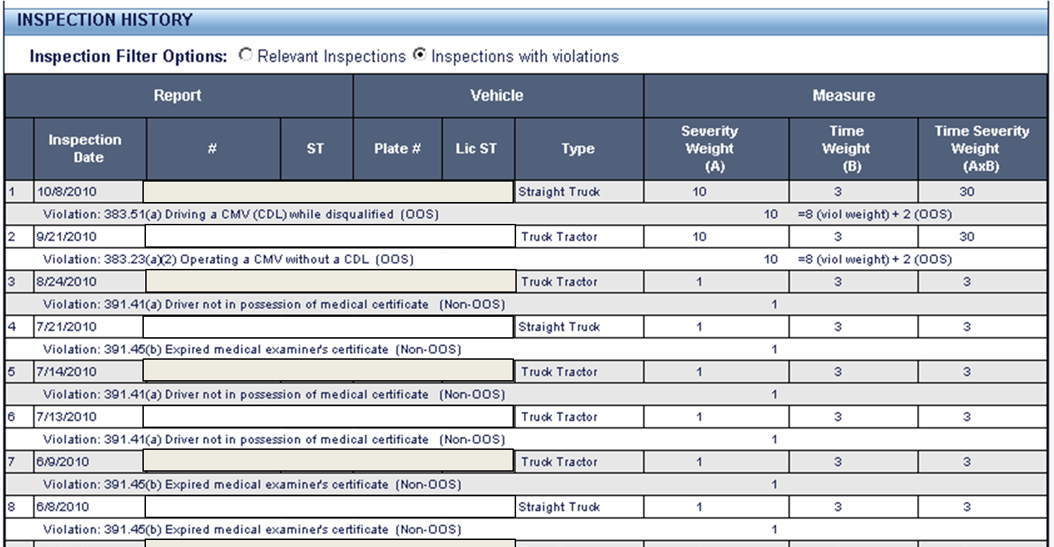
Further Drilldown in SMS

Slide 13
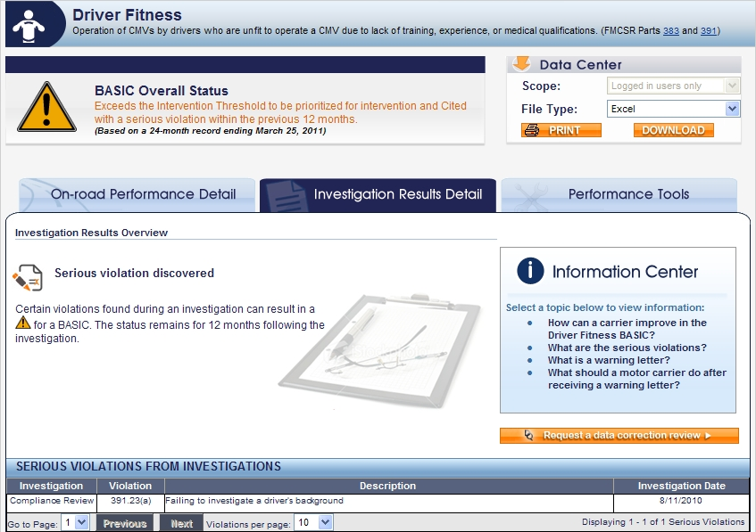
Further Drilldown in SMS

Slide 14
Public Use of SMS Data
SMS is not a safety rating
Informed, current, and comprehensive picture of a motor carrier safety and compliance standing is provided by:
  Official safety rating on Safety and Fitness Electronic Records (SAFER )
  Authority and insurance status on Licensing and Insurance (L&I) website
  Intervention and priority status on SMS

Slide 15
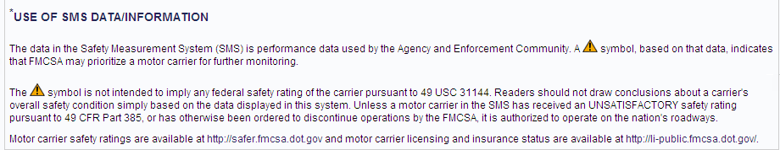
Public Use of SMS
What are the limitations of SMS?

Slide 16
CSA – Intervention Tools
Broader array of interventions to augment the Full Compliance Review
  Reaches more carriers
  Improves efficiency of investigations
  Identifies root causes and corrective actions

Slide 17
CSA - Intervention Tools
OLD
NEW
Full Compliance Review is single tool despite specific type or scope of problem
Efficient and effective intervention tools reach more carriers and
influence safety compliance earlier
Automated Warning Letters
Broader investigation types
Offsite Investigations
Focused Onsite Investigations
Comprehensive Onsite Investigations
Use of Safety Management Cycle
  Investigators determine “why” violations are occurring

Slide 18

CSA Intervention Tools:
Safety Interventions Process
The Safety Interventions process addresses the:
  WHAT
  Discovering violations and
  defining the problem
  WHY
  Identifying the cause or
  where the processes broke down
  HOW
  Determining how to fix it/prevent it by using the Safety Management Cycle (SMC) and Safety Improvement Resources

Slide 19
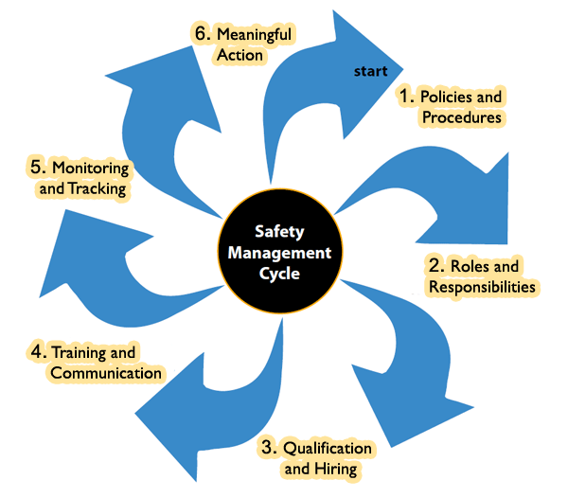
Safety Management Cycle

Slide 20
CSA Intervention Tools Implementation Status
Focused and comprehensive investigations now implemented in all states
  Over half of investigations are focused
  Includes application of safety management cycle
Automated warning letters implemented in all states
  Over 50,000 letters sent to date
    UMTRI test evaluation: 83% carriers improved within 12 months of receiving a Warning Letter
Offsite investigations implemented in 10 states
  Further deployment will occur with IT enhancements

Slide 21

CSA Fully Implemented
Old CR Model
Focused Investigations
SAME
INVESTIGATIVE
RESOURCES
Same Investigative Resources used to:
Address more known safety/compliance issues demonstrated roadside
Improve on-road performance and overall safety

Slide 22
New Safety Fitness Determination (SFD) Process and Status
CURRENT
One of three safety ratings issued following a Compliance Review
  Satisfactory, Conditional, Unsatisfactory
Rating is snapshot based on date of most recent Compliance Review
NEW SAFETY FITNESS REGULATIONS TO BE PROPOSED WOULD
Incorporate on-road safety performance
  Allow for proposed downgrade in formal SFD based on monthly update of measurement system
Continue to include major safety violations found as part of investigations
Notice of Proposed Rulemaking scheduled for 2013

Slide 23

Drivers

Slide 24
Drivers – CSA and Pre-Employment Screening Program (PSP)
FMCSA does not “rate” drivers
Investigators review drivers with more extensive violation histories during carrier investigations
Pre-Employment Screening Program (PSP):
  Is a Congressionally-mandated program
  Provides perspective employer with driver inspection, crash, and violation history if driver signs release
    No assessment or score provided with the data
3rd party vendors are aggregating PSP data for carriers and developing "CSA Driver scorecards“

Slide 25
CSA Analysis

Slide 26
SMS Data
Category | Approximate Number | Percentage of Uploaded Crashes
Carriers listed as active | 750K | 100%
Carriers with recent activity “pulse” in last three years | 525K | 100%
Carriers with insufficient data | 325K | 8%
Carriers with sufficient data to be assessed in at least one BASIC | 200K | 92%
Carriers with sufficient negative information to have a percentile assigned | 92K | 83%
Carriers with at least one BASIC above FMCSA intervention threshold | 50K | 45%

Slide 27
Effectiveness Testing
Approach:
Use historical data to examine the future crash rate of motor carriers above the SMS intervention threshold in one or more BASICs.
Perform a simulated SMS run that calculates carrier percentile ranks for each BASIC as of January 2010 using historical data from calendar years 2008 and 2009
Observe each carrier’s crash involvement over the 18-month period immediately following the simulated SMS timeframe : January 2010 to June 2011; and
Observe the relationship between the percentile ranks (from 0 to 100) in each BASIC and subsequent post-SMS carrier crash rates.

Slide 28
Effectiveness Testing Timeline
CSMS Identification Run Date
Jan ‘08
Jan ‘10
Jun ‘11
24 Months of data for CSMS Run
Post-Identification
Crash Period
28
Notes:
28

Slide 29
Unsafe Driving BASIC, Straight Segment

Slide 30
Unsafe Driving BASIC, Combo Segment

Slide 31
Crash Indicator, Straight Segment

Slide 32
Crash Indicator, Combo Segment

Slide 33
Fatigued Driving BASIC

Slide 34
Vehicle Maintenance BASIC

Slide 35
Driver Fitness BASIC

Slide 36
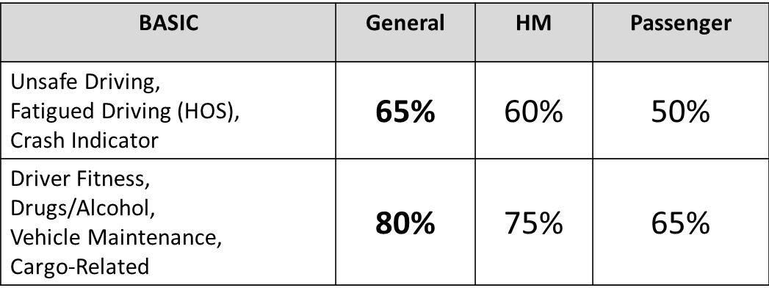
Effectiveness Results
A particularly strong association exists between high percentile ranks in the Unsafe Driving and Fatigued Driving (Hours-of-Service) BASICs and crashes
Driver Fitness BASIC does not have a statistical association with crash risk.
FMCSA optimizes resources and oversight responsibilities through more stringent Intervention Thresholds for BASICs with strongest associations to crash risk.

Slide 37
High-Risk Motor Carrier Criteria:
Crash OR Fatigue OR Unsafe ≥ 85
+
1 other BASIC at or above the “all other” motor carrier threshold
Any 4 or more BASICs at or above the “all other” motor carrier threshold
OR
Group of high-risk motor carriers have future crash rates more than double the crash rate of all active motor carriers

Slide 38
SMS Improvements

Slide 39
SMS Improvements
Recently Announced:
Driver Fitness BASIC – Suspended License violations
  Inspectors now collecting more detailed information roadside
  Allows SMS to weigh more heavily safety-based suspensions a motor carrier can identify through MVR checks

Slide 40
SMS Improvement Process
SMS is designed and intended to be continually improved.
  FMCSA has responded to feedback from industry, State Partners, and other stakeholders.
FMCSA has taken a systematic and transparent approach to rolling out improvements.
  Prioritize and package changes periodically.
  Provide enforcement personnel and motor carriers a preview period prior to implementation.
    Provides carriers an opportunity to review data, make improvements, and comment on enhancements.
  .
Notes:
.
40

Slide 41
SMS Improvements
March 2012 Federal Register Notice
  Announced the first set of improvements
  Opened preview website for motor carriers and law enforcement
  Opened comment period that was extended to end of July
August 24, 2012 Federal Register
  Responded to public comments
  Announced improvements to be implemented in December 2012

Slide 42
December 2012 SMS Improvements:
Announced in March and Previewed
Strengthen the Vehicle Maintenance BASIC by incorporating cargo/load securement violations from the Cargo-Related BASIC.
New HM BASIC
Better align SMS with Intermodal Equipment Provider (IEP) regulations.
Align violations included in SMS with CVSA inspection levels
More accurately ID carriers that transport significant quantities of HM
More accurately ID carriers that should be subject to lower passenger carrier intervention thresholds
Modify SMS public display to:
  Change terminology to fact-based descriptions instead of “insufficient data” and “inconclusive”
  Break out crashes with injuries and crashes with fatalities

Slide 43
Additional SMS Improvements Coming in December 2012
Based on careful consideration and stakeholder feedback during preview and comment period
Removal of 1-5 MPH speeding violations
Lowered severity weight for speeding violations with no MPH range above speed limit
Aligning severity weight of paper and electronic logbook violations
Renaming Fatigued Driving (HOS) BASIC to HOS Compliance BASIC

Slide 44
December 2012:
Move Cargo Securement Violations into Vehicle Maintenance BASIC
  Strengthen the Vehicle Maintenance BASIC by incorporating load securement violations from today’s Cargo-Related BASIC
  Mitigates bias in the current Cargo-Related BASIC whereby flatbed operators are disproportionately identified for intervention.
  Continues to identify motor carriers with systemic cargo securement compliance problems.
  Makes Vehicle Maintenance BASIC more effective.
  The Vehicle Maintenance BASIC will remain public.

Slide 45
December 2012: New HM BASIC
Change the Cargo-Related BASIC to Hazardous Materials (HM) BASIC
Removes load securement violations so that only HM violations remain.
Provides a more objective comparison with respect to HM compliance; consequences of crashes and cargo spills are increased when HM are involved.
Enables enforcement staff to better identify and address HM safety and compliance issues.
Will not be a public BASIC in December 2012.

Slide 46
December 2012: New HM BASIC
Does the proposed HM BASIC identify HM risk better than the current Cargo-Related BASIC?
  Effectiveness testing indicates the forthcoming HM BASIC results in a higher HM Violation rate than the current Cargo-Related BASIC.
SMS Effectiveness Test Results (using 80% Threshold)
BASIC | HM Inspections | HM Violation Rate | HM Out-of-Service (OOS) Rate
Cargo-Related (current) | 37,675 | 29.08% | 4.03%
HM (proposed) | 36,188 | 33.75% | 5.42%
*for the entire population, the HM violation rate is 23% and the HM OOS rate is 3.4%.

Slide 47
December 2012
  Better align SMS with IEP regulations
  Currently, SMS does not use violations associated with the condition of an IEP trailer (if it is assigned to an IEP).
  FMCSA has recently revamped IEP logic to properly attribute each IEP trailer violation to either the IEP or the motor carrier based on the ability of the driver to find the violation as part of a pre-trip inspection.
  IEP violations assigned to a motor carrier will be used toward calculating the carrier’s Vehicle Maintenance BASIC

Slide 48
December 2012
Eliminate vehicle violations derived from driver-only inspections and driver violations from vehicle-only inspections
  SMS includes Level III (driver-only) inspections in the Vehicle Maintenance BASIC only when vehicle violations are noted on the inspection
  Enforcement and industry have raised concerns that some vehicle violations fall outside the scope of the inspection and could bias the BASIC’s results
  Analysis showed that this concern merited attention, so FMCSA will:
  Remove vehicle violations found during driver-only inspections
  Remove driver violations found during vehicle-only inspections

Slide 49
December 2012:
New HM Intervention Threshold Criteria
More effectively identify carriers involved in transporting HM
New Intervention Threshold definition:
  At least 2 placardable HM inspections; 1 within past 12 months, and
  At least 5% of total inspections indicated as placardable HM inspections.
The HM Intervention Threshold continues to apply to carriers with HM safety permits.
More stringent Intervention Thresholds are applied to all BASICs except the proposed HM BASIC.
New definition will enable FMCSA to focus resources on carriers involved in the majority of placardable HM transport.

Slide 50
December 2012:
HM BASIC vs. HM Intervention Threshold
Proposed HM BASIC – measures violations cited on inspections where carriers have placardable amounts of HM.
  Must have at least 5 vehicle inspections with placardable amounts of HM and at least 1 HM violation.
  Used to identify carriers with safety problems in carrying HM to be prioritized for investigations.
Proposed HM Intervention Threshold – set for carriers that carry HM as a significant part of their business.
  Must have 2+ HM placarded inspections in the last 24 months with one in the last 12 months and at least 5% of total inspections must be HM.
  Used to identify HM carriers that are subject to the more stringent Intervention Thresholds in all of the BASICs (except HM) to be prioritized for investigations.

Slide 51
December 2012
More effectively ID carriers involved in transporting passengers for lower intervention thresholds
Today:
Passenger carrier authority in L&I database
Exempt for-hire, business and non-business PMCP with at least one passenger vehicle in MCMIS
December 2012:
Active passenger carrier authority and at least one 9-15 or 16+ passenger vehicle; OR
MCMIS operation classification of for-hire and at least one 9-15 or 16+ passenger vehicle
PMCP with 16+ passenger vehicle

Slide 52
December 2012
Change the SMS Display to address feedback about current terminology
  Feedback has indicated that stakeholders find some current terminology confusing
  FMCSA is:
  Replacing the terms “Inconclusive” and “Insufficient data” with fact-based descriptions
  Breaking out crashes with fatalities and crashes with injuries

Slide 53
Additional SMS Improvements Coming in December 2012
Removal of 1-5 MPH speeding violations from Unsafe Driving BASIC
Current speedometer regulations (49 CFR 393.82) only require accuracy within 5 mph
When effective, change will be applied to historical violations and violations moving forward

Slide 54
Additional SMS Improvements Coming in December 2012
Lowered severity weight for speeding violations that do not designate MPH range above the speed limit: Effective December

Slide 55
Additional SMS Improvements Coming in December 2012
Alignment of paper and electronic logbook violation weights
All “form and manner” to be weighted 1
  Paper currently weighted 2
All “no logbook” to be weighted 5
  Electronic “no logbook” currently weighted 1

Slide 56
Additional SMS Improvements Coming in December 2012
  Renaming the Fatigued Driving (HOS) BASIC to the HOS Compliance BASIC
    To reflect that BASIC includes HOS recordkeeping violations that do not, by themselves, indicate fatigued driving or driving in excess of HOS limitations

Slide 57
Collective Impact of December 2012 Improvements
Motor carriers identified for interventions under the December 2012 methodology have a higher future crash rate and higher HM violation rate than the carriers identified under the current methodology.
Also, these identified carriers are involved in more crashes.
Notes:
57

Slide 58
Future Improvements to SMS and broader CSA
What kind of changes to SMS are being considered for the next round of proposed improvements?
    Comprehensive modifications to roadside violation severity weights per MCSAC
    Recalibration of the Utilization Factor used to incorporate VMT for the Crash and Unsafe Driving BASICs
    Adjustment to safety event groupings in all BASICs
    Other?

Slide 59
Motor Carrier Safety Advisory Committee
TASK 12-03

Slide 60
MCSAC CSA Subcommittee
MCSAC CSA subcommittee to accomplish the following objectives in its deliberations:
Identify and make recommendations for enhancements of the CSA program. These topics should include but not be limited to SMS and the interventions/investigative processes.
Prioritize recommended enhancements of CSA to enable the Agency to direct its efforts to the most important or timely needs of the program.

Slide 61
MCSAC CSA Subcommittee
Develop a timeline for meeting milestones and objectives and submitting recommendations to the Administrator
  First letter report following the December 2012 meeting of the full MCSAC committee.
The Agency has not established a deadline for this task to ensure the committee has flexibility in prioritizing topic

Slide 62
MCSAC CSA Subcommittee
Potential Deliberation/Recommendation Topics:
Enhancements to public display of SMS data and messaging to users
Intervention thresholds
  Adjustments based on relationship to crash risk
DataQs
  Process or approach for violations dismissed by a Court
Roadside “screening” vs. inspection

Slide 63
MCSAC CSA Subcommittee
Potential Deliberation/Recommendation Topics:
Merits of recognizing area of operation in the SMS
  Urban vs. rural
  Operation in States with more robust enforcement
Merits of credit for safety technology investments/alternative compliance
Merits of segmenting by industry type and information system/data collection changes that would be needed
  truckload, LTL, private, bulk HM, flat-bed, urban, rural, motorcoach

