Slide 1
Wireless Roadside Inspection Pilot Tests
Chris Flanigan
FMCSA/Office of Analysis, Research, and Technology
Motor Carrier Safety Advisory Committee Briefing
August 30-31, 2011

Slide 2
Acronyms
CMRS – Commercial Mobile Radio Services
CMV – Commercial Motor Vehicle
CVII – Commercial Vehicle Infrastructure Integration
DSRC – Dedicated Short-Range Communications
EOBR – Electronic Onboard Recorder
GHz – Gigahertz
ID – Identification
MHz – Megahertz
NAS– North American Standard for truck inspections
POC – Proof of Concept
SDMS – Safety Data Message Set
USDOT – U.S. Department of Transportation
WRI – Wireless Roadside Inspection

Slide 3
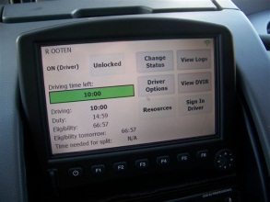

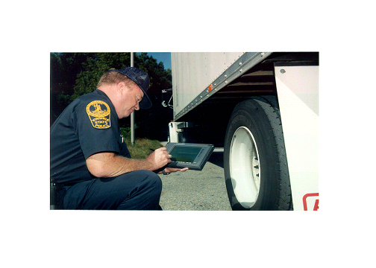

WRI Overview
Vision
  Motor Carrier safety improved through dramatic increases in roadside safety inspections
  Frequent driver and vehicle safety assessments ensure compliance
  Safe and legal motor carrier transportation not hindered
  Wide industry and public agency participation
Goal
  Improved motor carrier safety due to increased compliance caused by higher frequency of roadside safety inspections using wireless technologies.

Slide 4
WRI Pilot Test
Evaluate WRI technical and operational feasibility
Conduct limited end-to-end testing
Integrate CMVs and roadside systems with carrier and Government office systems
Check driver qualification and log data at highway speeds
Test different communication paths in three States
Incorporate EOBRs, fleet management technologies, e-screening systems

Slide 5
WRI Potential Benefits to State Partners
More inspections (up to 85 million per year)
Driver, vehicle, carrier checks while CMV is moving
Focus on unsafe drivers/vehicles within safe carriers
Improve productivity and efficiency of resources
Increase revenues from scofflaws
Check inter- vs. intrastate operations

Slide 6
WRI Potential Benefits/Incentives to Industry
Credit for positive inspections and safe operations
Level playing field across operators
Transparency—Real-time WRI results to carriers
Fewer roadside inspections
  Reduced delays
  Fuel savings
  Equipment wear
  Emissions reductions
Lower insurance costs
More data for fleet management of drivers and vehicles

Slide 7





WRI System Overview
Roadside Law Enforcement and Compliance Staff/Systems
Office Systems
Roadside
Federal CMV Safety Systems
WRI Initial Data
Processing
Traditional Screening/ Inspection Station
Mobile Enforcement
Virtual Weigh Station
WRI Network
Management
Roadside WRI Node
State CMV
Safety Systems
Onboard WRI
Equipment
Other Onboard Equipment
Motor Carrier or
Service Provider
Systems
Applications
Human-machine interface
EOBR, Vehicle Data Bus, Standard Messages
Commercial Motor Vehicle

Slide 8
Exploring Different Communications Paths
New York – Dedicated Short Range Communications
  5.9 GHz transponders integrated with onboard systems as part of CVII initiative
  Used in WRI Proof of Concept and USDOT’s Vehicle-to-Vehicle and Vehicle-to-Infrastructure initiatives.
Tennessee – Commercial Mobile Radio Service
  Existing Fleet Management Systems
Kentucky – Universal Identification
  License plate and USDOT# reading cameras
  E-screening transponders (900 MHz)

Slide 9


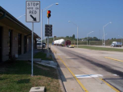
NY–Dedicated Short-Range Communications - 5.9 GHz
Government
System
6
NAS “Level-WRI” Inspection Report
Motor Carrier
Ops. Center
SDMS is evaluated for safety issues
1
Roadside
Enforcement
SDMS
Request for SDMS
SDMS is compiled and sent to the DSRC Road Side Equipment
5
SDMS
4
DSRC
RSE
2
Req. for SDMS
3 Data Collected

Slide 10
WRI Commercial Mobile Radio Services (CMRS)
Communications Path
2
Geofence Locations
Government
System
Motor Carrier
Ops. Center
SDMS sent to Government System
6
7
NAS “Level-WRI” Inspection Report
Roadside
Enforcement
SDMS Message is compiled using both vehicle-based and back-office data
SDMS is evaluated for safety issues
1
3
Creates Geofence
Locations
Sends Vehicle Data
via CMRS
Vehicle:
Crosses into Geofence
On-board data collected
Sends Geofence
via CMRS
5
Geofence
4 Data Collected
Notes:
Path B – using existing onboard computers for fleet management systems.

Slide 11
KY – Universal ID Platform
4
Request for SDMS Sent to Motor Carrier
Government
System
Motor Carrier
Ops. Center
SDMS sent to Gov. Back Office
5
6
NAS “Level-WRI” Inspection Report
6
Inspection Report
CMV Safety Alert
3
Weigh/Inspection Station
Screening Computer
Vehicle ID
Reader
Vehicle ID
KY CMV Headquarters
KY Government Back Office
2
Vehicle ID
1

Slide 12
Preliminary Findings
Approximately 917 Safety Data Messages from 34 vehicles
Performance data—End-to-end data flow latency—average range 34 to 46 seconds
Geo-fence size, shape, and location are key performance elements
Test participants’ overall view of WRI positive, noted several enhancement areas
Data validations and security authentication via communications protocol a key issue

Slide 13
WRI Program Phases & Schedule
2006
2007
2008
2009
2010
2011
2012
2013
2014
Phase I:
Concept Development
& Verification
POC Test
Phase II:
System & Strategy
Definition
Phase III:
Finalize Deployment
Strategies & Impacts
One Location
Two Vehicles
Vehicle to Roadside
Pilot Tests
Corridors
Several Vehicles
Alternate Technologies
Multiple communication technologies
Roadside to Office
Field Operational Test
Deploy WRI Program
Multi-Corridor/Jurisdiction Fleet
Selected Technologies
Full Network
Go / No Go Decision Point

Slide 14
Questions?
Chris Flanigan
FMCSA
202-385-2384
chris.flanigan@dot.gov

