Slide 1


Violation to Crash Risk Relationship
Dave Madsen, Volpe Center
Motor Carrier Safety Advisory Committee (MCSAC) for Compliance, Safety, Accountability (CSA)
December 2012
The National Transportation Systems Center
U.S. Department of Transportation
Research and Innovative Technology Administration
John A. Volpe National Transportation Systems Center
Advancing transportation innovation for the public good

Slide 2
Topics
Pre-CSA Driver-Based Study
Driver Regression Model
  Major component in assigning severity weights in SMS
CSMS Effectiveness Test
  Carrier based crash-risk model

Slide 3
Pre-CSA Driver Study (2006)
Goal: To find out if the roadside data robust enough to support a BASIC (Behavior Analysis Safety Improvement Category) structure.
New Data Set: Individual CMV Drivers Safety profiles based on inspections and crashes
  “MCMIS for Drivers”
  Precursor for Pre-employment Screening Program (PSP) and Driver Information Resource (DIR)

Slide 4
Pre-CSA Driver Study Approach
Compared CMV drivers’ BASIC violation rates from inspections for different levels of crash involvement.
  Population: Drivers with substantial inspection history (7+ inspections excluding post-crash inspections)
  Crash involvement – Place each driver into 1 of 3 pools
Notes:
4
4
Drivers in new DIR over three year period (2003-2005 for Inspections), (2001-2005 for Crashes).
About 250,000 drivers.

Slide 5
Pre-CSA Driver Study Approach (cont.)
  BASIC violation rate
    Mapped each driver’s violations to BASICs and derived a rate
    Calculated average violation rate by BASIC for drivers in each crash pool

Slide 6
Pre-CSA Driver Study Results
Notes:
6

Slide 7
Pre-CSA Driver Study Conclusions
Demonstrated association between poor driver safety performance in each BASIC and increase in crash involvement even using simple (non-weighted) violation rates.
Strongest associations occur in BASICs directly related to driver behavior behind the wheel, rather than vehicle or cargo-related BASICs.
  Confirms Large Truck Crash Causation Study results.

Slide 8
Topics
Pre-CSA Driver-Based Study: Confirms association between BASICs and crash risk
Driver Regression Model
  Major component in assigning severity weights in SMS
CSMS Effectiveness Test
  Carrier based crash-risk model

Slide 9
Driver Regression Model (2007)
Goal: To provide a better means of identifying safety problems by weighting violations within a BASIC based on crash risk.
Model results were the basis of the SMS violation severity weights.

Slide 10
Driver Regression Model Approach
BASIC Mapping
  All safety-related roadside violations mapped to appropriate BASIC.
Violation Grouping
  Grouped ‘like’ violations together in each BASIC
    Allows rarely cited violations to be used in statistical analysis.
    Ensures similar violations receive same severity weight.

Slide 11
Driver Regression Model Approach
  Driver Regression Model
  Using the same driver violation / crash data used in the Pre-CSA Driver-Based Study (250K Drivers)
    Statistical regression (Negative Binomial) was conducted on violation groups in each BASIC.
    Regression measures relationship between violation rates in each violation group (e.g., tires, brakes) and crash involvement.

Slide 12
Driver Regression Model Results
      Of the 34 violations groups tested where crash relationship might be expected, 27 (79%) showed positive statistically significant relationships between high violation rates and increased crash occurrence at a driver level.
    Example: Unsafe Driving BASIC
Violation Group | Regression Coefficients | Statistically Significant (p < 0.01)
Reckless Driving | 1.94 | Yes
Dangerous Driving | 1.17 | Yes
Speeding related | 1.11 | Yes
Other Driver Violations | 1.11 | Yes
HM related | 1.00 | No
Notes:
45 total Violation Groups
“1” here represents no relationship between violation and crashes. Higher the number, stronger the relationship.
ATRI study had Reckless driving as the violation with the highest relationship to crash risk.

Slide 13
Driver Regression Model Conclusion
    Given that many of the violation groups had statistically significant relationships with crash involvement, Negative Binomial coefficients were used to generate initial violation severity weights from 1 to 10.
    Further modifications were made to account for violations related to crash consequence (e.g., HM)

Slide 14
Topics
Pre-CSA Driver-Based Study: Confirms association between BASICs and crash risk
Driver Regression Model: Defines initial severity weights for violation groups
CSMS Effectiveness Test
  Carrier based crash-risk model

Slide 15
CSMS Effectiveness Test (2007 to Present)
Goal: To provide means of assessing CSMS’ ability to identify carriers with safety problems that lead to high crash risk.
  CSMS Effectiveness Test measures ability to target carriers with a high future crash rate using historical data.
Notes:
FMCSA is analyzing the effectiveness to make more information decisions about their program.

Slide 16
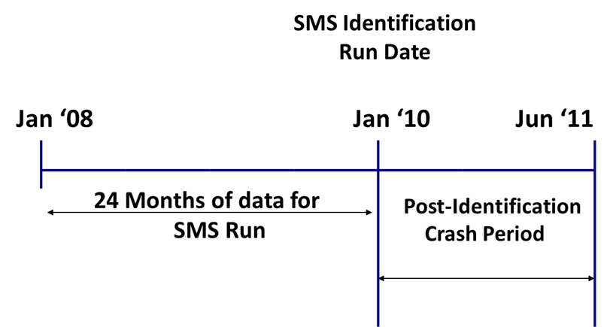
CSMS Effectiveness Test Timeline

Slide 17
CSMS Effectiveness – HOS Compliance BASIC
Strong relationship between HOS Compliance BASIC and future crash risk
UMTRI CSA Evaluation and Recent ATRI paper shows similar findings

Slide 18
CSMS Effectiveness – Vehicle Maintenance BASIC
Strong relationship between Vehicle Maintenance BASIC and future crash risk
UMTRI CSA Evaluation and Recent ATRI paper shows similar findings

Slide 19
CSMS Effectiveness – Driver Fitness
Negative relationship between Driver Fitness BASIC and future crash risk
UMTRI CSA Evaluation and Recent ATRI paper shows similar findings

Slide 20
CSMS Effectiveness – Driver Fitness
Why does this negative relationship exist?
One significant area is lack of specificity in certain violations.
1) Most common violation in Driver Fitness: missing medical card.
  The driver may have misplaced the card: Not safety-related.
  The driver may have an expired medical card: Potentially safety-related.
  The driver may be medically unqualified: Strongly safety-related.
2) “Operating while suspended“ violations do not specify reason. Recent ASPEN improvements provide for more precise severity weights for suspensions.
The inability to distinguish between these cases significantly clouds the relationship with future crashes.

Slide 21
CSMS Effectiveness – Results
Strongest relationships with future crash risk exist for Unsafe Driving, Hours-of-Service, and Vehicle Maintenance BASICs and Crash Indicator
Other BASICs show a weaker relationship to crash risk
FMCSA optimizes resources and oversight responsibilities through more stringent Intervention Thresholds for BASICs with strongest associations to crash risk
Crash rates of Carriers above and below BASIC thresholds
BASIC | Above Threshold : Crashes per 100 PU | Below Threshold: Crashes per 100 PU | Increase in Crash Rate
Unsafe Driving | 7.10 | 3.90 | 82%
Hours of Service Compliance | 6.97 | 4.00 | 74%
Driver Fitness | 2.85 | 4.43 | -36%
Controlled Substance / Alcohol | 2.81 | 5.25 | -47%
Vehicle Maintenance | 5.79 | 3.87 | 50%
HM Compliance | 5.27 | 4.04 | 31%
Crash | 6.59 | 3.58 | 84%
1+ BASIC (any BASIC) | 5.05 | 3.05 | 66%
Notes:
The Intervention threshold is 65% for the Unsafe Driving, HOS, and Crash BASICs.
The Intervention threshold is 80% for the remaining BASICs.
The Unsafe Driving, Hours of Service, Vehicle Maintenance, and Crash BASICs all show significantly higher crash rates for carriers above the intervention threshold.
Carriers with 1 or more BASICs above the intervention threshold have a 66% higher crash rate than those ‘off of FMCSA’s radar.’

Slide 22
Summary
Pre-CSA Driver-Based Study: Confirms association between BASICs and crash risk
Driver Regression Model: Defines initial severity weights for violation groups
CSMS Effectiveness Test: Identifies BASICs with strongest relationships to future crash risk at a carrier level

Slide 23
Summary: Crash Coverage
The CSMS is intended to prioritize FMCSA resources on the carriers that represent a risk to the public.
The CSMS succeeds in this mission. Carriers with percentiles are those involved in the majority of crashes.
Carrier Category | Approximate Number of Carriers | Percentage of Uploaded Crashes
Carriers Listed as Active | 750K | 100%
Carriers with Recent Activity “Pulse” in last 3 years | 525K | 100%
Carriers with Insufficient Data | 325K | 8%
Carriers with Sufficient Data to Be Assessed in at Least 1 BASIC | 200K | 92%
Carriers with Sufficient Negative Information to Have a Percentile Assigned | 92K | 83%
Carriers with At Least 1 BASIC above FMCSA Intervention Threshold | 50K | 45%

