Slide 1

DOT Office of Inspector General
Roles and Mission and FMCSA Related Work
Briefing to Motor Carrier Safety Advisory Committee
November 20, 2012
Assistant Inspector General for Highway and Transit Audits
Joe Comé (202.366.0377)

Slide 2
Key Areas for Discussion
  Our Role and Organization
  Recently Completed and Ongoing
  FMCSA-Related Work
  How We Select Audit Topics for Review
  How We Conduct Our Audit Work
  Questions

Slide 3
DOT OIG: A Brief Introduction
  Statutory Responsibilities
  Conduct independent and objective audits and investigations
  Promote economy, efficiency, and effectiveness
  Prevent and detect waste, fraud, and abuse
  Review pending legislation and regulations
  Keep the Secretary and Congress fully and currently informed
OIG audits and investigations identify vulnerabilities to DOT programs and operations, and capitalize on new and improved approaches for addressing them

Slide 4
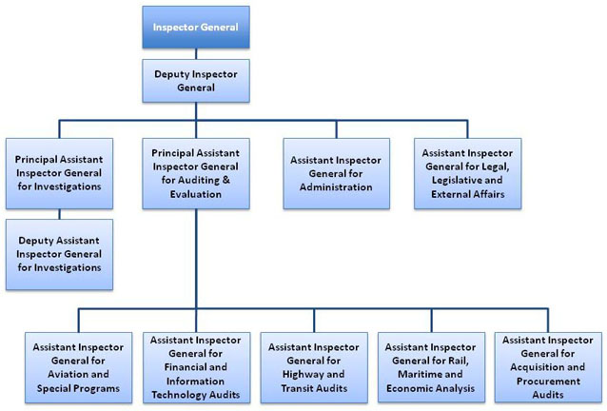
DOT OIG’s Organization
Regional Offices
Audit
Atlanta, GA
Baltimore, MD
Cambridge, MA
Fort Worth, TX
New York, NY
Oklahoma City, OK
San Francisco, CA
Seattle, WA
Investigations
Cambridge, MA
Chicago, IL
Fort Worth, TX
New York, NY
San Francisco, CA
Sunrise, FL
Washington DC
Deputy Assistant Inspector General
Deputy Assistant Inspector General

Slide 5
Recent FMCSA-Related Testimony or Audit Reports
  Testimony: Principal Assistant Inspector General for Investigations Timothy Barry Testified before the Senate Committee on Commerce, Science, and Transportation, on Investigative Work Involving Household Goods Transportation Fraud-September 2012.
  Audit Report: Increased Participation and Improved Oversight Mechanisms Would Benefit the NAFTA Pilot Program-Issued August 2012.
  Audit Report: Timely and Targeted FMCSA Action is Needed to Fully Address National Transportation Safety Board Recommendations for Improving Passenger Carrier Oversight –Issued April 2012.

Slide 6
Ongoing Audit Work
Follow-up Audit Initiated of NAFTA Cross-Border Safety Requirements-Audit Announced in August 2012
  Audit Objectives: To determine whether: (1) FMCSA continues to comply with the safety requirements set forth in Section 350(c); and (2) FMCSA has taken sufficient action to implement our prior recommendations for improving its capacity to perform bus inspections at United States–Mexico border crossings.
  Status: Ongoing
Request from House Committee on Transportation and Infrastructure to review FMCSA’s Compliance, Safety, Accountability (CSA) program.—Requested in October 2012.
  Status: Planning Underway.

Slide 7
How We Select our Audit Work
Requested Reviews
  Congressional Requests
  Secretarial or Modal Requests
Self-Initiated Reviews
  Alignment with Strategic Plans
  24-Month Planning Process

Slide 8
How We Conduct Audit Work
Select and Maintain Qualified Staff
Focus Work Using Objectives
Obtain and Document Sufficient Evidence
Safeguard Independence (Audit vs. Advisory)
Follow Quality Control Procedures
Obtain Views of Activity Audited

Slide 9
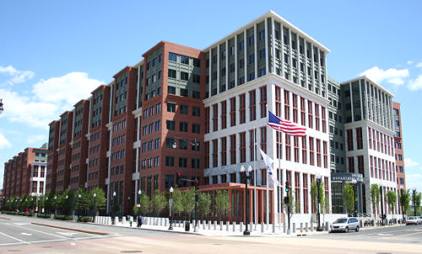
Contact Information
National OIG Hotline: (800) 424 - 9071 or
(202) 366 -1461
OIG Hotline E-mail: hotline@oig.dot.gov
OIG Web Page: www.oig.dot.gov

Slide 10
Questions & Comments

