Slide 1

SCREENING FOR
OBSTRUCTIVE SLEEP APNEA IN
COMMERCIAL VEHICLE OPERATORS
Wednesday, December 7, 2011
Alexandria, VA
Indira Gurubhagavatula, MD, MPH
Assistant Professor of Medicine
University of Pennsylvania Medical Center
Director, Sleep Disorders Clinic
Philadelphia VA Medical Center

Slide 2
My background
FMCSA-funded study of commercial drivers
  Screening for sleep apnea
  Laboratory measures of sleepiness
NIH – NIOSH/CDC-funded study of screening for sleep apnea in commercial drivers
  In progress
Screening commercial vehicle operators for sleep apnea
Notes:
10 y ago, community-based study, drew 4286 CDL holders from around Phila; we studied 406 of them in our lab, did PSG, MSLT, PVT, DADT
-- purpose was to evaluate prevalence;
-- evaluated screening stratgies for osa and lab measures of sleepiness
NIH: more recent, last year; =100; screening using in-home sleep studies
Clinicl program

Slide 3
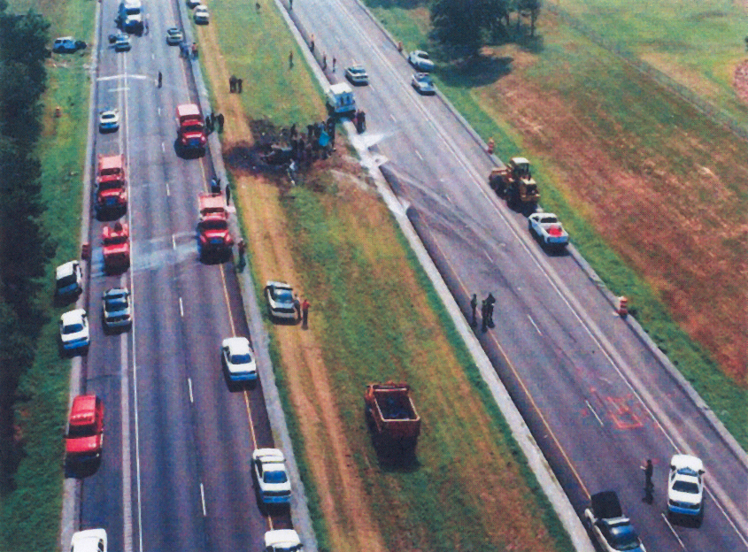
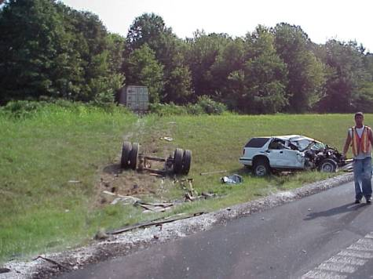
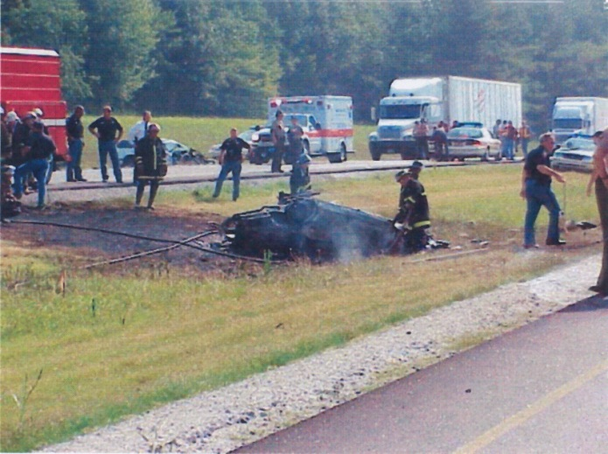
Jackson, Tennessee, July 26, 2000
Tennessee State Trooper Killed
Driver of Chevy Blazer Seriously Injured
Notes:
http://www.awakeinphilly.org/Legal/Engum/26July2000TNaccident.shtml
Jackson, TN – July 26, 2000 A loaded semi-trailer, traveling eastbound at about 65 mph in a 55 mph construction zone hit a state trooper car from behind, which subsequently exploded and caught fire. The cruiser was trailing construction vehicles traveling along the highway. The semi then crossed the sunken meridian and entered the westbound lanes, colliding with a pickup truck before coming to rest on the opposite shoulder. The police officer was killed and the driver of the pickup was seriously injured.
The National Transportation Safety Board (NTSB) investigated the accident and found three safety issues that contributed to the accident:
Lack of communication between the Tennessee Department of Transportation, its contractors, and the Tennessee Highway Patrol.
Inadequate planning and coordinating of traffic control responsibilities between highway construction personnel and law enforcement officers before engaging in work zone activities.
Inadequate training for officers in safe traffic control procedures within highway work zones.
Idaho Trucker Charged With Murder For Killing Trooper
An Idaho trucker who killed a Tennessee State trooper in a July 26 accident has been charged with second-degree murder and three other felony counts.
According to Associated Press reports, trucker Clifford James Engum's tractor-trailer smashed into the back of Trooper Lynn Ross's patrol car on Interstate 40 near Jackson, TN. Joyce Ann Misener of Rogers, AR, was killed and seven others injured in a chain of wrecks caused by the accident.
Engum has been charged with second-degree murder, vehicular homicide, aggravated assault and reckless endangerment. He was also charged with a misdemeanor count of reckless driving. District Attorney Jerry Woodall said he could serve up to 20 years in prison on the murder charge, with up to 10 more years each for vehicular homicide and aggravated assault charges and five years for reckless endangerment.
defendant Clifford Engum was driving a tractor trailer truck owned by defendant Eck Miller Transportation Company, Inc., and was traveling east on Interstate 40 when, at exit 86, his truck plowed into the rear of 40 year old Lynn McCarthy Ross's patrol car, sending the patrol car careening approximately 150 feet down the east lanes of the interstate and into the median where the patrol car flipped upside down and exploded. Trooper Lynn Ross (male) was killed as a result of the accident.
****No evidence that brakes were applied; no evidence that he tried to redirect the vehicle****; Lighting was fine, trooper’s vehicle had emergency lights on; charged w/driving while sleepy, speeding, failing to take corrective action
Deceased had three minor children at home
12. Defendant Eck Miller was negligent, careless and reckless in its decision to employ, retain and allow defendant Engum to operate its tractor trailers on public streets and highways. Defendant Eck Miller negligently entrusted its tractor trailer to Clifford Engum despite the fat that he had a substandard driving record, despite the fact that he had previously been found guilty of falsifying a logbook, and despite the fact that Engum, while operating a tractor trailer truck, had previously been involved in a substantially similar rear-end collision tat resulted in serious injuries and damages to two (2) Utah State Troopers and the vehicles they were operating.
WHEREFORE, plaintiffs demand judgement against the defendants for compensatory damages in the amount of Five Million and No/100 Dollars ($5,000,000.00) and for punitive damages in the amount of Fifty Million and No/100 Dollars ($50,000,000.00), together with court costs and discretionary costs incurred in prosecuting this action. The plaintiffs further demand that a jury be impaneled to try this case.

Slide 4
TIMELINE OF EVENTS LEADING TO CRASH
12/96
ADVISED TO HAVE SLEEP STUDY
7/97
UTAH CRASH,
2 TROOPERS INJURED
8/97
OSA DIAGNOSED
9/97
SURGERY WITH NO FOLLOW UP
8/99
DOES NOT REPORT OSA, LOW THYROID OR THYROID MEDICINE;
CDL RENEWED
7/26/00
CRASH,
DEATH OF STATE TROOPER
http://www.awakeinphilly.org/Legal/Engum/26July2000TNaccident.shtml
Notes:
July 1997, when he struck a stopped highway patrol car in Utah, seriously injuring two troopers. The patrol car had been parked on the roadway to prevent other vehicles from running into a load of spilled gravel.⁹ After the Jackson, Tennessee, accident, the driver stated to the THP that he might have fallen asleep immediately before the accident. (got charged with a misdemeanor and was fined)
In September 1998, the driver was diagnosed with hypothyroidism¹² and placed on replacement thyroid hormone. He noted this condition on his October 1998 commercial driver medical examination form and was found by the physician performing the examination to have markedly diminished deep tendon reflexes.¹³ The physician noted that the driver had just begun replacement therapy but did not limit or deny the medical certificate.
On his August 1999 commercial driver medical examination form, the driver made no mention of hypothyroidism or his history of sleep apnea. Although he had been prescribed medication for his hypothyroidism, he indicated that he was not on any medication.
Following the accident, a pill bottle was found in the driver's truck cab. The bottle contained 85 of 90 pills of levothyroxine, a thyroid hormone replacement. The prescription date was 1998, with an expiration date of December 1999. The labeling noted that the prescription was the first of four available for refill of the medication. A blood test performed by the THP following this accident indicated that his thyroid hormone level was markedly low. Symptoms of untreated hypothyroidism may include fatigue, lethargy, constipation, cold intolerance, stiffness and cramping of the muscles, carpal tunnel syndrome, and, over time, a slowing of intellectual and motor activity, a decrease in appetite, and an increase in weight. Obstructive sleep apnea is also associated with untreated hypothyroidism.¹⁴
Neither obstructive sleep apnea nor hypothyroidism is specifically disqualifying for commercial drivers, although nonbinding Federal Motor Carrier Safety Administration (FMCSA) advisory criteria note that "there are many conditions that interfere with oxygen exchange ... including ... sleep apnea. If the medical examiner detects a respiratory dysfunction that in any way is likely to interfere with the driver's ability to safely control and drive a commercial motor vehicle, the driver must be referred to a specialist for further evaluation or therapy."¹⁵ No FMCSA guidelines address hypothyroidism.
Apneic Trucker Who Killed Tennessee
Trooper Owes Family $5 Million
Just where is that dividing line between providing for your family and being irresponsible? For Clifford Engum, that line has been made clear by his actions, or rather, his lack of action.
Engum, you see, used to drive big rigs down the highways of the United States. He did that until he was sent to prison for killing a Tennessee state trooper. Let's back up just a minute here and look at the many events that led to Engun being used as a classic example of irresponsibility behind the wheel of a vehicle — and his work vehicle being an 18-wheeler.
In terms of coming into the public spotlight, Engum's story begins in July 1997 when he was involved in an accident and injured two state trooper in Utah. In that accident, the patrol car was parked in the roadway to prevent other vehicles from running into a pile of gravel which had been spilled in the roadway. Engum plowed into the patrol car, with his tractor-semitrailer, seriously injuring two troopers.
Seven months before this accident, in December 1996, however, Engum had been hospitalized for an infection in his legs. While hospitalized, Engum was warned by his physician at the VA hospital that he likely had sleep apnea and should undergo a sleep study to determine if he did, in fact, have apnea, and determine its severity.
Being the upstanding pillar of the community that history now shows Engum to have been, he told the doctors he would take part in the strongly suggested sleep study “promptly.” He explained he didn't have time to have a sleep study performed in December 1996, according to medical records released by the National Transportation Safety Board (NTSB). According to the medical records, he told the doctors at the VA hospital he had to return to work.
For Engum, promptly getting a sleep study meant going for the study in August 1997 — one month after careening his truck into the patrol car in Utah, injuring the two state troopers. Bear in mind, this accident occurred more than seven months after being told by doctors at the VA hospital that he likely suffered from obstructive sleep apnea.
After his sleep study, Engum was told that he did, in fact, have sleep apnea, and required a CPAP machine to treat the condition. After receiving his CPAP in September 1997, Engum decided he could not tolerate the machine, and instead, opted for a surgical fix. Now, since there is no surgery available that effectively cures sleep apnea, he likely had a procedure which either eliminated his snoring, which may have helped reduce the number of apneas he suffered per hour while sleeping, but even that isn't clear. It seems there were some post-operative complications, including swelling of the neck, which resulted in difficulty swallowing and anxiety for Engum. Despite the problems, Engum failed to keep a post-operative appointment, and then failed to have a follow-up sleep study to see if the surgery had lessened the severity of his apnea or even the total number of apneas he suffered per hour.
Then, more than 42 months later, Engum killed a Tennessee state trooper when he fell asleep at the wheel of the tractor-semitrailer he was driving for Eck Miller Transportation Co.
According to medical information released by the NTSB, Engum should have been disqualified from having a commercial driver's license (CDL) for several reasons -- one being that he suffered from untreated sleep apnea. Had Engum been disqualified from having a CDL, and possibly even a regular driver's license, the Tennessee trooper would be alive today.
The role of apnea in this case: extreme.
The role of non-compliance in this case: extreme.
The role of CPAP or BiPAP in this case: none (Engum was non-compliant)

Slide 5
OUTCOME
Pleaded guilty to
  vehicular homicide by recklessness
  aggravated assault with a deadly weapon
Driver and company responsible for paying $3.25 million judgment to trooper’s family

Slide 6
FOUR Criteria for POPULATION screening
High prevalence
Associated with adverse consequences
Long interval between symptom onset and the development of adverse consequences
Identifiable in the latent stage
Effective treatment is available
Baumel, AJRCCM 1994

Slide 7
outline
Symptoms, prevalence, risk factors
Consequences
Diagnosis
Treatment
Industry initiatives
Available guidelines
Recommendations

Slide 8
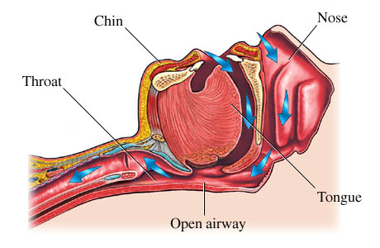
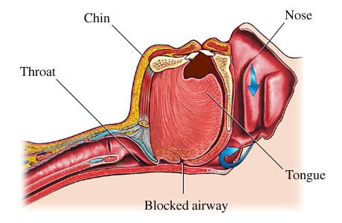
WHAT IS SLEEP APNEA?
Snoring
Hypopneas
Apneas
AWAKE
ASLEEP
http://content.revolutionhealth.com/contentimages/n5551303.jpg
http://www.thetmjcenter.com/sleep_apnea.jpg

Slide 9
WHAT IS SLEEP APNEA?
Recurrent stops in breathing (apneas) or
decrements in airflow (hypopneas) during sleep
Fall in oxygen level
(hypoxia)
Arousal from sleep
- high blood pressure
- heart attack
- stroke
Neuro-cognitive effects
SLEEPINESS
- crash risk

Slide 10
SYMPTOMS OF OSA
DURING SLEEP
DURING WAKEFULNESS
loud snoring
choking during sleep
gasping/snorting
witnessed apneas
nighttime urination
sleepiness despite adequate sleep duration
low mood, memory, concentration
Reduced attention, reaction time
Morning headache
Impotence
worse with weight gain, age, alcohol

Slide 11
SELF-REPORTED SYMPTOMS ARE NOT ALWAYS RELIABLE
USE OBJECTIVE EVALUATION

Slide 12
Who is at risk for osa?
Airway crowding
Central obesity
Large tongue
Jaw set back
Large tonsils
Demographic
Middle age
Male gender
Heredity
Menopause
“Floppy” airway
Alcohol
Narcotics
Sedatives
Age
Low thyroid function
Nose problems
Deviated septum
Polyps, allergies
Smoking
Race

Slide 13
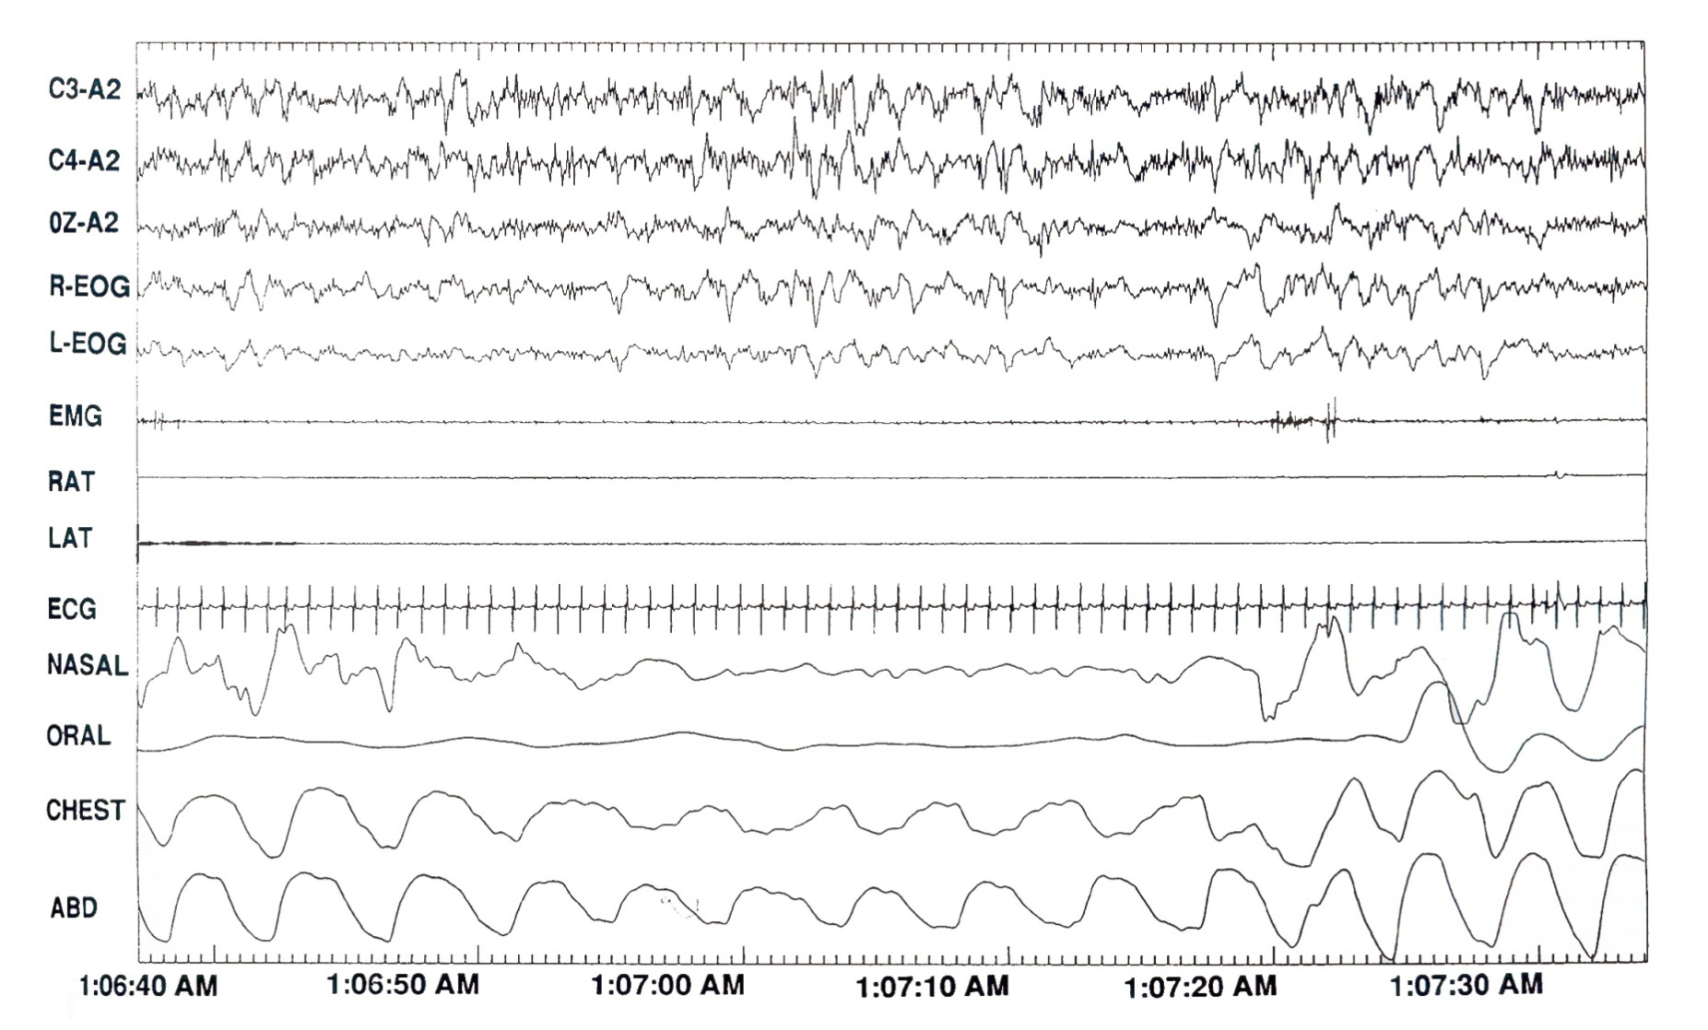
EXAMPLE OF AN APNEA

Slide 14
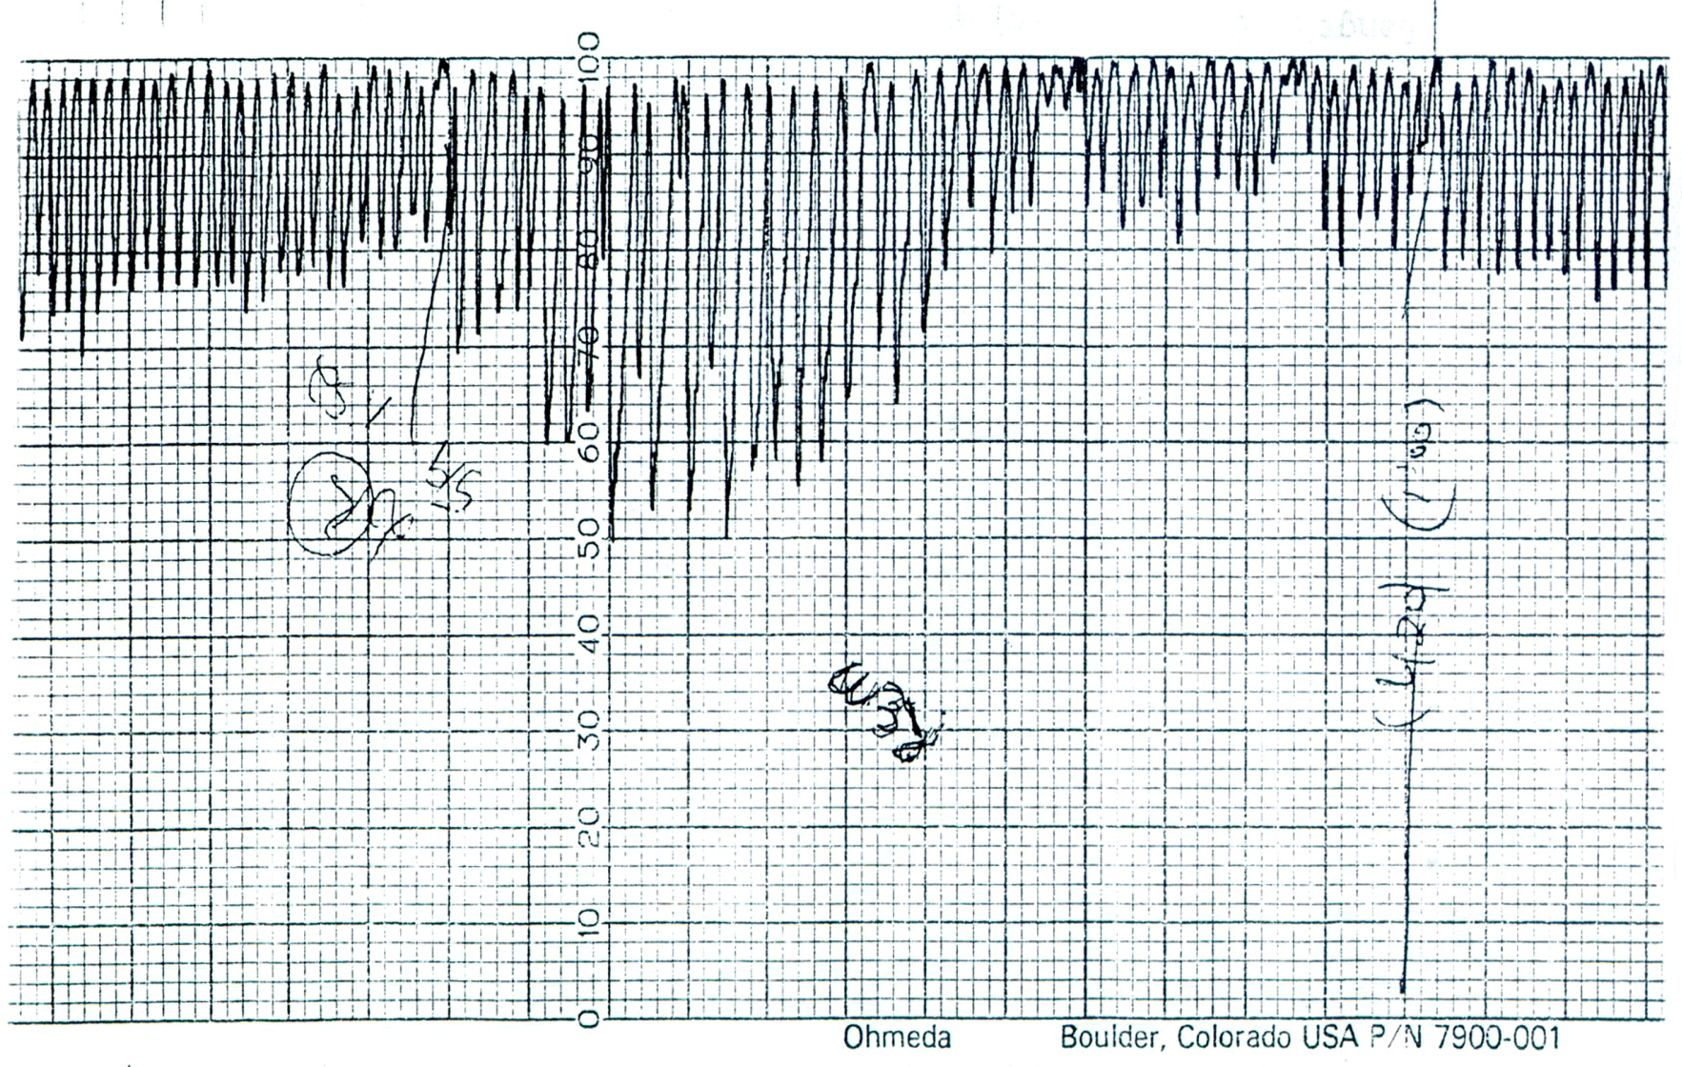
OSA AND OXYGEN LEVEL DURING SLEEP

Slide 15
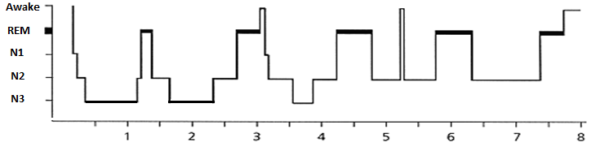
Normal sleep architecture
HOURS OF SLEEP
Notes:
What does a normal night’s sleep look like, anyway?

Slide 16
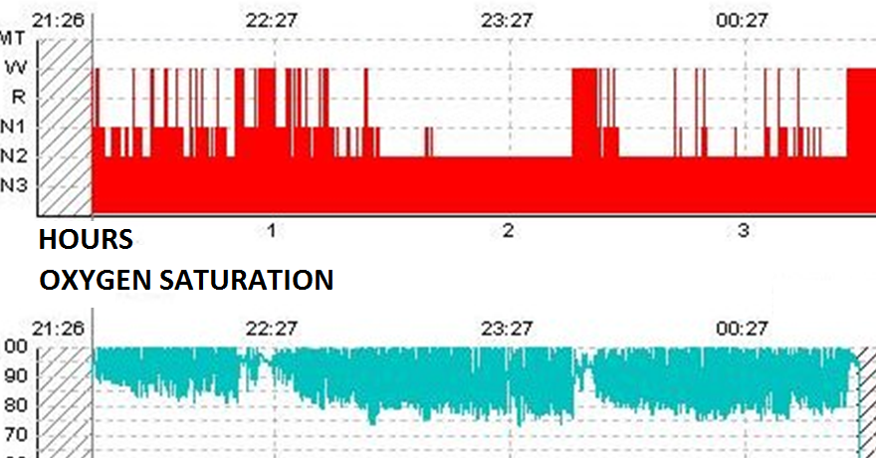
sleep architecture during sleep apnea
Sleep fragmentation
No N3, REM
Desaturation
www.thoracic.org

Slide 17
APNEAS + HYPOPNEAS
HOURS OF SLEEP
Apnea-hypopnea index
Severity | AHI (events/hour)
None | [0-5)
Mild | [5-15)
Moderate | [15-30)
Severe | >=30
AASM Task Force, Sleep, 1999

Slide 18
IS SEVERE SLEEP APNEA COMMON IN COMMERCIAL DRIVERS?
COMMERCIAL DRIVERS
FMCSA | AUSTRALIA | STANFORD
4.7% | 10.6% | 10%
prevalence of AHI >= 30 events/hour
Pack et al: FMCSA Pub. #DOT-RT-02-030,Washington, DC, 2002
Howard et al: AJRCCM (170):1014, 2004
Stoohs et al, Chest (107):1275, 1995

Slide 19
FOUR Criteria for POPULATION screening
High prevalence
Associated with adverse consequences
Long interval between symptom onset and the development of adverse consequences
Identifiable in the latent stage
Effective treatment is available
Baumel, AJRCCM 1994

Slide 20
WHY IS APNEA SO COMMON IN COMMERCIAL DRIVERS?
Airway crowding
Central obesity
Large tongue
Jaw set back
Large tonsils
Demographic
Middle age
Male gender
Heredity
Menopause
“Floppy” airway
Alcohol
Narcotics
Sedatives
Age
Low thyroid function
Nose problems
Deviated septum
Polyps, allergies
Smoking
Race
Pack et al: FMCSA Pub. #DOT-RT-02-030,Washington, DC, 2002
Howard et al: AJRCCM (170):1014, 2004
Stoohs et al, Chest (107):1275, 1995

Slide 21
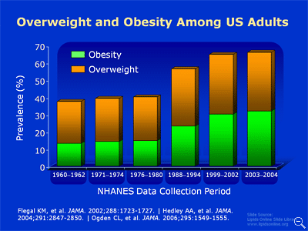
OBESITY: A GROWING PROBLEM

Slide 22
BMI DISTRIBUTION IN TWO COHORTS OF
CDL HOLDERS, 2002 and 2011
Percent in BMI range
Pack et al: FMCSA Pub. #DOT-RT-02-030,Washington, DC, 2002
NIOSH/CDC R01 OH-009149-3, 2011

Slide 23
WHY IS OSA IN COMMERCIAL DRIVERS OF PARTICULAR IMPORTANCE?

Slide 24
SLEEPINESS AND CRASHES IN CMV OPERATORS: 2009
341,000 police-reported large truck and bus crashes
  4,321 death
  60,000 injuries
  278,000 property damage
Traffic crash victims in truck and bus crashes
  3,619 killed
  33,000 injured
http://www.fmcsa.dot.gov/documents/facts-research/CMV-Facts.pdf

Slide 25
COST OF CMV CRASHES (2008 DOLLARS)
 | Fatal | Injury | Property Damage Only | TOTAL
 | $23 billion | $20 billion | $5 billion | $48 billion
Non-fatal crash | $91,112/crash
Fatal crash | $3.6 million/crash
http://www.fmcsa.dot.gov/documents/facts-research/CMV-Facts.pdf
http://www.fmcsa.dot.gov/facts-research/facts-figures/analysis-statistics/cmvfacts.htm
http://ai.volpe.dot.gov/carrierresearchresults/pdfs/crash%20costs%202006.pdf
Notes:
This study provides the latest estimates of unit costs for highway crashes involving
medium/heavy trucks by severity. Based on the latest data available, the estimated
cost of police-reported crashes involving trucks with a gross weight rating of more
than 10,000 pounds averaged $91,112 (in 2005 dollars). These costs represent the
present value, computed at a 4% discount rate, of all costs over the victims’ expected
life span that result from a crash. They include medically related costs, emergency
services costs, property damage costs, lost productivity, and the monetized value of
the pain, suffering, and quality of life that the family loses because of a death or
injury. Other notable findings include:
· Crashes in which truck-tractors with two or three trailers were involved were the
rarest but their cost was the highest among all crashes – $ 289,549 per crash.
· Crashes in which straight trucks with no trailers were involved had the lowest
cost – $ 56,296 per crash.
· The average cost of property damage only (PDO) crashes was $15,114
· The costs per non-fatal injury crash averaged $ 195,258.
· As expected, fatal crashes cost more than any other crashes. The average cost of
fatal crashes was $ 3,604,518 per crash.
· The cost estimates exclude mental health care costs for crash victims, roadside
furniture repair costs, cargo delays, earnings lost by family and friends caring for
the injured, and the value of schoolwork lost.

Slide 26
Cdl holder self-reports
102 CDL HOLDERS
250 VETERANS
Sleepiness while driving
Slight 25 (24.5%)
Moderate 4 (3.9%)
High 0 (0%)
4 (1.7%)
5 (2.1%)
22 (9.1%)
Accidents
Ever 68 (67%)
Single-vehicle 13 (13%)
Sleepy 4 (3.9%)
NIOSH/CDC R01 OH-009149-3
K23 RR16068
VISN4 PILOT PROJECT GRANT

Slide 27
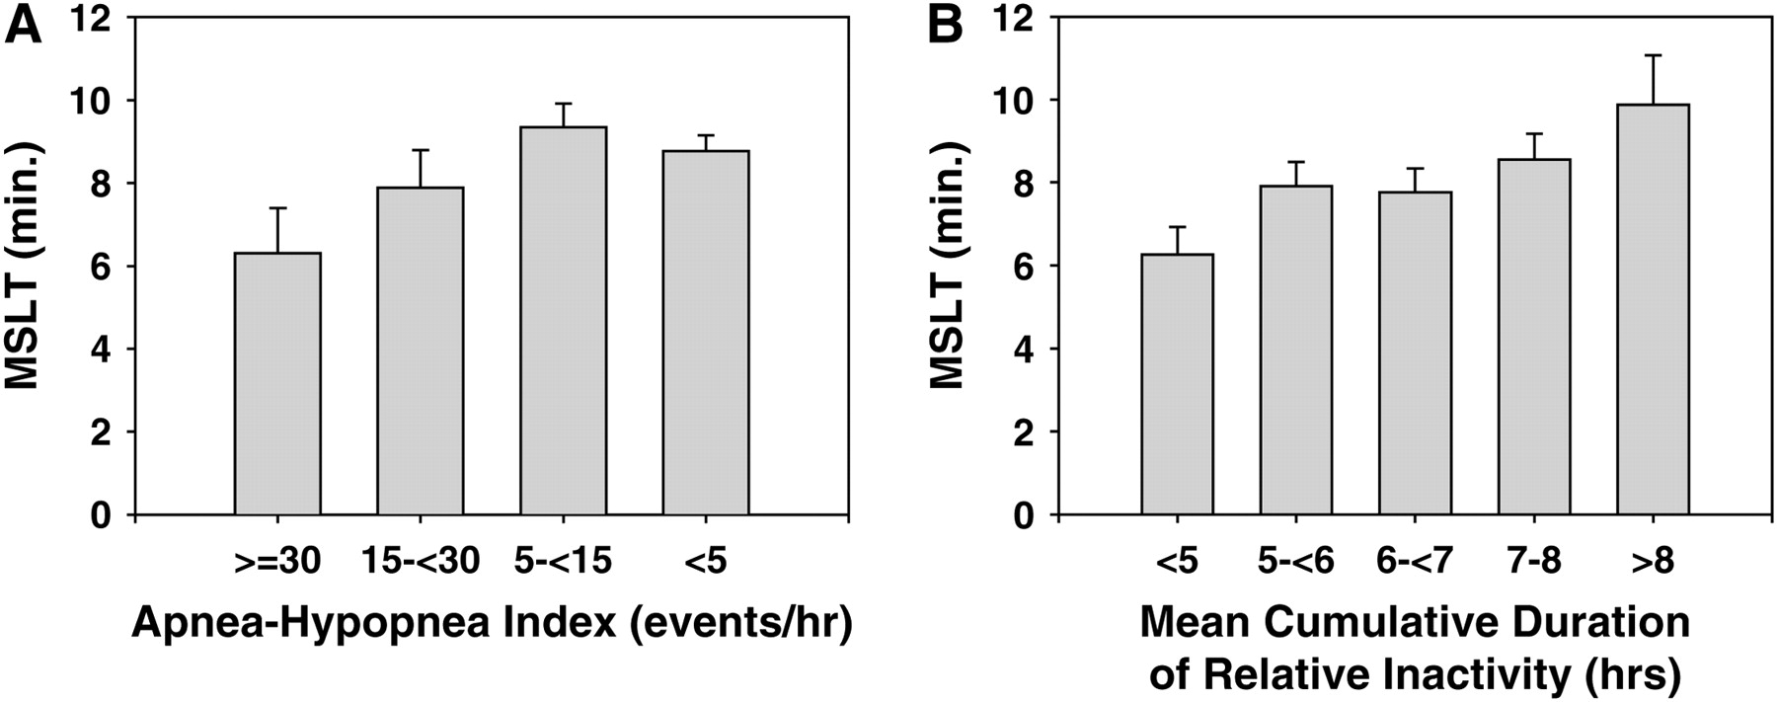
Estimates of OBJECTIVELY MEASURED SLEEPINESS IN COMMERCIAL DRIVERS
Pack et al, AJRCCM 174(4): 446, 2006
Notes:
Least-squares estimates of mean Multiple Sleep Latency Test (MSLT) with standard errors controlling for apnea severity category, sleep duration category, age, sex, and body mass index. (A) Apnea–hypopnea index category. (B) Mean length of cumulative duration of relative inactivity.
Sleepiness plays an important role in major crashes of commercial vehicles. Because determinants are likely to include inadequate sleep and sleep apnea, we evaluated the role of short sleep durations over 1 wk at home and sleep apnea in subjective sleepiness (Epworth Sleepiness Scale), objective sleepiness (reduced sleep latency as determined by the Multiple Sleep Latency Test), and neurobehavioral functioning (lapses in performance, tracking error in Divided Attention Driving Task) in commercial drivers. Studies were conducted in 247 of 551 drivers at higher risk for apnea and in 159 of 778 drivers at lower risk. A multivariate linear association between the sets of outcomes and risk factors was confirmed (p < 0.0001). Increases in subjective sleepinesswere associated with shorter sleep durations but not with increases in severity of apnea. Increases in objective sleepiness and performance lapses, as well as poorer lane tracking, were associated with shorter sleep durations. Associations with sleep apnea severity were not as robust and not strictly monotonic. A significant linear association with sleep apnea was demonstrated only for reduced sleep latency. The effects of severe apnea (apnea–hypopnea index, at least 30 episodes/h), which occurred in 4.7%, and of sleep duration less than 5 h/night, which occurred in 13.5%, were similar in terms of their impact on objective sleepiness. Thus, addressing impairment in commercial drivers requires addressing both insufficient sleep and sleep apnea, the former being more common.
27

Slide 28
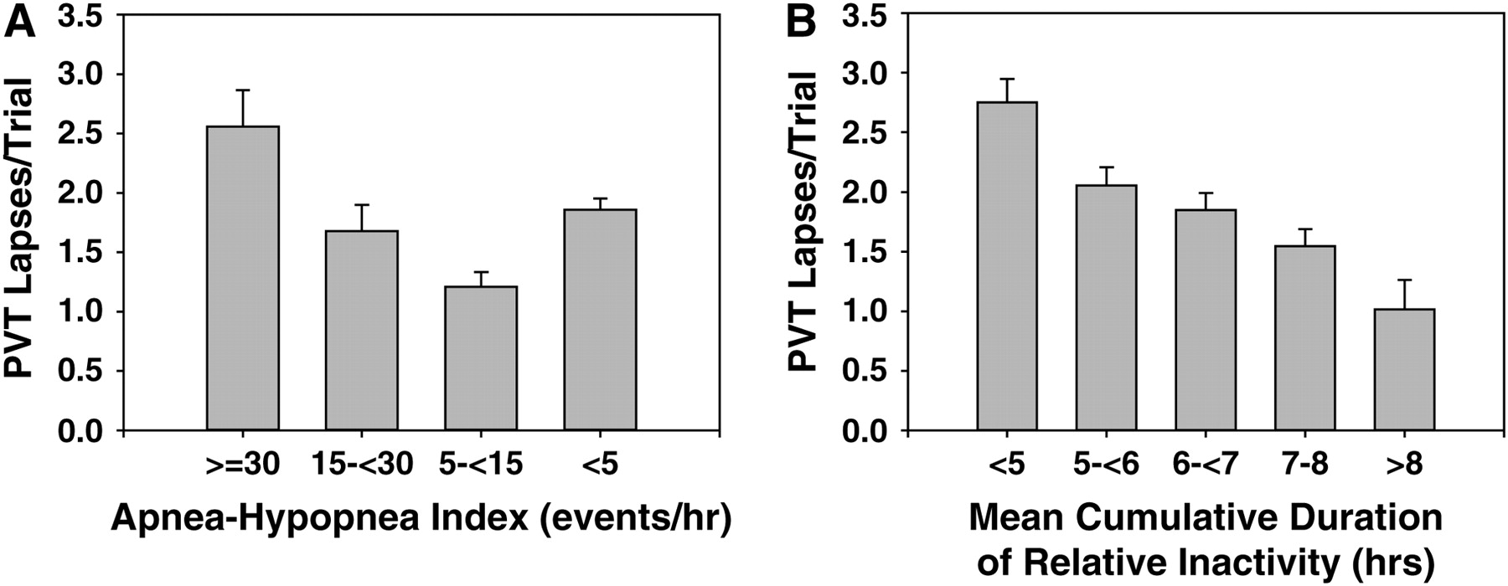
Estimated Lapses during psychomotor vigilance testing IN COMMERCIAL DRIVERS
Pack et al, AJRCCM 174(4): 446, 2006

Slide 29
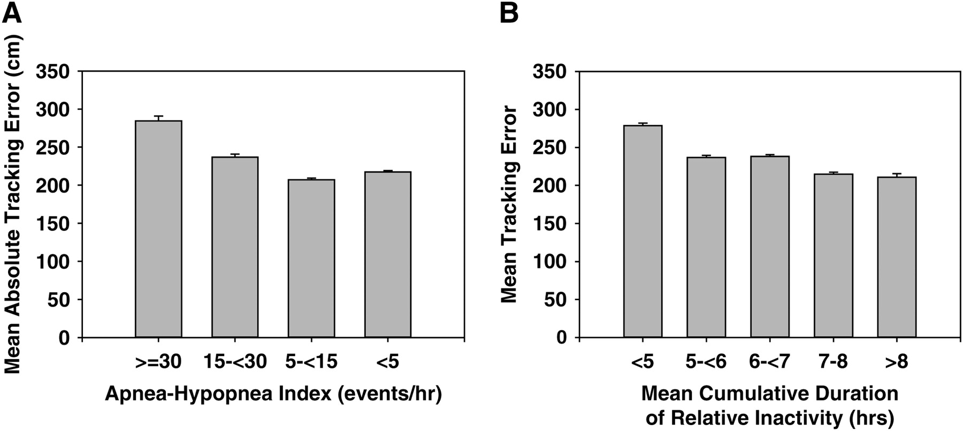
Estimated Divided attention driving errors IN COMMERCIAL DRIVERS
Pack et al, AJRCCM 174(4): 446, 2006

Slide 30
FOUR Criteria for POPULATION screening
High prevalence
Associated with adverse consequences
Long interval between symptom onset and the development of adverse consequences
Identifiable in the latent stage
Effective treatment is available
Baumel, AJRCCM 1994

Slide 31
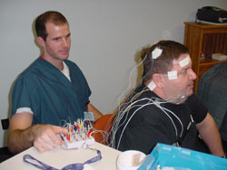
SLEEP STUDY
Brain waves
Eye movement
Chin, leg muscles
Chest and abdomen effort
Airflow, snoring
Oxygen level
85% of cases remain undiagnosed

Slide 32
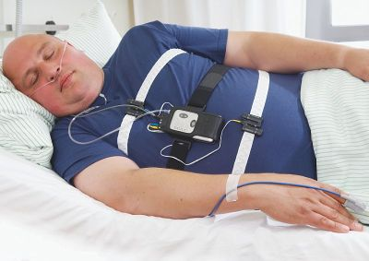
PORTABLE SLEEP STUDY
Brain waves
Eye movement
Chin, leg muscles
Chest and abdomen effort
Airflow, snoring
Oxygen level
http://www.fette-thimm.de/img/embletta400.jpg

Slide 33
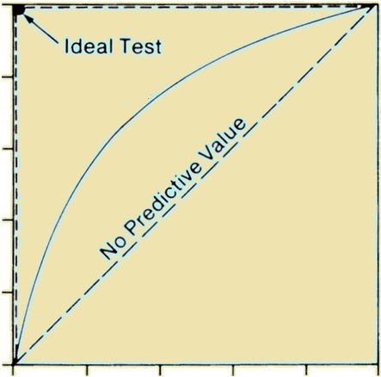
RECEIVER OPERATING CHARACTERISTIC CURVE
HOW DO WE ASSESS HOW WELL DIAGNOSTIC TECHNOLOGIES WORK?
1
0.8
AUC=1
0.6
Actual test
Sensitivity (%)
0.4
AUC=0.5
0.2
0
0
1
1-Specificity (%)

Slide 34
Usefulness of SCREENING TOOLS IN PREDICTING SEVERE APNEA in
57 CDL HOLDERS
 | Neck circumference | BMI | oximetry | In-home, abridged study | Full sleep study
AUC* | 0.68 | 0.72 | 0.91 | 0.96 | 1
N | 57 | 57 | 57 | 57 | 57
*Area under receiver-operating characteristic curve
0.5 = poor, 1=perfect
NIOSH/CDC R01 OH-009149-3

Slide 35
FOUR Criteria for POPULATION screening
High prevalence
Associated with adverse consequences
Long interval between symptom onset and the development of adverse consequences
Identifiable in the latent stage
Effective treatment is available
Baumel, AJRCCM 1994

Slide 36
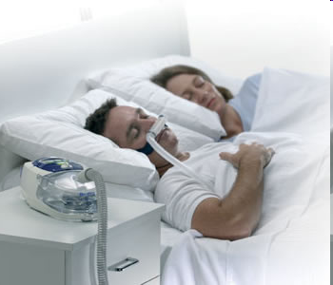
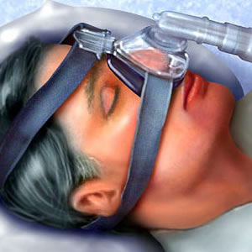
TREATMENT OF OSA: CONTINUOUS POSITIVE AIRWAY PRESSURE (CPAP)
http://www.apneesante.com/english/images/cpap_couple3.png
http://www.bluewatersleepclinic.com/images/cpap.jpg

Slide 37
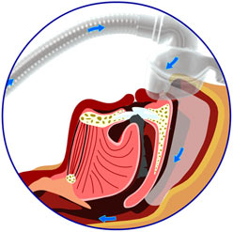
TREATMENT OF OSA: CONTINUOUS POSITIVE AIRWAY PRESSURE (CPAP)
http://www.sleepwise.com.au/images/D912193040.gif
http://www.resmed.com/uk/images/cpap_treatment.jpg

Slide 38
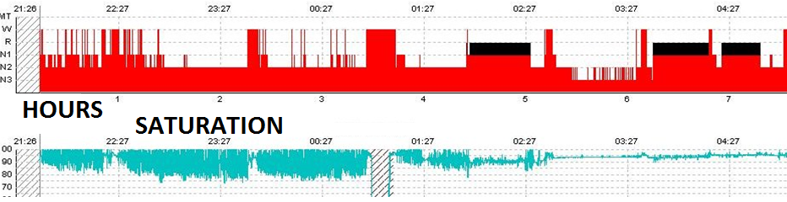
EFFECTS OF CPAP ON SLEEP AND SAO2
Without CPAP
Sleep fragmentation
No N3, REM
Desaturation
With CPAP
Sleep consolidation
REM rebound
Slow wave sleep achieved
Saturation restored
www.thoracic.org
Notes:
Degree of desaturation remits
As CPAP is increased, get REM rebound, get SWS!
Some smaller events persist in REM sleep
CPAP is further increased so that REM apnea is abolished and Sat is maintained above 90%.

Slide 39
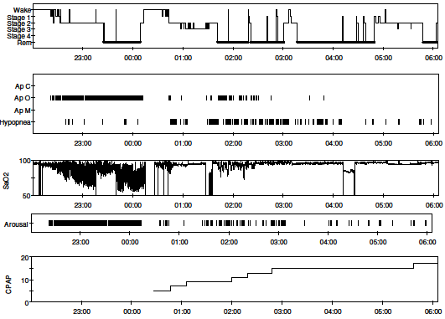
REM REBOUND AFTER CPAP
Notes:
Professional driver with severe OSA
AHI 114/h
CPAP 17 → dropped to 10/hour
Felt better on the first night

Slide 40
treatment for osa
Wear CPAP during sleep (in berth)
Lose weight
Avoid sedatives, alcohol, narcotics
Make sure nasal passages are open
Follow safe driving habits
Monitor blood pressure, heart health

Slide 41
WHAT ARE THE BENEFITS OF CPAP?
Lowers crash risk
Improves alertness
Improves performance on driving simulator
Lowers blood pressure
Raises oxygen level
Lowers AHI
More efficient work performance
Reduces health care costs

Slide 42
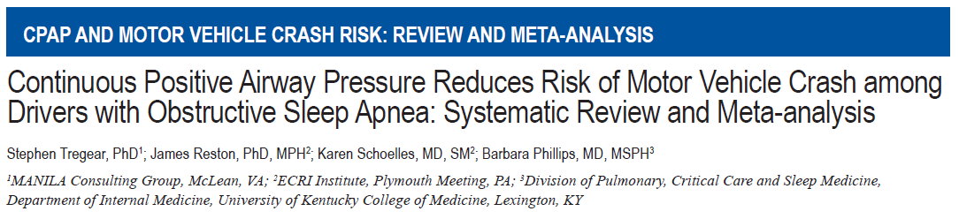
9 studies of crash risk in OSA patients showed that after treatment with CPAP:
  Crash risk dropped
    risk ratio = 0.278, 95% CI: 0.22 to 0.35; P < 0.001
  Daytime sleepiness improved after one night
  Simulated driving performance improved within 2-7 days
funded by FMCSA GS-10F-0177N/DTMC75-06-F-00039
Tregear, Sleep, 33(10):1373, 2010

Slide 43
DATA FROM 9 STUDIES SHOW THAT AFTER CPAP,
CRASH RISK DROPS,
AND POOLED ESTIMATE FROM 3 STUDIES SHOWED IT DROPS TO RATES SIMILAR TO THOSE SEEN IN CONTROLS
funded by FMCSA GS-10F-0177N/DTMC75-06-F-00039
Tregear, Sleep, 33(10):1373, 2010
Notes:
Pooling of the data using a random-effects model meta-analysis (Figure 1) found that CPAP significantly reduces the risk for a motor vehicle crash among individuals with severe OSA (Pre-Post Treatment Crash Risk Ratio [RR] = 0.278, 95% CI: 0.22 to 0.35; P < 0.001). This equates to large reduction in observed crash risk (65% to 78%) following the onset of treatment. A series of sensitivity analyses found our findings to be robust. We performed an additional sensitivity analysis to determine whether excluding data from the subgroup of individuals included in Engleman et al.35 who experienced noninjurious crashes had an impact on our findings. We examined the impact of replacing the findings from the injurious treatment group in this study with crash data from the group of individuals who experienced noninjurious crashes. This analysis confirmed the robustness of our original findings.

Slide 44
INDUSTRY INITIATIVES: Waste Management, Inc.
12 months before vs 24 months after CPAP
 | OSA + CPAP N=156 | OSA, no CPAP N=92
Missed workdays | ↓ 40.6% | ↑ 33.6%
Disability claimant rates | ↓↓ 47.8% | ↓ 9.1%
Total health plan and disability costs | ↓↓ $6341 | ↓ $1,206
OSA group had fewer claims in “Other” and Circulatory System disorders
Hoffman, JOEM 52(5): 473, 2010

Slide 45
INDUSTRY INITIATIVES: SCHNEIDER TRUCKING
N=348 DRIVERS WITH OSA
PMPM health care spending | ↓ $539 (47.8%) (p<.0001)
Preventable driving accidents (225 FT-CPAP-treated drivers) | ↓ 73%
Driver retention rate, compared to 2004 global corporate rate | ↑ 2.29 times
“CPAP as a treatment for sleep apnea yielded very high returns…
produces both short and long-term savings and reduces hospitalizations.”
Don Osterberg, Sleep Apnea & Trucking Conference, BWI Airport, 5/12/2010
http://www.sleephealth.com/Collateral/Documents/English-US/Schneider_TB_Symposium_Paper.pdf

Slide 46
INDUSTRY INITIATIVES: JB HUNT
Clinical trial in progress
Partnered with two sleep provider groups to screen drivers for apnea
Will assess
  Compliance
  Health care costs
  Accident rates

Slide 47
HOW DO WE KNOW PATIENTS ARE USING CPAP?
MONITORING SYSTEMS
REPORTED DATA
Data cards
SD cards
Remote/wireless
Hours of use
Pressure level
Residual apnea
Mask leak
Issues can be addressed in “real” time

Slide 48
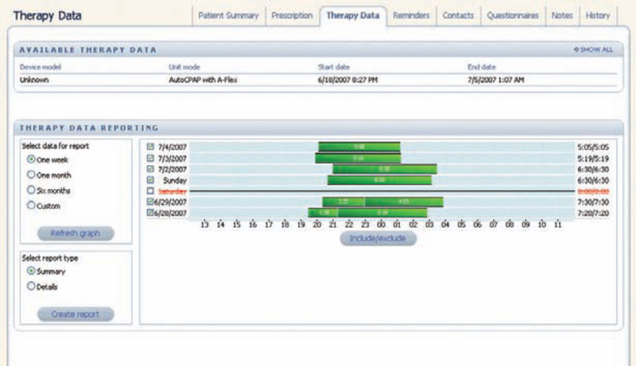

Slide 49
FOUR Criteria for POPULATION screening
High prevalence
Associated with adverse consequences
Long interval between symptom onset and the development of adverse consequences
Identifiable in the latent stage
Effective treatment is available
Baumel, AJRCCM 1994

Slide 50
SCREENING AND MANAGEMENT GUIDELINES FOR OSA IN COMMERCIAL DRIVERS

Slide 51
TWO SETS OF GUIDELINES ARE AVAILABLE FOR SCREENING AND TREATMENT
When to keep driver
  in-service
  conditional in-service
  out-of-service
Diagnosis
Treatment
Reinstatement after out of service
MEP
TRI-SOCIETY TASK FORCE
http://www.fmcsa.dot.gov/rules-regulations/TOPICS/mep/report/Sleep-MEP-Panel-Recommendations-508.pdf
Hartenbaum, CHEST, 130:902, 2006

Slide 52
ARE GUIDELINES ENOUGH?
Screened 456
Referred for PSG 53 (12%)
33 lost to follow up
OSA confirmed 20 (100%)
(7 by self-report,
13 by new testing)
Demonstrated CPAP compliance 1
“Drivers identified by the consensus criteria have a high likelihood of OSA. Drivers’ poor compliance with PSGs and OSA treatment support federally mandated screening of commercial drivers”
Parks, JOEM, 51 (3): 275, 2009
Notes:
“Because OSA screening is not mandated by the FMCSA and no central registry of examinations or examiner exists, drivers could ignore a PSG
referral and seek medical certification froms another clinic. The majority of clinics and practitioners performing CDME examinations do not apply
the JTF guidelines or other rigorous OSA screening protocols (unpublished observations).”
14 were unwilling to provide objective documentation of compliance.
3 drivers submitted reports documenting non-compliance,
two drivers refused CPAP.
Finally, another driver did not tolerate CPAP and was prescribed “auto-PAP,” with compliance data pending at the close of follow-up.
To evaluate consensus criteria for screening commercial
drivers for obstructive sleep apnea (OSA). Methods: Consecutive drivers
underwent OSA screening using Joint Task Force consensus criteria at
commercial driver medical examinations. Outcomes included: clinical
yield of screening; and drivers’ compliance with polysomnography (PSG)
referrals and OSA treatment. Results: Among 456 drivers, 53 (12%)
were referred for PSG, and 20/20 were confirmed to have OSA,
supporting a high positive predictive value. The other 33 drivers referred
for PSG were lost to follow-up but demonstrated no significant differences
from those with confirmed OSA. After diagnosis, only one of 20
drivers with confirmed OSA demonstrated treatment compliance. Conclusions:
Drivers identified by the consensus criteria have a high
likelihood of OSA. Drivers’ poor compliance with PSGs and OSA
treatment support federally mandated screening of commercial drivers.
(J Occup Environ Med. 2009;51:275–282)

Slide 53
SUMMARY
SLEEP APNEA IS
  COMMON IN COMMERCIAL DRIVERS
  CAUSES SLEEPINESS
  LINKED TO CRASHES
  CAN BE DIAGNOSED IN THE HOME
CPAP TREATMENT IS
  INEXPENSIVE
  ACCESSIBLE
  REDUCES CRASHES AND LOWERS COSTS
  TRACKABLE IN REAL-TIME
TWO SETS OF GUIDELINES ARE AVAILABLE FOR SCREENING AND EVALUATING FITNESS FOR DUTY
NOT ENOUGH DRIVERS ARE GETTING HELPED

Slide 54
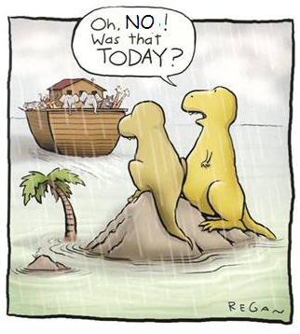
WHAT NEXT?
Notes:
The time is right for us to act

Slide 55
TIMELINE OF EVENTS LEADING TO CRASH
12/96
ADVISED TO HAVE SLEEP STUDY
7/97
UTAH CRASH,
2 TROOPERS INJURED
8/97
OSA DIAGNOSED
9/97
SURGERY WITH NO FOLLOW UP
8/99
DOES NOT REPORT OSA, LOW THYROID OR THYROID MEDICINE;
CDL RENEWED
7/26/00
CRASH,
DEATH OF STATE TROOPER
http://www.awakeinphilly.org/Legal/Engum/26July2000TNaccident.shtml
Notes:
Had he known in 1996 what would eventually happen in 2000- that he would lose his job, his company would go out of business, he would be liable for millions of dollars in legal claims, and that he would cause the death of another individual and serious injury to another and injuries to others, he might have behaved differently;
But the research data says that his pattern of behavior is typical –
The avoidance of discovery, and perhaps a feeling that he did not perceive himself to be impaired.
This is where a mandate can make a difference.

Slide 56
acknowledgements
Allan Pack, MD, PhD
Greg Maislin, MS, MA
Sharon Hurley, BA
Lindsay Wick, MS
Christian Morales, MD
Kim Halscheid, BA
Sleep Lab Technologists
Beth Staley
William Wieland
Haideliza Soto - Calderon
Funding sources
FMCSA
NIOSH/CDC
R01 OH-009149-3

Slide 57
Questions?

