Slide 1
Schedule II Opioids and Stimulants & CMV Crash Risk and Driver Performance Christine Brittle, Ph.D. Katherine Fiedler, Ph.D. Chris Cotterman Jacquelyn Palmer

Slide 2
Roadmap
Introduction and Purpose
Background
Overview of Research Questions
Search Methodology
Q1a
Q1b
Q2
Q3
Conclusion

Slide 3
Purpose
FMCSA asked Acclaro Research Solutions, Inc. (Acclaro) to conduct a systematic literature review
The review looks at how the licit (legal) use of Schedule II opioids and stimulants may impact the risk of CMV crashes or indirect measures of driver performance
These findings, along with input from an expert review panel and FMCSA’s Medical Review Board, are used to inform policy and decision-making
Notes:
[Skip, go fast]

Slide 4
Research Questions
Q1a: What is the relationship between licit use of prescribed Schedule II opioids or stimulants and the risk of a motor vehicle crash?
Q1b: What is the relationship between licit use of prescribed Schedule II opioids or stimulants and indirect measures of driver performance?
Q2: Are the effects of licit use of prescribed opioids or stimulants measureable by serum levels? Do these effects remain consistent or vary based on metabolism or other pharmacokinetic parameters?
Q3: Do the effects worsen or improve when: 1) drug-drug interactions take place with other Schedule II or over-the-counter medications; or 2) the drug has been chronically administered over a period of time (stable use)?
Notes:
Note that these questions came from the MRB, but that we slightly modified them to make them more discrete and searchable for our review

Slide 5
Search Methodology
Search Strategy
Sources Searched
Defined search terms a priori
"potentially driver-impairing" OR "PDI" OR "drug driving" OR "drugged driving"…
Systematically searched for full-length articles published January 1, 2006 to December 2013
Retrieved abstracts reviewed for inclusion/exclusion
Articles meeting inclusion standards were retrieved in full text and reviewed thoroughly for final inclusion
Included articles evaluated for quality of evidence
Research databases (n=11)
Academic Search Premier, Business Source Complete, Cochrane Library, CINAHL, Embase, Health Business Elite, National Guideline Clearinghouse, PubMed, ProQuest, Science Direct, TRID
Commercial, non-profit, and government websites (n=18)
National Transportation Safety Board, American Pain Society, FMCSA, FDA, American Trucking Association, etc.
Reference sections of all included articles
Notes:
Systematic search strategy, using 11 different research databases, plus relevant websites.
Acclaro developed specific search strings and keywords for each question.
For the first part of the search, we reviewed titles and abstracts of more than 5,000 results.
After the initial review, duplicate articles were dropped and we conducted a second review based on a full text review against our inclusion criteria (see next slide).
Relevant articles based on the full text review were included in the study.
These articles were reviewed in detail, including references, which were used to identify additional studies that might be relevant.

Slide 6
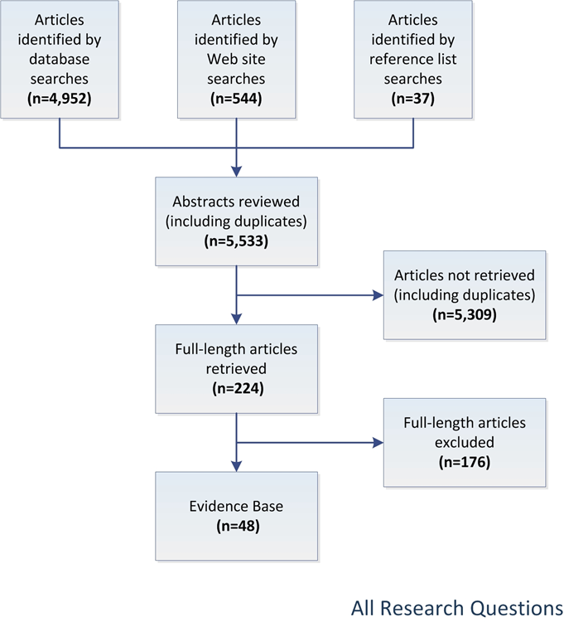
Search Methodology
Inclusion Criteria
Published in English
Full-length articles
n=10 or more subjects enrolled
Most subjects must be 18+
Study on the licit use of prescribed Schedule II opioids or stimulants
If illicit use is included, the effects must be separable
If drugs other than Schedule II opioids or stimulants are included, the effects must be separable
Published after January 1, 2006
The most complete publication will be the primary reference
Notes:
These were the criteria we were reviewing against [reference content on slide]
Chart shows the main sources of materials for the study – three main streams, databases, websites, reference lists, over 5,000 abstracts reviewed
Retrieved 224 articles in full text, included 48 for the study

Slide 7
Evaluation of Quality of Evidence and Characterization of Evidence
Included articles were reviewed for bias using the standards of the Cochrane Bias Methods Group
Studies rated in discrete categories such as selection bias, attrition bias, reporting bias, etc.
All studies were deemed acceptable quality and none were dropped
Overall body of evidence for each research question and topic was rated on a four-point scale:
Strong: Evidence is convincing; highly unlikely new evidence will change conclusions
Moderate: Evidence is somewhat convincing, small chance new evidence will change conclusions
Weak: Some evidence exists, but there is a reasonable chance new evidence would overturn conclusions
Unacceptably Weak: Insufficient evidence to draw conclusions
Notes:
Each article was rated along several discrete dimensions, following the Cochrane Method group standards; none were dropped based on this analysis, all were of acceptable quality
We used the existing system to characterize the overall evidence used in previous evidence reports, following a four-point scale [describe scale from slide]

Slide 8
Research Question 1a
What is the relationship between licit use of prescribed Schedule II opioids or stimulants and the risk of a motor vehicle crash?
Evidence base n=25

Slide 9
Q 1a Conclusions
There is moderate evidence to support the contention that licit use of opioids increases the risk of a motor vehicle crash.
Several large and recent studies link opioid use to increased risk of driver fatalities, driver injury, crash risk, and unsafe driver actions.
Most identified studies show increased risk. However, many of the findings are drawn from the same large European dataset, and many of them also classify all opioids together. Results for specific opioids are more limited and less convincing.
Notes:
[Not much to add here, but I would read them all– same for all slides like this]

Slide 10
Q1a Conclusions
There is weak evidence to support the contention that licit use of stimulants increases the risk of a motor vehicle crash.
Most of the available evidence pertains to amphetamines and comes from a large European study which showed an increased risk of driver fatalities, driver injury, and crash risk.
The use of stimulants to address driver medical conditions such as attention deficit hyperactivity disorder (ADHD) may improve driver crash risk based on one small study. Further research is required.

Slide 11
Research Question 1b
What is the relationship between licit use of prescribed Schedule II opioids or stimulants and indirect measures of driver performance?
Evidence base n=29

Slide 12
Q1b Conclusions
There is moderate evidence that licit use of opioids negatively impacts indirect measures of driver performance.
Studies generally found indicators of impairment, especially for drug-naïve individuals. Impairment was most pronounced on psychomotor vigilance tasks related to pertinent driving skills such as attention, vision, auditory perception, and reaction time.
Fewer studies included driving simulators or roadside driving tests; however, where these tests were included, findings tended not to be significant. Findings vary across drug and dose.

Slide 13
Q1b Conclusions
There is weak evidence that licit use of stimulants positively impacts indirect measures of driver performance among drivers with ADHD based on consistent findings among a small number of studies.
The handful of relevant studies generally found that stimulants improve performance among adults with ADHD on psychomotor vigilance tests related to reaction time and complex tasks, as well as performance in a driving simulator related to speeding and weaving.

Slide 14
Q1b Conclusions
There is moderate evidence that licit use of stimulants has minimal or positive indirect measures of driver performance among drivers taking low doses of stimulants.
The handful of relevant studies generally found limited or no negative outcomes and some small improvements in psychomotor vigilance tasks related to reaction time, coherence, car-following, accuracy, and speed. Effects tend to be dose specific, and may only be present for the use of small or moderate doses.
Results were mixed as to whether stimulants can help to counter the effects of sleep deprivation.

Slide 15
Research Question 2
Are the effects of licit use of prescribed opioids or stimulants measureable by serum levels? Do these effects remain consistent or vary based on metabolism or other pharmacokinetic parameters?
Evidence base n=14

Slide 16
Q2 Conclusions
There is moderate evidence that the effects of opioids and stimulants are measureable by serum levels.
Findings were generally consistent across studies that serum levels are comparable to other methods in investigating relationships between licit drug use and driving impairment. However, this relationship likely exists for only certain Schedule II medications, and may also be subject to floor or ceiling effects.
Investigating relationships by serum level allows for a better understanding of possible variation due to differences in how individuals metabolize medicines.

Slide 17
Research Question 3
Do the effects worsen or improve when: 1) drug-drug interactions take place with other Schedule II or over-the-counter medications; or 2) the drug has been chronically administered over a period of time (stable use)?
Evidence base n=19

Slide 18
Q3 Conclusions
The evidence pertaining to whether Schedule II opioids and stimulants interact with other Schedule II or prescription medications is unacceptably weak.
Limited data investigates the question of interactions, and what data do exist, conflict. Findings are likely drug and dose specific, and an insufficient evidence base exists at this time to adequately address the question.

Slide 19
Q3 Conclusions
There is moderate evidence that stable use of Schedule II opioids is associated with reduced negative impacts.
Consistent data suggest that the negative impacts of opioids on driving and driving related skills diminish over time when doses remain stable. This is not the case for positive impacts, such as those that may be associated with methadone maintenance treatments. However, negative effects of opioids may still remain, even in chronic users.

Slide 20
Q3 Conclusions
The evidence pertaining to whether chronic use of stimulants impacts driving or driving related skills is unacceptably weak. A limited evidence base makes it difficult to draw conclusions on this topic.

Slide 21
Conclusion

Slide 22
Overall Conclusions
Moderate evidence to support the contention that licit use of opioids increases the risk of a motor vehicle crash
Weak evidence to support the contention that licit use of stimulants increases the risk of a motor vehicle crash
Moderate evidence that licit use of opioids negatively impacts indirect measures of driver performance
Weak evidence that licit use of stimulants positively impacts indirect measures of driver performance among drivers with ADHD
Moderate evidence that licit use of stimulants has minimal or positive indirect measures of driver performance among drivers taking low doses of stimulants

Slide 23
Overall Conclusions
Moderate evidence that the effects of opioids and stimulants are measureable by serum levels
Unacceptably weak evidence of Schedule II opioid and stimulant’s interactions with other Schedule II or prescription medications
Moderate evidence that stable use of Schedule II opioids is associated with reduced negative impacts on driving and driving related skills
Unacceptably weak evidence of chronic use of stimulants’ impact on driving or driving related skills

