Slide 1

Entry Level Driver Training in Mexico
Thursday, April 23, 2015
Arlington, Virginia
Federal Motor Carrier Transportation Administration
Secretariat of Communications and Transportation (SCT)
Mexico

Slide 2

Content
  1 Background
  Origin of Training Centers
  Training Centers
  Training Programs
  Regulatory Framework
  Accreditation of CECAFs
  Training Centers Historical Evolution 2001-2014
  The Training Modes
  Federal Driver’s License
  Training Update
  Training Centers’ Main Areas of Opportunity
  Conclusion
Notes:
Through a brief summary will be announce the origins, the main objectives, performance and operation of the Motor Carrier Training Centres in Mexico, as well as analyze the Regulatory Framework which supports for individuals performing the function of train drivers vehicles used for public, private and cargo transport.
Among the main functions delegated to the Training Centers, is the apply a uniform policy on training, so as to increase road safety and that of road users, as well as having a more competitive sector.

Slide 3
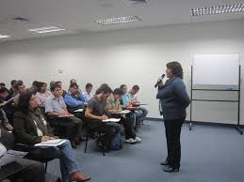
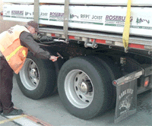
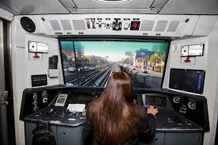
1 Background
Notes:
As result of the importance of transportation of passengers and freight in Mexico, training models are intended to promote road safety, reduce road mishaps reduce environmental pollutants and implement efficient save fuel techniques.
Therefore, the Secretariat of Communications and Transportation (SCT), through the Federal Motor Carrier Administration (DGAF, for its acronym in Spanish), convene those interested in driver’s training of motor transport, to join this task, in order to have professional and competent staff to do this work.

Slide 4
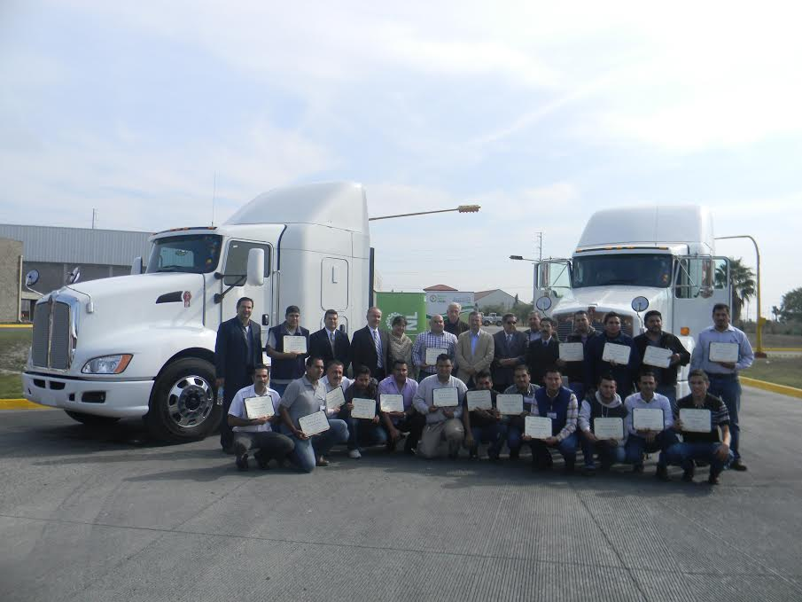
2 Origin of Training Centers
Training Subdirectorate
Contribute to increased road safety (decrease crashes)
Achieving competitive service levels internationally (Cross border transport)
Contribute to the professionalization of Federal motor carrier drivers
Notes:
The origin of Training Centers is due to the need to train and professionalize the Federal Motor Carrier drivers.
As a result, in the year of 1997, the DGAF establishes mechanisms as marking guidelines to establish and operate Training Centers and Instruction, in which courses on topics that the drivers should know are given.
This is done in coordination with the Motor Carrier organizations, public and private sectors, to promote and coordinate training activities.

Slide 5
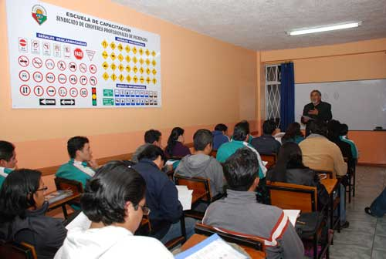
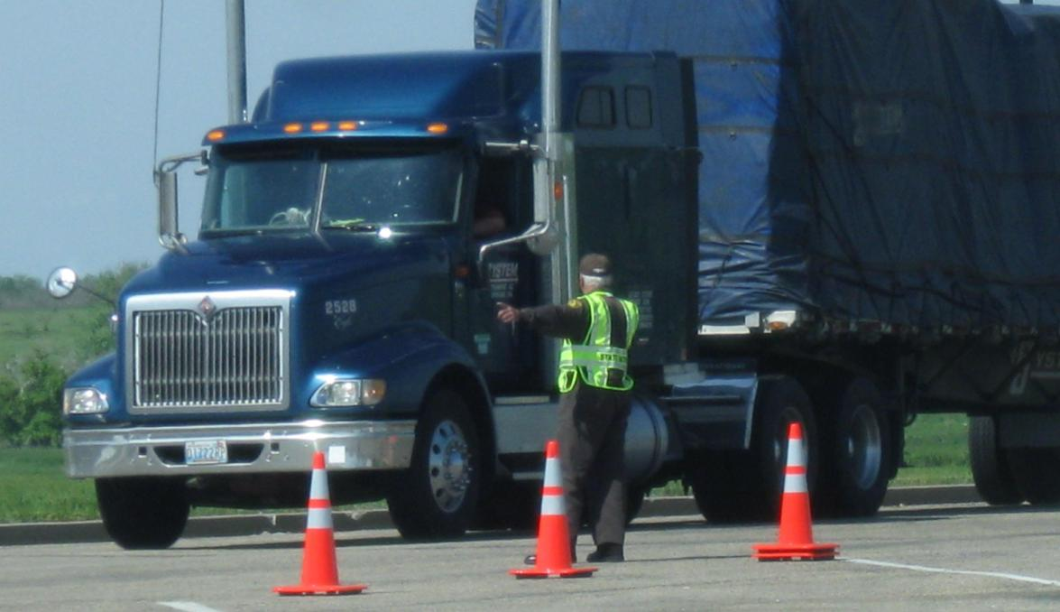
3 Training Centers
Professional Culture of Driving
Crash Prevention
Road Safety
Operation of vehicles and driving
Environment
Notes:
The SCT invites all actors interested in creating training centers for providing this service, according to the Training Programs and comply with the requirements of the Law of Roads, Bridges and Federal Motor Carrier and Federal Motor Carrier Regulations and Auxiliary Services.
To carry out motor carrier operations drivers are trained in areas such as:

Slide 6
3 Training Programs
Training Programs
Requirement to obtain Licencia Federal de Conductor
Support labor competition, develop professional driver
Promote topics to develop skills and driver education drivers
Establish a homogeneous model of teaching - learning
Notes:
On June 11, 2003, published the first Minimum Training Programmes, within which the topics to be taught by the training centers are integrated.
Amog its objetives we find:
The development, approval and publication of the draft of the Training Programs for Federal Motor Carrier Service and Private Transport, aims to:
Promote road safety in the operation of federal motor carrier and private transport on the federal road network and environmental care.

Slide 7
4 Regulatory Framework
Organic Law of the Federal Public Administration
Gives SCT the authority to
  Establish transportation policies & programs
  Promote and organize transportation training development
Law of Roads, Bridges and Federal Motor Carrier
Requires motor carriers to provide their drivers with necessary training
Requires driver training centers to be acredited by the government
Notes:
In the Article 36.- Corresponds to the Secretariat of Communications and Transportation the clea of the following matters:
I.- Formulate and establish policies and programs for transport and communications development according to the country's needs.
XXVI.- Promote and, where appropriate, organize training, research and technological development in communications and transport.
Law of Roads, Bridges and Federal Motor Carrier.
Article 37.- Permit holders will be required, in accordance with the law of matter, to provide their drivers training and qualification to make the provision of services efficient, safe and effective.
Article 57.- To operate a training center and qualification of drivers of federal motor carrier services, authorizations granted by the correspondent authorities will be required. The Secretariat will coordinate with the relevant authorities for establishment requirements, as well as plans and training programs and qualification.

Slide 8
4 Regulatory Framework
According to the Regulation of Federal Motor Carrier and Auxiliary Services (RAFSA)
A training certificate is required to obtain a Licencia Federal de Conductor
Training Certificate must be from an SCT accredited institution
Training centers must be registered with the Secretariat of Education
Instructors must be registered with the Secretariat of Labor
Notes:
To obtain the federal driver's license, the applicant must submit a written request to the Secretariat, and attach various documents, among them the Training Certificate.
The Training Certificate must be obtained through schools, institutions, educative centers, training centers of the federal motor carrier permit holders, private transportation, with official recognition by the Secretariat.
Drivers’ Instructors of the Federal Motor Carrier and Private Transportation, must have official certification, training Study for work, issued by the Secretariat of Public Education (SEP, for its acronym in Spanish) and to be registered before the Secretariat of Labor and Social Welfare (STPS, for its acronym in Spanish).

Slide 9
5 Accreditation of Training Centers. RAFSA Art 93
For accreditation, permit holders must submit the following documentation:
I. Birth certificate and a valid ID, whether it people Doing Business As or Constitutive Laws or Incorporation of the Company in case of denominated Corporation, Limited Liability Company or Incorporate
II. Where appropriate, certified copy of power granted to the legal representative before a notary public
III. Training Center’s proof of address and proof of legal occupancy by the time the courses are given
IV. Training center registration before the Secretariat of Labor or official certification of studies job training, granted by the Secretariat of Education
V. List of instructors providing training at the training center
VI. Registration of instructors before the Secretariat of Labor
VII. Letter of responsibility acceptance by the legal representative of the training center
/1 RAFSA: Reglamento de Autotransporte Federal y Servicios Auxiliares

Slide 10
5 Accreditation of Training Centers. RAFSA Art 93
Facilities
Classroom
Manoeuvres yard
Workshop with a diesel engine included
Computer equipment
Vehicles or simulators
Notes:
The Training Certificate must be obtained through schools, institutions, educative centers, training centers of the federal motor carrier permit holders, private transportation, with official recognition by the Secretariat. Cumpliendo con lo siguinte
a) Vehicles and / or simulators type tractor truck, tank truck and others, depending on the type of training and service mode.
b) One or more classrooms for theoretical courses,
c) Workshop and / or laboratory with equipment, fixtures and proportional to the number of students tools.
d) Computer equipment for the exchange of information between the training center and the Secretariat, and
e) Ownership or legal possession vehicles and simulators.
And the Ownership or legal possession of land for use as manoeuvres yard with an area of thirty meters wide by sixty meters.

Slide 11
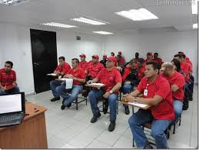
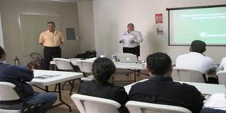
6 Training Centers Federal Motor Carrier (CECAFs)
There are currently 233 CECAFs accredited by the SCT, of which 194 are external and 39 internal.
External
194
Internal
39
Notes:
Internal- Those centers that train their staff (drivers that are part of the template for company drivers).
External.- Those centers that train drivers for the federal motor carrier service in general.

Slide 12
MAP OF CECAFs AUTHORIZED BY THE SCT
FOR DRIVERS OF THE FEDERAL MOTOR CARRIER AND PRIVATE TRANSPORT
Baja California
Sonora
5
4
Chihuahua
4
Baja California Sur
10
Sinaloa
Durango
Coahuila
Nuevo León
5
2
Querétaro
1
5
1
3
11
Tamaulipas
7
Zacatecas
21
1
San Luis Potosí
18
9
Nayarit
Ags.
3
1
D.F.
2
3
4
4
1
Yucatán
Aguascalientes
Gto.
Qro.
7
Tlaxcala
1
8
7
Hgo.
3
2
Jalisco
1
Quintana Roo
Edo. México
2
1
2
Colima
3
5
D.F
Tlax.
Veracruz
2
Michoacán
22
Mor.
Puebla
Campeche
1
3
5
Tabasco
17
1
8
233 CECAF – In Operation.
Guerrero
1
4
Oaxaca
39 CECAF – Internal.
Morelos
2
2
Chiapas
1
4
194 CECAF – External.
* CECAF Training Center Federal Motor Carrier
April 2015
Notes:
There is currently a CECAF 's in each state of Mexico.

Slide 13
7 Training Centers Historical Evolution 2001-2014
Type of Training Centers | 2001 | 2002 | 2003 | 2004 | 2005 | 2006 | 2007 | 2008 | 2009 | 2010 | 2011 | 2012 | 2013 | 2014
Internal | 31 | 37 | 62 | 55 | 49 | 50 | 51 | 53 | 53 | 53 | 46 | 44 | 42 | 191
External | 75 | 87 | 94 | 79 | 93 | 102 | 115 | 125 | 134 | 146 | 167 | 191 | 189 | 39
Total | 106 | 124 | 156 | 134 | 142 | 152 | 166 | 178 | 187 | 199 | 213 | 235 | 231 | 230
The evolution of External Training Centers are trending upward, while Internals have a minimum level down.
Source: Subdirección de Planeación. DGAF

Slide 14
8 Training Modes
Mode | Course
General Freight | Truck Unit
 | Tractor Truck Fifth wheel
Passenger and Tourism | Passenger and Tourism
HazMats | HazMats
Airport Taxi/Tourist Guide | Airport Taxi/Tourist Guide
Notes:
Currently, the contents of training programs and skills are being updated with issues related to:
Driving techniques and operation of heavy vehicles, as well as policy, regulatory, technical, prevention of accidents, road safety, defensive driving, driving technique, efficient operation of vehicles and Intelligent Transportation Systems issues.
Incorporate education on the use of Intelligent Technologies in the operation of vehicles.
Meet the regulatory framework.
This project is in its phase revision by the Federal Commission for Regulatory Improvement (COFEMER, for its acronym in Spanish) to continue its formalization.

Slide 15
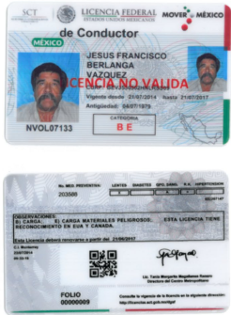
9 Federal Driver’s License.
Category | Authorizes Driving
“A” | Passenger and Tourism
“B” | Freight in its various forms, (except HazMats)
“C” | Load two or three axes
“D” | Tourist Guide Driver
“E” | HazMats
“F” | Ports and Airports
Notes:
After training and examination by the SCT-DGAF the driver get its federal license in the mode by which he took their training
The Federal Driver's license must be renewed every five years, except for the "E" category, which must be renewed every three years.
All the categories may be applicable for international license.

Slide 16
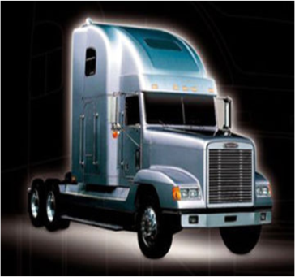
10 Training Update
Promote road safety in the operation of federal motor carrier and private transport on the federal road network and environmental care
Update the contents of knowledge and skills in cutting-edge issues related to:
  Driving techniques and operation of heavy vehicles, as well as policy, regulatory, technical, prevention of accidents, road safety, defensive driving, driving technique, efficient operation of vehicles and Intelligent Transportation Systems issues
Incorporate education on the use of Intelligent Technologies in the operation of vehicles
Meet the regulatory framework
Notes:
Training Programs Update.
The development, approval and publication of the draft of the Training Programs for Federal Motor Carrier Service and Private Transport, aims to:
This project is in its phase revision by the Federal Commission for Regulatory Improvement (COFEMER, for its acronym in Spanish) to continue its formalization.

Slide 17
10 Training Update
Module No. | Topic | Duration (hours)
1 | Diagnostic Evaluation. | 2 Theory 2 Practice
2 | Introduction to Federal Motor Carrier. | 4 Theory
3 | Professional Driver culture. | 4 Theory
4 | Accident Prevention. | 4 Theory
5 | Education and Emotional Health. | 4 Theory
6 | Regulatory Framework. | 8 Theory
7 | Education and Road Safety. | 8 Theory
8 | Comprehensive knowledge of the vehicle and Fault Detection. | 8 Theory
9 | Vehicle and Driving operation. | 12 Practice
10 | Handling Cargo | 4 Theory
11 | Coupling , decoupling and Articulated Vehicle Driving. | 2 Theory 6 Practice
12 | Driver 's Common Diseases. | 4 Theory
13 | Culture of Service. | 4 Theory
14 | Environment. | 2 Theory
15 | Intelligent Transportation Systems. | 2 Theory
16 | Basic and Technical English. | 8 Theory 8 Practice
Total |  | 96
Notes:
The Centre should record the course with the number of hours corresponding to allocate attendance each day and complete the course hours. Only then SCT can issue the constancy, otherwise the SIAF not released it.
Now the SIAF has two windows concerning Training Centers: for the management of the Centers for SCT’s control like consultations folios, dates, etc., and other to support the operation of the Training Centers, as registration control of assistance of participants and courses, which has enabled each Training Center entering a username and password.

Slide 18
11 Training Centers’ Main Areas of Opportunity
Areas of Opportunity | Alternative Solution
Inhibit the alleged sale of training certificate without attending the course | Implement biometric identification for drivers and instructors
Reduce uncertainty regarding the ability of instructors | Establish a mechanism that allows instructors to demonstrate their knowledge and skills for teaching, prior to obtaining official recognition
Enhance monitoring Training Centers (CECAFs) | Increase frequency of audits
Notes:
Within the operation of training centers, we find opportunity areas such as

Slide 19
12 Conclusion
The training process required and regulated by the SCT is useful to professionalize drivers and to improve the safety and efficiency of federal motor carrier services
It is a system that also involves qualities and areas for improvement that should be addressed permanently
Training in Mexico, as well as involving an educational process, is required to complete the process of obtaining Federal License
Renewal training can be perceived by drivers as a waste of money and time, and be frowned upon. This is why training has to add value to the driver. There may be useful elements for the driver in "real life" such as the use of Internet tools and information on handling new vehicle technologies
We at the SCT-DGAF hope that this information is useful to FMCSA’s Entry-Level Driver Training Advisory Committee and remain available to provide further information
Notes:
Within the operation of training centers, we find opportunity areas such as

Slide 20
Questions?
Thank you!
Federal Motor Carrier Transportation Administration
Salvador Monroy
Director,
Motor Carrier Transportation International Services
Secretariat of Communications and Transportation (SCT)
Mexico samonroy@sct.gob.mx
+ (52) (55) 5011 9209

