Slide 1
FMCSA Motorcoach Activities
February 2012

Slide 2
Agenda
FMCSA Actions Related to Motorcoach Safety
Motorcoach Safety Action Plan
Motorcoach Safety Summit
SaferBus Mobile Application
CSA Policy Change for Passenger Carriers

Slide 3
Motorcoach Safety Action Plan
FMCSA has been active with implementing the Motorcoach Safety Action Plan since the plan was released in November 2009.
The action plan took a fresh look at motorcoach safety issues and identified actions to address outstanding safety problems with schedules for implementation.
The plan is now undergoing an update.

Slide 4
Motorcoach Safety Action Plan
Initiate rulemaking to require electronic on-board recording devices on all motorcoaches to better monitor drivers’ duty hours and manage fatigue.
- Proposed rule was published on February 1, 2011.
- Final rule is under development.
Initiate rulemaking to propose prohibiting texting and limiting the use of cellular telephones and other devices by motorcoach drivers.
- FMCSA issued a Final Rule banning text messaging while operating a commercial motor vehicle – effective on October 27, 2010.
- FMCSA issued a Final Rule restricting the use of hand-held mobile telephones by drivers of commercial motor vehicles – effective on
January 3, 2012.

Slide 5
Motorcoach Safety Action Plan
Enhance oversight of carriers attempting to evade sanctions and of other unsafe motorcoach companies.
- Sustaining and improving the operating authority application vetting program
- On-going activities such as strike force operations – for example, the nationwide Passenger Carrier Strike Force was conducted September 23 to October 7, 2011
- Using more legal tools such as cease and desist orders, subpoenas, and imminent hazard orders
Establish minimum knowledge requirements for people applying for authority to transport passengers.
- Advanced Notice of Proposed Rulemaking on New Entrant Safety Assurance was published on August 25, 2009. Comments are under review.

Slide 6
2011 National Passenger Carrier Strike Force
Over 8,300 Passenger Vehicle Inspections
8% Vehicle OOS Rate, 5% Driver OOS Rate
Over 7,000 vehicle violations including over 875 vehicle OOS violations
Over 1,700 driver violations including over 475 driver OOS violations
Over 100 carriers cited for operating without required authority
458 Compliance Reviews of Passenger Carriers
64% - Satisfactory rating
11% - Conditional rating
2% - Unsatisfactory rating
23% - No rating (drug/alcohol or other focus)

Slide 7
National Motorcoach Safety Summit
The Summit was the culmination of regional roundtable discussions held in New York, Texas, Ohio, and California in August 2011. Prior to the Summit, FMCSA strived to empower consumers to make smart choices before buying tickets and boarding motorcoaches.
- Posted and circulated consumer safety checklists that motorcoach passengers can use to make informed decisions when selecting a motorcoach company
- Upgraded the toll-free hotline for the reporting of unsafe motorcoach drivers and companies and began developing enhancements to on-line complaint capacities for passengers

Slide 8
Motorcoach Safety Summit
USDOT hosted a National Motorcoach Safety Summit in Washington, DC on September 23, 2011. The Summit was held to increase awareness of the importance of motorcoach safety and to energize and empower stakeholders, partners, and the public to take personal responsibility in making motorcoach transportation safer.

Slide 9
11 breakout sessions were conducted during the Summit with a focus on four major themes:
Training and Knowledge Gaps
Uniformity of Enforcement
Fatigue
Outreach and Public Awareness
With the ideas and collaborative partnerships developed at the Summit, we believe all participants are better equipped to raise the safety bar and safety culture within the motorcoach industry.
National Motorcoach Safety Summit

Slide 10
National Motorcoach Safety Summit
The Web cast is available for viewing on the FMCSA Web site.
Recommendations from the Summit were documented and a preliminary Summit report is available on-line.
We are reviewing the information gathered during the regional and national events to use what we learned to enhance motorcoach safety.
A free iPhone/iPad “app” will be released this winter. The “app” will give people a quick and easy way to look up the safety record of a registered motorcoach company.

Slide 11
SaferBus Mobile Application
The “Look Before You Book” campaign with the SaferBus app as its primary feature grew out of the discussions related to the Summit.

Slide 12
SaferBus Mobile Application
SaferBus app provides 24/7 access to important safety information that passengers should review before selecting a bus company for transportation.
We believe consumers who are armed with good information will choose the safest – not necessarily the cheapest – way to get from one place to another.
SaferBus app users can link to the NCCDB Web site and file a complaint from their iPhone or iPad.
Droid compatible SaferBus app is being developed too.

Slide 13
CSA Change – Mandatory Passenger Carriers
A passenger carrier becomes mandatory for a compliance review when all of the following occurs --
Certain combinations of SMS BASICs are over specific thresholds
During the first month (No two consecutive months required as in the past)
No comprehensive compliance review in the previous 12 months
A mandatory comprehensive compliance review must be completed within 90 days
Previous policy was 12 months
Notes:
There are two possible combinations of BASICs which result in a motor carrier being categorized as High Risk:
(“1 + 1” combination) - Crash or Fatigue or Unsafe BASIC > or = 85 PLUS 1 other BASIC > or = all other motor carrier threshold
(“4 or more” combination) - any 4 or more BASICs > or = all other motor carrier threshold

Slide 14
On-going efforts to improve safety
Revision of Driver fatigue video
Bus Leasing
Passenger Carrier Drivers’ hours of service
Program evaluation
Review authorities
Organizational Assessment
Recommended changes/alignment

Slide 15
Compliance, Safety, Accountability Update

Slide 16
Agenda
Task Related to CSA Safety Measurement System roadside violation severity weights
Upcoming Improvements
Crash Accountability
Notes:
16

Slide 17
MCSAC report on Violation Severity Weights
Task requested committee to
Determine if individual roadside violations are in the correct violation group
Within each BASIC, rank each violation group in priority of crash risk
Use the priority ranking in Step B for each BASIC, assign a crash risk of “high”, “medium”, or “low” to each violation group
Notes:
17

Slide 18
MCSAC report summary
Provides requested violation grouping validation and “high”, “medium”, “low” severity designation
Recommends a proactive outreach initiative with shippers, insurers and other users of CSA SMS data
HM in general should be a separate BASIC
Periodic review of ASPEN violation data and severity weights based on new data
Consistent and uniform inspection selection processes

Slide 19
Agency’s plan- Severity Weights
Weightings have garnered significant attention, but level of precision is not a major factor
SMS objective is to identify systematic problems across multiple inspections
Simplification of weights to “high, medium, low” to have little impact on effectiveness of SMS
Therefore, adjustments in alignment with MCSAC recommendations of high, medium, low are slated for the 2nd set of SMS enhancements

Slide 20
Agency’s plan- Shipper Outreach
Began outreach efforts to better inform shippers, insurers and other stakeholders consistent with MCSAC recommendation
Held initial feedback gathering conference calls with:
ATA
Transportation Intermediaries Association (TIA)
National Industrial Transportation League (NITL)
Great West Casualty
Notes:
Information available in different FMCSA systems can be confusing
Would prefer a simple FMSCA label that protects from potential liability

Slide 21
Next Steps on Shipper Outreach
Development of fact sheet and educational material geared toward shippers and other non-motor carrier stakeholders
Webinars

Slide 22
Agency’s plan- HM BASIC
SMS Enhancement package #1 includes development of HM BASIC
Moving “load securement” violations from Cargo BASIC into Vehicle Maintenance BASIC
Remaining violations are HM
Targeting early Summer release of HM BASIC following Carrier Preview

Slide 23
Agency’s plan- ASPEN
ASPEN violation table modifications
Associated with Roadside Uniformity efforts
Designed to improve the consistency of inspections
Modifications to violations and descriptions based on CVSA proposal
Enhancements to ASPEN
Operating while suspended license violations breakouts (safety v. non-safety)
Data will be used to increase effectiveness of Driver Fitness BASIC

Slide 24
Agency’s plan – Consistent Inspection Selection and Processes
Improvements to Inspection Selection System (ISS) (Feb/Mar)
Establish meaningful, safety based red lights
“Insufficient” capped at 74 ISS value
10k carriers selected at random on monthly basis
100 reserved for OOS carriers
Reprioritize to focus on behaviors impacted during fixed site inspection
Continue work with CVSA in establishing policies to for consistency
Operational policy 14 used as basis for ASPEN modifications
Screening vs. Inspection

Slide 25
Notes on SMS Effectiveness
UMTRI and internal analysis have confirmed that SMS is an effective tool for the identification of high risk motor carriers
Certain BASICs have stronger associations with future crash risk
Cargo & Driver Fitness and plans to address
Small carriers
Notes:
25

Slide 26
A Look at Some Numbers
Category | Approximate Number | Percentage of Uploaded Crashes
Carriers Listed as Active | 750K | 100%
Carriers with Recent Activity “Pulse” in last 3 years | 525K | 100%
Carriers with Insufficient Data | 325K | 8%
Carriers with Sufficient Data to Be Assessed in at Least 1 BASIC | 200K | 92%
Carriers with Sufficient Negative Information to Have a Percentile Assigned | 92K | 83%
Carriers with At Least 1 BASIC above FMCSA Intervention Threshold | 50K | 45%

Slide 27
SMS Improvements

Slide 28
Where are we headed over the next few months?
Recognize there will be continued and varied calls for improvements to SMS
Plan to Apply a systematic approach to rolling out SMS improvements and leverage what worked well during initial start-up
Prioritize and package changes at regular intervals moving forward - Two times per year
Carrier “Preview” Period Prior to Implementation

Slide 29
Plan for SMS Improvements
Perform analysis to determine impacts
Who will be impacted? How will they be impacted? How significant are these impacts?
Inform the field about the proposed SMS changes (what & why)
Webinars & CSA Website, Enforcement Data Preview period
Inform the public through the website and Federal Register
Show carriers impact of forthcoming changes in advance through a
Carrier Data Preview period (March 2012)
Make adjustments based on feedback
Go live, implementing improvements (June 2012)

Slide 30
SMS Improvements – Package #1
HM BASIC (already discussed)
Vehicle Maintenance (already discussed)
Intermodal Equipment Providers
Elimination of vehicle violations from Level 3 (driver only) inspections
Redefining which carriers are subject to HM and Passenger Carrier intervention threshold
Refining presentation of terms “inconclusive” and “insufficient” and providing context on percentiles

Slide 31
SMS Improvements – Potential Package #2
Under Consideration for 2nd set of SMS Improvements (Late 2012)
Broad Violation Severity Weight Adjustments based on MCSAC recommendations (already discussed)
Examining VMT “caps” for Crash and Unsafe Driving BASIC
Safety Event Grouping in all BASICs

Slide 32
Crash Accountability

Slide 33
Crash Accountability Overview
Goal: Address concerns related to the preventability of crashes.
Crash BASIC in SMS currently considers all recordable crashes
Federal Register Notice planned for February 2012
Notice and comment, planned program launch summer of 2012
Program will be phased in
Second notice will be published announcing launch

Slide 34
Crash Accountability Overview
Process will allow carriers to submit a Police Accident Report (PAR) through DATAQs
If crash is deemed not accountable after review of PAR submitted through DATAQs, the determination will be reflected on SMS online
Impact on scoring to be determined, will be included in a future data preview.

Slide 35
Questions??

Slide 36
Back-Up Slides

Slide 37
Shippers and FMSCA Data
Three Primary Public Sources of FMSCA Safety Data
Safety and Fitness Electronic Records System (SAFER)
Licensing & Insurance Online (L&I)
CSA Safety Measurement System (SMS)

Slide 38
Shippers and FMCSA Data (SAFER)
What does SAFER provide?
Carrier census information
Inspection OOS rates compared to National Averages over last 24 months
Carrier crashes over last 24 months
Carrier Safety Fitness Rating
Satisfactory, Conditional, Unsatisfactory
Flag if Carrier is Prohibited from Operating
http://safer.fmcsa.dot.gov

Slide 39
Shippers and FMCSA Data (SAFER)

Slide 40
Shippers and FMCSA Data (SAFER)

Slide 41
Shippers and FMCSA Data (SAFER)

Slide 42
Shippers and FMCSA Data (SAFER)
What are some advantages of SAFER? Users can quickly:
Determine if carrier has Unsatisfactory safety rating and is prohibited from operating
Examine carrier OOS rates compared to National averages
Determine if a carrier has a Satisfactory safety rating
What are limitations with SAFER and Safety Fitness Ratings?
Satisfactory safety rating does not mean carrier is currently in compliance and operating safely
Rating is only a snapshot based on date of most recent compliance review

Slide 43
Shippers and FMSCA Data (L&I Online)
What does L&I Provide?
FMSCA operating authority Status for “for-hire” carriers
Insurance status
Flag if carrier is under an FMCSA order prohibiting operations
What are the limitations of L&I?
Generally only provides authority and insurance status

Slide 44
Shippers and FMSCA Data (L&I Online)

Slide 45
New Safety Measurement System (SMS) Public Website http://ai.fmcsa.dot.gov/SMS

Slide 46
Shippers and FMCSA Data (CSA - SMS)
What does SMS provide?
Carrier census information
Assessment of motor carrier on road performance and investigation results over most recent 24 months in BASICs
Overall BASIC status
Status above threshold means carrier may be prioritized for intervention
Flag if carrier is under an FMCSA order prohibiting operations
Driver and Vehicle Inspection OOS rates
Links to detailed individual inspection results and trend data
Links to SAFER and L&I for current safety rating and authority/insurance status

Slide 47
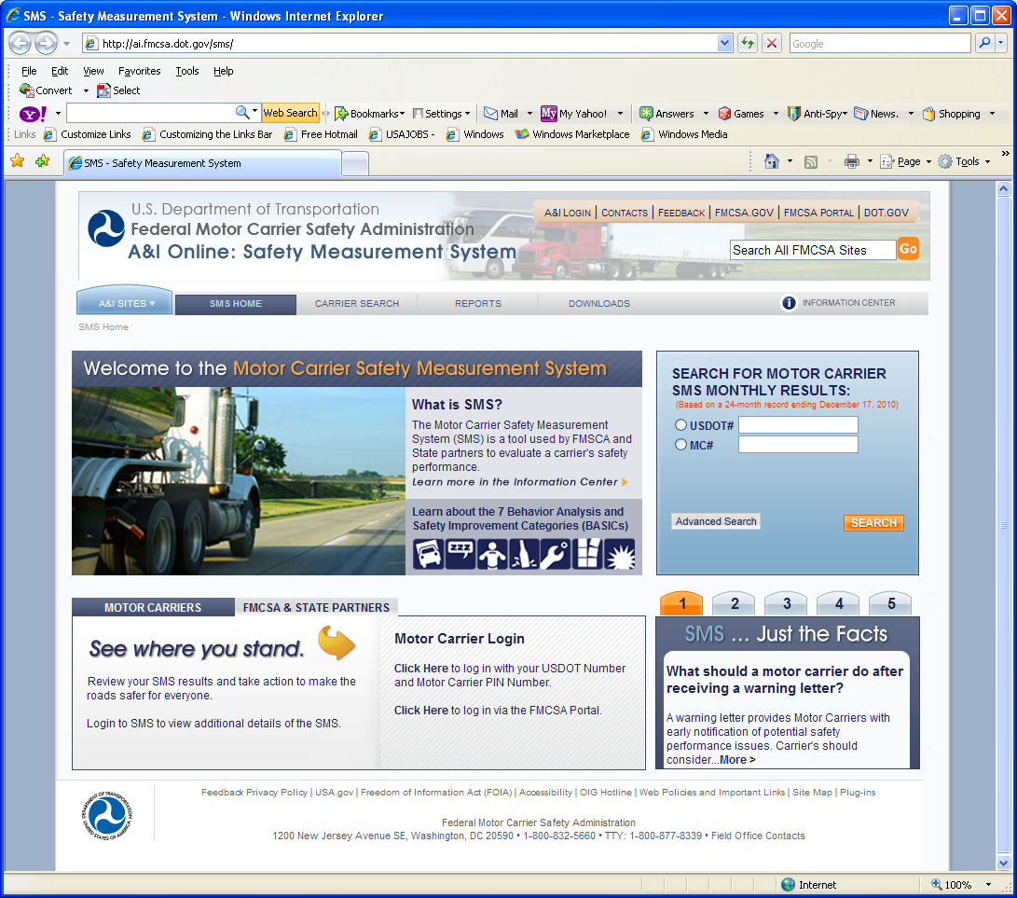
Shippers and FMSCA Data (CSA – SMS)

Slide 48
Shippers and FMCSA Data (CSA – SMS)

Slide 49
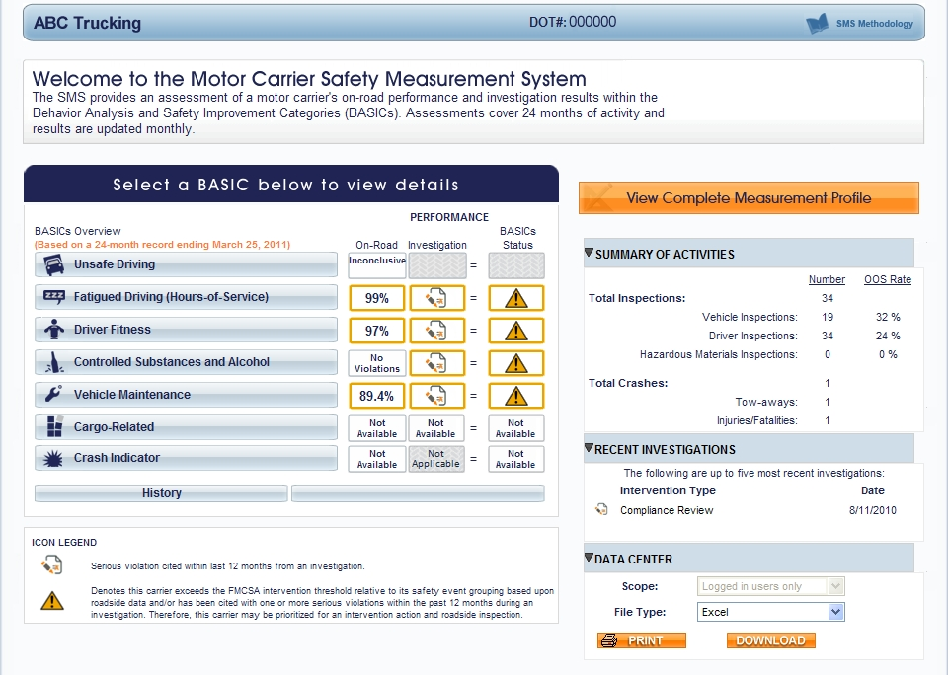
Carrier Measurement: SMS Results

Slide 50
Shippers and FMCSA Data (CSA-SMS)
What are the limitations with SMS?

