Slide 1
On board device basics
Prepared by:
Jim Angel PeopleNet
Dave Kraft Qualcomm
Tom Cuthbertson XATA

Slide 2
Disclaimers
The content of this presentation reflects the experience and views of the individual preparers of this material. This presentation is intended to provide a basic level of understanding about electronic HOS capabilities as are widely implemented in the US. The materials are not intended to provide any representations for products and services. They also should not be considered as a definitive reference of requirements and system performance capabilities.
The Federal Motor Carrier Safety Administration (FMCSA) does not endorse or recommend any specific products and services for electronic driver logs and related systems. FMCSA is not responsible for the factual content of the presented materials, nor that the representation of device capabilities are consistent with regulations.

Slide 3
Training Outline
Electronic HOS Defined
Basic Configuration
On-Board Devices
Electronic HOS Support Systems
Three Basic Options
Driver Convenience
Carrier Convenience
Inspection Process

Slide 4
Electronic hos Defined

Slide 5
On board device today
AOBRD 395.15
Final rule in 1988
GPS not yet available
Engine Control Module (ECM) not yet available
Currently confused in the market with anything that provides any type of electronic information
Laptop
Tachograph
Smart Phone (395.8 app)
Etc.
Defined as: “an electric, electronic, electromechanical, or mechanical device capable of recording driver's duty status information accurately and automatically.
Market has driven requested features such as:
Communication to/from driver and carrier
Engine monitoring
MPG reporting
Automated fuel tax reporting
GPS location information
Driver HOS alerts
Carrier compliance tools
Driver performance

Slide 6
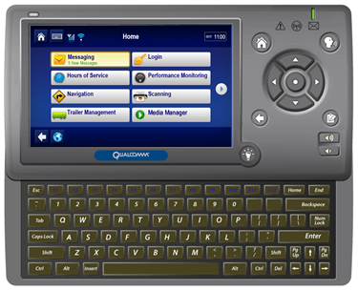
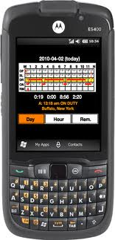
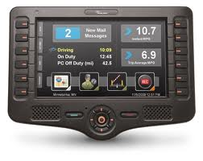
What is an onboard device now?
Device features expanded greatly over last decade
Report and monitor MPG
ECM data and fault codes
Integration with routing and dispatch software
Navigation, with turn by turn directions
Electronic Hours of Service
Support system web sites for real time information
Compliance and payroll reports
and much more
Qualcomm MCP 200
XATA Turnpike
PeopleNet BLU 2

Slide 7
Basic configuration

Slide 8
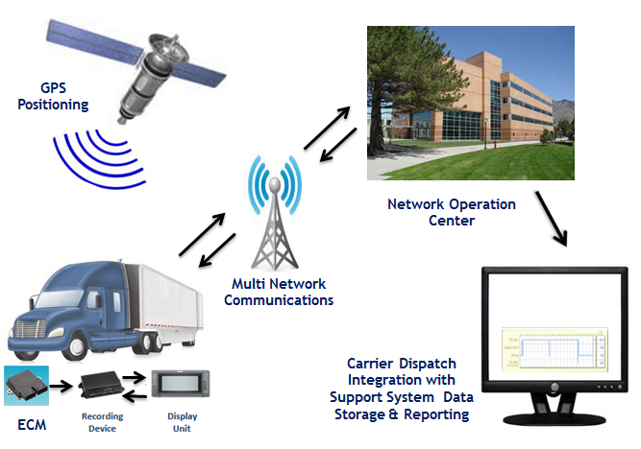
How does it work?

Slide 9
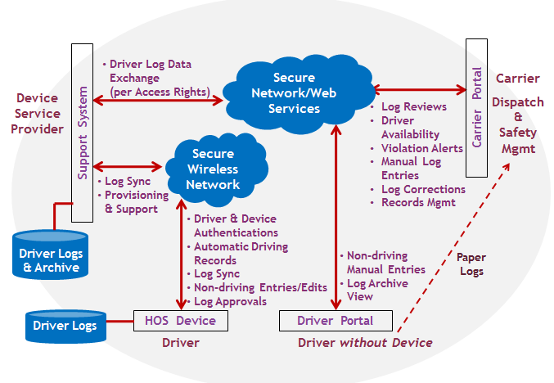
Information Flows

Slide 10
Onboard devices

Slide 11
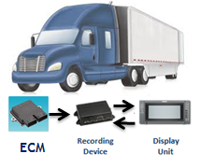
Vehicle System overview
Device Requirements
395.15 Regulation
Unique ID for all drivers
Vehicle synchronization for drive recording
Basic duty status event recording
Basic display requirements
Sensor failure detection / alert
Market Driven Capabilities
Grid-graph and other added display features
GPS and map database (for automatic location recording)
Wireless log synchronization between on-board system and host support system (for compliance management)
On-board device and driver ID authenticated at host system
Unique driver/co-driver ID and login
ECM /GPS used to detect vehicle movement for automated start and stop of driving time
Driver makes manual entries for non-driving duty status events
Devices vary in appearance and features
395.15 only defines data for inspection display and not standard formats
Wireless transmission to support systems

Slide 12
Vehicle system – Issues for Mandated electronic logging systems
Certification:
Hardware technology has many options subject to performance requirements
Self-certification = no standard approach to testing
Buyer beware without 3rd party certification
Enforcement Interface:
No standard formats to support manual roadside inspections
Limited access to information about annotations, sensor failures, log data gaps/exceptions, and position details
Data transfers via USB or Wi-Fi hotspots (802.11) are not necessarily to be trusted
Security Controls: (requirements not specified)
System integrity verified with installation and data diagnostics
Driver ID and vehicle device ID validated by support system
Trusted uploads from support system to maintain current logs for drivers

Slide 13
Electronic HOS support systems

Slide 14
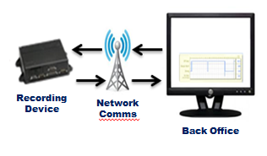
Support system overview
Support System Capabilities
395.15
Logs submitted within 13 days
Basic log data record content
Log data retained for 6 months
Archive in location separate from device
Carrier Driven Enhancements
Logs submitted near real-time
Log archive with structured data records
Archive in cloud services model with access controls by service provider
Annotation features with audit trail and update to on-board unit
HOS displays/alerts
Web portal for driver access functions
Security features of providers ensure data is secure and private
Support system must not allow data alteration or deletion
Web portal access and features provide compliance management and log data reviews
Driver log archives available for inspection access with similar presentation to a paper log

Slide 15
Support system – Issues for Mandated electronic logging systems
Certification:
Support system often has many features beyond what is required in the rule
Certification complexity of large scale systems
Enforcement Interface:
Incomplete specifications for data formatting and transfer protocols
Data transfers via USB or CD-ROM for investigations are not necessarily to be trusted
Data transfers from support system via web services have not been identified for use with investigations
Security Controls:
(requirements not specified)
Trusted data transfers between vehicle system and support system via wireless networks
Support system access controls for log reviews and corrections
Support system access controls for controlled issuance of driver IDs
Technical access controls to prevent manipulation of log archives
Update of vehicle system software in trusted manner

Slide 16
Electronic HOS Functionality
Logs are typically synchronized with support system in near real time:
There can be an combination of the following: at each time of duty status change, end of day and/or beginning of day
Ensures carrier management reviews and log corrections are updated timely in 7 & 8 day logs
Affords slip seat operations or shift operations to have up to date logs without paper for each driver
Logs automatically follow driver to different truck

Slide 17
basic options
Notes:
EOBR systems have significant differences in terms of overall technical architecture and operational models . . .

Slide 18
Primary systems design
Common features:
Majority of devices today have wireless connectivity via cellular/satellite or both
Near real-time communication between carrier and driver
GPS, and automated locations for duty status change
Auto duty status change based on vehicle movement
Basic Options:
Fleet management system – system mounted in vehicle
Handheld device and smart phone system – ECM interface box in vehicle but display units can operate outside vehicle
Devices that only do electronic driver logs – not really used today or not really compliant
Lap-top
Tachograph
Smart Phone (395.8 app)
Etc.

Slide 19
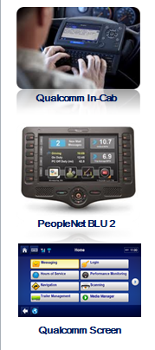
Fleet management system
System features:
Electronic HOS is an application
Turnkey system approach for hardware/services
Telematics services
Integrated GPS tracking
Integrated vehicle data monitoring services
Log archive services
Carrier portal for records and compliance mgmt
Other applications and services also available
Security:
Requires driver login
Software updates controlled by provider, and only given by support tech, or OTA, (Over the Air) service
Data access only through the HOS application
Data auto archived
Secure Web-based access to correct or edit logs
Secure driver Web access for logs review and entry of non-driving events
Secure auto data sync with host system and device

Slide 20
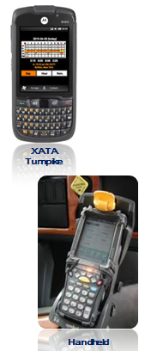
Handheld Device & Smart Phone Systems
System features:
Electronic HOS is an application
Device & wireless services may be purchased separately
Additional “black box” for vehicle interface
Integrated GPS tracking
Log archive services
Carrier portal for records and compliance management
Other applications and services also available
Security:
Requires driver login
System security features to manage unique driver ID.
Software and update controlled by end user
Proprietary data protection applied
Data auto archived
Secure Web-based access to correct or edit logs
Secure driver Web access for logs review and entry of non-driving events
Secure auto data sync with host system and device

Slide 21
Driver Convenience
Notes:
EOBR systems have significant differences in terms of overall technical architecture and operational models . . .

Slide 22
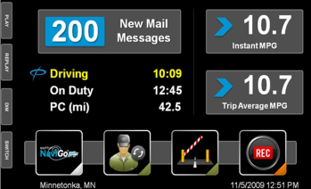
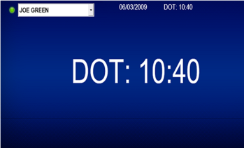
Driver features
Current HOS available time
Proactive warnings when time in last hour
Enter/View/annotate duty status (no driving)
Enter/Edit load & trailer data
Display summary, graph and detail views
Display 24 hour and 7 & 8 day log views
Review/Approve logs
Generate log report/fax for inspection (if needed)
Auto duty status change based on start and stop
PeopleNet SafeMode
Qualcomm Screen

Slide 23
Carrier Convenience
Notes:
EOBR systems have significant differences in terms of overall technical architecture and operational models . . .

Slide 24
Carrier features
Current HOS available
Load planning
HOS compliance
Enter/View/Edit duty status
Violations alert and reporting available
HOS alerts when drivers running out of time
Display 24 Hour and 7 and 8 day log views
Review/Approve logs
Print logs for driver or for audit
Multiple reports tied to HOS for payroll, and driver utilization
Driver behavior
Productivity
Many others that assist in carrier and vehicle management

Slide 25
Roadside inspection process
Notes:
EOBR systems have significant differences in terms of overall technical architecture and operational models . . .

Slide 26
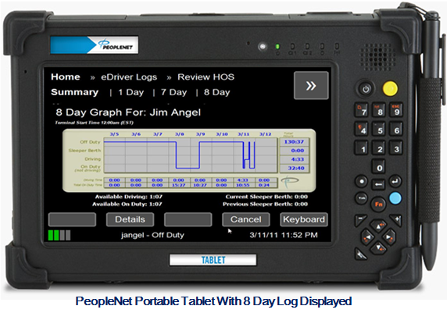
The Inspection Experience

Slide 27
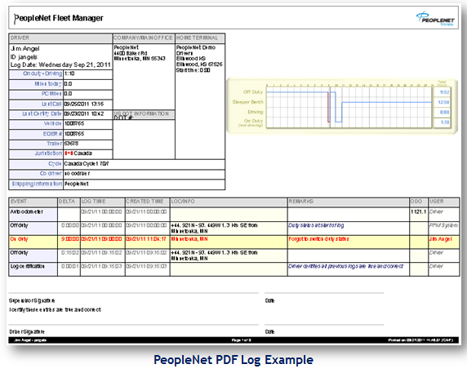

Slide 28
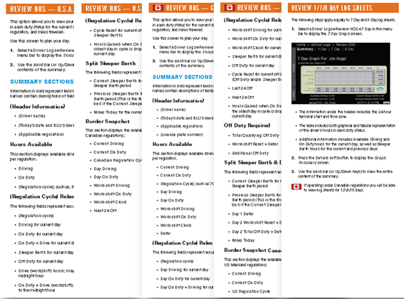
Quick reference guide (Required)

Slide 29
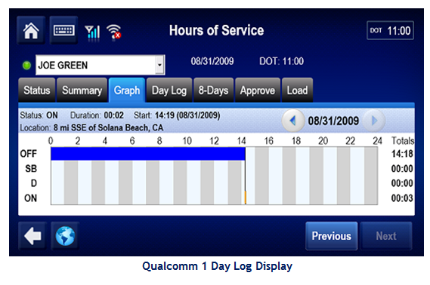
The Inspection Experience

Slide 30
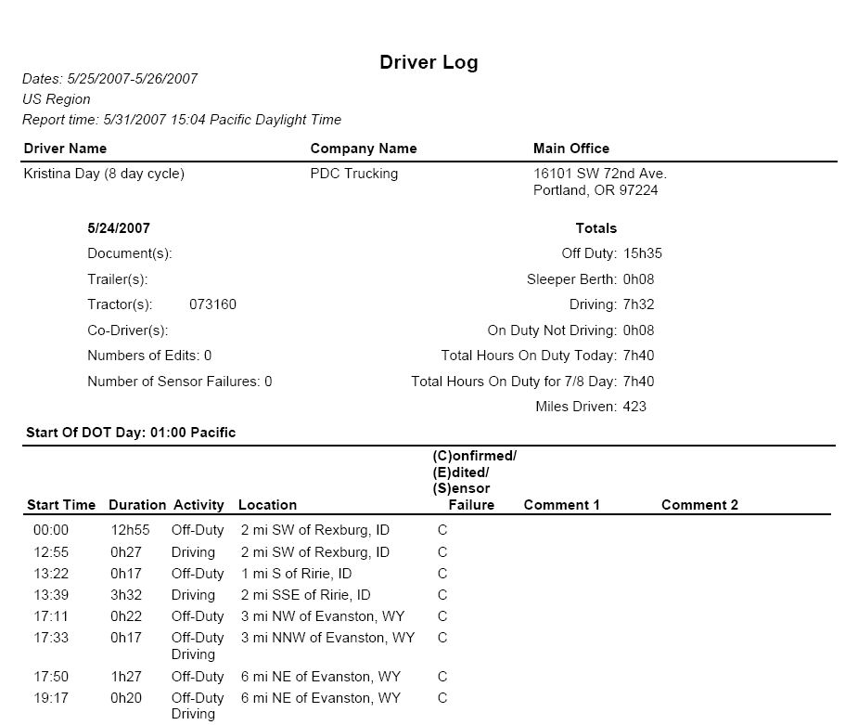
Driver Log Report Qualcomm

Slide 31
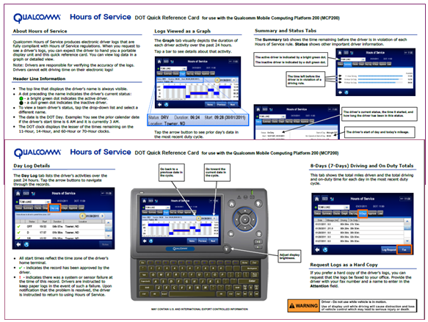
Cab Card Example

Slide 32
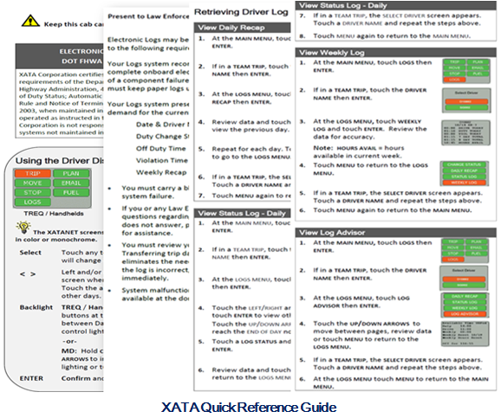

Slide 34
summary
Carriers using on-board devices for a lot more than HOS compliance
Routing
Dispatch Planning
Payroll
Carrier compliance
Violation reports
Ability to print, fax, or email drivers logs to enforcement, roadside or in a CR
Voluntary adoption is growing for more reasons than HOS
Electronic HOS providers actively provide and participate in training enforcement on displays for inspection

Slide 35
Thank you
Jim Angel PeopleNet
Dave Kraft Qualcomm
Tom Cuthbertson XATA

