Slide 1
Obstructive Sleep Apnea
In Rail and Highway Accidents:
Recent History and Recommendations
Mary Pat McKay
Notes:
Good Morning. I will be discussing organizational factors within the FRA, Metro-North and MTA regarding medical certification.
[NEXT SLIDE]

Slide 2
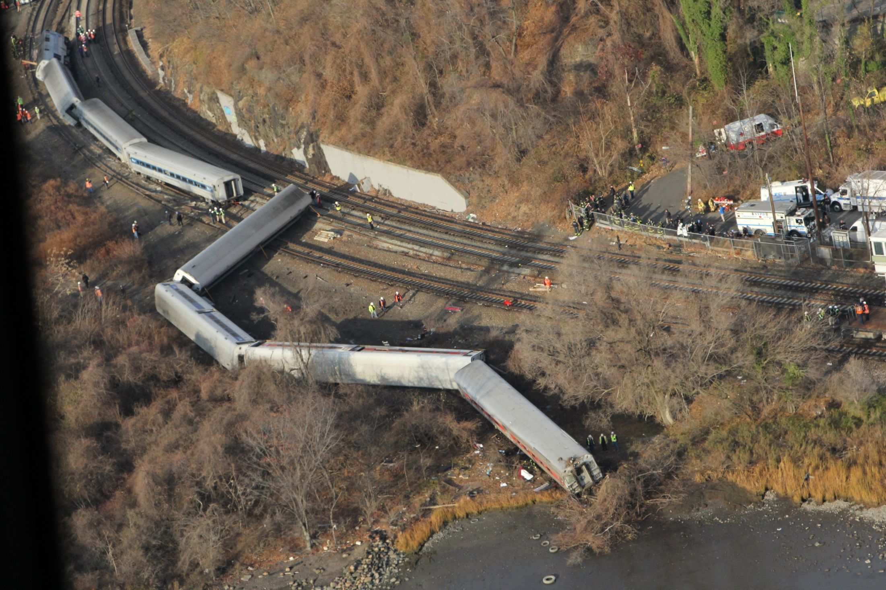
Notes:
On December 1, 2013 a Metro-North passenger train derailed and as a result, 4 people died and 61 others were injured. The NTSB determined that the probable cause of this accident was the engineer's noncompliance with the 30-mph speed restriction because he had fallen asleep due to undiagnosed severe obstructive sleep apnea exacerbated by a recent circadian rhythm shift required by his work schedule. The NTSB investigation found that medical issues among railroaders, and sleep apnea in particular, have not been adequately addressed by the Federal Railroad Administration, Metro-North, or New York MTA.
[NEXT SLIDE]

Slide 3
Risk Factors for
Obstructive Sleep Apnea
Male
Obesity
Snoring
Daytime sleepiness
High blood pressure
Age
Large neck circumference
Large hip circumference
Notes:
There are 8 recognized risk factors for obstructive sleep apnea.
Although his neck and hip circumference were never measured, the engineer in this accident was male, obese, snored, and had complained about fatigue nearly two years before the accident and when he was asked, after the accident, had excessive daytime sleepiness.
[NEXT SLIDE]

Slide 4
Risk Factors for
Obstructive Sleep Apnea
Male
Obesity
Snoring
Daytime sleepiness
High blood pressure
Age
Large neck circumference
Large hip circumference
Notes:
Based on this information, it was predictable that the engineer was likely to have obstructive sleep apnea. However, neither Metro-North’s occupational medical evaluations nor the engineer’s primary care providers identified these risk factors or further evaluated him for the condition before the accident.
[NEXT SLIDE]

Slide 5
Lay of the Land in 2000
FMCSA: CDL Holders
  Disqualifying medical conditions
  Medical certification
    History, medication review, vital signs, physical examination
FRA: Safety Sensitive Employees
  Vision and hearing testing
  Vision standards
  Hearing standards
Notes:
1970 federal register:
Accident experience in recent years has
demonstrated that reduction of the effects
of organic and physical disorders, emotional
impairments, and other limitations of the
good health of drivers are increasingly important
factors in accident prevention.

Slide 6
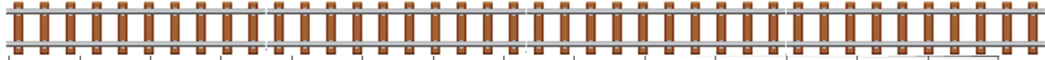
OSA: Rail and Highway Accidents
2000
2002
2004
2006
2008
2010
2012
2014
 | Highway Accident
 | Railroad Accident
 | Rail Transit Accident

Slide 7
OSA: Rail and Highway Accidents
Jackson, TN
2000
2002
2004
2006
2008
2010
2012
2014
 | Highway Accident
 | Railroad Accident
 | Rail Transit Accident

Slide 8
July, 2000: Jackson, TN
Notes:
Tractor Trailer at a driver-estimated speed of 65 mph in a 55-mph work zone,
collided with the trailing Tennessee Highway Patrol vehicle. Witnesses reported that the
patrol car exploded and caught fire at impact. The patrol car was pushed approximately
192 feet before it came to rest in the median. The tractor-semitrailer continued through a
61-foot depressed earthen median and into the westbound lanes, where it collided with a
1997 Chevrolet Blazer. The tractor-semitrailer then continued across the travel lanes and
came to rest in a wooded area on the north side of I-40. The State trooper in the Tennessee
Highway Patrol vehicle was killed, and the Chevrolet driver was seriously injured.
Driver had diagnosed but untreated moderate sleep apnea and untreated hypothyroidism.

Slide 9
OSA: Rail and Highway Accidents
2000
2002
2004
2006
2008
2010
2012
2014
BWI, MD
 | Highway Accident
 | Railroad Accident
 | Rail Transit Accident
Notes:
Metro-North’s fatal derailment in December 2013 was not the first time obstructive sleep apnea contributed to a rail accident. In fact, in the United States, there is a long history of rail accidents where sleep disorders or other medical conditions contributed to or caused the accident.
In the last 14 years, there have been two rail transit accidents where the operator’s obstructive sleep apnea contributed to fatigue.
[NEXT SLIDE]

Slide 10
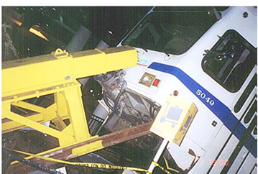
August, 2000: BWI Station, MD
2004
2006
2008
2010
2012
Newton, MA
Notes:
In August, 2000, a transit train struck the hydraulic bumping post at the terminus of track No. 2 at the BWI Airport Station and derailed with 22 passengers on board.
[NEXT SLIDE]

Slide 11
OSA: Rail and Highway Accidents
Clarkston, MI
2000
2002
2004
2006
2008
2010
2012
2014
 | Highway Accident
 | Railroad Accident
 | Rail Transit Accident

Slide 12
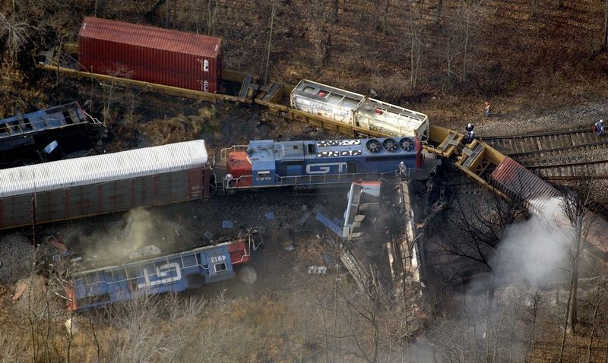
November, 2001: Clarkston, MI
Notes:
2 traincrew died, and 2 were seriously injured

Slide 13
OSA: Rail and Highway Accidents
2000
2002
2004
2006
2008
2010
2012
2014
Newton, MA
 | Highway Accident
 | Railroad Accident
 | Rail Transit Accident

Slide 14
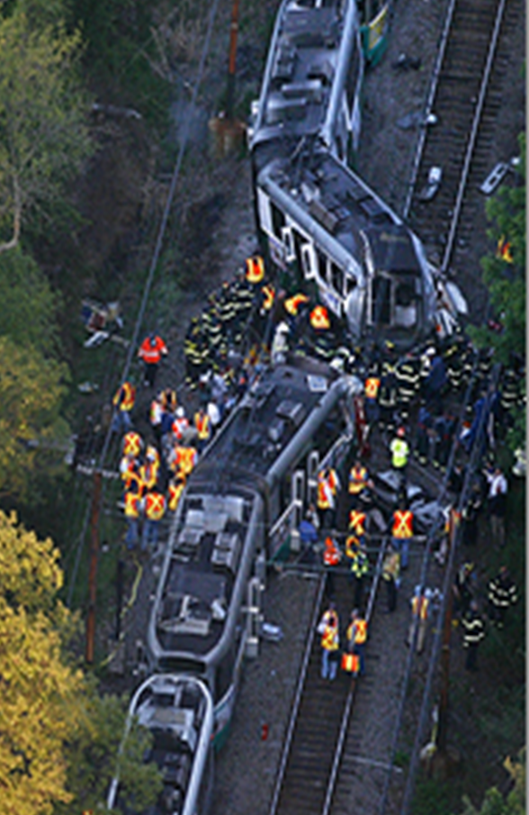
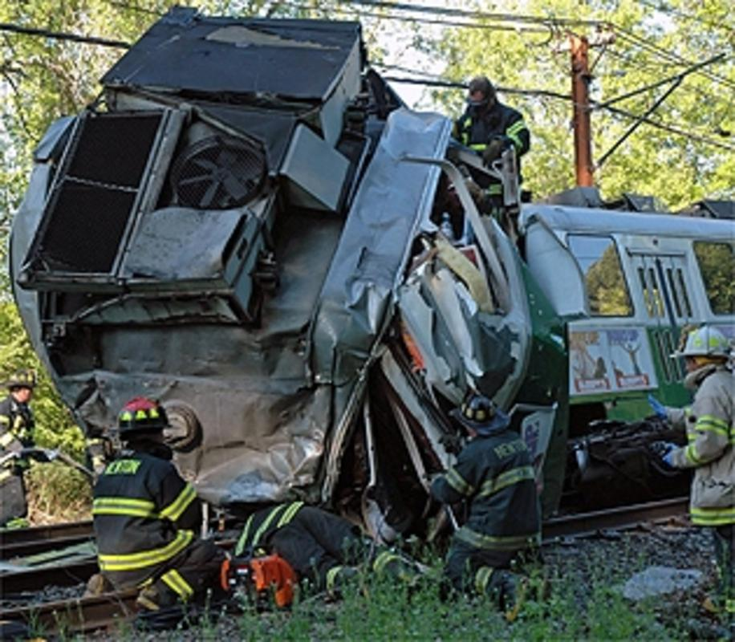
May, 2008: Newton, MA
2010
2012
2014
Notes:
In 2008, two transit trains collided in Newton MA with about 180 passengers on board. One operator died and one passenger was seriously injured. Others had minor injuries. These two accidents resulted in safety recommendations to each of the rail transit agencies regarding the need for improved evaluation of obstructive sleep apnea among rail transit operators.
[NEXT SLIDE]

Slide 15
OSA: Rail and Highway Accidents
Miami, OK
2000
2002
2004
2006
2008
2010
2012
2014
 | Highway Accident
 | Railroad Accident
 | Rail Transit Accident

Slide 16

July 2009: Miami, OK
Notes:
As a result of the Volvo combination unit’s striking the slowed and stopped vehicle queue on I-44, 10 passenger vehicle occupants died, and the tractor trailer driver and 5 occupants 5 were injured,
Driver’s fatigue, as a result of acute sleep loss, circadian disruption associated with his shift work schedule, and mild sleep apnea,

Slide 17
OSA: Rail and Highway Accidents
NYC, NY
2000
2002
2004
2006
2008
2010
2012
2014
 | Highway Accident
 | Railroad Accident
 | Rail Transit Accident

Slide 18
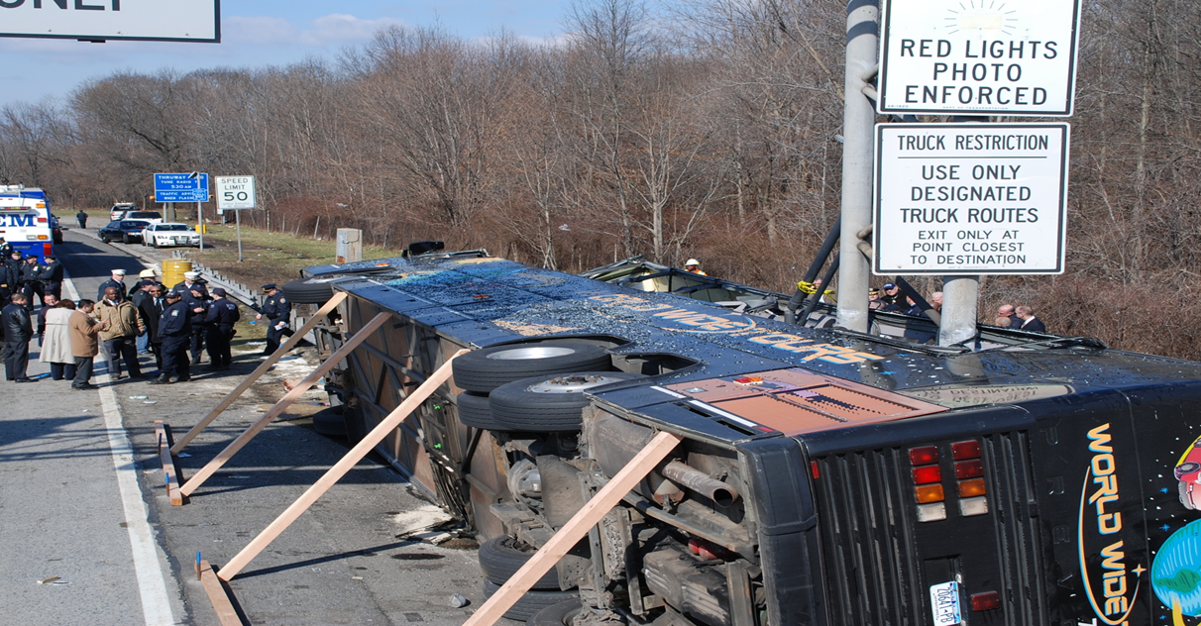
March, 2011: NYC, NY
Notes:
The motorcoach drifted off the roadway and crossed the rumble strip on the 10-foot-wide right shoulder, struck a guardrail then overturned to the right 90°, flattening the guardrail as it continued to slide forward. The front of the motorcoach collided with an overhead vertical highway signpost, shown in this picture, which tore through nearly the entire length of the bus.
As a result of this accident, 15 passengers died, 17 were injured, and the driver was minorly injured.

Slide 19
OSA: Rail and Highway Accidents
2000
2002
2004
2006
2008
2010
2012
2014
Red Oak, IA
 | Highway Accident
 | Railroad Accident
 | Rail Transit Accident

Slide 20
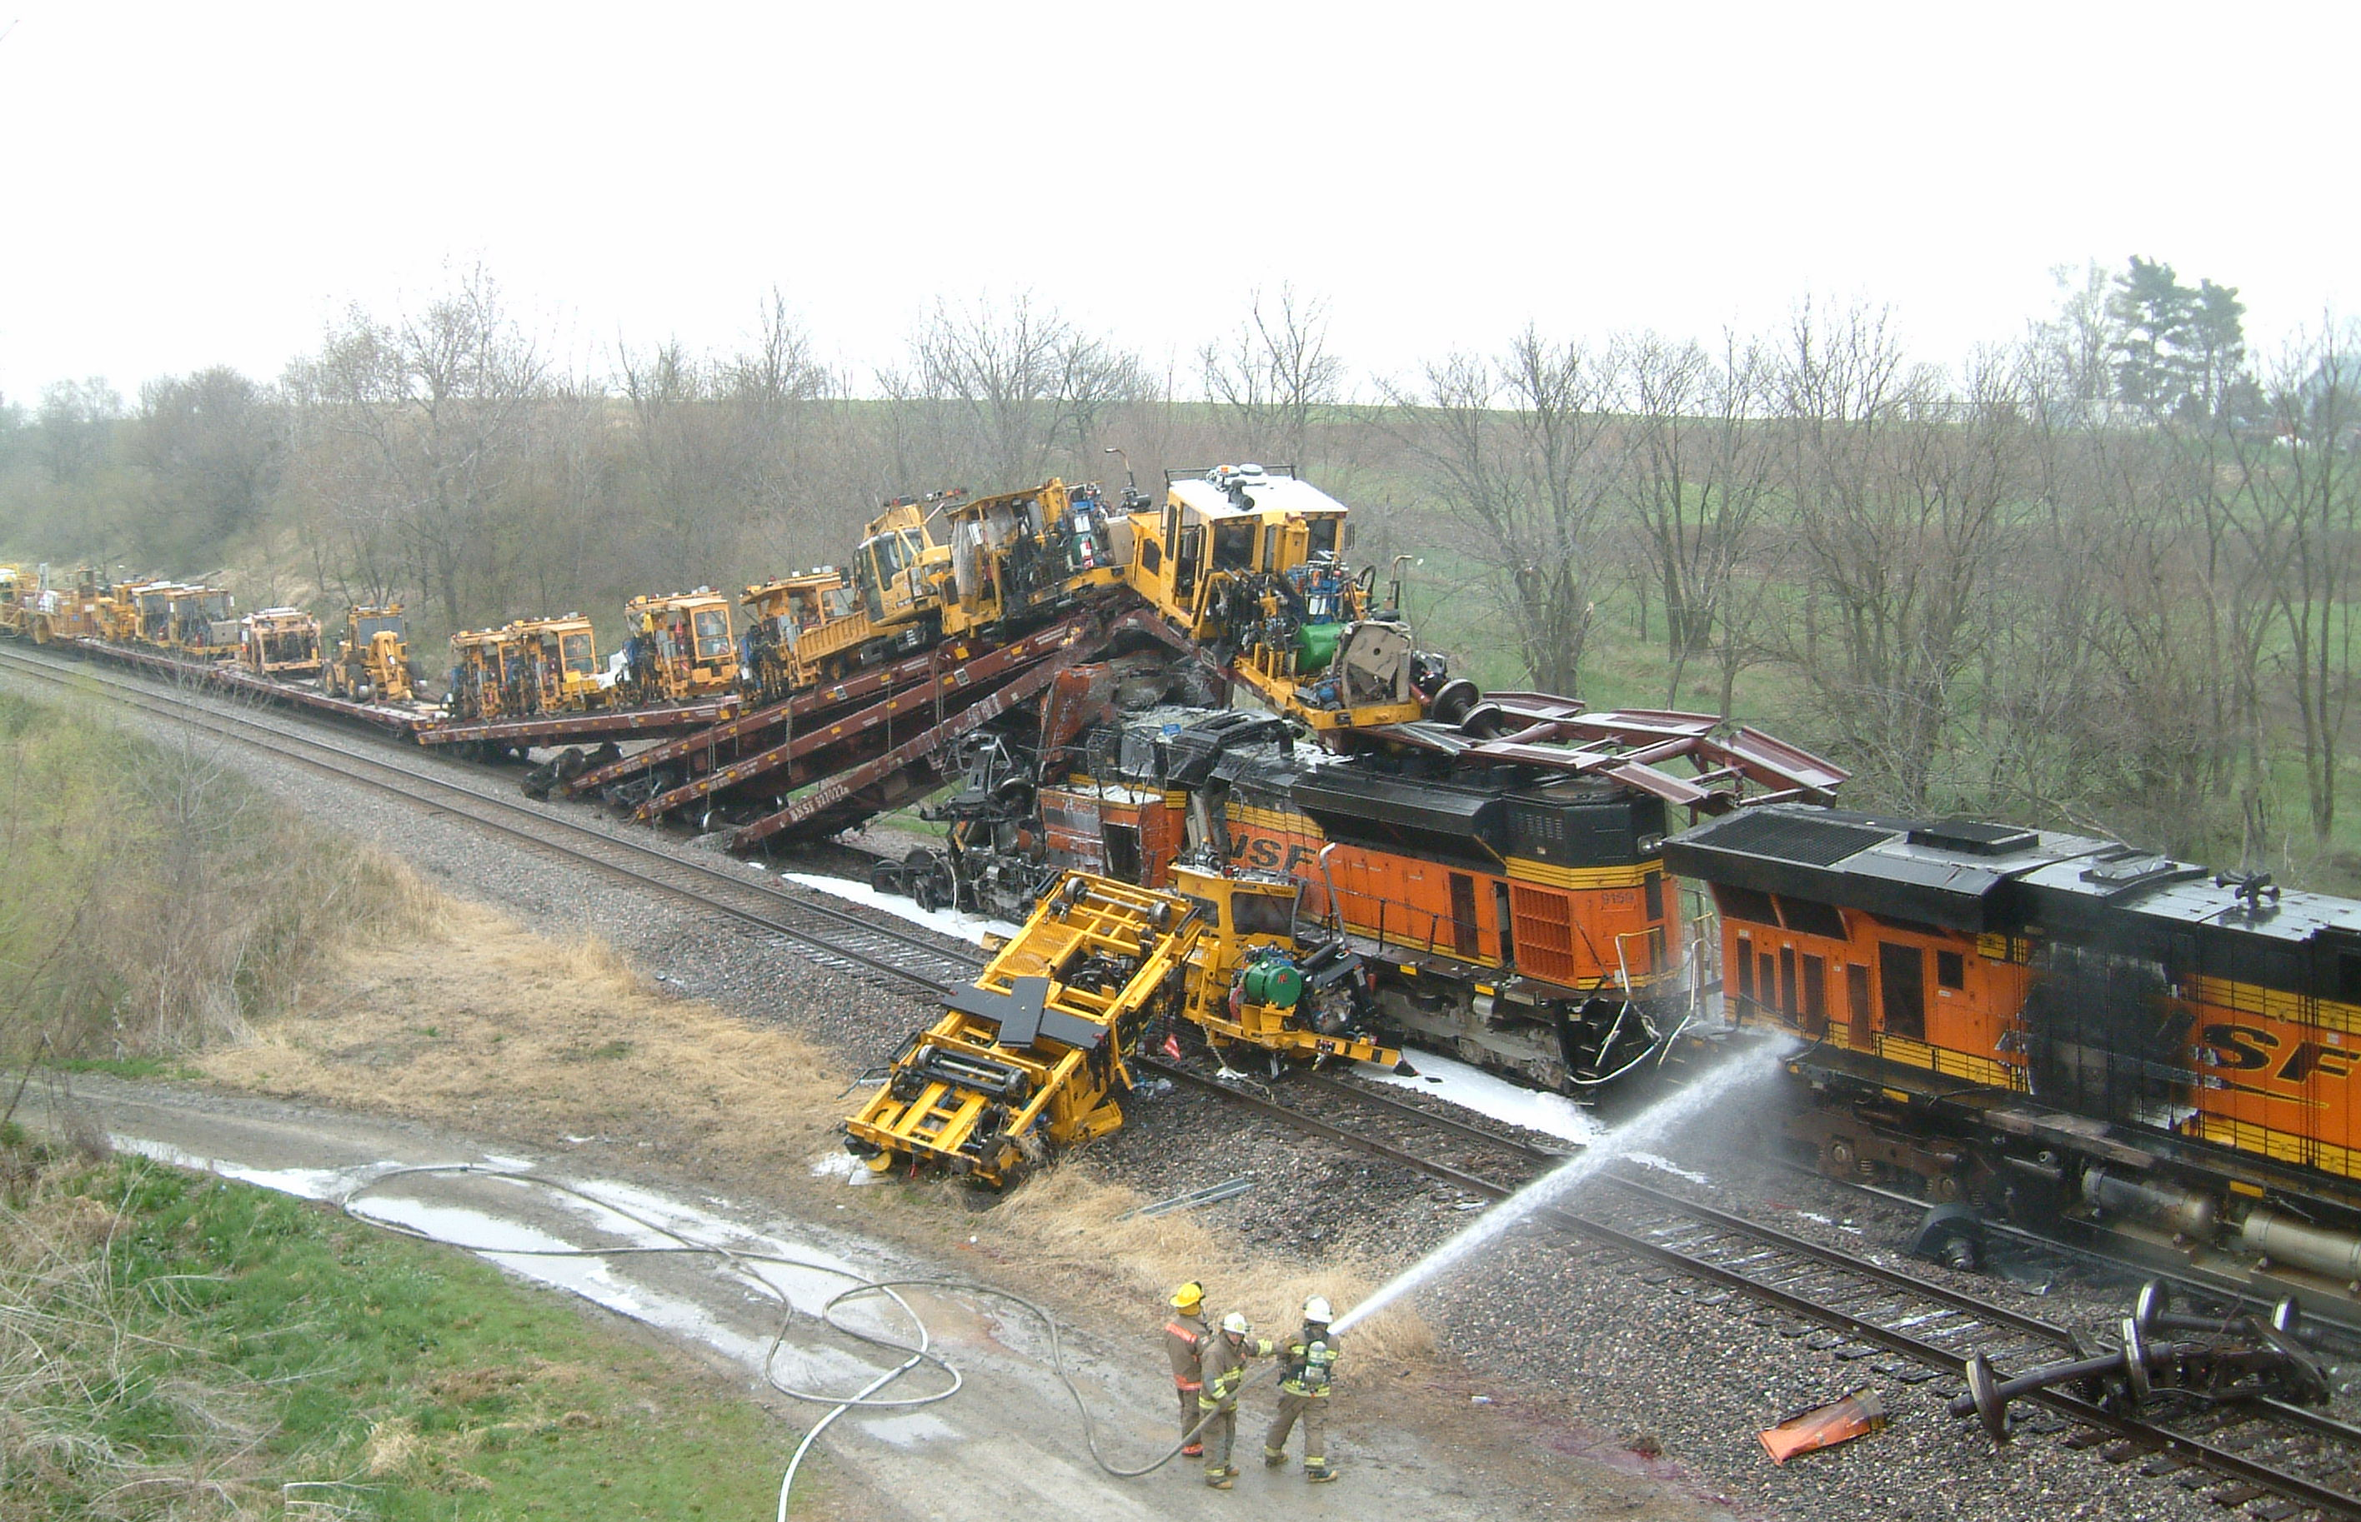
Medical Conditions and Rail Accidents
April, 2011: Red Oak, IA
RSIA 2008
Clarkston, MI
2000
2002
2004
2006
2008
2010
2012
2014
BWI, MD
Newton, MA
Red Oak, IA
 | Railroad Accident
 | Rail Transit Accident
Notes:
The NTSB determined the collision occurred due to “the failure of the crew of the striking train …. to stop because they had fallen asleep due to fatigue resulting from their irregular work schedules and their medical conditions.” Among others, the medical conditions included probable sleep apnea, restless leg syndrome, and chronic insomnia.
As a result, the NTSB issued similar recommendations to the FRA and the BNSF railroad, asking BNSF to screen and asking the FRA to require railroads to screen employees in safety-sensitive positions for sleep disorders. The recommendation to the FRA is classified as open, unacceptable action. BNSF responded that it would be unable to comply without the support of federal regulation.
[NEXT SLIDE]

Slide 21
OSA: Rail and Highway Accidents
2000
2002
2004
2006
2008
2010
2012
2014
Chaffee, MO
 | Highway Accident
 | Railroad Accident
 | Rail Transit Accident

Slide 22
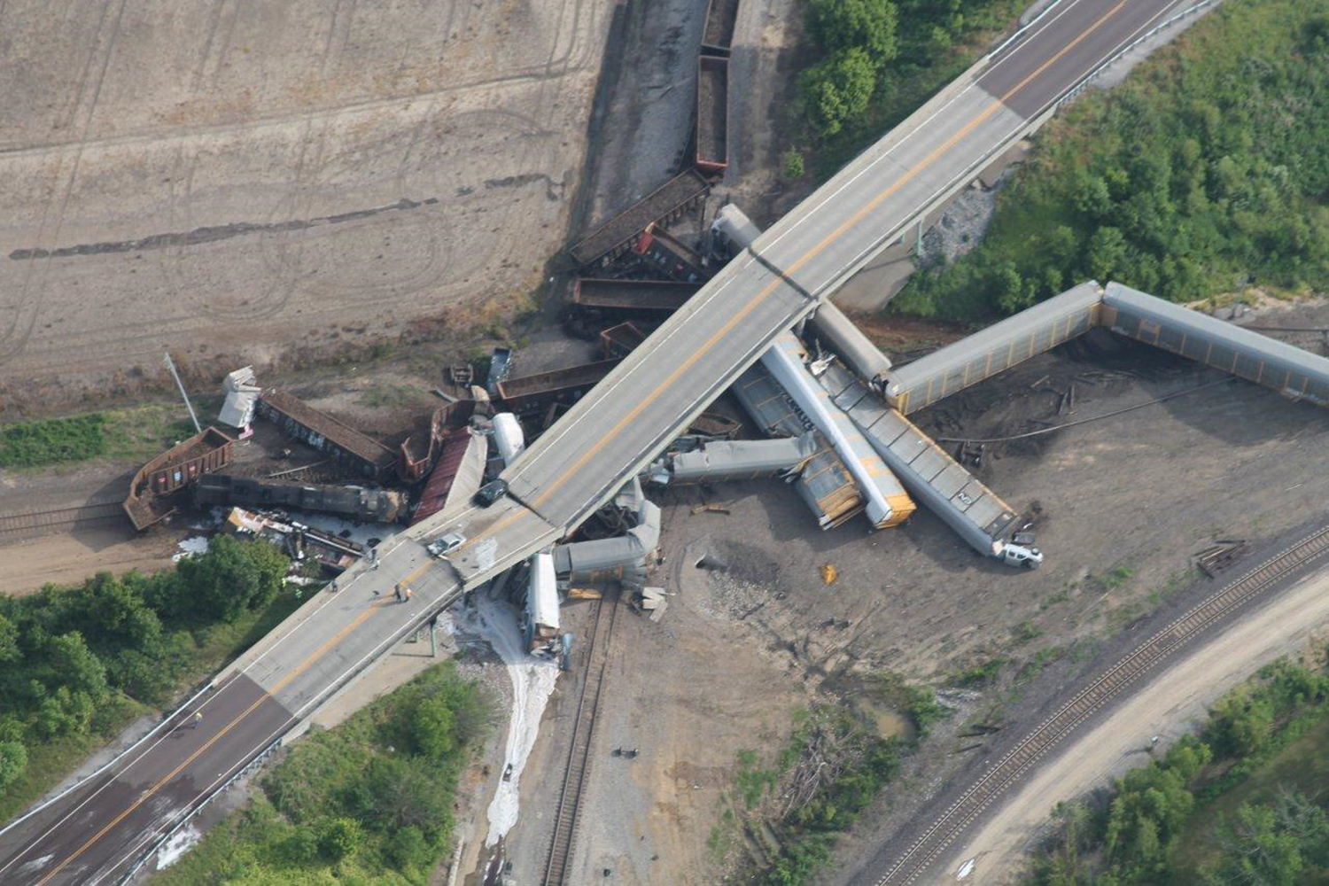
May 2013: Chaffee, MO

Slide 23
OSA: Rail and Highway Accidents
2000
2002
2004
2006
2008
2010
2012
2014
Bronx, NY
 | Highway Accident
 | Railroad Accident
 | Rail Transit Accident

Slide 24
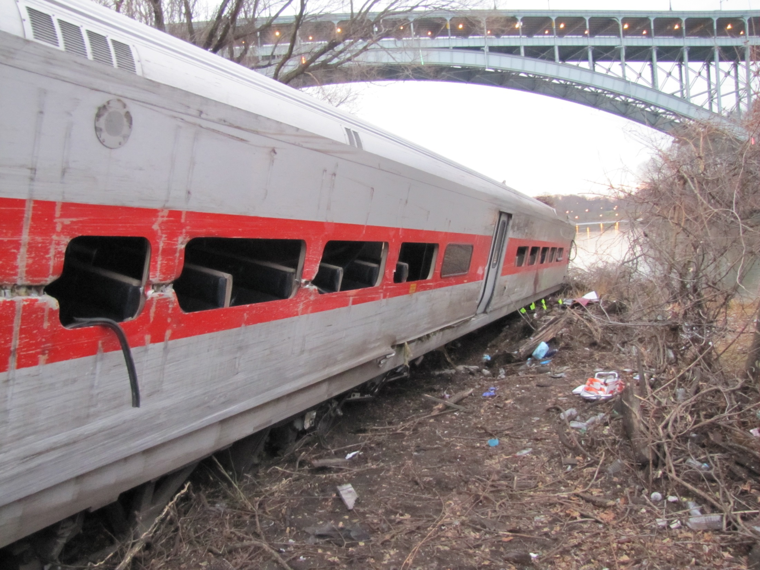
Medical Conditions and Rail Accidents
RSIA 2008
Deadline
December 2013: Bronx, NY
Clarkston, MI
2000
2002
2004
2006
2008
2010
2012
2014
BWI, MD
Newton, MA
Red Oak, IA
Goodwell, OK
 | Railroad Accident
 | Rail Transit Accident
Chaffee, MO
Metro-North Bronx, NY
Notes:
As this timeline demonstrates, had the FRA complied with the NTSB’s earlier recommendations or met the deadline set out in the RSIA of 2008, it is likely that the Metro-North engineer’s severe obstructive sleep apnea would have been identified and treated, and this fatal accident would have been prevented. Staff has proposed recommendations in this area.
[NEXT SLIDE]

Slide 25
OSA: Rail and Highway Accidents
Jackson, TN
Miami, OK
NYC, NY
2000
2002
2004
2006
2008
2010
2012
2014
BWI, MD
Newton, MA
Clarkston, MI
Chaffee, MO
 | Highway Accident
 | Railroad Accident
 | Rail Transit Accident
Red Oak, IA
Bronx, NY
Notes:
Only the ones NTSB has investigated
Often, not JUST OSA - schedules, circadian rhythm, other medical conditions including sleep disorders

Slide 26
OSA in Transportation – Risk Management
Higher OSA rate than the general public
  ~95% male
  ~50% obese
  Older
Mitigate the risk: screen, evaluate, ensure adequate treatment
Notes:
Male gender, age, obesity, hypertension, neck circumference (collar size above 17 inches for men), larger hip circumference, excessive daytime sleepiness, and snoring are all risk factors for OSA.,,,, Commercial drivers and locomotive operators are predominantly male. According to the US Department of Labor, in 2014, 92.6 percent of industrial truck and tractor operators, 94.2 percent of driver/sales workers and truck drivers, and 98.6 percent of locomotive engineers and operators were male. According to US government sources, the median age of the working population is 42 and about 35% of the US adult population is obese., However, more than 53% of commercial drivers are obese and their average age is slightly older, about 46.
Peppard PE, Young T, Barnet JH, Palta M, Hagen EW, Hla KM. Increased prevalence of sleep-disordered breathing in adults. Am J Epidemiol. 2013;177(9):1006-14.
Seidell JC. Waist circumference and waist/hip ratio in relation to all-cause mortality, cancer and sleep apnea. Eur J Clin Nutr. 2010;64(1):35-41.
Young T, Shahar E, Nieto FJ, Redline S, Newman AB, Gottlieb DJ, Walsleben JA, Finn L, Enright P, Samet JM; Sleep Heart Health Study Research Group. Predictors of sleep-disordered breathing in community-dwelling adults: the Sleep Heart Health Study. Arch Intern Med. 2002;162(8):893-900.
Olson LG, King MT, Hensley MJ, Saunders NA. A Community Study of Snoring and Sleep-disordered Breathing Prevalence. Am J Respir Crit Care Med 1995;152:711-6.
Young T1, Skatrud J, Peppard PE. Risk factors for obstructive sleep apnea in adults. JAMA. 2004;291(16):2013-6.
US Department of Labor. Women’s Bureau. Women in NonTraditional Occupations. http://www.dol.gov/wb/stats/Nontraditional%20Occupations.pdf Accessed 3/15/2016.
US Department of Labor, Bureau of Labor Statistics. Median age of the labor force, by gender, race and ethnicity. http://www.bls.gov/emp/ep_table_306.htm Accessed 3/15/2016.
Centers for Disease Control and Prevention. National Center for Health Statistics. Obesity and overweight. http://www.cdc.gov/nchs/fastats/obesity-overweight.htm Accessed 3/15/2016.
Thiese MS, Moffitt G, Hanowski RJ, Kales SN, Porter RJ, Hegmann KT. Commercial Driver Medical Examinations: Prevalence of Obesity, Comorbidities, and Certification Outcomes. J Occup Environ Med. 2015;57(6):659-65.

Slide 27
OSA: Rail and Highway Progress
Addition of OSA Screening to medical history
National Registry
Certified Medical Examiners
2000
2002
2004
2006
2008
2010
2012
2014
Medical Standards Working Group
2006-2011
 | Highway Accident
 | Railroad Accident
 | Rail Transit Accident

Slide 28
Lay of the Land in 2016
FMCSA: CDL Holders
  List of disqualifying medical conditions
  Standardized medical certification
    Revised history form, medication review, vital signs, physical examination
    Certified Medical Examiners
FRA: Safety Sensitive Employees
  Vision and hearing testing
  Vision standards
  Hearing standards

Slide 29
FMCSA: Medical Certification 2016
Anyone licensed to perform a physical exam in any state/territory
  Chiropractors
  Physical Therapists
Pass 10 hour course, online test

Slide 30
Safety Recommendation H-09-15
Implement a program to identify commercial drivers at high risk for obstructive sleep apnea and require that those drivers provide evidence through the medical certification process of having been appropriately evaluated and, if treatment is needed, effectively treated for that disorder before being granted unrestricted medical certification.
Open, Acceptable

Slide 31
Safety Recommendation H-09-16
Develop and disseminate guidance for commercial drivers, employers, and physicians regarding the identification and treatment of individuals at high risk of obstructive sleep apnea (OSA), emphasizing that drivers who have OSA that is effectively treated are routinely approved for continued medical certification.
Open, Acceptable

Slide 32
Safety Recommendation R-12-16
Require railroads to medically screen employees in safety-sensitive positions for sleep apnea and other sleep disorders.
Open, Unacceptable

Slide 33
Safety Recommendation R-13-21
Develop medical certification regulations:
  (1) a complete medical history that includes specific screening for sleep disorders, a review of current medications, and a thorough physical examination
  (2) standardization of testing protocols
  (3) centralized oversight of certification decisions for employees who fail initial testing
  consider requiring that medical examinations be performed by those with specific training and certification in evaluating medication use and health issues related to occupational safety on railroads.
Open, Unacceptable

Slide 34
Rulemaking and specific standards are needed to address the hazard OSA presents in the railroad and highway environments.

Slide 35
Notes:
This concludes my presentation.
[NEXT SLIDE]

