Slide 1
Obstructive Sleep Apnea and Commercial Motor Vehicle
Driver Safety
The Evidence
Presented by:
Stephen Tregear, DPhil
Program Director
Division of Evidence-based Decision and Policy Making
Manila Consulting Group

Slide 2
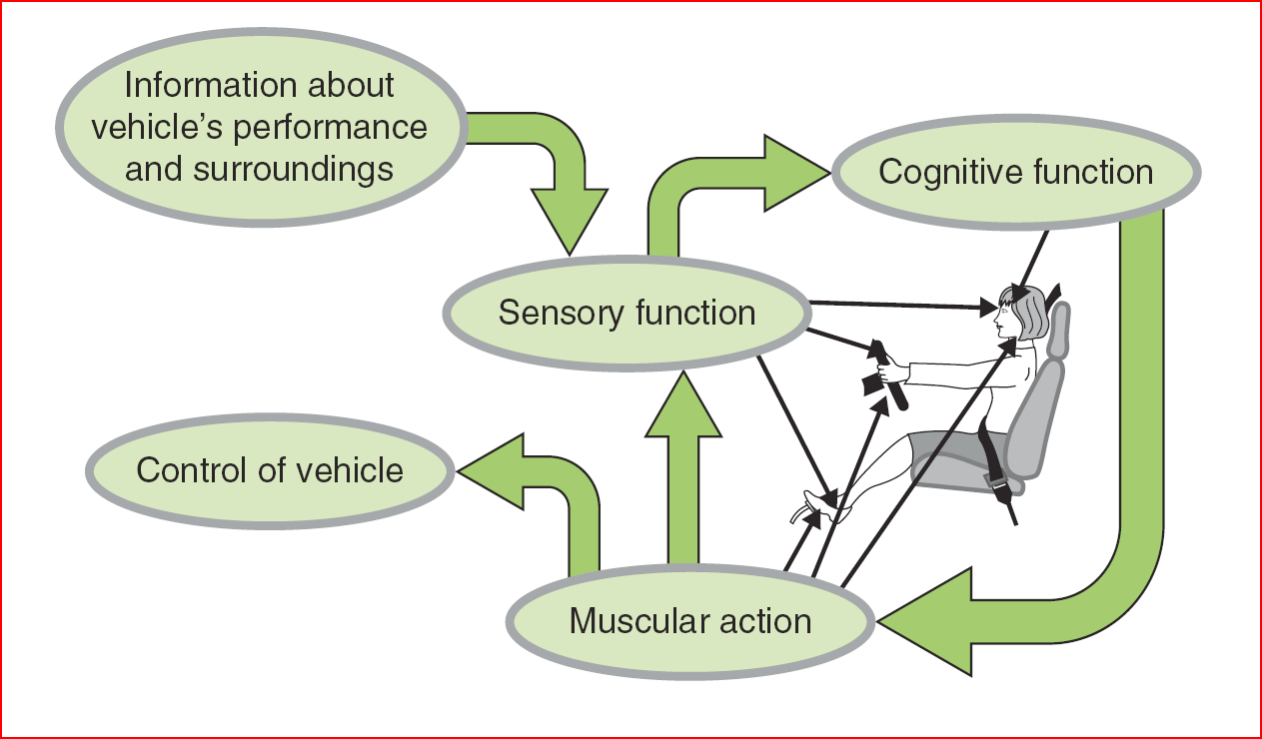
The Driving Task

Slide 3
Sleep Apnea: Associated Problems
Excessive daytime sleepiness
Cognitive function reduced
Psychomotor performance impaired
Comorbid conditions
  Hypertension
  Cardiovascular Disease
  Diabetes

Slide 4
Background
Original evidence report presented to FMCSA in July 2007
  http://www.fmcsa.dot.gov/rules-regulations/TOPICS/mep/report/Sleep-Apnea-Final-Executive-Summary-prot.pdf
MEP held in August 2007
MEP recommendations presented to MRB and FMCSA in January 2008
  http://www.fmcsa.dot.gov/rules-regulations/TOPICS/mep/report/Sleep-MEP-Panel-Recommendations-508.pdf

Slide 5
Background
Article published in the Journal of Clinical Sleep Medicine in 2009
  Obstructive Sleep Apnea and Risk of Motor Vehicle Crash: Systematic Review and Meta-Analysis. Tregear et al. JCSM 2009; 5:573-81.
Article published in Sleep in 2010
  Continuous Positive Airway Pressure Reduces Risk of Motor Vehicle Crash among Drivers with Obstructive Sleep Apnea: Systematic Review and Meta-analysis. Tregear et al. SLEEP 2010;33:1373-1380.
Evidence Report – Update Nov 30 2011

Slide 6
OSA and Crash Risk
Evidence Base
  18 studies
  2 studies specifically enrolled CMV drivers
  Study Design: Case-control and retrospective cohort
  Study Quality = Low/moderate

Slide 7
OSA and Crash Risk
Data pooled using meta-analysis
  Crash data from 18 studies examined
  Crash data from 10 studies pooled
  Crash data from 8 studies not pooled because data presented not sufficient to determine the crash rate ratio and 95% confidence intervals

Slide 8
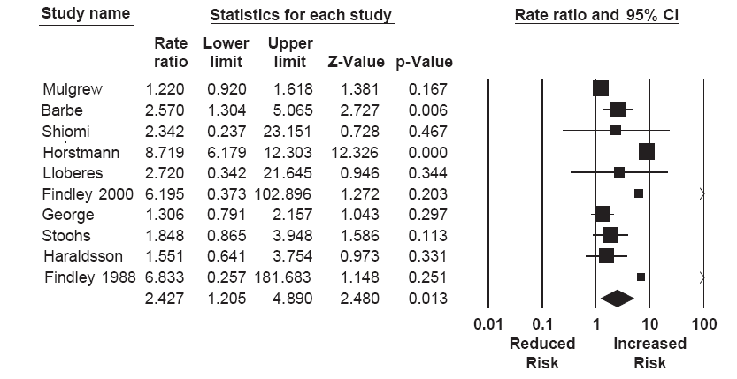
OSA and Crash Risk

Slide 9
OSA and Crash Risk
Individuals with OSA are at increased risk for crash
  Precise estimate of magnitude of this increased risk not calculated
  Crash Risk Rate in region of 1.20 to 4.89
  Crash risk among individuals with a diagnosis of OSA is between 20% and 489% higher than comparable individuals without the disorder

Slide 10
OSA and Crash Risk Among CMV Drivers
Howard et al. 2004
  Australia
  2,342 of 3,268 (72%) responded
  CMV drivers with sleep apnea syndrome (symptom diagnosis [MAPS] ≥ 5 + ESS ≥ 11) vs. CMV drivers not diagnosed with sleep apnea syndrome (controls)
  Drivers diagnosed with sleep apnea syndrome (MAP Score ≥ 0.5 and ESS Score ≥ 11) found to be at an increased risk for crash (OR = 1.3, 95% CI: 1.00-1.69)

Slide 11
OSA and Crash Risk Among CMV Drivers
Stoohs et al. 1994
  Cross-sectional population of 90 CMV drivers aged 20-64 years who agreed to overnight recordings (Mesam IV)
  Recordings consisted of:
    Oxygen saturation
    Heart rate
    Snoring sounds
    Body position/movement
  Crash data – self reported via questionnaire
  Main outcome measures included:
    Crash rate over previous 5 years
    ODI
    Total sleep time

Slide 12
OSA and Crash Risk Among CMV Drivers
Explanatory Variable | Findings | Significant (P <0.05)?
Crashes and sleep-disordered breathing (SDB) | Drivers diagnosed with SDB (ODI ≥ 10) accounted for 23 of the 42 crashes, whereas drivers without SDB (ODI < 10) caused 19 of all reported crashes. | No
 | Drivers with SDB caused twice as many crashes/mile driven (0.085 crashes/10,000 miles) than drivers without SDB (0.046 crashes/10,000 miles). | No
Crashes and severity of SDB | Though crash frequency was about 100% higher in drivers with SDB: increasing severity of SDB was not significantly associated with an increase in crash frequency. | No
Crashes and excessive daytime sleepiness (EDS) | There was significantly higher crash frequency in drivers complaining of EDS (0.18 crashes/10,000 miles) as opposed to drivers without a complaint of EDS (0.06 crashes/10,000 miles). | Yes
 | Using the scores for self-reported sleepiness, the isolated use of EDS as a predictive parameter for the occurrence of crashes had a sensitivity of 9% and a specificity of 92%. | NA
Crashes and obesity | Non-obese drivers (BMI < 30 kg/m²) had a mean of 0.045 crashes/10,000 miles compared to a mean of 0.1 crashes/10,000 miles in obese truck drivers. | Yes
 | Non-obese truck drivers without SDB caused 77% more crashes/10,000 miles than non-obese drivers with nocturnal breathing abnormalities. | No
 | Obese truck drivers with SDB caused 45% more crashes/mile driven than obese drivers without SDB. | No
 | Using the scores for obesity (≥ 30 kg/m²) as a predictor for driving crashes, this predictor had a sensitivity of 49% and a specificity of 71%. | NA

Slide 13
OSA and Crash Risk Among CMV Drivers
Explanatory Variable | Findings | Significant (P <0.05)?
Crashes, EDS, and obesity | When combined, EDS and a BMI ≥ 30 kg/m² had a sensitivity of 53% and a specificity of 68% in predicting drivers with crashes. | NA
Crashes, SDB, EDS, and obesity | When combined, SDB, EDS and a BMI ≥ 30 kg/m² had a sensitivity of 76% and a specificity of 35% in predicting drivers with crashes. | NA

Slide 14
OSA and Crash Risk Among CMV Drivers
CMV drivers with OSA are at an increased risk for a crash when compared to their counterparts who do not have the disorder
  A precise estimate of magnitude of this increased risk cannot be determined at this time

Slide 15
Treatment Effectiveness
3 separate evidence bases developed
  Crash – 9 studies
    All CPAP
  Simulated driving performance – 10 studies
    8 CPAP
    1 medication (theophylline)
    1 dental appliance (mandibular advancement)
    1 surgery (UPPP)
  Indirect measures – 48 studies
    3 Behavioral modification
    32 CPAP
    2 Dental appliances
    8 medication
    6 surgery

Slide 16
Treatment Effectiveness

Slide 17
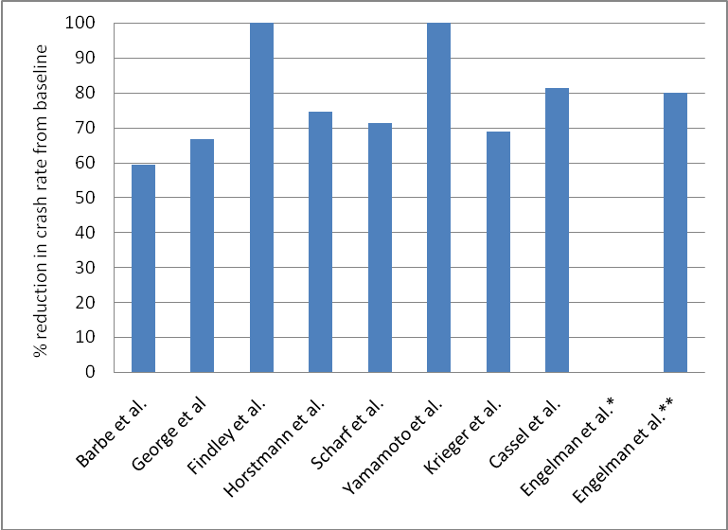
Treatment Effectiveness
% Reduction in Crash Rate Following CPAP
*Any non-injurious crash; **Any injurious crash

Slide 18
Key Question 5: Treatment Effectiveness
Crash risk reduced by approx 72% following CPAP

Slide 19
Treatment Effectiveness
But is this reduction large enough to reduce crash risk to “normal” levels?
Reference | Year | Crash rate after treatment | Time period | Non-OSA control crash rate | Time period | Crash Rate Ratio (95% CI) | P-value
Barbe et al.(68) | 2006 | 3.74 per 1,000,000 km | 2 years | 1.74 per 1,000,000 km | 2 years | 2.15 (1.87 to 2.48) | <0.001
George et al.(151) | 2001 | 0.06 crashes per person/year | 3 years | 0.07 crashes per person/year | 3 years | 0.86 (0.56 to 1.32) | 0.487
Findley et al.(72) | 2000 | 0.00 crashes per person/year | 2 years | 0.01 crashes per person/year | 2 years | 0.41 (0.02 to 11.01) | 0.595

Slide 20
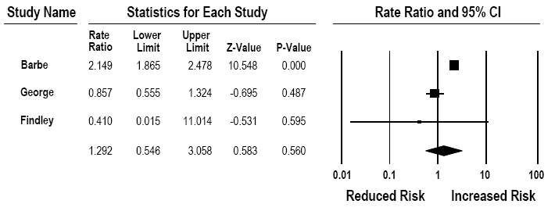
Treatment Effectiveness
Indirect measures suggest that not all individuals will attain normal levels of function

Slide 21
Time to Reach Optimal Effectiveness
14 studies looked at CPAP
  12 CPAP
  1 CPAP & Oral Appliances
  1 CPAP and Medication

Slide 22
Time to Reach Optimal Effectiveness
The impact that CPAP has on crash risk reduction among individuals with OSA is seen after as little as one night of treatment
  Simulated driving performance, severity of disordered respiration, blood oxygen saturation, and some (but not all) measures of cognitive and psychomotor performance improve significantly following a single night of treatment
  Exactly how many nights of treatment are required until CPAP exerts maximum benefit is not known but evidence suggests <2 weeks

Slide 23
Time to Deteriorate
4 studies looked at impact of CPAP cessation
Cessation of CPAP leads to a decrease in simulated driving ability and increases in both OSA severity and daytime sleepiness (SoE: Minimally Acceptable)
  The exact rate at which deterioration occurs cannot be determined; however, this deterioration may occur as soon as 24 hours following cessation of treatment

Slide 24
Screening and Diagnosis of OSA
Moderate/severe OSA is a threat to driver safety that can be effectively treated
Drivers with moderate/severe OSA need to be identified and treatment started
How might this be done?
  Can those with undiagnosed moderate/severe OSA be readily identified (screened) by medical examiners?
  Can obtaining a confirmatory diagnosis be made more accessible to CMV drivers than overnight polysomnography (PSG)?

Slide 25
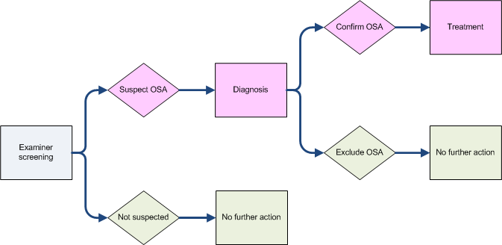
Screening and Diagnosis of OSA

Slide 26
Screening for OSA
What can medical examiner use to help identify potential OSA sufferers?
  Subjective sleepiness scales?
  Medical History?
  Anthropomorphic measures?
  Algorithms

Slide 27
Screening for OSA
Subjective sleepiness scales – not useful
Medical history – may be useful
Anthropomorphic measures –may be useful
  BMI
  Neck circumference
  Others
Algorithms - may be useful

Slide 28
Diagnosis of OSA
Are there alternatives to overnight PSG?
  Portable systems
43 studies assessed the diagnostic performance attributes of a portable sleep monitoring system

Slide 29
Diagnosis of OSA
Portable Device Level | Severity | K= | Diagnostic OR (D) | Slope | Homogeneous? | Summary Sensitivity at mean threshold | Summary Specificity at mean threshold
II | AHI≥10 | 1 | NC | NC | NA | 80.0 | 90.0
 | AHI≥20 | 1 | NC | NC | NA | 100.0 | 100.0
III | AHI≥5 | 8 | 6.8469 | 0.047 | No | 98.8 (95.5-99.7) | 92.8 (77.4-98.0)
 | AHI≥10 | 12 | 4.2516 | -0.34692 | No | 89.0 (84.0-92.6) | 89.9 (85.2-93.3)
 | AHI≥15 | 11 | 4.2428 | -0.3869 | No | 90.2 (84.8-93.8) | 87.0 (80.3-91.7)
 | AHI≥20 | 12 | 4.0601 | -0.0394 | No | 89.5 (86.4-91.9) | 87.1 (83.5-90.0)
 | AHI≥25 | 1 | NC | NC | No | 44.0 | 81.0
 | AHI≥30 | 3 | 3.1918 | -1.0407 | No | 83.2 (69.4-91.6) | 87.0 (75.3-93.6)
 | AHI≥35 | 0 | NA | NA | NA | NA | NA
 | AHI≥40 | 4 | 5.6825 | 0.7383 | No | 82.7 (58.9-94.1) | 95.4 (86.2-98.6)
IV | AHI≥5 | 7 | 4.0245 | -0.2613 | No | 90.0 (86.8-92.5) | 84.4 (79.7-88.1)
 | AHI≥10 | 17 | 4.3044 | -0.2540 | No | 92.1 (89.5-94.1) | 83.7 (78.9-87.6)
 | AHI≥15 | 15 | 4.2310 | 0.1045 | No | 84.5 (79.4-88.6) | 92.1 (89.1-94.3)
 | AHI≥20 | 7 | 4.4236 | 0.3255 | No | 87.6 (82.0-91.6) | 91.2 (87.6-94.2)
 | AHI≥25 | 0 | NA | NA | NA | NA | NA
 | AHI≥30 | 5 | 3.9701 | 0.1574 | No | 64.6 (54.9-73.2) | 95.2 (93.0-96.8)
 | AHI≥35 | 0 | NA | NA | NA | NA | NA
 | AHI≥40 | 0 | NA | NA | NA | NA | NA

Slide 30
Diagnosis of OSA
A number of portable sleep monitoring systems, though not as accurate as the current reference standard (PSG), offer an alternative method for assessing the severity of OSA in a large number of individuals at a relatively low cost

Slide 31
Evidence Report – Update 2011

Slide 32
Purpose of Update
32
To update and synthesize research conducted since the last review related to diagnostic alternatives to PSG for the identification of OSA.
  Key Question# 1: Are screening/diagnostic algorithms available that will enable examiners to identify those individuals at higher risk for moderate-to-severe OSA, thereby referring these individuals for confirmation by PSG?
  Key Question #2: Are portable monitoring devices comparable to in-laboratory, technician-attended PSG in the identification of individuals with OSA?

Slide 33
Summary: Key Question #1
33
12 studies measured diagnostic performance of an algorithm/ model developed to predict the presence and/or severity of OSA
  No recommendations can be made in support of any one algorithm as an appropriate screening tool to aid in OSA diagnoses.
  The algorithms investigated in this report (and any future algorithms developed) need to be tested among CMV drivers, in order to better determine their suitability in screening for moderate-to-severe OSA among this population.

Slide 34
Summary: Key Question #2
14 articles (9 systematic reviews; 4 RCTs, 1 diagnostic cohort of CMV drivers) provided evidence related the performance of PM devices compared to PSG in the diagnosis of OSA
The findings of this updated systematic review support our previous findings that a number of portable sleep monitoring systems, though not as accurate as the current reference standard (PSG) do offer an alternative method by which the severity of PSA may be assessed in a large number of individuals at a relatively low cost

Slide 35
Summary: Key Question #2
35
Findings of Systematic Reviews (k=9)
  Majority of PM devices could differentiate those with and without OSA and those with severe OSA from mild-to-moderate OSA
  Strongest evidence for Level 3 devices
  Manual scoring provides more consistent results than automatic scoring
  PM devices tend to result in more data loss though new technologies with alarms help reduce this
  PM devices tend to be associated with higher cost savings (even accounting for data loss)

Slide 36
Summary: Key Question #2
36
Meta-Analysis of Epworth Sleepiness Scores; PM vs. PSG

