Slide 1
On-Board Monitoring for Commercial Motor Vehicle Safety
April 10, 2013
Dr. Martin Walker,
Chief Research Division, FMCSA

Slide 2
Agenda
Onboard Monitoring Background
Low Cost Driving Behavior Mgmt System (DBMS)
Impact of OBM on Bus Safety
Onboard Monitoring Field Operational Test (FOT)
Summary

Slide 3
Problem
In 2010, more than 3,944 fatalities and 106,000 injuries from crashes involving large trucks.
Numerous studies have shown at-risk driving behaviors to be the primarily contributing factor in vehicle crashes.
Top 3 factors leading to Safety Critical Events from Drowsy Driver Warning System Field Operational Test.
Inadequate evasive action
Internal distraction
External distraction
Notes:
(Treat et al., 1979; Hendricks, Fell, and Freedman, 1999)

Slide 4
Why Focus On Behaviors?
Driver reasons accounted for the overwhelming majority of the critical reasons
– 87% for the trucks and
– 92% for passenger vehicles
Top critical reasons from LTCCS
Driver decision errors
Driving too fast for conditions
Driver Recognition errors
Inattention
Inadequate surveillance
Fatal
Crash
Crash
Near Crash
Crash-Relevant Conflict
At-Risk Behavior
Note: Adapted from Heinrich et. al.,1980

Slide 5
Onboard Monitoring System Program
Objective:
Determine whether onboard monitoring of driver performance and feedback (real-time and delayed) can improve driver behavior and CMV Safety
Three Projects:
Project #1 Low Cost Driving Behavior Mgmt System (DBMS)
Project #2 Impact of OBM on Bus Safety
Project #3 Onboard Monitoring Field Operational Test (FOT)

Slide 6
Low Cost Driving Behavior Mgmt System
DriveCam; started in 1998; event-based recorder; used in more than 62,000 vehicles
Placed on truck’s windshield
2 cameras
Driver’s face
Forward view
3 accelerometers
Y-, x-, and z-axis
Recording in constant loop
Trigger greater than or equal to │0.5 g│
Saves 8 sec before, 4 sec after trigger
Event status light

Slide 7
Video Example
Notes:
Experimental Design.
We are planning to conduct this pilot-test using both a local short haul and a long haul carrier. 50 vehicle each with data collection for a total of 16 weeks – 4 week base line and a 12 week intervention.

Slide 8
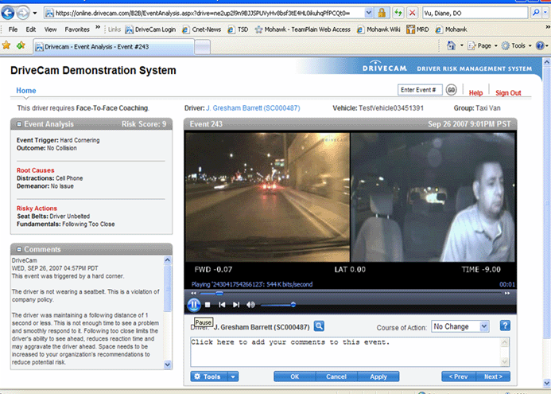
HindSight Software

Slide 9
Research Design
Baseline/Intervention design
4-week Baseline phase
Vehicle instrumented with event recorder
Drive on normal, revenue producing deliveries
Managers do not see recorded data
No coaching or feedback
13-week Intervention phase
Vehicle instrumented with event recorder
Drive on normal, revenue producing deliveries
Managers see recorded data
Coaching and feedback
Notes:
9

Slide 10
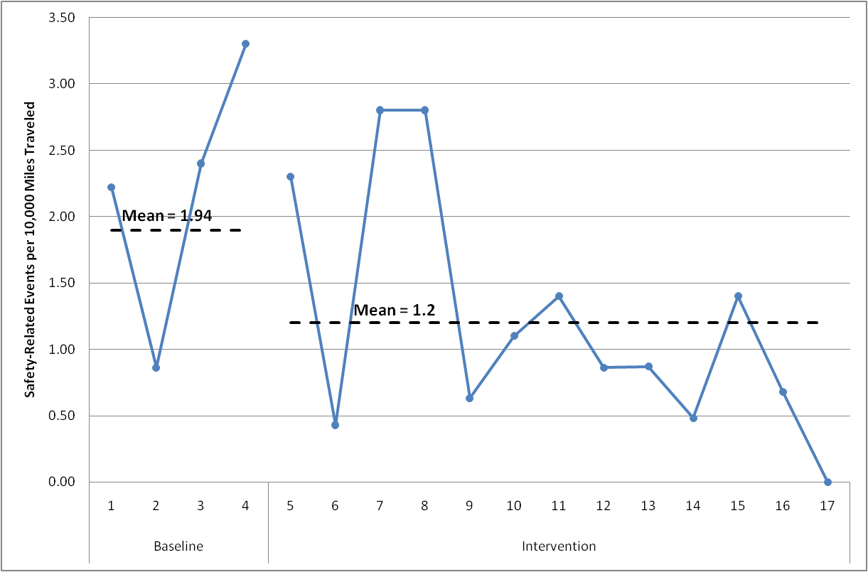
Carrier A - Results
38.1% reduction in the mean rate of safety-related events/10,000 miles

Slide 11
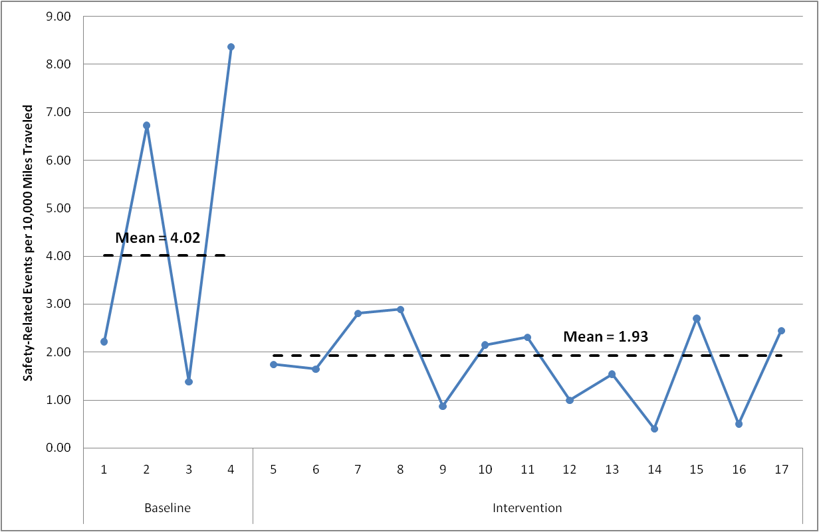
Carrier B - Results
52.2% reduction in the mean rate of safety-related events/10,000 miles

Slide 12
Impact of OBMS on Safety
San Francisco Muni Bus Case Study with OBMS
Purpose: Examine the longer term impact of OBMS of carrier safety.
Scope:
Classic Before/After Design
San Francisco MTA installed DriveCam systems in all Muni busses in Nov 09 to record the cause of crashes and monitor dangerous driving behavior of bus drivers.

Slide 13
Impact of OBMS on Safety
San Francisco Muni Bus Case Study with OBMS
Results:
System had a very positive impact on changing driver behavior. Overall a 50% reduction in bus crashes -- avoidable crashes decreased 33%; unavoidable decreased 57%.
SFMTA Safety Manager: “System works well as both a training tool and a disciplinary measure; Drivers are more aware of their actions because of the camera, and they’re receiving better training because of the information gathered from past crashes; System helps to avoid potential lawsuits from pedestrians and passengers.”
Crash Reduction
SF MTA | 2009 | 2010
Muni Bus Crashes | 964 | 483

Slide 14
OBMS FOT
Objective. To determine whether an onboard monitoring system capturing driver performance and providing feedback (real-time and delayed) can improve driver safety.
Purpose. Develop and Test an integrated state-of-art OBMS for commercial drivers.
Evaluate effectiveness, acceptance, and safety impact.
Collect naturalistic data for future research.
Provides opportunity for a carrier to try out OBMS.
Method. SmartDrive systems and VTTI Data Acquisitions Systems will run together, in parallel.

Slide 15
Research Partners and Roles
Cooperative Agreement Team
Manager: VTTI
Vendor/Data Collector: SmartDrive/VTTI
Independent Evaluator: University of Washington
Study 1: OBMS Evaluation
Type of Data: Epoch
Data Collector: SmartDrive
IRB of Record: University of Washington
Study 2: Naturalistic Data Collection
Type of Data: Continuous
Data Collector: VTTI
IRB of Record: Virginia Tech

Slide 16
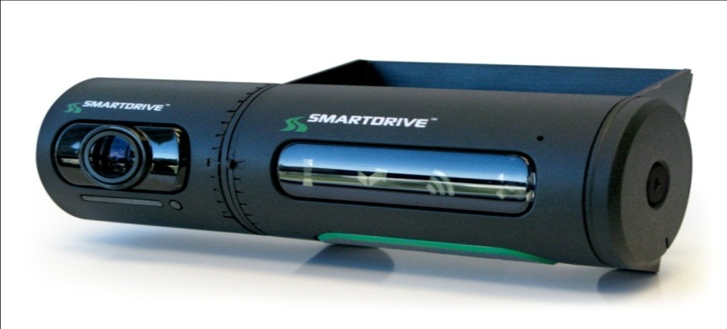
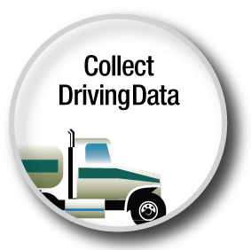
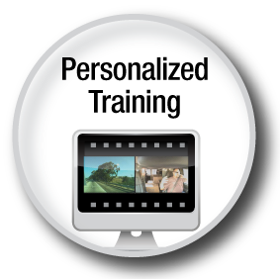
Driver Skills Improvement Program

Slide 17
CMV OBMS Fleets
Potentially as many as 6 different fleets will participate in the FOT
Fleet | Location | Operation | Number of Trucks | Number of Drivers | Drivers Recruited for NDS | Planned Install to Begin
A | Baton Rouge, LA | Grocery- Reefer | 68 | 79 | 56 | 2/18/13
B | Escanaba, MI | Dry goods - Various operations including long-haul, regional; company | 15*/99 | 99 | 16 | 3/04/13
C | Selma, NC | Fuel-tanker; slip-seat | 38 | 80 | 4 + TBD | 3/18/13
E | Los Angeles, CA | Motor Coach | 23 | 43 | TBD | 4/29/13
F | Berkeley, CA | Motor Coach | 8* | 12 | TBD | 4/29/13
D | San Antonio, TX | Motor Coach | 21 | TBD | TBD | 5/13/13
 |  | TOTAL | 175*/259 | ~343 | 76 + TBD

Slide 18
Conclusions
FMCSA has been actively working to develop and evaluate OBMS.
The Low Cost DBMS and SFMTA DriveCam studies has shown that a combination of OBMS and coaching can significantly improve safety.
The Agency is further evaluating OBMS with more motor carriers and collecting naturalistic driving data for future research.
Notes:
18

Slide 19
Contact Information:
Martin Walker
Martin.R.Walker@dot.gov
202 385-2364

