Slide 1
Presented to FMCSA
Motor Carrier Safety Advisory Committee, Medical Review Board and CSA Subcommittee
by
Roger Clarke, Chair, NAFMP
Sept 9 & 11, 2013
Alexandria, Virginia

Slide 2
Who is NAFMP?
Alberta Transportation
Alberta Occupational Health and Safety
Alberta Workers’ Compensation Board
Commission de la santé et de la sécurité du travail du Québec (CSST)
Federal Motor Carrier Safety Administration
Société de l’assurance automobile du Québec (SAAQ)
Transport Canada
With in-kind operational support and continued guidance by Alberta Motor Transport Association and American Transportation Research Institute
All held together by the potential of fatigue management

Slide 3
Why Fatigue Management?
Fatigue is under-represented in police-generated CV collision statistics
Research results vary, but certainly all indicate that CV driver fatigue is a significant highway safety issue
Fatigue is a factor in 13% of heavy vehicle crashes (Large Truck Crash Causation Study, 2006)
Fatigue is a principle cause in 31% of crashes fatal to the CV driver (NTSB 1990)

Slide 4
Why Fatigue Management?, cont’d
Limitations of Hours of Service regulations
Off duty behavior
Health and medical conditions
Corporate culture in some carriers
Difficulty in enforcement
Poor circadian “fit” for some drivers
Scheduling conflict
Lack of rest facilities
Wait times at pickup and drop-off locations
Canada/U.S. sponsored study on hours of service regulations came with a recommendation to “develop a fatigue management program”

Slide 5
Development Approach and Guiding Principles
Along with a vision to develop a comprehensive FMP, the following were adopted to guide development:
Conduct a literature review to determine which fatigue countermeasures held promise in mitigating fatigue
Integrate all such countermeasures into a comprehensive approach to fatigue management
Verify the effectiveness of each countermeasure in truck and coach operating environment
Conduct all field research within regulatory limits
Conduct research in a variety of jurisdictions, geography, carrier types and conditions

Slide 6
Development Approach and Guiding Principles, cont’d
Develop all materials, guidance, and support required, to create effective and feasible fatigue management program for motor carriers
Make all guidance and support materials available free of charge, on a public website
Continually update the website to include new technology, medical and other advances in the field
Develop as a voluntary program for drivers and carriers
Develop all materials and guidance in both French and English

Slide 7
Elements Included in NAFMP
Education and training
Family members
Drivers
Dispatchers
Trainers
Carrier management
Carrier clients
Corporate culture
Sleep disorder screening and treatment
Fatigue measurement technology
Scheduling tools
Features added later included implementation guidance and ROI Calculator

Slide 8
Complexity and Obstacles
Widely dispersed drivers
Medical and research ethics and legal issues
The demand on drivers time and scheduling
Clinical availability
Confidentiality
Training time, including family members
Train the trainer
Long term interest, retention and culture
Long held attitude by dispatch and clients
Funding of each phase

Slide 9
Research Teams
Phase 1 and 2: Literature research, identification of potential elements, program development and testing in an operating environment
Canadian Sleep Institute, Adam Moscovitch, with M Reimer, R Heslegrave, D Boivin, M Hirshkowitz, W Rhodes and M Kealey
Phase 3: Program refinement and testing with measurement in a carrier operating environment
Human Factors North, Alison Smiley with T Smahel, Diane Boivin, P Boudreau, John Remmers, Melody Turner, Mark Rosekind, and Kevin Gregory
Phase 4: Development of learning modules, website, implementation manual and ROI calculator
VTTI, development of the leaning modules and implementation manual
Adder Consulting, development of the website
ATRI, development of the return-on-investment calculator

Slide 10
Participating Carriers
Phase 1 and 2
Manteis Transport
Canadian Freightways
Greyhound (Canada)
Grimshaw Trucking
Phase 3
Robert Transport
ECL Group
JB Hunt

Slide 11
Results
Increased sleep time and sleep quality
Improved psychomotor performance and alertness on duty
Reduction in the number of close calls or near accidents
Confirmation that sleep disorder screening and treatment is feasible and does result in substantial reduction in fatigue levels through improved sleep duration and quality of rest
Improvement in carrier corporate culture with respect to fatigue as reflected in policy and practice

Slide 12
Results, cont’d
Subjective reporting of less overall fatigue in drivers
Reduction in absenteeism and fewer road infractions
Improved alertness
29% severe sleep apnea found in test sample, sufficient to warrant medical intervention
Medical intervention raised the sleep time on average, from 3.9 hours to 6.8 hours

Slide 13
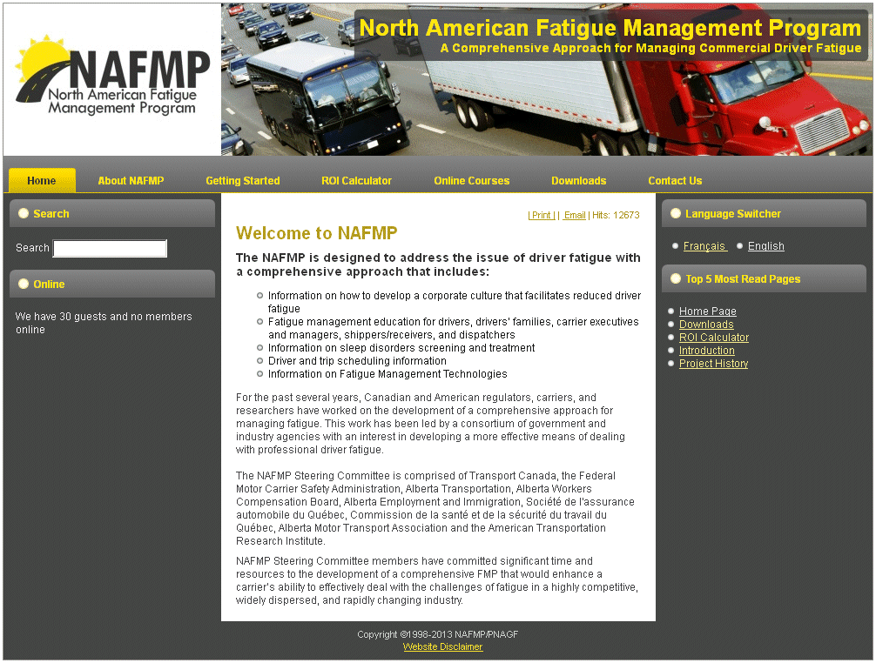
NAFMP Website

Slide 14
What’s Next?
Further refinement, updates and development to possibly include:
Spanish translation
Certification for drivers, dispatchers, trainers that successfully complete the program and demonstrate understanding
Certification of carriers that have fully implemented the program
Development of a detailed risk assessment tool for carriers
Incorporate elements from the Canada, U.S. Napping study
Continue to work with insurance companies, carriers and regulators in the development of incentives and deployment options that support the growth of the program, and promote greater highway safety.

Slide 15
Questions?
Thanks for the opportunity to present the NAFMP

