Slide 1
Should Non-Preventable Crashes be Removed from Crash Basic?
MCSAC Subcommittee on CSA
September 11, 2013
Presented by Ted L. Perryman

Slide 2
WHY MOTOR CARRIERS ARE
UPSET
Round Rock, TX. February 10, 2013. Young 19 year old student fell off of an interstate highway overpass onto the pavement and was struck and killed by tractor trailer.
Williston, ND. April 15, 2013. A man stole a passenger vehicle and after leading police in a high speed chase (speeds exceeding 70 mph in a 25 mph zone) crashed his vehicle into the side of tanker truck causing the both vehicles to explode in flames.

Slide 3
WHY MOTOR CARRIERS ARE UPSET
North Stafford, VA. April 18, 2013. A man was killed when he parked his vehicle on the side of I-95 and exited his vehicle walking in front of a southbound tractor-trailer.
McAllen, TX. May 7, 2013. Motorist was killed in a fiery crash early in the morning when he drove wrong way on an interstate at a high rate of speed hitting a tractor-trailer head on.
Lake George, NY. June 10, 2013. Motorist was killed driving the wrong way on an interstate traveling 85 mph when she hit a box truck head on. The deceased motorist had been drinking at a local bar just hours before the crash.

Slide 4
National Safety Counsel
“Preventable accident is one in which the driver failed to do everything that reasonably could have been done to avoid the accident.”

Slide 5
FMCSR Part 385
“Preventable accident…means an accident that involved a commercial motor vehicle…that could have been averted but for an act, or failure to act, by the motor carrier or the driver.”
Section 385.3 FMCSR (Safety Fitness Procedures)

Slide 6
FMCSR Part 385
“If a driver, who exercises normal judgment and foresight could have foreseen the possibility of the accident that in fact occurred, and avoided it by taking steps within his/her control which would not have risked causing another kind of mishap, the accident was preventable.”
Part 385, Appendix B, Accident Factor

Slide 7
Negligence
The term “negligent” as used in these instructions means the failure to use the highest degree of care. The phrase “highest degree of care” means that degree of care that a very careful person would use under the same or similar circumstances.
Missouri Approved Instruction 11.03

Slide 8
Negligence
When I use the word “negligence” in these instructions, I mean the failure to do something which a reasonably careful person would do, or the doing of something which a reasonably careful person would not do, under circumstances similar to those shown by the evidence. The law does not say how a reasonably careful person would act under those circumstances. That is for you to decide.
Illinois Pattern Instruction 10.01

Slide 9
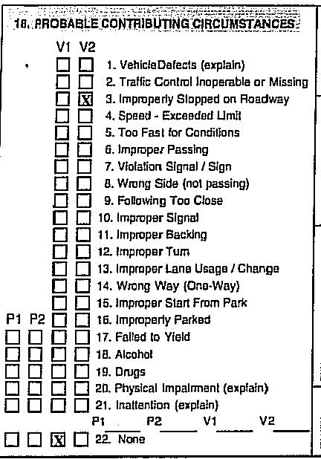
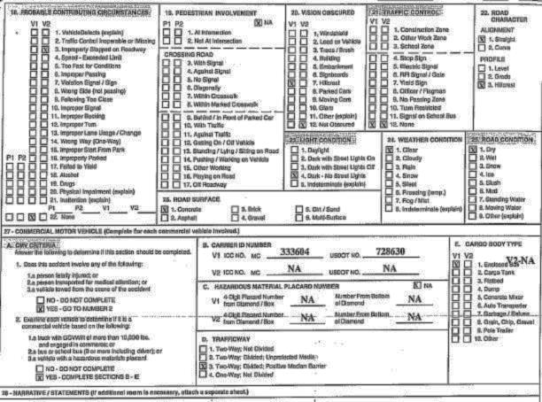
MISSOURI

Slide 10
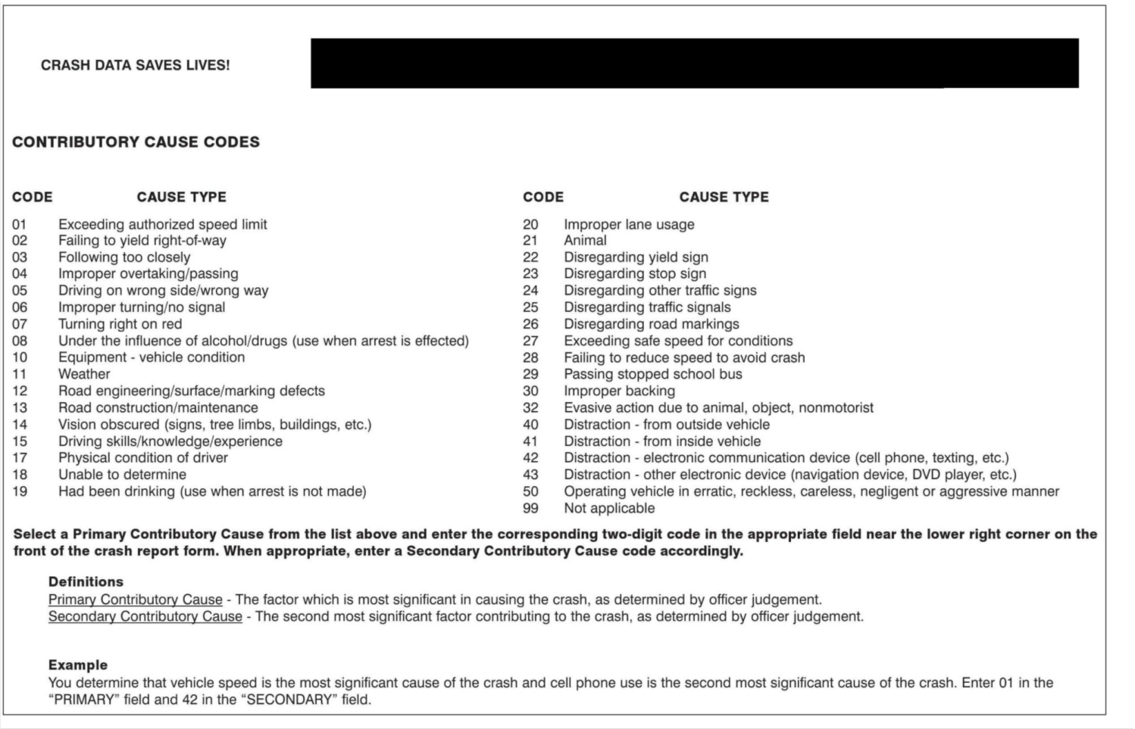
ILLINOIS

Slide 11
TABLE 3A DRIVERS IN FATAL AND INJURY COLLISIONS AND DRIVERS WHO WERE AT FAULT BY TYPE OF VEHICLE - 2010
DRIVER IN FATAL COLLISIONS DRIVERS IN INJURY COLLISIONS
Percent At Percent At
Total At Fault Fault Total At Fault Fault
STATEWIDE VEHICLE TYPE*
Passenger car 2,315 1,266 54.7 204,025 96,861 47.5
Passenger car with trailer 3 2 66.7 484 234 48.3
Motorcycle/scooter 373 244 65.4 9,818 5,530 56.3
Moped 44 27 61.4
Pickup or panel truck 606 316 52.1 32,045 16,333 51.0
Pickup or panel truck with trailer 19 7 36.8 789 365 46.3
Truck or truck tractor 66 13 19.7 2,234 1,090 48.8
Truck or truck tractor with trailer 147 28 19.0 2,863 1,060 37.0
School bus 8 1 12.5 341 87 25.5
Other bus 27 6 22.2 1,328 498 37.5
Emergency vehicle 11 3 27.3 1,464 550 37.6
Highway construction equipment 37 16 43.2
Other 16 10 62.5 402 182 45.3
Not stated1/ 107 41 38.3 35,124 17,011 48.4
TOTAL 3,698 1,937 52.4 290,998 139,844 48.1
*May be under reported for Non-CHP agencies due to a traffic collisions report form revision July 2003. (See Preface for details.)
1/May be over reported for Non-CHP agencies due to a traffic collisions report form revision July 2003. (See Preface for details.)

Slide 12
CSA Scores IN The Courtroom
MCSAC Subcommittee on CSA
September 11, 2013
Presented by Ted L. Perryman

Slide 13
CSA In Litigation
“The trucking industry has undergone major regulatory changes, and that means major new discovery issues for trial lawyers. Last year, the FMCSA launched the CSA program to toughen safety requirements for commercial carriers. Carriers are now operating under more stringent standards.”
American Association for Justice, Trial Magazine, February 2011

Slide 14
Discovery Requests
In the three years before the wreck, were you found deficient in any BASIC by the FMCSA? If so, the date of each deficiency finding and list by date all BASIC categories in which you were found deficient?
If you maintain that any BASIC measurement is incorrect or unjustified explain your contention and the basis for your contention. Explain all efforts you have made to correct the data that you contend is incorrect or unjustified?
Trial Magazine 2011

Slide 15
Discovery Requests
Do you admit that a violation of a BASIC can lead to a crash?
Do you admit that violation of a BASIC increases the risk of a crash?
Do you admit that any violation of a BASIC is unsafe?
Do you admit that violation of a BASIC endangers the public?”
Trial Magazine 2011

Slide 16
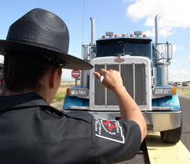
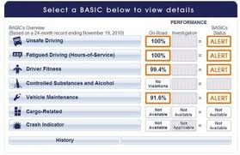
Types of CSA Evidence
Percentile Rankings in each BASIC
Roadside Inspections
Citations or violations of FMCSRs or state law
Crashes

Slide 17
Trucking Accident
Facts:
Tractor-trailer rear-ends claimant vehicle and it is alleged that truck driver was “driving too fast for conditions” and “following too closely.”
CSA Score:
Motor Carrier’s Unsafe Driving Ranking is 75 and has an Alert status. Motor carrier has received several citations for “driving too fast for conditions” and “following too closely” in the preceding 24 months.

Slide 18
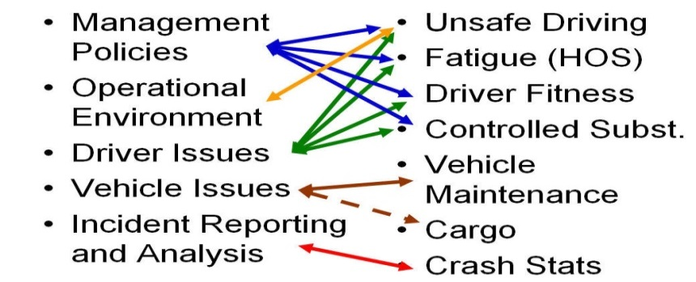
IS CSA Relevant In A Trucking Accident Case?
In most accident cases CSA evidence should not be admissible.
Evidence of a crime, wrong, or other act is not
admissible to prove a person’s character in order to
show that on a particular occasion the person acted in
accordance with the character. Rule 404(B)

Slide 19
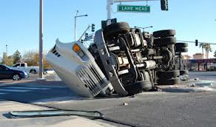
Trucking Accident
Facts: Tractor trailer rear-ends claimant vehicle and it is alleged that truck driver was “following too closely” and was fatigued because he was in violation of HOS rules. Claimant alleges that motor carrier failed to monitor and train its drivers on HOS and operating while fatigued.
CSA Scores: Motor Carrier has HOS score of 72 and on Alert status with majority of violations being “form and manner” in the past 24 months.
Admissible: Rule 404(b)(2) says MAYBE.

Slide 20
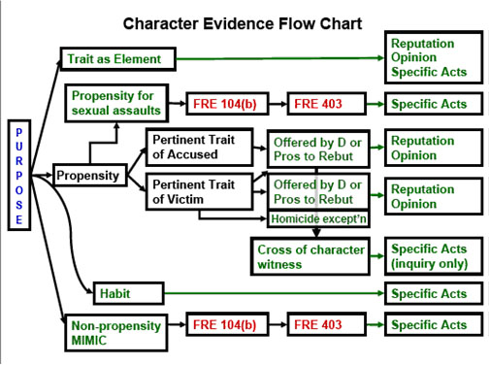
Character Evidence - Rule 404
Crimes, Wrongs or Other Acts
(2) This evidence may be admissible for another purpose, such as proving motive, opportunity, intent, preparation, plan, knowledge, identity, absence of mistake, or lack of accident.

Slide 21
The problem with Rule 404
It permits an attorney to plead the “right” words and suddenly CSA can be admissible.
Negligence claims made directly against Motor Carrier
Negligent Hiring
Negligent Retention
Failure to train, monitor, and supervise

Slide 22
Hearsay evidence
Hearsay Rule: An out of court statement offered to prove the truth of the matter.
CSA Scores: Are hearsay because they are compiled by the FMCSA (out of court) and being offered to prove that the motor carrier is unsafe.

Slide 23
Hearsay Exception – Public Records exception
Admissible if:
(iii) in a civil case if factual findings are from a legally authorized investigation; and
(B) neither the source of information nor other circumstances indicate a lack of trustworthiness.

Slide 24
Factual Findings
Not limited to purely factual observations. Includes opinions conclusions and evaluations.
Must be final in nature.

Slide 25
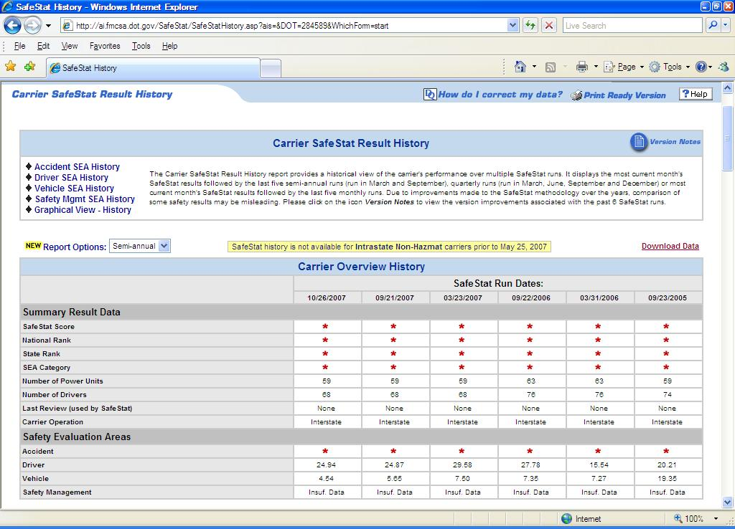
Disclaimer
“The SMS is not a Safety Fitness Determination nor is it a safety rating pursuant to 49 CFR, Part 385; also, it does not represent FMCSA’s final determination about the safety of the carrier.”

Slide 26
Trustworthiness
Burden is on motor carrier to establish untrustworthiness.
Appears to be a case by case determination without specific definition.

Slide 27
Examples of Unreliability of CSA Basic Rankings
Research Studies Show Lack of Statistical Correlation.
Statistical Outliers are Common.
Regional Enforcement Disparity.
Untimely Data.
Methodology is Subjective and Arbitrary

Slide 28
“CSA information and rankings are established by the FMCSA and are admissible as government records … when relevant in your case. There has been extensive public comments and changes to the system as a result of comments from the American Trucking Association (ATA) and others.
“The point is that CSA has been developed with the input of the trucking industry and the ATA. The federal regulations require this data to be recorded and kept for the public. As long as it is causally relevant to the crash you are handling, there is no sound evidentiary reason to preclude CSA information.”
Chapter 10, Section 8 of Litigating Truck Accident Cases by Michael Jay Leizerman

Slide 29
CSA Evidence Can be Costly to Motor Carrier
High scores or rankings will be used to reflect on the “character” of the company.
CSA rankings are misleading concerning the character of the company.
Alert symbol denotes motor carrier is unsafe.
Even non-Alert scores that exceed 50% reflect negatively on motor carrier.
The number and types of violations in each BASIC reflect negatively.
Misused by juries to establish liability.
Misused by juries to increase the value of jury awards.

Slide 30
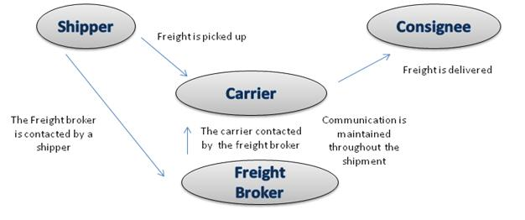
Broker-Shipper Liability
Theories of Liability against Broker-Shipper
Traditional principal/agent or employer/employee relationship (control or right to control).
Joint Venture between Broker and Motor Carrier.
Negligent Hiring or Selection.

Slide 31
Broker-Shipper Liability
To succeed on a claim of Negligent Hiring, the injured party must prove:
The motor carrier was, in fact, incompetent or unskilled to perform the job for which it was hired, and
The harm that resulted arose out of that incompetence, and
The broker/shipper knew or should have known of the incompetence.
CSA rankings and data are used to prove that the motor carrier was incompetent and that broker/shipper should have known of the incompetency by viewing the FMCSA website.

Slide 32
Disclaimer
“The SMS is not a Safety Fitness Determination nor is it a safety rating pursuant to 49 CFR, Part 385; also, it does not represent FMCSA’s final determination about the safety of the carrier.”

Slide 33
Thank You
Questions?
Ted L. Perryman
tperryman@robertsperryman.com
314-421-1850

