Slide 1
Motorcoach Driver Research
December 8, 2011
Dr. Martin R. Walker, Chief,
Research Division

Slide 2
Agenda
Analysis, Research, and Technology (ART) Office
MC HOS and How They Differ From Trucking
Recent Research
TRB-Sponsored Studies
Bus Crash Causation Study
NTSB Report on Curbside Carriers
Potential Causes of Driver Fatigue: A Study on Transit Bus Operations
Analysis of the Relationship Between Operator Cumulative Driving Hours and Involvement in Preventable Collisions
Motorcoach Driver Fatigue
MC Driver Fatigue Concerns

Slide 3
ART Office
Vision:
A highly effective and innovative research program—partnering with both internal and external stakeholders to provide relevant, high quality, and insightful research to help create the safest commercial motor carrier environment in the world.
Mission:
Conduct analysis, research, and technology activities that support FMCSA’s mission to promote safe commercial motor vehicle operations through education, regulation, and enforcement.
Strategic Goals:
Produce Safer Drivers
Produce Safer Vehicles
Produce Safer Carriers
Conduct Crosscutting Safety Research

Slide 4
Driver Fatigue
Background:
The connection between driver fatigue and safety has been strongly demonstrated.
Driver fatigue can contribute to a variety of errors including:
Recognition Errors (did the driver “see” the threat?),
Decision Errors (did the driver select the correct course of action to prevent, avoid, mitigate, or negate the threat?),
Performance Errors (having selected a reasonable course of action, did the driver execute the action safely?), and
Critical non-performance (was the driver unconscious and unable to recognize the hazard?).
Fatigue has been given high priority in FMCSA’s research agenda, particularly leading up to the revision in HOS regulations.
The major objective of research in this area is identifying and mitigating the causes of driver fatigue that result in driver error.

Slide 5
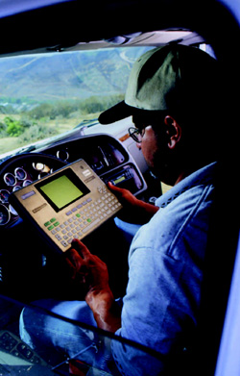
Driver Fatigue Research Plan
Reduce Crashes Due to Driver Fatigue
HOS
Research
Driver Characteristics
& Other Factors That Affect Fatigue
Driver Assist Technologies
Environment: Truck & Bus Ergonomics
Carrier
Implementing Fatigue Mgmt Programs
Driver
Vehicle
Carrier

Slide 6
Property vs. Passenger Driver HOS
HOURS-OF-SERVICE RULES
Property-Carrying CMV Drivers | Passenger-Carrying CMV Drivers
11-Hour Driving Limit May drive a maximum of 11 hours after 10 consecutive hours off duty. | 10-Hour Driving Limit May drive a maximum of 10 hours after 8 consecutive hours off duty.
14-Hour Limit May not drive beyond the 14th consecutive hour after coming on duty, following 10 consecutive hours off duty. Off-duty time does not extend the 14-hour period. | 15-Hour On-Duty Limit May not drive after having been on duty for 15 hours, following 8 consecutive hours off duty. Off-duty time is not included in the 15-hour period.
60/70-Hour On-Duty Limit May not drive after 60/70 hours on duty in 7/8 consecutive days. A driver may restart a 7/8-consecutive-day period after taking 34 or more consecutive hours off duty. | 60/70-Hour On-Duty Limit May not drive after 60/70 hours on duty in 7/8 consecutive days.
Sleeper Berth Provision Drivers using the sleeper berth provision must take at least 8 consecutive hours in the sleeper berth, plus a separate 2 consecutive hours either in the sleeper berth, off duty, or any combination of the two. | Sleeper Berth Provision Drivers using a sleeper berth must take at least 8 hours in the sleeper berth, and may split the sleeper-berth time into two periods provided neither is less than 2 hours.
Notes:
Travel time—
(1) When a property-carrying commercial motor vehicle driver at the direction of the motor carrier is traveling, but not driving or assuming any other responsibility to the carrier, such time must be counted as on-duty time unless the driver is afforded at least 10 consecutive hours off duty when arriving at destination, in which case he/she must be considered off duty for the entire period.
(2) When a passenger-carrying commercial motor vehicle driver at the direction of the motor carrier is traveling, but not driving or assuming any other responsibility to the carrier, such time must be counted as on-duty time unless the driver is afforded at least 8 consecutive hours off duty when arriving at destination, in which case he/she must be considered off duty for the entire period.

Slide 7
TRB-Sponsored Studies
Operational Differences and Similarities Among the Motorcoach, School Bus, and Trucking Industries, 2005
Method:
Literature review and limited interviews were conducted with drivers and safety managers.
Findings:
Report documented a comparison of differences and similarities among the 3 types of commercial vehicle industries.
Such a comparison would allow the govt, as well as industry associations, to access a single resource when seeking information on industry profiles, safety statistics, and general business operations.

Slide 8
TRB-Sponsored Studies
Motorcoach Industry Hours of Service and Fatigue Management Techniques, 2005
Method:
Literature review and limited surveys were conducted with drivers and safety managers.
Findings:
Report documented the unique features of the extended workday that typifies motorcoach operations.
Identifies techniques that motorcoach managers, front-line employees, and drivers use to reduce fatigue-related incidents.

Slide 9
Bus Crash Causation Study (BCCS)
Background:
Approximately 50 people are killed and fewer than 1,000 are injured annually in cross-country and intercity bus crashes.
FMCSA collected crash data in northeastern New Jersey, which is part of the New York City metropolitan area.
The BCCS was designed to collect more than 400 data elements on each crash that included at least one bus and at least one fatality or injury.
Method:
Data collection included 40 buses involved in 39 fatal and injury crashes that occurred in New Jersey in 2005 and 2006.
Each crash was coded for:
Critical Event (the event after which a crash is unavoidable);
Critical Reason (the immediate reason for the critical event); and
Associated Factors (all factors selected from the current understanding of conditions related to crash risk and present at the time of the crash).

Slide 10
Bus Crash Causation Study (BCCS)
Findings:
Human errors by bus drivers, other vehicle drivers, and pedestrians or bicyclists were assigned as the critical reasons for bus crashes in 90% of the cases.
Of the 19 crashes in which the bus was assigned the critical reason for the crash, driver error was the specific reason in 15 cases.
19 Crash Critical Reasons: Pedestrian entering traffic lane (5) Lane change/run off road (4) Other vehicle stopped in lane (3) Traveling too fast for conditions (3) Other (4)
Associated Factors Coded to Bus Drivers
Associated Factor | Number
Line of sight (LOS) obstructed by vehicle | 22
In a hurry | 16
Inadequate evasive action taken | 15
Uncomfortable/unfamiliar with the road | 11
Inadequate surveillance | 10
Made an illegal maneuver | 9
Prescription drug use | 8
Driver had vision problems | 6
Inattention/distraction | 5
Hazard masked by traffic flow | 4
Distracted by a person, object, or event | 4
LOS obscured by weather, poor light | 4
Misjudged gap or velocity | 4
Following too close | 3
Driver had hearing problems | 2
Traveling too fast | 2

Slide 11
NTSB Report on Curbside Carriers
Background:
Curbside Carriers (CSC) offer scheduled trips that begin or end at locations other than traditional bus terminals.
Method:
The report used FMCSA data to categorize CSC (71/4,172) and then compared crash and out-of-service (OOS) rates of these carriers to conventional bus operations.
Findings:
Report found that CSC with < 10 buses and carriers who have been in business for < 10 years have higher crash and OOS rates.
The fatal accident rate for CSC from Jan 05 to Mar 11 was 7 times that of conventional bus operations.
The exclusion of buses from routine enroute inspections—especially of curbside carriers that don’t operate from terminals—reduces opportunities to discover safety violations.
Bus driver fatigue, a contributing factor in many accidents, is a continuing safety concern.
Notes:
most of these operations pick up or discharge passengers at one or more curbside locations.

Slide 12
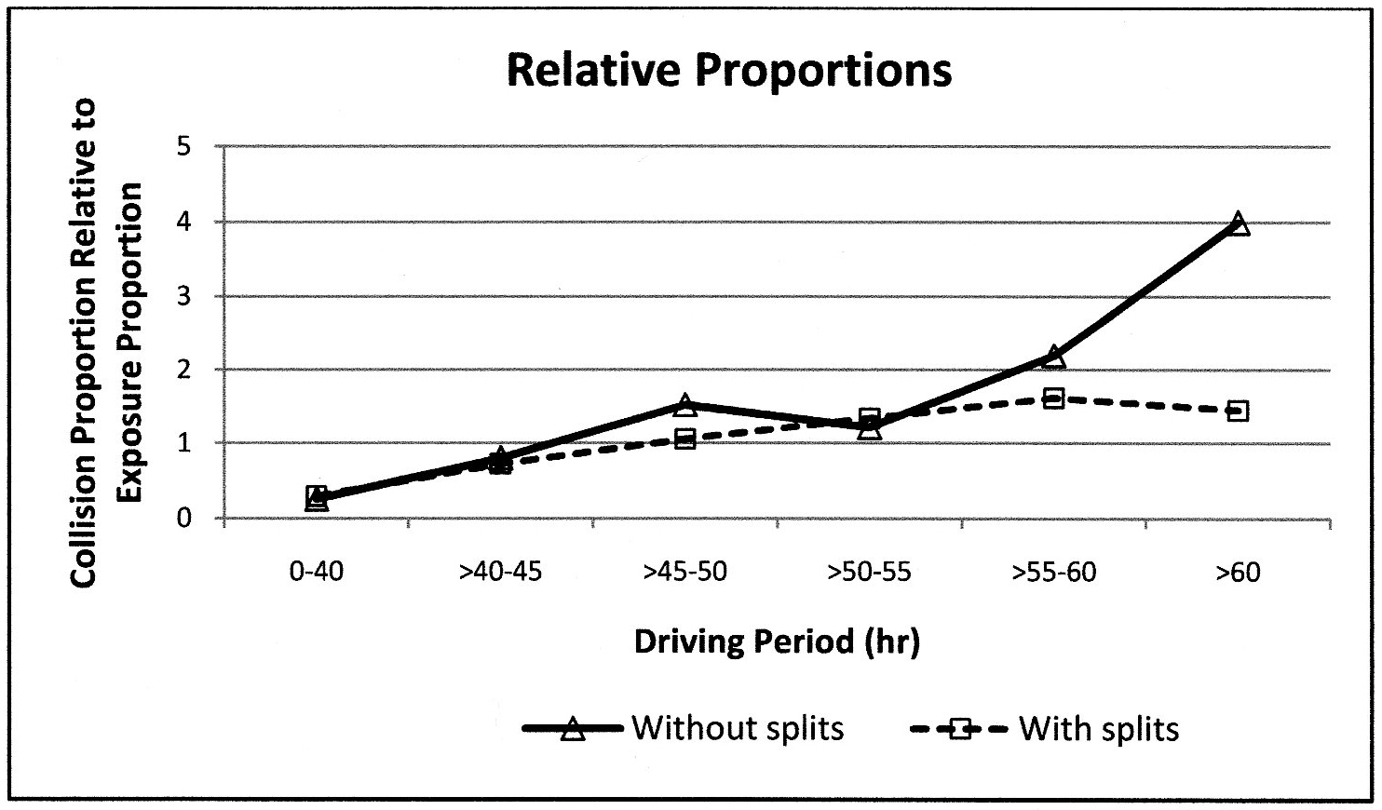
Evaluating MC Driving Hours & Crashes
Method:
This study examined the influence of bus driving hours on preventable collisions by employing data from incident reports and operator schedules to evaluate the correlation between driving hours and operator involvement in collisions.
Employed data from 4 transit agencies (2 large/2 small) in Florida.
Findings:
Identified a discernable pattern of an increased propensity of collision involvement with an increase in driving hours.
Preventable collisions are more likely occur with drivers that have long driving schedules (>60 hrs per week without splits are more likely to be involved in preventable collisions).
Notes:
ANALYSIS OF THE RELATIONSHIP BETWEEN OPERATOR CUMULATIVE DRIVING HOURS
AND INVOLVEMENT IN PREVENTABLE COLLISIONS
Thobias Sando, Ph.D.,
School of Engineering University of North Florida

Slide 13
Potential Causes of MC Driver Fatigue
Method:
Examined the safety impacts of the existing HOS policies using surveys, incident data and driver schedules to determine the relationship between crash involvement and operator schedules.
Factors of interest: shift pattern (start and end time), schedule pattern (split or non-split schedule) and time spent on driving.
Used fatigue assessment tool -- Fatigue Audit Interdynamics (FAID®) – to evaluate the fatigue risks of various aspects of driver schedules.
Findings:
Drivers working split schedules are more susceptible to fatigue than those working straight schedules.
Drivers working split schedules indicated less sleep time, long driving hours and early starting/late ending schedule patterns.
Found a strong statistically significant relationship between crash occurrence and fatigue condition.

Slide 14
MC Driver Fatigue Study
This research builds upon previous MC fatigue studies, examining operating practices and driver schedules to support improved regulatory policy.
Phase 1 – Industry interviews were used to develop research protocols to evaluate MC driver schedules.
Phase 2 – Collected driver schedules, actigraph data, and PVT measures on 80 MC drivers (charter, tour, regular route, and commuter express) to assess driver alertness.
Phase 3 – Developed project conclusions and recommendations for scheduling practices that demonstrate sound fatigue management, and provided recommendations for revisions, if necessary, to the HOS regulations.
Type of Operation | Number
Charter | 18
Tour | 13
Regular Route | 25
Commuter Express | 24
Total Drivers | 80

Slide 15
MC Driver Fatigue Concerns
Demand-Responsive Service Operations.
Irregular Work Shifts.
Schedule variations led to disruption of the rest cycle which increased fatigue risk.
Minimal advance notice of trips was also found to exacerbate fatigue risk.
Mid-Shift Break. Drivers commonly have a mid-shift break while passengers are at trip destination. What are the effects on driver fatigue of prolonged work days?
Driving During Circadian Lows. Drivers are likely to drive at the beginning or end of the day when alertness is lowest and performance is most impaired by fatigue.

Slide 16
MC Driver Fatigue Concerns
Fixed-Route Service Operations.
Backward Rotating Schedules. Many drivers report working the maximum backwards rotating 18-hr schedule (10 hrs driving/8 hrs off duty).
Opportunity for Adequate Sleep. Drivers need an average of 7 to 8 hrs of sleep daily (6 hrs to maintain health and 7 hrs to maintain alertness). Models of driver off-duty time would suggest that 8 hrs is not adequate.
Driving During Circadian Lows. Drivers report the highest frequency of driving between 12 to 6 a.m. when alertness is lowest and performance is most impaired by fatigue.
Notes:
Commuting time
MC positning and passenger pickup

Slide 17
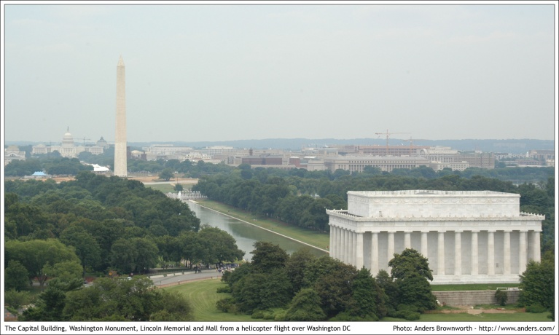
Thank You
Contact Information
Dr. Martin R. Walker
United States Department of Transportation
Federal Motor Carrier Safety Administration
Office of Analysis, Research and Technology
1200 New Jersey Ave, SE
Suite W68-310
Washington, D.C. 20590
202-385-2364
Martin.R.Walker@dot.gov
Research without Action is time Wasted,
Action without Research just Passes Time.
Research with Action can Change the World!

