Slide 1

Motorcoach Driver Fatigue Study
Sponsored by the
Federal Motor Carrier Safety Administration
Gregory Belenky, M.D.
Lora J. Wu, M.S.
Jack Hodges
Washington State University

Slide 2
Driver Sample
80 motorcoach drivers (20 women), middle-aged and overweight
Studied for an average of 30 consecutive days

Slide 3
Number of Volunteers by Operation
Charter -18
Tour -13
Regular Route - 25
Commuter Express -24

Slide 4
Exposure

Slide 5
Mean Duty Hours per Week by Driver - All
Notes:
All Mean = 45:35 STD = 16:03

Slide 6
Mean Duty Hours per Week by Driver – By Type of Operation
Notes:
Charter Mean = 37:38 STD = 16:00
Tour Mean = 53:20 STD = 18:43
Regular Route = 46:09 STD = 15:33
Commuter Express = 46:44 STD = 13:21
ANOVA
F(3,76) = 2.7, p = 0.0516 (n.s)

Slide 7
Duty Start Time by Duty Day – All
Notes:
All – Mean = 8:37 STD = 3:38

Slide 8
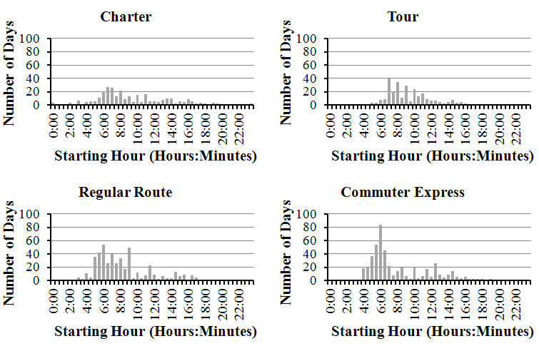
Duty Start Time by Duty Day –
By Type of Operation
Notes:
Charter – Mean = 9:23 STD = 4:19
Tour – Mean = 9:24 STD = 2:53
Regular Route Mean = 8:15 STD = 3:22
Commuter Express Mean = 8:01 STD = 3:38
ANOVA
F(3,1518) = 15.212; p = <0.01

Slide 9
Duty Start Time by Driver by Duty Day -All
Notes:
All – Mean = 8:39 STD = 2:11

Slide 10
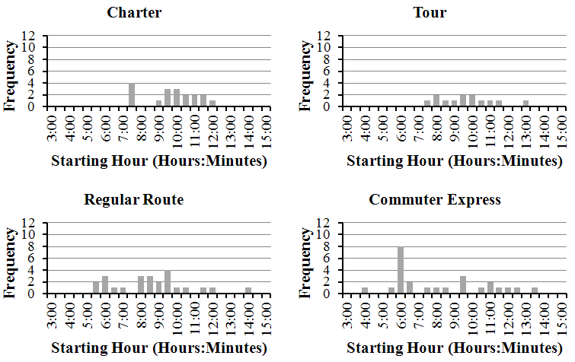
Duty Start Time by Driver by Duty Day – By Type of Operation
Notes:
Charter – Mean = 9:30 STD = 1:28
Tour – Mean = 9:25 STD = 1:34
Regular Route – Mean = 8:22 STD = 2:09
Commuter Express – Mean = 7:55 STD = 2:40
ANOVA
F(3, 76) = 2.643; p = 0.55 (n.s)

Slide 11
On Duty Time by Duty Day - All
Notes:
All – Mean = 10:36 STD = 3:32

Slide 12
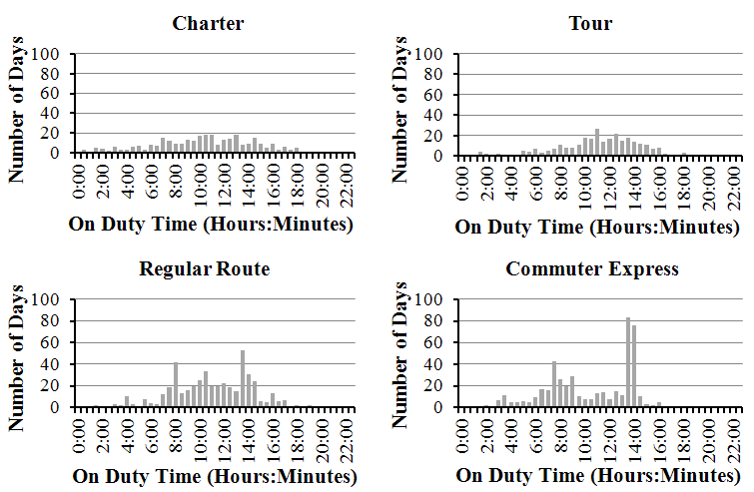
On Duty Time by Duty Day – By Type of Operation
Charter | B
Tour | A
Regular Route | B
Commuter Express | C
Notes:
Charter – Mean = 10:15 STD = 4:13
Tour – Mean = 10:58 STD = 3:18
Regular Route = 10:53 STD = 3:12
Commuter Express = 10:19 STD = 3:29
ANOVA
F(3, 1528) = 3.952; p = 0.008
Tukey Grouping Operation
A 1
B 2
B 0
C 3

Slide 13
Mean On Duty Time by Driver by Duty Day - All
Notes:
All – Mean = 10:34 STD = 1:54

Slide 14
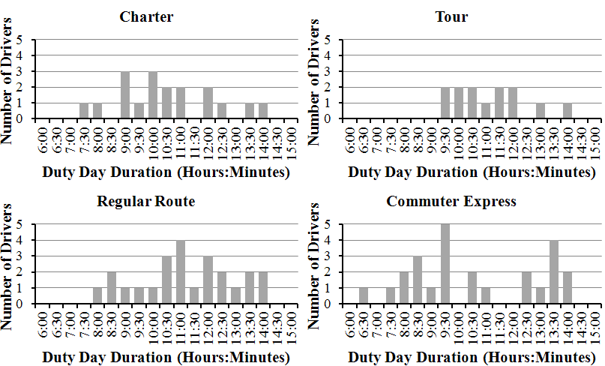
Mean On Duty Time by Driver by Duty Day – By Type of Operation
Notes:
Charter – Mean = 10:12 STD = 1:44
Tour – Mean = 10:52 STD = 1:23
Regular Route – Mean = 10:56 STD = 1:43
Commuter Express – Mean = 10:20 STD = 2:22
ANOVA
F(3, 76) = 0.750; p = 0.526 (n.s)

Slide 15
Total Sleep Time by Day - All
Notes:
All – Mean = 8:06 STD = 2:08

Slide 16
Total Sleep Time On/Off Duty by Day - All
Notes:
All – OFF Mean = 9:31 STD = 2:12
ON Mean = 7:28 SQRT = 1:51
T-test = t= 20.674 p= <0.01

Slide 17
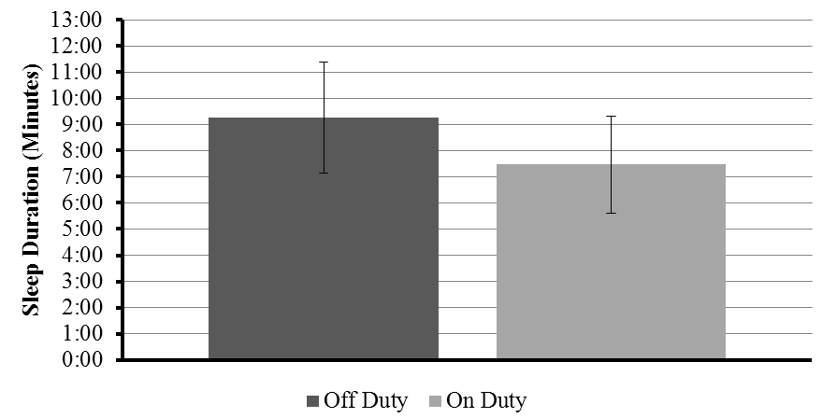
Total Sleep Time for On-Duty Days and Off-Duty Days

Slide 18
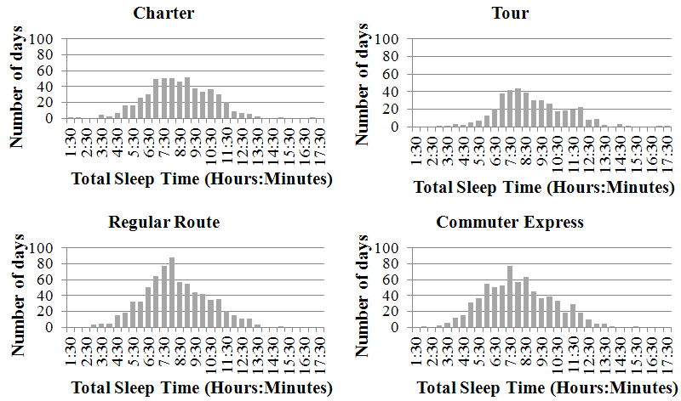
Total Sleep Time by Day – By Type of Operation
Charter | B
Tour | A
Regular Route | B
Commuter Express | C
Notes:
Charter – Mean = 8:13 STD = 2:04
Tour – Mean = 8:38 STD = 2:10
Regular Route – Mean = 8:01 STD = 2:03
Commuter Express – Mean = 7:46 STD = 2:11
Tukey Grouping Mean N Operation
A 623.66 325 Tour
B 563.68 495 Regular Route
B 547.20 349 Charter
C 508.66 526 Commuter Express

Slide 19
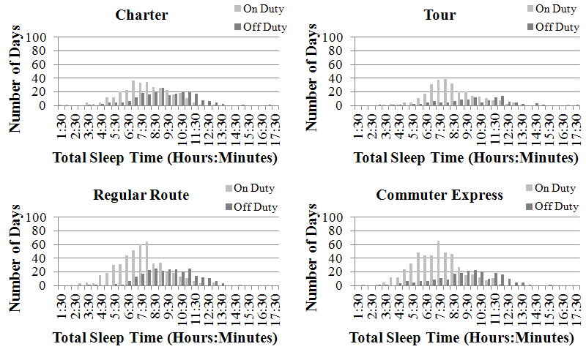
Total Sleep Time On/Off Duty by Day – By Type of Operation
Charter | A
Tour | B
Regular Route | C
Commuter Express | D
Notes:
Charter – Off Mean = 9:04 STD = 2:05 On = Mean 7:35 STD = 1:50
T-test = t= 6.358 p= <0.01
Tour – Off Mean = 9:45 STD = 2:26 ON Mean = 8:10 STD = 1:52
T-test = t= 6.358 p= <0.01
Regular Route – OFF Mean = 9:19 STD = 1:50 ON Mean = 7:19 STD = 1:48
T-test = t=14.0226 p= <0.01
Commuter Express – OFF Mean = 9:12 STD = 2:17 ON Mean = 7:05 STD = 1:46
T-test = t=12.32 p <0.01
Tukey Grouping Mean N Operation
A 8.51681 455 1
B 8.19630 546 0
C 7.98099 698 2
D 7.78882 725 3

Slide 20
Sleep by Operation On and Off Duty
Notes:
operation Off Duty On Duty Charter 9:05 7:31 Tour 9:22 8:04 Regular Route 9:15 7:18 Commuter Express 9:11 7:01

Slide 21
Average Total Sleep Time by Driver by Day - All
Notes:
All – Mean = 8:04 STD = 1:08

Slide 22
Average Total Sleep Time On/Off Duty by Driver by Day - All
Notes:
All – OFF Mean = 9:20 STD = 1:24 ON Mean = 7:20 STD = 1:25
Paired T-test (two tailed) p= <0.01 t= 12.293

Slide 23
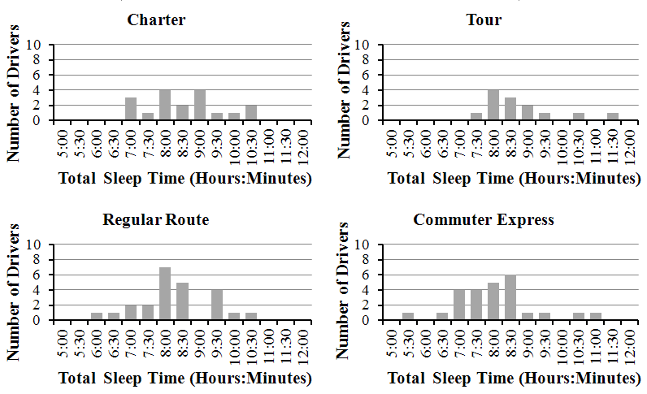
Average Total Sleep Time by Driver by Day – By Type of Operation
Notes:
Charter – Mean = 8:14 STD = 1:06
Tour – Mean = 8:36 STD = 1:04
Regular Route – Mean = 7:59 STD = 1:06
Commuter Express – Mean = 7:46 STD = 1:10
ANOVA
F(3, 76) = 1.766 , p = 0.161 (n.s)

Slide 24
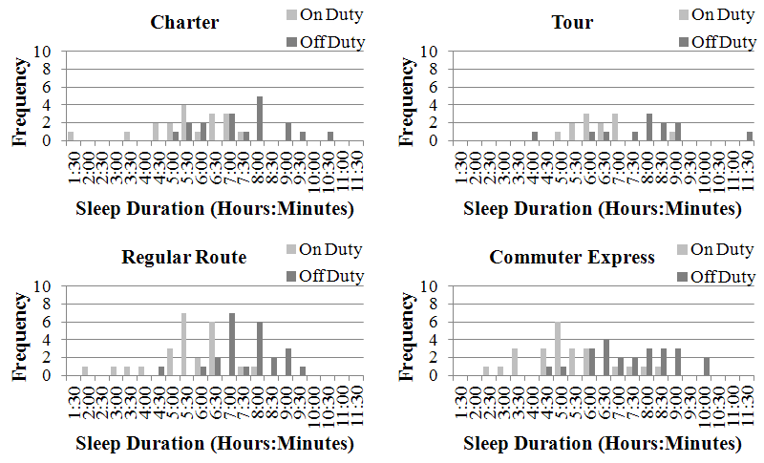
Average Total Sleep Time On/Off Duty by Driver by Day – By Type of Operation
Notes:
Charter – OFF Mean = 9:15 STD = 1:28 ON Mean = 7:20 STD = 1:30
Paired T-test (two tailed) p= <0.01 t= 5.99
Tour – OFF Mean = 9:41 STD = 1:48 ON Mean = 8:10 STD = 0:59
Paired T-test (two tailed) p= <0.01 t=3.9
Regular Route – OFF Mean = 9:20 STD = 1:05 ON Mean = 7:17 STD = 1:21
Paired T-test (two tailed) p= <0.01 t=6.894
Commuter Express – OFF Mean = 9:13 STD = 1:26 ON Mean = 6:59 STD = 1:29
Paired T-test (two tailed) p= <0.01 t=7.165

Slide 25
Correlation of On Duty Time by Duty Day with Total Sleep Time by Duty Day - All
Notes:
All – R = -0.359; F(1, 1527) = 226.216, p = <0.001

Slide 26
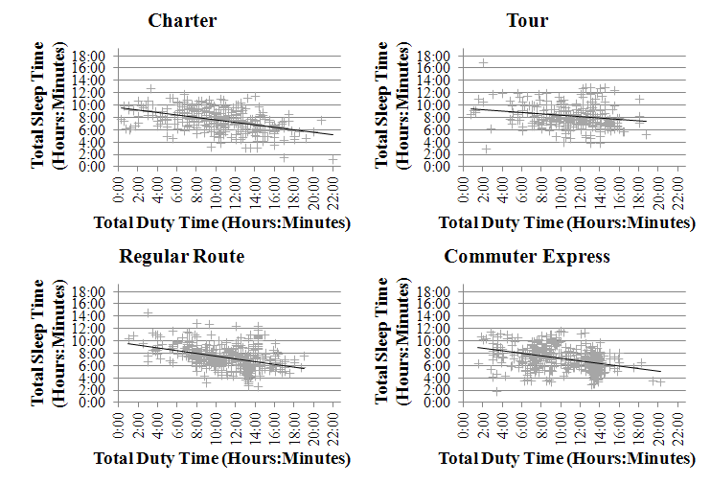
Correlation of On Duty Time by Duty Day with Total Sleep Time by Duty Day – By Type of Operation
Notes:
Charter – R = -0.462; F(1, 309) = 83.666, p = <0.001
Tour – R = -0.197; F(1, 284) = 11.496, p = <0.001
Regular Route – R = -0.408; F(1, 459) = 91.446, p = <0.001
Commuter Express – R = -0.397; F(1, 469) = 87.586, p = <0.001

Slide 27
Correlation of On Duty Time by Duty Day with Total Sleep Time by Duty Day by Driver - All
Notes:
All – R = -0.339; F(1, 76) = 9.847 , p = 0.002

Slide 28
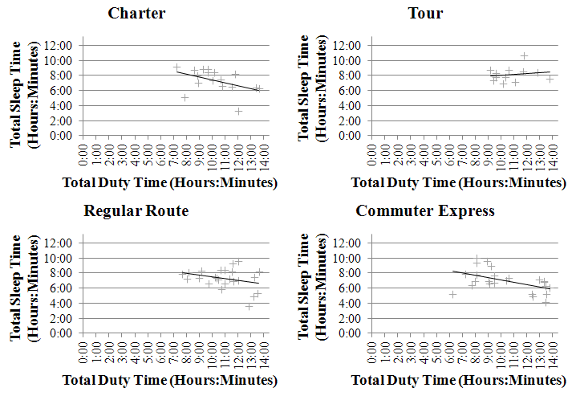
Correlation of On Duty Time by Duty Day with Total Sleep Time by Duty Day by Driver – By Type of Operation
Notes:
Charter – R = -0.442; F(1, 16) = 3.884, p = 0.066
Tour – R = -0.16; F(1, 10) = 0.262, p = 0.62
Regular Route – R = -0.306; F(1, 22) = 2.277, p = 0.146
Commuter Express – R = -0.499; F(1, 22) = 7.307, p = 0.013

Slide 29
Driver Subjective Fatigue at the Start and End of the Duty Day Measured using the Samn-Perelli Fatigue Scale - All
Notes:
All – START Mean = 2.199 STD = 0.783 END Mean = 3.857 STD = 1.014
T-test t= -14.628, p= <0.01

Slide 30
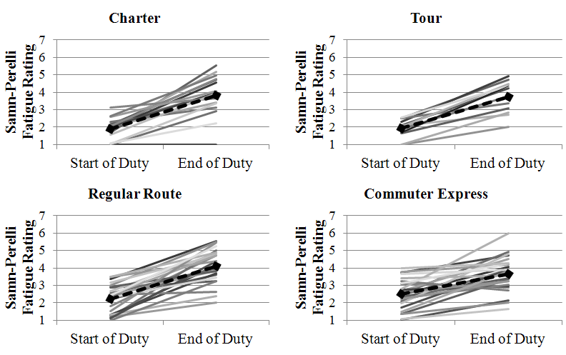
Driver Subjective Fatigue at the Start and End of the Duty Day Measured using the Samn-Perelli Fatigue Scale – By Type of Operation
Notes:
Charter – START Mean = 1.9 STD = 0.614 END Mean = 3.84 STD = 1.138
T-test t= -8.144, p= <0.01
Tour – START Mean = 1.932 STD = 0.528 END Mean = 3.739 STD = 0.92
T-test t= -9.147, p= <0.01
Regular Route – START Mean = 2.227 STD = 0.818 END Mean = 4.14 STD = 0.986
T-test t= -9.109, p= <0.01
Commuter Express – START Mean = 2.503 STD = 0.866 END Mean = 3.654 STD = 0.991
T-test t= -5.923, p= <0.01

Slide 31
Driver Subjective Sleepiness at the Start and end of the Duty Day Measured using the Karolinska Sleepiness Scale - All
Notes:
All – START Mean = 2.63 STD = 1.095 END Mean = 4.565 STD = 1.398
T-test t= -12.893, p= <0.01

Slide 32
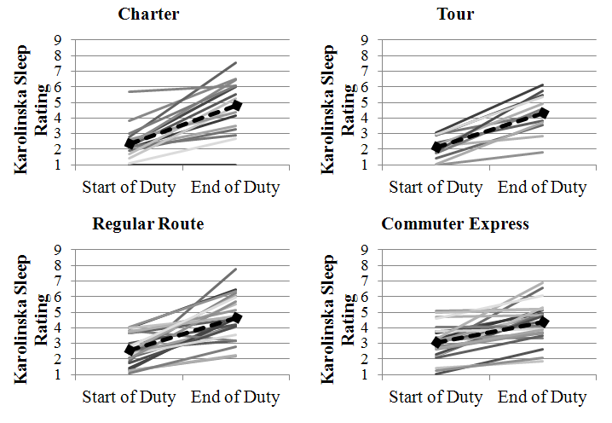
Driver Subjective Sleepiness at the Start and end of the Duty Day Measured using the Karolinska Sleepiness Scale – By Type of Operation
Notes:
Charter – START Mean = 2.388 STD = 1.095 END Mean = 4.827 STD = 1.719
T-test t= -7.164, p= <0.01
Tour – START Mean = 2.143 STD = 0.740 END Mean = 4.343 STD = 1.277
T-test t= -7.798, p= <0.01
Regular Route – START Mean = 2.568 STD = 0.989 END Mean = 4.681 STD = 1.415
T-test t= -7.247, p= <0.01
Commuter Express – START Mean = 3.088 STD = 1.101 END Mean = 4.383 STD = 1.231
T-test t= -5.774, p= <0.01

Slide 33
PVT

Slide 34
Summary of Findings
80 motorcoach drivers studied for ~30 days
Charter, Tour, Regular Route, Commuter Express
Start of duty in early to mid-morning
Duty day on average 10-11 hours
Worked an average of 40-50 hours/week
Slept an average of 7-8 hours on duty days and off duty days
Poorer performance and more fatigue and sleepiness at end of duty day compared to the beginning

Slide 35
Point of Contact
Gregory Belenky, M.D.
Research Professor and Director
Sleep and Performance Research Center
Washington State University
P.O. Box 1495
Spokane, WA 99210-1495
Phone: (509) 358-7738
FAX: (509) 358-7627
Email: belenky@wsu.edu

