Slide 1
FMCSA Medical Programs
Wellness Initiative
MRB/MCSAC Meeting
September 21-22, 2015
Pamela Perry RN, ACSM-CPT
Nurse Consultant
Medical Programs Division, FMCSA

Slide 2
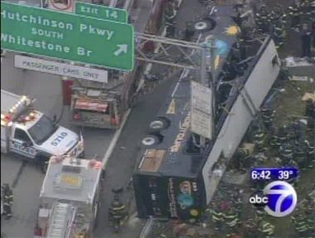
Mother’s Day Bus Crash – May 9, 1999

Slide 3
FMCSA Wellness page online
Quarterly updates
Includes a short health article (B/P, Pulse Oximetry, etc.)
Healthy eating tips
Recipe of the Month (easy to arrange with a truck kitchen)
Driver success story

Slide 4
Cooperative Initiative
Comprehensive Wellness initiative
Invites multiple stakeholders
Involves pulling together some of the industry Wellness Programs and evaluating what is working
Online page with links to a variety of options:
  Nutrition information
  Exercise opportunities for drivers
  Health evaluations and monitoring

Slide 5
Questions
Go to www.nationalregistry.fmcsa.dot.gov
or call(202)366-4001

