Slide 1
Federal Motor Carrier Safety Administration Intrastate Compatibility Overview

Slide 2
Statutory Requirement
As condition of MCSAP, States are required to have compatible intrastate regulations
To extent practicable, FMCSA must have intrastate tolerance guidelines that allow States flexibility while ensuring that allowable variances will not diminish safety
FMCSA has prescribed regulations for tolerance guidelines & intrastate compatibility standards in 49 CFR Part 350

Slide 3
Current Regulatory Guidelines
State laws must be identical to, or have the same effect as, the FMCSRs and be identical to the HMRs and be applicable to both interstate and intrastate transportation.
However, for intrastate transportation, certain limited variances, to the FMCSRs only (“Tolerance Guidelines”), are allowed (49 CFR 350.341):

Slide 4
Current Intrastate Tolerance Guidelines & Variances
A State may exempt intrastate CMVs under 26,001 lbs from any or all of its laws provided that the intrastate CMV is not used to:
Transport placardable amounts of Hazardous Materials, or
Transport 16 or more people, including the driver.
States may not grant exemptions based upon the type of transportation being performed (e.g., for-hire, private, etc.).

Slide 5
Intrastate Variances (cont.)
States may retain exemptions that apply to specific industries operating in intrastate commerce that were in effect before April, 1988 and remain in effect today unchanged.
States may not include exemptions based upon the distance a motor carrier or driver operates from the work reporting location.
This prohibition does not apply to those exemptions already contained in the FMCSRs nor to the extension of the mileage radius exemption contained in 49 CFR 395.1(e) from 100 to 150 miles.

Slide 6
Intrastate Variances (cont.)
Hours of service - State may allow intrastate operations to vary as follows:
(1) A 12-hour driving limit, provided driving a CMV after having been on duty more than 16 hours is prohibited.
(2) Driving prohibitions for drivers who have been on duty 70 hours in 7 consecutive days or 80 hours in 8 consecutive days.

Slide 7
Intrastate Variances (cont.)
Intrastate CMV drivers may be 18 years of age
States may provide grandfather clauses in their rules and regulations if such exemptions are uniform or in substantial harmony with the FMCSRs and provide an orderly transition to full regulatory adoption at a later date

Slide 8
Intrastate Variances (cont.)
Intrastate drivers who do not meet the interstate physical qualification standards may continue to be qualified to operate if the following three conditions are met:
(1) The driver was qualified under existing State law or regulation at the time the State adopted physical qualification standards compatible with the Federal standards in 49 CFR 391.41
(2) The otherwise non-qualifying medical or physical condition has not substantially worsened
(3) No other non-qualifying medical or physical condition has developed

Slide 9
Intrastate Variances (cont.)
The State may adopt or continue programs granting variances to intrastate drivers with medical or physical conditions that would otherwise be non-qualifying under the State's equivalent of 49 CFR 391.41 if the variances are based upon sound medical judgment combined with appropriate performance standards ensuring no adverse affect on safety.

Slide 10
Intrastate Variances (cont.)
The State may decide not to adopt laws and regulations that implement a registry of medical examiners trained and qualified to apply physical qualification standards or variances continued in effect or adopted by the State that apply to drivers of CMVs in intrastate commerce.

Slide 11
Other FMCSA Regulations
350.331(d) - As soon as practical after the effective date of any newly enacted regulation or amendment to the FMCSRs or HMRs, but no later than three years after that date, the State must amend its laws or regulations to make them compatible with the FMCSRs and/or HMRs, as amended.

Slide 12
MAP-21 – Agricultural Exemptions
To remain MCSAP-eligible, States have up to 3 years to adopt the amended regulations published in the March 14, 2013 Federal Register Notice for both inter and intrastate operations
States must exempt Covered Farm Vehicle operators from drug/alcohol testing requirements (this is a Federal preemption)

Slide 13
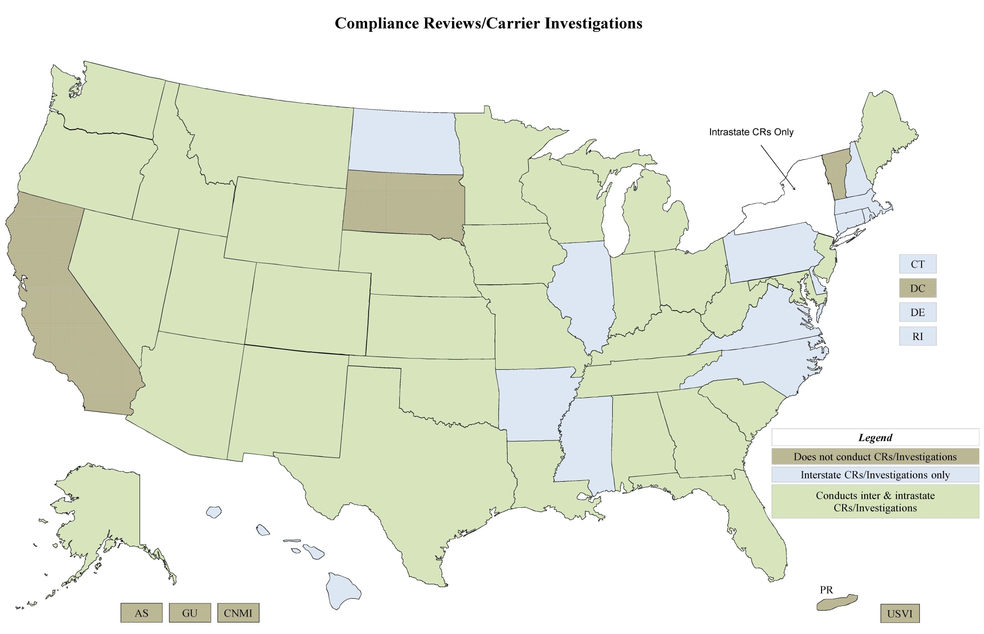

Slide 14
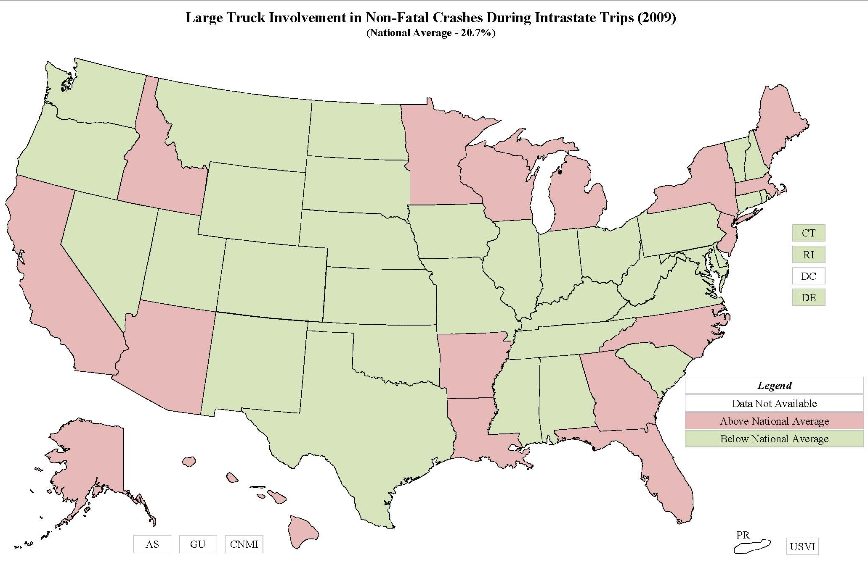

Slide 15
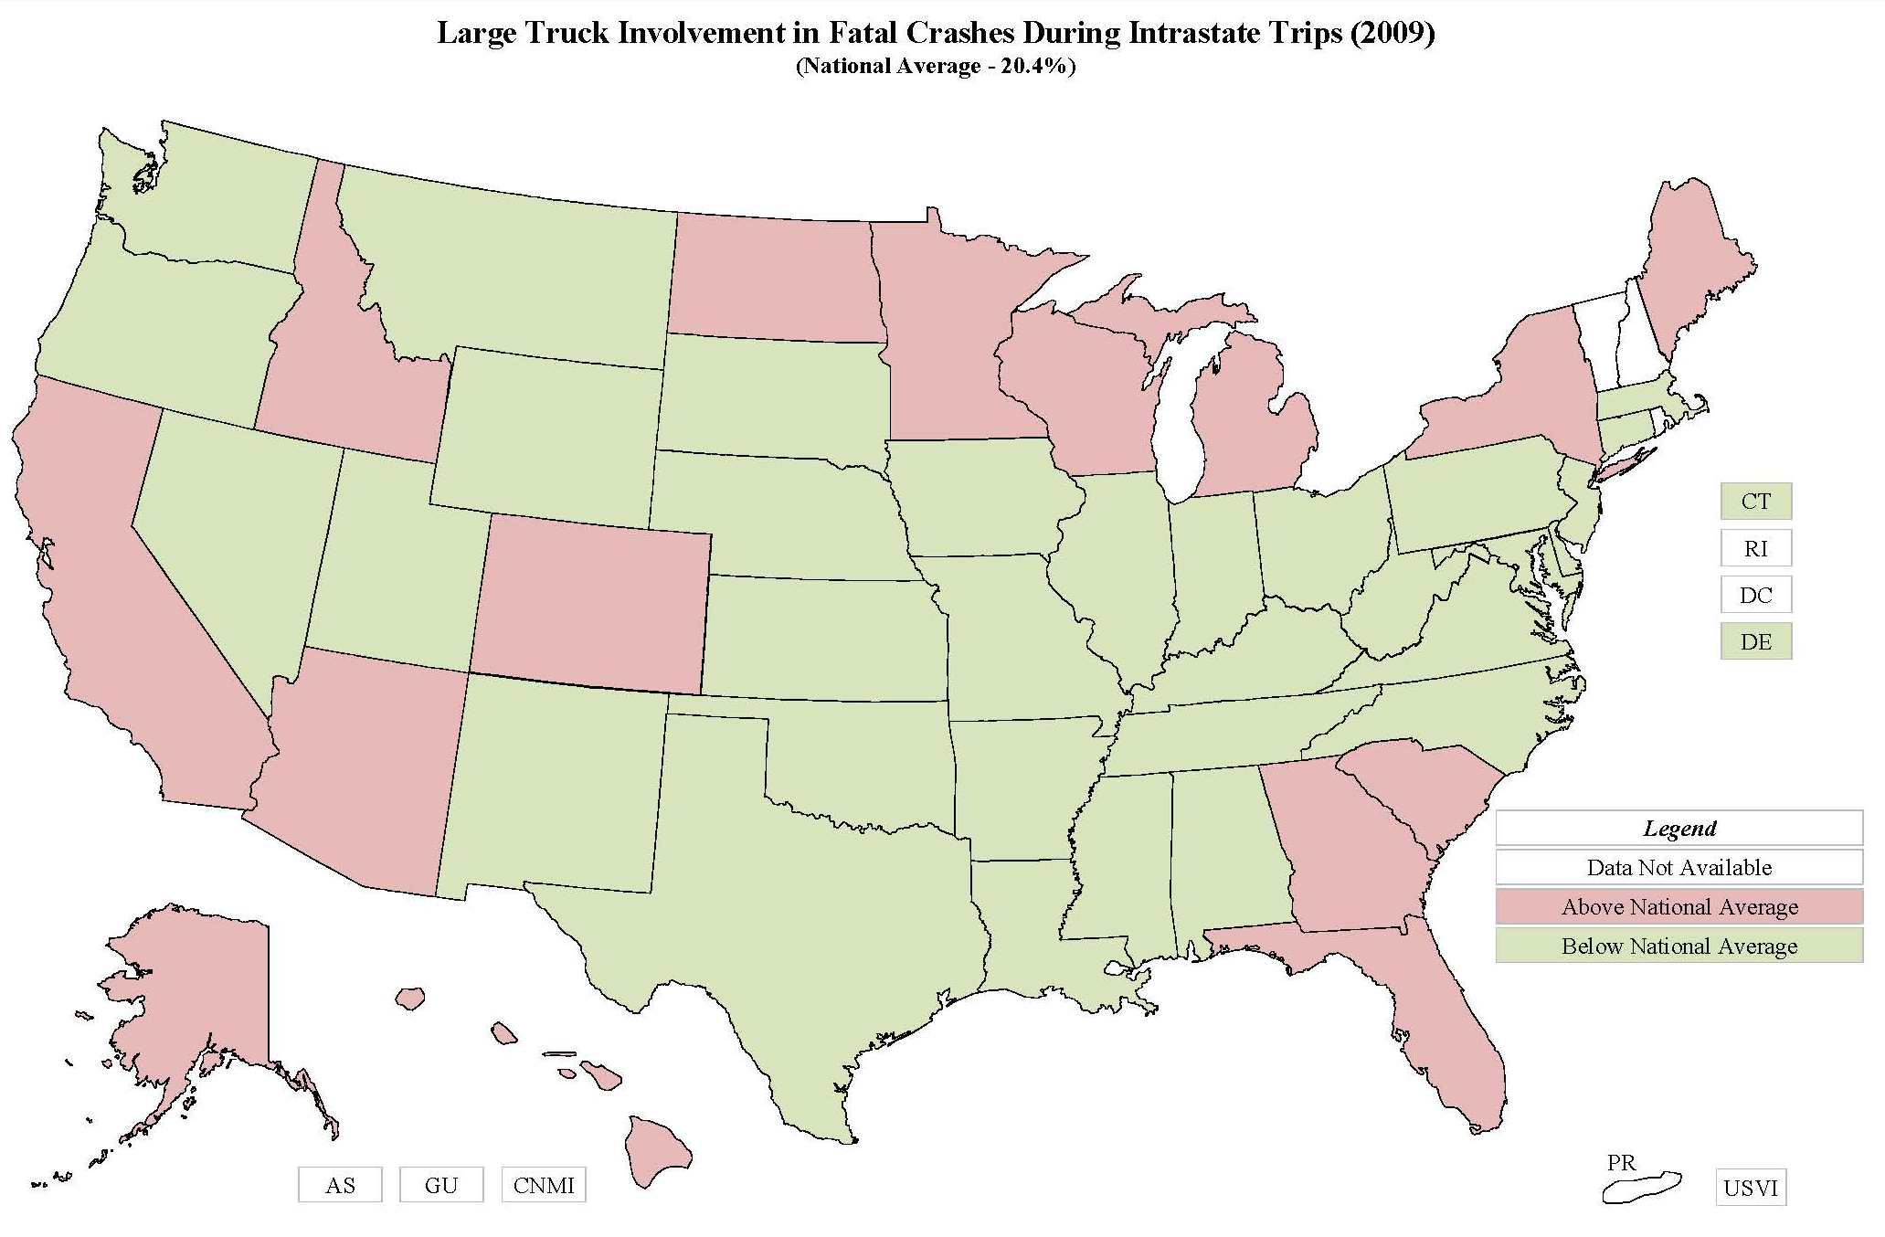

Slide 16
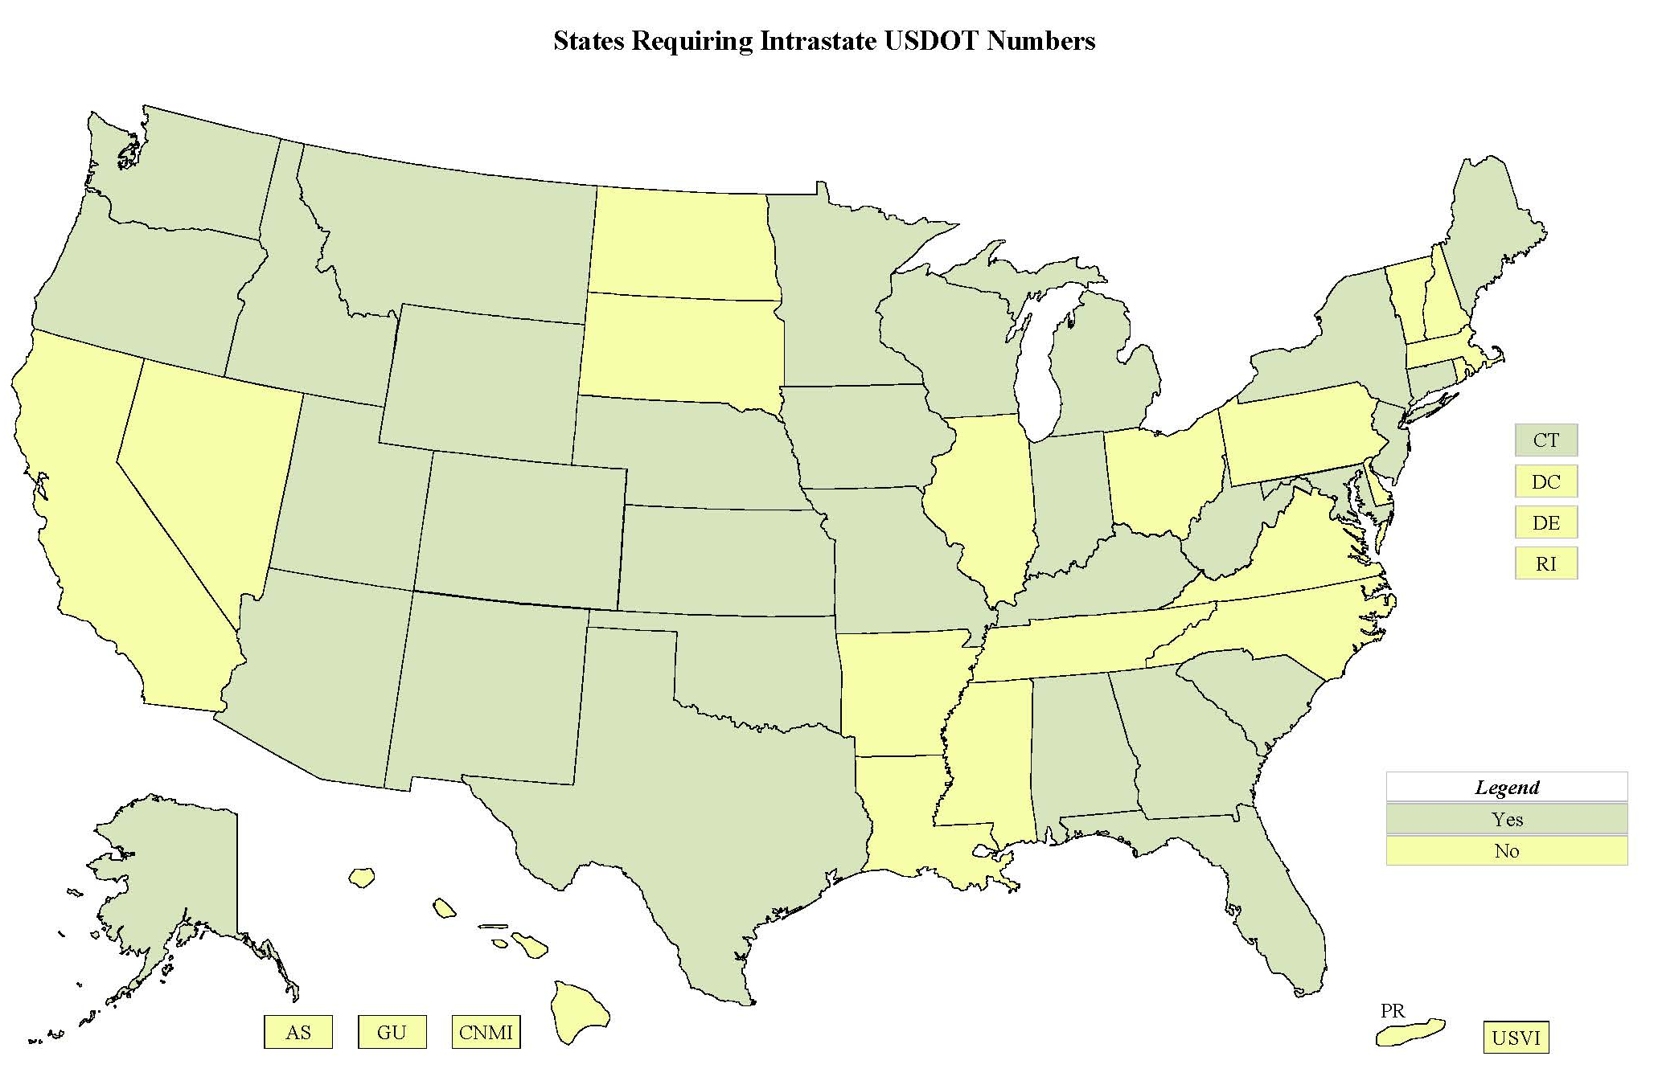

Slide 17
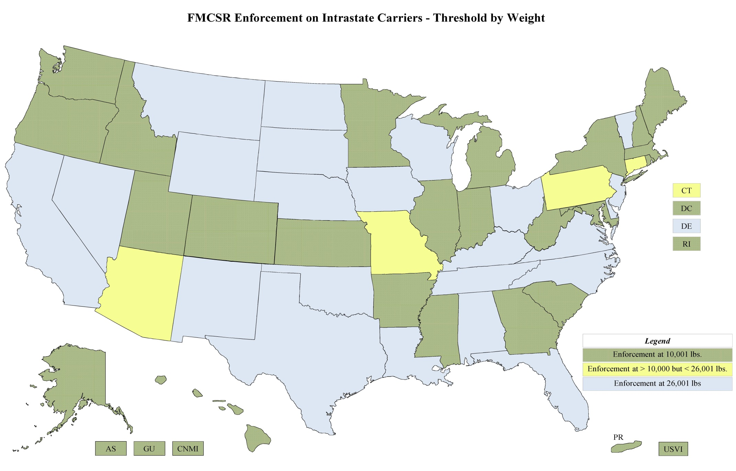

Slide 18
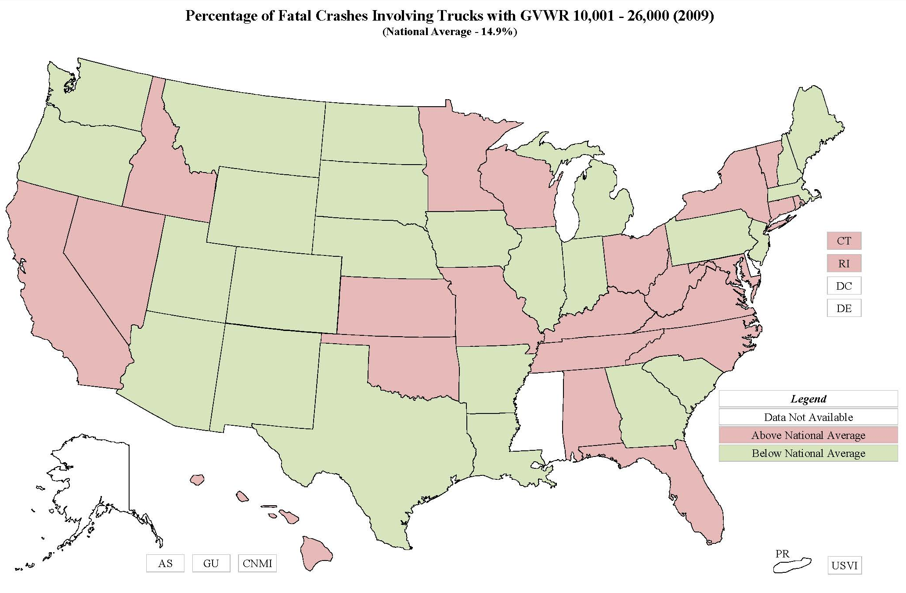

Slide 19
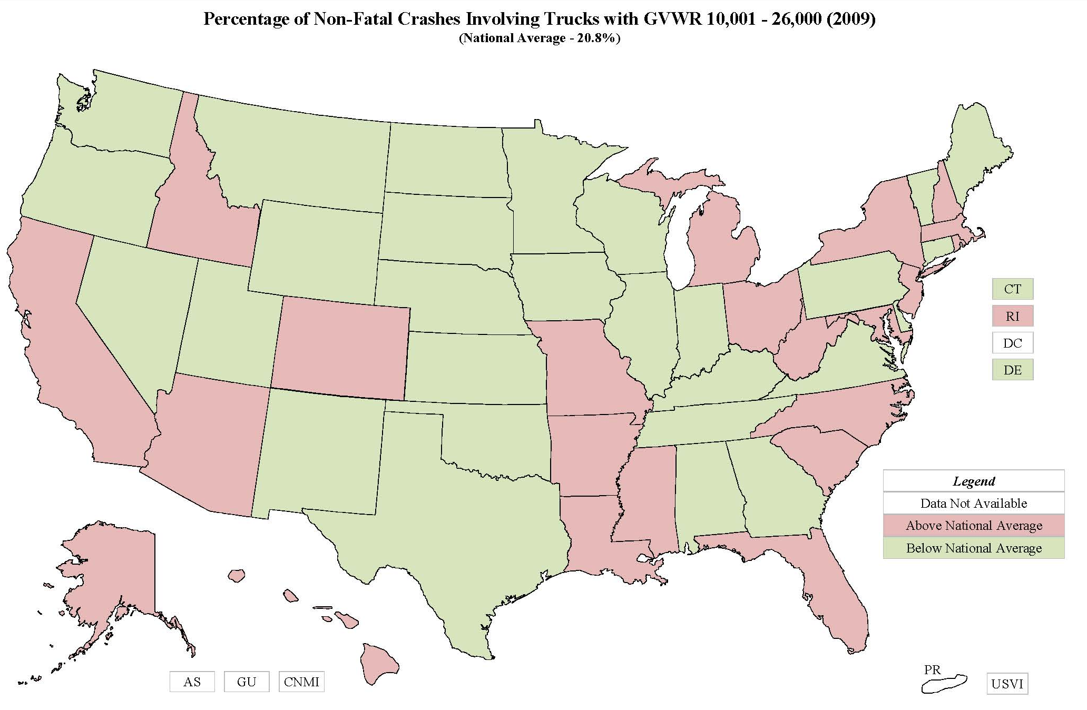

Slide 20
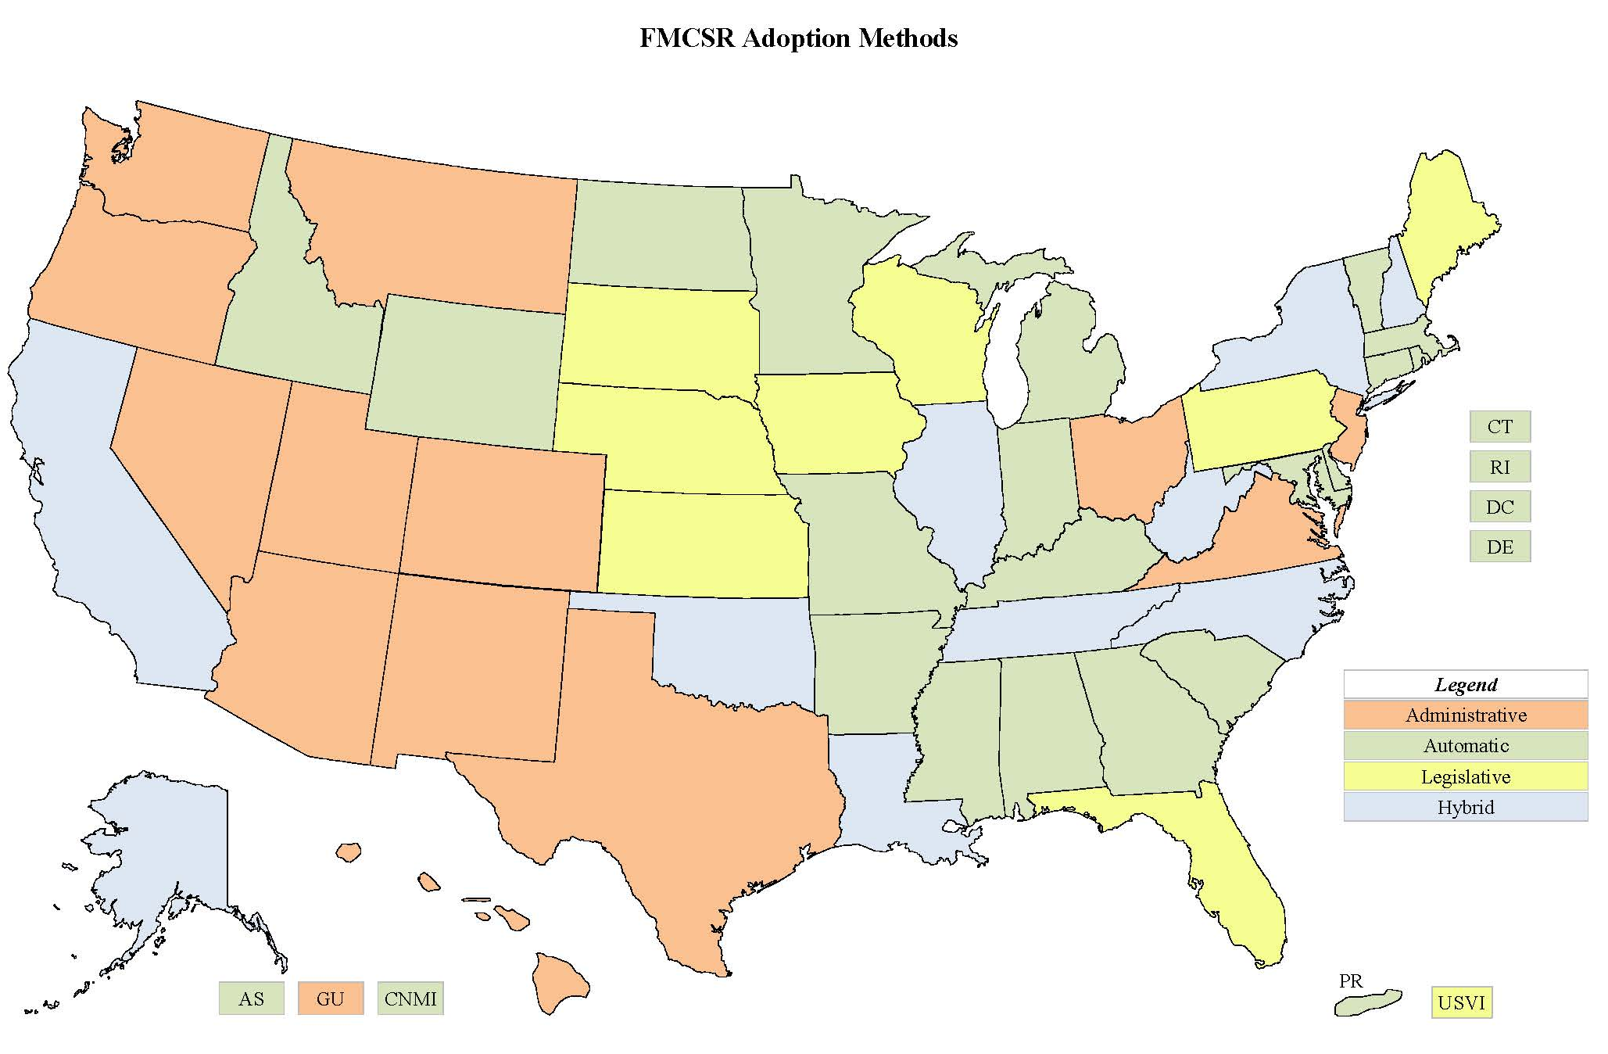

Slide 21
