Slide 1
Compliance, Safety, Accountability
Update to MCSAC
October 28, 2014

Slide 2
AGENDA
CSA Overview
Elements
Impacts
Study
SMS Display Enhancements
Adjudicated Citations
Continuous Improvement
CSA Phase 3

Slide 3
CSA Overview: Three Major Elements
Safety Measurement System (SMS)
Uses roadside inspection and investigation data to proactively identify high risk motor carriers for prioritization of interventions
Intervention Tools
Matches the most appropriate intervention to the specific safety problem at hand. Broad and progressive array of tools – warning letters, focused onsite/offsite investigations, compliance reviews
Safety Fitness Determination (SFD) Process
Will incorporate on-road performance and changes the standards for being found unfit through investigations (not based on SMS percentiles)

Slide 4
Safety Measurement System (SMS)
Uses Behavioral Analysis and Safety Improvement Categories (BASICs) to prioritize “high-risk” carriers per Congressional mandate:
Unsafe Driving
Hours-of-Service (HOS) Compliance
Driver Fitness
Controlled Substance/Alcohol
Vehicle Maintenance
Hazardous Materials Compliance (not publicly available)
Crash Indicator (not publicly available)
Status: Fully implemented December 2010 and subsequently enhanced December 2012 and August 2014, Ongoing Continuous Improvement

Slide 5
Intervention Tools
CSA utilizes an array and progressive set of interventions to promote safety and compliance:
Reaches more carriers
Improves efficiency of resources
Identifies root causes and corrective actions
Status:
Deployed Nationally: December 2010 through July 2011 – Automated Warning Letters, Comprehensive and Focused On-site Investigations, Safety Management Cycle
Deployed only in Original Test States: Offsite Investigations, Cooperative Safety Plans, Serious Violation Follow-up

Slide 6
Safety Fitness Determination (SFD) Process
Current SFD Ratings:
Tied to onsite investigations
Revised SFD Process:
Incorporate on-road safety performance as well as results of investigations
Produce an SFD to determine if a carrier is unfit to operate
Status:
NPRM 2015

Slide 7
CSA Impacts
Dramatic decreases in violation rates in a decade:
Annual roadside inspection violation rates have dropped 15% since December 2010
As of December 2013, FMCSA sent more than 90,000 warning letters
“SMS Online” hosted 68 million user sessions last year
Seventeen fold increase over SafeStat
Safety Culture has moved to the Boardroom

Slide 8
FMCSA 2014 SMS Effectiveness Study
SMS is a significant improvement over previous prioritization system
The carrier population identified by FMCSA as “High Risk” has more than twice the national average crash rate
SMS is prioritizing carriers with higher crash rates (79% higher) than active carriers not prioritized
Optimizes resources and oversight with more stringent intervention thresholds for BASICs with strongest associations to crash risk

Slide 9
SMS Display Enhancements
SMS display changes were launched on August 4, 2014.
Objectives:
Provide easier, more intuitive navigation and user-friendly features to clarify SMS as a prioritization tool for CSA Interventions
Provide a “one-stop-shop” for FMCSA safety information: incorporates Safety Rating, Licensing and Insurance, Penalties History
Retain and provide easy access to detailed information and improved performance monitoring tools

Slide 10
SMS Display Enhancements:
Notable Changes
Focuses on a carrier's individual performance measures (absolute) in lieu of relative percentiles.
Emphasizes a summary BASIC status, in lieu of relative percentiles.
Creates a centralized location for carrier information, safety ratings, insurance and operating authority status, and enforcement case history.
Acknowledges distinctions between BASICS and crash involvement by incorporating BASIC Status to Crash Rate Graphs.
Allows users to view and download the data for all carriers in same safety event group used to rank a motor carrier's BASIC percentile.
Provides carrier and driver Out-of-Service (OOS) rates and national averages.

Slide 11
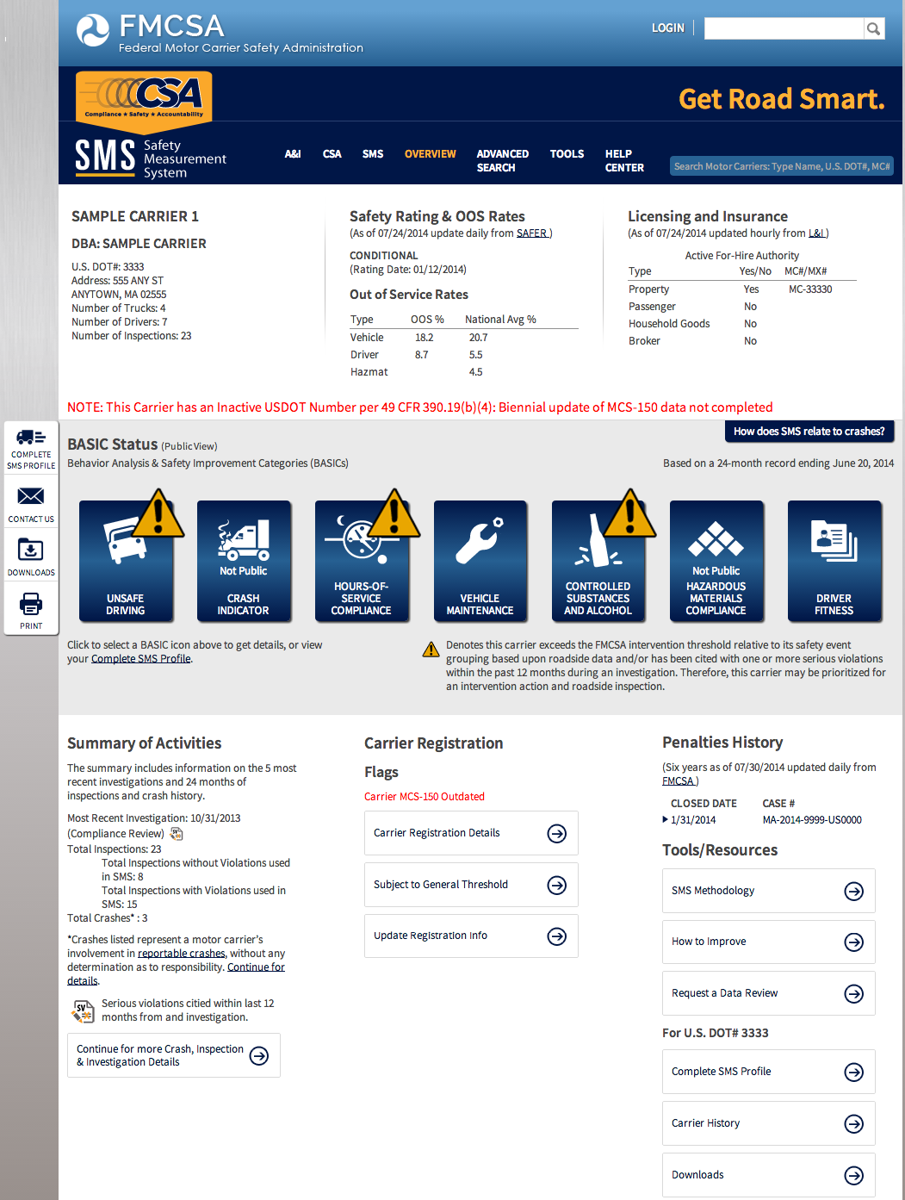

Slide 12
Adjudicated Citations: How the New Policy Works (effective August 23, 2014)
Adjudicated citation results will appear in SMS and PSP as follows:
Result of Adjudicated Citation Associated with a Violation | SMS | PSP
Dismissed without a fine or not guilty | Violation removed | Violation removed
Conviction of a different charge | Violation indicated as conviction of a different charge; SMS severity weight reduced to 1 | Violation indicated as conviction of a different charge
Conviction or dismissed with a fine | Violation retained | Violation retained
Carriers logged in to Portal or SMS will be able to see all of the violations listed on an inspection and associated adjudicated citation results.

Slide 13
Continuous Improvement (CI)
Assess CSA prioritization and intervention processes and recommend improvements to ensure the program’s continued effectiveness and efficiency.
What have we learned since CSA was rolled out in 2010?
Apply what we’ve learned to:
Improve the program’s safety effectiveness
Meet Congressional mandates, as well as Agency goals and commitments
Ensure successful CSA Phase 3 rollout (see slide 15)

Slide 14
CI Working Group (CIWG) Scope and Timeline
CSA Prioritization and Intervention
Assess current guiding principles, policies, and implementation practices
Determine what is and what is not working and make recommendations
Interventions Activities
Field Interviews and Surveys
CVSA Listening Session
Prioritization Analysis
Mandatory Carriers
Prioritization display
Use of Warning Letters
Timeline
May 2014: Kick-Off
February 2015: Recommendations

Slide 15
CSA Phase 3 Planning
What is CSA Phase 3?
Nationwide deployment of the interventions suite to include Offsites, Cooperative Safety Plans, and Serious Violation Follow-up
Includes new IT system (SENTRI) to support these CSA processes
Tentative Status and Plan
IT system delivery (expected end of 2015)
Training conducted (early 2016)
Internal/External Communications (throughout 2015)

