Slide 1
Motor Carrier Safety Advisory Committee Meeting
FMCSA Research Portfolio
June 2015

Slide 2
Presentation Overview
FMCSA’s Safety Research and Technology (R&T) Program.
Produce Safe Drivers.
Support Safe Carrier Operations.
Assess Safety Technologies.
Future Research Areas.

Slide 3
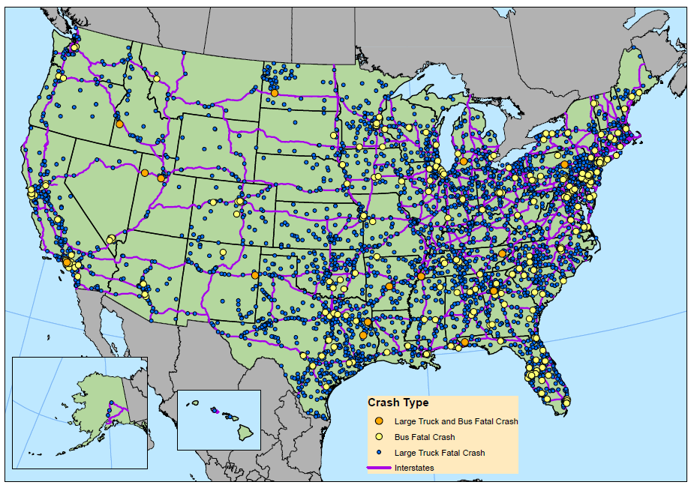
Large Truck and Bus Fatal Crashes, 2013
Source: National Highway Traffic Safety Administration (NHTSA), Fatality Analysis Reporting System (FARS).

Slide 4
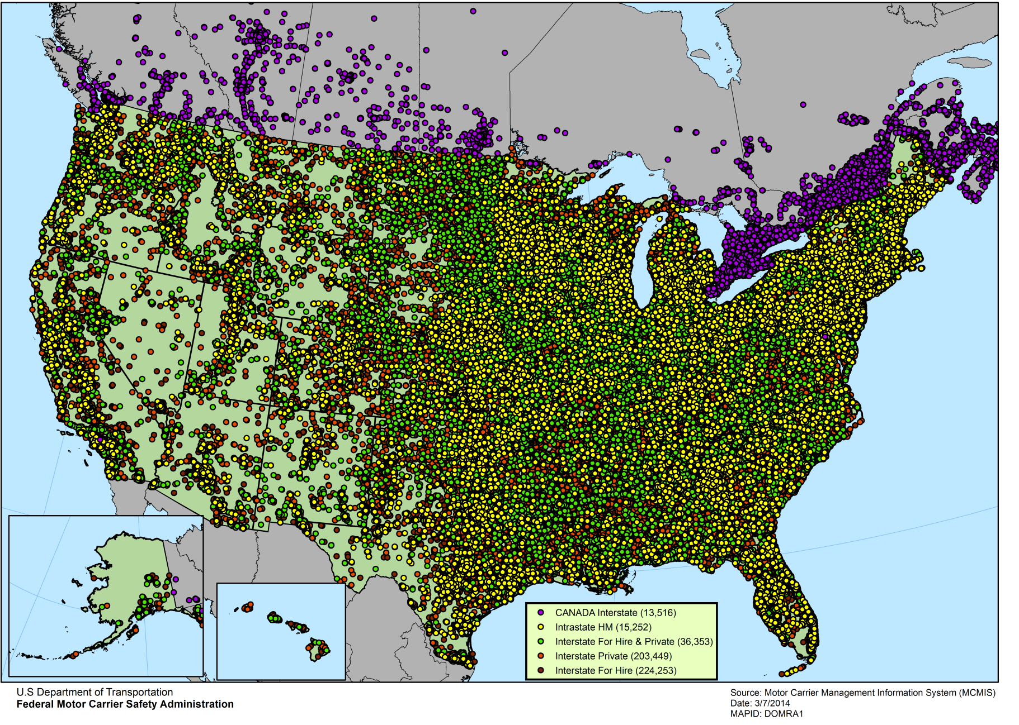
Locations of Carriers by Domicile, 2013

Slide 5
FMCSA Research and Technology Goals
Understand the causes of crashes.
Reduce driver fatigue.
Improve driver training.
Provide analysis for Agency rulemaking.
Identify best practices for the trucking and motorcoach industry.
Assess technology and innovative tools to improve safety.

Slide 6
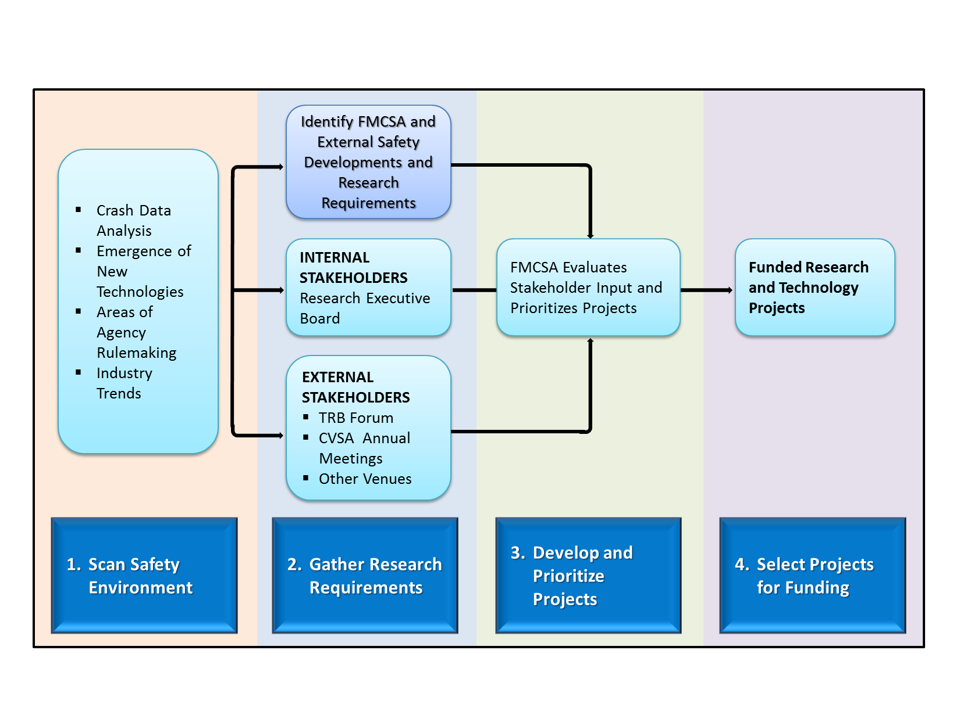
R&T Project Development Process

Slide 7
Strategic Research Areas
Produce Safer Drivers.
Support Safe Carrier Operations.
Assess Safety Technologies.

Slide 8
1. Produce Safe Drivers
Naturalistic driving studies.
Driver health.
Sleep and driver fatigue.

Slide 9
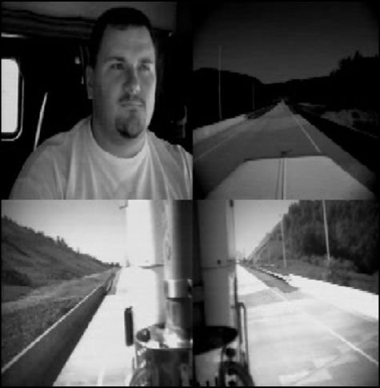
Naturalistic Driving Studies
Provides in-vehicle, real-time objective video identifying driver performance and crash precursors.
Truck cab equipped with video cameras to provide view of driver’s face, forward view, and two side mirror views.
Data provides better understanding of precursors to crashes and driver performance, inattention, distraction,
and fatigue.
Potential causes of crashes and potential countermeasures.
The four camera views.

Slide 10
CMV Driver Restart Study

Slide 11
CMV Driver Restart Study – Background
Background:
The Consolidated and Further Continuing Appropriations Act of 2015 directed FMCSA to conduct a CMV Driver Restart Study.
Study to measure and compare the fatigue and safety performance levels of drivers who use the two provisions of the HOS rule.
Driver recruitment is completed, and data collection is underway.

Slide 12
CMV Driver Restart Study – Overview
Compare driver work schedules to assess safety critical events, operator fatigue, and driver health using:
Electronic Logging Devices (ELDs).
Psychomotor Vigilance Tasks (PVTs):
A PVT is a reaction test (administered via a smartphone) which measures alertness.
Actigraph Watches:
Actigraph watches are devices that are worn on the wrist. These devices monitor drivers’ sleep patterns and sometimes other health measures, such as heart rate.
Onboard Monitoring Systems (OBMSs).
Study includes drivers from fleets of all sizes (small, medium, and large) and operations (including long-haul, regional, and short-haul) in various sectors of the industry (including flat-bed, refrigerated, tank, and dry-van).

Slide 13
Flexible Sleeper Berth Pilot Program
Photo Credit: Rennett Stowe (Flickr)

Slide 14
Flexible Sleeper Berth Pilot Program
Background:
Study results suggest that split sleep is preferable to consolidated daytime sleep (if consolidated nighttime sleep is not an option).
FMCSA is establishing a Flexible Sleeper Berth Pilot Program, as specified in 49 CFR Section 381.400. This Pilot Program will:
Allow the Agency to evaluate alternatives to the regulations, ensuring that safety goals are satisfied.
Provide temporary regulatory relief from the sleeper berth provision for participants, allowing some flexibility for drivers to split sleep when tired.
Status: Pilot Program is scheduled to begin later in 2015.

Slide 15
2. Support Safe Carrier Operations
Driver Detention Times.
Onboard Monitoring Systems (OMBS).

Slide 16
Driver Detention Times Study: Phases I and II
Goal: To better understand issues with driver detention and to develop strategies to help mitigate driver risk.
Approximately 4 percent of drivers reported that they had driven beyond the legal hours of service (HOS) limits due to detention time.
Carriers reported that approximately 12 percent of deliveries experienced some detention time.
Two Phases:
Phase 1: Methodology developed . Final report published on FMCSA website.
Phase 2: Evaluate the safety and operational impacts of driver detention time on work hours, HOS, violations, and crashes.

Slide 17
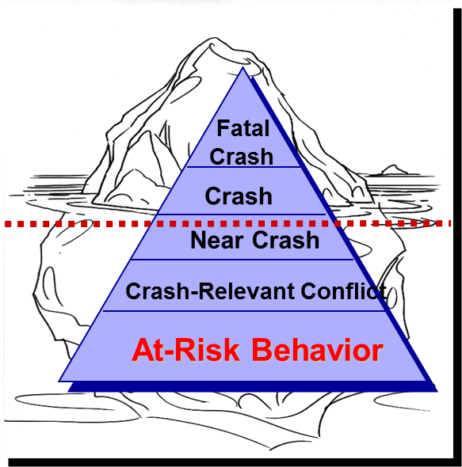
OBMS Systems Research
Goal: To determine whether onboard monitoring of driver performance and feedback (real-time and delayed) can improve driver behavior and CMV safety.

Slide 18
OBMS Data Acquisition System

Slide 19
3. Assess Safety Technologies
Advanced Roadside Inspection Technology.
Wireless Roadside Inspection (WRI).
International Border Crossing e-Screening (IBCE).
Alternative fuels.
Onboard safety systems.
Vehicle Automation.
Autonomous CMV vehicles.
Low speed seaport application.
Wireless Automatic Braking Systems (ABS) Assessment.
Electronic Logging Device (ELD) Test Procedures.

Slide 20
WRI – Overview
Assessment:
Fixed and mobile sites, of driver, carrier, and vehicle compliance via secure wireless communications while the CMV is traveling.
Phase 3 – Field Operational Test:
Maximum of 1,000 vehicles.
Multiple fleets.
Testing in Commercial Motor Vehicle Roadside Technology Consortium (CMVRTC) States: Georgia, Kentucky, Mississippi, North Carolina, and Tennessee.
20 inspection sites identified for data collection.

Slide 21
WRI – Impacts on Compliance, Safety, Accountability
Behavior Analysis and Safety
Improvement Categories (BASICs)
WRI can likely have an effect on two of the BASICs
HOS
Compliance
Unsafe
Driving
Crash
Indicator
Driver Fitness
SMS
HM
Compliance
Controlled
Substances/
Alcohol
Vehicle
Maintenance

Slide 22
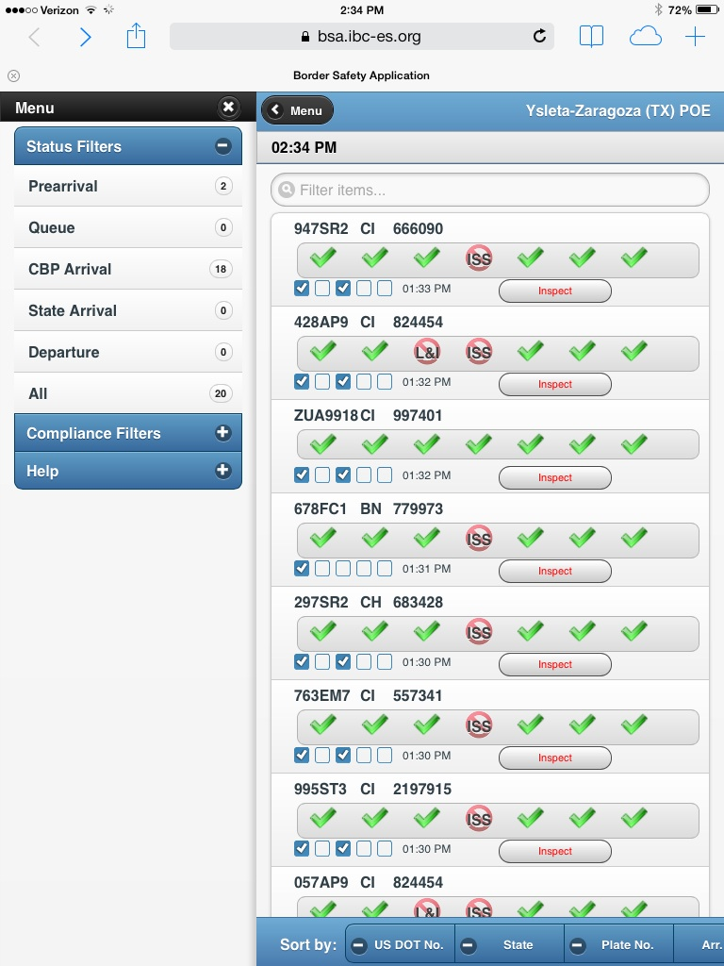
IBCES Functionality
Secure, cloud-based e-Screening delivers safety clearance checks directly to roaming inspectors on handheld tablets.
Application shows arriving trucks, their identification, and their clearance check results.
Secure, Web-based application supports scrolling, filtering and sorting of results.

Slide 23
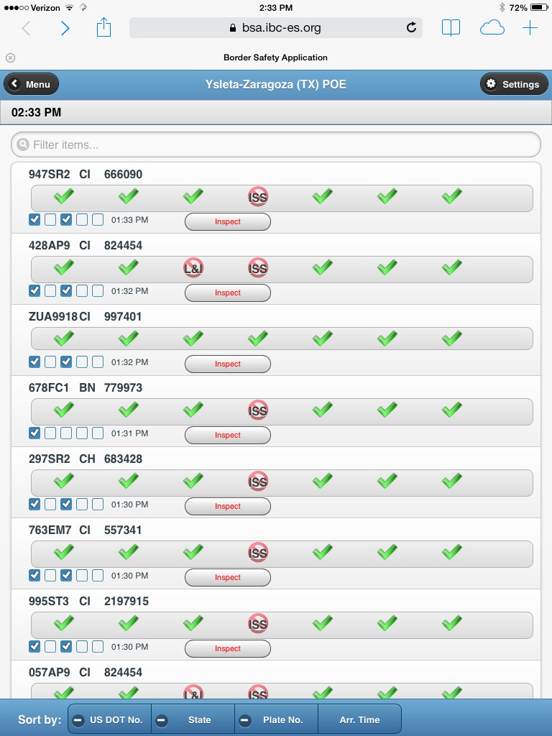
BSA Inspector Interface Field Test Version
Report for Each Arriving Tractor Identified by CBP
License Plate and USDOT Number Identification
E-Screening Clearance Checks
Three Phases
Check Mark– Pass
Strikethrough – No data available
“Universal No” Symbol - Fail
Carrier
OA - U.S. Operating Authority
OOS - Out of Service
L&I - Insurance
ISS - Safety score
Tractor
CVSA – Current CVSA decal
Driver
CDL – Current CDL or equiv.
HZ - HAZMAT endorsements

Slide 24
Alternative Fuels: Program Overview
Hydrogen (H2)
Piloted safety awareness training for drivers of electric-battery drayage trucks with H2 fuel-cell range extender at Long Beach Community College, 07/2013 .
Natural Gas
Published recommendations for FMCSRs, North American Standard (NAS) Inspection Procedures, and Out-Of-Service (OOS) Criteria in 05/2015.
Piloted a training class for inspectors to detect leaks in trucks in 09/2014; web-based training to be posted.
Electric & Hybrid-Electric
Final Report to recommend updates for FMCSRs, NAS Inspection Procedures, and OOS Criteria.
Plan to develop training for inspectors to check for high-voltage hazards.

Slide 25
Vehicle Automation – Autonomous CMV Vehicles
Goal: To better understand the impacts that autonomous vehicles will have on Federal regulations and safety.
Develop a research roadmap to encourage technology and to identify impacted Federal Motor Carrier Safety Regulations (FMCSRs).
Background: Autonomous vehicles could greatly improve CMV safety by reducing driver error and reducing congestion by moving trucks to off-peak periods.

Slide 26
Low Speed Automated Truck Queue at Ports and Warehouses
Goal: To evaluate the cost/benefit of automated truck movement in queues at ports and warehouses.
Technology scan of existing or near-term enabling technologies, cost estimation, and safety benefits.
Feasibility Study of automated truck movement at ports and warehouses allowing drivers to be "off-duty" while waiting for loading and unloading.
Background: Drivers in CMVs waiting in line or queues for unloading and loading at port terminals and warehouses are in "on-duty" driving status and therefore can incur productivity losses.

Slide 27
Wireless ABS Assessment
Goal: To develop a cost effective diagnostic tool for enforcement personnel to diagnose and enforce proper operation of the anti-lock braking system (ABS).
Laboratory and field tests will be conducted to verify the device functionality.
Background: Vehicle safety systems that build off the ABS technology, such as electronic stability control (ESC), rollover prevention, and automated braking are being installed on new CMVs. ESC functionality can become part of FMCSA vehicle safety regulations and inspections. Safety inspectors will need a method to simply and quickly identify any negative issues with these systems.

Slide 28
ELD Compliance Test Procedures
Goal: To develop compliance test procedures for ELD testing with respect to the functional specifications specified in the Supplemental Notice of Proposed Rulemaking (SNPRM).
Developing a training manual and test procedure to be used to verify ELD functionality.
Developing a verification process to ensure that the test procedures are sufficient to evaluate ELDs.
Background: SNPRM requires motor carries subject to record of duty status preparation requirements to use ELDs.

Slide 29
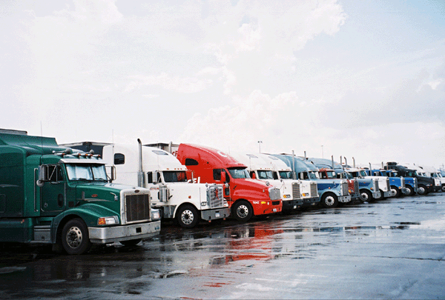
Future R&T Project Areas

Slide 30
Produce Safe Drivers
Longitudinal Study of CMV Driver Health.
Active Seat Suspension Effects on Operator Health and Highway Safety.
CMV and Personal Vehicle Crash Analysis.
Effects of Driver Fatigue Based on Length of Time Away from Home.

Slide 31
Enforcement Technologies
Mobile Application Development.
National Data Fusion Center.
Effectiveness of Weigh Station Pre-Clearance/E-screening Systems.
Second Generation Performance Brake Testing (PBT).

Slide 32
Assessing Safety Systems Using New Technologies
Hydraulic-Hybrid Commercial Vehicle Safety.
ELD Business Case Analysis for Early Adoption.
ELD Deployment Analysis.
Linking ELDs to Truck Parking.
Sideguards on Trucks to Reduce Pedestrian Fatalities.
Dynamic Onboard Brake Assessment Technology.

Slide 33
Thank You
Dr. Steven K. Smith
Analysis, Research, and Technology
Federal Motor Carrier Safety Administration
steven.k.smith@dot.gov

