Slide 1
It’s Time to Adjust Federal Minimum Insurance Levels
Notes:
The current federally-mandated minimum insurance limit of $750,000 for commercial motor vehicles was first introduced in the 1980 Motor Carrier Act. It was initially phased-in at $500,000 and fully implemented at the current level on January 1, 1985. It’s time to adjust the minimum levels to account for inflation. Adjusting for increased medical costs, the 2014 equivalent is at least $3,188,000.
Many catastrophically-injured victims of truck crashes end up on Medicaid, Medicare, Tricare or other government aid when the truck company does not have sufficient insurance to pay for the harm it caused.

Slide 2
Extrapolating 1935-1980 Financial Minimum Increase
Notes:
Commercial vehicle insurance minimums were $5,000 in 1935. It took until 1980 to vote to raise the minimum limit to $750,000. A similar increase (150x) in the current limits would result in insurance minimum limits of $112,500,000. Many large carriers already have insurance in this amount or more.
It is basic economics that all prices must eventually be adjusted for inflation. The time has passed to adjust the minimum insurance limits for inflation.

Slide 3
How Much for Equivalent Medical Care?
$750,000
1985
$4,422,000
2014
U.S. Bureau of Labor Statistics
Notes:
In 1980 dollars (the year $750,000 was first voted), the adjustment to present day dollars using the Medical Consumer Price Index is $4.42 million.

Slide 4
How Much for Equivalent Medical Care?
$750,000
1985
$3,188,000
2014
U.S. Bureau of Labor Statistics
Notes:
It takes $3.188 million dollars today to buy what $750,000 could purchase in 1985 (the year when the current financial minimum requirements for commercial motor vehicles was fully phased-in.)

Slide 5
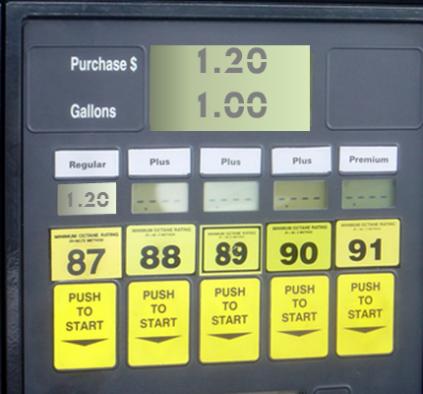
1985
U.S. Energy Information Administration
Notes:
Inflation is obvious when we look back. In 1985, the cost for a gallon of gas, was around $1.20.

Slide 6
1985
Dow Jones
Industrial Average
1,546
Notes:
In 1985, the Dow Jones rose from 1200 to 1546 (yes, fifteen hundred; not thousand.)

Slide 7
45 years of salary
1985
$16,822
2012
17 years of salary
$44,321
Social Security Administration
U.S. Bureau of Labor Statistics
Notes:
In 1985, $750,000 of insurance coverage would pay for 45 years of salary, using the national average wage index when a person was killed in a large truck crash. Today, the same minimums, which have not been adjusted for inflation, will only pay for 17 years of salary to the family of the deceased. This assumes no last medical expenses before death.

Slide 8
2013 MCMIS Large Truck Fatalities by Age Group
FMCSA Analysis & Information Online
Notes:
Reviewing large truck crash fatalities by age, it is clear that the current minimum insurance limits are not sufficient to compensate the family of the person killed for the lost income to the household, not including any bills for last medical expenses and other losses.

Slide 9
Nursing Home
$4.4 Million
Assisted Living
$2.4 Million
Notes:
Based on an average nursing home cost of $77,000 annually for a semi-private room in a nursing home and $42,000 annually for an assisted care facility, a catastrophically injured 20 year old requires $4,400,000 for semi-private nursing home (NH) care or $2,400,000 for an assisted living facility (ALF), assuming she will live to a life expectancy age of 77. This does not include the cost of any doctor’s care, hospital visits, surgeries or durable medical equipment. It has also not been increased for future health care cost inflation.
Life expectancy source: Social Security Administration
Cost source: Genworth 2014 Cost of Care Survey of 10,000 ALFs and NHs

Slide 10
Typical Elements of a Life Care Plan
Medication
Skilled care
Therapy services
Future surgeries
Home modifications
Household replacement services
Medical equipment and supplies
Psychological services/counseling
Notes:
Life care plans can help measure the financial needs of catastrophically injured victims who need future medical care.

Slide 11
Life Care Plan
Cost of care $2,979,000 to $11,008,000
$102,000 to $379,000/year x 29 years
Medications $591,000 $20,400/year x 29 years
Equipment $313,000 $10,800/year x 29 years
Supplies $696,000
$24,000/year x 29 years
Therapy $696,000
$24,000/year x 29 years
Medical services $232,000
$8,000/year x 29 years
$5,500,000 to $13,500,000
Notes:
Some of the financial cost of taking care of the victims of truck crashes can be calculated in a life care plan. Some illustrative life care plans follow.
This 28 year old Minnesota woman worked as an account manager for a large lending institution. She suffered severe brain damage in 2010 when a truck lost control and went across all lanes of traffic. This young mother remains in a semi-vegetative state. The trucking company had a $1 million insurance policy. The woman is now on Medicaid.

Slide 12
Life Care Plan
One Time Cost $328,000 to $347,000
Recurring Costs $2,454,000 to $3,114,000
Foot Surgery $10,000
Therapy:
Occupational $103,000 to $463,000
Speech $75,000 to $338,000
Cognitive $101,000 to $458,000
CT Scan $21,000
MRI $35,000
$3,130,000 to $4,798,000
Notes:
A tractor trailer crossed the median of the road and head-on hit this young father. He suffers orthopedic and brain injuries. He will have recurring prescription and home health care costs, in addition to future surgeries, occupations, speech and cognitive therapies.

Slide 13
Life Care Plan
Medical Care $1,224,000
Medical Equipment $159,000
Prosthetic Care $8,868,000
Home Modifications $181,000
Miscellaneous $667,000
Medication $226,000
Support Care $3,233,000
$14,560,000
Notes:
A tractor trailer cut this man’s legs off above the knees when it ran off road and crushed him between a disabled vehicle and his tow truck. He receives support care such as physical therapy to strengthen the portion of limbs remaining in the hope that he will be able to get out of his wheelchair and walk at least some distance in the future. Medical care includes regular doctor visits to address phantom pain in his feet, and pain in his stumps that keep him from sleeping through the night.

Slide 14
Life Care Plan
Respite Assistance $496,000
Attendant Care $7,229,000
Medical Expenses $1,386,000
$9,112,000
Notes:
A Florida tractor trailer driver encountered snow for the first time while driving down a hill in Pennsylvania. He slid through a red light an intersection where this young girl sat in the back of her mother’s minivan as the truck crashed into it.

Slide 15
Estimated Large Truck Losses Not Covered by Minimum Levels of Insurance
89.4% of insurance polices are $1M or less
89.4% x 3300 annual excess claims=2950
2950 x $2.3M = $6.8 Billion (UMTRI study)
2950 x $4M = $11.8 Billion
Best Estimate = $10 Billion Not Covered
Notes:
The FMCSA’s most recent CMV facts shows the total cost of injury and fatal CMV crashes at $71B for 2011, the last year for which data has been released.
The ATA study of Insurance Services Office statistics referenced in last month’s report show 89.4% of policies are written at $1M or less. Applying this 89% to the number of catastrophic claims results in 2950 claims with insufficient coverage (89.4% of 3300 losses). Applying a low range of $3.3M per claim (based on $2.7 reported in a 2007 UM Transportation Research Institute and adjusting for inflation) and a high range of $5M based on my experience with average life care plans, yields $6.8B to $11.8B per year in uncovered costs due to large truck crashes in which there is insufficient insurance.
This is the amount of financial strain out victim’s pockets or shifted to Medicaid or other government programs.

Slide 16
Insurance is a safety issue
Notes:
One of the original purposes of federally-mandated insurance minimum levels was increased safety entry standards for commercial truck drivers who wish to transport people or goods.
Police agencies do the best they can with resources they have. Still, less than 2% of carriers get safety audits due to lack of government resources.
The purpose of insurance is to spread risk for catastrophic loss. Good drivers and companies pay lower premiums. Bad drivers and companies pay their fair share which is higher premiums. When insurance companies determine the risk of any driver or carrier is too great — that is, their likelihood of causing a collision and therefore costing insurance company money is relatively high—then the insurance company will refuse to insure that driver or company. Insurance companies familiar with trucking will often insists on safety training and review compliance of safety regulations such as drug and alcohol. In this way, insurance companies performs an important safety function.
The current $5 million insurance limits for hazardous materials hauling, and the safety screening and training that accompanies this greater risk, is one reason why hazmat drivers are out-of-service four times less than other drivers.

Slide 17
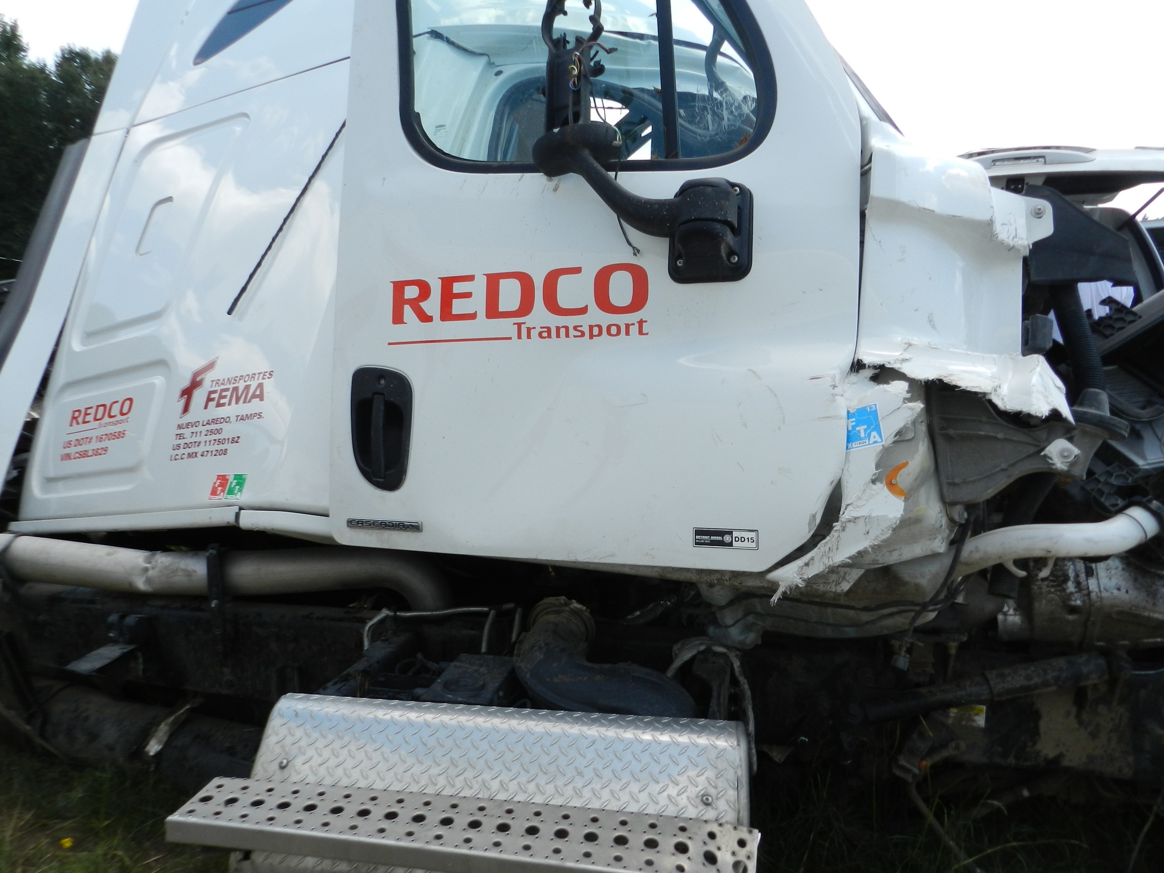
Notes:
On the opposite end of the spectrum are, for example, some Mexican carriers operating in the United States. The current minimum limits that are unadjusted for inflation allow some Mexican and other unsafe motor carriers to shift the financial burden to U.S. taxpayers. By not carrying enough insurance to cover the harm they, many truck crash victims end up on Medicaid, Medicare, Tricare and other government programs. This is a photo of a minivan hit by a tractor trailer in Louisiana. The man driving and his six year old son were killed, leaving behind a wife and younger child.
After the collision, the FMCSA ordered this company to cease operation and revoked the operating authority of REDCO. FEMA, its Mexican counterpart—owned by the same people—has CSA BASIC scores of “100” (the worst possible safety score) in two areas. They only carried a $1 million policy.

Slide 18
“… minimum [insurance limits] to be updated regularly.”
H.R. Rep. No. 96-1069 at 43.
Notes:
The 1980 House of Representatives Report to Congress stated that the goal of the Motor Carrier Act financial insurance minimums was to achieve a level “sufficient to require on site inspection by the insurance company with minimums to be updated regularly." H.R. Rep No. 96-1069 at 43.
Inflation has caused the relative risk to the insurance companies to decrease. $750,000 was a lot more valuable in 1985 than now. The more risk an insurance company has, the more likely it will be to thoroughly review driver safety records, to help put safety controls in place (like drug and alcohol testing) and to review the safety scores given by the FMCSA. Now, insurance companies do not have the same financial incentive to screen and train. This was an essential component of deregulation in 1980—putting in place sufficient insurance minimum limits to ensure free market forces would give insurance companies to real safety incentives.

Slide 19
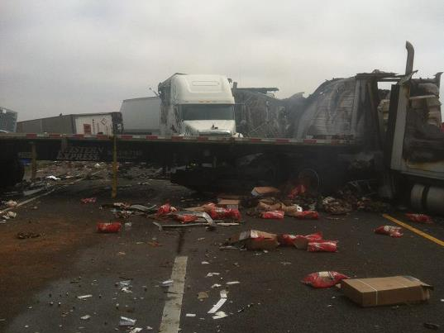
Notes:
Many truck drivers are killed, or their driving careers ended, due to the carelessness of another truck driver. An inflationary adjustment in insurance minimums will help truck drivers too.

Slide 20
Contact:
Michael Leizerman michael@leizerman.com
Robert Collins houstonlaw1@aol.com
Peter Kestner pete@CrawfordKestner.com

