Slide 1
MCSAC CSA Subcommittee
CSA Program Update
June 17th, 2013

Slide 2
Agenda
Status update on CSA for 2013
SMS Display Enhancements
Other initiatives underway

Slide 3
Recap: February 2013
Gathered input from CSA Subcommittee to improve display of the Agency’s Safety Measurement System (SMS) prioritization results to the public
Demonstration of public SMS website
Facilitated discussion regarding opportunities for improvements and clarity

Slide 4
Why is the Agency focusing on SMS Display?
Agency began making prioritization information available publicly over a decade ago
Two years into implementation SMS Online: ~48 million sessions/year
SafeStat Online website : ~4 million sessions/year

Slide 5
Goal: Improve display and increase an understanding of the information
Challenge : we are dealing with various users with various needs
Objective: display results and work to build better understanding
Experience: more informed users will leverage information in the best way to meet their purposes, and promote safety
Highly Informed
Less Informed
Notes:
We are Transparent.
Workforce prioritization tool to be more accessible
1) Various type
2) Level of exposure
200-300 feedbacks per month
More informed users are less critical → and are more apt to leverage available safety info to improve safety

Slide 6
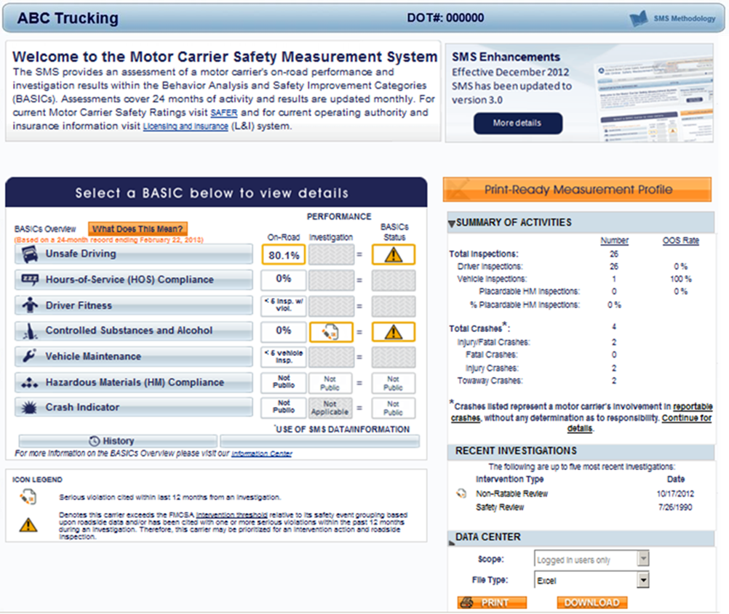
Public Display of SMS Results
Notes:
BQ

Slide 7
Objectives Established
Reinforce SMS as prioritization
Reinforce safety mission
Focus on setting foundation for SFD
Emphasize relative vs. absolute performance
Clarity on Safety Event Groups

Slide 8
Objectives Established
One stop shop
Address concerns with “insufficient data” carriers
Retain detailed data
Recognize distinctions between BASICs and crash risk

Slide 9
Next Steps
Incorporating field feedback
Finalize mockups and begin coding preview website
FR Notice
Release of preview site to companies / Release of mockups for public
Analyze results
Publish plan

Slide 10
Additional 2013 priorities
Crash Weighting
CSA Program Effectiveness Update
Continue to analyze impacts of potential SMS methodology improvements
Severity weights
Recalibration of the Utilization Factor
Adjustment to safety event groupings in all BASICs (dynamic groups)

Slide 11
Thank you!
Courtney.Stevenson@dot.gov
202-366-5421

