Slide 1
Regulatory Flexibility Act: FMCSA Section 610 Agenda and Review Methodology August 28, 2012 Strategic Planning and Program Evaluation Division

Slide 2
Regulatory Flexibility Act: Section 610 Reviews
Key Requirement:
Federal agencies must analyze the impact of their regulatory actions on small entities.
Section 610 of RFA: Requires periodic review to determine if there is
SEISNOSE: Significant Economic Impact on a Substantial Number Of Small Entities.

Slide 3
SEISNOSE Determination:
If there is evidence of SEISNOSE, the agency should explore ways to mitigate those costs.
Significant is not defined in the RFA. Previous FMCSA analyses have used 1% of annual revenue of a single vehicle. Annual revenue is roughly $172,000, so annual costs would need to be greater than $1,720.
SBA defines a “small” business in the trucking industry as one with annual revenues under $25.5 million. This roughly equals any company with a fleet size smaller than 150.

Slide 4
Cost Exceptions
Imposed by statute;
Imposed by other agencies;
Imposed by State law;
Imposed as a prudent/ordinary business practice; and
Imposed due to non-compliance, such as fines.

Slide 5
Review Methodology:
1. Does the regulation impose a (non-exempt) cost?
2. What is the magnitude of the cost?
3. How many are affected?
4. How many are small entities?
5. Is there a SEISNOSE?
6. Any other changes that will improve the regulation or decrease regulatory burden?

Slide 6
2011-2012 Review Agenda:
§390: FMCSRs, General
§391: Qualifications of Drivers and Longer Combination Vehicle (LCV) Driver Instructors
§392: Driving of CMVs
§393: Parts and Accessories Necessary for Safe Operation
§396: Inspections, Repair, and Maintenance
§397: Transportation of Hazardous Materials; Driving and Parking Rules
§398: Transportation of Migrant Workers
§399: Employee Safety and Health Standards

Slide 7
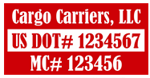
§390 - FMCSRs, General
Requirements imposing costs:
Applying for DOT number
Record-keeping
Marking vehicle with DOT number
Small cost, below threshold = No SEISNOSE
Recommend allowing electronic signatures and document storage
FMCSA Regulatory Guidance; Electronic Signatures
URS Rulemaking Electronic Filing of MCSA-1

Slide 8
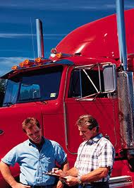
§391 - Qualifications of Drivers and Longer Combination Vehicle (LCV) Driver Instructors
Requirements imposing costs:
Gathering employee background info
Maintain record of effort (1 year)
Response to information requests (30 days)
Reporting of former employers who do not provide this information
Costs below threshold = No SEISNOSE

Slide 9
§391 - Qualifications of Drivers and Longer Combination Vehicle (LCV) Driver Instructors
Are these specified driver history checks standard business practice?
Is each element necessary?
Does the info checking impact employment decisions?
Could it be made easier to access this information?
Pre-employment Screening Program (PSP)
National Driver Registry (NDR)
Others
How do these rules impact owner operators?

Slide 10
§392 – Driving of CMVs
General safety standards for the operation of CMVs.
Requirements imposing costs:
Prohibition against driving while ill or fatigued
Inspections (pre-trip)
Railroad crossing stops
Emergency warning devices (use of the triangles).
Small cost, below threshold = No SEISNOSE

Slide 11
§393 - Parts and Accessories Necessary for Safe Operation
Relies heavily on FMVSS
In certain cases uses performance versus design standards allowing for flexibility and innovation
Rules modified in past to allow for new technologies
Vehicles meeting standards easily obtained through manufacturers
Prudent business practices = No SEISNOSE

Slide 12
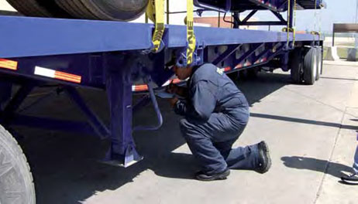
§396: Inspections, Repair, and Maintenance
Must maintain vehicles in proper working order
Minimum qualifications for persons conducting the annual inspection; brake-related inspection, repair and maintenance.
Requires 3 types of inspections:
Unannounced roadside inspections
Daily inspections by driver (post-trip inspection report)
Comprehensive annual inspection
Systemic inspection, repair and maintenance program (routine maintenance and repair schedule)
Costs below threshold = No SEISNOSE
Division of Responsibilities for IME

Slide 13
§397: Transportation of Hazardous Materials; Driving and Parking Rules
Subpart A: Hazardous Materials
No SEISNOSE
Subpart C: Routing of Non-Radioactive Materials
No SEISNOSE
Subpart D: Routing of Radioactive Materials
No SEISNOSE
Subpart E: Preemption Procedure
No SEISNOSE

Slide 14
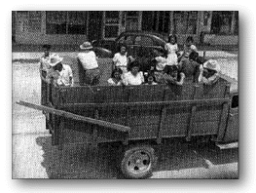
§398: Transportation of Migrant Workers
Basically unchanged since 1957
Applies to:
Anyone other than common carrier
Transporting 3 or more “migrant” farmworker (an individual going to or from employment in agriculture
(not family members)
Interstate travel > 75 miles
In vehicle other than passenger vehicle or station wagon
Other than 9-15 passenger buses (FMCSRs)
Related to driver qualifications, safe driving, vehicle parts, accessories, maintenance, inspections, hours of service, and roadside inspections
Farmworkers.org

Slide 15
§398: Transportation of Migrant Workers
Driver Qualifications:
Physical qualifications cover disease or impairment, eyesight, hearing, and addiction
Examinations every 3 years (FMCSRs= 2 years)
Age 21
Sufficient English
Appropriate State license

Slide 16
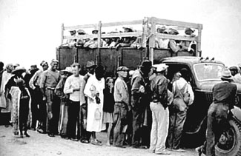
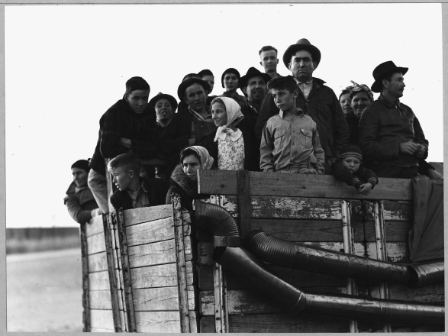
§398: Transportation of Migrant Workers
Vehicle Requirements:
Ventilation
Sides walls 60” high
Seats: backrests, 18” deep, 2 feet between back rests
A top to shelter from inclement weather
Specified exit, doors that can be secured
Steps not more than 18” from ground
Passengers have means of communicating with driver
Must protect from cold
National Heritage Museum
Dorthea Lange

Slide 17
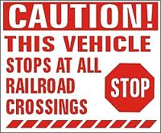
§398: Transportation of Migrant Workers
May drive no longer than 10 hours
Must be given an 8 hour stop
every 600 miles
2 provisions are more strict than the FMCSRs
Require chocking when parked
Display railroad crossings sign

Slide 18
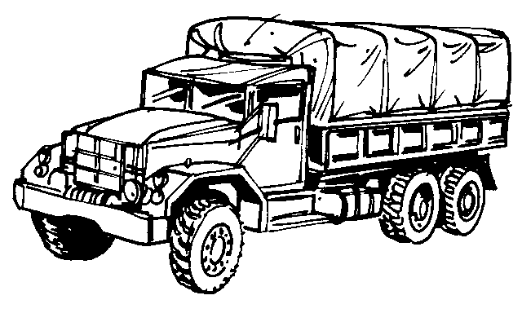
§398: Transportation of Migrant Workers
Prudent business practice = No SEISNOSE
Discussion
Is this part still necessary?
What is it covering?
Is transporting people in trucks still an acceptable practice? (even if there is ventilation and seating)
DOL incorporates Part 398 into their own regulations (minus 75 mile exception)
If it serves a purpose, why are the rules limited to agricultural workers?
Are State regulations adequate?

Slide 19
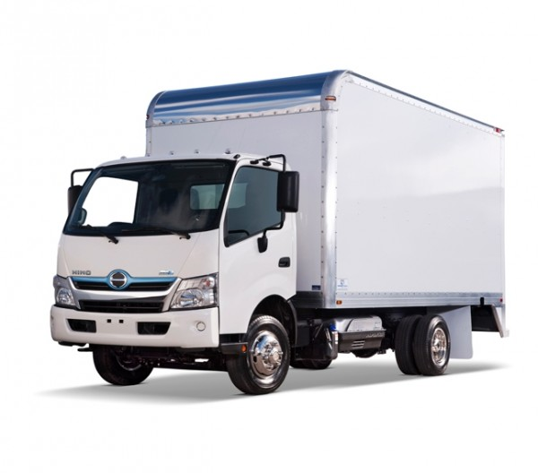
§399: Employee Safety and Health Standards
Unchanged since its introduction in 1979
Applies only to Cab-over-engine (COE) truck and truck tractors
Steps, handholds, and decks
size
location
grip
strength requirements
A “person” entering, exiting, or accessing the back of the cab must be able to have three limbs in contact with the vehicle at all times.

Slide 20
§399: Employee Safety and Health Standards
COE design no longer popular
Slip and fall injuries still significant risk: 25% happen while using steps
81 of 928 cab configurations (8%) require arm force greater than 35% of a driver’s body weight according to 2010 UMTRI study: “Hand Positions and Forces During Truck Ingress”
SAE initiated development of new standards in October 2010 (started a working group)
No other regulations for CMV handholds and steps

Slide 21
§399: Employee Safety and Health Standards
No SEISNOSE
Discussion Questions
Could FMCSA rely on private sector standards?
Are there so few COE trucks/truck tractors being manufactured that the rule is no longer needed?

Slide 22
MCSAC Task 12-04
Provide a letter report with recommendations and suggestions on FMCSA’s Section 610 agenda and review methodology for conducting Section 610 Reviews for SEISNOSE under the RFA.
Complete discussions and issue the letter report at the end of December 2012 meeting.

Slide 23
Technical Representatives:
Larry W. Minor, Associate Administrator for Policy, FMCSA, 202-366-2551
Dee Williams, Chief, Strategic Planning and Program Evaluation, FMCSA, 202-493-0192
Catherine Taylor, Economist, Economic Analysis Division, Volpe, 617-494-2380

