Slide 1
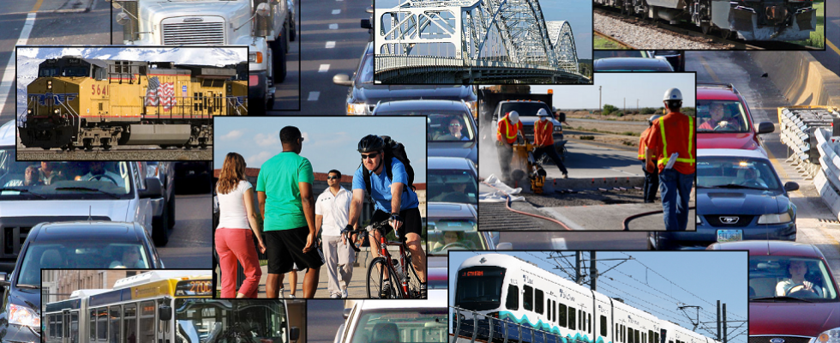
GROW AMERICA Act

Slide 2
GROW AMERICA Act
The GROW AMERICA Act, or Generating Renewal, Opportunity, and Work with Accelerated Mobility, Efficiency, and Rebuilding of Infrastructure and Communities throughout America, will:
support millions of American jobs repairing and modernizing our roads, bridges, railways, and transit systems;
help ensure that American businesses can compete effectively in the global economy and grow; and
pave the way forward by increasing access to the ladders of opportunity that help Americans get ahead.

Slide 3
FMCSA (Title V) – Key Focus Areas
Motorcoach Safety
Driver Compensation
Grant Program Restructuring

Slide 4
Motorcoach Safety
En Route Bus Inspections
Would expand locations under grant statute to require States to permit inspection of motorcoaches wherever food, shelter and sanitation for passengers can be provided
Jurisdiction Over Passenger Brokers
Bus brokers would be required to register with FMCSA
Would help prevent unsafe bus companies from reorganizing as unregulated brokers and ensure transportation through authorized carriers only

Slide 5
Driver Compensation
Current driver pay structure (by mile or trip), and unpaid time at shipper and receiver facilities, create dangerous pressures to exceed hours-of-service limits
Would authorize a rule to require certain truck and bus drivers be paid minimum hourly wage for on-duty not driving time
Only HOS log drivers would be affected
No amendment to Fair Labor Standards Act; pay would be in addition to pay required under FLSA

Slide 6
Grant Program Restructuring
Would consolidate five grant programs into a single formula program
Eliminate wasteful duplication of State and Federal administrative processes
Grant programs affected:
Motor Carrier Safety Assistance Program (MCSAP) -- Basic and Incentive
Performance and Registration Information System Management (PRISM)
Safety Data Improvement
New Entrant Grants
Border Enforcement Grant
Would allow use of MCSAP funds to enforce household goods regulations
State participation in PRISM, Safety Data Improvement and New Entrant would become mandatory

Slide 7
Grants (cont.) -- Federal Share
Would establish a minimum Federal share of 85% for all FMCSA grant programs
FMCSA would have flexibility, by program, to increase Federal share
Current (80%) Federal share for MCSAP, FMCSA’s largest grant program, would increase to 85%
Federal share would also increase for Innovative Technology Deployment Program (currently CVISN)
Federal share would decrease by up to 15% for certain smaller FMCSA grant programs.

Slide 8
Grants (cont.) -- Innovative Technology Deployment Program
Would expand and restructure current Commercial Vehicle Information Systems and Networks Program (CVISN)
Greater flexibility for advanced technology solutions that support CMV information systems and networks
Eliminate core and expanded funding caps

