Slide 1
Overview of the Evaluation of CSA 2010 Operational Model Test
Daniel Blower
December 5, 2012

Slide 2
Overview of presentation
Paul Green of UMTRI was the lead investigator.
Study evaluated the CSA 2010 pilot test.
Some study questions:
Are the BASICs related to safety?
Do the BASICs do a better job of identifying unsafe carriers than SafeStat?
Does the intervention process in CSA do a better job of improving carrier safety than SafeStat?

Slide 3
CSA 2010 Pilot Test
Four states: Colorado, Georgia, Missouri, New Jersey
Carriers randomly assigned as Test or Controls (about 35,000 each).
29 months (February 2008 to June 2009)
Data: Carrier, crash, inspection, and intervention files.
Non-participating carriers (not in test states) used to evaluate BASICs.
The BASICs: Unsafe driving; Fatigued driving; Controlled substances & alcohol; Vehicle Maintenance; Improper loading/cargo securement; Crash indicator.

Slide 4
Most SMS BASICs are related to Carrier Safety, though weak for Driver Fitness and Cargo Loading/Securement

Slide 5
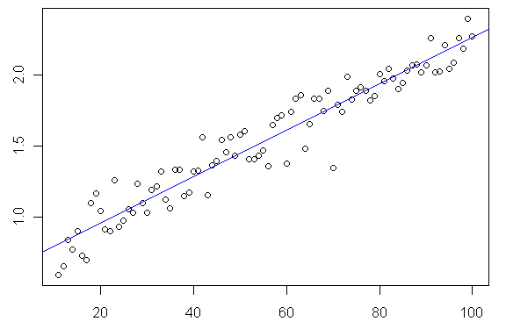
Association Between Crash Rates and BASIC 1 – Unsafe Driving
Nonparticipating Carriers 18-Month Crash Rates
Log Crash Rate Per 100 PUs
Unsafe Driving Percentile

Slide 6
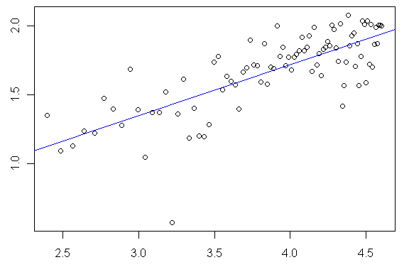
Association Between Crash Rates and BASIC 2 – Fatigued Driving
Nonparticipating Carriers 18-Month Crash Rates
Log Crash Rate Per 100 PUs
Log Fatigued Driving Percentile

Slide 7
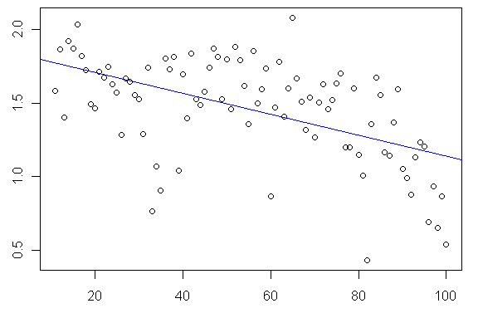
Association Between Crash Rates and BASIC 3 – Driver Fitness
Nonparticipating Carriers 18-Month Crash Rates
Log Crash Rate Per 100 PUs
Driver Fitness Percentile

Slide 8
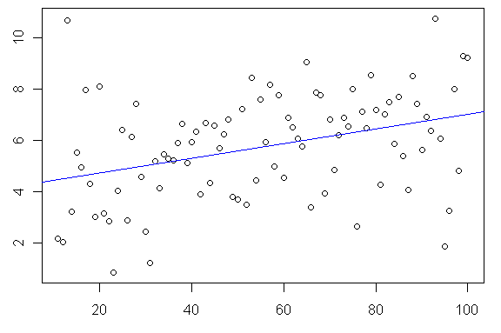
Association Between Crash Rates and BASIC 4 – Controlled Substance / Alcohol
Nonparticipating Carriers 18-Month Crash Rates
Crash Rate Per 100 PUs
Controlled Substance/Alcohol Percentile

Slide 9
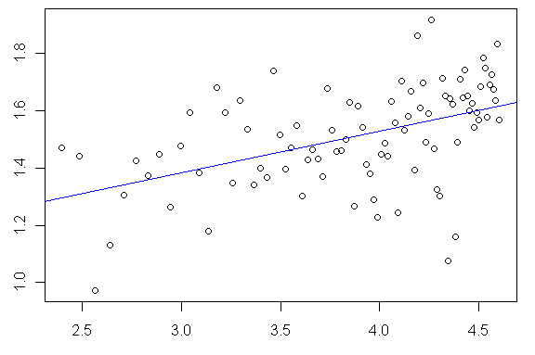
Association Between Crash Rates and BASIC 5 – Vehicle Maintenance
Nonparticipating Carriers 18-Month Crash Rates
Log Crash Rate Per 100 PUs
Log Vehicle Maintenance Percentile

Slide 10
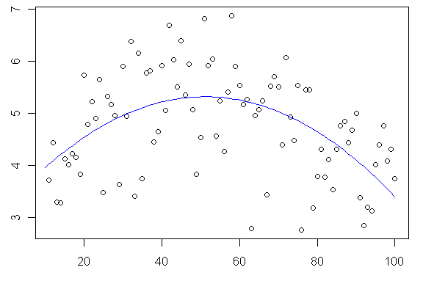
Association Between Crash Rates and BASIC 6 – Improper Loading/Cargo Securement
Nonparticipating Carriers 18-Month Crash Rates
Crash Rate Per 100 PUs
Improper Loading/Cargo Securement Percentile

Slide 11
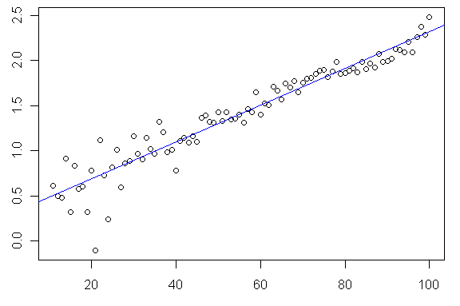
Association Between Crash Rates and the Crash Indicator
Nonparticipating Carriers 18-Month Crash Rates
Crash Rate Per 100 PUs
Crash Indicator Percentile

Slide 12
18-Month Crash Rates (Feb 2008 – Jul 2009)
Nonparticipating Carriers with Recent Activity
BASIC Threshold Exceeded | Carriers | Crash Rate per 100 PU | Ratio to Not Identified
Unsafe Driving | 9,245 | 7.44 | 3.56
Fatigued Driving | 17,959 | 6.24 | 2.99
Driver Fitness | 3,981 | 3.04 | 1.46
Controlled Substance and Alcohol | 1,013 | 6.55 | 3.14
Vehicle Maintenance | 18,700 | 4.87 | 2.33
Improper Loading/Cargo Securement | 9,409 | 3.97 | 1.90
Crash Indicator | 5,077 | 7.32 | 3.51
Exceeded Any BASIC | 44,881 | 4.94 | 2.37
Exceeded No BASICs | 428,966 | 2.09 | 1.00
All Carriers | 473,847 | 3.15 | 1.51
Crash rates vary by BASIC exceeded.
Crash rates for Unsafe, Fatigued, Alcohol, Veh. Maint. all high.
Crash rates lower for BASICs with weak associations.
Carrier Group | Carriers | Crash Rate per 100 PU | Ratio to Not Identified
SafeStat A/B | 5,402 | 6.94 | 2.30
SafeStat C | 3,389 | 4.94 | 1.64
SafeStat A/B/C | 8,791 | 6.20 | 2.06
SafeStat Not Identified | 465,056 | 3.01 | 1.00
All Carriers | 473,847 | 3.15 | 1.05
exceed at least 1 BASIC

Slide 13
Identifying Unsafe Carriers by CSA 2010 and SafeStat
Test and control carriers categorized by SafeStat and BASIC classifications (over 29 months)
Exceeded Any BASIC Threshold | SafeStat A/B |  | Total
 | A/B at Least Once | Never SafeStat A/B
At Least Once | 1,776 | 9,521 | 11,297
Never | 121 | 69,649 | 69,770
Total | 1,897 | 79,170 | 81,067
9,521 carriers identified under CSA, but not under SafeStat
121 A/B carriers with no BASICs exceeded.

Slide 14
CSA 2010 Will “Touch” About 3 Times as Many Carriers Currently Get CRs
Annual Percentage of Test Group Carriers with Recent Activity Touched by Interventions (Original Four States CO, GA, MO, NJ – 29 Months)
Average number of Test carriers with Recent Activity | Total interventions | Total carriers with Recent Activity with Interventions | Annual number of carriers with Recent Activity with Interventions | Annual percentage of carriers touched
22,586 | 10,095 | 5,419 | 2,242 | 9.9
Estimated Annual Percentage of Active Carriers Nationwide
with Compliance Reviews (2009)
Estimated carriers nationwide | Estimated annual CR | Estimated active carriers with CR | Annual Percentage of carriers with CR
514,000 | 16,733 | 16,262 | 3.2

Slide 15
Effect of Intervention on BASICs Scores

Slide 16
Vehicle Maintenance BASIC
Percentage of carriers exceeding the Vehicle Maintenance BASIC with 12 months of follow-up after exceeding BASIC threshold
Test carriers closed-completed with one intervention Control carriers with no CR during model test

Slide 17
Fatigued Driving BASIC
Percentage of carriers exceeding the Fatigued Driving BASIC with 12 months of follow-up after exceeding BASIC threshold
Test carriers closed-completed with one intervention Control carriers with no CR during model test
No

Slide 18
Unsafe Driving BASIC
Percentage of carriers exceeding the Unsafe Driving BASIC with 12 months of follow-up after exceeding BASIC threshold
Test carriers closed-completed with one intervention Control carriers with no CR during model test

Slide 19
Effectiveness of Intervention Types on Improving BASICs Scores

Slide 20
Primary Intervention Patterns
Initiated in First Year of Phase 2
Intervention type |  | N | Percent | Mean crash rate
1st intervention | 2nd intervention
Warning letter | None | 668 | 33.3 | 2.9
On-site focused | None | 180 | 9.0 | 4.9
Warning letter | On-site focused | 145 | 7.2 | 3.6
On-site comprehensive | None | 130 | 6.5 | 4.9
On-site focused | CSP | 125 | 6.2 | 4.6
Off-site | CSP | 92 | 4.6 | 4.2
Warning letter | Off-site | 88 | 4.4 | 3.4
On-site comprehensive | NOC | 80 | 4.0 | 6.2
Off-site | None | 72 | 3.6 | 4.1
On-site comprehensive | CSP | 49 | 2.4 | 7.5
Top 10 intervention patterns
Represent 81.3% of all patterns
79 total different intervention patterns
First intervention and number of interventions reflect carrier safety
No

Slide 21
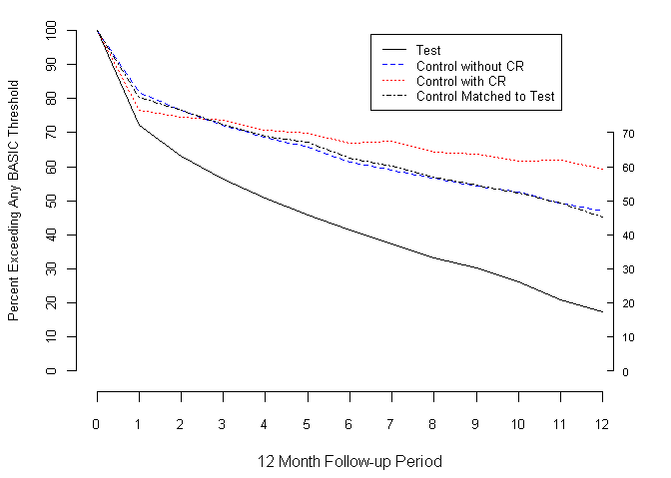
Effectiveness of the Warning Letter
Percentage of carriers exceeding any BASIC threshold The test group received a Warning Letter Only

Slide 22
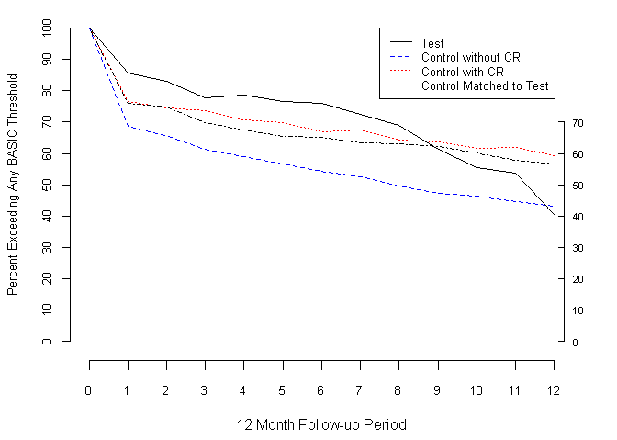
Effectiveness of the On-site Focused Investigation
Percentage of carriers exceeding any BASIC threshold The test group received an On-site Focused Investigation
No

Slide 23
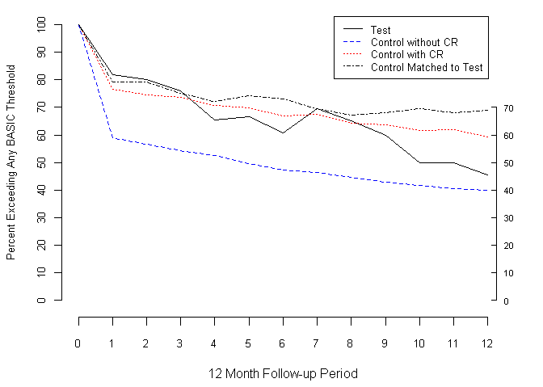
Effectiveness of the On-site Comprehensive Investigation
Percentage of carriers exceeding any BASIC threshold The test group received an On-site Comprehensive Investigation
No

Slide 24
Cost Comparison of CSA 2010 and SafeStat Models
No

Slide 25
Cost of Interventions and Compliance Reviews
Includes Labor Hours, Govt Miles, Vouchers, and Expenses
CSA Intervention Types | Avg Cost | Median
Cooperative Safety Plan (CSP) | $95 | $72
Notice of Violation (NOV) | 118 | 96
Notice of Claim (NOC) | 428 | 192
Off-site Investigation | 451 | 406
On-site Focused Investigation | 677 | 588
On-site Comprehensive Investigation | 1,038 | 877
Warning letter | Nominal | Nominal
Estimated annual test group costs | $675,000
Control group
Compliance review (CR) | $1,438 | $1,058
Estimated annual control group costs | $785,000
No

Slide 26
Feedback from Field Staff
No

Slide 27
Survey of Field Staff
8 states; 18 surveys sent out/10 returned; half were state employees
Questions covered:
Prioritization of carriers & recommended intervention.
Effectiveness of identifying unsafe carriers in comparison with SafeStat.
Effectiveness of document requests & processing.
Effectiveness of “process breakdown” identification methodology.
Effectiveness of NOVs &CSPs.
No

Slide 28
Field Staff Response Positive, Overall
The SMS:
“The BASIC measurement system is a tremendous improvement in identifying unsafe motor carrier operations. Investigative officers and roadside inspectors have long understood the need to recognize all roadside performance behaviors in the measurement process. This portion of CSA2010 has been the most well received.” “More comprehensive and fair in measuring safety. Ratings 1 to 10: SafeStat = 5 and the CSA SMS = 9+”
“We are now seeing larger carriers more so than in the past. I contribute the change to the new SMS safety yardstick that is being applied equally across all carriers.”
Interventions and “process breakdown”
“[T]he system prioritization seemed to recognize traditional problem carriers in combination with carriers FMCSA has had no prior contact with (but that did have deficiencies).”
“We are in support of all established interventions. Each have their place.” “The recommended types of interventions shown in CSI for the interstate carriers have been spot on.”
No

Slide 29
Field Staff Response Positive, Overall (2)
“The Process Breakdown process is a tremendous improvement in identifying unsafe motor carrier operations…However, this new process has focused the investigation toward identifying any and all performance behaviors which may lead to unsafe operations.”
“Much better assessment of the carrier at the time of intervention. It identifies problem areas within the carrier, and an investigator can easily find and focus on areas of deficiencies.” “With the addition of the breakdown into seven different areas it allows a much clearer view of a carrier’s compliance break­downs and enables the Division to task resources accordingly.”
“This helps in getting at the root cause of why the violations may be happening.”
No

Slide 30
Some problems identified:
“Older data (more than one year old) carries too much weight … If they don’t have issues NOW, we’re still wasting time and energy seeing carriers that don’t necessarily need to be seen.”
“Ensure adequate roadside inspection activity in the past 6 to 12 months prior to assignment. There have been several instances where a carrier has not had activity recent enough to cite violations in Capri.”
“We have had very poor results with the CSP—mainly because the consultants who are most often contacted by the carriers are advising carriers not to sign CSPs.”
Bottom line:
“It’s better but could still be improved”
No

Slide 31
Conclusions
Most (not all) BASICs are related to carrier safety.
CSA identifies substantially more carriers for interventions than SafeStat.
CSA interventions significantly reduce % of carriers exceeding a BASIC threshold compared to control group.
Warning letter was the most common intervention & most intervention cycles required only one intervention.
More intrusive interventions (on-site focused, on-site comprehensive) were used for more severe violations and took longer to show effect.
CSA test group costs overall 14% lower than control group.
Feedback from field is positive: CSA identifies right carriers and interventions are appropriate and generally effective.

