Slide 1
Overview of Passenger Carrier Topics and Sub-topics

Slide 2
Model Motorcoach Driver Curriculum
Overall
Height
Width
Weight
Fleet differences
Tail swing
Turn radius
Interior
Vehicle Controls
Seat adjustment
Mirror adjustment
Master control switch
Start
Shift
Brakes (service, parking, &
emergency)
ABS
Steering
Accelerator
Retarders
Lighting
(interior & exterior)
Cruise control
Windshield washer & wiper
Vehicle Orientation

Slide 3
Model Motorcoach Driver Curriculum
Route planning/familiarization
Map/Online Map/GPS use
Rest/fatigue
Circadian Rhythms
Wellness/Nutrition
Drugs/Alcohol
Rx & non‐Rx medications
Diet
Exercise
State Law familiarization
Idling
Chains
Weather consideration
Trip Preparation

Slide 4
Model Motorcoach Driver Curriculum
DVIR review
Engine Compartment
Airbrake system
Walk around inspection
Wheels/tires (including inflation)
Headlights/Flashers/Stop lamps/turn signals
Interior
Warning lamps
Windshield wipers
Compartment inspection (security)
Emergency devices (Triangles
Wheelchair Lift
Adjusting seat & mirrors
Flat & convex adjustment
En‐route inspections
DVIR completion (end)
Vehicle Inspection

Slide 5
Model Motorcoach Driver Curriculum
Greeting/screening passengers
Assisting passengers during boarding/disembarking
Luggage screening & loading considerations
Safe lifting
Hazardous materials considerations
Choosing loading/alighting locations
Passenger safety briefing
Handling unruly passengers
Boarding & Alighting Passengers

Slide 6
Model Motorcoach Driver Curriculum
ADA requirements/paperwork
Sensitivity training
Lift operation
Securement/stowage of mobility aids
Americans w/Disabilities Act

Slide 7
Model Motorcoach Driver Curriculum
Definitions
Maximum driving times
Completing a log
Special situations/exemptions
Driver FAQs
Hours of Service

Slide 8
Model Motorcoach Driver Curriculum
Whistleblower Protection
Know the dimensions of your coach
Starting & stopping
Blind spots
Left and right turns
Pivot point
Search patterns/mirror usage
Managing side space
Defensive driving
Space Management
Intersections
Passing & Lane Changing
Backing
Pedestrian Awareness
Distracted Driving/cell phone use
Safe Driving Principles

Slide 9
Model Motorcoach Driver Curriculum
Breakdowns
Triangles
Passenger management
Collisions
Priorities/responsibilities
Skids/skid recovery
Blowouts
Managing aggressive behavior
Fires
Passenger evacuation
Passenger illness
Driver illness
Emergency Situations

Slide 10
Model Motorcoach Driver Curriculum
Driving at night
Adverse weather
Rain
Snow
Fog
Ice
Mountain driving
Construction zones
Special Driving Conditions

Slide 11
Model Motorcoach Driver Curriculum
Officer interaction
Driver responsibilities
Violation ramifications – company and driver
Passenger instruction / care
Enforcement Inspections

Slide 12
Model Motorcoach Driver Curriculum
Suggested topic Area of curriculum
Service animals
ADA Act
Fire symptoms/signs Emergency Situations
Incorporate scenarios to develop sound vs. instinctual
thinking
Emergency Situations
What to do/how to handle mechanical breakdown Emergency Situations
Dealing with group pressure Hours of Service
Fatigue management while en‐route
Safe Driving Principles
Managing cockpit overload (technology) Safe Driving Principles
Retarders/Jake brakes/Intarders ‐ safe usage Safe Driving Principles
RR crossings Safe Driving Principles
Seat belt use Safe Driving Principles
Tag axle usage
Safe Driving Principles
Emotional well‐being
Safe Driving Principles/
Trip Preparation
Emergency vehicles Special Driving Conditions
Road rage Special Driving Conditions
Communication plan (who to contact in emergency)
Trip Preparation
Food metabolism/effects of insulin production Trip Preparation
Fuel planning (where to get fuel along trip) Trip Preparation
How to obtain proper rest Trip Preparation
Trip schedule awareness Trip Preparation
What to do if ill
Trip Preparation
Scales & Weight Limited Roads
Trip Preparation (Stet
Laws)
Proper vehicle documentation on‐board Vehicle Inspection
Specificity in DVIR write‐ups Vehicle Inspection
Additional comments from stakeholders

Slide 13
Motorcoach Operator (Driver) Program
Driver Qualifications
Vehicle Maintenance
Safe Driving
Passenger Issues
Security

Slide 14
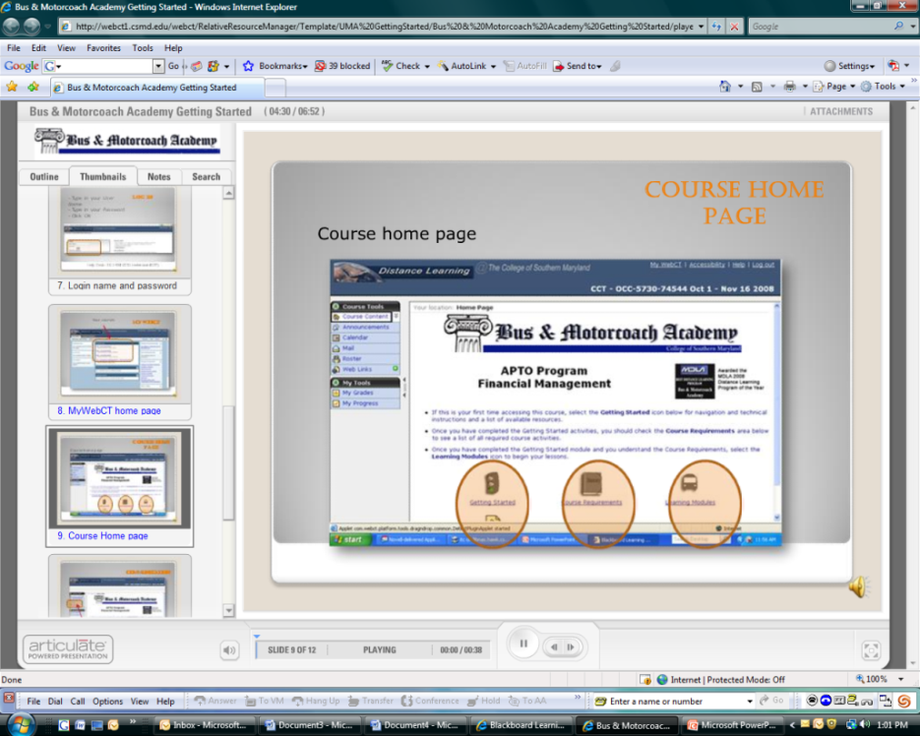
easy instructions…

Slide 15
Motorcoach Operator (Driver) Program
Driver Qualifications | Introduction to the Motorcoach Industry | Company Policies & Rules | Federal, State and Local Laws & Regulations | Personal Health (Driver Fatigue Hours of Service) Case Studies
Vehicle Maintenance | Equipment Familiarity and Use | Breakdowns and Emergencies | Driver Conduct at Scene, Post-Accident Activity | Understanding Litigation Fuel Economy
Safe Driving | Driving Procedures | Special Driving Conditions | Off-Road Vehicle Handling | Case Studies in Safety
Passenger Issues | Transporting Passengers and Baggage Including Special Needs Passengers | School Bus Considerations | Transit Considerations | Customer Care
Security – Driver | OPSEC Transport | OPSEC Driver – Crisis Response | Highway Watch Program

Slide 16
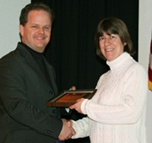
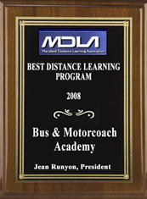
College of Southern Maryland Recognized w/Distant Learning Award for the Bus & Motorcoach Academy
CSM Program Wins Distance Learning Award March 2008
CSM's Bus and Motorcoach Academy, developed in conjunction with the United Motorcoach Association, was awarded the 2008 Maryland Distance Learning Association Award for Distance Learning Program of the Year. Criteria for the award included quality of the program, scope of the program, and innovative program design.

Slide 17
Motorcoach Operator (Driver) Program
8 years
500 learners
16 – 24 hours
85% Completion rate

Slide 18
Prevost Preparatory School

Slide 19
Prevost Preparatory School for Professional Motorcoach Drivers
Online classes prepare prospective drivers for state written and learners permit. Courses include:

Slide 20
Prevost Preparatory School for Professional Motorcoach Drivers
Managing Passengers

Slide 21
Prevost Preparatory School for Professional Motorcoach Drivers
Course Description: This course features “First Observer” techniques, guidelines and procedures relevant to the driver, including crisis response. After completing this program, students will be familiar with the requirements of the Highway Watch Program and understand how to implement the “First Observer” recommended practices. Students will also learn how to increase the security of their motorcoach in the field, as well as how to handle security/crime-related situations.
Security

Slide 22
Prevost Preparatory School for Professional Motorcoach Drivers
Course Description: This course highlights the motorcoach driver profession by identifying the unique skills, knowledge and responsibilities associated with operating a motorcoach. The course includes employer's regulatory responsibilities as well as the driver’s. Basic ethics and behavior are included, along with United States Department of Transportation whistleblower regulations. The course addresses the driver’s responsibility of maintaining a Commercial Driver’s License in good standing and the Federal Pre-Employment Screening process. The basics of wardrobe selection, grooming and basic courtesies, as well as information about typical company rules and policies will be provided. Other topics include personal health for the motorcoach operator, issues of driver fatigue and hours of service.
The Motorcoach Driver Profession

Slide 23
Prevost Preparatory School for Professional Motorcoach Drivers
Course Description: This course explores safe driving procedures under normal and special conditions, off-road vehicle handling and in-depth case studies in safety as related to the motorcoach industry. After completing this course, students will be familiar with general safe driving practices, understand the importance of various road conditions, and be able to analyze various driving scenarios to develop critical thinking skills needed to handle on-road and off-road situations. Also included in this course is basic knowledge of passenger carrier driver’s hours-of-service and properly maintaining a logbook.
Safe Driving

Slide 24
Prevost Preparatory School for Professional Motorcoach Drivers
Course Description: The nature of commercial motor vehicle operations requires frequent interaction with enforcement personnel. These interactions can range in purpose from basic highway enforcement, security issues, and routine vehicle and driver inspections. Drivers engage a large cross-section of law enforcement officials whose training, experience, and personalities vary significantly. This course covers the basic responsibilities of the driver when engaging Federal, state and local law enforcement officials, and passenger care during inspections. Also covered are the basic North American Commercial Vehicle Safety Alliance inspections and out-of-service criteria. The course also highlights the driver's basic priorities after a crash including responsibilities securing the passengers, seeking assistance, cooperating with enforcement officials and taking notes and photographs.
Engaging Enforcement Officials

Slide 25
Prevost Preparatory School for Professional Motorcoach Drivers
Course Description: The modern motorcoach contains complex systems. Today’s driver may not have basic familiarity with basic automotive functions. While it is generally not the duty of a professional driver to repair a bus or motorcoach; it is often critical for the driver to make basic assessments in order to effectively communicate with shop personnel and manufacture technicians. This course highlights the critical pre-trip inspection and assessment of the condition of the bus and/or motorcoach, basic parts identification, fuse location, fluid levels, climate control, and fire extinguisher. Also highlighted are tire inspection, condition, and tire-pressure monitoring.
Motorcoach in Motion

Slide 26
Prevost Preparatory School
Course Description: This course covers basic route planning, map reading skills (including map symbols), distances, proper utilization of advanced electronic mapping systems, Global Position Systems, online mapping and route searches, electronic “street views”, and obtaining advanced traffic advisories. Weather conditions frequently contribute to bus and motorcoach crashes. Anticipating weather conditions better prepares a professional driver for route deviations and/or appropriate vehicle changes that mitigate the chances of a crash. This course will cover the appropriate places to obtain advance weather reports and road conditions, coordinating with company dispatch along with group leaders. The course will also cover the use of chains, tire pressure, effects of altitude, allowing ample time, and general systems checks.
Navigation & Weather

Slide 27
Prevost Preparatory School
Once a prospective driver obtains their driver permit, they are eligible to obtain
BEHIND-THE-WHEEL TRAINING
in Richmond, VA that prepares them for their Skills Test.

Slide 28
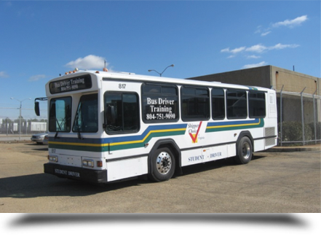
Prevost Preparatory School
Behind the Wheel Training Begins
MARCH 2015 !

Slide 29
Prevost Preparatory School for Professional Motorcoach Drivers
Also available:
ONSITE
BEHIND-THE-WHEEL TRAINING
Contact Ken Presley for arrangements.

Slide 30
Lancer
Needs a favorable loss history
Trainer
Based on company needs
Curriculum
Fundamentals
Hours of Service
Fatigue
Tired
Sleepy
Sleep Deprived

Slide 31
Lancer
Scheduled Service
Charter
Tours
Supervision
DriveCam
Types
Pre CDL – Post CDL
Age and human factors
Adult learning theory is different

Slide 32
Questions?

