Slide 1
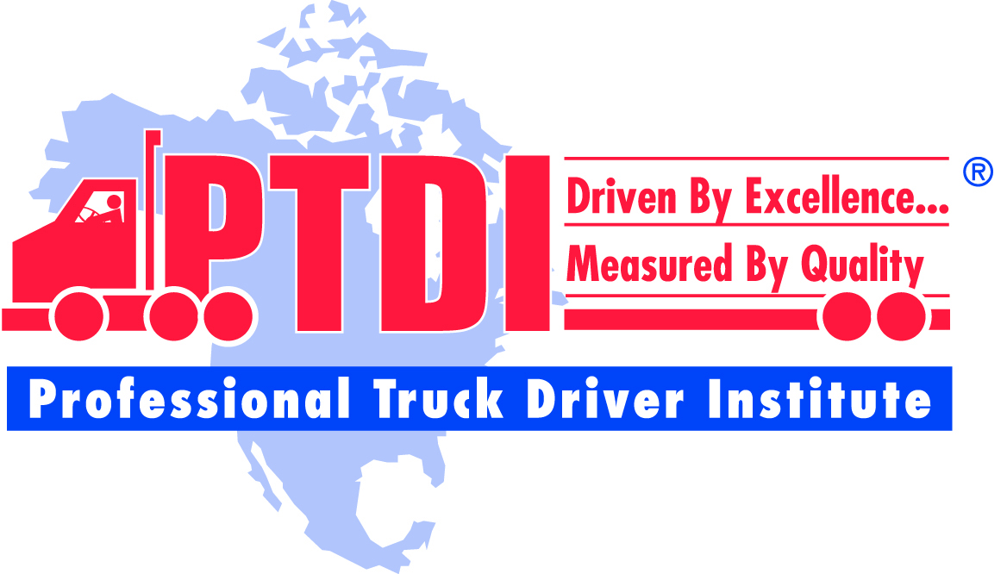
Professional Truck Driver Institute
Driven by Excellence
Measured by Quality
March 19, 2015

Slide 2
PTDI History
Non Profit organization incorporated in 1986
Developed first voluntary curriculum and certification standards
Continually working with schools and industry for improvement
Notes:
Non Profit organization incorporated in 1986
One of it’s goals was to be the nation’s foremost advocate of optimum standards and professionalism for entry level commercial driver training
The original stakeholders worked to develop the first voluntary curriculum and certification standards
In it’s present form, PTDI continually working with schools and the training/carrier industry for improvement. We recently completed a four year project to review and revise the standards.

Slide 3
PTDI Mission
Establish minimum entry-level driver training standards the industry and public can respect
Ensure availability of a reliable, consistently trained pool of drivers to meet the trucking industry’s needs
Notes:
This statement was our original mission, but after almost 25 years, I feel we do not have minimum standards, but actually “best practice” standards for both curriculum, as well as program certification. This is illustrated by the fact that the PTDI standards have been specifically noted by TRB in two of their Truck and Bus Safety Synthesis reports on “Training of Commercial Drivers” and “Effectiveness of Commercial Motor Vehicle Driver Training Curricula and Delivery Methods”.

Slide 4
PTDI Standards
Developed by bringing together representatives from:
Motor Carriers
Training Schools
Insurance Carriers
Other Trucking Safety Interest Groups
Incorporated FHWA “Minimum Standards for Training Tractor-Trailer Drivers”
Notes:
These are the folks that helped develop these standards, and it looks like the same group is represented here.

Slide 5
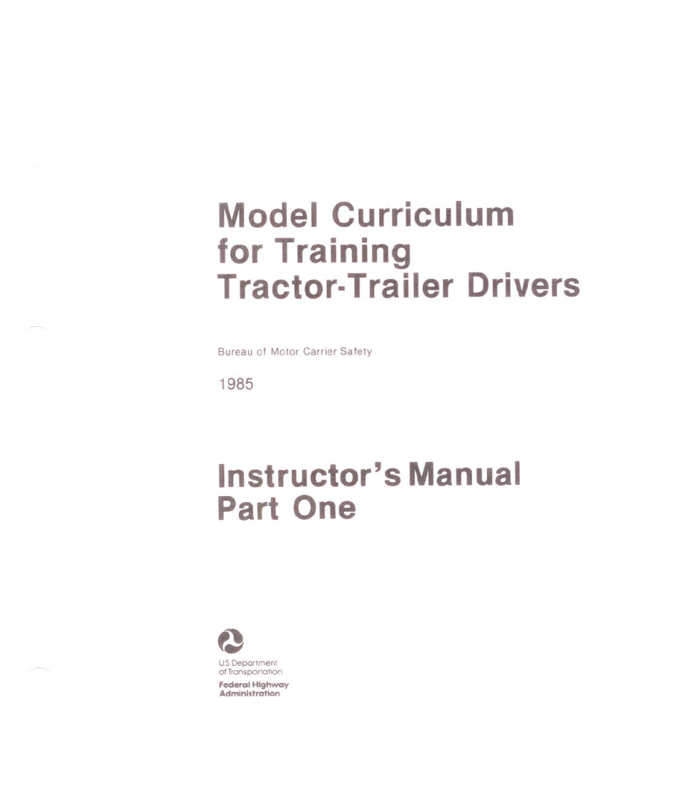
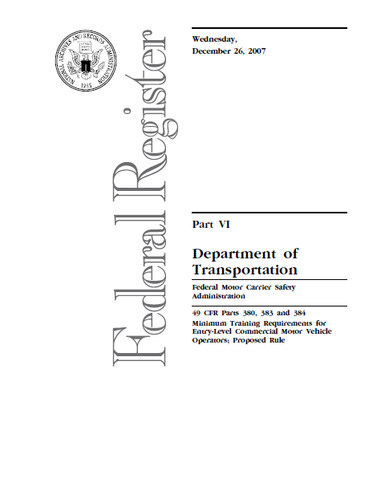
Some Might Even Remember

Slide 6
PTDI Standards
Curriculum
Basic Operation
Safe Operating Practices
Advanced Operating Practices
Vehicle Systems and malfunctions
Non Vehicle Activities
Course Administration
Instructional Personnel
Training Vehicles
Instruction
Currently – 58 schools with certified programs (3/15/15)
For a complete version of the standards, go to:
http://ptdi.org/standards/index.aspx
Notes:
As a quick overview of both the curriculum standards, as well as the certification standards..
The curriculum consists of 148 hours of instruction (104 classroom, and 44 BTW) in
Basic Operation
Safe Operating Practices
Advanced Operating Practices
Vehicle Systems and malfunctions
Non Vehicle Activities
The certification standards, in addition to the curriculum include standards on
Course Administration
Instructional Personnel
Training Vehicles
Instruction
Currently, we have 58 schools with certified programs (8/31/12)

Slide 7
Certification

Slide 8
PTDI Certification
School may attend a voluntary pre-certification workshop
School requests application package. For recertifications, PTDI automatically sends package when due. The recertification package and process may vary from that shown below.
PTDI sends school application package including: Confirmation Form, Application for Certification, Verification of Eligibility Form, Steps in PTDI Certification/Recertification Process, Fee Schedule

Slide 9
PTDI Certification-cont:
Upon receipt of above completed application package including application fee from the school, PTDI sends the school a Self-Evaluation Report (SER) package made up of:
Instructions for Completing Self-Evaluation Report (SER)
Standards Documentation Form & Variance Form
Request for Course Catalog
Catalog/Printed Materials Checklist
Instructor Qualifications Form
Request for Course Outline
Request for Examples of Classroom, Range & Street Lesson Plans
Content and Hours Match Form
Time Waiver Form
Request for copies of ads and web pages
Request for completed attendance & time record for a sample student
Employers Who Hire Graduates Form

Slide 10
PTDI Certification
A one-day on-site evaluation, and Program Evaluation Report (PER) is conducted by an Educational Team Leader (ETL), a Subject Matter Expert (SME), and a PTDI staff member.
The Certification Committee reviews the SER, the PER and any other materials submitted.
If the course meets the requirements, the course is certified for five years.
PTDI notifies the school of the Certification Committee's decision within 30 days after the Committee meeting at which the course is considered. Rev. 10/15/03
For a complete review of the process, go to
http://ptdi.org/course/membership.aspx#certification

