Slide 1
MCSAC CSA SUBCOMMITTEE
DataQs System
June 18, 2013
Washington, DC
Presented by Jeremy Crowell, Volpe Center
Led by Bill Banister, FMCSA

Slide 2
Notes:
DataQs was released in 2004 to provides motor carriers, commercial drivers, and the public an opportunity to seek and obtain correction of information that FMCSA maintains and disseminates. As you may be able to see, the number of RDRs increased since 2004. You can also see how other FMCSA programs may have an impact on the number of DataQs requests. For example, the large spike in August/September 2010 may have been a result of the CSA Data Review website being released. As more carriers were made aware of that website, you can see a greater increase in October. However, as people became more familiar with the preview and the SMS results were released in December, you can see the number of requests decreased. A similar occurrence in 2011 with the CSA Warning letters also occurred.
If we take a closer look at this 2012 line that I have highlighted here…. (next slide)
Overall notes
184,147 Crash and Inspection RDRs
1,132 still open
72,189 closed with no data correction made (39%)
110,826 closed with data correction made (61%)
40,441 Inspection Report Requests
95 still open
7,328 closed with no report available (18%)
33,018 closed with report sent (82%)

Slide 3
2012 Crash RDRs
Over 130,000 vehicles involved in FMCSA reportable crashes in 2012.
Over 4,000 crash RDRs submitted in 2012.
Notes:
…we can see the break-out of the different crash RDR types and their final status. Typically, a status of closed – no correction made is used when the reviewing agency determines the information on the crash record is correct and will remain as it is. However, a closed – correction made status is used when the reviewing agency determines the request contains enough information to make a change to the crash record.
As the data currently shows, the majority of the RDRs are due to the crash being assigned to the wrong carrier. This chart also shows that a large number of those requests are closed and a correction was made. This information likely indicates an issue with reporting the correct carrier at the time of the event.
Approximately 3% of crashes are requested to be reviewed.

Slide 4
2012 Inspection RDRs
Over 3.5 million inspections performed in 2012.
Over 33,500 RDRs submitted in 2012.
Notes:
This chart, like the crash chart I just showed, displays the number of inspection RDRs. As you can see, many requests are entered to request a review of violation information, but many are closed with no data correction made. However, many requests to review carrier assignment are closed with data correction made. Similar to the crash information, the information available here may indicate a possible training opportunity.
All of this information, combined with feedback received from both our State partners and other public users of the DataQs website, resulted in the recent update to the website.
<1% of inspections are requested to be reviewed.
4

Slide 5
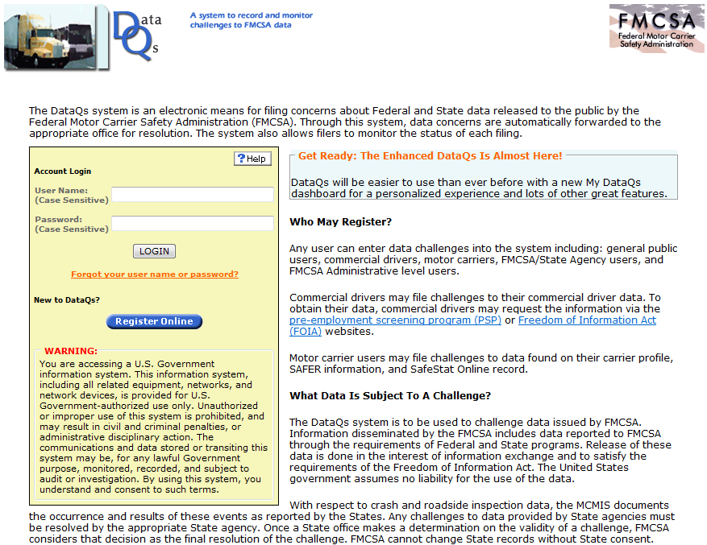
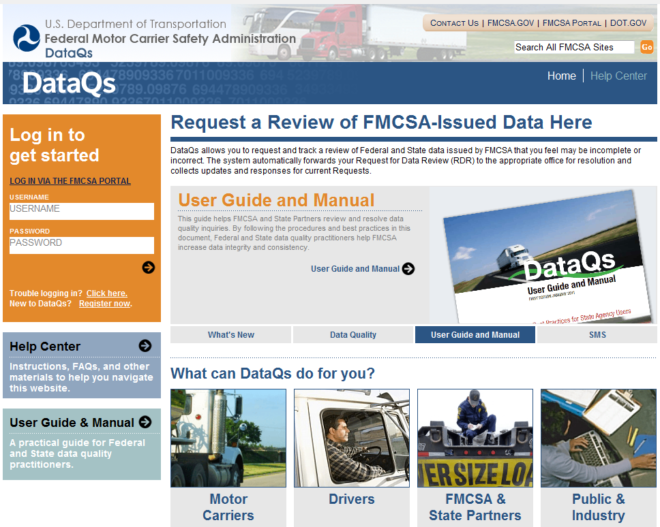
Updated DataQs
Notes:
An older version of the site can be seen on the left-hand side of this slide. As you can see, the screenshot provided is just the login page and it was getting overly crowded and confusing.
On April 27, the website was updated with major system enhancements. As seen on the right-hand side of this slide, the very first thing you will notice is a cleaner login page. This helps the public to understand why they are here and what their role is in regards to the quality of the data. The enhancements include a new user experience that helps to not only guide the user through proper submission of their request, but also added new reporting tools to aid the States in identification of potential training needs.

Slide 6
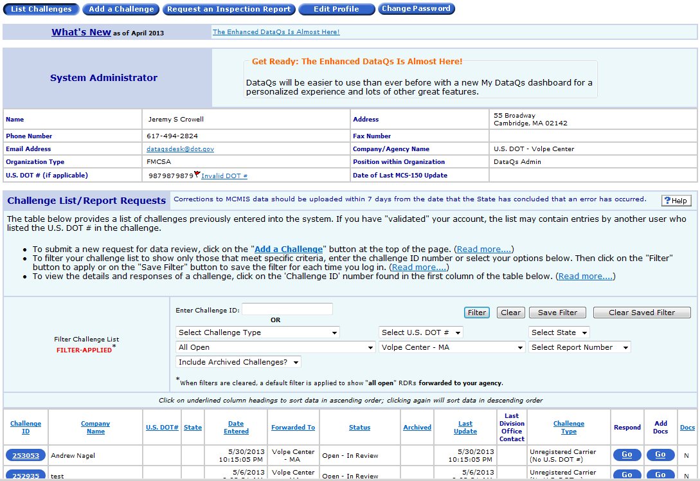
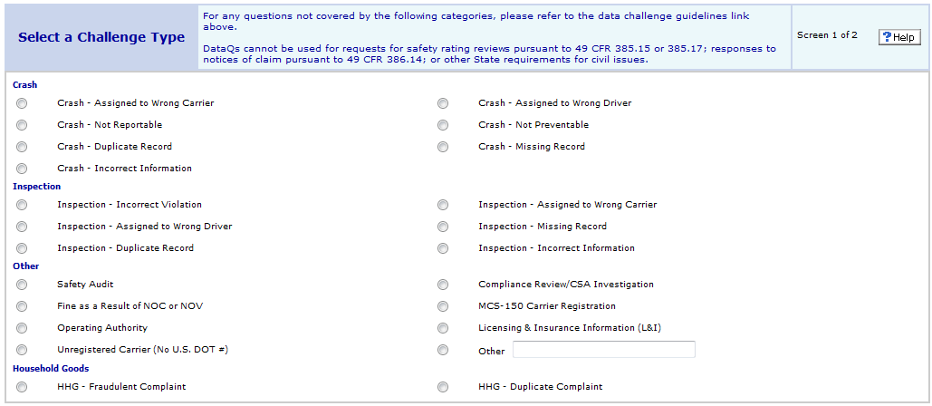
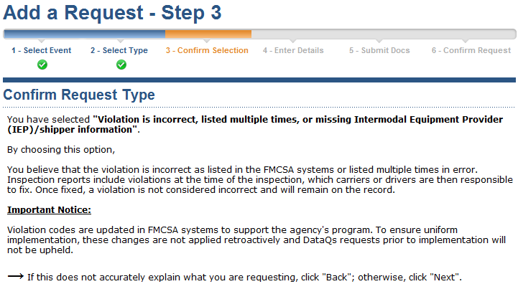
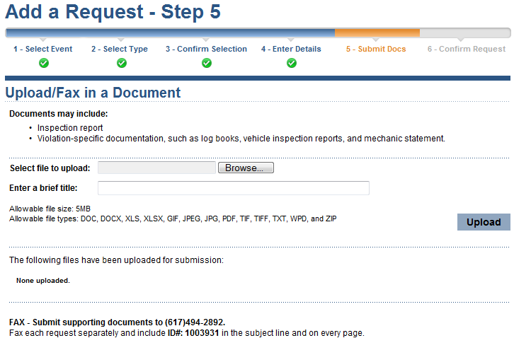
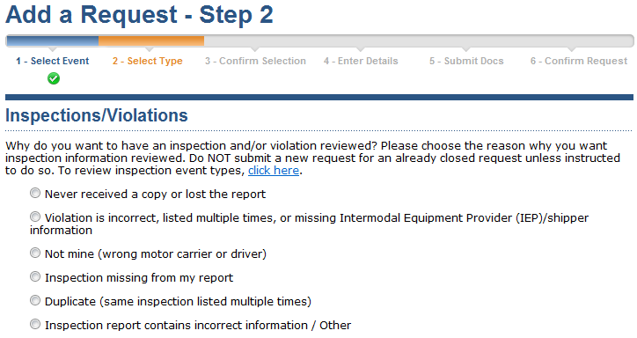
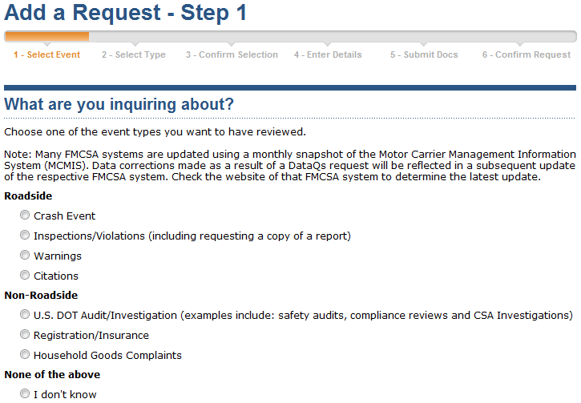
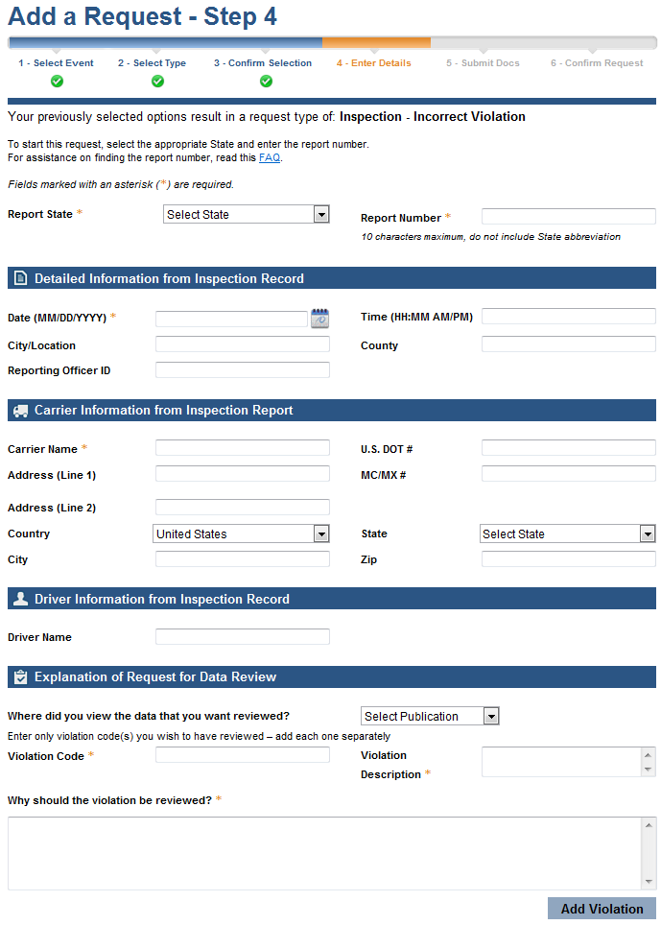
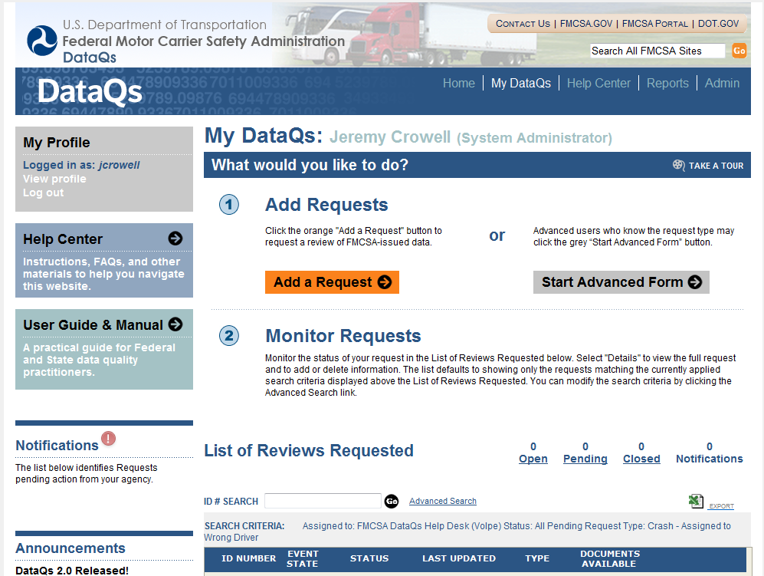
Updated DataQs
Notes:
The left-hand side of this slide shows how the old system was very “table-y” and looked like a database, as someone called it. Users were very confused as to what to do first and how to navigate the website. Once they figured it out, they were presented with a list of different types and forced to pick one. If they didn’t know which, they would pick one at random. This lead to difficulties analyzing the types of requests. There was also no education for the users regarding how to use DataQs properly or about the FMCSA programs.
With the update, as seen on the right-hand side, users are told exactly what they need to do and how to do it.
Once they click the “Add a Request” button, they will be asked to select the Event.
They will then be asked to select a Type, pertaining to the event.
They will then be asked to confirm the request. This page allows the system to explain more about the event type they chose and is important for reporting out on the different types of requests the States are reviewing.
Once they confirm the type, the input form is displayed where they can type in their information. By selecting a State and entering the ten (10) character report number, the form will be pre-filled with the FMCSA MCMIS information. This new feature helps ensure the user is entering a correct report number so the State will be able to review the appropriate information. Another new feature with this form is the ability to list out each violation to be reviewed. This feature allows another reporting option where the States can identify what violation codes get reviewed the most and perhaps identify training needs in this area.
Step 5 encourages the user to submit supporting documentation. By submitting documentation, you will help expedite the review process. However, falsified information is punishable by law and there is a warning message posted on the website.
The final step allows the user to review their information prior to clicking Submit. This helps to ensure the user has submitted everything they need and to make sure their information is correct to the best of their knowledge.

Slide 7
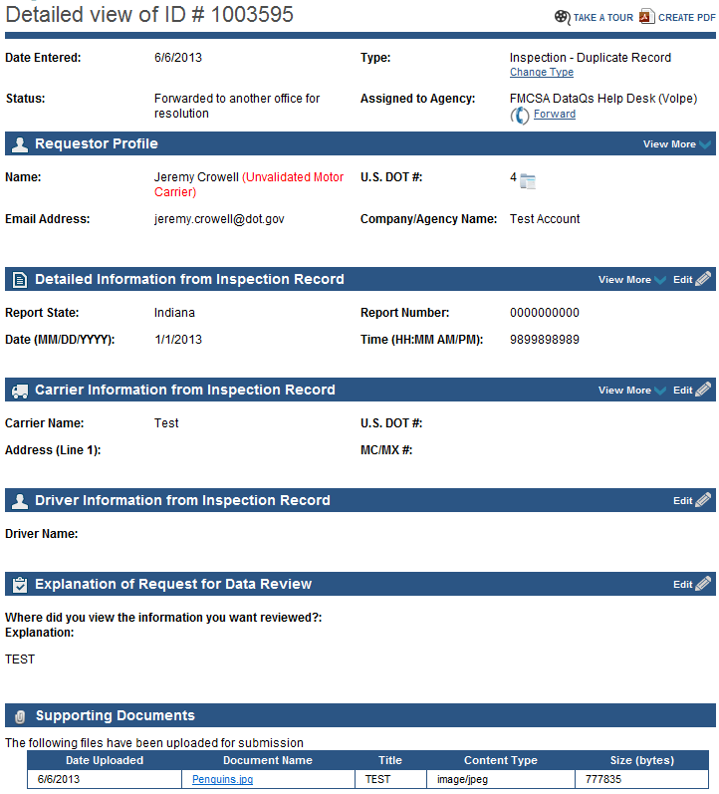
Detailed View
Notes:
After assisting the user with their submission, the DataQs website assists the State analysts with their review process. The first item is identifying if the user account was validated, where the user has provided the system with the FMCSA-issued motor carrier PIN. An added feature is a link to the carrier’s SMS results. This may assist the analyst in reviewing the carrier information provided and in their research of the requested review. Another added feature is a link to a detailed copy of a valid report number. The enhancements also include the ability to edit information in case mistakes were made during the submission process. For example, an invalid report number. Lastly, an added feature is listing the supporting documents within the detailed view, instead of on a separate area.

Slide 8
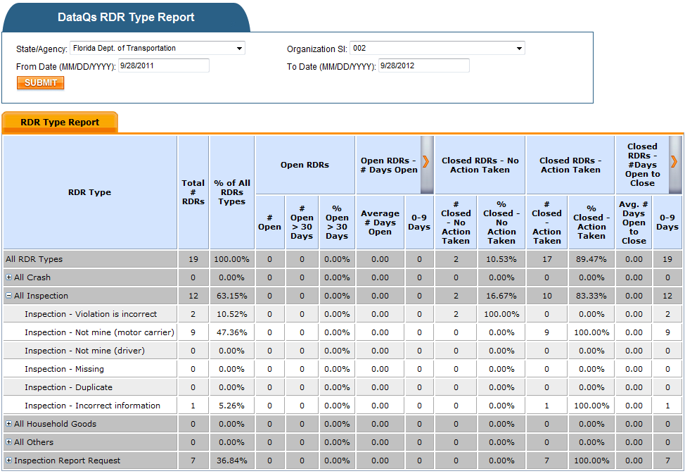
New DataQs Reports
Notes:
With the enhancements, a new series of reports were made available.
New reports are available in the Data Quality Module, in a password protected area.
An Open/Closed report, shown in the background, allows users to customize the date range and RDR type as well as drill-down from national level down to the inspector/officer
An RDR Type Report, shown on the bottom right, allows you to select the State, office, inspector of choice, and view the RDRs for that entity for all types
A Violation Report provides a breakdown of the common violations entered through the inspection – incorrect violation RDR allowing drill-down similar to the open/closed report. There is also a report that allows you to select the entity of interest and view all of the violations that have had an RDR for that entity.
All reports allow either filtering or drill-downs from national, to service center, to state, to agency, to inspection/officer
Reports also allow users to target the date range of interest by selecting customizable date range, the RDR type, and the office of interest

Slide 9
Reporting Tools
Support improved data quality and DataQs response performance
Report Feature | Report will help assist the Agency to identify:
Compares the RDR volumes and status (closed with correction made vs. closed with no correction made) among States/agencies | Outliers may point to potential data quality issues
Compares the length of time RDRs are open among States/agencies | Outliers may indicate potential response performance problems
Drill-down to inspector/officer level by RDR type and violation type | Identify potential training issues
Create customized report focusing on RDR type and time range | Identify potential system problems at the State and FMCSA level

Slide 10
Contact Information
Bill Banister Chief, Analysis Division
FMCSA
(202) 385-2388
William.Bannister@dot.gov
Jeremy Crowell
DataQs System Project Manager
Volpe National Transportation Systems Center
(617) 494-2824
Jeremy.Crowell@dot.gov

