Slide 1
Diabetes and Commercial Motor Vehicle
Driver Safety
Updated Evidence Report
PREPARED FOR:
Federal Motor Carrier Safety Administration
Medical Review Board Meeting, June 30, 2011
Prepared By:
Michelle Tregear, PhD
Senior Research Analyst
Manila Consulting Group

Slide 2
Epidemiology
2009 Statistics for Diabetes
23.6 million in the United Sates have diabetes (~8% of the US population; ~11.8% of males >20 years)
  17.9 million diagnosed
  5.7 million undiagnosed
Number of new cases are rising

Slide 3
Risk Factors for Type 2 Diabetes
Age >45 years
Excess body weight (especially around the waist)*
Family history of diabetes
HDL cholesterol under 35 mg/dL
High blood levels of triglycerides (250 mg/dL or more)
High blood pressure (>140/90 mmHg)
Impaired glucose tolerance
Low activity level (exercising less than 3 times a week)
Metabolic syndrome
*Leading Risk Factor

Slide 4
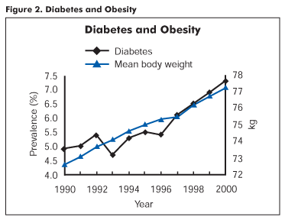
Obesity in CMV Drivers
U.S. adults (based on national
statistics)
  ~36.2% overweight (BMI 25-29)
  ~27.2 to 35.1% obese (BMI >30-39)
  ~5.7% morbidly obese (BMI (>40)
CMV drivers (based on several
studies)
  30 to 40% overweight
  33.4 to 57.2% obese
  16.5% morbidly obese
Source: National Diabetes Education Program, NIH
http://ndep.nih.gov/publications/PublicationDetail.aspx?PubId=26

Slide 5
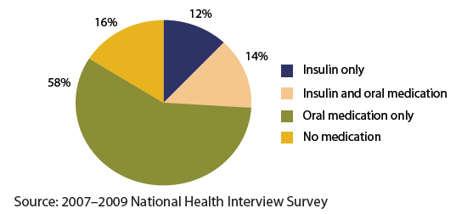
Treatment of Diabetes
Treatments are aimed at maintaining blood glucose levels
  Diet (no medication)
  Oral medications
  Insulin
  Insulin and oral
  medications

Slide 6
Current Requirements for CMV Drivers
Requirements related to diabetes, per
49 CFR 391.41(b)(3):
  Has no established medical history or clinical diagnosis of diabetes mellitus currently requiring insulin for control

Slide 7
Diabetes Exemption Program
FMCSA currently offers exemptions to qualifying drivers
Factors considered:
  Meet all other physical requirements except for use of insulin
  No severe hypoglycemic reactions in previous 12 months
  No recurring (two or more) severe hypoglycemic reactions in previous 5 years
  Has no loss of position and/or pedal sensation
  Has no peripheral neuropathy or retinopathy that interferes with safe driving
Requires annual recertification, including:
  Endocrine evaluation and vision evaluation

Slide 8
Evidence Report Background
Original evidence report presented to FMCSA in July 2006
  http://www.fmcsa.dot.gov/rules-regulations/TOPICS/mep/report/Final-Diabetes-Executive-Summary-prot.pdf
MEP held in August 2006
MEP recommendations presented to MRB and FMCSA in November 2006
  http://www.mrb.fmcsa.dot.gov/110106_meeting.aspx

Slide 9
Evidence Report Background
New searches requested by FMCSA in late August 2010
Conducted updated searches for original key questions; addressed new question (re: injectable, non-insulin treatment)
New evidence identified for each key question; evidence review updated
This presentation summarizes all of this work

Slide 10
Key Questions
Key Question 1: Are individuals with diabetes mellitus at increased risk for a motor vehicle crash when compared with comparable individuals who do not have diabetes?
Key Question 2: Is hypoglycemia an important risk factor for a motor vehicle crash among individuals with diabetes mellitus?

Slide 11
Key Questions
Key Question 3:
  What risk factors are associated with an increased incidence of severe hypoglycemia, and
  What is the incidence of severe hypoglycemia with different treatments and treatment modalities (e.g., use of injectable, non-insulin drugs such as Byetta)?
Key Question 4: How effective is hypoglycemia awareness training in preventing the consequences of hypoglycemia?

Slide 12
Key Question 1: Crash Risk
Searches of electronic databases such as PubMed/Medline, CINAHL, Cochrane Library, PsychINFO, TRIS, etc, and hand searches of the literature
Applied retrieval criteria
19 studies included
All case-control
Quality = Low/moderate
Applied inclusion criteria

Slide 13
Key Question 1: Included Studies
Reference | Year | Location | Quality**
*Skurtveit et al. | 2009 | Norway | Moderate
*Lonnen et al. | 2008 | United Kingdom | Low
*Hemmelgam et al. | 2006 | Canada | Moderate
Cox et al. | 2003 | USA, Germany, Netherlands, Scotland, and Switzerland | Moderate
Laberge-Nadeau et al. | 2000 | Canada | Moderate
McGwin et al. | 1999 | USA | Moderate
Gresset et al. | 1994 | Canada | Low
Koepsell et al. | 1994 | USA | Moderate
Hansotia et al. | 1991 | USA | Low
Stevens et al. | 1989 | Northern Ireland | Low
Eadington et al. | 1988 | Scotland | Low
Songer et al. | 1988 | USA | Low
De Klerk et al. | 1983 | Australia | Low
Davis et al. | 1973 | USA | Low
Ysander et al. | 1970 | Sweden | Moderate
Campbell et al. | 1969 | Canada | Low
McMurray et al. | 1968 | USA | Low
Ysander et al. | 1966 | Canada | Low
Waller et al. | 1965 | USA | Low
** Newcastle-Ottawa Quality Assessment Scale

Slide 14
Key Question 1: Included Studies
Scenarios for Investigating Risk of Crash in Diabetes
N=15 Studies
(1 with CMV Drivers)
N=4 Studies

Slide 15
Key Question 1: Crash Risk Among CMV Drivers
Laberge-Nadeau et al. 2000 (Quality = Moderate)
  Canada
  One,
  case-control
  study of
  CMV license
  holders

Slide 16
Key Question 1: Crash Risk Among CMV Drivers
Summary
  Increased crash risk for professional drivers with a permit to drive a straight truck (ST) and with uncomplicated diabetes
  The pattern of risk observed among drivers of straight trucks was different to that of articulated truck drivers
    May be the result of stricter medical standards when hiring drivers?
  Risk ratios (RRs) for crash increased with distance driven.
    While the RRs for ST drivers were not significantly different from the reference category, there was a trend toward increasing RR with distance driven

Slide 17
Key Question 1: Crash Risk Among Drivers
15 Case-Control Studies Comparing Risk of Crash among Comparable Drivers with and without Diabetes
Comparing
Risk Ratios (RR)
Comparing
Odds Ratios (OR)

Slide 18
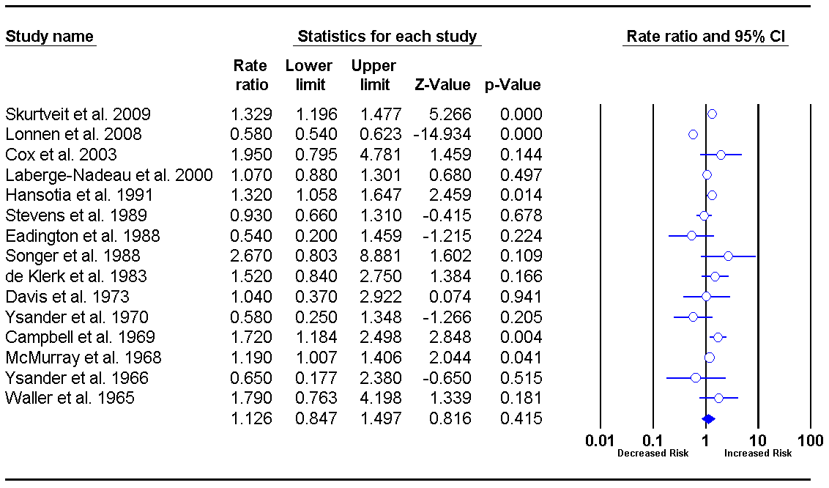
Key Question 1: Crash Risk Among Drivers
New Studies
Not Significant

Slide 19
Key Question 1: Crash Risk Among Drivers
DVLA* published a statement regarding Lonnen et al. study: They stated that risk of crash among individuals with diabetes was underestimated due to the three-year medical review that is required for license renewal in the UK, which removes those at highest risk from driving population.
This prompted us to conduct a subgroup analysis that is new to the 2010 Updated Evidence Report
*UK Driver and Vehicle Licensing Agency

Slide 20
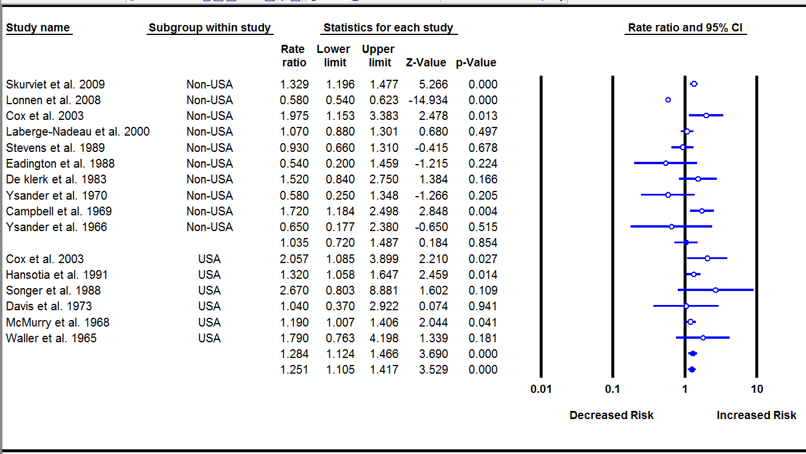
Key Question 1: Crash Risk Among Drivers
Summary for Non-USA
Summary for USA
Significant increase in
crash risk in USA studies; But not in the non-USA studies

Slide 21
Key Question 1: Crash Risk Among Subgroups
Insulin Dependent vs. Oral Medication or Diet
Subgroup Analysis
  Insulin-treated vs. oral medication and/or diet
  Five of the original studies, one new study
  Findings:
  Random Effects Meta-analysis:
  Risk Ratio = 1.537 (95% CI: 0.603–3.915, P=0.368)
  Not significant
  New Analysis: Further categorized by U.S. vs. Non-U.S.
    Findings:
    Random Effects Meta-analysis:
      U.S. subgroup: Risk Ratio = 2.753 (95% CI: 1.537–4.930, P=0.001)
      Non U.S. subgroup: Risk Ratio = 1.036 (95% CI: 0.682–1.573, P=0.868)

Slide 22
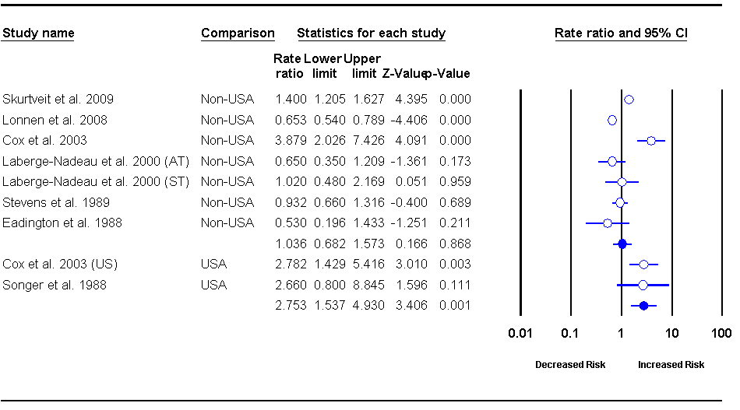
Key Question 1: Crash Risk Among Subgroups
Summary for Non-USA
Summary for USA
Significant increase in crash risk for individuals treated with insulin compared to oral medication or diet, in USA studies; But not in the non-USA studies

Slide 23
Key Question 2: Is Hypoglycemia a Risk Factor?
27 studies included
  3 simulated driving
  25 cognitive/ psychomotor testing
All case-control studies
None specific to CMV drivers
Overall quality = Moderate

Slide 24
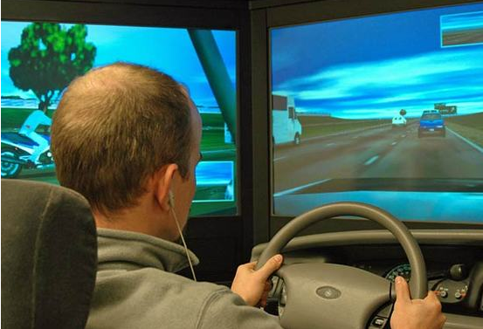
Key Question 2: Is Hypoglycemia a Risk Factor?
Driving simulator studies
  3 studies (no new studies identified in 2010 update)
  Hypoglycemia has a significant deleterious effect on the driving ability of some individuals with type 1 (or IDDM) when measured using a driving simulator (Strength of Evidence: Moderate)
  The specific aspects affected by low blood glucose levels varied in studies
    Midline crossing
    Swerving
    Driving at high speeds
  The blood glucose levels at
  which impairment becomes
  apparent vary across studies
  (3.6 – 2.6 mmol/L)

Slide 25
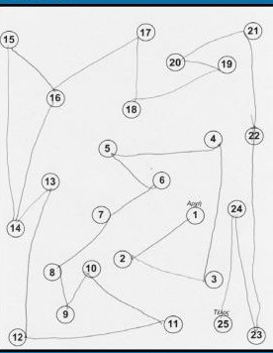
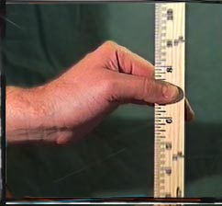
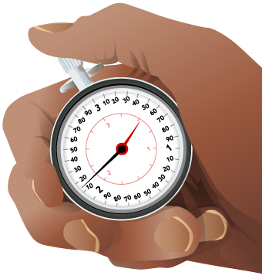
Key Question 2: Is Hypoglycemia a Risk Factor?
Cognitive and Psychomotor Functions
  25 studies
  Hypoglycemia has a significant deleterious effect on the cognitive and psychomotor function of individuals with type 1 diabetes mellitus (or IDDM) as measured by a number of different cognitive and psychomotor function tests (Strength of Evidence: Moderate)
  Some key points to note:
    Some individuals appeared not to be affected
    by low to moderate levels of hypoglycemia
    Other individuals appeared to be unaware
    that they were hypoglycemic and/or they tended to underestimate the impact that hypoglycemia was having on their cognitive and psychomotor function

Slide 26
Key Question 3: Risk Factors for Severe Hypoglycemia
Background for this question
Primary aim of modern treatments for individuals with diabetes is to control blood glucose levels at near normal levels
  Why? Tight control reduces the risk for developing the long-term complications associated with type 1 and type 2 diabetes (e.g., retinopathy, nephropathy, neuropathy, cardiovascular disease, etc.)
  However, there is an increased risk of hypoglycemia with tighter blood glucose control
Objective for this question
To identify treatment-related risk factors for experiencing severe hypoglycemia

Slide 27
Key Question 3: Risk Factors for Severe Hypoglycemia

Slide 28
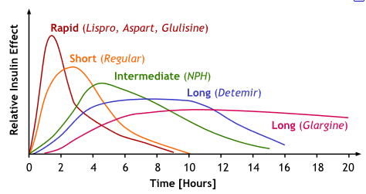
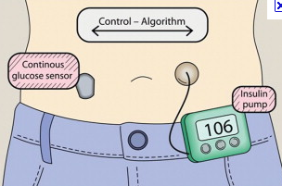
Key Question 3: Risk Factors for Severe Hypoglycemia
Types of Insulin
  Short-acting insulin analogues: 2 recent meta-analyses; no differences observed
  in rate of severe hypoglycemia
  compared with regular insulin
  Long-acting insulin analogues: 5 systematic reviews; in 4 of 5 studies, reductions in severe hypoglycemia compared with regular insulin
Delivery of Insulin
  Continuous subcutaneous insulin infusion:
  Mixed findings; 2 studies suggest it
  reduces risk of severe hypoglycemia;
  other studies demonstrated no
  significant differences but trends
  toward reductions in occurrence
  of severe hypoglycemia

Slide 29
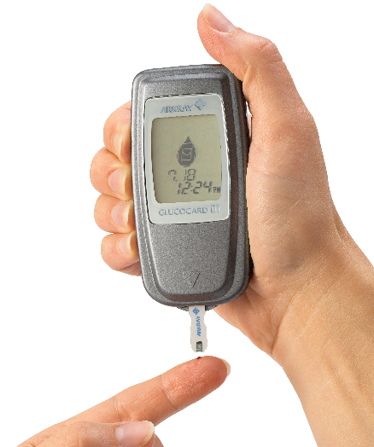
Key Question 3: Risk Factors for Severe Hypoglycemia
Intensive vs. Standard Glycemic Control
  Intensive Glycemic Control: 2 recent meta-analyses; in both of these meta-analyses, the incidence of severe hypoglycemic events was significantly increased. However, did not
  increase the risk for severe hypoglycemia
  in patients with type 2 diabetes.
Monitoring Glucose Levels
  Self-Monitoring of Blood Glucose (SMBG):
  In two recent meta-analyses of the effect of
  SMBG in non-insulin treated patients with
  type 2 diabetes, SMBG was found to be
  associated with significant increases in the
  rate of hypoglycemia.

Slide 30
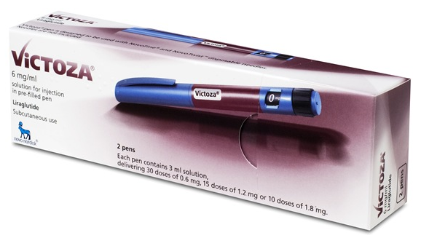
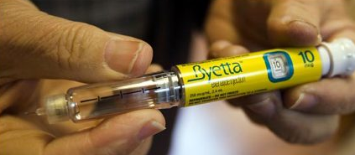
Key Question 3: Risk Factors for Severe Hypoglycemia
New to the 2010 Update
Non-insulin Injectable
Treatments for Type 2
Diabetes
  Exenatide (Byetta®)
  Liraglutide (Victoza®)
  Target Evidence Review conducted by ARIF for the DVLA in 2008, and two more recent meta-analyses
Enhance insulin secretion only when glucose levels are high
Suppress inappropriately elevated glucagon secretion
Slow gastric emptying

Slide 31
Key Question 3: Risk Factors for Severe Hypoglycemia
Summary for Byetta Studies
  Rates of severe hypoglycemia are low
  Patients taking a sulphonylureas
  with exanatide are at increased risk for hypoglycemia compared to individuals taking sulphonylurea alone
  Incidence of hypoglycemia was higher with higher dose of exanatide
  Based on these results: DVLA in UK requires CMV drivers to be reviewed if they take exanatide or liraglutide with a sulphonylurea
Act by increasing insulin release

Slide 32
Key Question 4: Hypoglycemia Awareness Training
8 studies
All RCTs or CTs
Moderate quality

Slide 33

BGAT (or HyPOS)
  Training programs
    Promotes the belief that
    "symptom perception is a skill"
    that can be developed. If a
    person doesn't recognize his
    or her individual signs (or cues)
    of hypoglycemia, awareness can be enhanced
  Trains individuals to recognize signs and symptoms of hypoglycemia, particularly in individuals who are unaware when they become hypoglycemic

Slide 34
Key Question 4: Hypoglycemia Awareness Training
Awareness training programs (i.e., BGAT and HyPOS) improve the ability of individuals with type 1 diabetes to improve the accuracy in estimating their blood glucose levels (Strength of Evidence: Moderate) (based on 6 studies)
Inconsistent evidence precludes a determination from being made concerning whether awareness training (BGAT or HyPOS) is effective in reducing the incidence of severe hypoglycemia. Two studies found no improvements. One study demonstrated improvements.
(based on 3 studies)

Slide 35
Summary of Findings
Key Question 1:
  Meta analysis of 15 studies (comparing crash risk in individuals with diabetes to those without) demonstrated a non-significant increase in crash risk for individuals with diabetes. This is different to the 2006 report.
    New: Subgroup analysis suggest an increased risk of crash for drivers of the general population in the U.S., but not in other countries
    New: Subgroup analyses suggest an increased risk of crash for drivers with diabetes who are insulin-dependent in the U.S., but not in other countries
  The subgroup analyses suggest that medical review requirements for drivers with diabetes in other countries such as the UK, may remove of individuals at greatest risk from the roads

Slide 36
Summary of Findings
Key Question 2:
  No change in findings from original evidence report
  Driver simulation studies suggest that driving functions are impacted by induced hypoglycemia
  Cognitive and psychomotor functions are impacted to varying degrees in individuals by induced hypoglycemia

Slide 37
Summary of Findings
Key Question 3:
  No change in findings from original evidence report
  Treatment related risk factors for severe hypoglycemia include: long duration of disease, long duration of insulin use, lower HbA1C levels, impaired hypoglycemia awareness
  New to this report: assessment of non-insulin injectable drugs; rates of severe hypoglycemia are low, but taking Byetta with a sulphonylureas increases the risk for hypoglycemia
Key Question 4:
  No change in findings from original evidence report
  Hypoglycemia awareness training programs (i.e., BGAT and HyPOS) improve the ability of individuals in estimating their blood glucose levels, but the evidence is less clear about whether it reduces the incidence of severe hypoglycemia.

