Slide 1


Commercial Driver Perspectives on Obstructive Sleep Apnea
Rebecca M. Brewster
President and COO
American Transportation Research Institute

Slide 2

ATRI
Trucking industry’s NFP research organization
Safety
Mobility
Economic Analysis
Technology
Environment
www.atri-online.org

Slide 3














Board of Directors

Slide 4






































Research Advisory Committee

Slide 5

2015 Top Industry Issues
Hours-of-Service
CSA
Driver Shortage
Driver Retention
Truck Parking
ELD Mandate
Driver Health & Wellness
Economy
Transportation Infrastructure/ Congestion/Funding
Driver Distraction

Slide 6
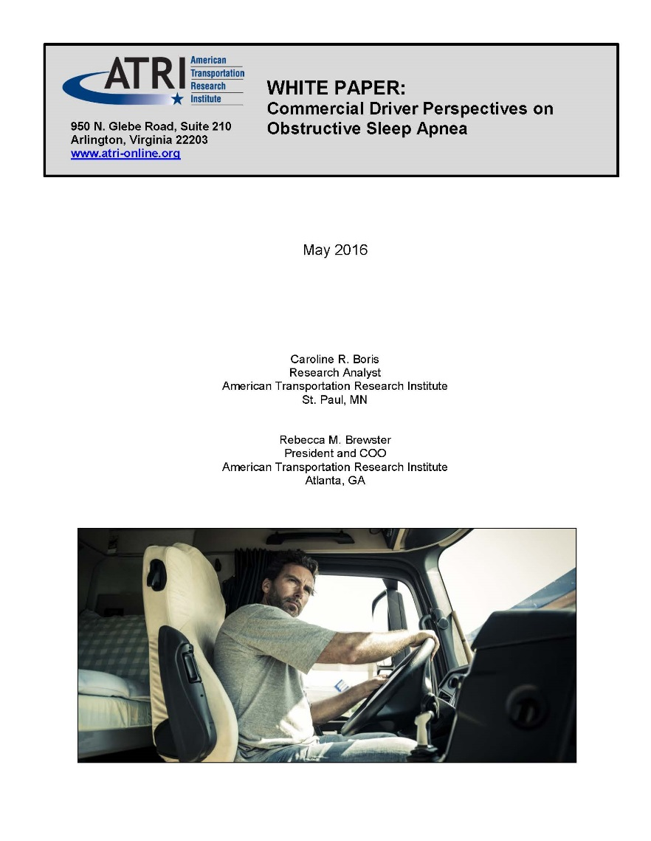

Obstructive Sleep Apnea ANPRM
Top RAC priority for 2016
FMCSA Advanced Notice of Proposed Rulemaking on OSA; comment period open through July 8, 2016
Over 800 drivers participated in ATRI survey
Notes:
6

Slide 7
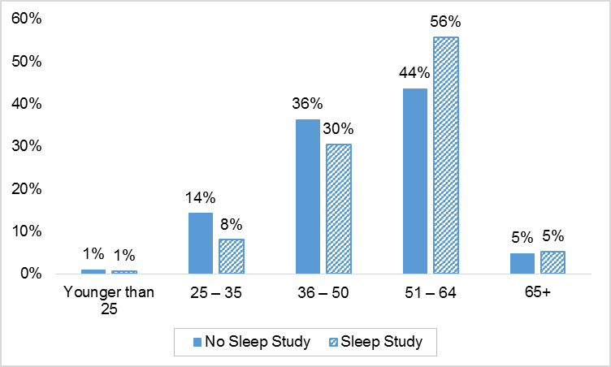
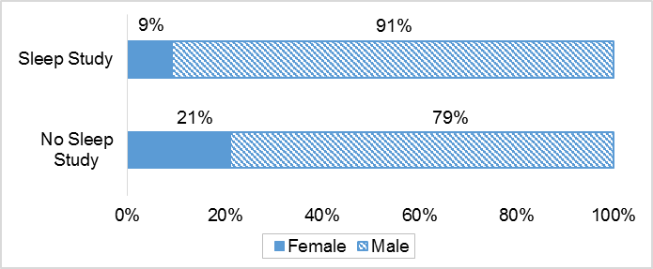
Respondent Demographics
72% Employee Drivers
28% O/O, IC

Slide 8

Driver Experience – OSA
Does your carrier have a defined OSA policy?
 | Employee Drivers | O-O/I-C Leased to a Motor Carrier
Yes | 24% | 12%
No | 46% | 57%
Don’t Know | 30% | 32%
Is the CME or clinic you go to for DOT physicals chosen by your carrier?
 | Employee Drivers | O-O/I-C Leased to a Motor Carrier
Yes | 65% | 39%
No | 28% | 59%
Don’t Know | 7% | 2%

Slide 9
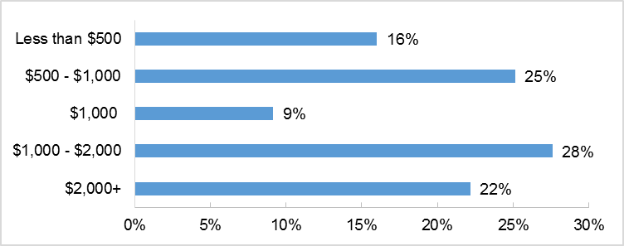
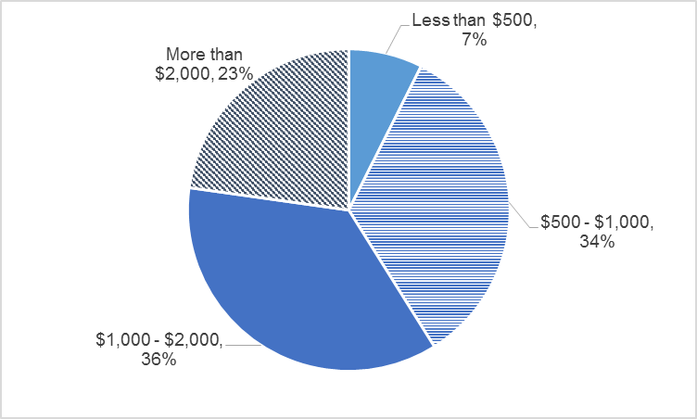
No Sleep Study Drivers
70% believe in-lab sleep study necessary for diagnosis
Driver Estimates of Sleep Study Costs
Driver Estimates of CPAP Costs

Slide 10
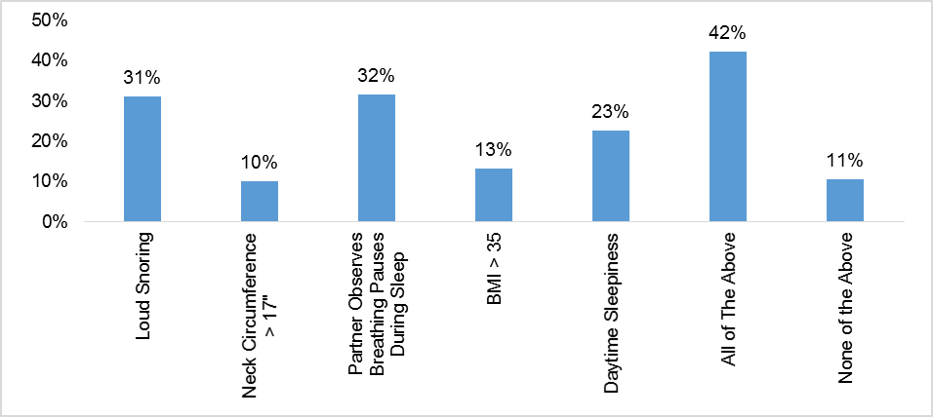
No Sleep Study Drivers

Slide 11
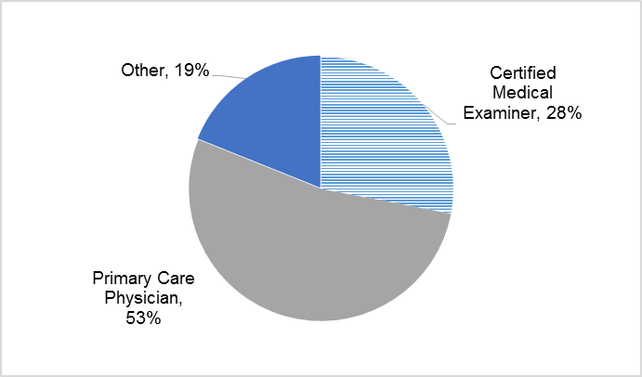
Sleep Study Drivers
Who referred you for a sleep study?

Slide 12
Sleep Study Drivers
Did you get a second opinion on the need for a sleep study after referral?
  88% did not
85% completed in-lab sleep studies
15% home sleep studies

Slide 13
Driver Expense for Sleep Study
53% paid out-of-pocket costs
Average driver out-of-pocket cost $1,220; nearly 1.5 weeks of average driver pay at $835/week
67% of employee drivers said health insurance covered some portion of sleep study costs
15% of employee drivers said employer covered some portion of sleep study costs
61% of drivers with no health care coverage of sleep study out-of-pocket costs >$1,000 vs. 32% with health care coverage of sleep study with out-of-pocket costs >$1,000
Notes:
13

Slide 14
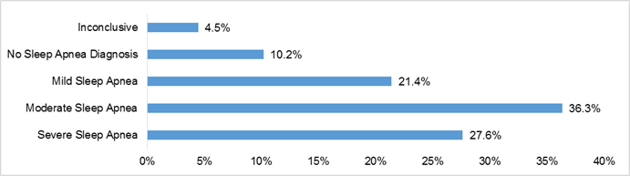
Sleep Study Drivers
Age | Inconclusive / No OSA Diagnosis | Mild OSA | Moderate OSA | Severe OSA
50 or Younger | 20% | 22% | 29% | 29%
51+ | 10% | 21% | 42% | 27%

Slide 15
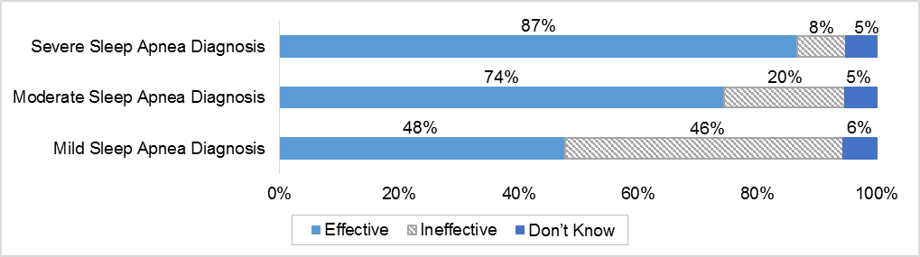
Driver Treatment for OSA
CPAP most prescribed treatment – 94%
  72% found CPAP effective
  21% did not find CPAP effective
  7% unsure of treatment efficacy
Perceived efficacy impacted by OSA severity
Notes:
15

Slide 16
CPAP Treatment Impacts
 | OSA Severity | Agree | Disagree | Don’t Know | No Change
My blood pressure has decreased | Mild | 0% | 0% | 14% | 86%
 | Moderate | 30% | 0% | 0% | 70%
 | Severe | 75% | 0% | 0% | 25%
Amount of sleep has increased | Mild | 32% | 43% | 0% | 25%
 | Moderate | 54% | 23% | 1% | 22%
 | Severe | 71% | 13% | 2% | 13%
My weight has decreased | Mild | 29% | 0% | 14% | 57%
 | Moderate | 50% | 10% | 0% | 40%
 | Severe | 50% | 25% | 0% | 25%
I feel better when I wake up | Mild | 44% | 26% | 1% | 28%
 | Moderate | 75% | 13% | 0% | 13%
 | Severe | 84% | 3% | 1% | 12%
Notes:
16

Slide 17
Driver Perceptions – OSA
Rationale for OSA rulemaking
  Clarify relationship OSA and crash risk
  Quantify affected population of CMV drivers with OSA
Driver acceptance of sleep study referral criteria
  Drivers do not believe neck circumference and BMI should be used as sole metrics for referral to sleep study
Driver sleep study costs are significant
  Flexibility for home sleep studies will reduce cost impacts and reduce time off work for study

Slide 18
Driver Perceptions – OSA
OSA screening procedures must be clarified
  36% of ATRI sample who completed sleep study did not require treatment
CPAP not effective for treating all OSA drivers
  Among mild OSA drivers in ATRI sample, 91% treating with CPAP (though not required)
  Less than half experienced improved sleep with CPAP treatment
Preventing conflicts of interest – CMEs, sleep clinics, treatment providers – will be critical

Slide 19

Questions?
Rebecca Brewster
rbrewster@trucking.org
770-432-0628
www.atri-online.org
@ATRIPREZ

