Slide 1
Commercial Vehicle Safety Data Quality and Uniformity

Slide 2
Presentation Overview
The Context
Areas of Focus

Slide 3
The Context
Why is data quality so important?
What are the current issues?
What has CVSA been doing about it?
Notes:
Building Blocks
Regulatory Framework
Inspections ( 3 pieces, all are distinct, necessary and complementary)
Roadside Inspection Levels, Procedures, OOSC, Training & Certification
Appendix G
Pre-trip
3. Safety Management Cycle/CSA
Why is it important?
2008 – Data Uniformity Ad Hoc Committee -- Four Core Components
Consistent documentation of roadside inspection and violation data
Standardized processes for challenging data
Increased awareness of high level goals of the inspection program
Uniform inspection selection processes
Why improve?
Performance measurement (industry AND enforcement)
Legislation, Regulations, Policy and Program development/evaluation
Ensure we are focusing on the right things for the right reasons

Slide 4
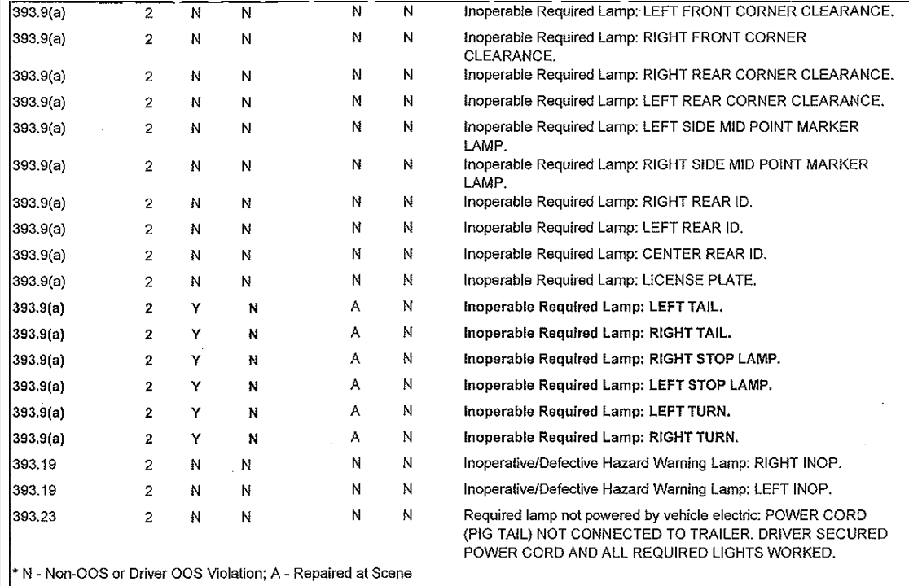
Carrier sees 19 Violations
Should be 9 Separate Violations
SMS sees 3 Separate Violations
Notes:
This is an actual list of violations documented on a roadside inspection report.
The Carrier, when looking at the list, sees 19 separate violations.
However, when the inspection report goes into SMS, the systems sees 3 different violations – because there are only 3 violation codes.
However, there are actually 9 violations. The violations refer to 9 separate lighting requirements that are not met. The first four violations refer to clearance lights – even though all four are out, it is only one violation – not having proper clearance lighting.
Once the software is updated to mirror CVSA’s Operational Policy 14 – which I will discuss later – the system will guide how the violations are processed through the system.

Slide 5
Notes:
Read the slide

Slide 6
Improve Regulatory Framework
Issue: Regulations outdated and inconsistent with interpretations, regulatory guidance, operational policies and enforcement memos
CVSA Recommendations:
CVSA Petitions for Rulemaking
Incorporate changes implemented through:
Interpretations
Regulatory guidance
Operational Policies
Enforcement memos
Notes:
Issue: Regulations outdated and inconsistent with interpretations, regulatory guidance, operational policies and enforcement memos
FMCSA issues guidance documents to correct technical errors in published rules or to clarify vague regulatory language within the safety regulations while improvements to the regulations make their way through the rulemaking process
The number of full rulemakings that can make it through the agency in any given year is limited by staff and funding, and a number of higher profile rules tend to push simple technical changes back in the queue.
As a result, a disconnect has developed between written regulation, regulatory guidance and interpretations, leading to confusion and inconsistencies.
These inconsistencies undermine the quality of the data going into CSA
CVSA Actions:
CVSA is working to address this through petitions for rulemaking, policy positions that promote regulatory effectiveness and improvements and our ongoing committee deliberations that help identify issues and provide solutions
Sample petitions:
383.5 & 390.5 – GVWR/GCWR
393.5 – Major Tread Grooves
393.118 – Dressed Lumber
Sample Interpretations
AOBRD/EOBR/ELD
Sample Regulatory Guidance
CDL Suspensions and Withdrawals

Slide 7
Roadside Inspection Software
Update Roadside Inspection Violations
Issue: Disconnect between less specific regulatory references and more detailed violation codes in roadside inspection software
Hardcode Inspection Violations
Issue: Too many variations in violation descriptions documented on roadside inspection report
Implement Smart Logic
Issue: Improper cataloging of multiple roadside inspection violations of the same regulatory cite
Notes:
Update Roadside Inspection Violations
CVSA Recommendation (reference lighting example earlier):
Updating Violation Tables
Original work completed by CVSA Data Quality Ad Hoc in 2008
Working with CVSA Committees D(river-traffic Enforcement, Hazardous Materials, Vehicle)
Hardcode Inspection Violations
CVSA Recommendations:
Violations should be ‘hard coded’ – unchangeable within the software
Ability to add additional clarifying descriptive information
Violation information should be mirrored through roadside software → SAFETYNET → MCMIS
Implement Smart Logic
CVSA Recommendations:
Short term – Training
Long term – Implement Smart Logic programming changes within roadside inspection software, CVSA Operation Policy 14 - How to Properly Document a Violation

Slide 8
Getting it right at the point of entry
Ensure correct entries for those interacting with the systems
Carriers, States, Inspectors, Investigators, Brokers, FMCSA
URS should help
Need to effectively police the system (quality control)
Examples
Issue: Carriers improperly identified roadside
Issue: Improperly documented roadside inspection violations (incorrect inspection violations)
Lack of clarity in regulations is a contributing factor
Issue: Lack of consistency in data viewed by roadside enforcement
Notes:
CVSA Recommendations
System Edit checks
Enforcement on carriers/brokers not providing updated information as required
Enhanced vetting/oversight processes by FMCSA
Ensure all systems have updated information and are consistent
Training
Improve regulatory framework
CVSA Training Committee
North American Standard Training Materials
Annual Refresher / In-Service Training
CVSA North American Inspectors Championship
Operational Policy #14
Basics2Roadside Training

Slide 9
Effective Due Process
Implement Effective DataQs Review Process
Issue: Lack of uniformity in processing DataQ challenges
Implement effective DataQ Due Process
Issue: No uniform process or final authority for resolving a DataQ challenge when the motor carrier and DataQ administrator continue to disagree
Address Adjudication of Citations
Issue: No uniform process for how to handle an adjudicated citation that is linked to a violation documented on a roadside inspection report
Notes:
CVSA Recommendations:
CVSA and FMCSA are currently working to how best to address these issues.
2013 Information Systems Users Workshop, Louisville, KY
Revised DataQs Guidelines Manual discussed
CVSA and FMCSA are continuing to evaluate Manual’s effectiveness
Promoting best practices
Training
Data Quality Ad Hoc Committee
Analyzing DataQs RDRs for trends and folding back into training courses

Slide 10
Additional Issues
Compliance vs. Crash Risk
Inspection vs. Screening
Regional Disparities in Enforcement
Crash Reporting
Notes:
Compliance v Crash Risk
Non-compliance is an important factor for safety. Enforcement needs visibility into all violations. Concerned that industry may pick and choose what regulations to comply with.
Inspection v Screening
Can/should we define a pre-inspection screen?
Should the definition be limiting in nature?
Can/should we draw a line at a specific point(s) at which a pre-inspection screen becomes an inspection?
Should we mandate that an inspection report be generated when a defined inspection starts?
Ultimate decision was no, data should not drive operations. The inspection is based on the critical items. However, issue has merit and needs further work.
Regional Disparities
Each state is different in operational configuration (sworn vs non-sworn, permanent scales vs mobile), problem areas, industry types/vehicle configurations.
Crash Reporting
Each state is different, crash forms/data collected, who responds to the scene big issue, many not CMV trained, urban vs rural issue

Slide 11
Data Quality AdHoc Committee
Identify strengths and weaknesses in the collection, documentation, use and application of roadside inspection and enforcement data.
Develop and promote solutions that improve the uniformity, reciprocity, accuracy and timeliness of roadside inspection and enforcement data.
Develop suggested standardized processes for handling challenges to roadside inspection and enforcement data.
Improve awareness and understanding of the need for uniform and consistent driver/vehicle inspections and inspection selection policies.
Examine possible metrics for measuring data quality.
Notes:
The ad hoc was reinstated in January of this year
The ad hoc is in the process of discussing each issue area

Slide 12
Summary
What has been accomplished and where are we going?
Notes:
Operational Policy #13
Operational Policy #14
Basics 2 Roadside Training
DataQs progress
Documentation of violations improving
Data Quality improving
Importance of accurate data and inspector’s role
Where are we going?

Slide 13
Thank you! Questions?
Major Mark Savage
CVSA President
Colorado State Patrol
303-916-1853
mark.savage@state.co.us

