Slide 1


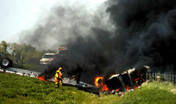
Division of
Addressing Obstructive Sleep Apnea in
Commercial Motor Carrier Drivers
Medical Review Board & Motor Carrier
Safety Advisory Committee, Federal
Motor Carrier Safety Administration
Department of Transportation
December 7, 2011
Charles A. Czeisler, Ph.D., M.D.*
Baldino Professor of Sleep Medicine
Director, Division of Sleep Medicine
Harvard Medical School
Chief, Division of Sleep Medicine,
Department of Medicine, Brigham & Women’s Hospital
JEFF COOPER / Salina Journal © 2007 and 2008 Salina Journal Smoke rolls off the wrecked tractor-trailer that was involved in the crash on Interstate Highway 135 near the Mentor interchange, south of Salina.
*Dr. Czeisler is/was a consultant to Bombardier, Boston Celtics, Cephalon/Teva, Columbia River Bar Pilots, Delta Airlines/Comair, Eli Lilly, Garda Inspectorate—Republic of Ireland, Johnson & Johnson, Koninklijke Philips Electronics, Minnesota Timberwolves, Portland Trail Blazers, Sanofi-Aventis, Somnus, Vanda, Zeo; receives royalties from McGraw Hill, New York Times, Penguin Press and Philips Respironics; has an equity interest in Lifetrac, Somnus, Vanda and Zeo; is an expert witness in legal cases; and is the incumbent of a professorship at Harvard endowed by Cephalon.

Slide 2
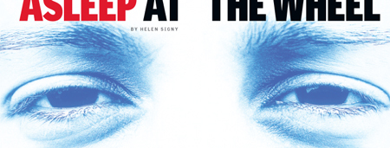
ASLEEP AT THE WHEEL
~20 %
of
crashes
250,000 U.S. drivers fall asleep at the wheel daily
Drowsy driving crash every 25 seconds
(1.2 million drowsy driving crashes/year)
Drowsy driving injury each minute
(500,000 injuries annually)
Drowsy driving debilitating injury every 10 min
(55,000 debilitating injuries annually)
Drowsy driving fatality every 70 minutes
(~7,500 deaths annually)
Sources: NHTSA, 2006 IOM Report, NSF Annual Survey, NHTSA 100-car study, NTSB

Slide 3
Top Three
Preventable Causes of Fatal Motor Vehicle Crashes
Drunk Driving ~10,500 deaths annually
Drowsy Driving ~ 7,500 deaths annually
Distracted Driving ~ 5,500 deaths annually

Slide 4
Drowsy Operator or Fatigue-related incident
Operator impaired by drowsiness
  Sleep deficiency
    Insufficient Sleep (acute or chronic)
    Sleep Disorder
  Circadian disruption
  Drug- or alcohol-induced
  Secondary to other medical condition
Drowsy drivers seek distractions to stay awake
  Sleep deficiency increases distractibility

Slide 5
Trucker Jailed on Two Counts of Vehicular Homicide
Mother, 25, Infant Son Killed in Kansas CA
January 10, 2007 & November 6, 2008
By DAVID CLOUSTON
© 2007 and 2008 Salina Journal
JEFF COOPER / Salina Journal Smoke rolls off the wrecked tractor-trailer that was involved in the crash on Interstate Highway 135 near the Mentor interchange, south of Salina.
Scott A. Wegrzyn
Diagnosed with sleep apnea 4 years earlier
BMI 45.3 (353 lbs, 6’2”); AHI 62: given 90-day provisional medical certification after revealing sleep apnea
Instructed to undergo apnea reevaluation; 2x crashes
Instead, obtained 2-year medical certification from another doctor, not told of sleep apnea diagnosis
No braking/evasive maneuver before hitting median

Slide 6
Adverse impact of sleep deficiency/circadian disruption on operator performance
Slowed reaction time
Increased risk of lapses of attention
Increased risk of automatic behavior
Increased distractibility
Impaired judgment (not as risk averse)
Fast and sloppy (speed/accuracy tradeoff)
Impaired memory
Increased risk of falling asleep

Slide 7
Drowsiness is Special Problem for Commercial Motor Vehicle Operators
Operating commercial motor vehicles is routine, highly over-learned task with minimal novelty
Drivers are usually in a sedentary position
At night, commercial motor vehicle drivers are usually in dim light or near darkness
Task is uniquely vulnerable to momentary lapse of attention or slowed reaction time

Slide 8
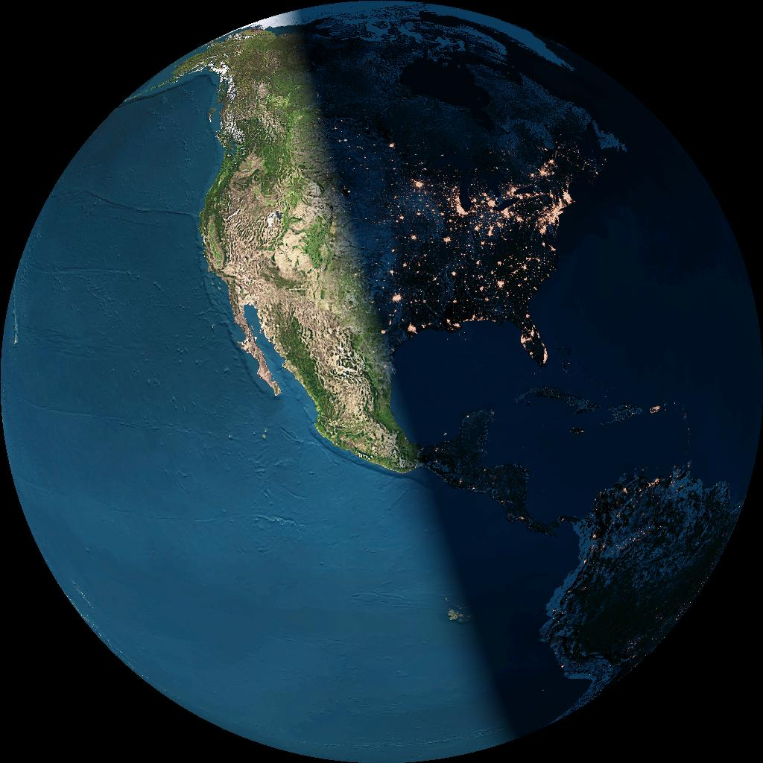
PHYSIOLOGICAL DETERMINANTS OF FATIGUE
Consecutive Waking Hours
Night Sleep Duration
Biological Time of Day (circadian rhythms)
Sleep Inertia
Use of Stimulants or Hypnotics
Medical Condition; Clinical Sleep Disorders; Age

Slide 9
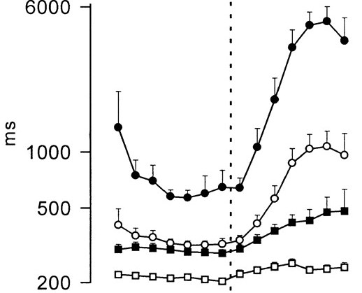
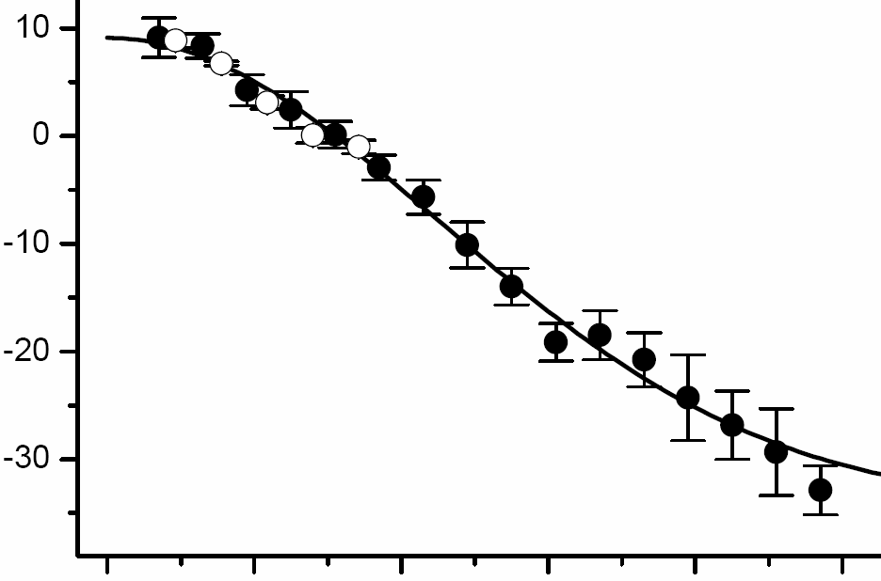
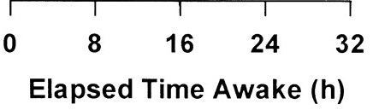
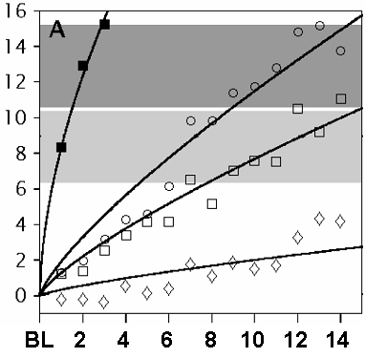
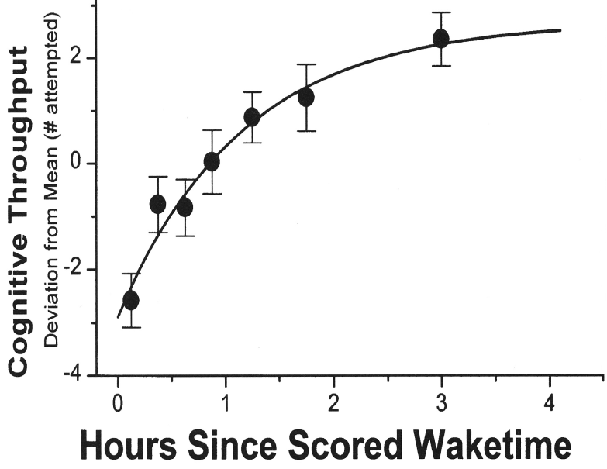
1 – Circadian time of day
2 – Acute sleep deprivation
Slowest 10%
Mean
Psychomotor performance
reaction time (ms)
Cognitive throughput
Deviation from mean (#)
Median
Fastest 10%
Time since waking (h)
8
16
0
8
16
0
10
20
30
40
50
Approximate time of day
3 – Chronic sleep deficiency
4 – Sleep inertia
4 h TIB
No sleep
Cognitive throughput
Deviation from mean (#)
Psychomotor performance
lapses (#)
6 h TIB
8 h TIB
Study days
Time since waking (h)

Slide 10
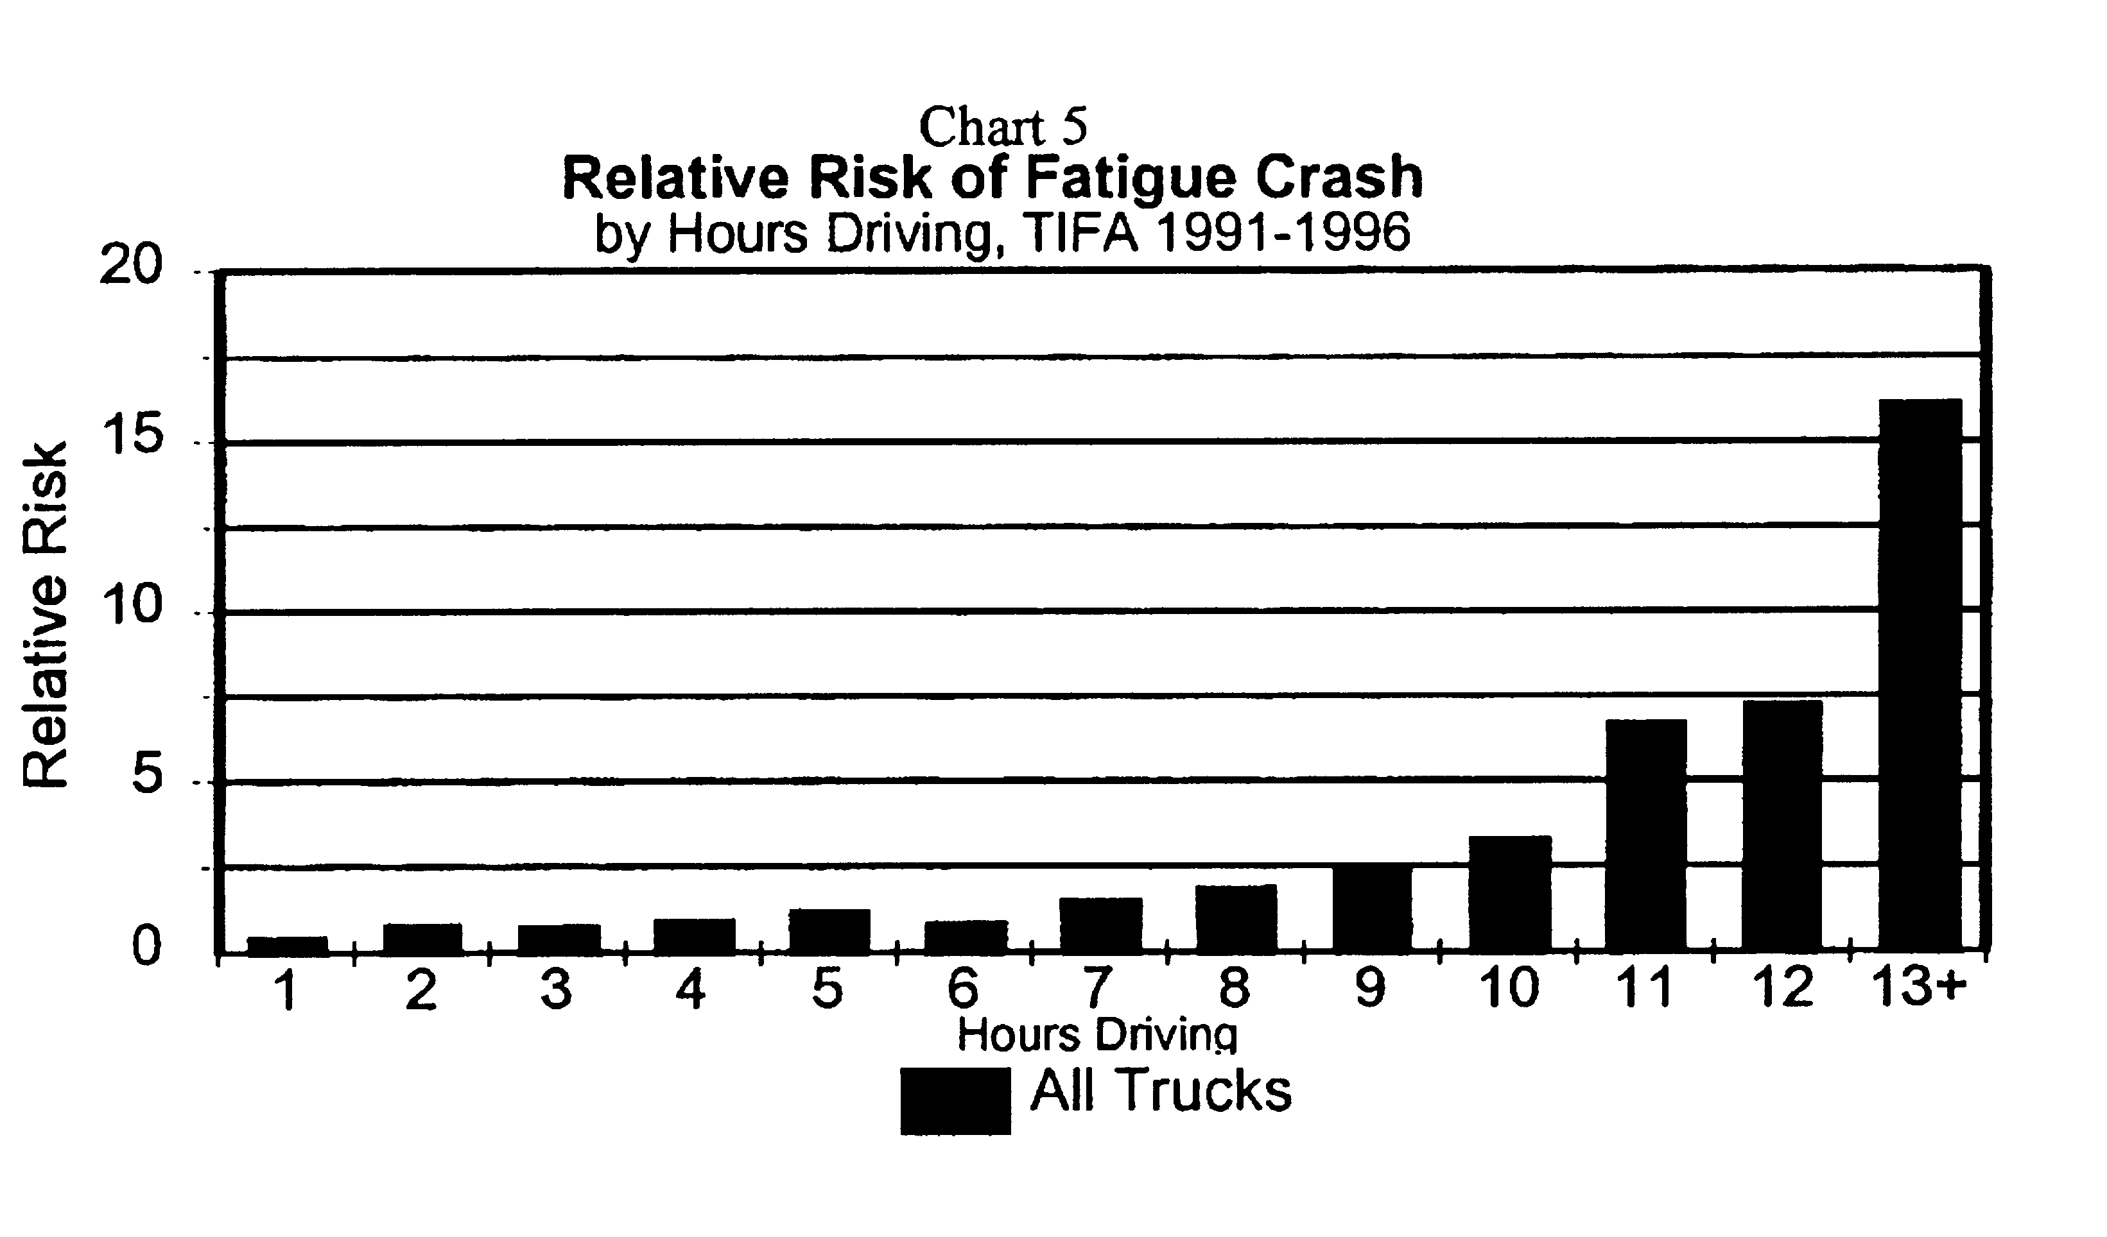
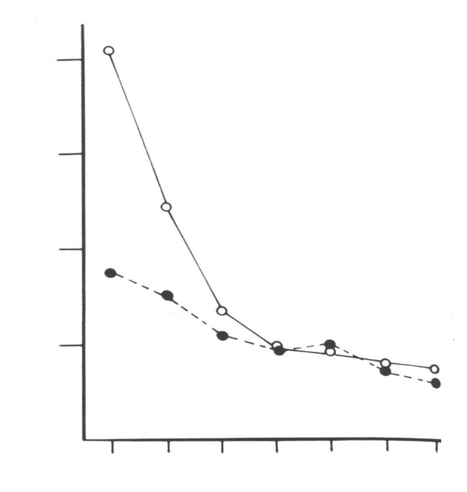
1 – Circadian time of day
2 – Acute sleep deprivation
Time course of single vehicle truck accidents
Single vehicle truck accidents by hours driving
Slowest 10%
Mean
Psychomotor performance
reaction time (ms)
Cognitive throughput
Deviation from mean (#)
Median
Fastest 10%
Time since waking (h)
8
16
0
8
16
0
10
20
30
40
50
Approximate time of day
3 – Chronic sleep deprivation
4 – Sleep inertia
Pilot crashes by
time since waking
4
Fighters
Lapses of attention by MDs
on two work schedules
3
30-hour shifts, 85 h/wk
Hourly accident coefficient
2
16-hour shifts, 65 h/wk
1
All aircraft
Time since waking (h)
1 2 3 4 5 6 7
Hours since 6:00 h wake time

Slide 11
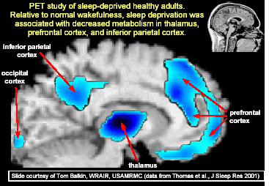


Performance Impairment in Cognitive Psychomotor Performance
24 hours of wakefulness (at 8 am) induces impairment equivalent to blood alcohol concentration of 0.10%
D. Dawson and K. Reid, Nature 388: 235, 1997
Changes in brain activity after sleep loss
Christian Cajochen,PhD
Cajochen C, Khalsa SBS, Wyatt JK, Czeisler CA, Dijk D-J. Am J Physiol 277: R640-R649, 1999

Slide 12
NTSB: Fatigue Is the Most Common Cause (31%) of Fatal-to-driver Truck Crashes
National Transportation Safety Board Safety Study (SS-1995/01)

Slide 13
Overnight Trucking and Drowsy Driving
Polysomnographic recordings reveal that truck drivers working between midnight and noon sleep an average of only 3.8 hours per day^{1,2}
Videos recordings revealed that truck drivers are often drowsy while driving
  Forty-five drivers (56 percent) had at least 1 six-minute interval of drowsiness while driving
  1067 of the 1989 six-minute segments (54 percent) that showed drowsy drivers involved just eight drivers
¹Wylie et al., Commercial Motor Vehicle Driver Fatigue and Alertness Study: Technical Summary. Report No. FHWA-MC-97-001, National Technical Information Service, Springfield, VA, November, 1996.
²Mitler, M. M., Miller, J. C., Lipsitz, J. J., Walsh, J. K., and Wylie, C. D. The sleep of long-haul truck drivers. New England Journal of Medicine 337, 755-761. 1997.

Slide 14

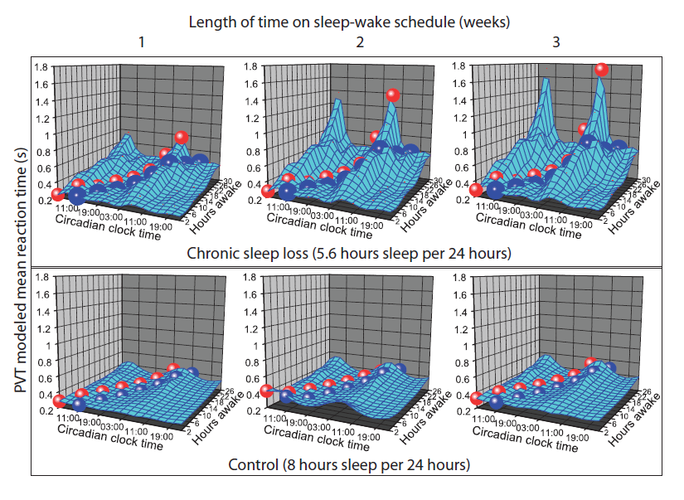

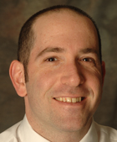
Chronic Sleep Curtailment Accentuates Vulnerability to Extended (>24-h) Wakefulness
Daniel Cohen, MD
Cohen DA, Wang W, Wyatt JK, Kronauer RE, Dijk D-J, Czeisler CA, Klerman EB. Uncovering residual effects of chronic sleep loss. ScienceTransl Med 2: 14ra3, 2010.

Slide 15
Drivers in multiple states in the U.S. (California,* Colorado,* Florida,* Maryland, Massachusetts, Michigan, New Jersey,* Virginia), Australia, Britain,* Germany and Japan have been convicted of vehicular homicide for driving when impaired by sleepiness. Employers who sanctioned excessive hours violating hour of service regulations incarcerated in US & UK.
New Jersey has amended its vehicular homicide statue statute to add "driving after having been without sleep for a period in excess of 24 consecutive hours" to the definition of reckless, explicitly subjecting sleep-deprived drivers in that state to conviction of criminal homicide
Similar legislation—endorsed by the Sleep Research Society, the National Sleep Foundation and the American Academy of Sleep Medicine—is pending in Illinois, New York, Massachusetts and Michigan
*and incarcerated

Slide 16
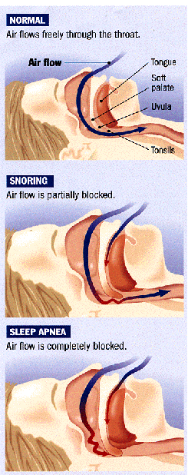
Obstructive Sleep Apnea (OSA)
Temporarily stopping breathing during sleep
  Caused by narrowing of airway during sleep
  Reduces oxygen to the lungs
Symptoms
  Snoring plus ‘gasping’ or stopping breathing
  Excessive sleepiness during wake
  Large neck size
  Obesity
  High prevalence in overweight middle-aged men
  Leading known cause of high blood pressure
  Higher risk of CV disease, hypertension,
  and stroke
  Higher rate of drowsy driver car crashes
  Most people are undiagnosed
http://www.sleephealth.com

Slide 17
Obstructive Sleep Apnea (OSA)
OSA → sleep fragmentation and excessive sleepiness
Most OSA patients are undiagnosed/untreated
Vigilance , planning, sequential thinking, the ability to sustain attention are degraded in OSA patients
Reaction times in OSA patients are comparable to a blood alcohol concentration of 0.080 g/dL
Greatly increased vulnerability to sleep deprivation
Obesity (BMI > 30 kg/m²) → high risk of OSA
FMCSA Medical Advisory Board recommends mandatory objective OSA screening of CDL holders with BMI > 30
One-third of American adults are obese (BMI > 30 kg/m²)

Slide 18
Current FMCSA Medical Qualification Standard is only obliquely relevant to OSA
Current standard
49 CFR 391.41 (b) (5) of the Federal Motor Carrier Safety Regulations
  No established medical history or clinical diagnosis of respiratory dysfunction likely to interfere with the ability to control and drive a commercial motor vehicle safely

Slide 19
Current 1988 FMCSA Guidance on OSA never required as Medical Qualification Standard
Conference on Neurological Disorders and Commercial Drivers (1988)
  The patient with sleep apnea syndrome having symptoms of excessive daytime somnolence cannot take part in interstate driving, because they likely will be involved in hazardous driving and accidents resulting from sleepiness. Even if these patients do not have the sleep attacks, they suffer from daytime fatigue and tiredness. These symptoms will be compounded by the natural fatigue and monotony associated with the long hours of driving, thus causing increased vulnerability to accidents. Therefore, those patients who are not on any treatment and are suffering from symptoms related to EDS should not be allowed to participate in interstate driving.
  Those patients with sleep apnea syndrome whose symptoms (e.g., EDS, fatigue etc.) can be controlled by surgical treatment, e.g., permanent tracheostomy, may be permitted to drive after 3 month period free of symptoms, provided there is constant medical supervision. Laboratory studies (e.g., PSG and MSLT) must be performed to document absence of EDS and sleep apnea.

Slide 20
Recommendations of 1991 OMC Consensus Conference on Medical Qualification Standard for OSA: Not implemented by FMCSA
Conference on Pulmonary/Respiratory Disorders and Commercial Drivers (1990)
  Individuals with suspected or untreated sleep apnea (symptoms of snoring and hypersomnolence) should be considered medically unqualified to operate a commercial vehicle until the diagnosis has been dispelled or the condition has been treated successfully. In addition, as a condition of continuing qualification, commercial drivers who are being treated for sleep apnea should agree to continue uninterrupted therapy as long as they maintain their commercial driver’s license. They should also undergo yearly multiple sleep latency testing (MSLT).

Slide 21
2000 FMCSA revised the commercial driver medical examination form
New question asks whether the driver “has a sleep disorder, pauses in breathing while asleep, daytime sleepiness, or loud snoring.”*
In a case series of 1,443 consecutive CDMEs using the new CDME form, none of the 1443 CMV drivers examined checked “yes” to the question on the CDME medical examination form “Sleep disorders, pauses in breathing while asleep, daytime sleepiness, loud snoring” (Talmage JB, Hudson TB, Hegmann KT, Thiese MS. Consensus criteria for screening commercial drivers for obstructive sleep apnea: evidence of efficacy. J Occup Environ Med. 2008;50: 324–329).
*Physical qualification of drivers; medical examination; certificate. Federal Motor Carrier Safety Administration (FMCSA), DOT. Final rule. Federal Register, 2000; 65(194): p. 59363-59380.

Slide 22
2005 Safe, Accountable, Flexible, Efficient Transportation Equity Act: A Legacy for Users (SAFETEA–LU)
“The Secretary, acting through the Federal Motor Carrier Safety Administration—shall establish and maintain a current national registry of medical examiners who are qualified to perform examinations and issue medical certificates.”
2008 FMCSA issued NPRM for a National Registry of Certified Medical Examiners (NRCME)—No final rule issued
Medical examiners would be required to successfully complete required training and pass a certification test before being listed on the NRCME [would enhance examiner competency]
FMCSA would also implement requirements for medical examiners to transmit to FMCSA on a monthly basis certain information about completed Medical Examination Reports of commercial motor vehicle (CMV) drivers [would eliminate examiner shopping]
National registry of certified medical examiners. Federal Motor Carrier Safety Administration 49 CFR Parts 390 and 391. Available at: http://nrcme.fmcas.dot.gov/

Slide 23
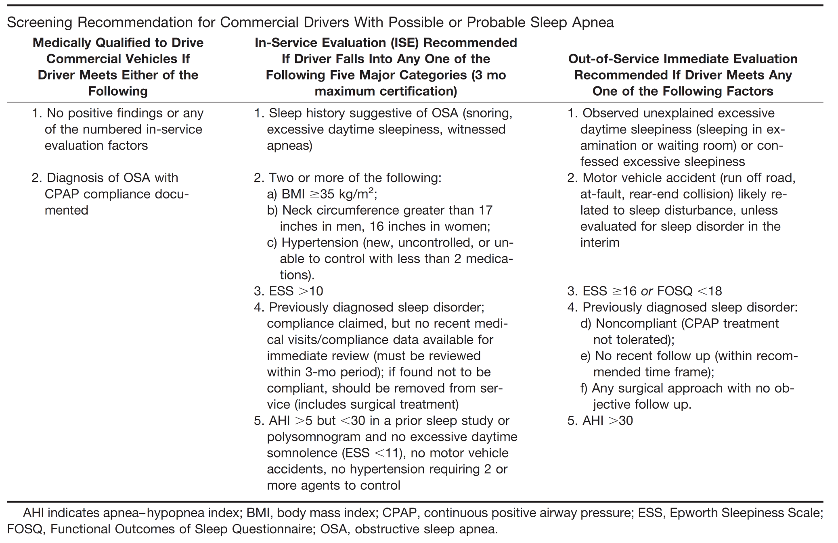
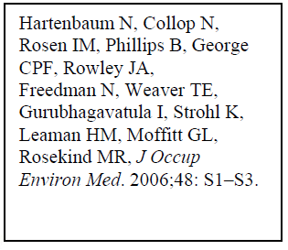
Recommendations of 2006 Joint Task Force* on OSA in CMV drivers: Not implemented by FMCSA
*American College of Chest Physicians, American College of Occupational and Environmental Medicine, National Sleep Foundation

Slide 24
Examiner implementation of JTF Task Force recommendations ineffective without regulatory support
  Case series of 1443 consecutive CDMEs: 13% high OSA risk; 95% of those tested had OSA.
  Second case series of 456 consecutive CDMEs: 12% high OSA risk; 100% had OSA; only 5% compliant with treatment
  Third case series of 1833 undiagnosed drivers: 10% high OSA risk; nearly 80% had OSA.
  29%, 62% and 66% of high risk drivers did not return for recertification examination
Talmage JB, Hudson TB, Hegmann KT, Thiese MS. Consensus criteria for screening commercial drivers for obstructive sleep apnea: evidence of efficacy. J Occup Environ Med. 2008;50: 324–329; Parks PD, Durand G, Tsismenakis AJ, Vela-Bueno A, Kales SN. Screening for obstructive sleep apnea during commercial driver medical examinations. J Occup Environ Med. 2009;51:275–282; Xie W, Chakrabarty S, Levine R, Johnson R, Talmage JB. Factors associated with obstructive sleep apnea among commercial motor vehicle drivers. J Occup Environ Med. 2011;53:169–173.

Slide 25
Examiner implementation of JTF Task Force recommendations ineffective without regulatory support
  “Some of those who screen positive (require a PSG) at a pre-employment examination have chosen to resign and seek employment elsewhere.”
  “Because OSA screening is not mandated by the FMCSA and no central registry of examinations or examiners exists, drivers could ignore a PSG referral and seek medical certification from another clinic, [most of which] do not apply…rigorous OSA screening protocols. Thus, any OSA screening strategy in this population will be ineffective unless the FMCSA mandates the strategy and prohibits drivers from doctor-shopping….”
Talmage JB, Hudson TB, Hegmann KT, Thiese MS. Consensus criteria for screening commercial drivers for obstructive sleep apnea: evidence of efficacy. J Occup Environ Med. 2008;50: 324–329; Parks PD, Durand G, Tsismenakis AJ, Vela-Bueno A, Kales SN. Screening for obstructive sleep apnea during commercial driver medical examinations. J Occup Environ Med. 2009;51:275–282.

Slide 26


2007 FMCSA Medical Expert Panel
Recommendations Adopted by MRB in 2008:
Obstructive Sleep Apnea and Commercial Motor Vehicle Driver Safety
NONE IMPLEMENTED by FMCSA
Federal Motor Carrier Safety Administration
Medical Expert Panel Members:
Sonia Ancoli-Israel PhD
Charles A Czeisler, PhD, MD, FRCP
Charles F P George, MD, FRCPC
Christian Guilleminault, MD, BiolD
Allan I Pack, MB, ChB, PhD
26

Slide 27
2009 NTSB Recommendations to FMCSA
  Implement a program to identify commercial drivers at high risk for obstructive sleep apnea and require that those drivers provide evidence through the medical certification process of having been appropriately evaluated and, if treatment is needed, effectively treated for that disorder before being granted unrestricted medical certification. (NTSB Recommendation H-09-15)”
  Develop and disseminate guidance for commercial drivers, employers, and physicians regarding the identification and treatment of individuals at high risk of obstructive sleep apnea (OSA), emphasizing that drivers who have OSA that is effectively treated are routinely approved for continued medical certification. (NTSB Recommendation H-09-16).
Available at: http://www.ntsb.gov/doclib/recletters/2009/H09_15_16.pdf

Slide 28
2009 NTSB Letter to FMCSA
  “In spite of … limited guidance regarding drivers who are excessively sleepy or already diagnosed with OSA, the FMCSA currently provides no guidance regarding how to identify commercial drivers at risk for OSA. The FMCSA Medical Review Board recommended in January 2008 that the FMCSA require screening for OSA in all drivers with a BMI over 30, but the FMCSA has not acted on this recommendation.”
  -Dr. Deborah Hersman, Chair, National Transportation Safety Board
Available at: http://www.ntsb.gov/doclib/recletters/2009/H09_15_16.pdf

Slide 29
Trucker Jailed on Two Counts of Vehicular Homicide
Mother, 25, Infant Son Killed in Kansas CA
January 10, 2007 & November 6, 2008
By DAVID CLOUSTON
© 2007 and 2008 Salina Journal
JEFF COOPER / Salina Journal Smoke rolls off the wrecked tractor-trailer that was involved in the crash on Interstate Highway 135 near the Mentor interchange, south of Salina.
Scott A. Wegrzyn
Diagnosed with sleep apnea 4 years earlier
BMI 45.3 (353 lbs, 6’2”); AHI 62: given 90-day provisional medical certification after revealing sleep apnea
Instructed to undergo apnea reevaluation; 2x crashes
Instead, obtained 2-year medical certification from another doctor, not told of sleep apnea diagnosis
No braking/evasive maneuver before hitting median

Slide 30
Regulatory Failures Illustrated by
Mr. Scott Wegrzyn’s Fatal Crash
Failure to identify obstructive sleep apnea directly¹ in regulatory framework for CMV drivers
Failure to establish regulatory requirement to identify and treat CMV drivers at high risk for OSA
Failure to require immediate disqualification of drivers diagnosed with OSA who are untreated
Failure to ensure that medical examiners are competent to recognize risk factors (e.g., BMI 45)
¹Closest mention is oblique reference to a “respiratory dysfunction likely to interfere with his/her ability to control and drive a commercial motor vehicle safely.” 49 CFR 391.41 (b) (5) of the Federal Motor Carrier Safety Regulations

Slide 31
Regulatory Failures Illustrated by
Mr. Scott Wegrzyn’s Fatal Crash
Failure to record Medical Examination Reports for Commercial Driver Fitness Determination (NRCME)
Failure to prohibit CDL holders from shopping for examiners who will provide medical qualification
Failure to require that carriers have access to OSA medical records
Reliance on un-validated self-reports ( “Do you have a history of sleep disorders… daytime sleepiness or loud snoring?”) instead of objective measures to evaluate OSA risk

Slide 32
2008 FMCSA MEP Recommendation 1:
General Guidance
A diagnosis of OSA should preclude an individual from obtaining unconditional certification to drive a CMV for the purposes of interstate commerce.
A diagnosis of OSA, however, should not exclude all individuals with the disorder from driving a CMV; certification may be possible in some instances.

Slide 33
2008 FMCSA MEP Recommendation 1:
General Guidance
An individual with a diagnosis of OSA may be certified to drive a CMV if that individual meets the following criteria:
    Has untreated OSA with an apnea-hypopnea index (AHI) ≤ 20, AND
    Has no daytime sleepiness, OR
    Has OSA that is being effectively treated.
An individual with OSA who meets the requirements for certification described above should be recertified annually, based on demonstrating satisfactory compliance with therapy.

Slide 34
2008 FMCSA MEP Recommendation 2:
Specific Guidance—Drivers who should be disqualified immediately or denied certification
Individuals who report that they have experienced excessive sleepiness while driving, OR
Individuals who have experienced a crash associated with falling asleep, OR
Individuals with an AHI greater than 20, until such an individual has been adherent to Positive Airway Pressure (PAP). They can be conditionally certified based on the criteria for Continuous Positive Airway Pressure (CPAP) compliance as outlined in Guideline 3

Slide 35
2008 FMCSA MEP Recommendation 2:
Specific Guidance—Drivers who should be disqualified immediately or denied certification
Individuals who have undergone surgery and who are pending the findings of a three-month post-operative evaluation.
Individuals who have been found to be non-compliant with their treatment at any point, OR
Individuals who have a Body Mass Index (BMI) greater than [30 kg/m² MAB FMCSA] or [33 kg/m² MEP FMCSA] (pending evaluation by a sleep study)

Slide 36
Risk Factors for Obstructive Sleep Apnea
High Prevalence of Obesity in Commercial Motor Vehicle Drivers
  Obesity
  Obesity
  Obesity
  Ethnic background
  Upper airway anatomy
  Endocrine abnormalities
  Menopausal status
  Genetic factors
(Gurubhagavatula et al. AJRCCM, 170: 371, 2004)

Slide 37
Preliminary PSG diagnostic data from occupational screening of symptomatic (n=60) and non-symptomatic (n=54) workers
BMI >25 PPV: MMS 67%; MS 31%*
BMI >30 PPV: MMS 80%; MS 36%
BMI >35 PPV: MMS 92%; MS 75%
BMI <25 NPV: MMS 67%; MS 87%
BMI <30 NPV: MMS 48%; MS 76%
BMI <35 NPV: MMS 41%; MS 77%
*MMS: RDI >10 or RDI>5, with SaO₂ desaturations to <85%; MS: RDI >25
Rajaratnam et al., in press, 2011

Slide 38
Extrapolation of number of licensed CMV drivers in US with OSA by BMI category
CDL Holders (n=14m)
BMI <25: MMS OSA 0.6m; MS OSA 0.2m*
BMI >25: MMS OSA 9.9m; MS OSA 3.8m
BMI >30: MMS OSA 5.6m; MS OSA 2.5m
BMI >35: MMS OSA 2.6m; MS OSA 2.1m
Active interstate truck/bus drivers (n=7m)
BMI <25: MMS OSA 0.3m; MS OSA 0.1m
BMI >25: MMS OSA 4.8m; MS OSA 1.9m
BMI >30: MMS OSA 2.8m; MS OSA 1.2m
BMI >35: MMS OSA 1.3m; MS OSA 1.0m
4
Million
MS
OSA
2
Million
MS
OSA
*MMS: RDI >10 or RDI>5, with SaO₂ desaturations to <85%; MS: RDI >25

Slide 39
2008 FMCSA MEP Recommendation 3:
Conditional Certification
Diagnosed with OSA → Treated using CPAP machine with ability to monitor compliance → one month certification
If compliant with CPAP at one month → three month certification
If compliant with CPAP at three months → 1 year certification
    Warn driver about danger of stopping therapy
    Warn driver they could be liable if not using therapy and involved in crash
Recheck compliance in one year (all data)
Minimal CPAP compliance > 4 hours/day, 70% of days

Slide 40
Post-MEP Recommendation (Czeisler)
CPAP compliance alone is insufficient to demonstrate efficacy of treatment, unless OSA patients are found to be responsive to treatment, as demonstrated by an improvement in an objective measure of sleep tendency, such as an MWT (e.g., France), MSLT, or the ability to sustain attention as measured by repeated testing of neurobehavioral performance, using an instrument such as the psychomotor vigilance test,* or, more optimally, a bona fide occupational qualification, e.g., based on sustained night driving in a truck or bus simulator
*Zhang C, Varvarigou V, Parks PD, Gautam S, Bueno AV, Malhotra A, Kales SN. Psychomotor Vigilance Testing of Professional Drivers in the Occupational Health Clinic: A Potential Objective Screen for Daytime Sleepiness. Journal of Occupational & Environmental Medicine. doi: 10.1097/JOM.0b013e318223d3d6.

Slide 41
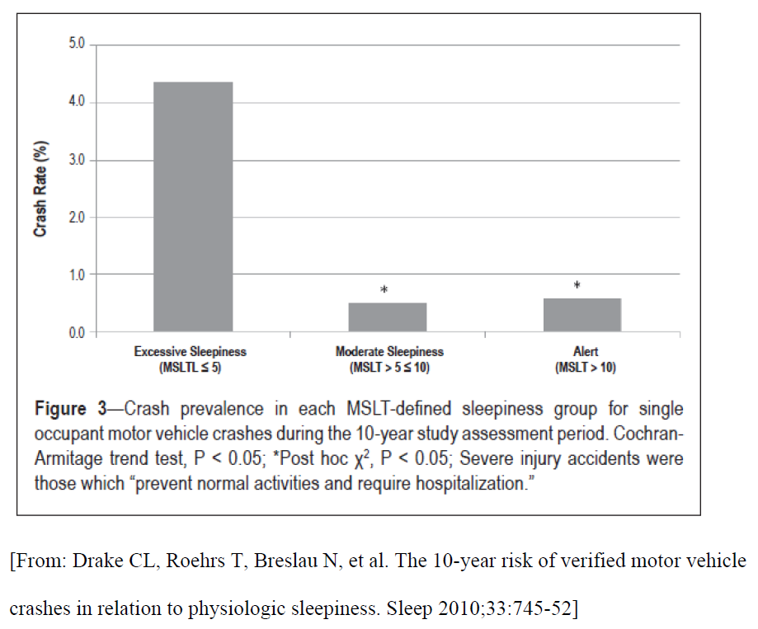
N.B. ESS was not correlated with crash risk

Slide 42
2008 FMCSA MEP Recommendation 4:
Specific Guidance—Referral for Confirmation of Diagnosis or Stratification of Severity
Individuals who meet the following criteria should be required to undergo an evaluation to confirm the diagnosis of, and, if necessary, stratify the severity of OSA:
    Those categorized as high risk for OSA according to the Berlin Questionnaire, OR
    Those with a BMI ≥ 30 kg/m2, OR
    Those judged to be at risk for OSA based on a clinical evaluation (see Guideline 5)

Slide 43
2008 FMCSA MEP Recommendation 13:
Patient Education
Individuals with OSA who meet the criteria for certification should be provided with education on the following:
  The importance of adequate sleep
  Lifestyle changes
    Weight loss
    Smoking cessation
    Exercise
    Reduced alcohol intake
  The importance of treatment compliance (if relevant)

Slide 44
2008 FMCSA MEP Recommendation 13:
Patient Education
  The consequences of untreated OSA include:
    Loss of certification
    Crash
    Hypertension
    Cognitive dysfunction
    Heart disease
    Reduced quality of life
    Reflux
    Headaches
    Shorter survival
    Sleep disruption

Slide 45
2008 FMCSA MEP Recommendation 14:
Areas Requiring Development of Guidance
Other causes of excessive daytime sleepiness
  Insufficient sleep
    Insufficient time in bed/sleep deprivation
    Medical illnesses
      e.g. chronic pain syndromes
  Other primary sleep disorders
    Narcolepsy
    Idiopathic hypersomnia
    Restless Legs Syndrome
    Shift work sleep disorder
  Hours of service

Slide 46
2008 FMCSA MEP Recommendation 14:
Areas Requiring Development of Guidance
Development of a national registry of certified drivers to include:
  Full medical history
  Medical examiners would be responsible for populating the registry

Slide 47
2008 FMCSA MEP Recommendation 14:
Areas Requiring Development of Guidance
Further research is required in the following areas:
  Effects of OSA on crash risk among CMV drivers
  Effects of different treatments of OSA on crash risk among CMV drivers
  Risk factors for crash among individuals with OSA and other sleep problems
  Improved risk stratification and prediction in CMVs
  Evaluation of alternatives to polysomnography in CMV drivers

Slide 48
Additional Recommendations
The Medical Expert Panel made the following additional recommendations:
The FMCSA consider creating incentives for large trucking companies to develop fatigue risk management programs (e.g., Schneider, J.B. Hunt)
The FMCSA should couple a dissemination strategy derived from these model programs

Slide 49
Action needed on MEP Recommendations that were adopted by the MRB in 2008
Potential Obstacles to Implementation
  Large number of CMV drivers affected
  Reliance on BMI alone to determine which drivers are at high OSA risk and will require objective testing
    Will miss non-obese drivers who have OSA (false negatives)
    Will require some obese drivers who do not have OSA to undergo screening (false positives)
Advantages of Implementation
  Implement effective means of combating fatigue beyond simple focus on HOS limits
  Improve driver health and reduce crash risk

Slide 50
The cumulative effects of sleep loss and sleep disorders represent an under-recognized public health problem and have been associated
with a wide range of health consequences, including an increased risk of hypertension,
diabetes, obesity, depression, heart attack, and stroke.

Slide 51
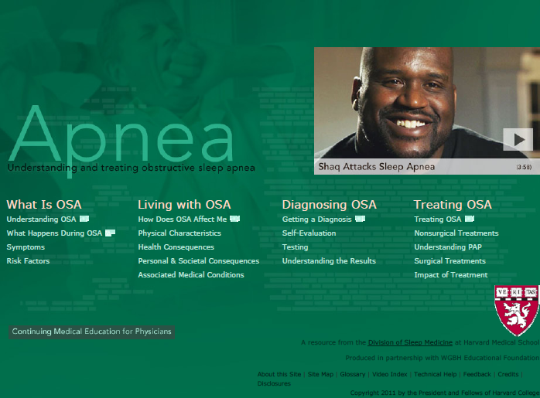

http://understandingsleep.org

Slide 52
Standards/Guidelines - Australia
The criteria for an unconditional license are NOT met:
  If the person has established sleep apnea syndrome (sleep apnea on a diagnostic sleep study and excessive daytime sleepiness), with moderate to severe sleepiness, until treatment is effective. Consideration should be given to how long-distance drivers will comply with treatment such as CPAP.
  If there is a history suggestive of sleep apnea in association with severe daytime sleepiness, until investigated and treated. Severe sleepiness is indicated by frequent self-reported sleepiness while driving, motor vehicle crashes caused by inattention or sleepiness or an Epworth Sleepiness Scale Score of 16 to 24.
A conditional license may be granted by the Driver Licensing Authority, taking into account the opinion of a specialist in sleep disorders, and the nature of the driving task, and subject to annual review: For those with established sleep apnea syndrome (sleep apnea on a diagnostic sleep study and excessive daytime sleepiness) who are on satisfactory treatment.

Slide 53
Standards/Guidelines - Canada
The following recommendations should only be made by physicians familiar with the interpretation of sleep studies.
Regardless of apnea severity, all patients with OSA are subject to sleep schedule irregularities and subsequent sleepiness. Because impairment from sleep apnea, sleep restriction and irregular sleep schedules may be interactive, all patients should be advised about the dangers of driving when drowsy.
Patients with mild OSA without daytime somnolence who report no difficulty with driving are at low risk for motor vehicle crashes and should be safe to drive any type of motor vehicle.
Patients with OSA, documented by a sleep study, who are compliant with CPAP or who have had successful UPPP treatment, should be safe to drive any type of motor vehicle.
Patients with moderate to severe OSA, documented by sleep study, who are not compliant with treatment and are considered at increased risk for motor vehicle crashes by the treating physician, should not drive any type of motor vehicle.
Patients with a high apnea-hypopnea index, especially if associated with right heart failure or excessive daytime somnolence, should be considered at high risk for motor vehicle crashes.
Patients with OSA who are believed to be compliant with treatment but who are subsequently involved in a motor vehicle crash in which they were at fault should not drive for at least 1 month. During this period, their compliance with therapy must be reassessed. After the 1-month period, they may or may not drive depending on the results of the reassessment.

Slide 54
Standards/Guidelines - UK
Driving must cease until satisfactory control of symptoms has been attained, with ongoing compliance with treatment, confirmed by consultant /specialist opinion. Regular, normally annual, licensing review required.

Slide 55
Standards/Guidelines – New Zealand
Driving should cease for individuals who meet the high-risk driver profile as follows:
  are suspected of having OSA syndrome where there is a high level of concern regarding the risk of excessive sleepiness while driving while the individual is waiting for the diagnosis to be confirmed by a sleep study
  complain of severe daytime sleepiness and a history of sleep-related motor vehicle crashes or equivalent level of concern
  have a sleep study that demonstrates severe OSA syndrome and either it is untreatable or the individual is unwilling or unable to accept treatment
Individuals may resume driving or can drive if their OSA syndrome is adequately treated under specialist supervision with satisfactory control of symptoms. Consideration should be given to the type of driving and hours of driving an individual undertakes. If there is any residual risk of daytime sleepiness medical practitioners should recommend a restriction in working hours or shift work. The Director of Land Transport Safety or the Director’s delegate may impose license conditions for regular medical assessment. Medical follow-up may be delegated to the General Practitioner.

Slide 56
Recommendation 5:
Specific Guidance—Identification of Individuals with Undiagnosed OSA
Symptoms suggestive of OSA include:
  Chronic loud snoring
  Witnessed apneas or breathing pauses during sleep
  Daytime sleepiness
Risk factors for OSA are:
  Advancing age
  BMI ≥28 kg/m2
  Small jaw
  Large neck size (≥ 17 inches (male) ≥15.5 (female))
  Small airway (a narrow or edematous oropharynx)
  Family history of sleep apnea

Slide 57
Recommendation 6:
Specific Guidance—Method of Diagnosis and Severity
The preferred method of diagnosis and assessment of disease severity is overnight polysomnography (PSG)
Acceptable alternative methods for assessment of risk in CMV drivers include objective recording devices validated against PSG that include at least five hours of measurements of:
  oxygen saturation, AND
  nasal pressure, AND
  sleep/wake time.
Regardless of the type of study performed, individuals should be tested while on their usual chronic medication regime.

Slide 58
Recommendation 7:
Specific Guidance—Treatment of OSA–Positive Airway Pressure (PAP)
The Medical Expert Panel recommends that the FMCSA consider adopting the following guidelines on the appropriate treatment of individuals with moderate-to-severe OSA:
All Individuals with OSA who require treatment should be referred to a physician with a specific expertise in the diagnosis and management of obstructive sleep apnea.
PAP is the preferred method of therapy
Adequate PAP pressure should be established through one of the following means:
  an in-laboratory titration study
  an auto-titration system without an in-laboratory titration

Slide 59
Recommendation 7:
Specific Guidance—Treatment of OSA–Positive Airway Pressure (PAP)
Individuals with OSA who have been treated with PAP may be certified if they have been successfully treated for a minimum of one week
  Successful PAP treatment is defined as follows:
    Demonstration of good compliance with treatment (see below)
    Resolution of excessive sleepiness when driving

Slide 60
Recommendation 7:
Specific Guidance—Treatment of OSA–Positive Airway Pressure (PAP)
Individuals with OSA who are treated with PAP must demonstrate compliance with treatment and this must be documented objectively
  Compliance is defined as using PAP for the duration of total sleep time.
    Optimal treatment efficacy occurs with seven hours or more of use during sleep; however, four hours of documented time at pressure per major sleep episode is minimally acceptable.
    Based on current standards of practice, an acceptable CPAP use is at least four hours of use per night on at least 70 percent of nights.

Slide 61
Recommendation 8:
Specific Guidance—Treatment of OSA–Alternatives to PAP
Dental appliances and surgery are considered to be potential alternatives to PAP for the treatment of OSA.
  Currently there is no method of measuring compliance among individuals treated with dental appliances. Consequently, use of dental appliances cannot be considered an acceptable alternative to PAP in individuals who require certification to drive a CMV in interstate commerce.
  Compliance among individuals who have undergone surgical treatment for OSA is less of an issue. Consequently, surgical treatment (bariatric, upper airway soft tissue, facial bone, and tracheostomy) is deemed an acceptable alternative to PAP (see later guidelines).

Slide 62
Recommendation 9:
Specific Guidance—Treatment of OSA—Bariatric Surgery
Individuals who have undergone bariatric surgery may be certified if they are:
  Compliant with PAP (see guideline for PAP requirements) OR
  Six months post-operative (to allow time for weight loss) AND
  Cleared by treating physician with a specific expertise in diagnosis and management of obstructive sleep apnea AND
  Sleep exam indicates that AHI ≤ 10 AND
  No longer excessively sleepy

Slide 63
Recommendation 9:
Specific Guidance—Treatment of OSA—Bariatric Surgery
For individuals certified based on these criteria, re-evaluation by sleep study within two years if they are not on PAP therapy
Individuals who are off PAP therapy should be given information that they need to seek re-evaluation if they gain significant weight (>5%) or their symptoms of OSA recur.

Slide 64
Recommendation 10:
Specific Guidance—Treatment of OSA—Oropharyngeal Surgery
Individuals with OSA who have been treated with oropharyngeal surgery may be certified if they:
  Are > 1 month post surgery AND
  Are cleared by treating physician with a specific expertise in diagnosis and management of obstructive sleep apnea AND
  Do not experience daytime sleepiness AND
  Have an AHI < 10

Slide 65
Recommendation 10:
Specific Guidance—Treatment of OSA—Oropharyngeal Surgery
Annual recertification required
  Annual objective testing with AHI < 10 AND
  No daytime sleepiness

Slide 66
Recommendation 11:
Specific Guidance—Treatment of OSA–Facial Bone Surgery
Individuals with OSA who have been treated with facial bone surgery may be certified if they:
  Are >1 month post surgery AND
  Are cleared by treating physician with a specific expertise in diagnosis and management of obstructive sleep apnea AND
  Do not experience daytime sleepiness AND
  Have an AHI < 10

Slide 67
Recommendation 11:
Specific Guidance—Treatment of OSA–Facial Bone Surgery
Annual Recertification required
  Annual objective testing with AHI < 10 AND
  No daytime sleepiness

Slide 68
Recommendation 12:
Specific Guidance—Treatment of OSA–Tracheostomy
Individuals with OSA who have been treated with oropharyngeal surgery may be certified if they:
  Are > 1 month post surgery AND
  Are cleared by treating physician with a specific expertise in diagnosis and management of obstructive sleep apnea AND
  Do not experience daytime sleepiness AND
  Have an AHI < 10

Slide 69
Recommendation 12:
Specific Guidance—Treatment of OSA–Tracheostomy
Annual recertification required
  Annual objective testing with AHI < 10 AND
  No daytime sleepiness

Slide 70
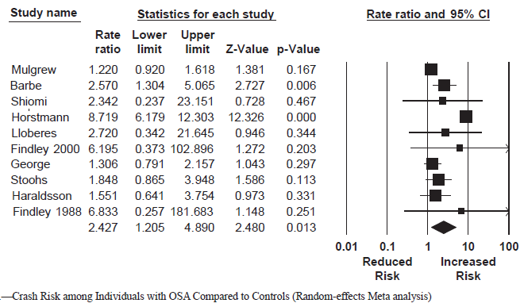

Higher Crash Risk in Drivers with OSA
(Random Effects Meta-Analysis)

Slide 71
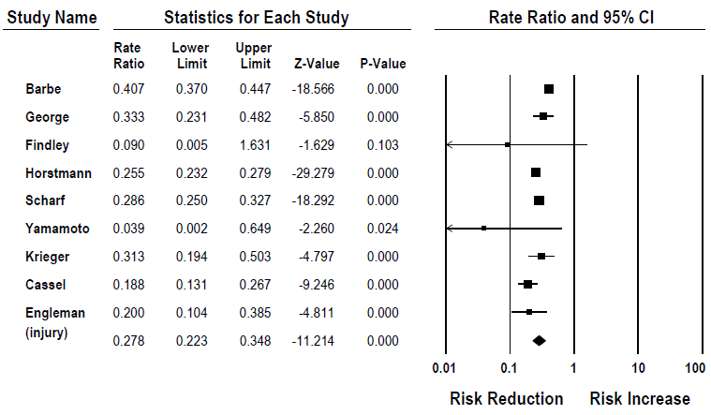
Random-effects meta-analysis of pre-post CPAP crash risk ratio data
Tregear S; Reston J; Schoelles K; Phillips B. Continuous positive airway pressure reduces risk of motor vehicle crash among drivers with obstructive sleep apnea. Sleep 2010;33:1373.

Slide 72
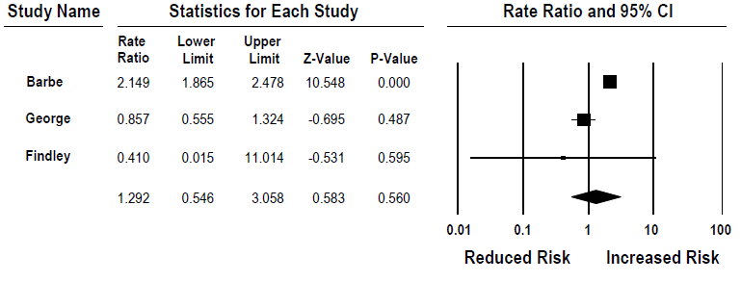
Random-effects meta-analysis of post CPAP crash risk versus no OSA controls
Tregear S; Reston J; Schoelles K; Phillips B. Continuous positive airway pressure reduces risk of motor vehicle crash among drivers with obstructive sleep apnea. Sleep 2010;33:1373.

Slide 73
Bona fide occupational qualification
Overnight truck driving simulator, measuring lane deviation, reaction time, emergency response time, attentional failures, performance.

Slide 74
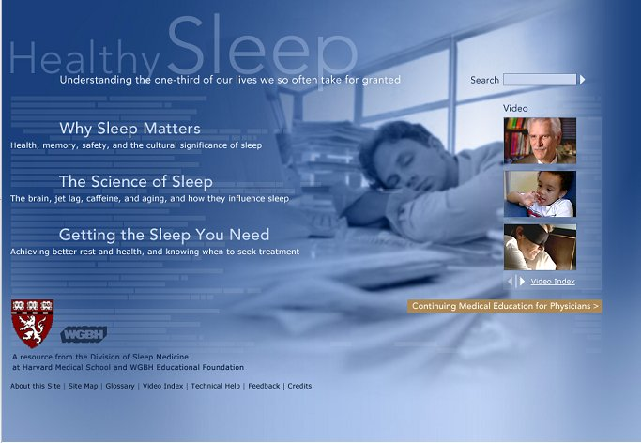
www.healthysleep.med.harvard.edu
http://understandingsleep.org

