Slide 1

CSA: Analyzing the Relationship of Scores to Crash Risk
Rebecca M. Brewster
President and COO
American Transportation Research Institute

Slide 2
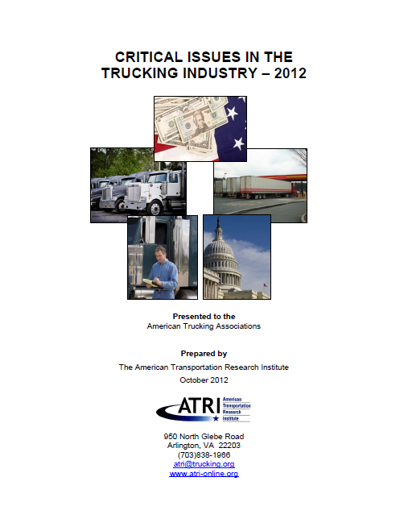

2012 Top Industry Issues
CSA
Hours-of-Service
Economy
Driver Shortage
Fuel Issues
EOBR Mandate
Driver Retention
Truck Parking
Driver Health/Wellness
Congestion (tied)
Highway Infrastructure (tied)

Slide 3

ATRI Methodology
  Crash Risk Data Analysis
Supply Chain Impacts
    Carriers
    Drivers
    Shippers / Brokers
    Enforcement
    Insurance Industry

Slide 4
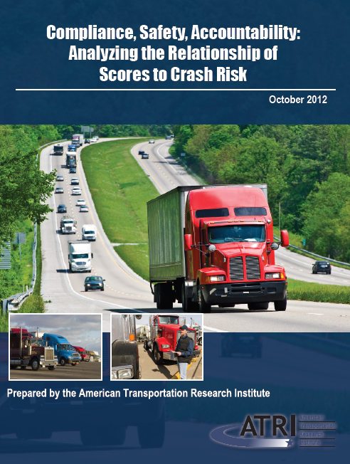
Crash Risk Data Analysis
Released Oct. 1, 2012
Highlights from previous research
Comparative review of statistical tools
Analyzed Both Percentile Scores & “Alerts”
www.atri-online.org

Slide 5
Going Beyond Correlations
A lack of a meaningful correlation does not necessarily mean a relationship does not exist

Slide 6
CSA Statistical Analysis

Slide 7
Data Utilized
July 2012 SMS Data
  All recently active interstate carriers and intrastate hazmat carriers (N = 471,306)
  24 months of historical crash data from MCMIS
Carrier Category | Number of Carriers | Percentage of Recently Active Carriers | Number of Crashes in Database | Percentage of Crashes in Database
Carriers with Recent Activity | 471,306 | 100% | 162,455 | 100%
Carriers with Insufficient Data | 270,846 | 57.5% | 11,831 | 7.3%
Carriers with Some Data but No Scores | 109,837 | 23.3% | 17,212 | 10.6%
Carriers with At Least 1 BASIC Score | 90,623 | 19.2% | 133,412 | 82.1%

Slide 8
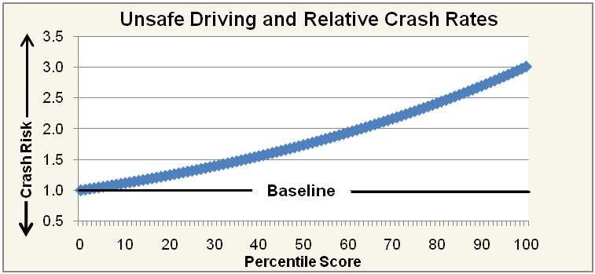
Unsafe Driving
Percentile Scores and Crash Rates

Slide 9
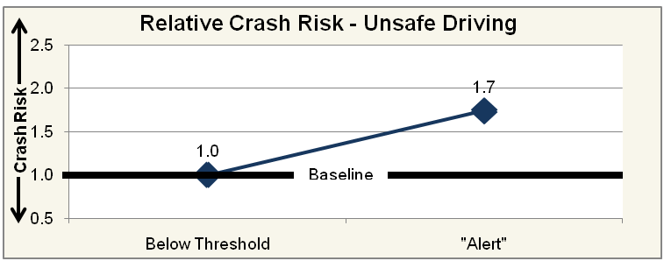
Unsafe Driving
Below Threshold vs. “Alert”

Slide 10
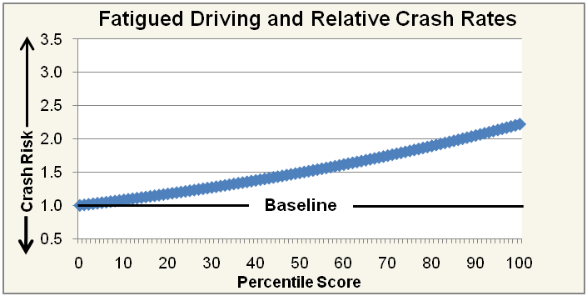
Fatigued Driving
Percentile Scores and Crash Rates

Slide 11
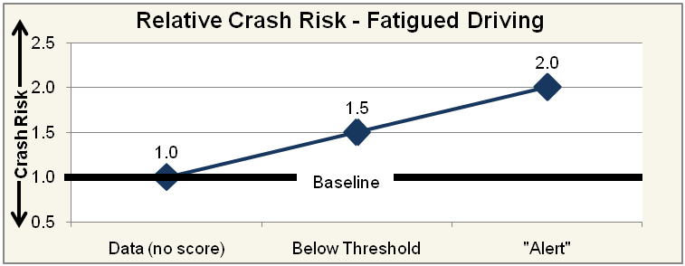
Fatigued Driving
No Score vs. Below Threshold vs. “Alert”

Slide 12
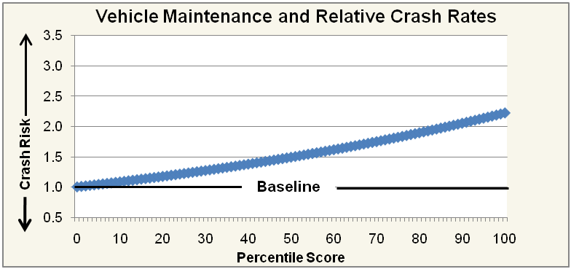
Vehicle Maintenance
Percentile Scores and Crash Rates

Slide 13
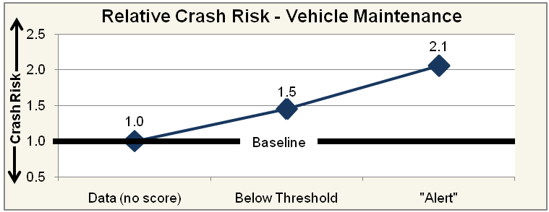
Vehicle Maintenance
No Score vs. Below Threshold vs. “Alert”

Slide 14
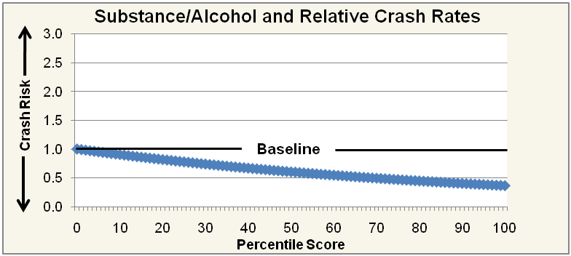
Controlled Substances/Alcohol
Percentile Scores and Crash Rates

Slide 15
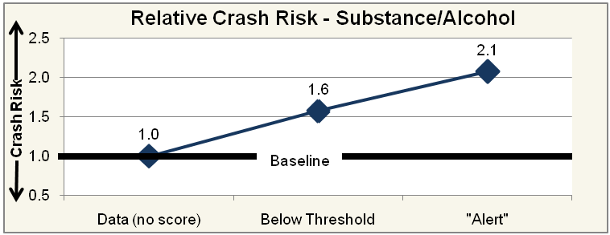
Controlled Substances/Alcohol
No Score vs. Below Threshold vs. “Alert”

Slide 16
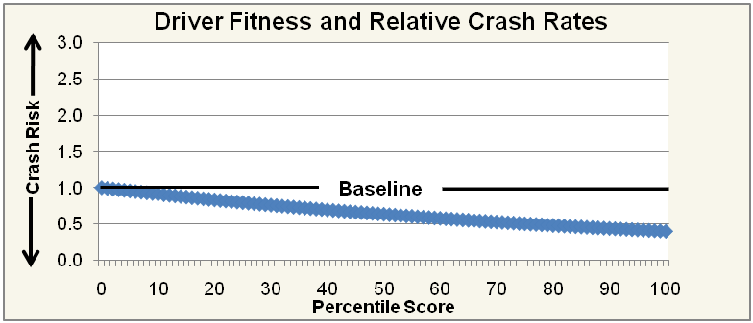
Driver Fitness
Percentile Scores and Crash Rates

Slide 17
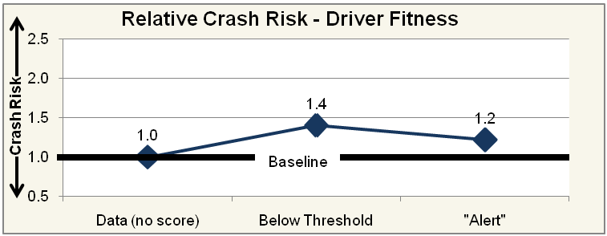
Driver Fitness
No Score vs. Below Threshold vs. “Alert”

Slide 18
Summary
Strong Support
  Unsafe Driving
  Fatigued Driving
  Vehicle Maintenance
Mixed Support
  Controlled Substances and Alcohol
No Support
  Driver Fitness

Slide 19
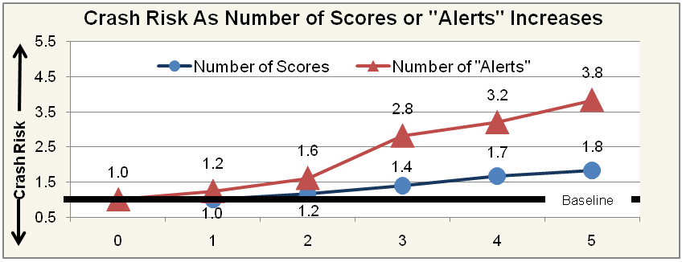
Crash Risk As Number of Scores or “Alerts” Increases

Slide 20
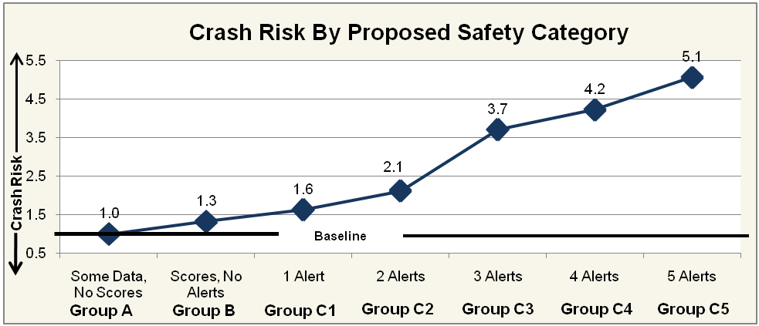
Statistically Defensible Safety Conclusions

Slide 21
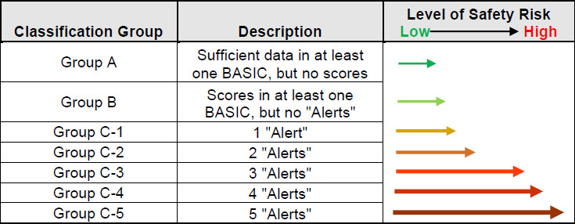
Statistically Defensible Safety Conclusions

Slide 22
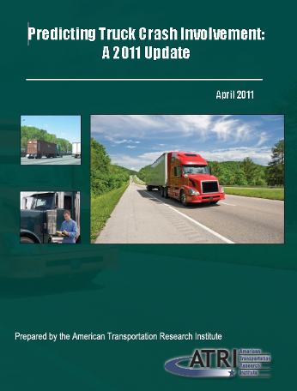
Truck Crash Predictor Model
2011 update to ATRI’s 2005 truck crash predictor model
Data analysis of over 570,000 individual driver records
Notes:
22

Slide 23
Predicting Truck Crash Involvement: 2011 Update
*2011* If a Driver has: | The Crash Likelihood Increases:
A Failure to Use / Improper Signal conviction | 96%
A Past Crash | 88%
An Improper Passing violation | 88%
An Improper Turn conviction | 84%
An Improper or Erratic Lane Change conviction | 80%
An Improper Lane/Location conviction | 68%
A Failure to Obey Traffic Sign conviction | 68%
A Speeding 15+ Speed Limit conviction | 67%
Any conviction | 65%
A Reckless/Careless/Negligent Driving conviction | 64%
Notes:
23
23

Slide 24
Violations |  | Increase in Crash Likelihood
Crash Indicator BASIC
Past Crash | 88%
Driver Fatigue BASIC
Hours-of-Service violation | 45%
False or No Log Book violation | 42%
Cargo-Related BASIC
Size and Weight violation** | 18%
Unsafe Driving BASIC
Reckless Driving violation | 88%
Failure to Yield Right of Way violation | 41%
Improper Turns violation | 15%
Improper Passing violation | 88%
Improper Lane Change violation | 41%
Following Too Close violation | 41%
Speeding violation | 38%
Failure to Obey Traffic Control Device violation | 21%
Driver Fitness BASIC
Disqualified Driver violation | 15%
Medical Certificate violation | 2%
*Weights are assigned to crashes contingent on crash severity (e.g. injuries, fatalities)
**Size and Weight violation has been removed from the Cargo-Related BASIC equation

Slide 25
Predicting Truck Crash Involvement:
2011 Update
Notes:
25
25
25

Slide 26
Questions?
Rebecca Brewster
rbrewster@trucking.org
www.atri-online.org

