Slide 1
2013 Large Truck and Bus Crash Overview
Office of Analysis, Research, and Technology
June 2015

Slide 2
Agenda
Data Sources.
2013 Overview Crash Statistics.
2013 Large Truck and Bus Crashes.
  By Severity and Vehicle Type.
  Work Zone Crashes.
  Occupant Fatalities.
  Pedestrian/Bicyclist Fatalities.
  Restraint Use.
  Driver-Related Factors.

Slide 3
Data Sources
The information in this presentation was compiled by the Analysis Division of the Federal Motor Carrier Safety Administration (FMCSA). The major sources for the data are described below:
  Fatality Analysis Reporting System (FARS). FARS, maintained by the National Highway Traffic Safety Administration (NHTSA), is a census of fatal crashes involving motor vehicles traveling on public trafficways. For more information on FARS, go to www.nhtsa.gov/FARS.
  General Estimates System (GES). GES, also maintained by NHTSA, is a probability-based nationally representative sample of police-reported fatal, injury, and property damage only crashes. For more information go to www.nhtsa.gov/NASS.
  Highway Statistics. Highway Statistics is an annual publication of the Office of Highway Policy Information of the Federal Highway Administration (FHWA). This presentation uses the vehicle miles traveled (VMT) data from Table VM-1. For more information on VMT data, go to www.fhwa.dot.gov/policyinformation/statistics/2013.

Slide 4
2013 Crash Overview Statistics
32,719 fatalities in motor vehicle crashes.
  Decrease of 3 percent (1,063 fatalities) compared to 2012.
  13 percent (4,251) of fatalities were in crashes involving a large truck or bus.
An estimated 2,313,000 persons were injured in crashes.
  Decrease of 2 percent (49,000 persons) compared to 2012.
  6 percent (133,000) of these injuries were in crashes involving a large truck or bus.

Slide 5
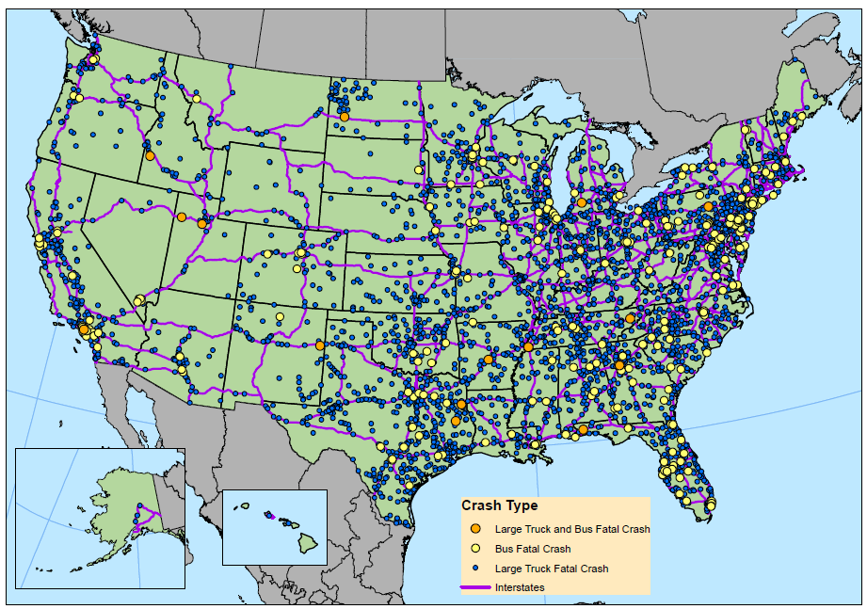
Large Truck and Bus Fatal Crashes, 2013
Source: National Highway Traffic Safety Administration (NHTSA), Fatality Analysis Reporting System (FARS).

Slide 6
Fatal Large Truck and Bus Crashes, 2005–2013
Source: National Highway Traffic Safety Administration (NHTSA), Fatality Analysis Reporting System (FARS).
In 2013, 4,251 persons were killed in large truck and bus crashes
*Increase of 1 percent (43) persons compared to 2012.

Slide 7
Large Truck and Bus Injury Crashes, 2005–2013
Source: National Highway Traffic Safety Administration (NHTSA), General Estimates System (GES).
In 2013, an estimated 133,000 persons were injured in large truck and bus crashes.
*Increase of 6 percent (7,000 persons) compared to 2012.

Slide 8
2013 Fatal Crashes by Number of Fatalities
Fatal Crashes involving at least 1 Large Truck or Bus with precisely 1 fatality and no (non-fatal) injuries | 1,946 | 51.1%
Fatal Crashes involving at least 1 Large Truck or Bus with precisely 1 fatality and at least 1 (non-fatal) injury | 1,513 | 39.8%
Fatal Crashes involving at least 1 Large Truck or Bus with more than 1 fatality (and any number of injuries) | 347 | 9.1%
Total Fatal Crashes Involving at least 1 Large Truck or Bus | 3,806 | 100.0%
Source: National Highway Traffic Safety Administration (NHTSA), Fatality Analysis Reporting System (FARS).

Slide 9
2013 Injury Crashes by Number of Injuries
Injury Crashes involving at least 1 Large Truck or Bus with precisely 1 person injured (and no fatalities) | 63,000 | 73%
Injury Crashes involving at least 1 Large Truck or Bus with more than 1 person injured (and no fatalities) | 23,000 | 27%
Total Injury Crashes Involving at least 1 Large Truck or Bus | 86,000 | 100%
Source: National Highway Traffic Safety Administration (NHTSA), General Estimates System (GES).

Slide 10
2013 Injuries in Fatal Crashes by Injury Severity
Total persons with A-level injury severity (Suspected Serious Injury) in Fatal Crashes involving at least 1 Large Truck or Bus | 934 | 26.0%
Total persons with B-level injury severity (Suspected Minor Injury) in Fatal Crashes involving at least 1 Large Truck or Bus | 1,373 | 38.3%
Total persons with C-level injury severity (Possible Injury) in Fatal Crashes involving at least 1 Large Truck or Bus | 1,282 | 35.7%
Total persons with A, B, or C-level injury severity in Fatal Crashes involving at least 1 Large Truck or Bus | 3,589 | 100.0%
Source: National Highway Traffic Safety Administration (NHTSA), Fatality Analysis Reporting System (FARS).
Note: Does not include “Injured, Severity Unknown” injuries (aka “U-level”)

Slide 11
2013 Injuries in Injury Crashes by Injury Severity
Total persons with A-level injury severity (Suspected Serious Injury) in Injury Crashes involving at least 1 Large Truck or Bus | 10,000 | 8%
Total persons with B-level injury severity (Suspected Minor Injury) in Injury Crashes involving at least 1 Large Truck or Bus | 37,000 | 30%
Total persons with C-level injury severity (Possible Injury) in Injury Crashes involving at least 1 Large Truck or Bus | 78,000 | 62%
Total persons with A, B, or C-level injury severity in Fatal Crashes involving at least 1 Large Truck or Bus | 125,000 | 100%
Source: National Highway Traffic Safety Administration (NHTSA), Fatality Analysis Reporting System (FARS).
Note: Does not include “Injured, Severity Unknown” injuries (aka “U-level”)

Slide 12
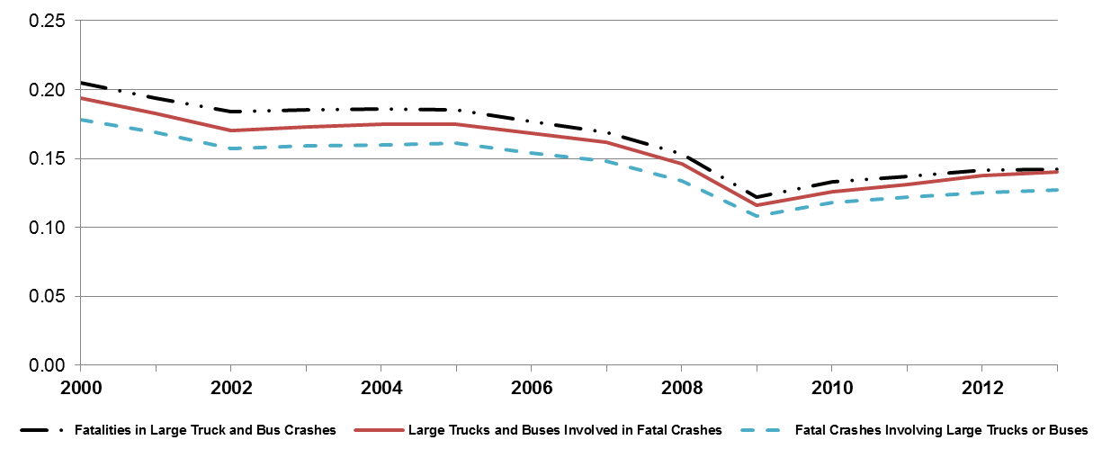
Large Truck and Bus Fatal Crash and Fatality Rates
2000–2013
Note: Rates are per 100 Million Vehicle Miles Traveled (VMT) by ALL Motor Vehicles
Source: Crashes: National Highway Traffic Safety Administration (NHTSA), Fatality Analysis Reporting System (FARS); Vehicle Miles Traveled (VMT): Federal Highway Administration (FHWA), Highway Statistics.

Slide 13
Large Truck and Bus Fatal Crash Data by State,
2012–2013
Note: * = less than 0.05 percent.
Source: National Highway Traffic Safety Administration (NHTSA), Fatality Analysis Reporting System (FARS).

Slide 14
Large Trucks in Fatal Crashes by Gross Vehicle Weight Rating, 2011‒2013
Note: Individual counts may not add to total due to vehicles with an unknown GVWR.
Source: National Highway Traffic Safety Administration (NHTSA), Fatality Analysis Reporting System (FARS).

Slide 15
Buses in Fatal Crashes by Type of Bus, 2011‒2013
Source: National Highway Traffic Safety Administration (NHTSA), Fatality Analysis Reporting System (FARS).

Slide 16
Work Zone Crashes

Slide 17
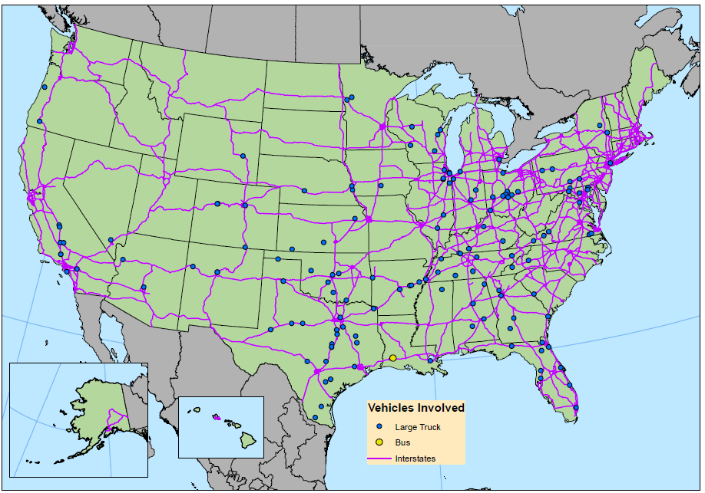
Fatal Crashes in Work Zones by Vehicles Involved, 2013
Source: National Highway Traffic Safety Administration (NHTSA), Fatality Analysis Reporting System (FARS).

Slide 18
Fatal Crashes by Work Zone, 2009‒2013
Source: National Highway Traffic Safety Administration (NHTSA), Fatality Analysis Reporting System (FARS).

Slide 19
Occupant Fatalities

Slide 20
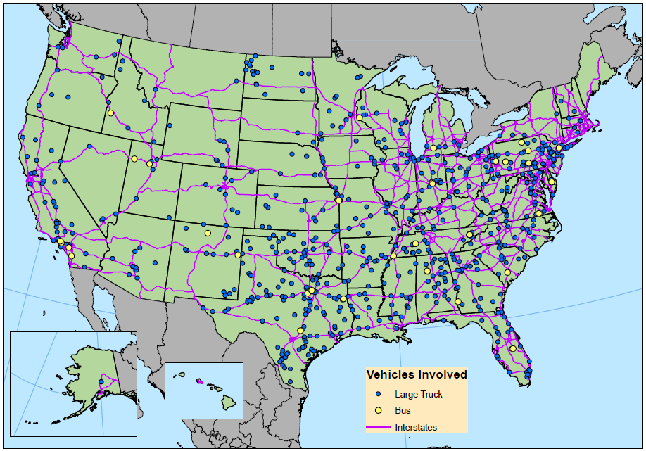
Large Truck and Bus Occupant Fatalities, 2013
Source: National Highway Traffic Safety Administration (NHTSA), Fatality Analysis Reporting System (FARS).

Slide 21
Occupant Fatalities in Large Truck Crashes by Vehicle Type, 2000‒2013
Source: National Highway Traffic Safety Administration (NHTSA), Fatality Analysis Reporting System (FARS).

Slide 22
Large Truck Occupant Fatalities by Time of Day,
2009‒2013
Source: National Highway Traffic Safety Administration (NHTSA), Fatality Analysis Reporting System (FARS).

Slide 23
Pedestrian and Bicyclist Fatalities

Slide 24
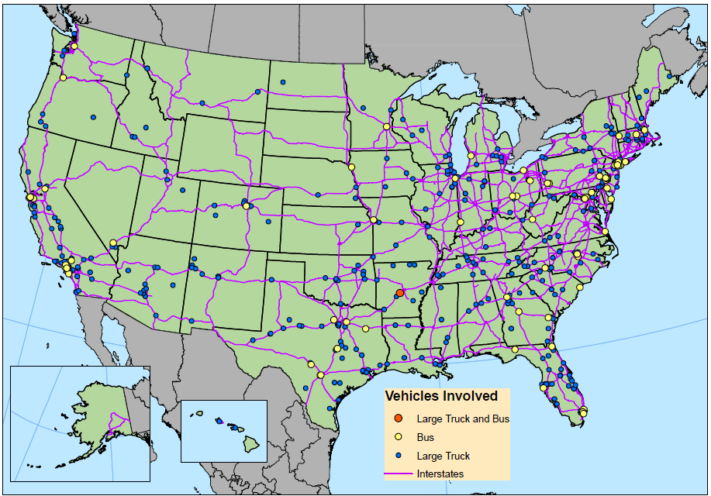
Pedestrian and Bicyclist Fatalities in Large Truck and Bus Crashes, 2013
Source: National Highway Traffic Safety Administration (NHTSA), Fatality Analysis Reporting System (FARS).

Slide 25
Pedestrian Fatalities in Large Truck and Bus Crashes, 2003‒2013
Source: National Highway Traffic Safety Administration (NHTSA), Fatality Analysis Reporting System (FARS).

Slide 26
Bicyclist Fatalities in Large Truck and Bus Crashes, 2003‒2013
Source: National Highway Traffic Safety Administration (NHTSA), Fatality Analysis Reporting System (FARS).

Slide 27
Restraint Use

Slide 28
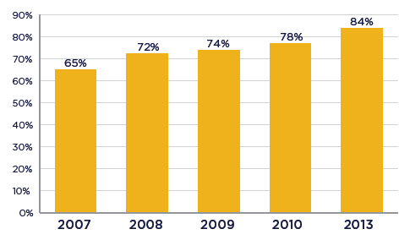
CMV Driver Safety Belt Usage, 2007‒2013
The Seat Belt Usage by Commercial Motor Vehicle Drivers (SBUCMVD) Survey showed that overall safety belt use for drivers has steadily increased each year from a use rate of 65 percent in 2007 to 84 percent in 2013.

Slide 29
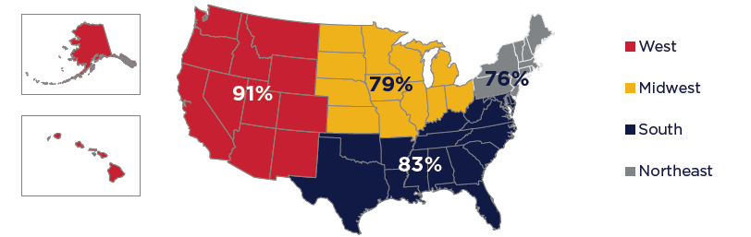
CMV Driver and Occupant Safety Belt Usage by Region, 2013
The usage rate for drivers and other occupants was highest in the West with 91 percent wearing a seat belt and lowest in the Northeast at 76 percent.

Slide 30
Large Truck Occupant Fatalities by Restraint Use and Ejection from the Vehicle, 2013
Source: National Highway Traffic Safety Administration (NHTSA), Fatality Analysis Reporting System (FARS).
At least 38 percent of large truck occupant fatalities did not use any safety restraint.
Of the 264 large truck occupant fatalities not wearing a safety restraint, 109 (41 percent) were partially or totally ejected from the vehicle.

Slide 31
Percent of Large Truck Occupant Fatalities with No Restraint Use, 2003‒2013
Source: National Highway Traffic Safety Administration (NHTSA), Fatality Analysis Reporting System (FARS).

Slide 32
Driver-Related Factors

Slide 33
Top Ten Driver-Related Crash Factors for Large Truck Drivers in Fatal Crashes, 2013
Source: National Highway Traffic Safety Administration (NHTSA), Fatality Analysis Reporting System (FARS).

Slide 34
Summary
  13 percent (4,251) of fatalities in 2013 were in crashes involving a large truck or bus and 6 percent (133,000) of injuries were in crashes involving a large truck or bus.
There were 691 occupant fatalities in fatal crashes involving large trucks, and 48 occupant fatalities in crashes involving buses.
28 percent of fatal work zone crashes involved at least one large truck, compared to 12 percent of all fatal crashes.
At least 38 percent of large truck occupant fatalities did not use any safety restraint.

Slide 35
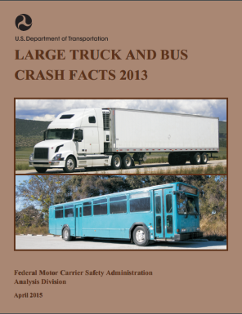
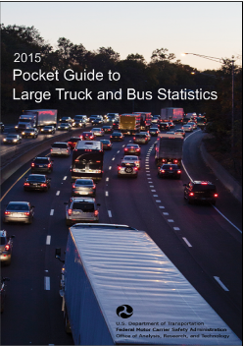
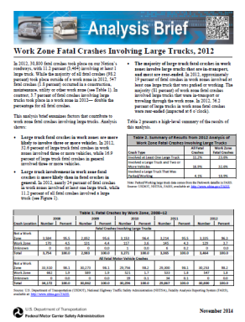
For More Information…
Large Truck and Bus Crash Facts Annual Publication
Available at: http://www.fmcsa.dot.gov/safety/data-and-statistics/large-truck-and-bus-crash-facts
Pocket Guide To Large Truck and Bus Statistics
Available at: http://www.fmcsa.dot.gov/safety/data-and-statistics/commercial-motor-vehicle-facts
FMCSA Analysis Briefs
Available at: http://www.fmcsa.dot.gov/safety/research-and-analysis/publications?keywords="Analysis Brief"&title=&author=&year=&to=&page=0

Slide 36
Thank You
FMCSA main website: www.fmcsa.dot.gov
NHTSA main website: www.nhtsa.dot.gov

