Slide 1
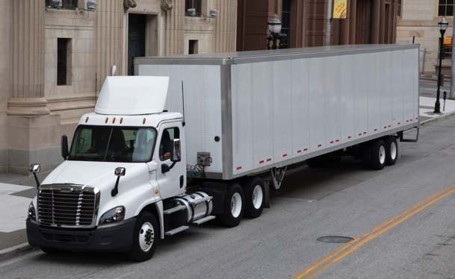
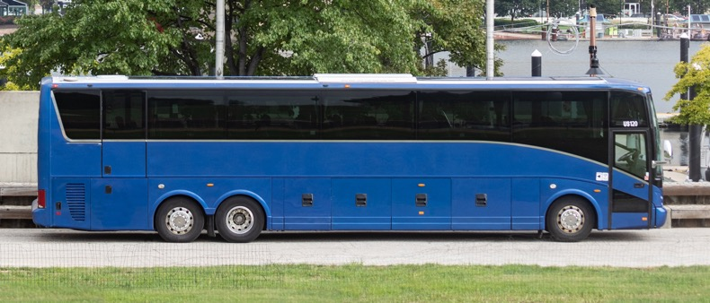
SCORE State User Guide – Release 2
1/26/2024
Notes:
Available cover design option. Please delete any unneeded cover page designs.

Slide 2
Table of Contents
This document is an introduction and navigation guide to the release 2 features added in SCORE application. Please click on the feature link to navigate to the corresponding slide.
Feature | Roles
CAP Implementation Extension State Creates the Request State Submits the Request View the Submitted CAP Implementation | All State users
II. Annual Certification Creation Submission Statuses | All State users
III. State Contests a Finding State Contests a Finding State Contests a Finding (Contd.) State Contests a Finding (Contd.) | All State users
Contd…

Slide 3
Table of Contents
Feature | Roles
IV. Noteworthy Observation Noteworthy Observation – Noteworthy Practice | All State users
V. APR & STR Checklist APR or STR Checklists – View APR or STR checklist – General Details APR or STR Checklist – View Checklist Questions APR or STR checklist – State & FMCSA Notes/Outcome | All State users
VI. Due Date Matrix
VII. State Portal Support Tickets & its Resolution

Slide 4
I.(i) CAP Implementation Extension – State Creates the Request
1
1a
2
If state would like to extend their CAP 'Proposed Completion Date', they can request 'CAP Implementation Extension'.
Note: An 'Approved' CAP would have a corresponding CAP Implementation form created under the 'Active Action Plan Implementation' dashboard.
1. On 'Assignments' page, scroll down to the 'Active Action Plan Implementation' dashboard.
1a. Click on 'Implementation Title' to view the 'Implementation details' page.
2. Click on the 'Request CAP Extension' button and 'CAP Extension Details' pop-up is displayed.

Slide 5
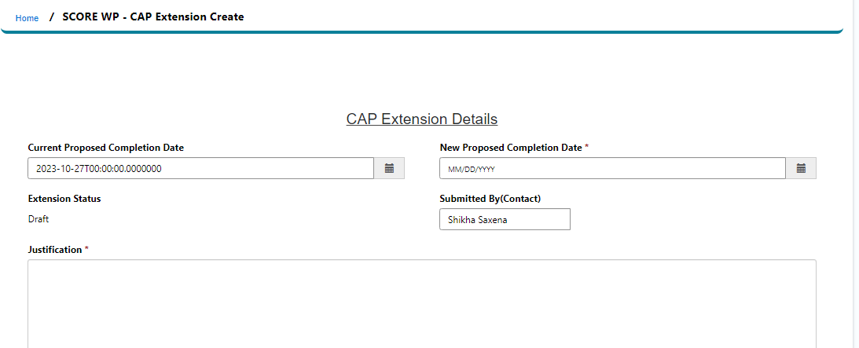
I.(ii) CAP Implementation Extension – State Submits the Request
3
4
3. On the pop-up, enter the required fields and click on the save button to view full 'CAP Extension details' page. Optionally, add 'External comments' and save.
4. Review the details and click on the 'Submit' button to send the Extension to FMCSA. The status is updated to 'FMCSA Review'.

Slide 6
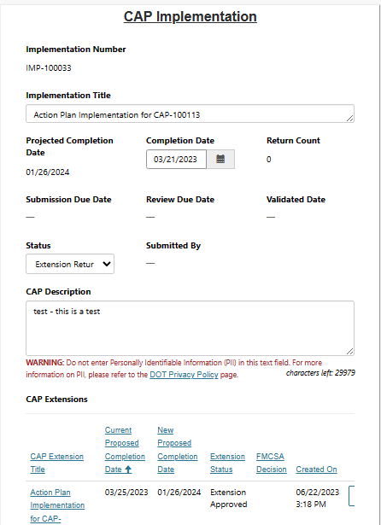
I.(iii) CAP Implementation Extension – View the submitted CAP Implementation
3
Please add supporting documents.
Details of submitted CAP Implementation Extensions are available under the 'CAP Extension' section on the CAP Implementation page.
If FMCSA approves the CAP Implementation Extension, the status is updated to 'Extension Approved' and the 'Proposed Completion Date' is updated as per the request. If FMCSA returns the CAP Implementation Extension, the status is updated to 'Extension Returned'.
The 'FMCSA Return Comments' are available on the CAP Extension Details page. The state user can edit the Justification and resubmit the request. FMCSA may return the CAP Implementation Extension twice for more information.
If FMCSA rejects the CAP Implementation Extension, the status is updated to 'Extension Rejected'. Click into the CAP Extension Title to view the rejected comments under the 'FMCSA Return Comments' on the CAP Extension Details page. The 'Proposed Completion Date' remains same, and the state must plan to submit the CAP Implementation as per the original Proposed Completion Date.
FMCSA may outright reject the request without returning them, the state has an option to resubmit a new 'CAP Implementation Extension'
1
2

Slide 7
II.(i) Annual Certification – Creation
1
2
2a
1. On Assignments page, scroll down to view the 'Active Annual certifications' dashboard.
2. Click on 'New' button to create a new Annual Certification.
2a. View an existing Annual Certification created by the FMCSA or submitted by the state by clicking into the 'Annual Certification Number'.

Slide 8
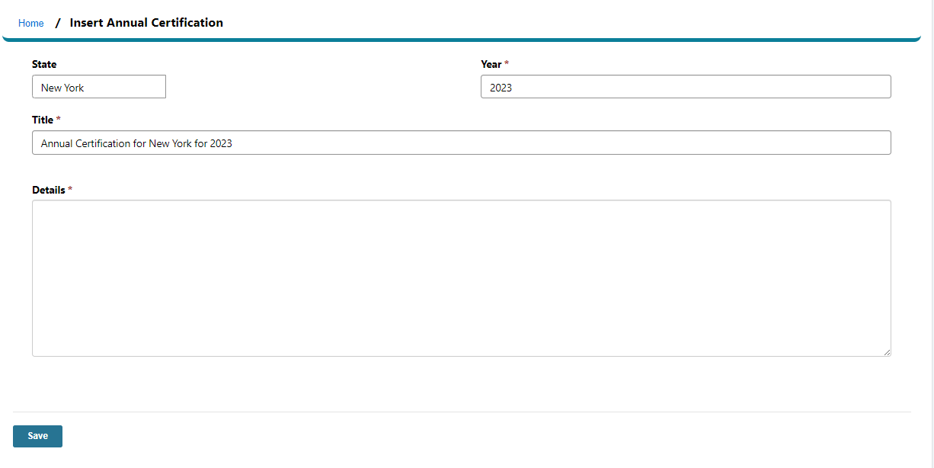
II.(ii) Annual Certification – Submission
3
3. Add the 'Details' on the Annual Certification page and 'Save'. Saved Annual Certifications are displayed under the Annual Certification dashboard as Draft.
Click on 'Submit' button to send the Annual Certification to FMCSA. The status is updated to 'FMCSA Review'.

Slide 9
II.(iii) Annual Certification – Statuses
3
3a
3. Annual Certification submitted by the State or FMCSA users will appear under the Annual Certification' dashboard.
3a. FMCSA may return an Annual Certification for more information. The status is updated to 'Returned for Edits'. The State may edit the 'Details' of the Annual Certification, optionally add any documents and resubmit it.
3b. FMCSA approves an Annual Certification, and the status is updated to 'Approved'. No further action is required by the state. Approved Annual Certifications are removed from the dashboard view. Click on 'All Content' link provided at the top bar and select 'All Annual Certifications' to view Approved Annual Certifications.
3b
3b
3b

Slide 10
III. State Contests a Finding
1
2
1. A Finding opened by FMCSA is displayed under the 'Active Findings and Action Plans' dashboard.
2. State user clicks into the 'Finding Title' to view the Finding/Action Plan details page.
If the state disagrees with the Finding, they may choose to Contest the Finding within 30 days from the date the Finding was opened.
3. Click on the 'Contest Finding' button and 'State Contest Finding' pop-up is displayed.
3

Slide 11
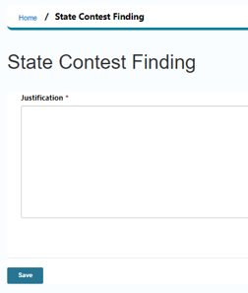
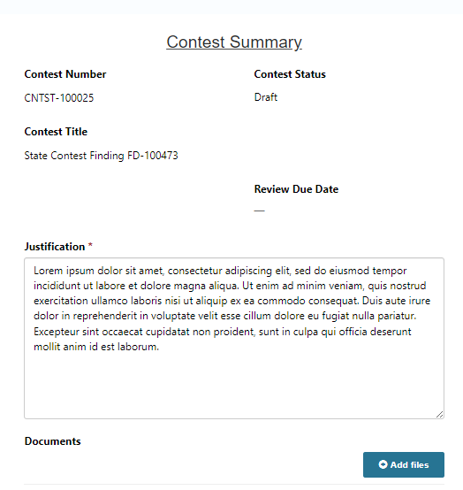
III. State Contests a Finding (Contd.)
4
4. Enter the 'Justification' and click on the save button to view State Content Finding page in detail.
5. Optionally add 'Documents' or 'External Comments' to share with FMCSA and hit the 'Save' button.
6. Review the details and click on the 'Submit' button for FMCSA to review the request.
5
5
6

Slide 12
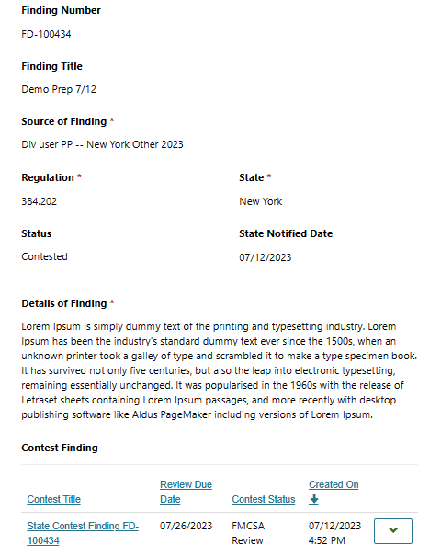
III. State Contests a Finding (Contd.)
The details of submitted 'Contested Finding' are displayed under the 'Contest Finding' section on the 'Finding/Action Plan details page'.
The status is updated to 'FMCSA Review' for the Contested Finding.
FMCSA may Approve the request and the Finding is closed for the state with the status as 'Contested- Accepted'. Contested Accepted Findings are moved from the dashboard to 'All Content'.
If FMCSA Rejects the request, the status is updated to 'Approved', the state is required to submit the CAP.
State may submit another request for 'Contested Finding' if it still under 30 days period from the day the Finding was opened.
1
2

Slide 13
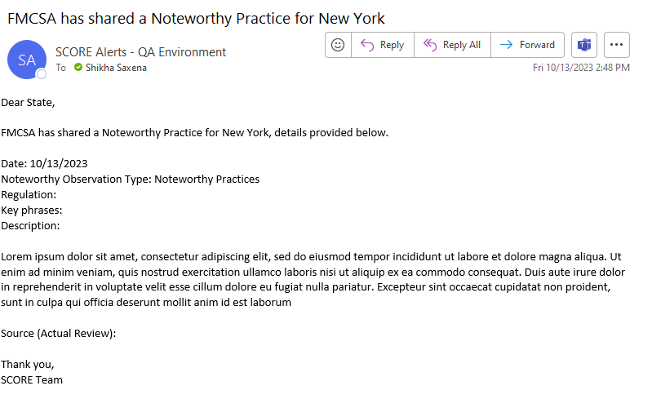
IV. Noteworthy Observation – Noteworthy Practice
1
The state users will receive an email notifying of 'Noteworthy Practice'.

Slide 14
V.(i) APR or STR Checklists - View
1
2
3
4
1. On Assignments page, go to the 'Active Reviews' dashboard.
2. Click on the 'Review Number' to view the 'Review details page'.
3. Scroll down the Review details page to view the 'Checklist section'.
4. Click on the dropdown provided for the checklist to view the 'Checklist page'.
Note: Entering the responses to the Checklist questions is optional for the state.

Slide 15
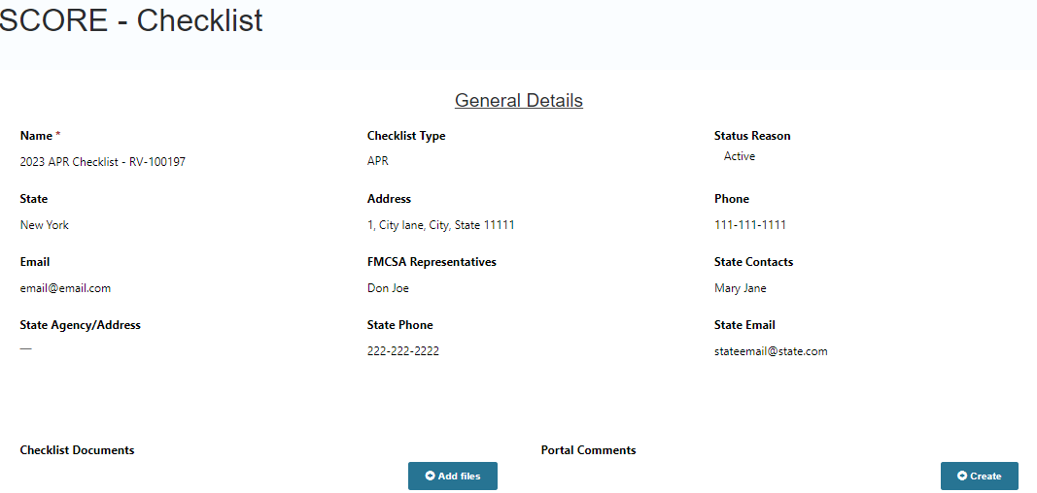
V.(ii) APR or STR checklist – General Details
4
4a
4a
4. View the 'General details' on the Checklist page.
4a. Additionally add 'Checklist Documents' or 'Portal Comments' on this page.

Slide 16
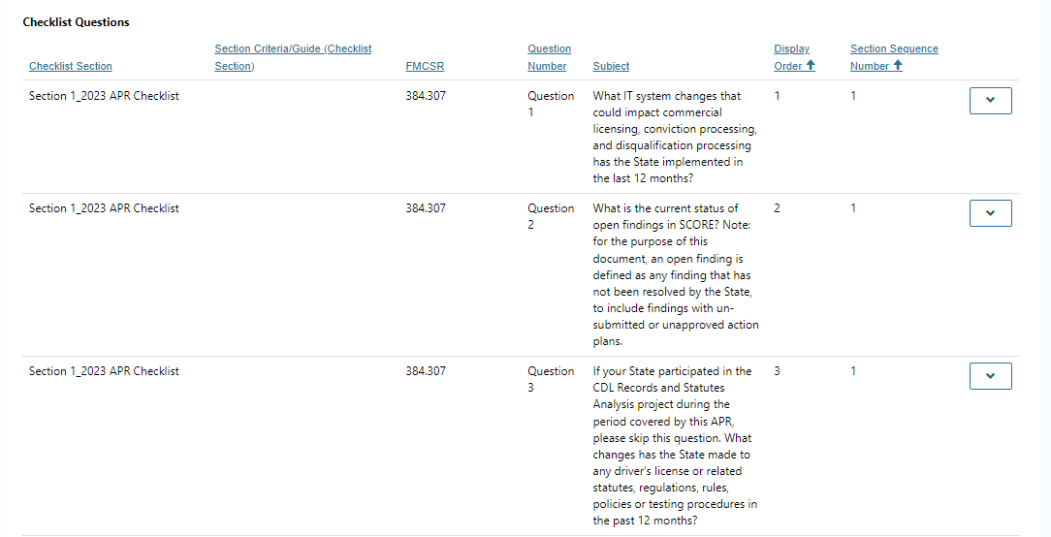
V.(iii) APR or STR Checklist – View Checklist Questions
5
6
5. Scroll down the Checklist page to view the 'Checklist Questions'.
6. Click on the dropdown arrow next to each question to view and answer the question.

Slide 17
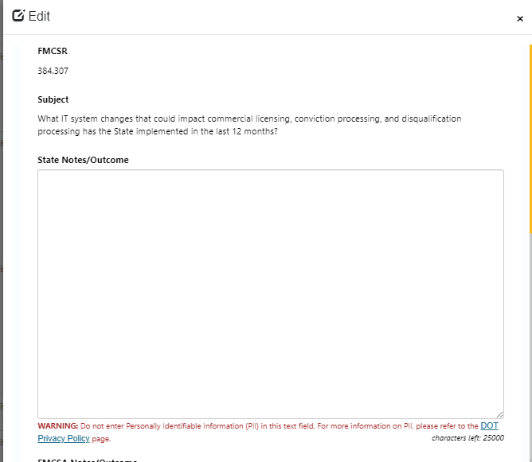
V.(iv) APR or STR checklist – State & FMCSA Notes/Outcome
7c
7. Each question opens in a pop-up. Respond to the question in the 'State Notes/Outcome' text box and click on the 'Save' button.
7a. View the ‘FMCSA Notes/Outcomes’ if any.
7b. Scroll down to 'External Comments', and optionally 'Add Comments' for FMCSA.
7c. Close the pop-up by clicking on the 'X' button and the user is navigated to the Checklist page.
Click on each of the Checklist Questions to enter the State Notes/Outcome' field.
Important Note:
Please make sure to click om the ‘Save’ button provided on the bottom left side of each question pop-up, otherwise you may lose the changes.
All responses saved are automatically updated for the FMCSA. There is NO separate submit button.
7
7a
7b

Slide 18
VI. Due Date Matrix
Form | FMCSA team Review Due Date | State Submission Due Date
Review | NA | NA
Finding | 14 days | NA
State Contests Finding | 14 days | 30 days from the day Finding is opened
CAP | 28 days | 49 days from the day Finding is opened
CAP Return 1 | 28 days due date remains same as the original CAP Due Date | 14 days
CAP Return 2 | 28 days due date remains same as the original CAP Due Date | 7 days
CAP Extension | NA | NA
Annual Certification | 14 days | NA
Noteworthy Observation | 14 days | NA

Slide 19
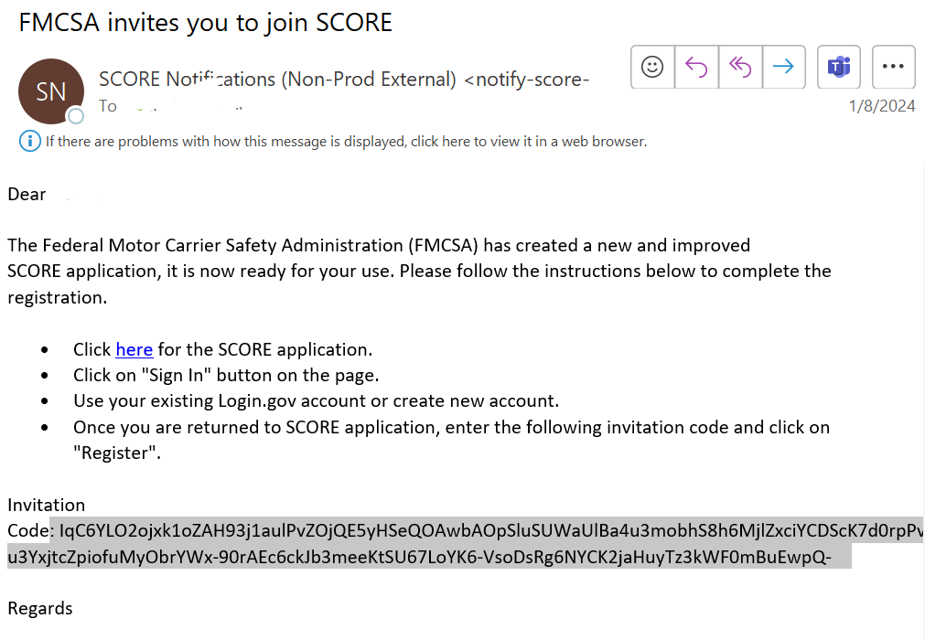
State Portal Support Tickets & its Resolution
Issue: When a user copy and pastes the invitation code, there is a sign in error.
Resolution: The sign-in error is caused due to additional space at the end of the invitation code. Deleting the space resolves the issue.
Spaces after the code

Slide 20
State Portal Support Tickets & its Resolution
Issue: How to save a form without submitting it?
Resolution: For all forms, the information can be saved as Drafts. These will appear in Draft status on Assignments page. When ready to Submit, click on the Submit button to send it through to FMCSA for review.
In the Portal, entries for Active Findings and Action Plans, Active Action Plan Implementation, and Active Annual Certifications, will be in the Not Started state the very first time. (Screenshot below)
Once, details are entered for any of these, and clicking on Save button, the entry moves to Draft state and a message appears on top of the page as per screenshot below:

