Slide 1
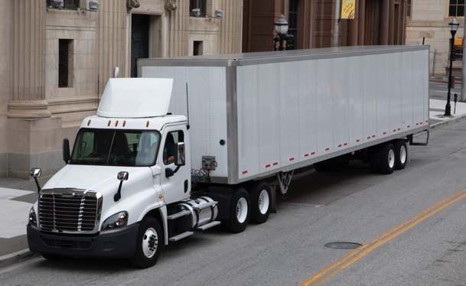
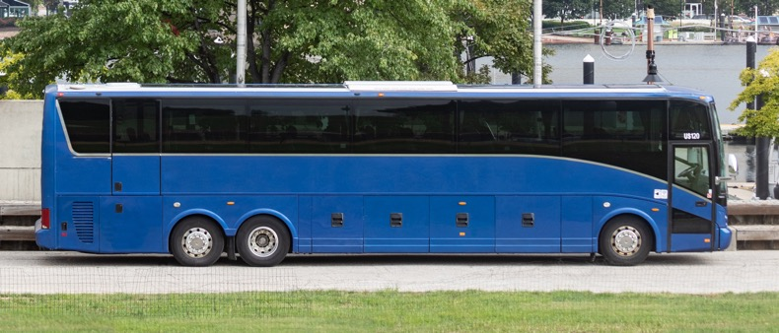
SCORE State Training – Release 2
02/14/2024
Notes:
Available cover design option. Please delete any unneeded cover page designs.

Slide 2
Agenda
Overview
SCORE State Site
Release 2 Functionality
Release 2 Overview
CAP Implementation Extension
Annual Certification
State Contests a Finding
Noteworthy Observation
APR & STR Checklists
Resources
State Portal Support Tickets & its Resolution
App Demo

Slide 3
Overview

Slide 4
SCORE State Site
State users can only use the website to access SCORE.
State users collaborate with FMCSA users on CAP Implementation Extensions, Annual Certification, State Contests a Finding, Noteworthy Observations and APR & STR Checklists.
State users can access the system using this link using the login.gov authentication: https://score.fmcsa.dot.gov

Slide 5
Release 2 Functionality

Slide 6
Release 2 Overview
CAP Implementation Extension
State can submit a request to extend the current 'Proposed Completion Date' for the CAP.
FMCSA can 'Approve', 'Return' for more information or 'Reject' the request.
Annual Certification
Either the State or FMCSA on behalf of the State can submit an Annual Certification.
FMCSA may 'Return for Edits' or 'Approve' an Annual Certification.
State contests a Finding
A State has 30 days to contest a Finding when a Finding is opened by the FMCSA.
FMCSA can 'Approve' or 'Reject' the request.
A State can submit another request if it is still under 30 days period.
Noteworthy Observation
FMCSA notifies the State via email if there is any 'Noteworthy Practice' for the State.
Checklist
For an 'APR' or 'STR' review, a checklist is created.
Checklist has multiple sections and questions associated with them.
Each question has an option for the State and the FMCSA to enter their Notes.

Slide 7
CAP Implementation Extension
State submits 'CAP Implementation Extension'
'CAP Implementation Extension' request is received by the FMCSA team.
FMCSA 'Approves' the request.
State receives the updated status in their SCORE dashboard.
FMCSA may 'Return to State' and state resubmits.
Third return from the FMCSA team is considered as 'Rejection'. State can submit a new request.

Slide 8
Annual Certification
State or the FMCSA on behalf of the state submits an 'Annual Certification'.
Annual Certification status is updated as 'Approved' or 'Returned' in State dashboard.
FMCSA reviews and 'Approves' or,
FMCSA 'Returns to State' and the state resubmits.

Slide 9
State Contests a Finding
State contests a Finding within 30 days of the Finding was opened.
FMCSA receives the request in their dashboard and 'Approves' it or, ‘Rejects’ it.
If FMCSA approves it, the Finding is closed, and the State views the updated status as 'Contested-Accepted' or,
If FMCSA Rejects it, the Finding remains open, the status is updated to 'Approved' and the State must submit the CAP.

Slide 10
Noteworthy Observation
FMCSA team approves a 'Noteworthy Practice' for the State.
The State is notified via email. No action is required.

Slide 11
APR or STR Checklists
A subsequent 'APR' or 'STR' checklist is created for a Review.
State enters responses to 'State Notes/Outcome'.
State can view the FMCSA responses in the 'FMCSA Notes/Outcome' field.
When the Review is complete, FMCSA marks it as 'Complete'

Slide 12
Resources
Quick Links
State Website Link: https://score.fmcsa.dot.gov
Help Documentation
SCORE Manuals - Training and User Guides | FMCSA (dot.gov)
For assistance contact SCORE support at:
FMCSA-SCORE-Support@dot.gov

Slide 13
State Portal Support Tickets & its Resolution
Feature | Issue | Resolution
Redeem Invitation Code | When user copy and pastes the invitation code, there is a sign in error. | The sign-in error is caused due to additional space at the end of the invitation code. Deleting the space resolves the issue.
Saving and Submitting forms | How to save a form without submitting it? | All forms - Information can be entered and saved in all the forms. Saved forms will appear in Draft status on My Assignments page. When ready to Submit, click on the Submit button to send it through to FMCSA for review.

Slide 14
App Demo

