Slide 1
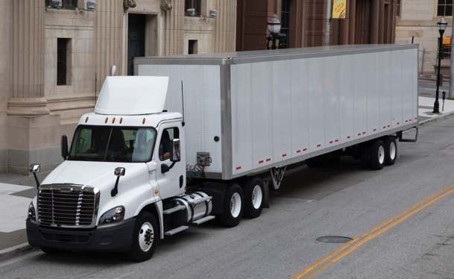
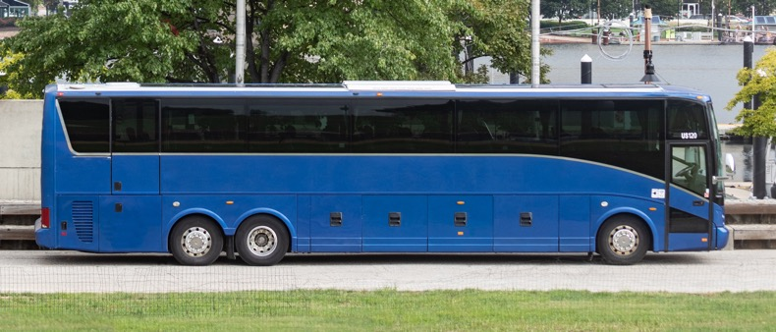
SCORE User Guide – Release 2
2/13/2024
Notes:
Available cover design option. Please delete any unneeded cover page designs.

Slide 2
Table of Contents
This document is a navigation guide to the enhancements made to the SCORE application. Additional features added to the SCORE System Release 2 are as below. Please click on the feature link to navigate to the corresponding slide.
Feature | Roles
CAP Implementation Extension State Submits FMCSA Reviews | State – Submission HQ, Division, SC – Review & Decision
II. Annual Certification State Submits FMCSA Reviews | State – Submission HQ, Division, SC – Review & Decision
III. State Contests Finding Submit HQ makes Decision | State – Submission HQ – Review & Decision
IV. Noteworthy Observation FMCSA Team Submits FMCSA Team Submits –Contd. HQ makes Decision | State – Submission HQ – Review & Decision
V. Editing Checklist APR or STR Checklist created for a Review Editing Checklist - APR (Enter details on the General tab) Editing Checklist - STR (Enter details on the General tab) Editing Checklist - APR or STR checklist Sections & Questions Editing Checklist - APR or STR Checklist Questions | HQ, Division, SC – Review, Edit & Decision State – Edits State Notes/Outcome

Slide 3
Table of Contents
This document is a navigation guide to the enhancements made to the SCORE application. Additional features added to the SCORE System Release 2 are as below. Please click on the feature link to navigate to the corresponding slide.
Feature | Roles
VI. Checklist Report – Checklist Questions Checklist Questions | Division, SC and HQ view
VII. New Checklist Creation New APR or STR Checklist Creation New APR or STR Checklist Creation - Contd. Addition of new APR or STR Checklist Section Addition of new APR or STR Checklist Questions | HQ or Admin – New Checklist Creation
VIII. Deactivation of an APR or STR Checklist Deactivation of an APR or STR Checklist | HQ or Admin – Deactivating & Activating of the Checklist
IX. Review Letter Generation (APR) Review Letter Generation (APR) Review Letter Generation (APR) – Contd. Review Letter Generation (APR) – Contd. Review Letter Generation (APR) - Manual upload of the Letter | State – Submission Division – Review & Decision
X. Due Date Matrix
XI. CRM Support Tickets & its Resolution

Slide 4
I.(i) CAP Implementation Extension – State Submits
1a
1b
When a State submits a request to extend the CAP Implementation date (Proposed Completion Date for CAP), FMCSA Division team receives the request in 'My Assignments' dashboard as shown above. Follow the steps below to complete the review process starting with Division, then SC and finally HQ make a final decision.
Division Review
1a. On 'My Assignments' page, Division team receives the CAP Implementation Extension in their 'CAP Implementations for Review' dashboard.
1b. Click into the 'CAP Extension Title' to view the 'Summary' tab. Scroll down to view the 'CAP Extension Details' section.
1c. Click on the 'Review Status' tab, under Division Reviewer's team, select 'Approve' to send it to the SC team or select 'Return to State' to send it to the state with notes. (Refer to the screenshot on the next slide)

Slide 5
I.(ii) CAP Implementation Extension – FMCSA Reviews
1c
1c
2c
3c
2. SC Review
2a. SC receives the Division approved extension in their 'CAP Implementations for Review' dashboard.
2b. Click into the 'CAP Extension Title' to view the details on the 'Summary' tab.
2c. Click on the 'Review Status' tab, under SC Reviewer's team, select 'Return to State' to send it to the state for edits or select 'Approve' to send it for HQ review.
3. HQ review
3a. HQ receives the SC approved extension in their 'CAP Implementations for Review' dashboard.
3b. Click into the 'CAP Extension Title' to view the details on the 'Summary' tab.
3c. Click on the 'Review Status' tab. Under HQ Reviewer's team, select 'Return to State' to send it to the state for edits or select 'Approve' and the 'Proposed CAP Completion Date' is updated for the FMCSA and the State.
Notes:
When the CAP Implementation Extension is returned to the state, they can make edits based on the return notes and resubmit it.
Third return from any of the FMCSA team (Division, SC or HQ) will be considered as a Rejection. The State must request a new CAP Implementation Extension if needed.

Slide 6
II.(i) Annual Certification – State Submits
1a
1b
State submits Annual Certification request to FMCSA. Division team receives the request in 'My Assignments' dashboard as shown above. Follow the steps below to complete the review process starting with Division, then it goes to both the SC & HQ teams. Either of the two teams (SC or HQ) can make the final decision. FMCSA has 14 days to make the final decision.
Division review
1a. On My Assignments page, Division team can view the 'Annual Certification dashboard'.
1b. Click into the 'Title' to view the details on the 'General' tab.
1c. Click on the 'Review Status' tab. Select a decision under the 'Division Reviewer Team'. (Refer to the screenshot on the next slide)
Select 'Approve' to send it for SC and HQ Review.
Select 'Return to State' to send it to the state to make edits. 'Reviewer Comments' are required when returning to the state.

Slide 7
II.(ii) Annual Certification – FMCSA Reviews
1c
2b
2b
2. SC or HQ Approves
2a. When Division team submits an Annual Certification, either SC or HQ can make the final decision.
2b. On the Review status tab, under the relevant Reviewer's Team:
Select 'Approve' and the Annual Certification status is updated to 'Approved' for both state and the FMCSA.
Select 'Return to State' and the Annual Certification status is updated to 'Returned for Edits' for both state and the FMCSA. 'Reviewer Comments' are required when returning to the state.
Annual Certification can be created by any FMCSA team (Division, SC or HQ).
Go to the 'Annual Certifications' dashboard on My Assignments page and click on the '+'New button on the right side of the table to view the 'Annual Certification' page.
Enter all the required details and click on save button and it is updated to 'Draft' status. Click on the 'Submit' button to submit it for the Division review.
When Division team submits an Annual Certification, the teams must follow step 1 & 2 to complete the process. When SC or HQ submits an Annual Certification, it is received by the Division team to be followed by step 1 & 2.

Slide 8
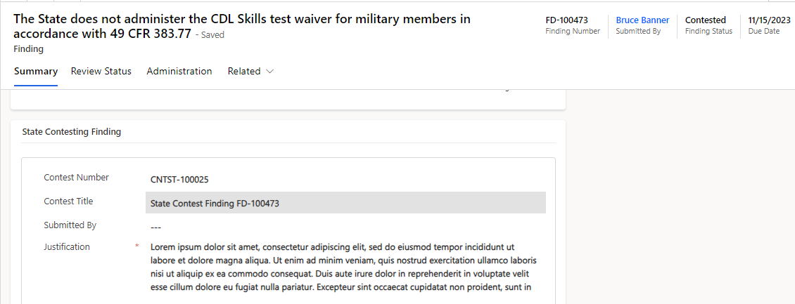
III.(i) State Contests Finding - Submit
1
2
When a Finding is opened, the state has 30 days to contest it if they disagree with it. State submits the contested Finding for FMCSA review. HQ team receives the request, and they have 14 days to make their decision. Follow the steps below to make the decision.
1. HQ team views the contested Finding on their 'Findings for Review' dashboard with 'Contested' status.
2. Click into the 'Finding Title' to navigate to the 'Summary' tab.
3. Scroll down the Summary tab to view the 'State Contested Finding details'.
3

Slide 9
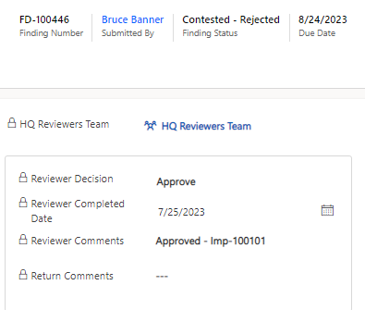
III.(ii) State Contests Finding – HQ makes Decision
4a
4b
4. Click on the 'Review Status' tab to select a decision:
Select 'Reject' if the state contesting the Finding is invalid. The Finding remains valid for the state, the Finding status is updated to 'Approved' and the state must submit the CAP. The state may submit another contesting request if they disagree with HQ's decision.
Select 'Approve' if the state contesting the Finding is valid. The Finding is then closed for both the FMCSA and the State. The Finding status is then updated to 'Contested-Accepted' indicating that the Finding was Contested by the State and FMCSA agreed with it.

Slide 10
IV.(i) Noteworthy Observation – FMCSA Team Submits
1
2
Any FMCSA reviewer (Division, SC or HQ) can create a Noteworthy Observation. All submitted 'Noteworthy Observations' are received by the HQ team. Follow the steps below to review and make a decision to either 'Approve' or 'Reject'. FMCSA has 14 days to decide once the Noteworthy Observation is submitted.
1. On My Assignments page, scroll down to 'Noteworthy Observations for Review' dashboard.
2. Click on '+' New button on the right side of the dashboard to open new Noteworthy Observation page.

Slide 11
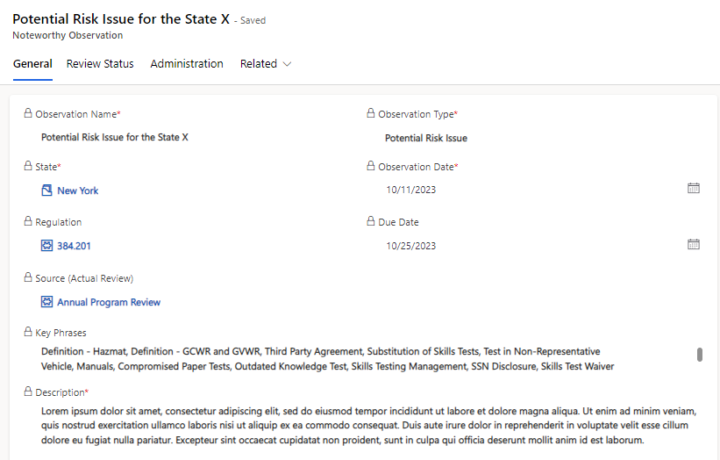
IV.(ii) Noteworthy Observation – FMCSA Team Submits - Contd.
3
3a
3. On the 'General tab', enter the required fields and click on the save button.
Saved noteworthy observations are available under the 'Draft Noteworthy Observations' on the left side of the 'Noteworthy Observations for Review' dashboard on 'My Assignments' page .
4. Click on the 'Submit' button provided at the top of the page to submit the Noteworthy Observation for HQ review.

Slide 12
IV.(iii) Noteworthy Observation - HQ makes Decision
5. HQ receives all the submitted Noteworthy Observation by Division, SC or HQ themselves, in their dashboard.
5a. From the 'Noteworthy Observations for Review' dashboard, click on the 'Name' link to view the details on the General tab.
5b. Click on the 'Review Status' tab, under the 'HQ Review's team', select a decision to 'Approve' or 'Reject' and save.
6. State is notified through email only for an approved 'Noteworthy Practices'.
7. If Potential Risk Issue or Program Improvements are approved or rejected, the notification is sent internally only.
5a
5b

Slide 13
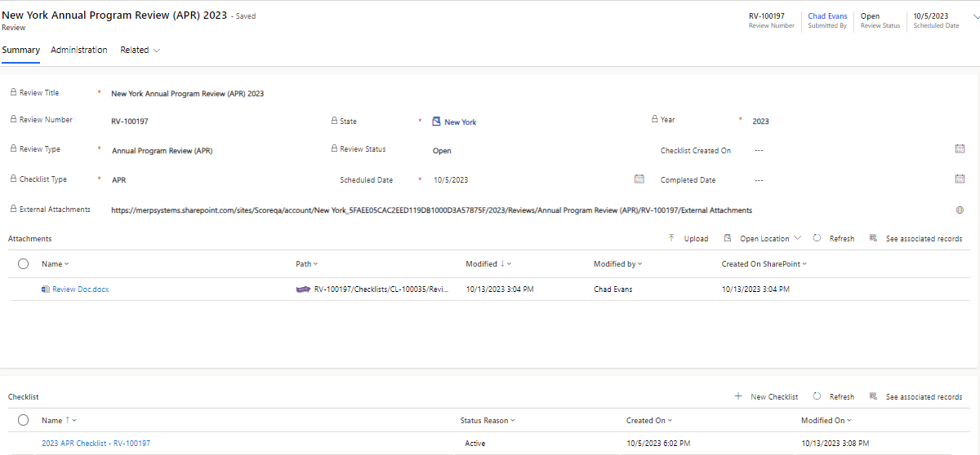
V.(i) Editing Checklist - APR or STR Checklist Created for a Review
1
2
Any FMCSA team (Division, SC or HQ) can submit a new Review from the 'Reviews' dashboard. A Checklist is created for each APR or STR Review. The Review stays on the submitter's (Division/SC or HQ) 'My Assignments', 'Reviews' dashboard. Follow the steps below to view and edit the checklist.
1. Each 'APR' or 'STR' Review creates a subsequent 'APR' or 'STR' checklist link on the 'Summary' tab under the 'Checklist section'.
2. Click on the checklist 'Name' to open to view the Checklist details on the 'General' tab.

Slide 14
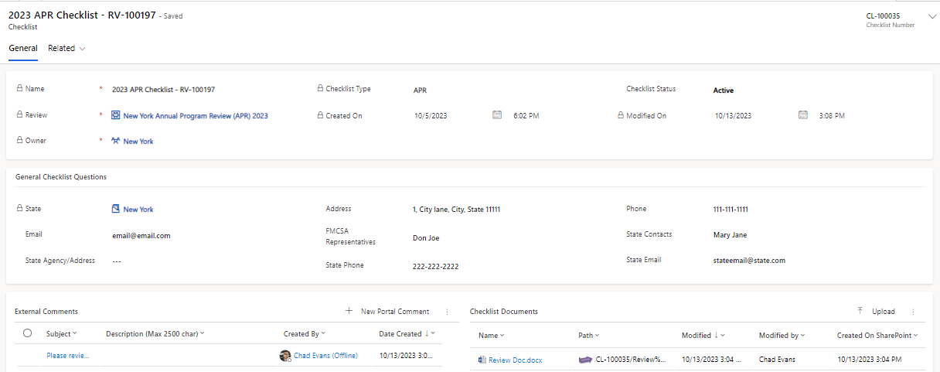
V.(ii) Editing Checklist – APR (Enter details on the General tab)
3
3a
3. 'General' tab provides different sections to view the details for the APR and STR Checklist. These sections are different for 'APR' and 'STR' checklists.
3a. For an 'APR Checklist, on the 'General ' tab, enter the details in the 'General Checklist Questions' section and click on the 'Save' button provided on the top ribbon.

Slide 15
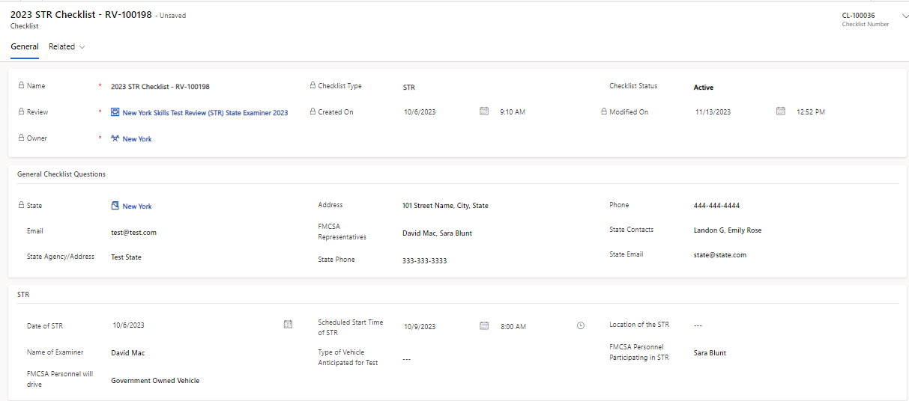
V.(iii) Editing Checklist – STR (Enter details on the General tab)
3b
3b.i
3b.ii
3b. For an 'STR Checklist, on the 'General ' tab, enter the information for the following sections and click on the 'Save' button provided on the top ribbon.
i.'General Checklist Questions'
ii. 'STR' section.

Slide 16
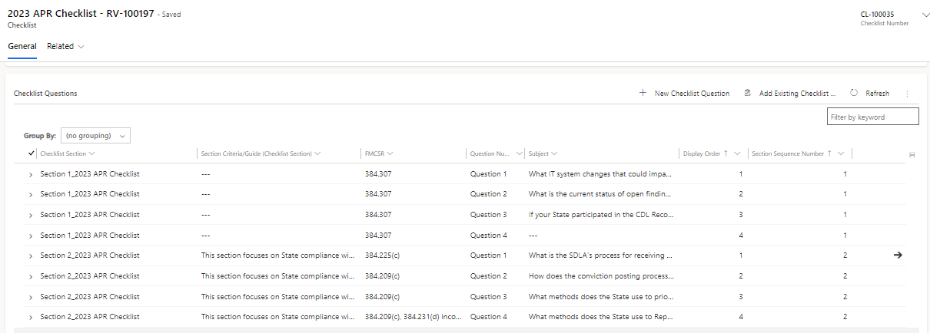
V.(iv) Editing Checklist - APR or STR checklist Sections & Questions
4
5
4. Scroll down on the 'General' tab to view the 'Checklist Questions.
5. Click into each Checklist 'Questions' to view the 'Checklist Question' page.

Slide 17
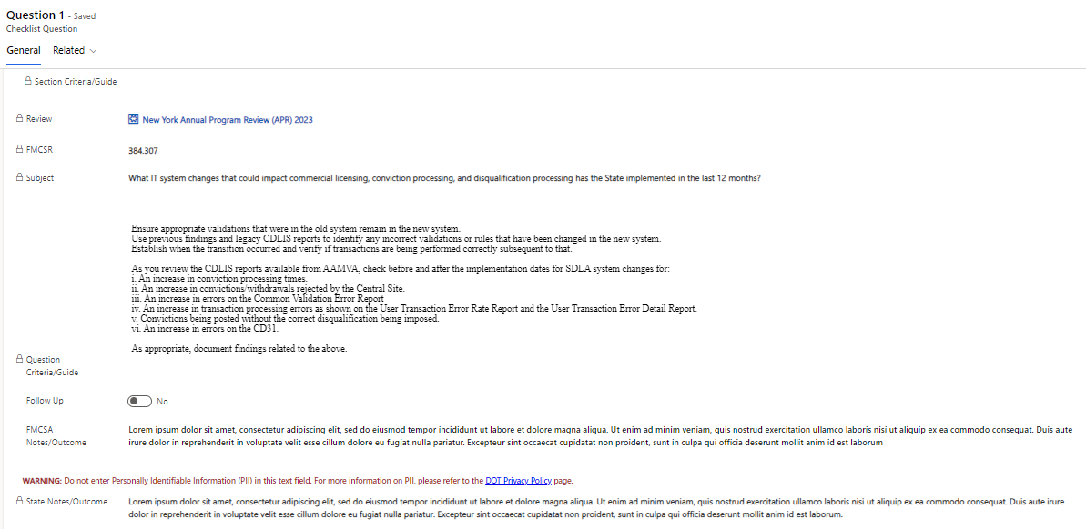
V.(v) Editing Checklist - APR or STR Checklist Questions
6
On 'Checklist Question page':
6. FMCSA reviewer can view the Section Criteria/ Guide, Review name, FMCSR, Subject and Question Criteria/Guide.
7. Enter 'FMCSA Notes/Outcomes' in the text box provided.
8. View the 'State Notes/Outcomes' when they enter the response.
7
8

Slide 18
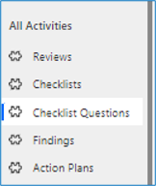
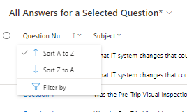
VI.(i) Checklist Report – Checklist Questions
2
1
Checklist Report display the all the questions in STR or APR checklists that have answers from the FMCSA or State.
Follow the steps below to access the 'All Answers for a Selected Question' Report.
On the left side panel of 'My Assignments' page, scroll down to 'All Activities'. Click on the 'Checklist Questions' option.
The screen on the right side displays, 'All Answers for a Selected Question'.
Filter on any of the column to suit your criteria by clicking on the column name, select 'Filter by' and enter the specific item. For example, type the 'Question Number' to view relevant results.
3

Slide 19
VII.(i) New APR or STR Checklist Creation
3
1
2
New Checklist can be added by HQ and Admin team. A checklist may contain multiple sections. Each section may have multiple questions associated with it. Follow the steps below to switch to the 'Administration' page and create a new 'APR' or 'STR' checklist.
1. On My Assignments page, at the bottom of the left side panel, Admin or HQ team can click on 'SCORE' and select 'Administration'.
2. From the left side panel, under the Checklist Master Data entity, click on the 'Checklist Question Sets' option to view the Checklists page on the right side of the screen.
3. Click on the '+' New button to create a new checklist and a new 'Checklist Question Set' page is opened.

Slide 20
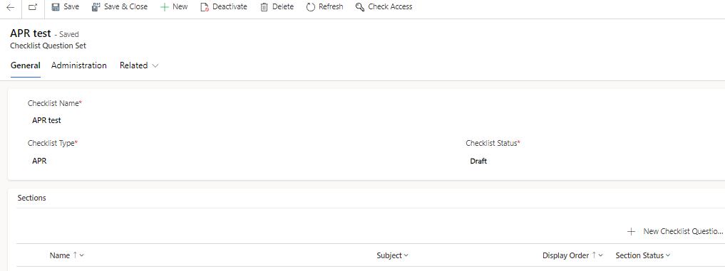
VII.(ii) New APR or STR Checklist Creation – Contd.
4
5
4. On the Checklist Question Set page, enter the 'Checklist Name', select the 'Checklist Type', the status and click on the save button. This opens a 'Sections' view under it.​
5.Click on the '+' New button provided on the right side of the Sections view to navigate to the 'New Checklist Question Set Section' page.

Slide 21
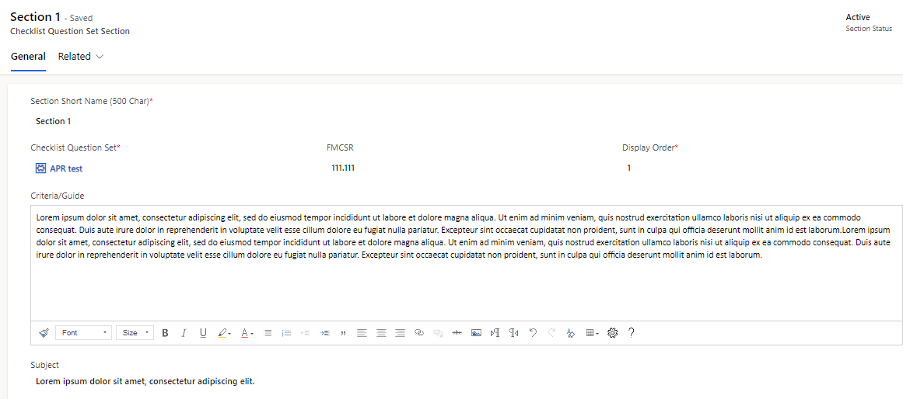
VII.(iii) Addition of new APR or STR Checklist Section
6
6. On the 'Checklist Question Set Section' page, enter 'Section Short Name' as Section 1, 2 3 etc. To indicate the section sequence. Enter the display order same as the Section Short Name number assigned. Enter other required details. Click on the Save button from the top ribbon to open 'New Checklist Question Set Question' view under it.

Slide 22
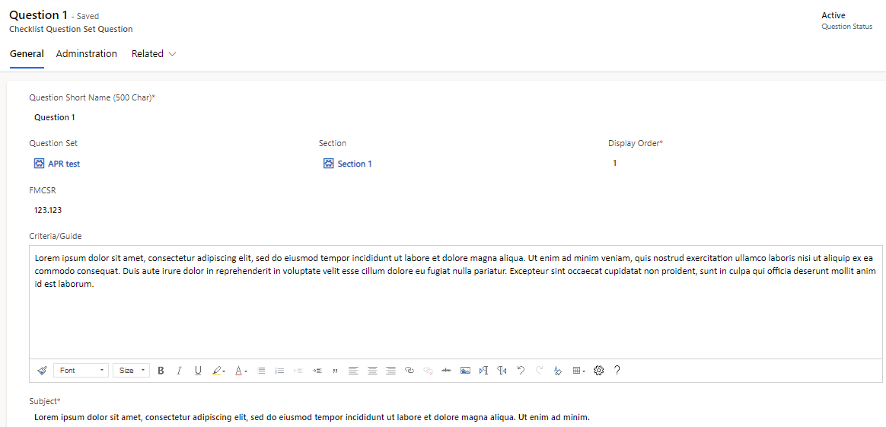
VII.(iv) Addition of new APR or STR Checklist Questions
7
7. Click on the '+' New button provided on the right side of the Questions view to navigate to open a 'New Checklist Question Set Question' page.
8. On the Questions page, enter the 'Question Set Name' as Question 1, 2, 3... to indicate the order of the question and enter the same number as 'Display Order'. Enter other required fields and click on the Save button from the top ribbon of the page.
9. To add more questions to the same section, go back to the 'Question'
page repeat steps 7 & 8.
10. To add more sections, go back to the 'Section' page and repeat step 5 & 6.
8

Slide 23
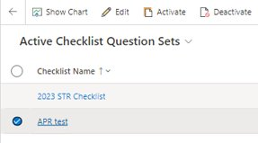
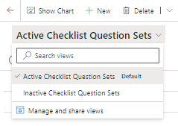
VIII.(i) Deactivation of an APR or STR Checklist
HQ or Admin team can 'Deactivate' an 'Active' APR or STR Checklist when they want to retire it and create a new one. Deactivated checklists will continue to appear for existing 'Reviews' only.
Deactivated Checklists can be 'Activated'.
Only one type of Checklist can be in 'Active' status.
Follow the steps below to 'Deactivate' or 'Activate' a checklist.
1
3
2
Deactivate a Checklist
On 'Administration' page, click on the 'Checklist Question Sets' page, select the checklist to be deactivated and from the top ribbon, click on the 'Deactivate' button.
Confirm the deactivation.
2. 'Active Checklist Questions' Set is the default view.
Click on the dropdown next to it and select 'Inactive Checklist Question' Sets to view the Inactive checklists.
3. From the 'Inactive Checklist Question Sets', select the checklist to be activated and click on the 'Activate' button from the top ribbon.

Slide 24
IX.(i) Review Letter Generation (APR)
2
3
1
Review Letter Generation option is available ONLY to Division team for ‘APR’ Reviews.. Division team can generate 'Review Letters' only for 'Completed' Reviews. Follow the steps below to complete a Review and generate the Review Letter.
Division views 'Reviews dashboard' on 'My Assignments' page. Click to view a Review in 'Open' status. On 'Summary' tab, enter the 'Completed Date' and save.
Refresh the page to view the updated status as 'Completed' and a new tab, 'Review Letter' is displayed.
Click to open the 'Review Letter' tab.

Slide 25
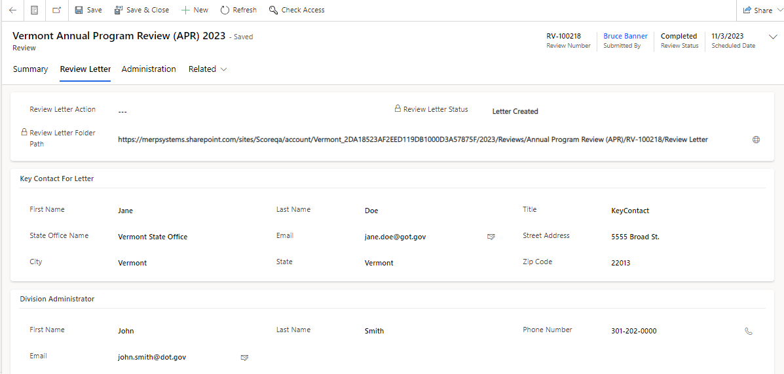
IX.(ii) Review Letter Generation (APR) - Contd.
4
6
7
4a
5
5a
4. Click on the 'Review Letter Action' options. Refer (4a) for the drop-down selection options and choose *'Generate Letter' and save.
5. Enter the required information for the 'Key Contact For Letter' section. (5a) Enter the required information for the 'Division Administrator' section and save.
6. Refresh the page and the status is updated to 'Letter Created'.
7. Click on the globe icon provided next to the 'Review Letter Folder Path' link to view the letter in the SharePoint. (Note: By default, SharePoint opens in a new tab).

Slide 26
IX.(iii) Review Letter Generation (APR) - Contd.
10
8
8. Click to open the generated letter in Word format. The letter auto-populates the 'Key Contact For Letter' and 'Division Administrator' details into the letter. You can edit the details if needed by opening the Word document and the changes are auto-saved.
9. Go back to the Review Letter tab.
10. Select, the 'Submit Letter' option from the 'Review Letter Action' dropdown, click on the 'Save' button, and the status is updated to 'Letter in Review'..
11. If the Division Administrator decides to return the letter back to the staff. They may select, the 'Return Letter' option from the "Review Letter Action' dropdown, click on the 'Save' button, and the status is updated to 'Letter Returned'.
12. If the Division Administrator decides to approve the letter, They may select, the 'Letter Approved' option from the 'Review Letter Action' dropdown, click on the 'Save' button, and the status is updated to 'Letter Approved'.
13. Approved letters will be signed by the Division Administrator outside the SCORE application.
14. Division staff will send the signed letter outside the SCORE application. Once done, they can select, the 'Letter Sent' option from the 'Review Letter Action' dropdown, click on the 'Save' button, and the status is updated to 'Letter Sent'.
Note: Make sure to refresh the page when a new 'Review Letter Action' is selected and saved. It may take a few seconds for the system to generate the letter and update the status. Refresh the page to see the updates.
Steps 11-14 also apply to letters that are created outside the system and are uploaded to the review.

Slide 27
IX.(iv) Review Letter Generation (APR) - Manual Upload of the Letter
4
5
APR Review letters can be created outside the SCORE application. Follow the steps below to complete the process.
1. Click to open the relevant Review.
2. Go to the Review Letter tab.
3. Click on the globe icon provided next to the 'Review Letter Folder Path' link to navigate to the SharePoint location.
4. Click on the 'Upload' button provided in SharePoint and follow the steps to upload the document.
5. The uploaded document is displayed on the screen.
6. Go back to the Review Letter tab and follow steps 11-14 from the previous slide.

Slide 28
X. Due Date Matrix
Form | FMCSA team Review Due Date | State Submission Due Date
Review | NA | NA
Finding | 14 days | NA
State Contests Finding | 14 days | 30 days from the day Finding is opened
CAP | 28 days | 49 days from the day Finding is opened
CAP Return 1 | 28 days due date remains same as the original CAP Due Date | 14 days
CAP Return 2 | 28 days due date remains same as the original CAP Due Date | 7 days
CAP Extension | NA | NA
Annual Certification | 14 days | NA
Noteworthy Observation | 14 days | NA

Slide 29
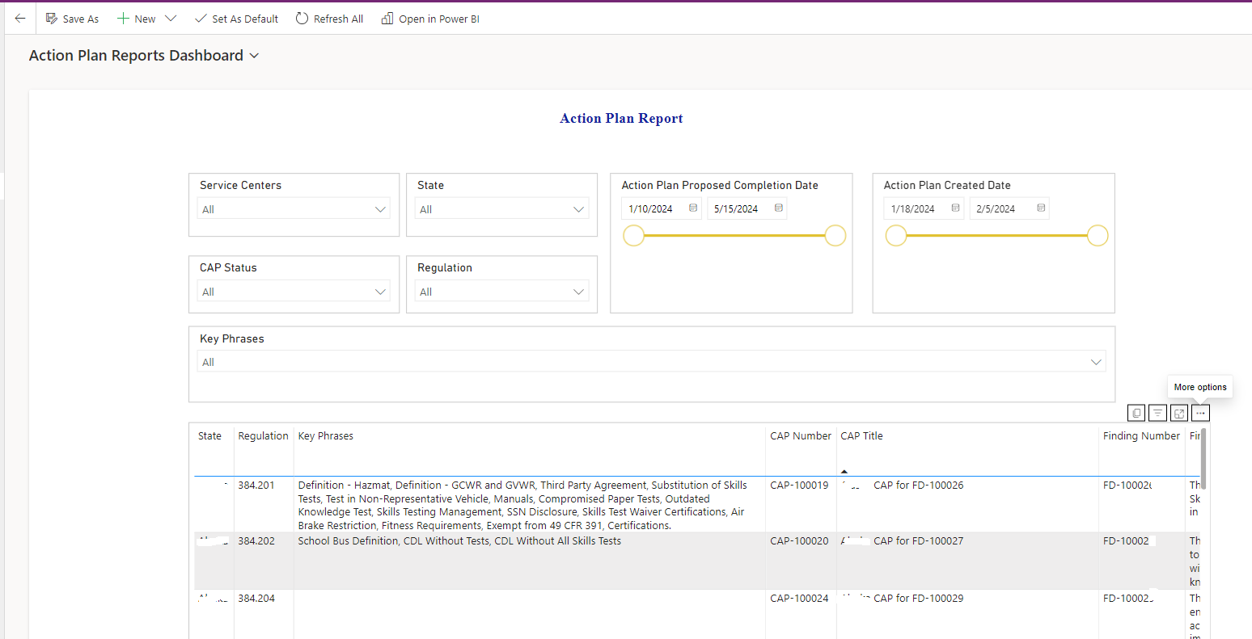
CRM Support Tickets & its Resolution
Export Option for Reports
a. Login to the CRM as FMCSA user. And Click on Reports from left hand side menu options.
b. From the Selector (the drop-down arrow as shown in screenshot) on top of the page, select the report you want to view/export.
c. Here we are taking Action Plan as
example and selecting that from
selector will open this
dashboard.

Slide 30
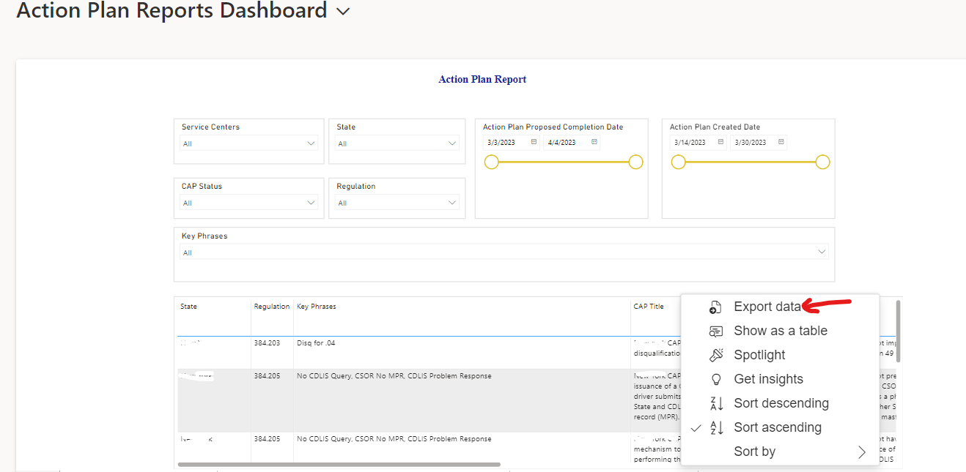
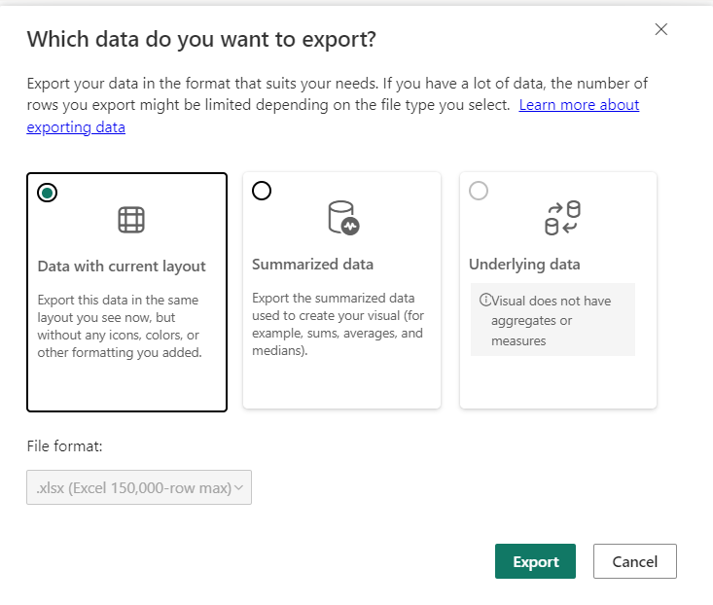
CRM Support Tickets & its Resolution
e. Hover over at the top right of the table to view the three dots and select Export Data. This will open another screen to select the layout where select the option to export with 'Data with current layout’.
f. Click Export. Once the data is exported successfully, it will show a message that data export is successful and the excel file will be downloaded to “Downloads” folder on your computer (shown at the top of the browser as well)

Slide 31
CRM Support Tickets & its Resolution
Updating Finding Title or Editing the Description
a. Finding title can only be edited in draft mode.​ b. Once the user submits it, it can only be rejected by the HQ user so that a new Finding with correct title can be used. Or,​ c. To avoid any spelling mistakes, click on the magnifier icon provided for the 'Titles for Finding' to make your selections.
New Look Toggle on top of screen – Switching to new look will disable some SCORE features in the CRM.

Slide 32
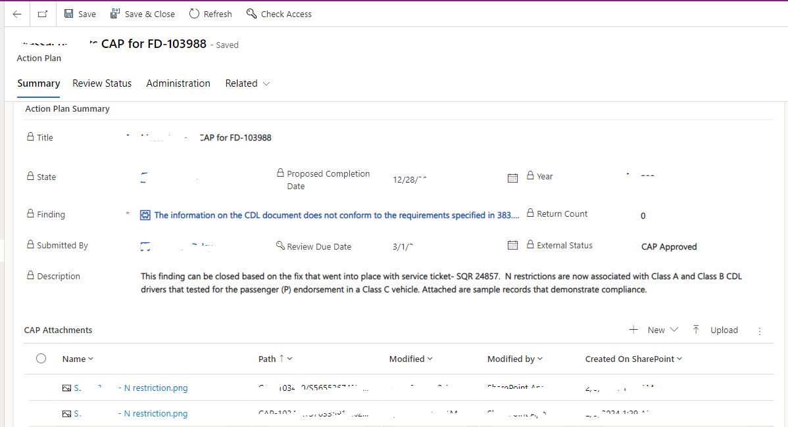
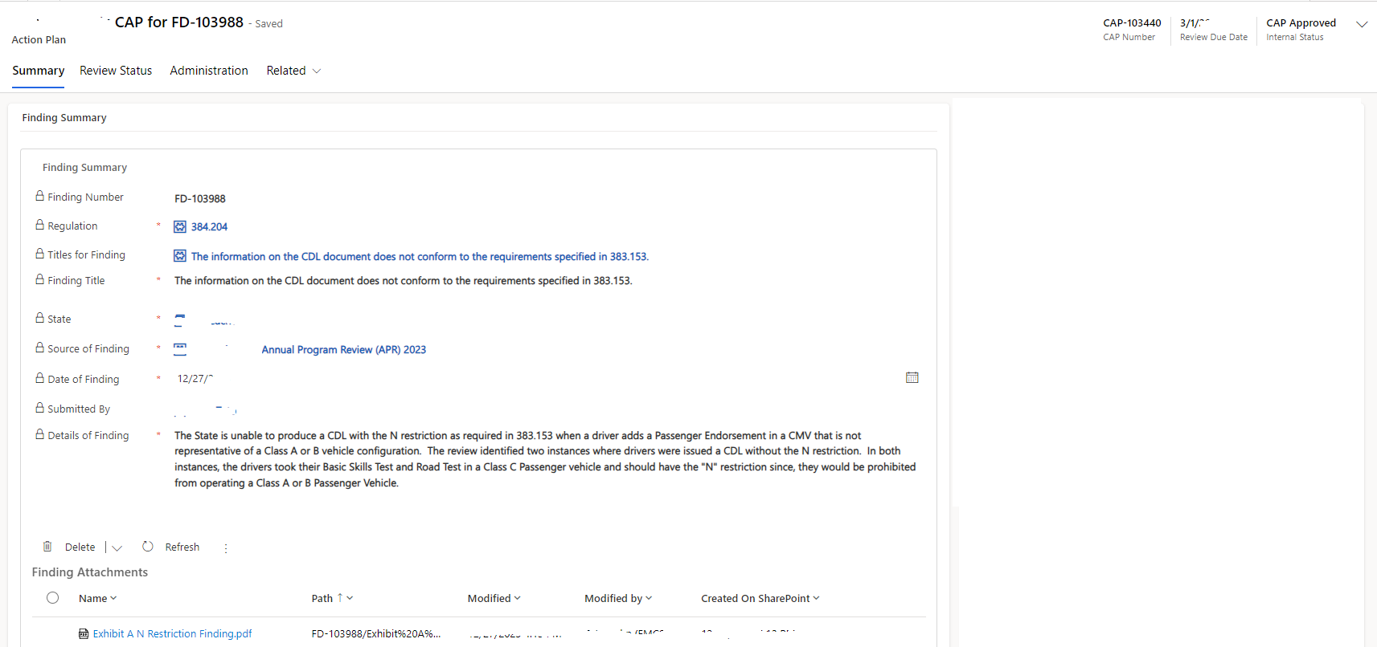
CRM Support Tickets & its Resolution
Opening attachments from child records
a. The issue reported was that if a Finding has an attachment, that cannot be opened from the its child record i.e. Action Plan/Action Plan Implementation/Contested Findings/CAP extension
b. The resolution to this is to go the Parent Record i.e. Findings and view the attachment.

Slide 33
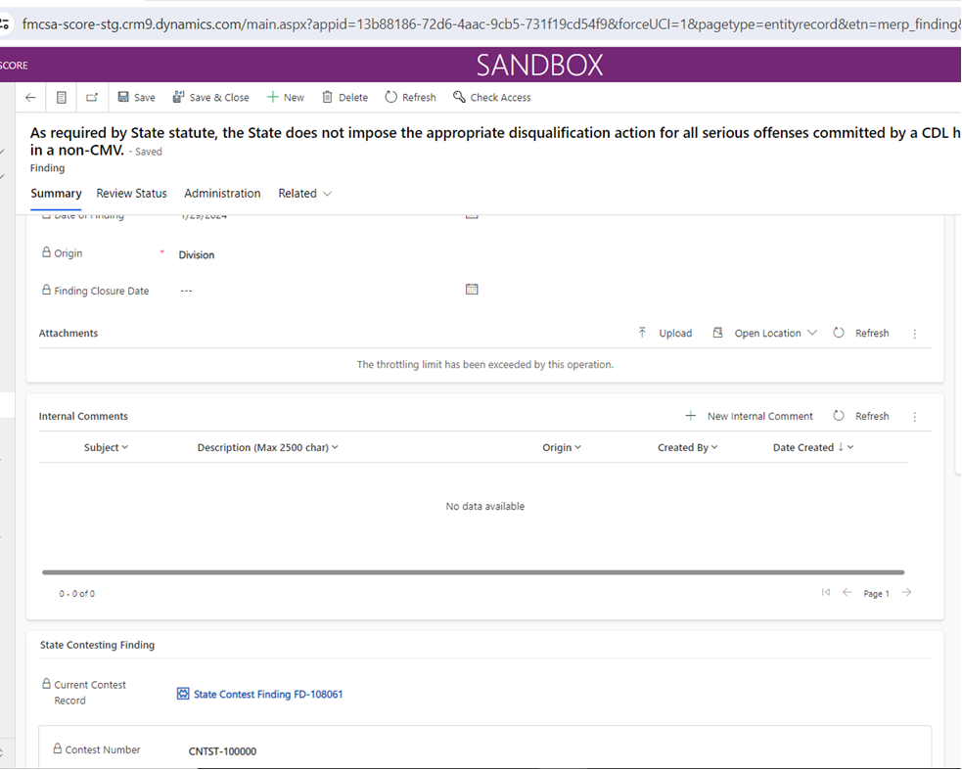
CRM Support Tickets & its Resolution
Throttling limit on uploading documents
a. Documents uploaded by the FMCSA or the State user
in any of the forms (Finding/Finding Contest/CAP/IMP) are
not displayed to the user. There is a message that
appears under the Attachments section,
'The throttling limit has been exceeded by this action’
b. The alternate is to: Click on the small drop-down arrow
besides Related and select Documents. The attachments
can be viewed from there.

