Slide 1
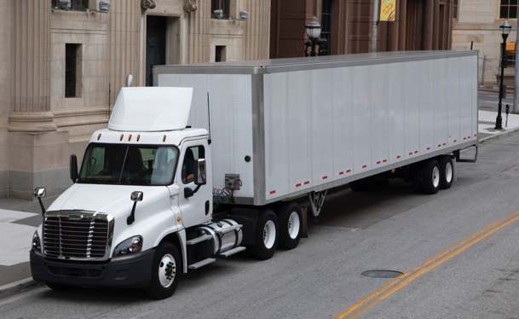
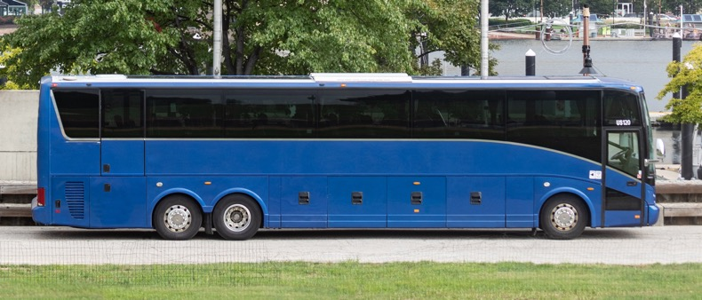
SCORE FMCSA Training – Release 2
02/13/2024
Notes:
Available cover design option. Please delete any unneeded cover page designs.

Slide 2
Agenda
Overview
FMCSA SCORE Application
SCORE State Site
SCORE User Groups
Release 2 Functionality
Release 2 Overview
CAP Implementation Extension
Annual Certification
State Contests a Finding
Noteworthy Observation
APR & STR Checklists
APR Review Letter Generation
Resources
CRM Tickets & its Resolution
App Demo

Slide 3
Overview

Slide 4
FMCSA SCORE Application
The new State Compliance Records Enterprise (SCORE) system is built within the PowerApps platform
SCORE is a web-based system used to track States' implementation of Commercial Drivers' License (CDL) regulations.
Current implementation of SCORE is on PowerApps platform that incorporates business logic and workflow capabilities to automate the regulatory activities.
With the Release 2 features, FMCSA users will be able to process CAP Implementation Extensions, Annual Certifications, State Contested Findings, Noteworthy Observations, APR & STR Checklists and Generate APR Letters.
FMCSA users can access the application at: https://fmcsa-score.crm9.dynamics.com/

Slide 5
SCORE State Site
State users can only use the website to access SCORE.
State users collaborate with FMCSA users on CAP Implementation Extensions, Annual Certification, State Contests a Finding, Noteworthy Observations and APR & STR Checklists.
State users can access the system using this link using the login.gov authentication: https://score.fmcsa.dot.gov

Slide 6
SCORE User Groups
Division
Service Center
HQ
State User
Administrator
Division users are assigned to 1 or more of the 51 jurisdictions. Division users can only create and review content for the jurisdictions that they have been assigned.
Service Centers users are assigned to 1 of the 4 Service Centers. Service Centers users can only create and review content for the Service Center that they have been assigned.
HQ users are assigned to all jurisdictions. HQ users can create and review content for all 51 jurisdictions. HQ is the only user group that can approve implementations.
State users are assigned only 1 jurisdiction. State users will use the site to collaborate on the content.
FMCSA Administrators have additional privileges that include changing regulations, deactivating content, sending out alerts, and managing user access.

Slide 7
Release 2 Functionality

Slide 8
Release 2 Overview
CAP Implementation Extension
State can submit a request to extend the current 'Proposed Completion Date' for the CAP.
FMCSA can 'Approve', 'Return' for more information or 'Reject' the request.
Annual Certification
Either a State or any FMCSA team (Division, SC or HQ) can submit an Annual Certification for a state.
All submitted Annual Certifications only require SC or HQ Approval.
State contests a Finding
A State has 30 days to contest a Finding when a Finding is opened by FMCSA.
HQ can Approve or Reject the request.
Noteworthy Observation
Any FMCSA team (Division, SC or HQ) can create a Noteworthy Observation.
There are three types - Potential Risk Issue, Program Improvements and Noteworthy Practices.
Checklist
When an APR or STR Review is opened, subsequent APR and STR Checklist is created for the same.
Checklist is available for both the FMCSA and the state.
Review Generation Letter
All APR Reviews have an option to generate letters.
APR letters can be generated, edited and signed online.

Slide 9
CAP Implementation Extension
State submits CAP Implementation Extension
CAP Implementation request is received by the Division team
Division 'Approves' the request, and it is sent to the Service Center for the review or,
Service Center 'Approves' the request, and it is sent to the HQ for their review or,
HQ 'Approves' the request or,
State receives the updated status in their SCORE dashboard.
Division may 'Return to State' and state resubmits.
Service Center may 'Return to State' and state resubmits.
HQ may 'Return to State' and state resubmits.
Third return from any of the FMCSA team is considered as 'Rejection'.
State can submit a new request.

Slide 10
Annual Certification
State or any of the FMCSA team (Division/SC or HQ) submits an Annual Certification.
Division team receives the Annual Certification submitted by the state and Approves it and, it is sent to Service Center and HQ team or,
Either Service Center or HQ can Approve it or,
Annual Certification status is updated in State dashboard (Approved or Returned)
Division 'Returns to State' and the state resubmits.
SC or HQ 'Returns to State' and the State resubmits.

Slide 11
State Contests a Finding
State contests a Finding within 30 days of the Finding was opened.
If HQ approves it, the Finding is closed, and the State views the updated status as 'Contested-Accepted' or,
HQ receives the request in their dashboard and 'Approves' it or, ‘Rejects’ it.
If HQ Rejects it, the Finding remains open, the status is updated to 'Approved' and the State must submit the CAP.

Slide 12
Noteworthy Observation
FMCSA team (Division, Service Center or HQ) submits a Noteworthy Observation.
HQ 'Approves' it or,
- The State is notified via email only if the Noteworthy Observation type is, 'Noteworthy Practices’.
- For 'Potential Risk Issue' or 'Program Improvement', only FMCSA is notified, and the status is updated.
HQ 'Rejects' the request.

Slide 13
APR & STR Checklist
FMCSA team submits an APR or STR Review
A subsequent APR or STR checklist is created
FMCSA team can view all the sections and the associated questions
FMCSA enters responses to 'FMCSA Notes/Outcome'
FMCSA can view the State responses in the 'State Notes/Outcome' field
When the Review is complete, enter the 'Completed Date' and the Review status is updated to 'Closed'

Slide 14
APR Review Letter Generation
Division team enters the 'Completed Date' for an APR Review and a new tab, 'Review Letter' is added to the Review.
Letter is generated and edited if needed. Alternatively, letter can be directly uploaded into SharePoint location provided on the 'Review Letter' tab.
Letter is submitted for Review.
Letter may be returned for additional edits.
Administrator approves the letter.
Letter is sent outside the system by postal mail to the state.

Slide 15
Resources
Quick Links​
SCORE App Link: https://fmcsa-score.crm9.dynamics.com/
State Website Link: https://score.fmcsa.dot.gov
​
Help Documentation
SCORE Manuals - Training and User Guides | FMCSA (dot.gov)
​
For assistance contact SCORE support at: ​
FMCSA-SCORE-Support@dot.gov​

Slide 16
CRM Support Tickets and its Resolution
Feature | Issue | Resolution
Reports | Export option for Reports is disabled for the Easter Service Center User 'Summer Bowman'. | I. Downloading reports from the reports section: 1. Login as an FMCSA user. 2. Go to the 'Reports' and select the report to download. 4. Hover over at the top right of the table to view the three dots and select option to export with 'Data with current layout'. II. Download/export data from the master tables by filtering and sorting.
Finding | Updating Finding title or Editing the description | 1. Finding title can only be edited in draft mode Or, 2. Once the user submits it, it can only be rejected by the HQ user so that a new Finding with correct title can be used. Or, 3. To avoid any spelling mistakes, click on the magnifier icon provided for the 'Titles for Finding' to make your selections.
UI | New Look feature | Switching to the 'Try the new look' option can disable some features, specifically if you are having issue viewing the attachments. Switching back to old view would solve such issues.
All forms - Attachments | Attachments added to parent records cannot be opened from child records | The attachments can be viewed by going to the Parent record.

Slide 17
App Demo

