Slide 1

FMCSA
Regulatory
Update
Robert W. Miller
Office Director for Policy, Strategic Planning, and Regulations
June 15, 2015

Slide 2
National Registry of Certified Medical Examiners
May 21, 2014 – All medical cards issued on or after 5/21/2015 must be provided by examiners on the National Registry.
April 23, 2015 – Final Rule published which updated forms and established new requirements for electronic transfer of medical certification information from National Registry to State Driver License Agency (SDLA).
January 2016 – Medical Examiners may begin voluntary use of new forms - National Registry will be updated to accept new forms
June 22, 2018 – Compliance date for the Final Rule. Mandatory use of new forms, MEs upload data for completed examinations within one business day, FMCSA electronically transmits medical certification data to SDLA.

Slide 3
National Registry of Certified Medical Examiners - Current Status
@ 42,000 certified medical examiners (completed the training, testing, and documentation verification)
@ 700 medical examiners have completed training and testing, and will be certified upon upload and verification of their documentation.
@ 300 medical examiners scheduled to take the exam.
@ 23,000 medical examiners registered at the website and we expect most will follow through with the training, testing, and certification.
Over 4.2 million examinations conducted in first year of implementation

Slide 4
Drug & Alcohol Clearinghouse (NPRM)
NPRM published Feb 20, 2014
Proposed to establish a single on-line clearinghouse of positive Drug & Alcohol results and drivers who refuse to be tested.
Closes loophole for “job hopping” drivers who fail to report previous positive tests and/or fail to complete return-to-duty programs.
Drivers must sign a consent form for employers to check.
Final Rule expected to be published in Early 2016.

Slide 5
Drug & Alcohol Clearinghouse
Reporting:
  Employers/Service Agents must report positive tests & refusals
  Employers must report actual knowledge of DUIs
  Labs must report annual summary of activity
Searching:
  Employers check pre-employment and annually for all drivers
  State Driver License Agencies check before issuing CDL
  NTSB access during crash investigation
Retention:
  3 to 5 years in proposal – asked for comments
  Record removed at end of 3/5 years if return-to-duty completed
  Record retained indefinitely if return-to-duty not completed

Slide 6
Electronic Logging Devices (ELDs)
(SNPRM)
Prescribes minimum technical standards; performance based standards - flexibility
Limited exception, only requires drivers who need to keep RODS to use ELDs
Establishes explicit requirements for HOS supporting documents - specify the “number, type and frequency” in accordance with the statute.
Prohibits harassment of drivers - establishes a complaint process for drivers, due process for carriers, and specifies civil penalties.
Final Rule expected in Fall 2015

Slide 7
Entry Level Driver Training (ELDT)
Key Issues for Reg-Neg
  Should FMCSA specify the number of hours or use a performance-based approach?
  What is the best oversight method for ensuring proper driver training and training program compliance?
  What should be included in the curriculum for Class A and Class B CDLs, and for passenger and hazardous materials endorsement?
  When should FMCSA begin enforcement of the new requirements?

Slide 8
Results of the Negotiations
Series of 6, 2-day meetings February - May
Achieved consensus on ELDT Rulemaking Proposal
  Applicability
  Training Provider and Instructor Qualifications
  Curriculum (Class A, Class B, Passenger, School Bus, HM)
  Refresher Training (Suspended, Revoked)
  Training Provider Registry – All schools and programs must be registered and submit students’ training certificates to FMCSA; FMCSA will forward the certificates to the State Driver Licensing Agencies.

Slide 9
Next Steps for ELDT
Rulemaking team will complete drafting the NPRM by July 2015.
Publish NPRM - October 2015.
Publish Final Rule - October 2016.
Compliance/Implementation Date - 2019.

Slide 10

Other Rulemaking Actions
  Diabetes (NPRM published 5/5/2015, comments by 7/6/2015)
  Confidential Business Information – (FR published 6/10/2015)
  Prohibiting Coercion (FR – Fall 2015)*
  Speed Limiters - @ OMB (NPRM – Fall 2015)
  Safety Fitness Determination (NPRM – Fall 2015)
  URS 2 (NPRM – Spring 2016)*
  Military CDL requirements (NPRM – Spring 2016)*
* MAP-21

Slide 11
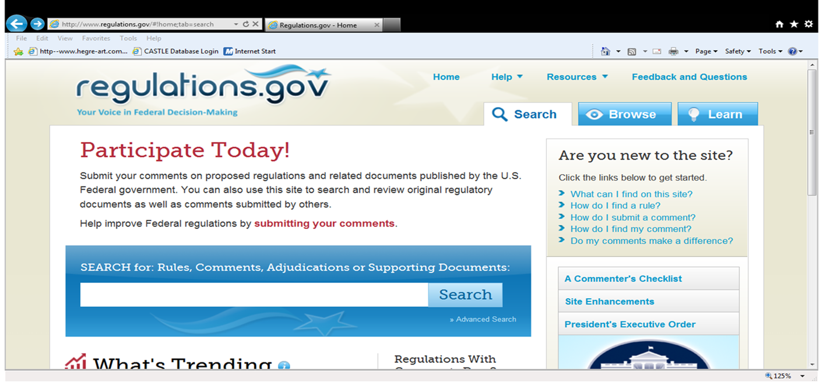
http://www.regulations.gov
Search by Docket # or Name of Rule

