Slide 1
Safety Tips for CMV Drivers

Slide 2
FMCSA Overview
The Federal Motor Carrier Safety Administration’s (FMCSA) primary mission is to prevent commercial motor vehicle (CMV)-related crashes, injuries, and fatalities. CMVs include large trucks, buses, limousines, and other commercial vehicles.
FMCSA’s Our Roads, Our Safety campaign encourages road users to share the road safely with large trucks and buses.
Our Roads, Our Safety offers many helpful and shareable resources that educate and remind everyone on the road to practice road safety.
www.ShareTheRoadSafely.gov
Notes:
The Federal Motor Carrier Safety Administration’s (FMCSA) primary mission is to reduce commercial motor vehicle-related fatalities and injuries. Activities of the Administration contribute to ensuring safety in motor carrier operations through strong enforcement of safety regulations; targeting high-risk carriers and commercial motor vehicle drivers; improving safety information systems and commercial motor vehicle technologies; strengthening commercial motor vehicle equipment and operating standards; and increasing safety awareness. To accomplish these activities, the Administration works with Federal, State, and local enforcement agencies, the motor carrier industry, labor and safety interest groups, and others.
We appreciate all that YOU do to keep our roads safe every day!
We’re here to support YOU!

Slide 3
Our Roads, Our Safety – CMV Key Messages
The following key messages are central to the Our Roads, Our Safety campaign:
FMCSA’s primary mission is to prevent crashes and fatalities involving large trucks and buses. The agency is an important resource and partner for CMV drivers.
Staying safe while sharing the road is the personal and professional responsibility of CMV drivers.
Safely sharing the road is a way for CMV drivers to show their professionalism.
CMV drivers play an integral role in the national supply chain and help ensure the safe delivery of goods.
CMV drivers take pride in their unique skills, vehicles, and driving capabilities.
Healthy drivers can lead to safer drivers.

Slide 4
CMV Driver Safety Facts and Tips
Speeding | Distracted Driving | Hazardous Weather
The large size and weight of trucks and buses increases driving challenges, including acceleration, braking, and maneuverability. Large vehicles accelerate slower uphill and may gain speed quickly downhill. Drive at a safe speed, be aware of your surroundings, and never drive above the speed limit. | Avoid taking calls and texting while driving. Set and review your navigation before you leave for your destination. This way, you can avoid the distraction of entering information while driving. Get a good night’s sleep. Having adequate sleep allows you to focus and not become drowsy or distracted. Avoid eating and drinking while driving. Having a cup or food in your hand while driving can take your focus off the road. | Large trucks and buses have long stopping distances, and in rain, snow, or ice, those become even longer. Make careful wide turns. Turning requires extra care when roads are wet or icy. Adjust your vehicle’s speed and following distance to appropriately match weather conditions, road conditions, visibility, and traffic. Avoid driving through flooded roadways and alter your vehicle’s route if it’s unsafe.

Slide 5
Explaining CMV Safety Challenges to Other Drivers
CMV drivers face unique safety challenges including longer stopping distances, large blind spots, and wide turns. So, we educate others (non-CMV drivers) on the road in the following ways:
Long Stopping Distances | Large Blind Spots | Wide Turns
Large trucks and buses need the length of up to two football fields to safely stop. Leave extra space when merging in front of these large vehicles, to give them the stopping space they need. | Avoid lingering in blind spots. If you can’t see a truck or bus driver’s face in their mirror, they can’t see you. | Trucks and buses need extra space and time to make wide turns carefully. Wait for large vehicles to finish turning before continuing your journey. Pay close attention when trucks and buses are turning right, as they may not be able to easily turn from the right lane and may initially move left to create enough turning space.

Slide 6
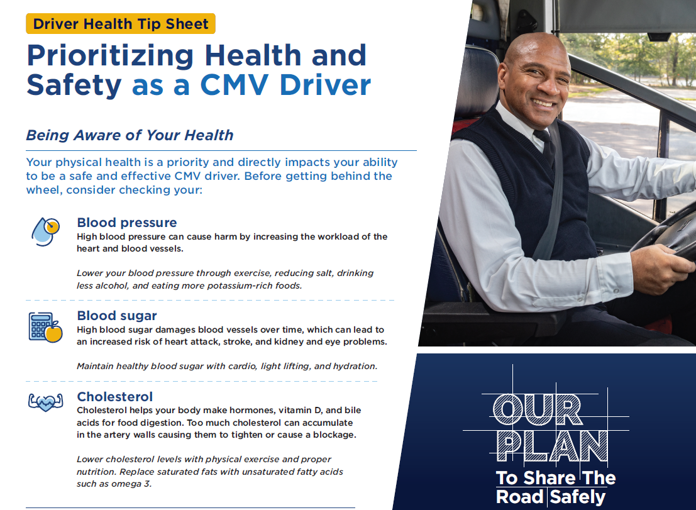
CMV Driver Health and Wellness
Your physical health is a priority and directly impacts your ability to be a safe and effective CMV driver. Before getting behind the wheel, consider the following.
Prioritize sleep. Try to get 7-8 hours of sleep per night and consider taking a 15-minute power nap while at a truck stop or rest area.
Eat healthy. Avoid salty food, and eat lots of vegetables, fruits, and other foods high in fiber. Eat more potassium-rich foods such as bananas, avocado, spinach, and more. Keep a cooler full of nutritious foods with you.
Try different exercises. Evaluate what exercises you can do that don’t require equipment such as walking, bench presses, lunges, jumping jacks, squats, and more, and build a routine you enjoy alongside your cab.
Take your prescriptions properly. Make sure your prescription and over-the-counter medications aren’t causing drowsiness, and schedule them appropriately.

Slide 7
Download and Share FMCSA Resources
Get tip sheets, visor cards, graphics, and other resources to share with your audiences!
www.fmcsa.dot.gov/ourroads/cmv-driver-toolkit
Need printed materials? Contact FMCSA.Outreach@dot.gov
Notes:
If you need any assets printed, please reach out: FMCSA.Outreach@dot.gov

Slide 8
Thank you!

