Slide 1
Work Zone Safety Awareness
[INSERT DATE OF PRESENTATION]
Notes:
Available cover design option. Please delete any unneeded cover page designs.

Slide 2
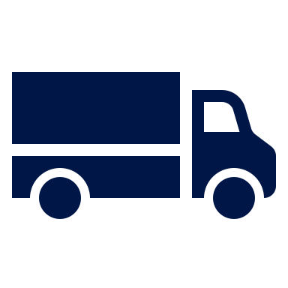
Traveling Safely Through Work Zones
Traveling safely, slowly, and attentively through work zones is critically important, particularly as a commercial motor vehicle (CMV). Narrow lanes, sudden stops, traffic pattern shifts, and uneven road surfaces present unique challenges in these areas for large trucks and buses.
Large trucks are overrepresented in fatal work zone crashes.
33%
of fatal crashes in 2019 involved CMVs¹
¹National Work Zone Safety Information Clearinghouse

Slide 3
Work Zone Safety Driving Tips
Move early into an
open lane
Reduce speeds
Pay attention to signs and signals
Avoid distractions while behind the wheel
Be prepared to stop
or slow
Maintain extra space between vehicles
Research and plan your route ahead of time

Slide 4
2019 CMV-Related Work Zone Facts (National)¹
Total Work Zone Fatalities: 842
Drivers and Passengers: 690
Pedestrians and Bicyclists: 140
Others (Occupants of a non-motor vehicle transport device and persons on personal conveyances): 12
Total Fatal Work Zone Crashes Involving a CMV: 250
From 2018 to 2019, the number of fatal work zone crashes involving a large truck or bus increased by 16%.

