Slide 1
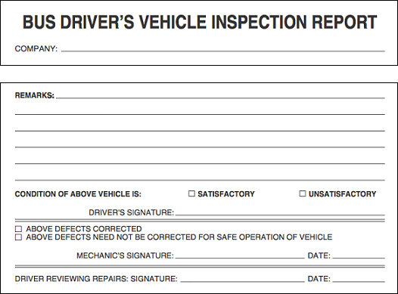
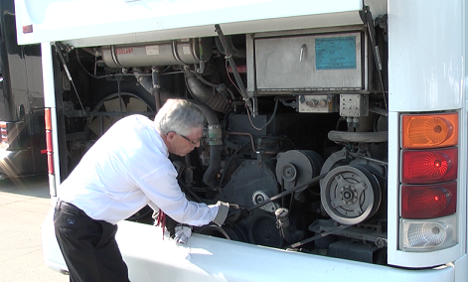
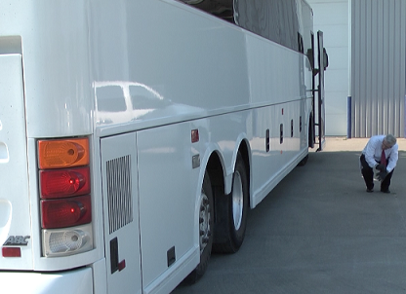
VEHICLE INSPECTIONS

Slide 2
Pre-trip inspections & En-route inspections
Vehicle Inspections: Lesson 1
Notes:
Conducting pre-trip inspections is critical in managing the safe operation of commercial vehicles. The purpose of the pre-trip is two-fold:
Be sure that any critical safety vehicle defects indicated by the previous driver have been addressed through evaluation and/or service; and
Be comfortable that the motorcoach you are about to operate is safe and in good working condition.
Drivers occasionally believe that a thorough pre-trip inspection is not necessary – especially if they work for a company who has a very good maintenance program and where there are generally few vehicle issues.
However, taking a motorcoach to pick up scores of passengers without doing a thorough pre-trip is simply asking for trouble and embarrassment when an issue occurs that would have been detected during a proper pre-trip. Not to mention that failing to conduct a pre- trip inspection (or post-trip, for that matter) is against federal safety regulations.
Pre-trip inspections are required to protect you, your passengers, and the public. Embrace them and always make time for one - not doing one is squandering your first opportunity of operating a successful and safe trip.
En-route inspections are not specifically required except under specific conditions, but experienced drivers know that a lot can happen between the time you start the coach and the end of the day’s trip. Checking for simple things like unusually hot wheels can help diagnose issues and prevent catastrophic events that could cause injury, death and significant stress for you and your company.

Slide 3
Pre-Trip Inspection
It is ultimately the Driver’s Responsibility to ensure that any commercial vehicle you operate is in good condition and in good working order.
Why you must inspect:
Safety - Early detection of malfunctions.
Federal Regulations - Required by law!
Costs - Small problems turn into big ones
Company Reputation
Notes:
As a professional driver it is your duty and responsibility to make sure that any vehicle you take out is in safe operating condition and good working order. Federal Motor Carrier Safety Regulations (FMCSRs) requires drivers to conduct vehicle inspections and document deficiencies discovered so the company can address them before the vehicle is next dispatched.
The identification and early detection of vehicle safety issues or deficiencies provide several benefits:
Prevents breakdowns, collisions and other unplanned incidents.
Ensures compliance with the FMCSRs.
Saves on repair and response costs - correcting maintenance problems before they become serious can save a company considerable money.
4. Enhances customer satisfaction & company reputation.
Thorough, consistent inspection procedures will allow a driver to systematically identify safety issues and also spot signs of any potential maintenance problem before it becomes serious and causes a breakdown, incident or collision.
While it’s important for drivers to inspect their vehicle at various times, perhaps the most important inspection is the pre-trip inspection. Regulations and common sense stipulate that a driver should be satisfied that his/her vehicle is in safe operating condition before taking it on the road - this means performing a pre-trip inspection.

Slide 4
Pre-Trip Inspection
Notes:
A major component of the pre-trip inspection process involves the last inspection report documented for any vehicle. At the end of the day, for each vehicle operated, a driver must complete an inspection report indicating vehicle deficiencies. At a minimum, the FMCSRs require the driver to report any defects or deficiencies that would affect the safe operation of the vehicle or might result in its mechanical breakdown - this involves performing a post-trip vehicle inspection as well. You will learn about completing these forms later.

Slide 5
Basic Pre-Trip Inspection Steps
Check overall appearance upon approach
Review previous trip vehicle inspection report
Conduct a walk-around inspection
Check the headlights, auxiliary lights, and four-way flashers
Check the stop lights and turn signals
Check the engine compartment
Adjust seat/mirrors and inspect the interior
Check the air-brake system
Notes:
See narrative/Instructor Manual for detail

Slide 6
Accessible Bus
Accessible buses require additional steps during the pre-trip inspection.
Cycle the lift or ramp, checking for smooth operation
Inspect the securement system, including floor tracks, anchorages, straps/tie-downs, seat belts and folding seats to ensure necessary components are present and functional
* If lift is not operational, check with dispatch to determine if you must change buses
Notes:
If the bus you are inspecting is an accessible bus, there are additional steps that must be taken to ensure it is operational and all necessary accessories are present before embarking on your charter or trip.
This step is important - you may have been assigned an accessible bus because its equipment is necessary for one or more passengers. If the lift is inoperable, or any necessary accessories are not present or functional, you should notify your dispatch immediately so that a decision can be made as whether to assign you another coach or tend to the issues prior to disembarking.
If the lift is not necessary for the assigned trip, and dispatch notifies you to take the bus anyway, you must report the deficiencies found on the vehicle inspection report.

Slide 7
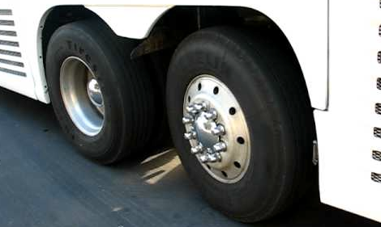
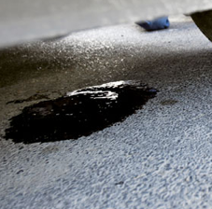
En-Route Inspection
Tires/Wheels
Lights
Leaks (oil, coolant, etc.)
Verify all compartments are closed
Check for damage
Note obstacles to pulling out/backing out
Notes:
At the completion of each day’s trip, you must complete a post-trip inspection of the coach, similar to the pre-trip inspection. However, what about any interim stops on the way to the final stop of each day?
Each time you stop en-route to that day’s destination provides another opportunity to check your coach for any obvious issues which could literally lead to trouble down the road. Here is what to look for:
Check the tires and wheels. Make sure that there aren’t any flat tires or tires that are low on, or leaking, air. Look for any signs of hub oil on the wheels, and check each tire/wheel for excessive heat. Any of these conditions could lead to a tire failure or fire and further investigation is warranted.
Check that all lights are working, especially at or near dusk or night. Remember, you rely on lights not only to see, but also to be seen.
Check for fluid leaks and any unusual odors, especially at the rear of the coach near the engine area. Fluid leaks in the engine compartment can also lead to fires depending on the source and location of the leak.
Be sure that all compartments are closed, especially the baggage bins.
Check for any new damage to the outside of the coach.
If you find anything seriously wrong, have it checked at that stop, or call your company and ask for further instructions.
Finally, remember to check for any obstacles around your coach that could give you trouble when leaving your stop, especially if you have to do any backing.

Slide 8
POST-TRIP INSPECTION & DOCUMENTATION
Vehicle Inspections: Lesson 2
Notes:
Post trip inspections are critical in managing the vehicle safety process. They provide an opportunity for drivers to detail any issues they experienced with the vehicle during operation that day.
Drivers should be as specific as possible with any of their information provided on post-trip inspection reports. Maintenance personnel need to understand the issue clearly so that they can investigate, duplicate the defect if necessary, and correct unsafe conditions.
This process is also important to the next driver who will be operating the same motorcoach. He or she will be relying on your detailed information with regard to safety issues to cue the maintenance staff to remedy. If a driver doesn’t take the time to properly document issues on the post trip inspection, maintenance staff won’t know of any pertinent issue(s), and the next driver may take the coach on a trip without knowing any issues existed, jeopardizing the safety of everyone on-board and potentially the general public.

Slide 9
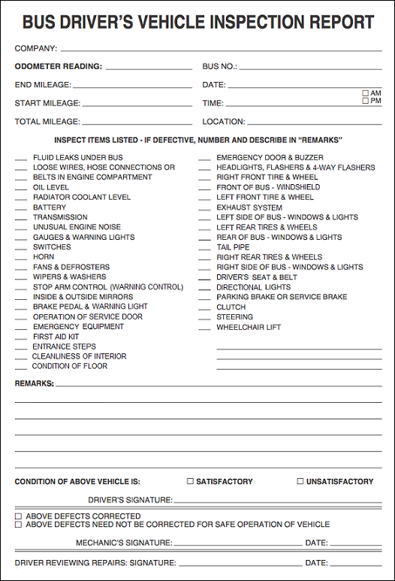
Post-Trip Inspection
Notes:
The procedures for doing a pre-trip and post-trip inspection are very similar. The biggest difference is how the post-trip inspection is documented.
When performing a post-trip inspection, you will fill out a form called the Vehicle Inspection Report, sometimes abbreviated and called a ‘DVIR’ or ‘VIR’ (these are the forms reviewed during the pre-trip inspection process). The report must be filled out and signed whether or not any defects or deficiencies are discovered.
Vehicle inspection reports differ by company, but there are certain items they are required to have/document. In general, the report must identify the vehicle and list any defect or deficiency discovered by or reported to the driver that would affect the safe operation of the vehicle or result in its mechanical breakdown. Specifically, the condition of the following components must be noted (at a minimum):
Service Brake
Parking Brake
Steering Mechanism
Lighting Devices & Reflectors
Tires
Wheels & Rims
Mirrors
Horn
Windshield Wipers
Emergency Equipment
In addition to vehicle component condition, drivers should report any unusual occurrences or issues observed while driving, even if they do not know the cause or component affected. For example, experiencing a loss or reduction of power or the vehicle pulling to one side under certain circumstances.
If there are no defects, deficiencies or concerns to report, the report has a location to indicate this. The driver must sign the report.
On two/co-driver trips, only one driver needs to sign the vehicle inspection report, provided both drivers agree as to the defects or deficiencies identified.

