Slide 1
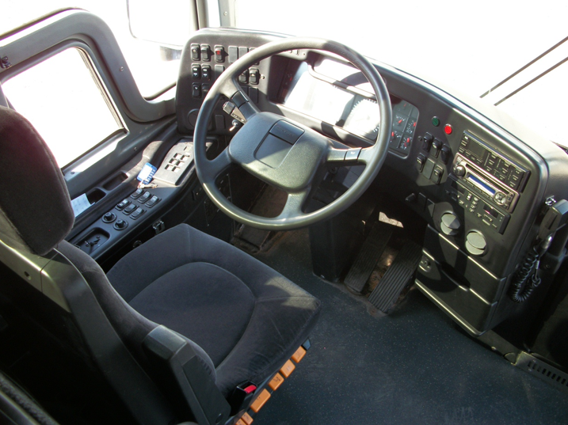
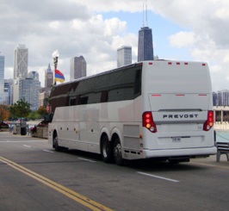
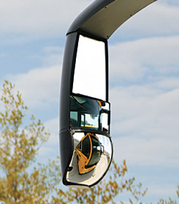
MOTORCOACH ORIENTATION AND FAMILIARIZATION

Slide 2
MOTORCOACH CONFIGURATION AND NOMENCLATURE
Motorcoach Orientation & Familiarization: Lesson 1
Notes:
Motorcoaches are complex and complicated machines, and they are ever evolving. If you’re new to the motorcoach industry, it will take you some time to become familiar with the various terminology, components, and systems in the modern motorcoach.
Even if you’ve been around the industry for a while, there is still much to learn - and perhaps even share with others - during the familiarization/orientation process. Different makes of motorcoaches can be vastly different, from both a vehicle controls standpoint as well as vehicle operating dynamics. There are constantly changing and evolving safety technologies on vehicles, such as electronic stability control, fire suppression, and collision avoidance. Other systems continue to evolve also, such as exhaust filter regeneration and associated diesel exhaust fluid.
No matter what your experience level and with what types of motorcoaches, you can always learn something new by paying close attention to the orientation and familiarization process and asking questions.

Slide 3
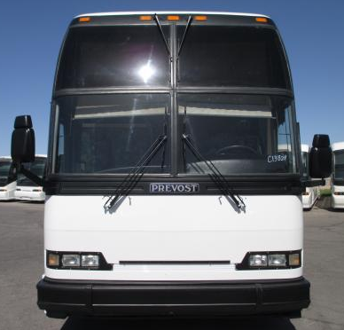
Motorcoach: Front View
Notes:
Items/components to detail - motorcoach front pictorial:
Overall height (point out differences in fleet if you operate buses with significant height differences)
Ground clearance (note differences if you operate vehicle classes with substantial clearance differences)
Mirrors (stress importance of these safety devices)
Steer wheels
Lighting (headlamps, clearance lights, etc.)
Windshield
Windshield wipers
Bumper (tire storage if applicable)
It’s critical for any driver to understand the various components and nomenclature of the vehicle you’re driving. Let’s review some basic components of a motorcoach.
In this image, you’re obviously looking at the front of the motor coach.
Take note that a motorcoach is tall. Sometimes, a motorcoach can be too tall for some of the clearances of bridges and other fixed objects such as hotel canopies. You should know the height of every motorcoach you operate so you are sure that you can navigate any low clearances safely.
Next, note that the motorcoach sits very low to the ground. Ground clearance is minimal.
You’ll know that there are two side view mirrors. These mirrors are a driver’s best friend – getting to know them well, and how to use them properly, can make or break your career as a motorcoach driver.
You can’t see them very well here, but your steering wheels are the front axle tires and wheels on a motorcoach.
Headlights, parking lights, & turn signals are seen just above the bumper. Clearance lights are present across the very top of the motor coach.
Note the large windshields, which may be one or multiple pieces of glass.
Along with the windshield are the windshield wipers. There are up to four (as seen here), depending upon the coach you are be operating
Finally, a note about the bumper. On many motorcoaches, the front bumper swings downward, allowing access to an area that holds the spare tire.

Slide 4
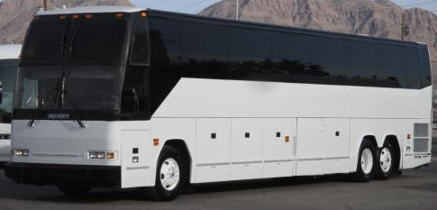
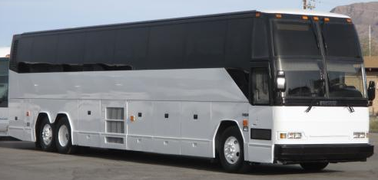
Motorcoach: Side View
Notes:
Items/components to detail - motorcoach side pictorials (show both sides):
Overall length
Overall height
Ground clearance
Side marker lights
Mirrors
Wheels & Axles (include nomenclature – i.e., steer, driver, tag, etc. and discussion of axle weight limits)
Service door
Windows/emergency exits
Rear overhang (discuss relation to tail swing)
Luggage bays (for bays containing specific equipment, indicate)
Compartment doors other than luggage bays (electrical, engine service, etc.)
Side cameras (if applicable)
Now, let’s look at the side of a motorcoach.
While this image also shows the height and low ground clearance of the motorcoach, it also shows the length - which is another key variable that you should know as a driver.
Take note again of your friends - the side view mirrors - in each of these images.
In addition to a better view of the steering wheel and axle, you can now see the drive and tag axles. The drive axle is the forward axle in the rear of the coach. The tag axle is the axle closest to the back of the coach – its main function is to support weight.
The main door used for entry for the driver and passengers is typically called the service door, and is on the right side of the coach.
The black windows that you see running the length of the sides of the motorcoach are great for passenger viewing. But they also serve another purpose – some of these are designated emergency exits, and can be accessed and opened for emergency egress.
The length of the coach from the tag axle to the rear bumper is called the rear overhang. The amount of rear overhang on different motorcoaches will vary; this is another important dimension for a driver to know and understand.
There are various doors along the bottom sides of the motor coach. Many of these access storage bays for luggage or other specific equipment. There are also doors that allow for easier access to various mechanical components, such as fuse panels, batteries, etc.
Some coaches may even have technology-related items on the sides, such as side view cameras.

Slide 5
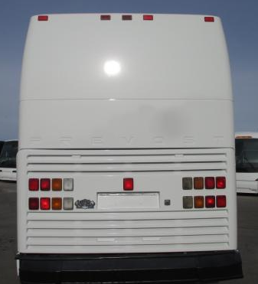
Motorcoach: Rear View
Notes:
Items/components to detail - motorcoach rear pictorial:
Overall height
Ground clearance
Engine compartment
Lighting (tail light assemblies, clearance lights, etc.)
Visible wheels/axle
Back up camera (if applicable)
Now let’s take a look at the rear of a motorcoach.
Again, note that it’s tall and low to the ground.
This rear panel with the louvers surrounding the lights actually opens upward to reveal, and allow access to, the engine.
You’ll notice lighting assemblies both on the lower portion, as well as additional clearance lights at the very top.
Sometimes you may notice additional technology equipment on the back of the motor coach, such as a backup camera.

Slide 6
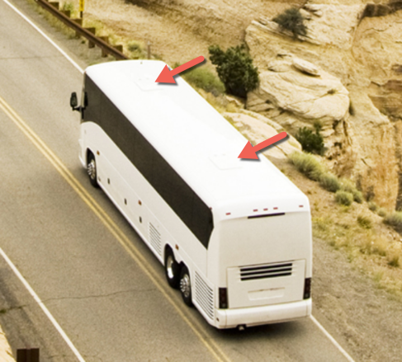
Motorcoach: Top View
Notes:
Items/components to detail - motorcoach top pictorial:
Emergency exit(s) (roof hatches)
Finally, let's look at the top of the motor coach. There's not much to describe or see here, except for one important attribute – motorcoaches typically have at least one roof hatch. Roof hatches serve as additional emergency exits and are particularly useful as exits if a coach rolls over onto its side.

Slide 7
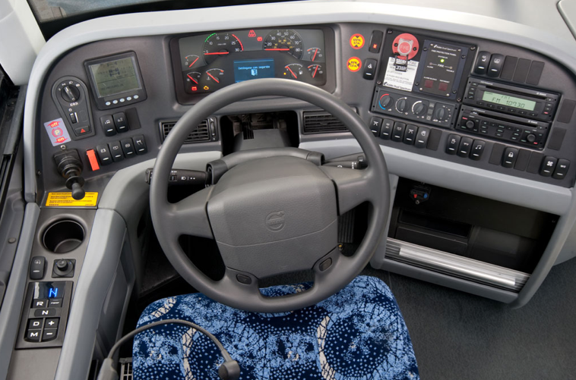
Driver Controls
Notes:
You’ll need to familiarize yourself with all of the driver controls in each of the coaches you operate. When seated, you’ll be in the vehicle cockpit, with control panels situated all around you. We’ll review each of these controls both here in the classroom and also when touring the coach(es).

Slide 8
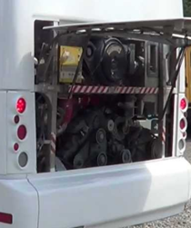
Systems: Engine
Power for mechanical and electrical systems
Rear of coach
Requires fluids, and regular maintenance
Engine trouble
Hard to visually see when driving due to location
“trouble” lights on dash can indicate issues as well as unusual operation
Notes:
Let’s discuss some major vehicle systems of a motorcoach. Like other motor vehicles, the engine provides power for the the mechanical and electrical systems of the vehicle. The engine is located in the rear of the motorcoach.
In order for engines to operate properly, they must be properly serviced and maintained, and key fluids, such as gas, oil, and coolant, must be present. There are various manufacturers of engines found on motorcoaches; when the vehicle inspection process is reviewed, your instructor will explain how to tell if fluid levels are appropriate on each engine type in the fleet.
Issues with the engine are often indicated via trouble lights on the dashboard or may be indicated simply by abnormal or unusual operation, such as experiencing low power.

Slide 9
Systems: Drivetrain
Components that transform engine power to turning the wheels
Transmission, driveshaft, axles, wheels
Periodic inspection and maintenance required
Drivetrain issues:
Usually felt/experienced or observed, depending upon component involved
Notes:
The drivetrain converts the power generated by the engine into forces that propel the coach forward or backward. Drivetrain components include the transmission, driveshaft, axles and wheels.
Periodic inspection and maintenance are required to insure proper drivetrain operation; inspections are usually done by maintenance personnel, since most drivetrain components are not fully visible to the driver. However, it is likely that a driver will experience or “feel” unusual operation if a drivetrain component is malfunctioning. Drivers may also see issues on visible components during vehicle inspections or a dash trouble light may indicate a problem.

Slide 10
Systems: Exhaust
Removes gases and fumes from vehicle; limits pollution and noise to environment
Unusual noise or vehicle performance issues may indicate system issues
Modern systems:
require fluid (DEF) to assist in pollutant management
regeneration process to burn collected soot; results in very high temperatures
Notes:
The exhaust system moves the gases and fumes created during engine combustion away from the vehicle. Exhaust gases pass through filters and a muffler before being discharged through the tailpipe. The exhaust system is exceptionally "hot" when the engine is running.
Regular inspections of the system by maintenance personnel help determine developing issues. Sudden issues may be detected by a driver or passengers; exhaust smells in the passenger cabin indicate a probable leak; sudden vehicle performance issues and excessive noise also may be indicative if exhaust system issues. These issues may or may not also be indicated via dashboard trouble indicators.
Modern exhaust systems require diesel exhaust fluid to assist in managing pollutant discharge. Many exhaust systems now also use a “regeneration” process to burn off soot collected in filters when critical levels are present. This process may need to be initiated by a driver while on a trip and, in some cases, can start independently. Dashboard lights usually indicate when this process is needed. A word of caution – this regeneration process results in extremely hot temperatures throughout the exhaust system, including at the discharge area of the tailpipe.

Slide 11
Systems: Suspension
Connects coach chassis to its wheels
Supports road handling and ride quality
May affect height relative to ground
Periodic inspection and maintenance
Suspension issues:
Visually observed or unusual operation (rough ride, not raising/lowering, etc.
Notes:
The suspension is the system of components that connects the coach to its wheels and allows the coach body to move relative to the tires. Suspension systems are most often associated with road handling and ride quality. On many motorcoaches, air suspensions can significantly affect the height and ground clearance of the coach.
Suspension components are maintained through periodic mechanical inspections, though drivers may notice issues by experiencing unusual differences in ride quality or visually observing unusual listing, leaning, or height positioning of the coach during vehicle inspection.

Slide 12
Systems: Brakes
Brake system uses air pressure to engage service/stopping brakes and release parking brake
Air system test required during driver vehicle inspection
Irregular function, warning sounds/lights, audible air leaks, and unusual heat at wheel indicate brake system issues
Notes:
Motorcoaches are equipped with air brake systems that rely on an air supply and release system to actuate the service or parking brake. Air storage tanks are filled with compressed air by the compressor, which is powered by the engine. When the driver steps on the brake pedal, airs flows from the storage tanks into the brake chambers, causing the brake to engage. For parking brakes, air is depleted from the system, allowing decompression of springs that cause the parking brake to engage.
The air brake system is required to be tested during driver pre-trip inspections. An air pressure gauge located on the dashboard indicates the availability of air pressure for safe vehicle operation, and the system includes warning tones and/or lights to warn of low air pressure. Proper brake system inspection procedures will be taught during the vehicle inspection module and related practice.
As with all critical components, regular inspections are required by mechanics. Drivers are generally alerted to system issues via air system warning tones, unusual operation, or audible air leaks from the system. Dragging brakes caused by partially-released parking brakes will result in unusual heat buildup and possible tire failure and fires.

Slide 13
SEAT & MIRROR ADJUSTMENT
Motorcoach Orientation & Familiarization: Lesson 2
Notes:
Proper seat and mirror adjustment cannot be stressed enough when it comes to the ability to operate a motorcoach without incident. Your ability to see what is around you in general, and specifically in critical areas, will allow a skilled driver to operate a coach without incident.
Unless you keep track of what is going on around the coach, you cannot correctly make the decisions you have to make while driving it. The front windshield gives you a panoramic view of what is in front of you; but to see what is happening behind and alongside your coach, you have to rely on your mirrors. The size, shape, location, and adjustment of the mirrors determine what you can see in these critical areas.
Seat adjustment is important because you need to be comfortable and alert for the many miles you will be driving. It is also important because of the relationship between seat adjustment and mirror adjustment. You should adjust the seat when you first sit in the coach, before adjusting your mirrors. Only after your seat is adjusted should you adjust the mirrors. Your view in the mirrors is dependent upon your seated position; any changes to the seating position will require a corresponding adjustment to the mirror positions. So, be sure you take the time to get the seat adjustment correct for your needs!

Slide 14
Driver Seating Area
Notes:
When we get out to the coach you’ll be shown the seat adjustment controls that will allow you to adjust the seat as necessary. For now, let’s simple review the options and considerations in adjusting the seat.
The seat is adjusted in two major ways: up and down (height) and forward and back. Both adjustments should permit you to reach and operate the accelerator, brake, and any other foot controls easily; the seat position should allow you to depress the brake pedal all the way to the floor. The height adjustment should eliminate pressure to the bottom of your thigh when your foot is on the accelerator. A seat that is too high can affect circulation to your legs and feet. The forward and back adjustment should let you easily touch the top of the steering wheel. When this is set properly, your elbows will be slightly bent when your hands are at the 8 and 4 o'clock positions on the steering wheel.

Slide 15
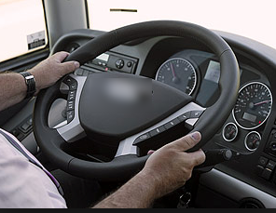
Introduction: Steering
Notes:
One of the reasons for setting your seat adjustment is so you can comfortably and correctly steer the coach. Steering a coach is a bit different than steering a car. You’ll steer the coach as follows:
Keep your hands on the wheel in the 8 o'clock and 4 o'clock positions.
Use a push-pull technique to steer. One hand pushes and the other hand pulls. For example, in turning the wheel to the right, the left hand pushes and the right hand pulls.
Do not put your hands over the top of the wheel. Your hands shouldn’t cross over/under each other as you make a turn.
Don't use the heel of your hand in the spokes of the wheel to help you turn.
You will notice that the steering wheel is a lot larger than a car's steering wheel. It is lower, and oriented in the horizontal plane. It is just as easy to turn as a car's wheel, but it takes many turns to go from a full right turn to a full left turn.
Avoid turning the wheel when the coach is not moving - you can damage the steering components.

Slide 16
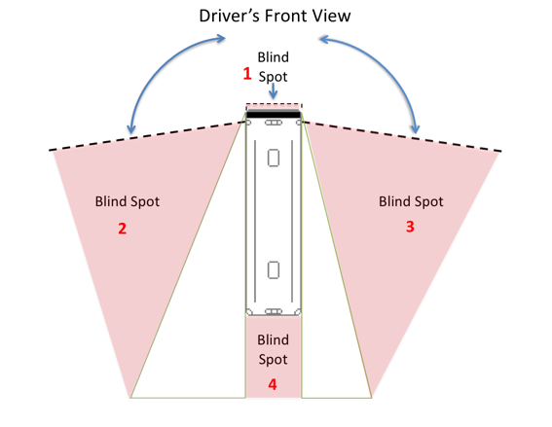
Blind Spots
Notes:
This picture shows the width of view for the right and left flat mirrors. Notice that you get a wider field of view from the left mirror than from the right mirror. This is because the driver sits closer to the left mirror.
Notice also that you have four blind spots:
One immediately in front of the coach. It is possible for a child or small adult, animal or other object to be immediately in front of the coach and hidden from view.
One on the coach’s left side. Cars passing or holding position in the left lane may be hidden from your view.
One on the coach’s right side. Cars in the right lane may not be visible to you, especially a small car up close to your door.
A large one at the rear of the coach. It is possible that three or four small vehicles could be in this blind spot, and you wouldn't be able to see them.

Slide 17
Side View Mirrors
Notes:
Setting your mirrors properly will minimize, but not eliminate, the blind spots to the sides of the coach.
The steps for mirror adjustment are very simple:
If necessary, move the arm holding each mirror so that you have an unobstructed view of the entire mirror.
Rotate both flat mirrors horizontally until the inside edges pick up the rear corners of the coach body. This is just to permit you to see what is happening right next to the coach. Rotating them inward any further is a common mistake and will limit their benefit – you don't need to see the side of the coach – you need to see what is along the outside of the coach.
Rotate the left (driver side) flat mirror vertically until the bottom one­third of the mirror shows the roadway. That is, the horizon is about one-third of the way from the bottom of the mirror.
Rotate the right flat mirror vertically until the bottom two-thirds of the mirror shows the roadway. The horizon should be about one-third of the way from the top of the mirror. You should be able to see the right rear wheel(s) of the coach.

Slide 18
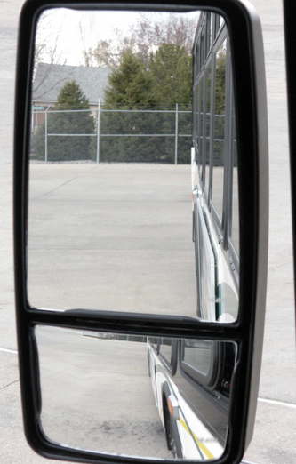
Convex Mirrors
Notes:
Because of their curvature, convex mirrors can show you areas that the flat mirrors do not. They help you see further out to the left and right and they allow you to see the roadway closer to the front of the coach, minimizing, but not eliminating, the left and right blind spots.
They are very common, though not all coaches may have them – so be sure you always set your flat mirrors properly even if you have convex mirrors on most coaches you operate. If you use convex mirrors to habitually compensate for incorrect flat mirror adjustment and you find yourself on a coach without the benefit of convex mirrors, you will have difficulty driving the coach without incident.
You probably have seen this warning: OBJECTS IN THIS MIRROR ARE MUCH CLOSER THAN THEY APPEAR. If so, you were looking in a convex mirror.

