Slide 1
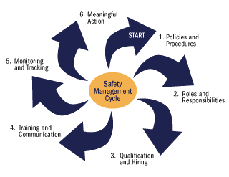
REGULATORY OVERVIEW & KEY REQUIREMENTS

Slide 2
BACKGROUND & APPLICABILITY
Regulatory Overview & Key Requirements: Lesson 1
Notes:
Commercial vehicle operations are subject to scrutiny from various regulatory agencies. The primary agency regulating both drivers and companies is the Federal Motor Carrier Safety Administration – an agency established for the sole purpose of promoting, ensuring and enforcing commercial vehicle safety. The regulations are complex – some are designed strictly for the carrier, some for drivers, and many apply to both the carrier and driver.
Understanding that carriers are monitored for compliance with these regulations – and potential consequences of not complying with them – is important. Drivers often feel that their company makes them do a lot of extra paperwork and other unnecessary activities outside their primary function of driving, but the truth is these practices are often required to avoid increased enforcement scrutiny, potential fines, threats to operating authority, and legal concerns. Increasingly, policies and practices in place to monitor and review both internal and driver compliance with regulations, and procedures in place to correct issues identified, are scrutinized to maintain the level of safety established by the safety regulations.

Slide 3
Federal Motor Carrier Safety Administration (FMCSA)
Established January 1, 2000
One of 12+ USDOT agencies/administrations
Federal, regional & state offices and personnel
Goal: reduce crashes and injuries involving commercial vehicles
Notes:
The Federal Motor Carrier Safety Administration began operations on January 1, 2000. It is one of over a dozen administrations housed under the United States Department of Transportation. The primary mission of the Federal Motor Carrier Safety Administration (FMCSA) is to reduce crashes, injuries and fatalities involving large trucks and buses.

Slide 4
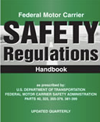
FMCSA Functions
Develop regulations to balance safety and efficiency
Enforce regulations
Use safety information systems to identify high-risk carriers
Education
Promote safety with partners
Notes:
In carrying out its safety mandate to reduce crashes, injuries, and fatalities involving large trucks and buses, FMCSA develops regulations that balance motor carrier (truck and bus companies) safety with efficiency. They develop and harness safety information systems to focus on higher risk carriers in enforcing the safety regulations, though enforcement is not limited to only identified high-risk carriers.
FMCSA functions also include educating carriers, drivers, and the public on regulations and safe practices, as well as partnering with stakeholders including federal, state, and local enforcement agencies, the motor carrier industry, safety groups, and organized labor on efforts to reduce bus and truck-related crashes.

Slide 5
Other Regulatory Agencies
US Department of Transportation (USDOT)
Federal Transit Administration (FTA)
State Regulations
Safety regulations
Numerous vehicle, roadway & environment laws
Department of Justice (DOJ)
Americans with Disabilities (ADA) regulations
Notes:
In addition to the FMCSA, there are other agencies with regulations applicable to motorcoach operations, though these regulations may be applicable only to certain types of motorcoach operations. For example, motorcoach operators that provide public transit services that are funded by the Federal Transit Administration must also comply with their regulations.
At the State level, there are safety regulations for operations not governed by the FMCSA, as well as numerous vehicle, roadway, and environmental laws applicable to any vehicle operating within each state.
The Department of Justice, as well as the Department of Transportation, enacts regulations specific to transportation of passengers with disabilities.

Slide 6
FMCSA Regulations
Title 49 CFR, Parts 300-399
Major Areas of Regulations - Motorcoach Operations
Training | Controlled Substances & Alcohol (testing & use)
Driver Licensing/CDL Standards | Vehicle Requirements
Driver Qualifications | Safe Driving Standards
Hours of Service | Inspection, Repair & Maintenance
Notes:
There are hundreds of FMCSA regulations applicable to commercial vehicle operations, some of them more specific to transportation modes other than motorcoach. FMCSA-promulgated regulations are found in Title 49, Parts 300-399 of the Coded Federal Regulations.
Significant areas of regulation pertinent to motorcoach operations include:
Part 380: Special Training Requirements
Part 382: Controlled Substances & Alcohol Use & Testing
Part 383: Commercial Driver’s License (CDL) standards
Part 391: Qualifications of Drivers
Part 392: Driving of Commercial Vehicles
Part 393: Parts & Accessories Necessary for Safe Operation
Part 395: Hours of Service of Drivers
Part 396: Inspection, Repair, and Maintenance
INSTRUCTOR TIP:
Show your students a copy of the Federal Motor Carrier Safety Regulations. You may also want to demonstrate to them how to find them online.

Slide 7
FMCSR Applicability
Interstate/Intrastate Operations
Carriers
Drivers
Carriers & Drivers
Notes:
There are some Federal Motor Carrier Safety Regulations which are applicable to all types and instances of commercial vehicle operations, such as regulations pertaining to CDLs, drug and alcohol testing and use, and hazardous material. However, there is some variability in the applicability of other FMCSRs depending largely on what type of operation is being conducted (for-hire or private) and whether the operation is occurring within a single state (intrastate) or between states (interstate). When applicable, FMCSRs are generally directed toward motor carriers (transportation companies), commercial vehicle drivers, or both.
For transportation conducted entirely within a single state that does not cross state lines and does not continue or originate a trip to/from out-of-state, the movement would be considered intrastate, and thus not subject to the FMCSRs. However, in instances where the FMCSRs are not directly applicable – such as an intrastate operation - they may still in fact be indirectly applicable. When FMCSRs do not apply due to the nature of the transportation, each state is responsible for, and has developed, their own carrier and driver safety regulations. In many cases, states have simply chosen to adopt the Federal Motor Carrier Safety Regulations, in part or in whole, as their intrastate safety regulations.

Slide 8
Carrier Regulation Overview
Financial responsibility/insurance requirements
Qualify/use only qualified drivers
Monitor driver conduct/performance
Schedule within/monitor drivers’ hours of service
Notes:
While we’ll mainly discuss driver responsibilities in this curriculum, now is a good time to briefly review regulations and the employer. Companies who operate commercial vehicles are bound by the same safety regulations as drivers. In fact, there are additional regulations for the employer. Not only must they be familiar with the driver regulations, but they also must oversee compliance with them in most cases.
Carriers must maintain a significant amount of liability insurance in the event there are injury incidents involving the operation of one of their commercial vehicles. They must ensure that any driver operating one of their commercial vehicles is properly qualified at the time of hire and remains properly qualified while driving a commercial vehicle for the company. Carriers must understand the hours of service limitations for commercial drivers - they may not dispatch a driver on a trip when they know driver is, or will be, in violation of these hours of service limitations.

Slide 9
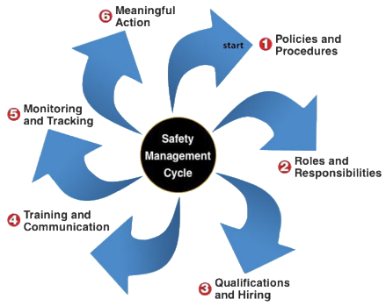
Carrier Regulation Overview
Implement/oversee vehicle inspection, maintenance & repair processes
Ensure vehicles meet safety & accessibility specifications
Develop policies and systematic practices to maintain compliance with safety regulations
Notes:
Employers must implement and oversee vehicle inspection, maintenance, and repair processes - many of which are specified in the safety regulations. There are also specific safety standards that each commercial vehicle must meet. While initial compliance with these standards is certified by the vehicle manufacturer, it is up to the carrier to ensure that vehicles continue to meet certain safety standards.
Finally, employers are required to develop policies and systematic practices to ensure compliance with all of the safety standards and regulations. This means that they must maintain specific documentation to show that they are maintaining compliance; and, as you might guess, this translates into documentation requirements of employees’ activities, including drivers. Drivers should understand that much of the documentation required by their employers is actually required to comply with the employer’s responsibility in meeting safety regulations.

Slide 10
Driver qualifications & responsibilities
Regulatory Overview & Key Requirements: Lesson 2
Notes:
Minimum requirements for the age, health, background and character have been established by federal and state safety regulations. Additionally, specific licensing requirements must be met depending on the type(s) of commercial vehicles operated. These higher standards for commercial drivers recognize the risk posed to the general public, any passengers, and themselves during the operation of these larger vehicles.
Company regulations require gathering specific information and checking into the background and character of potential drivers at the time of hire, as well as continuing reviews on a regular basis during the length of employment. Ensuring that drivers continue to meet the standards set forth is critical to a company’s safety profile, and their ability to operate legally.
Being the captain of a commercial vehicle is a serious responsibility, no matter what type of vehicle you’re operating or the cargo you are carrying. The rules established are in place to prevent incidents and collisions that can have serious consequences. Considering this, it is important that drivers meet their responsibilities with regard to safety – primarily, being truthful in disclosing information to all relevant parties, such as motor carriers and medical professionals, who are charged with ensuring that drivers meet the standards set forth. Another serious responsibility that drivers have is to voice concern if they are being asked to do something illegal – something that can affect everyone’s safety.

Slide 11
Minimum Driver Qualifications
Age | 21 years old
Comprehend, Converse, Complete | Able to read and speak English sufficiently to converse with the general public; Understand traffic signs and signals in English; Respond to official inquiries; Able to complete required functions & paperwork
Notes:
Federal regulations for commercial vehicle drivers in interstate operations include:
Minimum age of 21 years old
Ability to read and speak the English language sufficiently to converse with the general public, understand traffic signs and signals, and interact with officials (enforcement)
Be capable of making entries on reports and records (completing functions and paperwork required by regulation).

Slide 12
Minimum Driver Qualifications
Skills | Can safely operate CMV; Successful completion of road test
Certifications | Physically qualified (DOT medical); Valid & properly endorsed CDL
Driving History | Furnishes carrier with list of moving violations Has not been disqualified by reason of specified driving-related convictions
Notes:
(cont’d)
Additional qualifications include:
Can, by reason of experience, training, or both, safely operate the type of commercial motor vehicle he/she drives;
Is physically qualified to drive a commercial motor vehicle as evidenced by a valid medical examiner's certificate;
Has a state-issued, currently valid, and properly endorsed commercial driver’s license;
Has provided carrier with information on moving violations; and
Is not currently disqualified due to conviction of specified driving-related violations (391.15)
Also, if the carrier chooses to conduct a road test – and most do - successful completion is required.
While these qualifications are specific to interstate drivers, they may still apply indirectly for intrastate drivers in the many states that adopt the FMCSA regulations in whole or in part. Almost every motorcoach employer qualifies drivers to federal standards since wholly intrastate operations not directly required to comply with the FMCSRs are rare in the over-the-road motorcoach industry.

Slide 13
Disqualifying Offenses
Period of disqualification depends on the violation. Major offenses include:
Suspended/revoked/withdrawn drivers license
DUI: alcohol or drugs
Violating railroad crossing regulations
Violating out-of-service orders
Conviction of certain criminal offenses
Violation of texting/handheld cellular phone regulations
Notes:
There are numerous instances when a driver is disqualified from operating a commercial vehicle due to violations for which he/she is convicted. The period of disqualification varies depending upon the violation(s), but can include disqualification for life. Examples include:
Operating a motor vehicle while under the influence of alcohol, or any illegal/controlled substance
Transportation, possession, or unlawful use of certain drugs
Violating railroad crossing requirements
Violating out-of-service orders issued by enforcement officials
Conviction of certain criminal offenses, including leaving the scene of a crash resulting in injury or death and causing injury or death by negligent operation
Disqualifying offenses also include violation of texting and handheld cellular phone safety regulations.

Slide 14
Disqualifying Offenses
Serious moving violations can also lead to disqualification. These include:
Excessive speeding (>15 mph over speed limit)
Reckless driving
Improper/unsafe lane changes
Following too closely
Disqualifying infractions can include those committed in personal, non-commercial vehicles
Notes:
In addition to major offenses, being convicted of certain serious moving violations can also lead to driver disqualification from operating a commercial vehicle. Examples of these include excessive speeding, reckless driving, improper or unsafe lane changes, and following too closely.
It’s important to note that in some instances, the regulations include violations committed while driving a commercial vehicle as well as a non-commercial vehicle. In other words, being convicted of offenses while driving a personal vehicle can also count toward disqualifying sanctions of your CDL.
INSTRUCTOR NOTE:
Review all the disqualifying offenses, and durations of disqualification, listed in Parts 391.15 & 383.51.
In addition to FMCSA disqualification, licensees can also face state-based regulations affecting their licensure.

Slide 15
Employer Requirements
Employers are required to obtain:
Specific information on Employment Application
Information from recent, previous DOT-regulated employers
Motor vehicle record (initial and annual)
Violation listing (annual)
Failure/refusal to provide required information or consents/authorizations may prevent qualification
Notes:
Employers are required to obtain specific information and conduct specific actions to properly qualify commercial vehicle drivers. To begin with, the application must contain specific inquiries to meet regulatory requirements. Employers are required to make specific inquiries of previous DOT-regulated employers for which an applicant has worked. Additionally, employers must obtain – both at the time of hire and annually thereafter – each driver’s motor vehicle record, as well as a list of moving violations in the previous 12 months.
Drivers who fail to provide required information or fail to provide necessary consent for the employer obtain required information may not be able to be qualified as a commercial vehicle driver.

Slide 16
Physical Qualification
Pass examination by a DOT-certified medical examiner (minimum bi-annual)
Medical certificate issued with qualification expiration date
Must be updated with state driver license agency
Drivers must know and heed expiration
Notes:
NEW
Physical qualification exams for drivers must be conducted by a medical examiner who is certified by the Department of Transportation and listed on the National Registry of Certified Medical Examiners (NRCME). At a minimum, commercial drivers must pass a physical qualification/certification exam at least once every two years. Exams may be conducted more frequently due to the existence of certain medical conditions or by additional employment policy requirements.
Following the qualification exam, a medical certificate will be issued that contains the qualification expiration date. This certificate must be provided to the driver’s state driver license agency or the driver record will not be updated appropriately. Qualified drivers must be aware of this date and ensure they are re-certified prior to its expiration if they intend on driving commercial vehicles.

Slide 17
Physical Qualification
Drivers must be truthful in providing historical health information and answering questions
Medically disqualifying conditions
Hearing loss
Vision loss
Epilepsy
Insulin use
Notes:
NEW
As part of the medical certification exam, the examinee will be required to provide historical health information, and the medical examiner may ask additional questions pertinent to the qualification process. Examinees are required to be truthful in providing information and answering questions during the process.
The medical examiner has significant leeway in qualifying a driver. However, there are four medically disqualifying conditions that can prevent a commercial driver from being physically qualified. These conditions include: hearing or vision loss beyond specified thresholds, a diagnosis of epilepsy, or a diabetic condition requiring the use of insulin. In some cases, DOT-issued waivers can be obtained that provide for an exception for these conditions. Additionally, there are other conditions and diagnoses that may require special testing or waivers to be issued in order to obtain physical qualification.

Slide 18
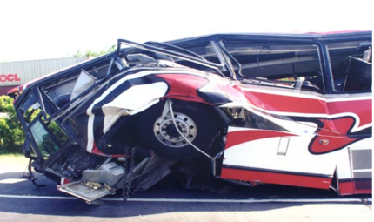
Learning from History
May 9, 1999
New Orleans, LA
Notes:
Occasionally drivers are not truthful when completing paperwork, including providing full disclosure during physical examinations. A primary purpose of the medical certification process is to provide reasonable assurances that drivers will be able to operate commercial vehicles safely, without complications from medical conditions that could jeopardize their capable operation of the vehicle.
A crash that occurred on May 9, 1999, in New Orleans, LA, provides us a potent reminder of what could go wrong if commercial drivers do not take their responsibilities seriously.

Slide 19
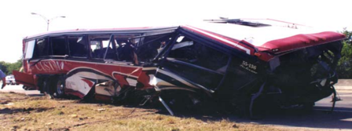
Learning from History
Mother’s Day
43 passengers
15 serious injuries
22 killed
Notes:
On May 9, 1999, about 9:00 a.m., a 55-passenger motorcoach was traveling eastbound on Interstate 610 in New Orleans, Louisiana. The bus, carrying 43 passengers, was en-route from La Place, Louisiana, to a casino approximately 80 miles away in Bay St. Louis, Mississippi. As the bus approached milepost 1.6, it departed the right side of the highway, crossed the shoulder, and went onto the grassy side slope alongside the shoulder. The bus continued on the side slope, struck the terminal end of a guardrail, traveled through a chain-link fence, vaulted over a paved golf cart path, collided with the far side of a dirt embankment, and then bounced and slid forward upright to its final resting position. Twenty-two passengers were killed; the bus driver and 15 passengers received serious injuries, and 6 passengers received minor injuries.
A witness riding in a van behind the bus stated that before the accident, she saw the bus drifting from the left lane to the center lane, then back to the left lane, before finally crossing the center and right lanes and departing the right side of the road. Surviving passengers did not indicate anything unusual about the trip or recall any sudden vehicle movements or actions immediately prior to the crash. One passenger recalled seeing the bus driver “slouch down”, come back up, then go down again.

Slide 20
Learning from History
Probable Cause
Driver incapacitation due to severe medical conditions
Failure to report medical history accurately to examining physician
Notes:
The ensuing National Transportation Safety Board (NTSB) investigation established that the driver possessed a current commercial driver's license and medical certificate, but suffered from several life-threatening medical conditions of the kidneys and heart.
The NTSB determined that the probable cause of this crash was the driver's incapacitation due to his severe medical conditions (heart and kidney) and the driver’s failure to report his medical problems. Drivers are required to report heart and kidney problems on the Medical Examination Report during the physical qualification process. In a post-accident interview, the physician who performed the examination informed Safety Board investigators that the driver indicated that he had no heart problems. The driver, who survived the crash, died several months later from a heart-related ailment.
GROUP DISCUSSION
[Text for both manuals -]
This driver likely had serious health issues for some time, and had “gotten away” with being dishonest on medical certifications without consequence for a long time. Do you think he felt his dishonesty was not such a big deal after this crash?
[Additional text for Instructor Manual- in italics]
Ask students how they would feel if they were dishonest and were in this driver’s shoes after this crash. Remind students that very few medical conditions are disqualifying, but that examining physicians need full disclosure so that they can verify that treatments for any conditions are consistent with managing any associated threat to safe vehicle operation.

Slide 21
Drug & Alcohol Use
Minimum testing requirements
Type of Test | Controlled Substance | Alcohol
Pre-employment | ✔
Random | ✔ | ✔
Post-accident | ✔ | ✔
Reasonable suspicion | ✔ | ✔
Return-to-duty | ✔ | ✔
Follow-up | ✔ | ✔
Notes:
DOT-regulated employers are required to administer a controlled substance and alcohol test program compliant with DOT regulations. Unlike many of the federal safety regulations, this requirement pertains to any driver operating a vehicle that requires a CDL, regardless of whether the operation is interstate or intrastate in nature.
The controlled substance and alcohol regulations require testing in specific instances. Testing for controlled substances, alcohol, or both, is required in the following situations: pre-employment, random, post-accident, reasonable suspicion, return to duty, and follow-up. Companies may choose to enact drug and alcohol use policies which are stricter than the requirements set forth in the DOT regulations.
Drivers are prohibited from operating commercial vehicles when under the influence of controlled substances or alcohol. Drivers who test positive or above specified thresholds during required tests (or refuse to test) are not permitted to operate commercial vehicles until they have successfully completed a treatment program specified by a substance abuse professional (SAP). In many cases, companies terminate driver employment if they test positive on a controlled substance or alcohol test. However, even if a driver is terminated by his/her employer, drivers are still required to successfully complete a SAP’s designated treatment program prior to driving commercial vehicles for any other DOT-regulated employer.
SAPs used to satisfy DOT drug and alcohol treatment requirements must be on an approved list by the National Association for Alcohol and Drug Abuse Counselors (NAADAC).
INSTRUCTOR NOTE:
Return to duty and follow-up drug and/or alcohol tests are required for drivers who tested positive on a DOT-regulated test, completed a SAP program, and are returning to commercial vehicle driving.

Slide 22
More on Drug & Alcohol Testing
Alcohol positive threshold = .04 BAC
Refusal to test/provide sample
Not reporting within reasonable time to test location as directed
Leave testing facility before providing sufficient sample
Provide false or adulterated sample
Same as Positive test
Notes:
In addition to having to complete a SAP’s prescribed treatment plan, testing positive on a DOT-regulated test also requires that the driver be removed from safety-sensitive functions, which includes driving a commercial vehicle.
Regarding alcohol use, any blood alcohol concentration (BAC) equal to or greater than .04 is considered a positive test by the DOT. DOT regulations also forbid driving a commercial vehicle with any BAC of .02 or greater, and drivers are not permitted to consume any amount of alcohol within four hours before driving a commercial vehicle. When a driver tests above the .02 BAC threshold, but under the .04 BAC threshold, regulations require that a minimum of 24 hours must pass before a driver is again eligible to drive a commercial vehicle.
In addition to actually exceeding threshold limits for a positive test, there are other scenarios where the result will be considered a positive test. These include:
Refusal to submit to a test or provide a breath or urine sample.
Failure to report within a reasonable amount of time to the test location as directed (in most cases, reasonable = immediately!).
Leaving a test facility before the process is complete or a sufficient sample has been provided.
Providing a false or adulterated sample, or failing to permit the observation/monitoring of a urine sample when required to do so.
There are occasions when a driver tests positive for a controlled substance and there is an acceptable explanation. Following any positive test, a driver will be contacted by a medical review officer (MRO) to check for any reasonable and acceptable explanation. For this reason, it’s important to provide reliable contact information at the time you are submitting to a substance abuse test – if the MRO cannot contact you within a specified timeframe, the result will be a classified as a verified positive test. Finally, all urine samples are tested as a split sample – this means that you have the ability/option to request a test on the split sample if the initial sample tests positive for a controlled substance.
Add to INSTRUCTOR NOTE
DOT Drug and Alcohol Testing Guide (For DOT Employees) is a publication that provides detailed information on DOT drug and alcohol regulations and testing processes. This publication is publicly available at no cost online, and may be beneficial to students in understanding the detailed processes and regulations involved in DOT drug and alcohol testing.

Slide 23
Driver Responsibilities
Truthful in completing official documents
Maintain valid driver license & medical certification
Notify employer when… :
Convicted for any moving violation (personal or commercial vehicle)
License has been surrendered, suspended, revoked or canceled
All
REQUIRED
By Law
Notes:
Drivers have key responsibilities in complying with rules, being honest with their employer and other officials, and operating commercial vehicles safely. Drivers must be truthful in completing official documents, such as employment applications and medical questionnaires. Another important responsibility for drivers is to maintain necessary credentials for operating a commercial vehicle. This includes keeping your license in good standing and renewing when necessary, as well as maintaining valid medical certification. Drivers should report any health issues which may affect current certification to their employer and physician.
Safety regulations also require drivers to notify their employer when they are convicted for any moving violation in a personal or commercial vehicle. Additionally, the driver must notify the employer immediately if a commercial driver’s license has been suspended, revoked, or canceled.

Slide 24
Driver Responsibilities
Comply with driving laws and statutes
Comply with DOT regulations
Follow company safety policies
Failure to follow laws, regulations and safety policies will severely affect current and potential opportunities for a motorcoach driver
Notes:
Compliance with laws and policies is another key responsibility of the driver. They should know the driving laws of the states they are operating in, with an understanding that varying rules in different states may require some advance preparation. Drivers must be knowledgeable of Federal and State safety regulations, as well as company policies.
Violation of any of these laws, regulations, or policies can severely affect the drivers employability. Driving law infractions are generally reflected on motor vehicle driving records, which commercial motor carriers are required to review frequently. Violations of DOT regulations discovered by enforcement personnel are recorded in a driver database that employers can query when reviewing potential drivers. And, violation of company policies will certainly be subject to disciplinary actions that could include termination.

Slide 25
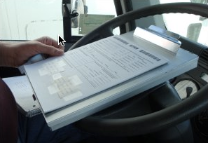
Driver Responsibilities
Paperwork Completion
Daily vehicle inspection reports
Hours of service recordkeeping
Company-required documentation
Trip-related documentation
Incident paperwork (accident reports, etc.)
Notes:
Perhaps one of the least favored aspects of being a professional driver is the paperwork responsibilities that go hand-in-hand with the position. Many of the regulated functions and requirements that pertain to the driver and the company must be properly documented. Examples include vehicle inspection reports and driver hours of service logs or time records. There’s also trip related documentation which needs to be assembled, itemized, and turned in by the driver during or after the trip. It is also common for specific paperwork to be completed when any type of incident or collision occurs.
The amount of paperwork required will be dependent upon each company’s policies, practices, and the extent to which any technology has been deployed to assist in meeting regulatory requirements.

Slide 26
Do Not Operate If Unsafe
Federal Whistleblower Protection provides the employee the right to question the safety practices of an employer without the employee's risk of losing a job or being subject to reprisals simply for stating a safety concern. (29 CFR Part 1978)
Concerns can be with driver him/herself, vehicle being operated, or company requirements
Report concerns and violations at www.osha.gov
or call (800) 321-OSHA
Notes:
The first and primary responsibility of a driver is safety. There are a lot of factors that can affect safe operations. The safety of the many passengers on-board a motorcoach and the public in general is a big responsibility. Drivers knowledgeable about regulatory requirements and safe operations should not be afraid to voice safety concerns to their employer. Federal whistleblower laws protect employees, including drivers, who question safety practices.
Employees whose jobs directly affect commercial motor vehicle safety or security are protected from retaliation by their employers for reporting violations of federal or state motor carrier safety or security regulations. They also are protected when refusing to operate a vehicle because of violations of federal safety or security regulations.
To file a complaint by phone, call OSHA toll-free at 1-800-321-OSHA, or contact your nearest OSHA office. You can also report concerns online at www.osha.gov.

Slide 27
Hours of service
Regulatory Overview & Key Requirements: Lesson 3
Notes:
Fatigued and drowsy driving is a frequent contributing factor to crashes that result in damage, possible injuries and fatalities – both to the person causing the crash and others who may be involved. This fact was recognized long ago and action was taken to try to minimize this risk in the operation of commercial vehicles.
The Federal Motor Carrier Safety Administration and its state counterparts have established safety regulations that limit the number of hours a driver can operate a commercial vehicle before specified rest is required. These regulations, known as hours of service regulations, are meant to reduce the potential for fatigued and drowsy drivers of commercial vehicles on public roadways.
The regulations established are not complex themselves, though rules associated with them can sometimes be confusing. Recordkeeping required in order to ensure compliance can also be tricky, and not complying with the requirements can spell big trouble for carriers and drivers – and potentially inconvenience passengers unnecessarily, resulting in customer service and image issues for the company. Documentation of compliance with hours of service has progressed to mostly electronic processes – electronic logging devices and software-assisted logs remove a lot of the variables of completing required paperwork. However, even when software-assisted or vehicle-based electronic systems are used, drivers must still understand the rules themselves, since they are required, as is the company employing them, to monitor compliance and adhere to the rules. Additionally, understanding how to document work/hours of service status manually will always be necessary should electronic systems fail or become unusable, or when drivers, who are otherwise excepted from logging their hours, must occasionally do so due to unusual company/trip operations.

Slide 28
Hours of Service Regulations
FMCSRs, Part 395
Limits for when and how long a driver can drive a motorcoach or any other passenger-carrying commercial vehicle
Goal: Keep fatigued drivers off the road
“Drowsy driving causes more than 100,000 crashes a year”
Notes:
The FMCSRs were developed to help ensure that commercial motor carriers were operating at higher standards than non-commercial carriers by enacting additional regulations that they are required to follow. One of the cornerstones of the FMCSRs are the hours of service regulations, which can be found in Part 395. These regulations were developed primarily to reduce the number of fatigued drivers on the public roadways. Fatigued drivers may be slow to notice or react to potentially dangerous situations and apt to fall asleep at the wheel and lose control of the vehicle. Hours of service regulations put limits in place for when and how long someone may drive a commercial vehicle, with the idea that these limits will help make sure that drivers are more likely to stay awake and alert while driving. Hours of service regulations differ for passenger and property-carrying commercial vehicles; it is important to note that the regulations covered in this lesson are for drivers of passenger-carrying commercial vehicles.
INSTRUCTOR TIP
Ask if any students have previous experience in the trucking or property-carrying industry. If so, emphasize that the hours of service regulations they learned and knew are different from what will be taught during this lesson.

Slide 29
Key Definitions
Gross Vehicle Weight Rating (GVWR) | Maximum loaded weight of a vehicle, including passengers and all cargo. The GVWR is usually specified by the vehicle manufacturer.
Designed or Used | A passenger vehicle can be classified based on how many passengers it carriers or was designed to carry, whichever is greater.
Direct Compensation | Payment made to the motor carrier by the passengers or a person acting on behalf of the passengers for the transportation services provided, and not included in a total package charge.
Hazardous Material | A substance or material which has been determined by the Secretary of Transportation to be capable of posing an unreasonable risk to health, safety, and property when transported.
Notes:
Applicability of the hours of service regulations (and many other safety regulations), depend on the whether a vehicle is classified as a commercial motor vehicle. Classification of passenger-carrying vehicles is dependent upon the weight of the vehicle, the passenger capacity, type of transportation provided, and whether specific amounts of hazardous material is being transported.
In general, one or more of the following characteristics is used to identify whether a passenger carrying vehicle is designated as a commercial vehicle by federal (interstate) standards:
Gross Vehicle Weight Rating - A vehicle’s gross vehicle weight rating (GVWR) is the maximum loaded weight of a vehicle, including passengers and all cargo. The GVWR is typically specified by the vehicle manufacture.
Capacity - A passenger vehicle can be classified based on either how many passengers it is actually carrying or how many passengers it was originally designed to carry - whichever is greater.
Type of transportation/compensation - There are different categories of passenger transportation, including for-hire and private. For-hire carriers are usually provided direct compensation for their services, meaning that passenger(s) pay specifically for the transportation services provided. Private or not for-hire carriers provide specific transportation to designated persons, usually as a complementary service to another primary business function. These carriers are compensated not specifically for the transportation service – instead, persons pay for an entire package, in which transportation services are included (e.g., airport shuttles, rental car shuttles, etc.). Other types of transportation that fall under the private, not-for-hire category is transportation performed by groups that are generally non-profit in nature, such as churches, charities, etc.
Hazardous material cargo – A passenger vehicle can also be classified as commercial if it carries hazardous materials in quantities in excess of specified amounts. The USDOT determines both what materials are considered hazardous, and their threshold amounts. If a hazardous material is carried above the specified threshold amount, the vehicle exterior of the vehicle must be marked, or placarded. Motorcoaches do not routinely carry significant quantities of hazardous materials and are limited from carrying quantities that would require such placarding.

Slide 30
Passenger Hours of Service Applicability
9 or more passengers, for direct compensation
GVWR or actually weighs
> 10,000 pounds
16 or more passengers
Hours of Service rules apply
Notes:
Federal hours of service limitations apply to drivers of specific commercial vehicles. Passenger-carrying vehicles whose drivers must comply with the hours of service rules include:
Vehicles involved in interstate commerce that have a gross vehicle weight rating (GVWR) or actually weigh more than 10,000 pounds (including passengers and cargo). If towing a trailer, the combination weight of the vehicle and the trailer would be combined to determine the vehicle weight.
Vehicles that are designed or used to transport nine or more passengers, including the driver, for direct compensation.
Vehicles that are designed or used to transport 16 or more passengers, including the driver.

Slide 31
Passenger Hours of Service Limits
Until required rest is received, cannot drive a commercial vehicle after:
10
10 hours of driving a commercial vehicle
15 hours on-duty
60 or 70 hours cumulative on-duty over the previous 7 or 8 days
15
60/70
Notes:
The passenger hours of service limitations establish the amount of time you can spend driving a passenger-carrying commercial vehicle over various time frames.
10-hour driving limit. A driver is allowed 10 hours of actual driving time before a required rest period; after driving for 10 hours, a driver cannot drive a commercial vehicle until they receive the required rest. There is no limit on how many of those hours can be driven at one time – a driver may drive for as little as a few minutes or as much as 10 hours in a row. However, once he/she has driven a total of 10 hours, the driving limit has been reached and a required rest period of at least eight consecutive hours is necessary before driving a commercial motor vehicle again.
15-hour on-duty limit. A driver is not permitted to drive a commercial motor vehicle after being on-duty 15 hours. Work other than driving a commercial vehicle may be done, but until the required rest period has been met, he/she may not drive. Any off-duty time taken during the day, such as a lunch break or nap, does not count toward this 15-hour limit as long as the off-duty period meets all the requirements (more detail on this coming up).
The 60/70-hour on-duty limit. This limit is based on a 7-day or 8-day period, depending on how many days a motor carrier operates. In simple terms, once a driver works the specified number of on-duty hours (60 or 70) in the specified time frame (7 or 8 days), the driver can no longer drive a commercial vehicle until they are under the applicable threshold.
This limit is sometimes thought of as a “weekly” limit. However, this limit is not based on a “set” week, such as Sunday through Saturday. The limit is based on a “rolling” or “floating” seven 7-day or 8-day period. The oldest day’s hours drop off at the end of each day when you calculate the total on-duty time for the past seven or eight days. For example, if you operate on a 70-hour/8-day schedule, the current day would be the newest day of your 8-day period and the hours you worked nine days ago would drop out of the calculation.
Drivers are required to follow whichever rule is applicable to the motor carrier for which they are driving. Motor carriers that do not operate vehicles seven days a week must follow the 60-hour/7 days rule, while motor carriers that operate commercial vehicles every day of the week can choose to operate under either limit. The majority of passenger transportation companies that operate seven days a week choose to operate under the 70-hour/8 days limit.
Instructor tip: Tell your students the cumulative hour rule your company uses.

Slide 32
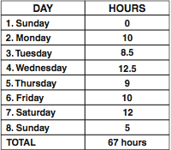
Required Rest Periods
10- and 15-hour rule limits are restarted/reset by obtaining a minimum 8 consecutive hours off-duty
60/7 and 70/8 limits cannot be restarted/reset – time available under the rules must be gained by limiting current/recent on-duty
Notes:
An eight -hour consecutive off-duty period resets/restarts both the 10-hour driving limit and the 15-hour cumulative on-duty limit. Until this eight-hour consecutive off-duty period is achieved, driving time and cumulative on-duty time continues to add up – even across days/work periods and jobs.
The cumulative on-duty limit cannot be reset to zero/restarted– it is a rolling computation that can only be affected by the passage of days and associated recalculation of on-duty hours.

Slide 33
Hours of Service Time Classifications
Driving | Time spent at the driving controls of a commercial vehicle
Sleeper berth | Time spent resting in an on-vehicle sleeper berth that meets the specified requirements in the regulations (§393.76).
On-duty | All time from the time a driver begins to work or is required to be in readiness to work
Off-duty | Any time when you are not working at the direction of a motor carrier, not being compensated for work, or are relieved of all responsibility
Notes:
There are specific classifications of time and duty that will be used when discussing hours of service and associated recordkeeping requirements. Understanding these terms is essential to complying with the regulations.
Driving means all time spent at the driving controls of a commercial vehicle in operation. In essence, if you’re in the driver’s seat, your time would be classified as driving time.
On-duty time is all time from when a driver begins to work or is required to be in readiness to work until the time the driver is relieved from work and all responsibility for performing work. This classification is a little more complicated than driving time, so additional explanation and exceptions will be provided throughout the rest of this lesson.
Time classified as sleeper berth is time spent resting in and on vehicle sleeper berth that meets all applicable requirements.
Off-duty time is time spent when you’re not being compensated for work or are relieved of all responsibility. Additional clarification of this classification will be made throughout this lesson.

Slide 34
On-Duty Time
All time working for a motor carrier, whether paid or not, including:
All time at a bus station, yard, terminal, or other facility of a motor carrier or customer
All time inspecting or servicing your vehicle
All time loading, unloading, or attending to a motorcoach/bus, including if broken down or if involved in an accident
Handling paperwork for trips | Driving a company car
Giving or receiving training | Submitting to drug/alcohol test
Notes:
The 15-hour and 60/70-hour limits are based on how many hours you are on-duty over a period of time. Just what kind of work is included in on-duty time? It includes all time you are working or are required to be ready to work, for any employer. Specifically, it includes the following activities:
All time you are required to be at a bus station, yard, terminal, or other facility of a motor carrier or customer, unless you have been relieved from duty by the motor carrier;
All time inspecting or servicing your vehicle, including fueling it and washing it;
All driving time;
All time loading, unloading, supervising, tending to your motorcoach/bus, or handling paperwork for trips;
All time taking care of your vehicle when it is broken down;
All time spent providing a breath, saliva, or urine sample for drug/alcohol testing, including travel to and from the collection site; and
All time spent doing any other work for any motor carrier, including giving or receiving training and driving a company car.

Slide 35
On-Duty Time
Also includes all time performing compensated work for anyone else other than a motor carrier
When it comes to Hours of Service, all work performed for any motor carrier a driver works for, and all compensated work for other employers, counts against available commercial vehicle driving time.
Notes:
On-duty time also includes all time performing compensated work for anyone else other than a motor carrier. This would include any job, even those not associated with commercial vehicles operations - such as working in a restaurant.
It is not unusual for many drivers to work for several motor carriers on a part-time basis. For instance, someone may drive a school bus during the week, and motorcoach charters on the weekend. When considering hours of service limitations, all on-duty time for any motor carrier must be included and recorded on time records as appropriate, along with any compensated work/duty time for non-motor carriers.

Slide 36
Off-Duty
Any time other than on-duty or sleeper berth time.
A driver is permitted to log off-duty during a work shift when:
He/she is relieved of all duty and responsibility for the care and custody of the vehicle, its accessories, and any cargo or passengers it may be carrying.
During the period, and for the duration of the period, the driver must be at liberty to pursue activities of his/her own choosing.
Notes:
By understanding the definition of on-duty time, you will get a good idea of what is considered off-duty time.
If you are relieved of duty and not doing any work (paid or unpaid) for a motor carrier, and you are not being compensated for work by anyone else, the time can be recorded as off-duty.
Passenger hours of service regulations also permit drivers to record routine stops and other portions of time during a work shift (when they are relieved of all duties) as off-duty. In order for this time to be considered off duty, a driver must be relieved of all duty and responsibility for performing work. The driver must be free to pursue activities of their own choosing and be able to leave the place where the commercial vehicle is parked.

Slide 37
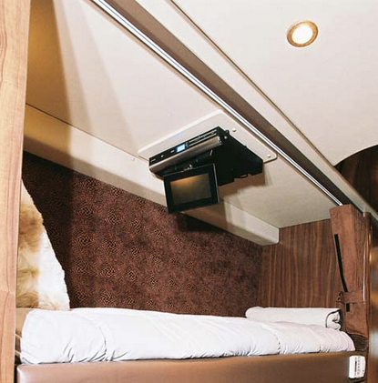
Sleeper Berth
Limited use in U.S. passenger transportation operations
Any on-board sleeper berth must meet the specific requirements detailed in §393.76
Notes:
INSTRUCTOR TIP This section touches on sleeper berths and how they relate to hours of service. If your fleet does not have any regulation-compliant sleeper berths, then you may wish to abbreviate the narrative associated with this slide. If you do have motorcoaches with recognized sleeper berths, you should expand on the content presented in this narrative since sleeper berth regulations are somewhat complex. You should also include your own sleeper berth computations in log exercises at the end of this lesson.
In general, sleeper berths are not common in U.S. motorcoach operations. When they do exist, they frequently do not physically meet the necessary requirements to be recognized as an official sleeper berth as defined in §393.76 of the Federal Motor Carrier Safety Regulations. Nonetheless, it is possible to have a regulatory-compliant sleeper berth in a motorcoach.
Existence of a sleeper berth can slightly affect hours of service compliance. When a sleeper berth is present, a driver can accumulate the equivalent of eight consecutive hours of off-duty time by combining off-duty time and time spent in the sleeper berth for the consecutive eight hours, as long as the time in the sleeper berth is at least two consecutive hours.
The driver may also use a split sleeper berth schedule, using two separate sleeper berth rest periods to meet the eight hours off-duty requirement. When using the split sleeper berth option:
Neither rest period can be shorter than two hours, and the two periods must equal at least eight hours;
The driving time in the period immediately before and after each qualifying rest period, when added together, cannot not exceed 10 hours;
The on-duty time in the period immediately before and after each qualifying rest period, when added together, cannot not include any driving time after the 15th hour.
The driver may not return to driving subject to the normal limits (non-sleeper berth split schedule) without taking at least eight-consecutive hours off duty, spending at least eight- consecutive hours in the sleeper berth, or a combination of at least eight-consecutive hours off duty and sleeper berth time.

Slide 38
WHAT IS YOUR DUTY STATUS?
Function | Duty Status ?
Driving the coach on a regular route
Sick leave (three days)
Performing a pre-trip vehicle inspection
Driving the coach to pick up a charter group (no passengers on board)
Broken down on the road
Driving to the lab for a random drug test
Stuck driving in a traffic jam
Resting on a parked coach between dropping off a group and picking them up
Notes:
EXERCISE –
Ask the students to look at these scenarios in their student guide and write in the duty status for each function. After five minutes, review the correct answer with them (listed below). The sixth and eight scenarios may/should generate some question, because the correct answer is dependent upon the circumstances. These are included to demonstrate that not all situations are cut and dry.
Driving the coach on a regular route- DRIVING
Sick leave (three days) – OFF DUTY (3 days)
Doing a pre-trip vehicle inspection – ON DUTY, NOT DRIVING
Driving the coach to pick up a charter group (no passengers on board) - DRIVING
Broken down on the road - ON DUTY, NOT DRIVING
Driving to the lab for a random drug test - ON DUTY, NOT DRIVING (unless provided a commercial vehicle to take to/from the clinic – then portions would include DRIVING)
Stuck driving in a traffic jam – DRIVING (as long as a driver is at the controls of the commercial vehicle, they are considered DRIVING – whether it is moving or not).
Resting on the coach between dropping off a group and picking them up – OFF DUTY, if they have been relieved of all responsibility for coach, are free to leave coach to pursue their own activities if they wanted to, and are not sitting in the driver’s seat. ON-DUTY, NOT DRIVING if they have not been relieved of responsibility but are not sitting in the driver’s seat.

Slide 39
Travel Time Exception
Non-driving travel at the direction of a motor carrier (on-duty by definition) can be logged as off-duty if:
Driver being transported receives at least eight consecutive hours off-duty once he/she arrives at destination (before beginning other duty for carrier)
This exception can only be utilized if the driver is a passenger in the transport vehicle. It is not applicable when the driver is operating the transport vehicle.
Notes:
“Travel time” refers to you being transported to a new location as part of your job, but you are not performing any of the driving on the trip. This could include riding in a motorcoach or bus passenger seat, or in any other type of transfer vehicle. While any travel done at the direction of a motor carrier is by definition considered on-duty time, this exception allows you to classify the travel time as off-duty when certain circumstances are met. Specifically, if you take at least eight consecutive hours off duty once you get to your destination, you may classify all of the time, including the travel time, as off-duty.
This exception can only be utilized if the driver is a passenger in the transport vehicle. It is not applicable when the driver does any of the driving him/herself.
Example:
Your company sends you on a bus for eight hours to a destination where you will later trade places with the driver so you can drive back. You are simply riding the bus and not doing any other work for your company. Before driving the bus you take eight consecutive hours off duty. In this case you may count all of the travel time as off duty as well.

Slide 40
Adverse Driving Conditions Exception
Permits additional two hours driving time (up to 12 hours). Applicable when:
Unexpected adverse driving conditions slow you down (fog, traffic jam from crash, weather)
Situation must not have been reasonably foreseeable at beginning of duty cycle (examples – rush hour congestion; snow when it is forecast)
Drivers invoking the adverse weather exception
must still maintain compliance with
15-hour driving limitation.
Notes:
When unexpected adverse driving conditions affect a trip, a driver may drive up to two extra hours to complete what could’ve been driven in normal conditions. This exception extends the 10-hour driving limit up to a maximum 12 hours. Adverse driving conditions mean things that were not known when a trip was started, like traffic resulting from a crash. Weather can also cited as an adverse driving condition, but generally only when the weather could not have been reasonably anticipated or known. Conditions that could have been reasonably anticipated such as congested traffic during a typical rush hour period would not be an acceptable adverse driving condition.
This exception does not extend the 15-hour on-duty limitation on driving a commercial vehicle, so even when invoking the adverse driving conditions exception, drivers must continue to maintain compliance with the 15-hour driving limitation/rule.
Example:
You come to work at 7:00 a.m., start driving at 8:00 a.m., and drive 8 hours when you are delayed by heavy fog at 4:00 p.m. The fog was not forecasted. At this point, the adverse driving conditions exception would allow you to drive for up to 4 more hours (2 hours to get to10 and 2 extra hours due to the fog), taking you to 8:00 p.m. for a total of 12 hours of driving.
If, however, you come to work at 7:00 a.m., start driving at 12:00 p.m. and drive into fog at 5:00 p.m., you could only drive until 10:00 p.m. for a total of 10 hours of driving. You would have to stop driving at 10:00 p.m. because you would have reached the 15-hour on-duty limit.

Slide 41
Additional Exceptions
Applicability | Exception
Emergency | Hours of service regulations applicable to that specific portion of a trip
Emergency Relief | All hours of service regulations
Alaska | Drive time limit: 15-hr. On-duty limit: 20-hr. Cumulative on-duty limit: 70/7 or 80/8
Federal, State or Local Government-operated | All hours of service regulations
Notes:
There are some other exceptions to the hours of service regulations. Similar to the adverse driving conditions exemption, a driver, in the event of an emergency, may complete his/her run without being in violation of the hours of service limitations, if such run reasonably could have been completed absent the emergency. Examples include a medical emergency or an accident that does not prevent the coach from finishing the run. Just like with the adverse driving condition exception, this exception cannot be claimed if the driver or carrier should have known of the emergency. For example, situations as a driver’s desire to get home, customers’ demands, shortage of drivers, or mechanical failures, are not considered emergencies.
Operations performed in connection with emergency relief, during declared national, regional, state, or local emergencies, are exempt from hours of service regulations. Examples include situations such as hurricane evacuation and response.
Coach operations conducted and operated by federal, state or local government are exempt from federal hours of service regulations. Local government operations are subject to state regulations that could affect this exception.
Drivers operating in Alaska are afforded longer duty periods due to the size of the state and limited development. In Alaska, the 10 hour driving limitation is extended to 15 hours before required rest is necessary. The 15-hour on-duty limit is increased to 20 hours. The 60/7 or 70/8 cumulative on-duty limits are also increased to 70 hours over 7 days and 80 hours over 8 days respectively.

Slide 42
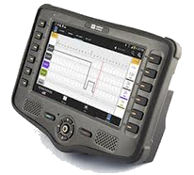
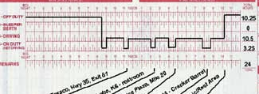
Recording Hours of Service
Time records must be maintained by drivers and/or carriers for at least six months
Since 2017, most drivers must use an Electronic Logging Device (ELD)
ELD devices use vehicle engine data to detect motion and record driving duty status
Notes:
NEW
In order to monitor compliance with hours of service limits, the DOT requires all commercial drivers to maintain daily records of their time, and all motor carriers to monitor drivers’ time.
There are multiple methods to recording hours of service, though each is meant to essentially record the same data. Historically, paper logs were generally used to log/record drivers’ hours of service in a grid-type log as seen in the image here. However, beginning in 2017, safety regulations mandated vehicle-integrated electronic logging devices - better known as ELDs - be used to record drivers’ hours of service for most commercial vehicle drivers. ELD systems record hours of service more accurately than previous methods, though they still use the same style of grid log to do so.
While each approved ELD system must meet certain specifications, operational use of each still varies significantly. Because of this, details on operating any specific ELD in use at this company will not be covered in this curriculum.

Slide 43
Driver Log Exceptions
(1) 100 air-mile radius exemption conditions:
Trip operates within a 100 air-mile radius of the driver’s normal work reporting location
Return to normal work reporting location and be released within 12 consecutive hours of beginning of shift
Driver in compliance with 10-hour driving rule and receives required 8 hours off-duty between each shift
Must have other form of time record
“100 air mile radius” = 115.08 “road” miles
Notes:
NEW
There are two general exceptions to the requirement to complete the grid-type logs we’ve been discussing. The first is generally known as the 100 air-mile radius exemption or short-haul exemption.
Drivers and carriers have historically been exempt from completing/maintaining detailed records of duty status in limited short-trip circumstances. When these circumstances occurred, detailed time records meeting regulatory requirements could be maintained in lieu of the detailed records of duty status. To use this exemption:
The trip must operate within a 100 air-mile radius of the driver’s normal work reporting location.
The driver must return to the normal work reporting location and be released within 12 hours of the beginning of the shift/trip.
The driver/trip must comply with the 10 hour driving rule/limit and the driver must receive the required minimum eight consecutive hours off-duty time between each shift/trip.
The obvious question that always arises is how to determine whether or not a trip operates within 100 air-mile radius. If a destination’s distance is not known relative to the actual air-mile radius from the dispatch location, then conversions can be useful. By definition, an air mile is a little longer than an “over the road” mile. In fact, one air mile is the equivalent of 1.15 statute or “over the road” miles. Accordingly, 100 air miles is the equivalent of 115.08 “over the road” miles.

Slide 44
Driver Log Exceptions
(2) Private carrier of passengers (non-business):
Not-for-hire transportation (not available to the public at large)
Transportation not conducted as part of a business/in furtherance of an enterprise
Driver log exceptions only apply to log completion.
These exceptions DO NOT exempt drivers from the Hours of Service driving rules and limitations.
Notes:
NEW
The second exception to completing driver grid logs is if the trip is being operated by a private motor carrier of passengers for a non-business purpose. Private motor carriers of passengers (PMCPs) are motor carriers that are not available for hire to the general public. There are two categories of PMCPs – business and non-business. Many times, private motor carriers of passengers are businesses transporting employees, contractors or others as part of the necessity of the business or commercial enterprise – these are considered business-related PMCPs. However, there are other times when a private motor carrier of passengers is transporting persons not done as part of a business – these are considered non-business PMCPs. Examples include churches, private schools, scout groups, civic organizations, and other charitable organizations that may purchase or lease vehicles for their own use in transporting their groups.
It is important to note that driver log exceptions only apply to completing driver logs. These exceptions do not exempt drivers (or companies) from the hours of service driving rules and limitations. Additionally, when a log exception is used, companies must still maintain accurate time records for each driver that includes at least: the time reported; the time relieved of duty; and the total hours on duty each day.

Slide 45
ELD Exceptions
ELD Exceptions/Exemptions
Vehicle older than MY 2000
Trip where driver grid logs not required
Short-haul/timecard exemption
PMCP/non-business
Infrequent trips where grid/paper log is required
No more than 8 days in any 30-day period
Notes:
NEW
While electronic logging devices are the required methodology to record driver hours in many circumstances, there are still times that paper logs or other methods to record hours of service may be used.
Drivers who use the 100-mile/short-haul/timecard exception and private, non-business carriers are not required to complete paper logs or use ELDs.
The following drivers are also exempted from using an ELD, though they must prepare logs on paper, or use another suitable electonic method, such as an Automatic On-Board Recording Device (AOBRD), or logging software program:
Drivers of vehicles manufactured before 2000.
Drivers who are required to keep Records of duty status (logs) not more than 8 days within any 30-day period.

Slide 46
Manual Log Knowledge
Even when a proper, vehicle-integrated ELD is used, drivers must have in their possession manual/paper logs in the event of ELD malfunction
All drivers must know how to complete a manual/paper log (record of duty status)
Notes:
Even when ELDs are the primary system in use to record a driver’s hours of service, drivers must still know how to manually prepare a paper log in the event that the ELD malfunctions during a trip. If an ELD system malfunctions, and a driver cannot complete manual/paper logs as required, then the driver can be placed out of service for not maintaining a record of duty status as required by regulation.
So, it is important for drivers to understand how to complete manual, or paper logs in the event they are required. For the rest of this section, we’ll review components of manual logs and their proper completion.

Slide 47
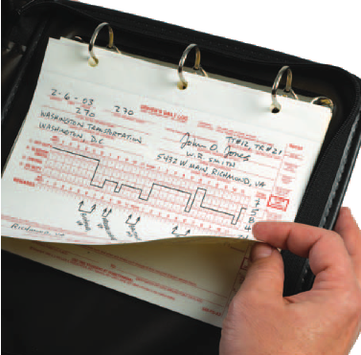
Driver’s Log Requirements
Must account for 24 hours of every day - even days off;
Current as of last change of duty status
Entries must be true and correct, and legible
If paper, completed in duplicate
If using ELD technology, no paper equivalent
Notes:
Driver logs need to be completed every day, whether you’re working or not. Each log must detail driver duty status during the entire 24 hours of each day. Log entries must be current to the last change of duty status, especially on days where you are driving a commercial vehicle. Information recorded on the log must be true and correct – there are significant ramifications for the driver and company if a log is discovered to have been falsified.
Paper logs are completed in duplicate – the original is submitted to the company, and the copy is kept by the driver. Entries should be legible and made by the driver, in the driver’s writing, except for a custom log that has some of the information pre-printed (such as company address).
To many drivers, logs seem like a hassle (even more so if they have to do them only occasionally!). But you must remember, authorized government inspectors may check your logs at any time during a trip, or during an inspection at a motor carrier.

Slide 48
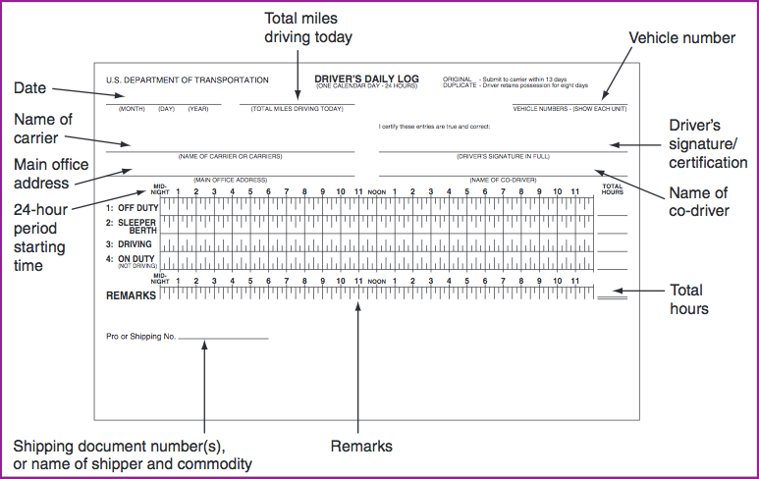
Required Information: Driver Log
Notes:
Even knowledgeable professional drivers have been tripped up filling out logs. Many of the violations that are found have nothing to do with driving too long or too often; they have to do with filling out the form incorrectly or incompletely.
Each label and arrow here is pointing to portions of the log that must be completed - in addition to the actual grid section in the center that details your duty status for every hour of the day. This graphic is representative of a driver log, though they can vary. Some companies have custom logs printed that may have some portions of the log pre-printed (Company Name, Main Address).
The top section is where general information is recorded. The middle section is where duty status is detailed for the whole day. The bottom section is for remarks – it is used to note the location of each change of duty status, detail any special circumstances, and record the charter/schedule number or the group name.
Instructor Note:
Tell the students to refer to the blank log included in their student guide as you review sections of the log. You also may wish to pass out a blank log used at your company for students to follow along – especially if the logs are customized or different from the example used in the lesson.

Slide 49
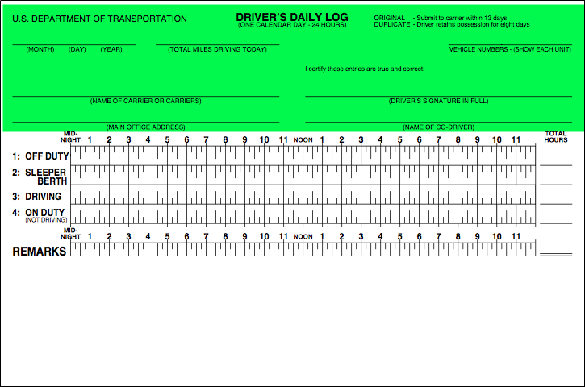
Completing the Driver Log
Notes:
Let’s review the top portion of the log and what a driver is responsible for completing.
Date. You must write down the month, day, and year for the beginning of each 24-hour period. (Multiple consecutive days off duty may be combined on one log page, with an explanation in the “Remarks”.)
Total miles driving today. You must write down the total number of miles you drove during the 24-hour period.
Motorcoach/bus number. You must write down either the vehicle number(s) assigned by your company, or the license number and licensing State for each vehicle operated during the 24-hour period.
Name of carrier. You must write down the name of the motor carrier(s) you are working for. If you work for more than one carrier in a 24-hour period, you must list the times you started and finished work for each carrier.
Main office address. You must write down your carrier’s main office address.
Your signature. You must certify that all of your entries are true and correct by signing your log with your legal name or name of record.
Name of co-driver. Sometimes there may be more than one driver operating a trip. If this is the case, you must write down the name of your co-driver. In our example, there is none listed.

Slide 50
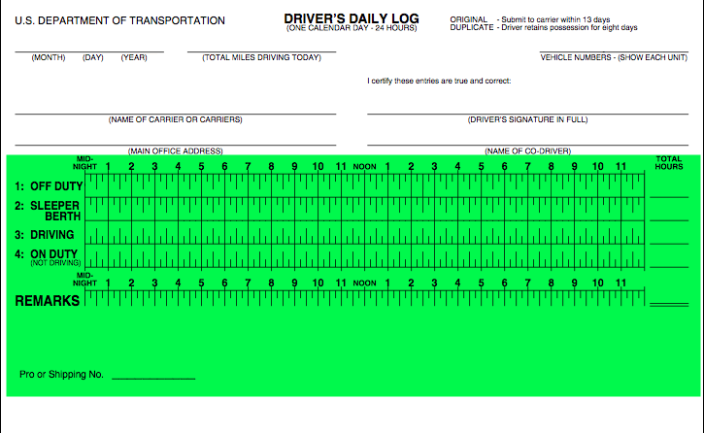
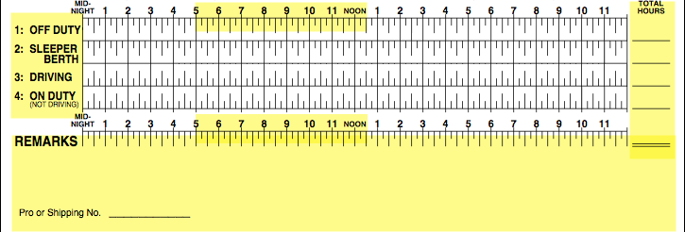
Completing the Driver Log
Notes:
Next, let’s look at the grid/duty status portion of the log as well as the remarks section.
Most log grids have four lines, though the second line – for sleeper berth – need not be present if a sleeper berth is not utilized. The grid will have lines for OFF DUTY, DRIVING, and ON DUTY (not driving) in all cases. The grid will also have the starting time and the hours marked above it – the vast majority of the time this is from midnight to midnight, though the carrier can change this, as long as the grid shows an entire 24 hour period and is consistent among all drivers.
Lines are drawn on the grid as follows:
Off Duty. Draw a solid line between the appropriate time markers to show the periods of time you are off duty.
Sleeper Berth. Draw a solid line between the appropriate time markers to show the periods of time you are resting in a sleeper berth.
Driving. Draw a solid line between the appropriate time markers to show the periods of time you are behind the wheel of a commercial motor vehicle in operation.
On Duty (Not Driving). Draw a solid line between the appropriate time markers to show the periods of time when you are on duty, but not driving a commercial motor vehicle.
Total hours. The total hours for each duty status must added up and recorded at the right side of the grid. The total of the entries must equal 24 hours.
Remarks. This is the area where the city, town, or village, and State abbreviation should be recorded when a change of duty status occurs. You should also explain any unusual circumstances or log entries that may be unclear when reviewed later, such as encountering adverse driving conditions.
Shipping document number(s), or name of shipper and commodity. There is generally a location in the remarks area of the log to record a shipping or trip number. This is where a descriptive and definitive identification of the trip must be written – typically a charter order/number or the name of the company / group you are transporting is recorded.

Slide 51
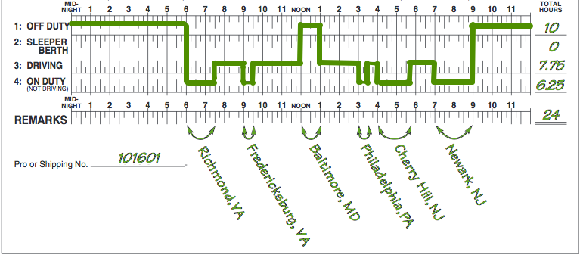
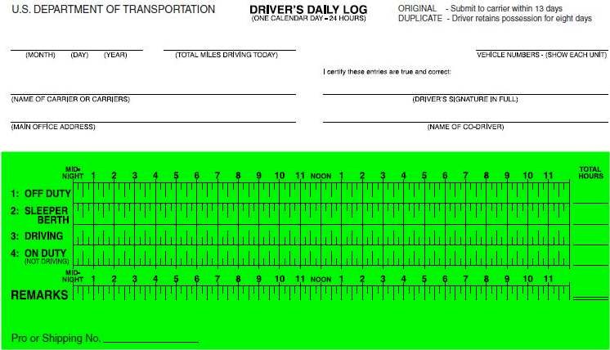
Completing the Driver Log
Notes:
INSTRUCTOR TIP – As you go through the the driver’s activities for the day in this narrative, point to the relevant time section on the grid log you are describing. For example, when indicating that he reported to work at 6 a.m., point to 6 am on the log to show the change of duty status. Also point out the relevant cities in the remarks section as they are mentioned in the description. Point out the total columns and explain how they are calculated. Finally, show where the driver recorded the charter number.
Here is an example of a completed grid, along with other necessary information.
In this sample log grid, the driver (Jeff) went from Richmond, Virginia, to Newark, New Jersey. Jeff’s day went like this:
Reported for work at 6 a.m. He checked in, loaded some luggage, and did a pre-trip inspection. This is on-duty time. Jeff marked midnight to 6 a.m. as off duty, then drew a line straight down to on duty, not driving, and then drew a horizontal line from 6 a.m. to 7:30 a.m.
After driving 1½ hours, the Jeff stopped to fuel his coach. Jeff marked the driving time on the driving line. The time at the fuel stop (½ hour) is marked on duty, not driving.
Jeff then drove for 2½ hours to Baltimore where he had lunch. He again recorded his driving time. After lunch he recorded his lunch time as off duty since he had instructions from his carrier to log his lunch time as off duty and did not have any work responsibilities during this time.
After lunch Jeff drove for 2 more hours and stopped in Philadelphia to discharge passengers. He recorded his time again. Following the half-hour stop, which he recorded as on duty, not driving, he started driving again.
Jeff then drove for 30 minutes to Cherry Hill, NJ, where he conducted a walking tour for 1¾ hours. Because he was working, he recorded this time as on duty.
At 5:45 Jeff began driving again. He reached his destination in Newark at 7:00 p.m. Jeff spent 2 hours assisting passengers, inspecting the vehicle, and doing paperwork. He went off duty at 9:00 p.m.
In the Remarks Section, Jeff wrote down the locations of each duty status changes as follows:
He reported for work at Richmond, VA.
He stopped and fueled his coach in Fredericksburg, VA.
He had lunch in Baltimore, MD.
He made a stop in Philadelphia, PA.
He exited the coach and worked for 2 hours in Cherry Hill, NJ.
He drove to Newark, NJ, completed some work, and went off duty.
Remember this when completing your log: You must keep the grid on your log current to your last change of duty status. For example, if an inspector stops you and asks to see your logbook, the final entry should show the time and place that you last started driving.

Slide 52
Time Rounding & Decimals
12:30
2:30
Each mark on grid graph
= 15 minutes
Duty status changes are rounded to nearest 1/4 hour
12:15
12:45
1:45
Duty status totals are recorded in decimals
Fraction of Hour | Decimal Equivalent
15 minutes | .25
30 minutes | .50
45 Minutes | .75
7:45
6:15
Notes:
Let’s look closer at the grid graph on the log. Notice that each hour on the graph is divided into four parts. In the example used on the previous page, all of the times used and duty status changes with driver Jeff happened at the top of an hour, or in quarter hour increments. That worked well when completing the grid log, where each of the vertical line stands for 15 minutes – or one quarter of an hour.
When filling in this graph, you always round everything to the nearest quarter hour. For example, if you changed from “Driving” to “On-Duty, Not Driving” at 1:41 a.m., you would show your duty status as “Driving” until 1:45 a.m. If you were to go from on-duty to off-duty at 12:36, you would show the duty status change to off-duty at 12:30 on the log.
When recording the total time for a duty status in the “Total Hours” column of the log, time is recorded in hours and fractions of hours as a decimal number. Since each 15 minutes equals one-quarter of an hour, converting fractions of hours to decimals is pretty simple. The conversion chart shows possible fractions of hours and their decimal equivalent. As seen in this example, 7.75 represents 7 hours and 45 minutes; 6.25 represents 6 hours and 15 minutes.

Slide 53
Rounding and Converting Exercise
Actual Time on Task | Rounded to Hours & Minutes | Converted to Decimal Fraction
12 hrs., 22 mins.
7 hrs., 10 mins.
10 hrs., 8 mins.
4 hrs., 5 mins.
1 hr., 7 mins.
Notes:
EXERCISE
During this exercise, the students will have practice converting actual times to decimal fractions. The first step will be taking the actual time on task and rounding it to the nearest quarter hour, as they will have to do when logging time on task on the log’s grid graph. The second step will be converting the rounded time, represented by hours and minutes, into a decimal fraction as they would when totaling each duty status line for the “Total Hours” column on the log.
Give the students approximately 10 minutes to complete the table in their student manual.
The following are the correct answers – go through each one and explain how the answer was reached.
12 hrs., 21 mins. → 12:15 → 12.25.
Because 22 minutes is closer to 15 minutes than 30 minutes, the time is rounded down to the 15 minute increment, resulting in a rounded 12 hours and 15 minutes. Converting 12 hours and 15 minutes to a decimal equates to 12.25.
7 hrs., 10 mins. → 7:15 → 7.25.
10 minutes is closer to the quarter hour (15 minutes) than the top of the hour (00 minutes), so the time is rounded up to the 15 minute increment, resulting in a rounded time of 7 hours and 15 minutes. 7 hours and 15 minutes equates to a decimal of 7.25 hours.
10 hrs., 8 mins. → 10:15 → 10.25
8 minutes is still closer to the quarter hour (15 minutes) than the top of the hour (though barely), so the time is rounded up to the 15 minute increment, resulting in a rounded time of 10 hours and 15 minutes. 10 hours and 15 minutes is represented by a decimal of 10.25 hours.
4 hrs., 5 mins. → 4:00 → 4.00
Because 5 minutes is closer to the top of the hour (00 minutes) than the quarter hour (15 minutes), the time is rounded down to the top of the hour, resulting in a rounded time of 4 hours and 00 minutes. Converting 4 hours and 00 minutes to a decimal equates to 4.00 hours.
1 hr., 7 mins. → 1:00 → 1.00
8 minutes closer to the top of the hour than the quarter hour (though barely), so the time is rounded down to the 00 minute increment, resulting in a rounded time of 1 hour and 00 minutes. 1.00 is the decimal representation of 1 hour and 00 minutes.
JAIME – below is narrative for this exercise for the student manual:
For this exercise, you’ll be rounding actual time on task given to the nearest 15 minute increment/quarter hour. This step will be similar to what you’ll be doing when you round your duty status time up or down on a log’s grid graph. After rounding the time on task, you’ll convert the rounded hours and minutes into a decimal representation of the hours and minutes.
Your instructor will review the answers and steps after you have tried.

Slide 54
Totaling Duty Status
Total On-duty, not driving
1.5 + .5 + .5 + 1.75 + 2.0
= 6.25
Notes:
The last task a driver needs to master to understand how to complete paper/manual logs properly is adding decimals together. Let’s look again at our log example from earlier, where our driver Jeff began his day in Richmond, VA and ended in Newark, NJ. The graphic here shows the grid graph portion of his log from the trip. You’ll notice that he changes duty status several times throughout the day, which is typical for a driver of a motorcoach on a trip. To get the total hours for each duty status, several different increments of time from each duty status must be added together.
For example, The total “off-duty” time calculated for the day is the result of adding three separate time increments. His first period of off-duty was for midnight until 6 a.m. He was again off-duty from noon until 1 p.m., and he was also off duty from 9 p.m. until midnight. To arrive at the 10 total hours logged off duty, the six hours from midnight to 6 a.m. is added to the one hour from noon to 1 p.m. and the three hours from 9 p.m. until midnight. 6 hours + 1 hour + 3 hours = 10 hours total.
Drivers will have to do this for each line of the duty status – and they may not all be as simple. You could have several time periods with fractional hours – either .25, .5, or .75 - that need to be added together. For example, let’s add the total “On-duty, not driving” time represented on the grid graph in our example. There are five separate increments of on duty, not driving:
The first is from 6 a.m. to 7:30 a.m. - 1.5 hours.
The second is from 9 a.m. until 9:30 a.m. - .5 hours.
The third is from 3 p.m. until 3:30 p.m. - .5 hours.
The fourth is from 4 p.m. until 5:40 p.m. – 1.75 hours.
The last is from 7 p.m. until 9 p.m. – 2.0 hours.
Adding up all of these on-duty, not driving increments results in the 6.25 total hours listed for the “on-duty, not driving” duty status line (1.5+.5+.5+1.75+2.0 = 6.25).

Slide 55
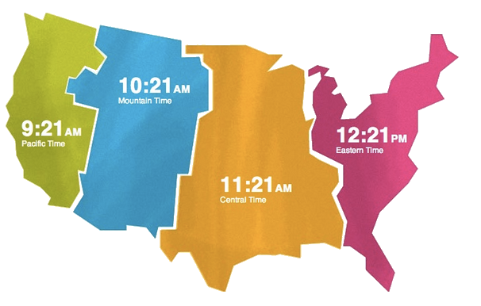
Additional Log Requirements
Logs to be completed according to time zone of home terminal
Original copy of log must be submitted within 13 days
Driver must carry previous 7 consecutive days of logs
Notes:
There are other requirements of completing logs that must be mentioned.
Depending upon company operations, it may not be unusual for a driver to be out on an extended trip where he/she crosses in and out of multiple times zones. Logging according to various time zones presents obvious issues, so the DOT requires all logs to be completed in the native time zone of the home terminal. Even when a driver crosses into other time zones, he/she should record the time on the log as the time at the home terminal. While electronic logs are programmed to record in the home time zone, drivers will have to know the difference between the current time and their home time when completing paper/manual logs to avoid confusion and errors. Drivers may find it easier to do this by keeping a watch or other manually set timepiece with them that they keep on their “home” time zone. Referring to such a timepiece when recording data on the driver log will help minimize confusion and any time errors.
In general, original copies of logs are turned into the company following a trip. However, if a trip lasts longer than 13 days, original logs will have to be submitted to the company via an alternate method. Regulations require that original logs be submitted to the carrier within 13 days of their completion.
Remember that enforcement officials can stop a commercial vehicle to review compliance with regulations – both vehicle and driver. So, to demonstrate compliance with hours of service regulations, drivers must carry a record of their logs for the previous 7 consecutive days so that compliance with the 60/7 or 70/8 rule can be assessed. The driver shall retain a copy of each record of duty status for the previous 7 consecutive days which shall be in his/her possession and available for inspection while on duty.
Instructor note:
Review the process for displaying or obtaining the previous 7 days logs in the event of an ELD system malfunctions.

Slide 56
Common Questions
Q: What if my duty status change does not occur in a town – what do I record for location in the Remarks section?
A: The highway number and the nearest milepost or highway number and service plaza name followed by the name of the nearest city, town, or village and State abbreviation.
Q: Can I log lunch or time between group drop off and pick up as “Off Duty” ?
A: Yes, as long as you are meet the requirements for off-duty – namely, you are relieved of all duty and responsibility for the vehicle and are free to pursue activities of your own choosing.
Q: What should I do if I have to make a correction on a log?
A: You can either complete an entirely new log or make corrections on the log with the error. Follow your company’s guidance on their policy.
Notes:
Completing a paper/manual log properly can be complicated as there are many scenarios that do not fit the examples that have been shown. Here are common questions that are frequently asked by drivers with regard to completing their log properly.
Instructor TIP:
You may want to cover other frequently asked questions particular to your operation. For example, if you do a lot of shuttle work, you will want to cover how to log multiple short stops in a town. Or, you may permit drivers to use a commercial vehicle for personal conveyance when on a trip.
Reviewing the guidance provided for §395.8 regarding records of duty status, may help you determine other topics to cover with students that are particularly relevant to your operations.

Slide 57
Common Questions
Q: What if I haven’t worked the previous 7 days before a trip – do I still need logs for those days?
A: Yes, you still need logs and you must account for all hours of compensated work - no matter who for - as well as any work performed for any motor carrier.
Q: If I perform compensated work elsewhere, can my part-time motor carrier employer require me to submit logs, work records or a signed statement of on-duty hours?
A: Yes – they need to know that you have enough hours available to complete a trip before they dispatch you.
Q: How should time spent attending safety meetings, ceremonies, celebrations, or other company safety events be recorded?
A: Off-duty if attendance is voluntary. On-duty, not driving if attendance is mandatory.

Slide 58
EXERCISE
Complete the driver’s daily log using the trip scenario provided in your guide/manual.
Notes:
EXERCISE
This exercise will help reinforce concepts presented by having students complete a paper/manual log according to the scenario in the guide.
Reference the page in the accompanying student manual where the logging scenario is detailed. Instruct students to use the information from the trip activities described in the exercise to complete the blank log on the following page in their manual.
The students should use their names, and your company name, address and terminal address - just as they will do on-the-job. Use today's date. The vehicle number is 146.
Give the students 15 minutes to complete the log before showing them the answer and reviewing the entries with them.

Slide 59
Driver Daily Log
(Today’s Date)
146
318
284
(Your Signature)
(Your Company Name)
none
(Your Company Main Address)
(Your Company Home Terminal Address)
13.75
00.00
06.25
04.00
24.00
(Home Terminal City and State)
(Home Terminal City and State)
Anytown, (this State)
MP 180 US 90
Boutton, (this State)
Mytown, (this state)
Charter Order 11461
Notes:
Review each area of the log completed according to the scenario with the students. Remind the students that logs can vary, and this one was somewhat different from the earlier example to show them minor, typical variations that they may experience. Ask the students long the way for answers and input before you explain incremental log entries.
Here is the Activity detail – with detail and description of filling out the log incrementally:
(1) Reported for work at 6:00 a.m. to carry out Charter Order #11461.
(2) Spent 15 minutes on paperwork and pre-trip inspection.
Log entries:
At this point, the log should have been started and the following items completed – Date, Company name and Address(es), Vehicle number and Charter order. Note that this log did not have a pre-printed area for the Charter Order/number as the earlier example did, so it should be simply written somewhere in the “Remarks” area.
The line for off-duty from midnight to 6 AM should be drawn, along with 15 minutes for “On-duty, not driving” from 6:00 – 6:15 AM for the vehicle inspection and paperwork. You would indicate the location where these activities occurred in the Remarks section (home terminal city and State).
(3) Drove 45 minutes to 100 Main Street, Anytown (this state) to pick up your group.
Log entry: When you arrived at Anytown, you should have drawn a line from 6:15 to 7:00 AM on the “Driving” line.
(4) Took 25 minutes to load.
Log entries:
After loading for 25 minutes and before leaving with the group, you should update the log by drawing a line in the “On-duty, nor driving” line from 7:00 – 7:30 AM (the 25 minutes is rounded up to 30 minutes). Also mark the location in the Remarks section (Anytown, your State)
(5) Had a front tire go flat, 84 minutes after leaving Anytown. Had to wait for the service truck to replace it. This delayed the trip by two hours. The breakdown location was milepost 180 on US 90 near Boulton, (this state).
Log entries:
At the point of the breakdown, you would update your log to reflect the driving time to the point of the breakdown. This would be reflected with a line in the “Driving” line from 7:00 to 8:30 AM (84 minutes rounds up to the nearest quarter hour, 90 minutes). Your time spent waiting for the service truck and tire repair would be logged as “On-duty, not driving”, and you would update the two hours spent in this activity prior to resuming the trip. You would also indicate the location of the breakdown – Milepost 180 on US 90, near Boulton, your State).
(6) Arrived at the Mytown Summer Camp, Mytown, (this state) at noon.
(7) Logged 30 minutes of time for unloading the coach and 30 minutes for lunch, eaten at the camp. While at the camp, you still had responsibility for the vehicle and had to remain close by in the event it needed to be re-positioned.
Log entries:
Upon arrival in Mytown, you should update the “Driving” line to reflect the travel time from the breakdown location to the camp (11:00 AM to Noon). Before departing, you would update the log to reflect the time spent unloading and eating lunch (Noon to 1:00 PM) in the “On-duty, not driving”. You would also detail the location of these activities and duty status changes in the Remarks section (Mytown, your State)
(8) Drove 3 hours back to the home terminal.
(9) Spent 21 minutes on post-trip inspection and paperwork. Then went off duty.
Log entries:
Upon arrival at the terminal, update the “Driving” status line to reflect the 3 hours driving from 1:00 – 4:00 pm and the Remarks section to indicate the location where the duty status change occurs.
After completing your post-trip inspection and paperwork, update the log to reflect the 15 minutes spent “On-duty, not driving” while conducting these activities (21 minutes rounds to the closest 15 minute interval – down in this case to 4:15 PM).
When completing your paperwork, you can draw your line reflecting off-duty status the rest of the day, from 4:15 PM to Midnight. You also would have calculated and recorded the “Total Miles Driving Today” based on the odometer readings. Finally, after reviewing the log for accuracy and completeness, you would sign it in the appropriate location.

Slide 60
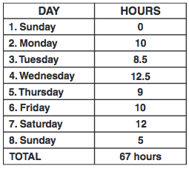
On-Duty Time Recap
Tracks total on-duty time over previous 6-8 days
Recaps not required to be completed, but resulting information is necessary to monitor compliance with cumulative hours of service limitations
Notes:
In order to maintain compliance with the 60/7 or 70/8 rules, it is necessary to know the total number of on-duty hours logged over the previous 6 days (60/7 rule), or previous 7 days (70/8 rule). Since most motorcoach operations fall under the 70/8 rule, we will be using this rule in our examples. Calculations for the 60/7 rule are similar – with just one less day.
Recapping on-duty time over the previous 7 days allows you determine how much on-duty time you have available on the current day (day 8 of the 70/8 rule) before you could be limited from driving a commercial vehicle (regardless of the 10 hour rule). Calculation of this on-duty time over the specified period has typically been known as a “log recap” or “log summary”. Log summaries or recaps are often included in log books, though their presence - or even completing them – is not a requirement. However, complying with the 60/7 or 70/8 rules IS a requirement, and, without knowing the previous on-duty summary, a driver could be in violation of this hours of service regulation.
With the advancement of technology, manually completing the recap is becoming far less common. Electronic log software performs these calculations in real time and there are other software applications available on computers and mobile phone that also maintain a recap and performs calculations for a driver. Nonetheless, understanding the concept behind the recap is important, as is the ability to manually calculate it should the need arise.

Slide 61
On-Duty Time Recap
All recaps are similar; all calculate the total on-duty time over previous 7 and 8 days
Only count on-duty hours/time
Total On-duty time =
“Driving” + “On-duty, not driving”
Notes:
Recaps used will vary by format and layout, but they all do the same thing: They help drivers and companies determine how many hours a driver can work tomorrow before reaching the 60- or 70-hour limit and are not allowed to drive a commercial vehicle anymore. Most recaps will summarize total on-duty hours recorded over the previous 7 and 8 days. A recap will not indicate when a driver is in violation of the 10- or 15-hour rules – drivers and companies must look at the daily log to determine those violations.
The time amounts used for the log recap are “on-duty” hours, which is time logged as “Driving” and “On-duty, not driving” on lines three and four of a daily log. The combination of these two duty status lines on a day’s log will give the total on-duty hours for any given day.

Slide 62
On-Duty Time Recap
Day |  | Total time On-duty
1 | Yesterday + 6 | 4.25
2 | Yesterday + 5 | 11
3 | Yesterday + 4 | 10
4 | Yesterday + 3 | 7.5
5 | Yesterday + 2 | 8.25
6 | Yesterday + 1 | 12.5
7 | Yesterday | 0
8 | Today | 11
 | total | 64.5
Adding up total on-duty hours for 8 consecutive days calculates if the driver reached the 70-hr limit over that timeframe
Notes:
Let’s review the 70/8 rule to determine why the recap is important to hours of service compliance. The 70/8 rule restricts a driver from driving a commercial vehicle after having been on-duty for 70 hours over the last 8 days. The 70-hour limit is fixed and does not change, and neither does the consecutive eight day window.
As stated previously, many recaps track the total on-duty time for the previous seven and eight days. In the example above, the total on-duty times (“Driving” time + “On-duty, not driving” time) are provided for eight days, including today. You can see by the total that at the end of the 8th day, the driver has amassed 64.5 on-duty hours, and has not reached the 70-hour limit. Remember, the rule is over eight days, so the only information obtained by adding up any eight day period is whether or not a driver had reached the 70-hour limit in that 8 day timeframe.

Slide 63
On-Duty Time Recap
Day |  | Total time On-duty
1 | Yesterday + 6 | 4.25
2 | Yesterday + 5 | 11
3 | Yesterday + 4 | 10
4 | Yesterday + 3 | 7.5
5 | Yesterday + 2 | 8.25
6 | Yesterday + 1 | 12.5
7 | Yesterday | 0
8 | Today | 11
 | total | 60.25
Total on-duty hours last 7 days can be used to calculate amount of hours a driver has available before the 70-hour limit would be reached during the next day
Notes:
If a company or driver discovered that the 70-hour limit was reached when looking back over eight days, the big question would then be whether or not the driver violated the hours of service rules by driving a commercial vehicle after having reached the 70th on-duty hour. This is not an ideal situation to be in, especially since the driver and company can easily forecast when the 70th on-duty hour will be reached – on the day it actually happens.
Using the same example, let’s look at the last seven days (including the current day). By calculating this number, we know how many total on-duty hours there have been the previous seven days and – more importantly – can calculate how many on-duty hours are available tomorrow before the 70th hour is reached and the driver can no longer drive.

Slide 64
On-Duty Time Recap
Calculation to determine available hours:
70
60.25
9.75
(Hour Limit)
-
(Total On-duty time, previous 7 days)
=
Available hours before reaching limit
Performing this calculation/recap at the end of each day permits a driver to verify that he/she can legally operate any trip that has been assigned the following day
Notes:
The calculation is simple:
70 – (total on-duty time, last 7 days) = (number of hours driver can be on-duty before cannot driver commercial vehicle)
70 – the hour rule limit – will never change. The total on duty time over the previous 7 days will fluctuate based on a driver’s work schedule, and so will the available hours.
Using our example, 70 – 60.25 = 9.75. So, after being on-duty the next day for 9.75 hours, the driver would no longer be able to drive a commercial vehicle.
Using this information, a driver can verify that they have the necessary available hours to operate any trip scheduled for the following day by reviewing the hours available against schedule of the trip assigned.
If you are ever assigned a trip for which you do not have the necessary hours available, you must notify dispatch immediately. Operating a trip when you know a violation will occur is against the law.
Reminder – the examples used here are based on the 70/8 rule. If your company operates on the 60/7 limit rule, the calculations would be adjusted by subtracting the total on-duty time from the previous 6 days from the hour limit of 60.

Slide 65
Recap Exercise
Date | Off-Duty | Driving | Sleeper Berth | On-Duty, Not Driving
6/07 | 17.5 | 5.75 | 0 | .75
6/08 | 16.75 | 4.25 | 0 | 3
6/09 | 15.25 | 7.75 | 0 | 1
6/10 | 14.5 | 8 | 0 | 1.5
6/11 | 24 | 0 | 0 | 0
6/12 | 16 | 6.75 | 0 | 1.25
6/13 | 9.75 | 12.5 | 0 | 1.75
6/14 | 13.25 | 9.5 | 0 | 1.25
6/15 | 15.75 | 6.25 | 0 | 2
Notes:
EXERCISE
This exercise will test knowledge of the students in both recapping and hours of service. Calculators should be used for this exercise. It’s a good idea to encourage students to purchase and carry with them their own calculators when they begin driving –a calculator can help them avoid simple errors on logs and necessary follow-up.
Tell the students to use the log summary data on the slide to answer the questions in their student manual. Here are the directions provided to them, and questions:
The busy summer season is in full swing at Brickyard Charters, which operates 7 days a week and under the 70/8 hours of service rule. You’ve just completed your post-trip inspection and paperwork for today, June 15th. Your recent log summaries are included on this slide. Using the data provided, answer the following:
Total on-duty time for the previous eight days. __________
2. Total time available to work tomorrow before you cannot drive the motorcoach. _____________
3. Were there any violations of the hours of service rules? ________________

Slide 66
Recap Exercise - Answers
Date | Driving | On-Duty, Not Driving | Total time On-duty
6/07 | 5.75 | .75 | 6.5
6/08 | 4.25 | 3 | 7.25
6/09 | 7.75 | 1 | 8.75
6/10 | 8 | 1.5 | 9.5
6/11 | 0 | 0 | 0
6/12 | 6.75 | 1.25 | 8
6/13 | 12.5 | 1.75 | 14.25
6/14 | 9.5 | 1.25 | 10.75
6/15 | 6.25 | 2 | 8.25
Notes:
EXERCISE answer – slide in instructor guide only
The first step in answering the questions is to calculate the total on-duty time each day. This is done by adding together the “Driving” and “On-duty, not driving” times each day. The “Off-duty” and “Sleeper Berth” times do not count toward on-duty time. In the chart here, the “Off-duty” and “Sleeper Berth” columns have been removed, and a “Total time On-duty” column has been added, showing each days’ total on-duty time.
With this information, we can answer question #1. There are actually nine days listed on the chart, so the first step is to realize that the data from 6/07 is irrelevant – it’s outside of the eight day window. To get the total on-duty time for the previous eight days, the total on-duty time for 6/08 through 6/15 is added together. The answer is 66.75 hours.
Total on-duty time for the previous eight days. 66.75 hours
To answer question #2, we first need to calculate the total on-duty time for the previous seven days. The total on-duty time for the previous seven days (6/09 through 6/15) is 59.5 hours. To determine the total time available to work tomorrow before the 70-hour limit is reached, subtract 59.5 from 70.
2. Total time available to work tomorrow before you cannot drive the motorcoach. 10.5 hours.
Question #3 actually cannot be definitively answered. If you limited your thinking to violations of the 70/8 rule when answering the question, the answer would be no. There are no violations of the 70/8 rule. However, if you looked more closely at the data, there does appear to be a violation of the 10-hour rule on 6/13. On that day, the driving time is listed as 12.5 – even if you were to assume a two-hour special driving condition exception was used, there would still be a violation. However, since we don’t have the actual log, we can’t be certain. It would have been possible to have 8 consecutive hours off during the 24 hour period and in the middle of some of the logged driving.
3. Were there any violations of the hours of service rules? No violations of the 70/8 rule. Possible 10 hour violation on 6/13, but would need to see the actual log to verify.

