Slide 1
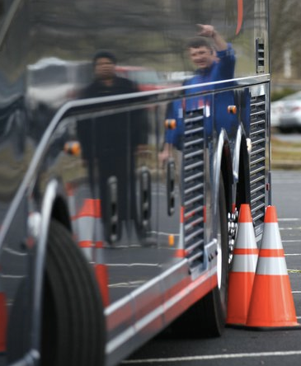
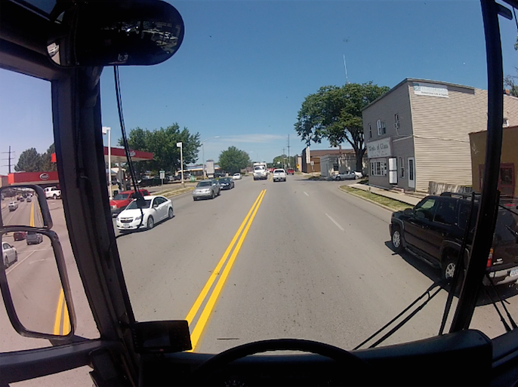
Behind the Wheel Training
Notes:
Purpose:
The purpose of this training module is to provide student drivers with off- and on-road practice with motorcoaches they will be operating. Off-road practice will focus on skill maneuvering and learning motorcoach vehicle dynamics. On the road practice will focus on maneuvering motor coaches in various real-world situations, and assessing existing and potential hazards in a variety of environments.
Module Overview:
The training module contains two classroom lessons and on-vehicle exercises. The classroom lessons are very brief and designed to prepare student drivers for the on-vehicle exercises that follow. The first lesson provides an overview of skill maneuvers that student drivers may be subject to during closed course/off-road skill course exercises. The second lesson provides instruction on expectations of student drivers while they are operating the coach during on-road practice in real world environments .
Lesson 1: Skill Course Maneuvering
Lesson 2: On-Road Practice

Slide 2
Skill course MANEUVERING
Behind the Wheel Training: Lesson 1
Notes:
Being able to operate a motorcoach safely is largely dependent on two concepts – knowing the dynamics of the coach and how they affect real-world operation and being able to identify existing and potential hazards around the coach while driving.
While anyone can study and “know” coach operation and dynamics, experiencing them in real life provides much better understanding. We will be spending a significant amount of time during behind-the-wheel training where each of you will gain plenty of experience in both of these areas.
You’ll first gain an appreciation for the motorcoach dynamics in a low-stress environment, where you can concentrate on understanding coach operations - from starting the coach to maneuvering it through a skill course. This closed-course practice will help you visually understand the capabilities and limitations of the motorcoach in operation. If you make a mistake on the skill course you’ll only be hitting a cone, barrel, or ball. But, in the real world, you could be striking a fixed object or, worse yet, a pedestrian.
The slides in this lesson will familiarize you with some of the skill maneuvers you may see on the closed course, though you will likely not see them in this order and may not see some of them at all, dependent upon space limitations.

Slide 3
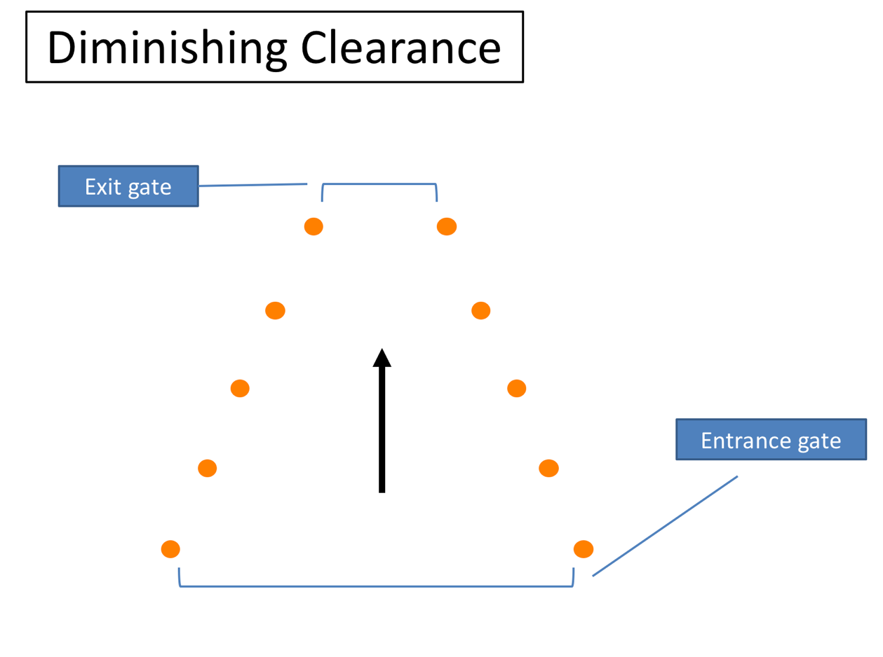
Diminishing Clearence
Notes:
This skill maneuver is known as “Diminishing Clearance” or “Straight Line”. It’s pretty straightforward and designed to help you understand the overall width of the motorcoach. As you proceed through the lane, the width of the lane will narrow, meaning the “exit gate” could be much tighter than the “entrance gate”.
Besides fitting through the width of the exit gate, there are no significant clearance issues, unless the course is set up to make you turn sharply shortly after exiting this maneuver. In that case, the exit gate cones could become pivot and rear clearance/overhang hazards.
Sometimes instructors will use a similar setup as this maneuver to help assist drivers with the concept of where the motorcoach tires track relative to the side of the coach and their seat. Instead of fitting the entire coach through the diminishing clearance, they ask drivers to roll their right or left side tires through it!

Slide 4
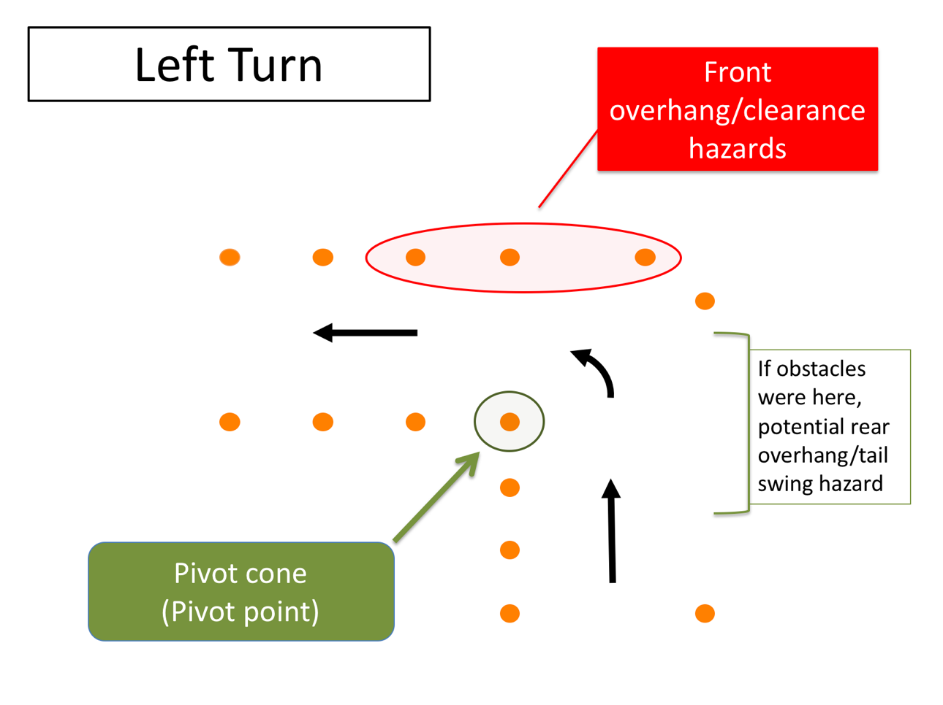
Left Turn
Notes:
The most basic of maneuvers is the left and right turn. While basic, they are much trickier in a motorcoach than in a regular passenger car. The large wheelbase means that you must account for the off-tracking during turn maneuvers. You also must be aware of the front and rear overhangs and their clearances when negotiating a turn.
To know when you can turn without striking or running over an object with your rear axles, you must know where the pivot point is on the coach. The pivot point can vary depending on whether a tag axle is present, and whether the tag axle is raised or lowered.
As you can see from the diagram, during this skill maneuver you will be making a left (or right) turn. The amount of “extra space” you have to make the turn can be adjusted to simulate varying, real-life scenarios on how “tight” a turn may be. The narrower the approach and exit lanes, the tighter you will need to make the turn around the pivot cone.
Your pivot cone is marked on the diagram – when you are on the course, you can imagine this is a curb or the centerline of the roadway. You must locate your vehicle’s pivot point properly relative to this pivot cone or you will strike it (and perhaps others if you turn way too early or too late).

Slide 5
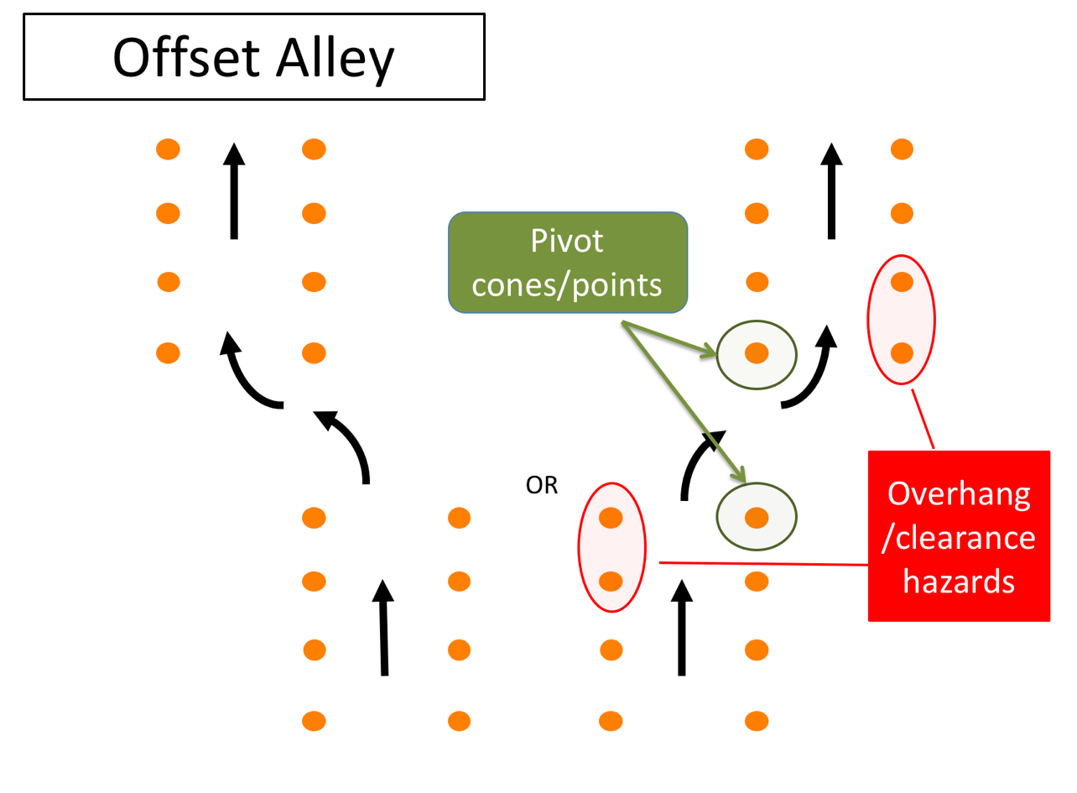
Offset Alley
Notes:
This skill maneuver is called the Offset Alley. As you can see, you will enter a straight alley and offset to the left or right, continuing through a second alley.
This skill maneuver will help you understand and realize turning maneuverability as well as front and rear overhang clearances. You’ll be moving laterally an entire width of the coach (8.5’) during the offset. The maneuver becomes more difficult the narrower the alleys and the closer they are together.
There are literally two pivots cones in this maneuver and several cones that will serve as potential overhang clearance hazards as you maneuver out of the first alley and into the second alley.

Slide 6
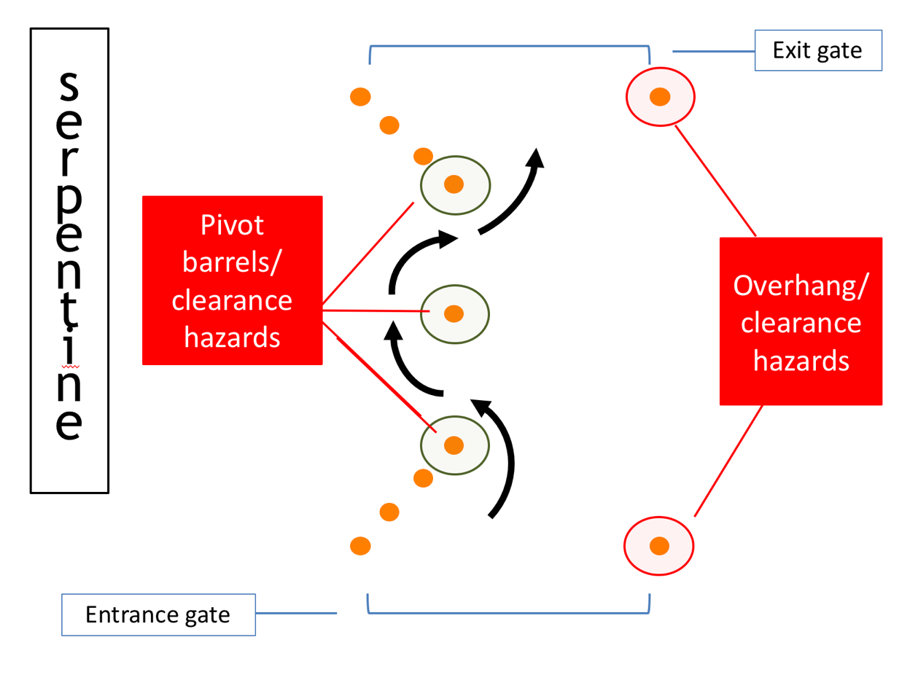
Serpentine
Notes:
The Serpentine is a difficult skill maneuver that will also help you understand turn radius, pivot points and overhang clearances (you should be noting a theme by now – knowing and understanding these items are key to being able to maneuver without incident). In this maneuver, your pivot cones (barrels) and clearance hazards are one and the same.
Difficulty level will depend on the spacing between the center obstacle and the last/first cones on the entrance/exit gates and the width of the entrance/exit gates. Experienced and skilled professionals are known to not only drive forward through the serpentine, but also backward!

Slide 7
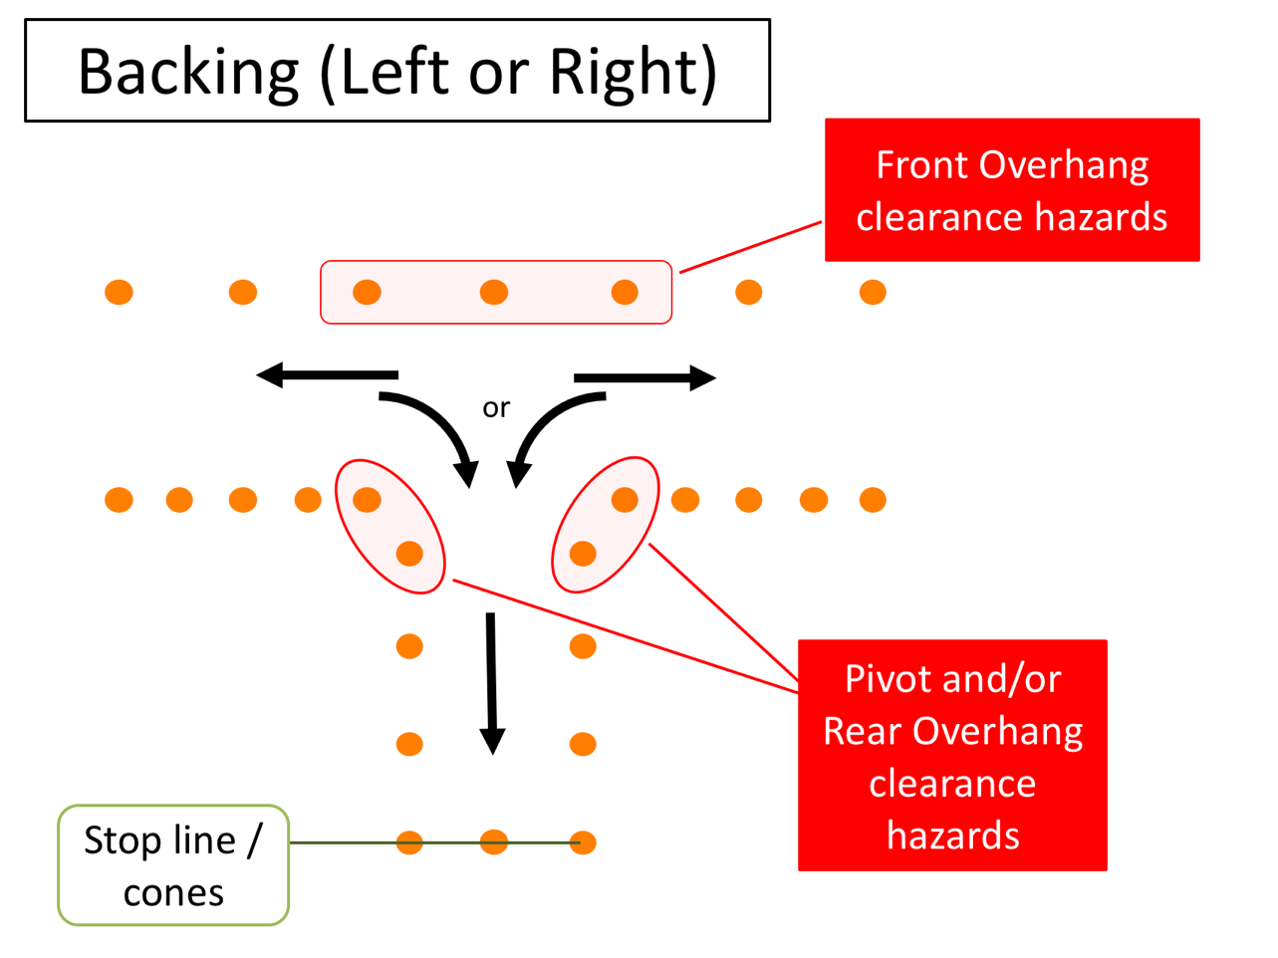
Backing (Left or Right)
Notes:
Alley backing is another tough skill maneuver, and hopefully one you won’t have to physically do very often at all. In fact, remember – it’s best to avoid backing whenever possible since backing incidents are common in the motorcoach business. This skill maneuver will test much the same as the previous: both pivot points and overhang clearances will come into play during the maneuver - but in a different direction!
Difficulty level will depend in part on what side you are backing from - you may be asked during this maneuver to back from the left or right of the alley. Essentially, you’ll pull down the lane in one direction until you pass the alley, then back 90 degrees into the alley. You’ll first start backing to the driver side since your vision field is much better than right or “blind” side backing. Once in the alley, the goal is usually to stop with your rear bumper as close as possible to the rear stop line without going over it.
The width of the lane and the alley, which will dictate clearances for rear and front overhangs, will set the difficulty level.

Slide 8
Parallel Park
Notes:
The “Parallel Park” maneuver is another backing exercise to help drivers understand clearances and sight issues when they are backing. For this maneuver, you will drive parallel past the “parking” stall and then be asked to back into the parking stall. Much like the Alley Backing, you will be asked to back in both directions, meaning you may back to your driver or passenger side when entering the stall.
Once in the stall, your goal is to come as close to the far-side stall edge line as possible without striking cones at the front or rear end of the stall. The far side stall edge is usually a block of wood or something similar to a curb – this allows you to swing your rear overhang over it during the maneuver without striking a barrier. A point on the coach will be designated from which they will judge distance to the stall edge (for example, rear drive axle).
Your largest hazards are the rear stall cones/barrels which you could strike with the rear bumper if you back to far into the stall. The front corner cone is also a hazard for the front overhang and/or bumper clearance – both on the way into the stall and on the way out.
The difficulty level of this skill maneuver is generally dictated by the length of the stall.

Slide 9
Stop Line
Notes:
Finally, there’s the “Stop Line”. This maneuver will help you judge the location of the front of the motorcoach relative to your seated position.
The general goal is to stop the coach in the stall with the front bumper as close as possible to the end cones (or line). The width of the alley can be adjusted to make it a tighter “fit” as you pull toward the stop line; the narrower it is, the more you may have to adjust prior to entering (may have to enter virtually straight on).

Slide 10
On-road practice
Behind the Wheel Training: Lesson 2
Notes:
With a good understanding of coach maneuvering dynamics, capabilities and limitations, it’s time to devote attention to the second core element of safe operations – putting your coach operational skills to the test in dynamic and changing real-world roadway environments. While the complexity of the skill maneuvers won’t be any more difficult, constantly changing stimuli will present distractions to the unlimited attention to task you’ve been afforded on the closed skill course.
You will also need to be assessing the changing environment for existing and potential hazards – in other words, driving defensively. You will be exposed to a wide range of operating environments to test your skill, ability, and hazard assessment capabilities. Since skill maneuver capabilities have been established and demonstrated on the closed course, much attention will be focused on the ability to operate the coach properly from a situational/environmental perspective, which includes the necessity to assess the operating environment for existing and potential hazards.

Slide 11
Commentary Driving
Defensive Driving training and evaluation while driving
Verbal, running commentary
> What you are seeing
> What you are thinking
What you see (or don’t see) evaluates what/where you are looking at
Notes:
Driving defensively means being alert to what is happening around your vehicle and being prepared to respond to emergencies if necessary. Though the basics of defensive driving can be taught in the classroom, it may be difficult for an instructor to truly understand if a student can employ the defensive driving concept in real-world scenarios. “Commentary driving” is a method which takes defensive driving learning outside the classroom and into the cockpit of the motorcoach, allowing for real-world assessment and teaching of defensive driving mindset and skills.
Commentary driving is simply giving a verbal, running commentary while driving. The verbal commentary includes what you see, what you are planning and what you are thinking. The commentary allows an experienced driver/instructor to evaluate where you are looking, what you are seeing, and what you are thinking.

Slide 12
What Will You Talk About?
What | When
Traffic signs, signals/controls and roadways | If indicative of potential hazard/conflict
Pedestrians, animals or objects in or near the road | When present
Other vehicles around you/what you see in mirrors | Occasionally in general and when changing position/location
Your actions & why | Whenever taking action
Obstructions to visibility | When present
Clearance hazards | When present
Notes:
Commentary driving is talking it through – it’s thinking out loud as you drive. It keeps your mind alert and focused on the job of driving. You will be applying the hazard-detection methods you have been taught and learning a way of thinking about driving that will serve you well in your driving career, even though you may never talk it through after this training course is over.
Your instructor will benefit because he/she can tell you what you are doing right, and can give you guidance or warnings if you fail to notice something important.
Here are the general types of things you should talk about when you are behind-the-wheel during the on-road exercises:
Traffic signs, signals, and intersecting roadways
Pedestrians, objects or animals in or near the road
Vehicles around you (in front, beside and behind)
What you see in your mirrors (vehicles gaining, vehicle passing, vehicles changing lanes)
Your actions & why taken (ex. – left turn signal on to change lanes)
Clearance hazards (ex. – “overpass ahead, clearance OK”)
Visibility obstructions
Your gauges occasionally (ex. – speed)
Road surface and weather conditions (if applicable)

Slide 13
How To Comment
✔ | Keep comments short - just a few words
✔ | Identify only the most critical hazards
✔ | Identify both actual and potential
✔ | Announce "Clear path" for no hazards
✖ | Identify hazards, don't explain
✖ | Don't look at the instructor
✖ | If you can't talk and drive, don't talk
Notes:
If you are a quiet person and perhaps a bit shy, you may struggle to speak out-loud in front of someone while driving and the process may itself cause you to concentrate less on your driving. The fact is, it will be unnatural for all student drivers at first. Commentary driving is a learning process itself and takes practice. So, don't go thinking you need to start verbally communicating everything you see right away. Start off slowly just by mentioning significant things and build from there.
How do you go about talking it through? What should you say and how should you say it? What shouldn't you say?
Here are a few do's and don'ts to guide you in talking it through:
Keep comments short - just a few words. Say things like "stop sign ahead" or "car tailgating" or "car waiting to pull out."
Identify only the most critical hazards. You can't identify every possible hazard. Concentrate on the ones you think are important. If your instructor disagrees or mentions a hazard you missed, that's okay. This is supposed to be a learning experience, for you and any other students who will be observing.
Identify both actual and potential. This means that you should mention both actual hazards - the ones that you are going to react to - and potential hazards - the ones you may have to react to.
Announce "Clear path" for no hazards. Once in a while - not all of the time – let your instructor know that you don't see any important hazards by saying "clear path."
Identify, don't explain. Mentioning the hazard is enough - you don't have to explain what you are going to do - you'll probably be doing it soon enough!
Don't look at the instructor. Keep focus on the roadway, gauges and mirrors.
If you can't talk and drive, don't talk. This is critical. If things get busy enough behind the wheel that you need to concentrate on driving rather than talking it through, stop talking and do it! Your first responsibility is to drive safely.
Your instructor will demonstrate some commentary driving first so you can see how to talk it through.

Slide 14
Example Commentary
What | Example(s)
Traffic signs, signals/controls and roadways | “Exit coming up – watching for merging traffic conflicts”
Pedestrians or animals in or near the road | “Pedestrian, near right corner”; “child playing in yard”
Other vehicles around you/what you see in mirrors | “6 seconds from vehicle ahead”; “vehicle passing on left”
Your actions & why | “Stale green light ahead, ready to brake”
Clearance hazards | “Hotel portico, clearance OK”
Notes:
Let's go over some examples of specific observations you should comment on. For example, with regard to other vehicles you should mention:
Vehicles you are overtaking
Vehicles pulling out
Vehicles signaling for a turn
Vehicles tailgating the coach
Vehicles entering from ramps
By mentioning these, you’re indicating actions you are initiating that require close attention (initiating pass – car passing could move into lane), and actions of others that you recognize and are paying attention to (vehicles pulling out, signaling turns, tailgating and merging from ramps).
The table on this slide gives some more examples of short commentary related to occurrences. Even if you really don't like the thought of commentary driving and miss some hazards at the beginning, you’ll eventually get better at it, which is the point – just like improving in completing skill course maneuvers. And, as a result of both your commentary driving, that of other student drivers that you observe, and feedback from the instructor, you’ll become a better defensive driver.

